Slide 1
Saving Animals Adventurer e-Honour
British Union Conference Adventist Youth UK & Ireland
By Deyvid Batista

Slide 2
Requirements
Why are animals endangered?
What happened to extinct animals? Why?
Identify and name at least 5 extinct animals.
Learn about 5 endangered animals.
How many animals are currently on the endangered species list. Collect pictures of at least 5 endangered animals and name them.
Why save endangered animals?
What can I do to help!?
Make a poster or booklet encouraging people to save endangered animals. Show it to someone.
Memorize Proverbs 12:10 NKJV.

Slide 3
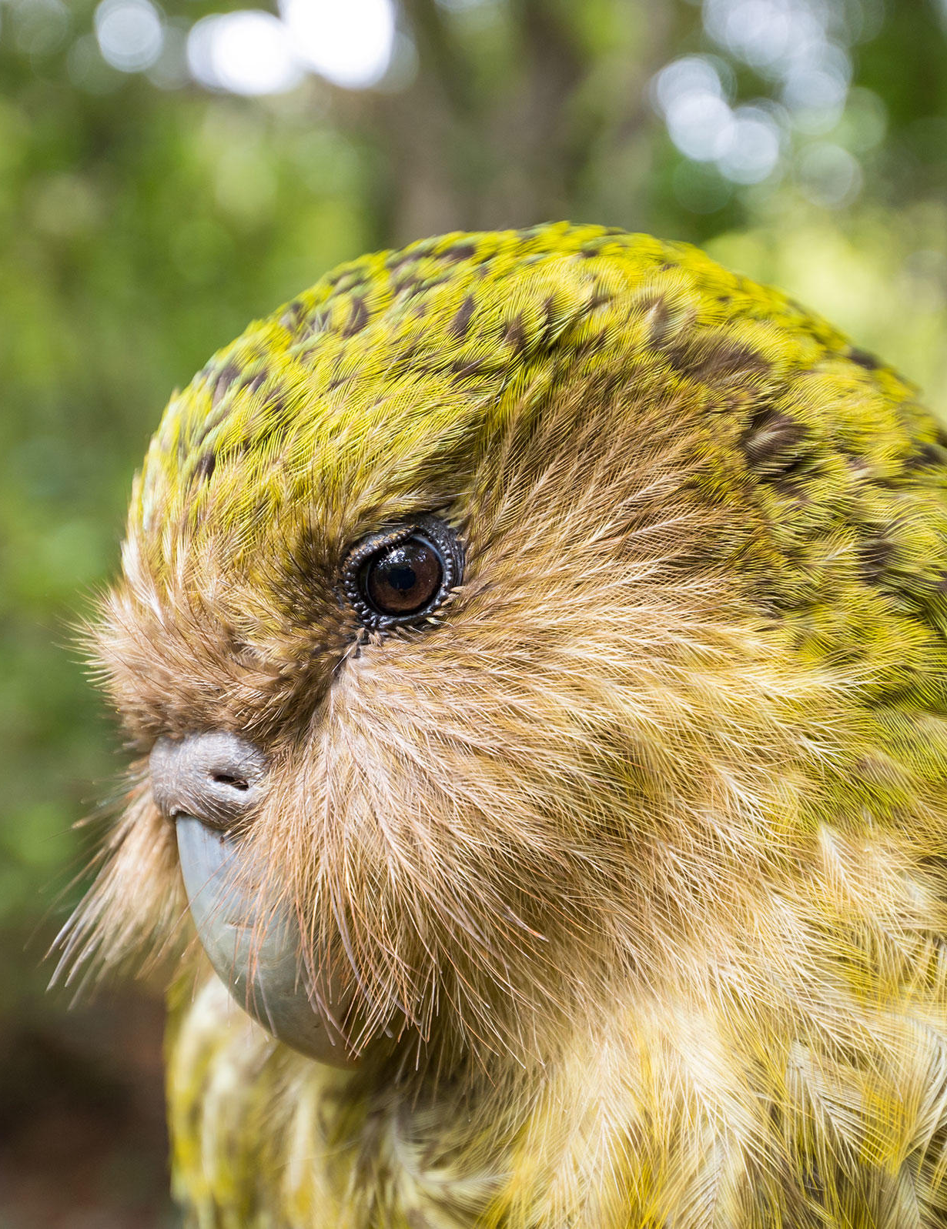
Kakapo
They are critically endangered with only around 140 individuals remaining, each one with an individual name.

Slide 4
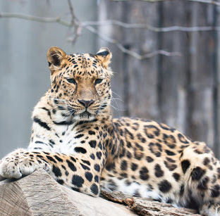
Amur Leopard
Unfortunately, Amur leopards are one of the world’s most endangered big cats. They are Critically Endangered and between 2014 and 2015, there were only around 92 Amur leopards left within their natural range. That number is now estimated to be less than 70.

Slide 5
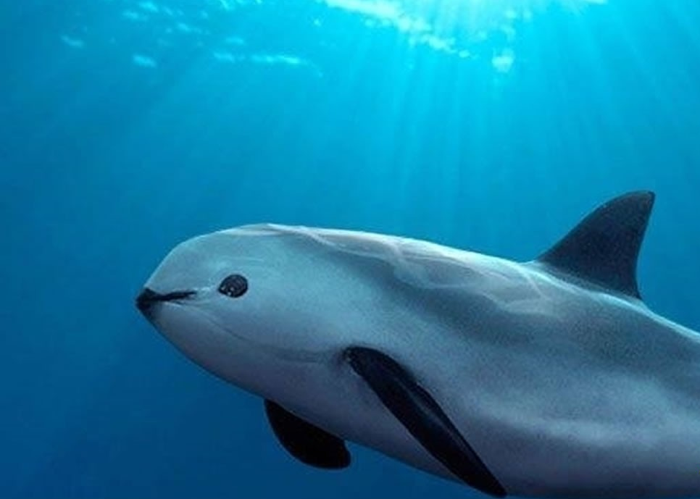
Vaquita
The vaquita is both the smallest and the most endangered marine animal in the world. It has been classified as Critically Endangered and in 2018, there were only around 6 to 22 vaquitas left. The latest estimate, from July 2019, suggests there are currently only 9.

Slide 6
Why are animals endangered?

Slide 7
1. Overhunting - This has been the fate of most large animals, slow animals and tasty animals when humans have migrated to a previously uninhabited area.
In so many parts of the world, humans have hunted certain animals to extinction or almost extinction. The predator animals that feed on these now extinct animals have also suffered, not only because they might also have been hunted, but because they no longer have a source of food.

Slide 8


Slide 9
Whose actions lead to this?
a. Human
b. Nature

Slide 10
Whose actions lead to this?
a. Human
b. Nature

Slide 11
2. Habitat loss - more and more land being cleared for farming, natural water sources being extracted or diverted leaving dried out river beds and lakes, mining and the movement of humans have either destroyed the only habitats in which some species can survive.

Slide 12
Whose actions lead to this?
a. Human
b. Nature

Slide 13
Whose actions lead to this?
a. Human
b. Nature

Slide 14
3. High specialization - Any changes such as a changing climate or a habitat loss can cause problems. The reason why is because some species have specific habitat requirements. Some animals they know exactly where to hunt, to make an ambush so when things change they cant hunt or do anything else as they don’t know the new place where they live.

Slide 15
Whose actions lead to this?
a. Human
b. Nature

Slide 16
Whose actions lead to this?
a. Human
b. Nature

Slide 17
4. Pollution - Although nobody is able to point one specific cause for the recent rapid decline in numbers and extinctions of many species, it appears that much of it is due to pollution. Pollution is something that can not be seen but harm the environment.
For example, the Peregrine Falcon almost became extinct in Canada when DDT (chemical compound) was widely used prior to becoming banned in the U.S. and Canada in 1971.

Slide 18
Whose actions lead to this?
a. Human
b. Nature

Slide 19
Whose actions lead to this?
a. Human
b. Nature

Slide 20
5. Invasive species - Invasive species (not local to that specific area) are a major cause of loss of diversity of both plants and animals.
A familiar example is the brown tree snake arriving in Guam on a cargo ship following WWII. The venomous brown snake has reduced the number of local birds, fruit bat and lizard populations.

Slide 21
Whose actions lead to this?
a. Human
b. Nature

Slide 22
Whose actions lead to this?
a. Human
b. Nature

Slide 23
6. Human-wildlife conflict - Our population is constantly increasing and more people move into areas where wildlife previously lived. Sadly, farmers feel the need of protecting they plants and animals by hunting animals and killing them.

Slide 24
Whose actions lead to this?
a. Human
b. Nature

Slide 25
Whose actions lead to this?
a. Human
b. Nature

Slide 26
7. Disease - Diseases kill humans and animals alike. The Ebola virus killed 5,000 critically endangered western gorillas between 2002 and 2003 at the Lossi Sanctuary and other hundreds of gorillas in the Odzala-Kokoua National Park in 2003-2004.

Slide 27
Whose actions lead to this?
a. Human
b. Nature

Slide 28
Whose actions lead to this?
a. Human
b. Nature

Slide 29
8. Low birth rate - Some species do not reproduce very often, and they may have few babies each time when they breed. Other species may take a number of years until they are able to reproduce, reducing their opportunity to breed over their lifetime.

Slide 30
Whose actions lead to this?
a. Human
b. Nature

Slide 31
Whose actions lead to this?
a. Human
b. Nature

Slide 32
9. Genetic vulnerability - Some species are not too strong to changes in the environment they live.
For example, if a population does not have a gene that is resistant to a certain disease, that disease may wipe out the entire population suddenly.

Slide 33
Whose actions lead to this?
a. Human
b. Nature

Slide 34
Whose actions lead to this?
a. Human
b. Nature

Slide 35
10. Small population - Some species can be found only in certain areas. If there are only a limited number of individuals of a species that are in existence to begin with, and the environment changes, there is a lower probability that such a species will survive in the future.
Rare species can easily become extinct in the face of hunting. The Sumatran Tiger is an example of a rare species that was over hunted to the point of extinction, as there were a very limited number of individuals to begin with.

Slide 36
Whose actions lead to this?
a. Human
b. Nature

Slide 37
Whose actions lead to this?
a. Human
b. Nature

Slide 38
Quiz Time!
?

Slide 39
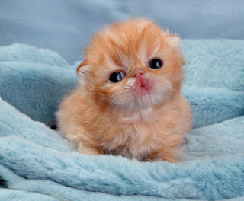
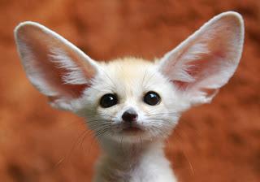
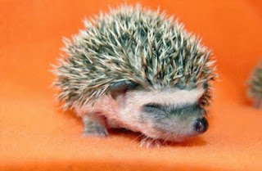
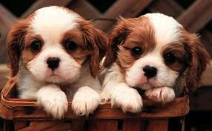

Slide 40
What is the world's most endangered sea turtle?
a. Kemp's Ridley Sea turtle
b. Leatherbacks
c. Loggerheads

Slide 41
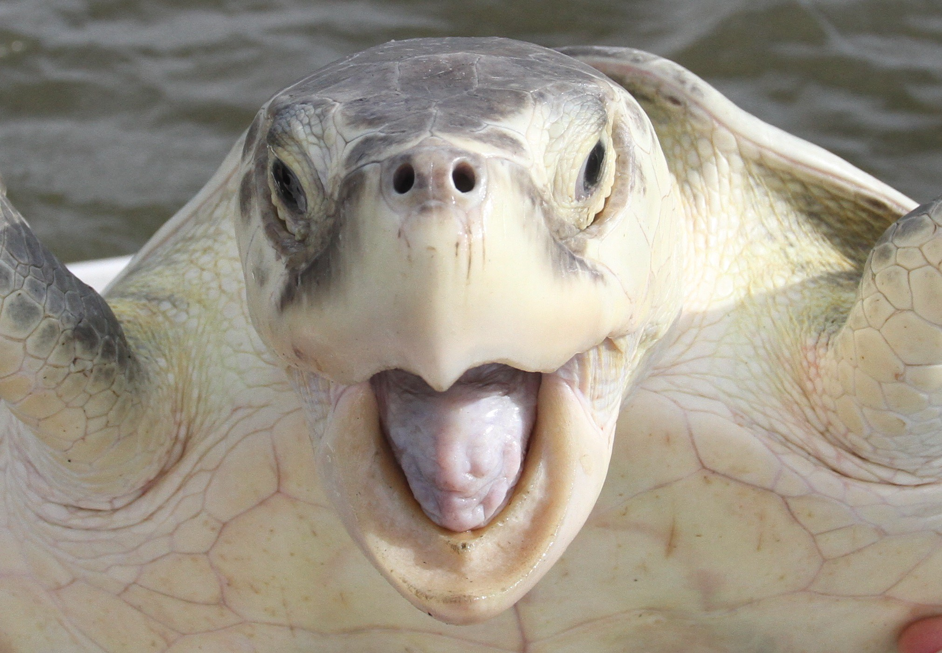

Slide 42
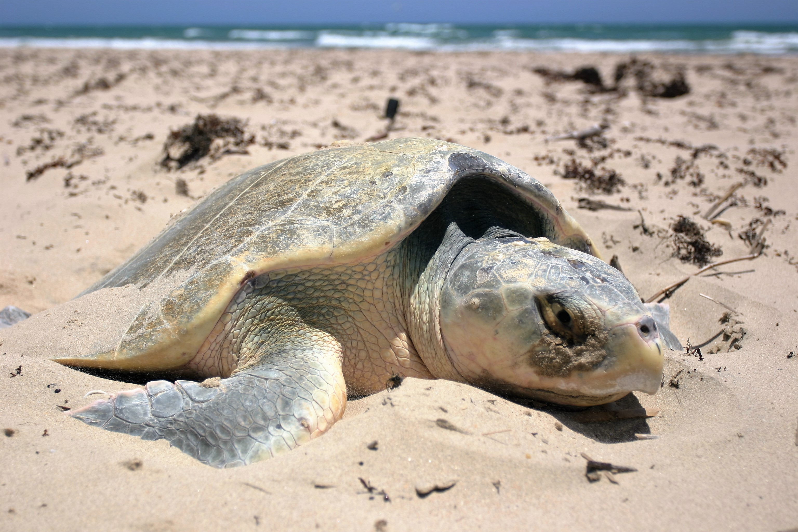

Slide 43
What is the world's most endangered sea turtle?
a. Kemp's Ridley Sea turtle
b. Leatherbacks
c. Loggerheads

Slide 44
What happened to extinct animals? Why?
About two dozen species were declared extinct (or nearly so) in 2019, although the total number of species lost this year probably numbers in the thousands. Scientists typically wait years or even decades before declaring a species well and truly extinct, and even then only after conducting extensive searches.

Slide 45
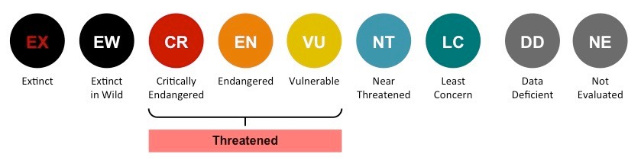

Slide 46
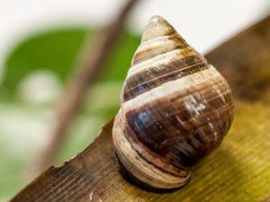
The last individual of this Hawaiian tree snail, known as “Lonesome George,” died in captivity on New Year’s Day. Disease and invasive predators drove it to extinction. This tiny creature’s disappearance probably generated the most media attention of any lost species in 2019.

Slide 47
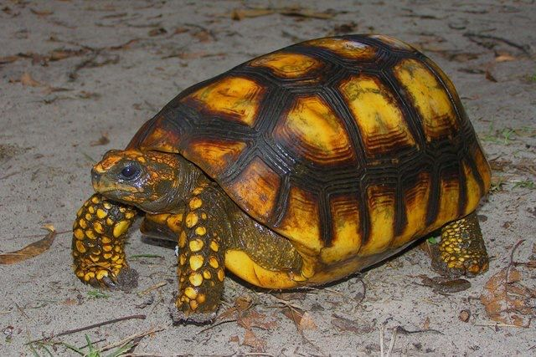
Yellow-footed tortoise

Slide 48
Quiz Time!
?

Slide 49
True or False? The polar bear was the first animal added to the Endangered Species list due to climate change.
True
False

Slide 50
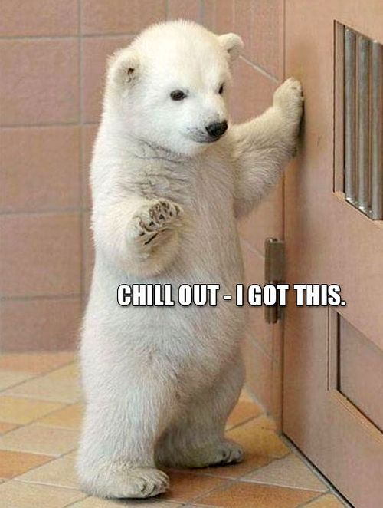

Slide 51
True or False? The polar bear was the first animal added to the Endangered Species list due to climate change.
True
False

Slide 52
Identify and name at least 5 extinct animals

Slide 53
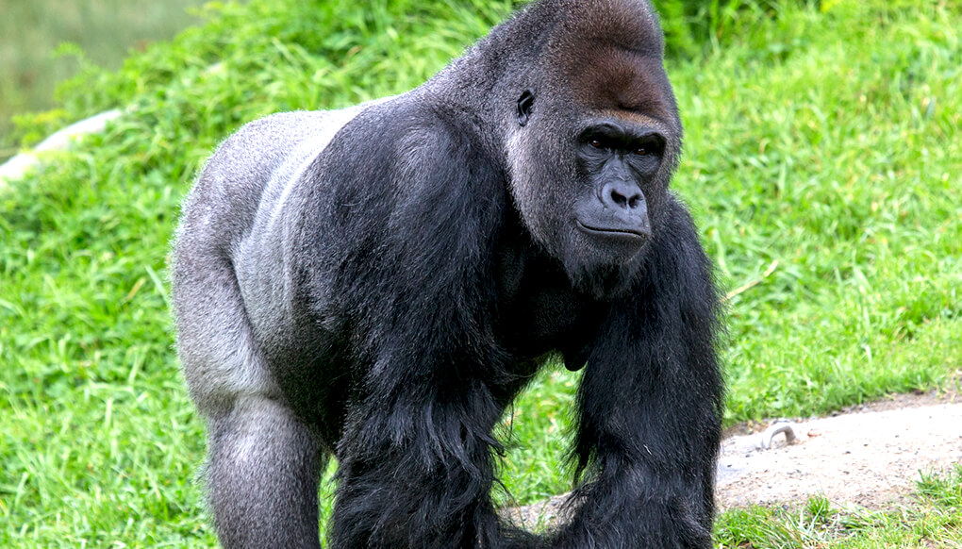
Western lowland gorilla

Slide 54
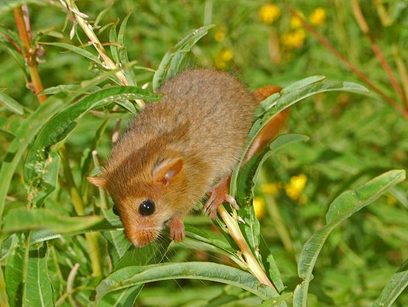
Hazel dormice are animals with big black eyes and golden-brown or sandy-orange fur. They are most commonly found in woody vegetation, coppice woodland and old hedgerows. Their diet is very diverse, from oak and willow flowers in spring to aphids and caterpillars in summer.

Slide 55
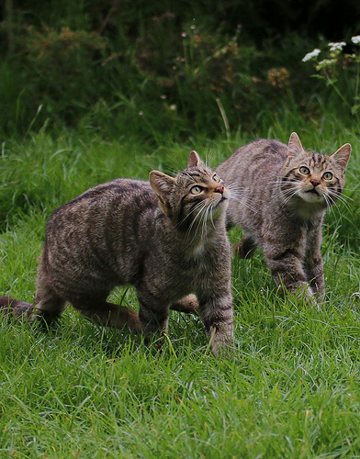
Also referred to as the Highland tiger, the Scottish wildcat is the only living native feline in the UK. These “small” tigers look just like domestic tabby cats but are typically bigger and heavier. They also have stripy furs and bushy tails with blunt tips and black bands. It is believed that wildcats settled in the country thousands of years ago.

Slide 56
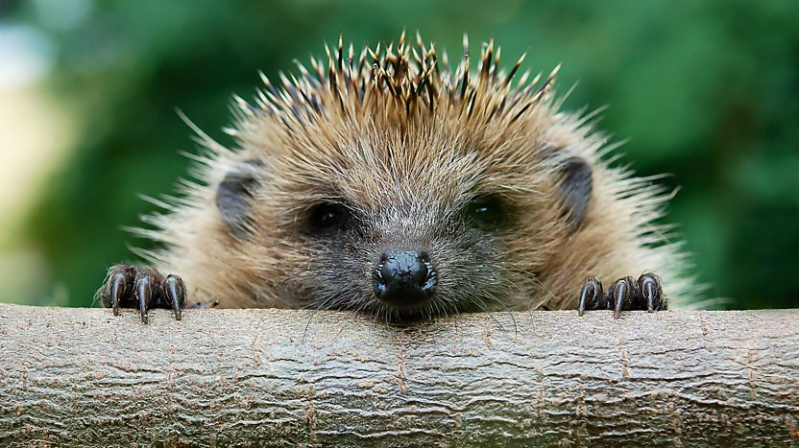
Hedgehogs are very familiar creatures in children’s stories, and even in campaigns helping us to learn how to cross the road safely. However, their numbers have fallen by 50% since the year 2000. The population is steadying in urban areas but declining in rural areas, and some campaigners have said that this is in part due to a decrease in the number of hedgerows in farmland across the UK.

Slide 57
How many animals are currently on the endangered species list. Collect pictures of at least 5 endangered animals and name them.
You may be wondering: How many animals are endangered, or what animals are endangered in 2020? For the most recent version of the list, IUCN researchers and scientists evaluated 63,837 species. Of that number, 19,817 are threatened with extinction; 3,947 landed in the Critically Endangered category; 5,766 qualified as Endangered, and over 10,000 species are listed under Vulnerable.

Slide 58
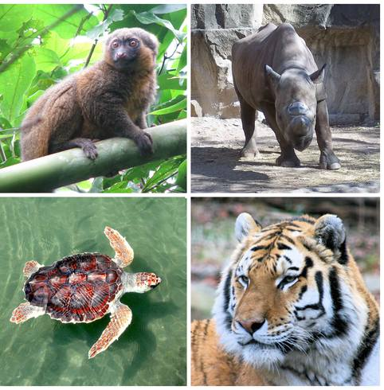

Slide 59
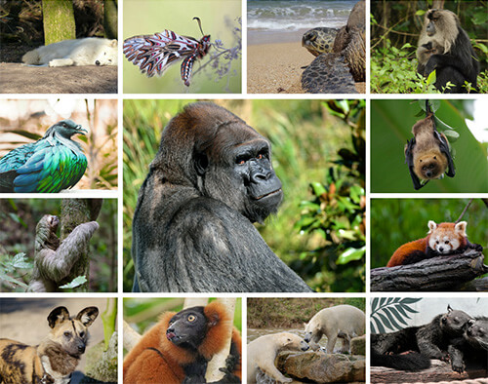

Slide 60
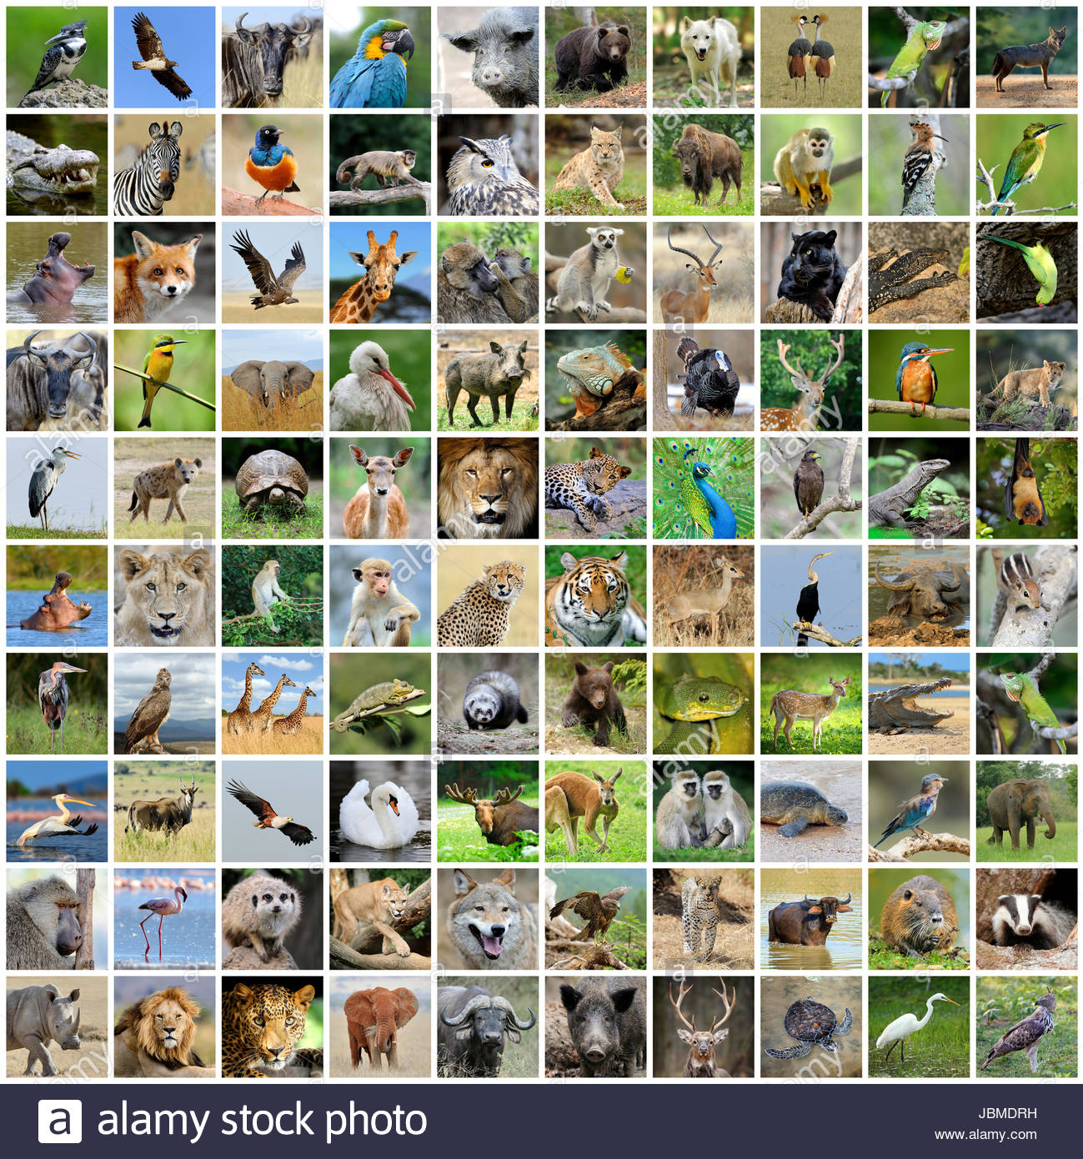

Slide 61
Why save endangered animals?

Slide 62
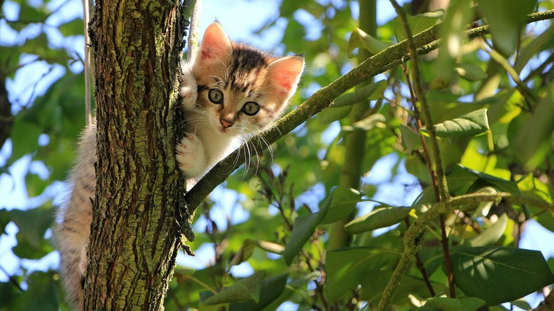
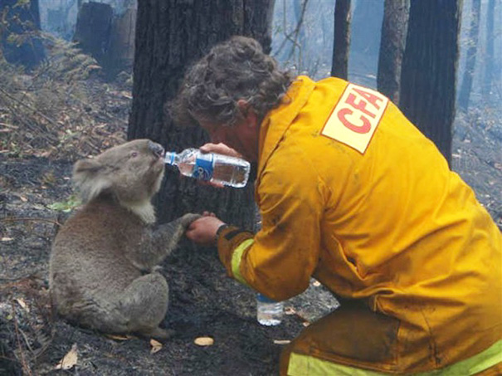

Slide 63
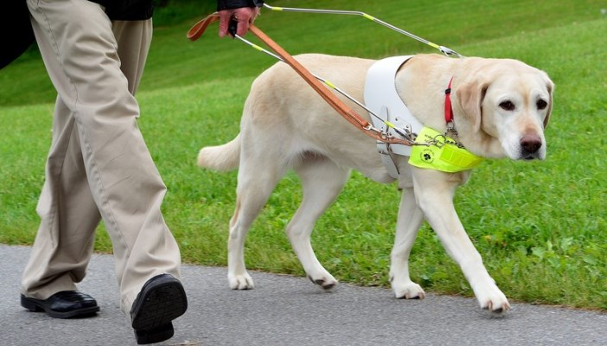
1. For the enjoyment of future generations
One of the strongest arguments for saving endangered animals is simply that we want to. We get a lot of pleasure out of seeing and interacting with animals. Species that go extinct now are no longer around for us or future generations to see and enjoy. They can only learn about them in books and on the internet. And, that is heartbreaking.

Slide 64
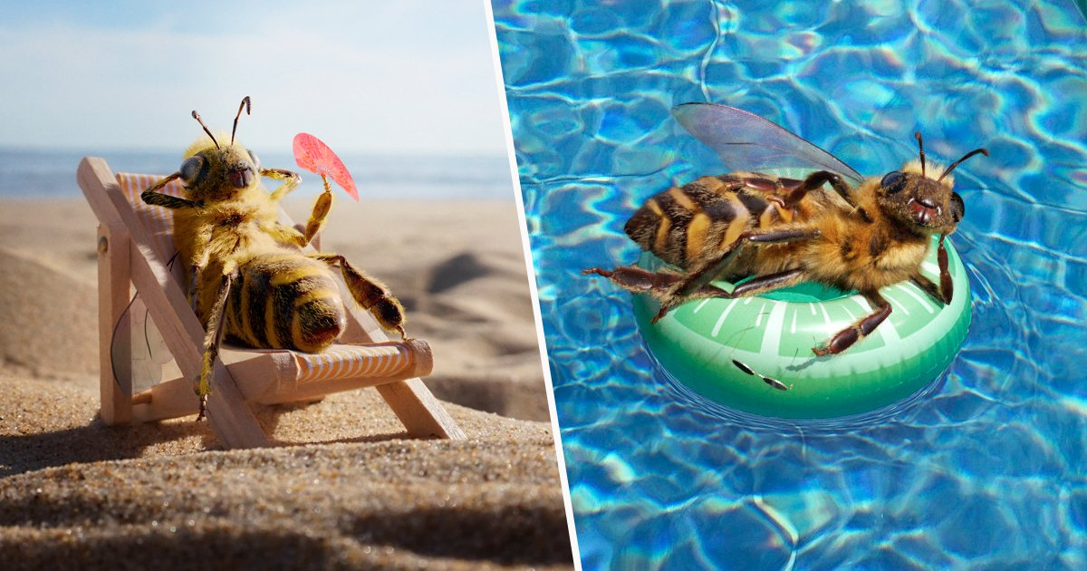
2. For the environment and other animals
Everything in nature is connected. If you remove one animal or plant it upsets the balance of nature, can change the ecosystem completely and may cause other animals to suffer. For example, bees may seem small and insignificant, but they have a huge role to play in our ecosystem – they are pollinators. This means they are responsible for the reproduction plants. Without bees, many plant species would go extinct, which would upset the entire foodchain.

Slide 65
3. For medicinal purposes
Many of our medicines have come from or been inspired by nature. The loss of plants and animals to extinction takes with it the potential for new cures and drugs that we have yet to discover.

Slide 66
What can you do to help endangered animals?

Slide 67
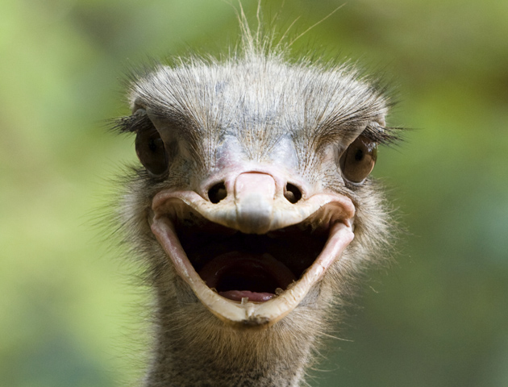

Slide 68
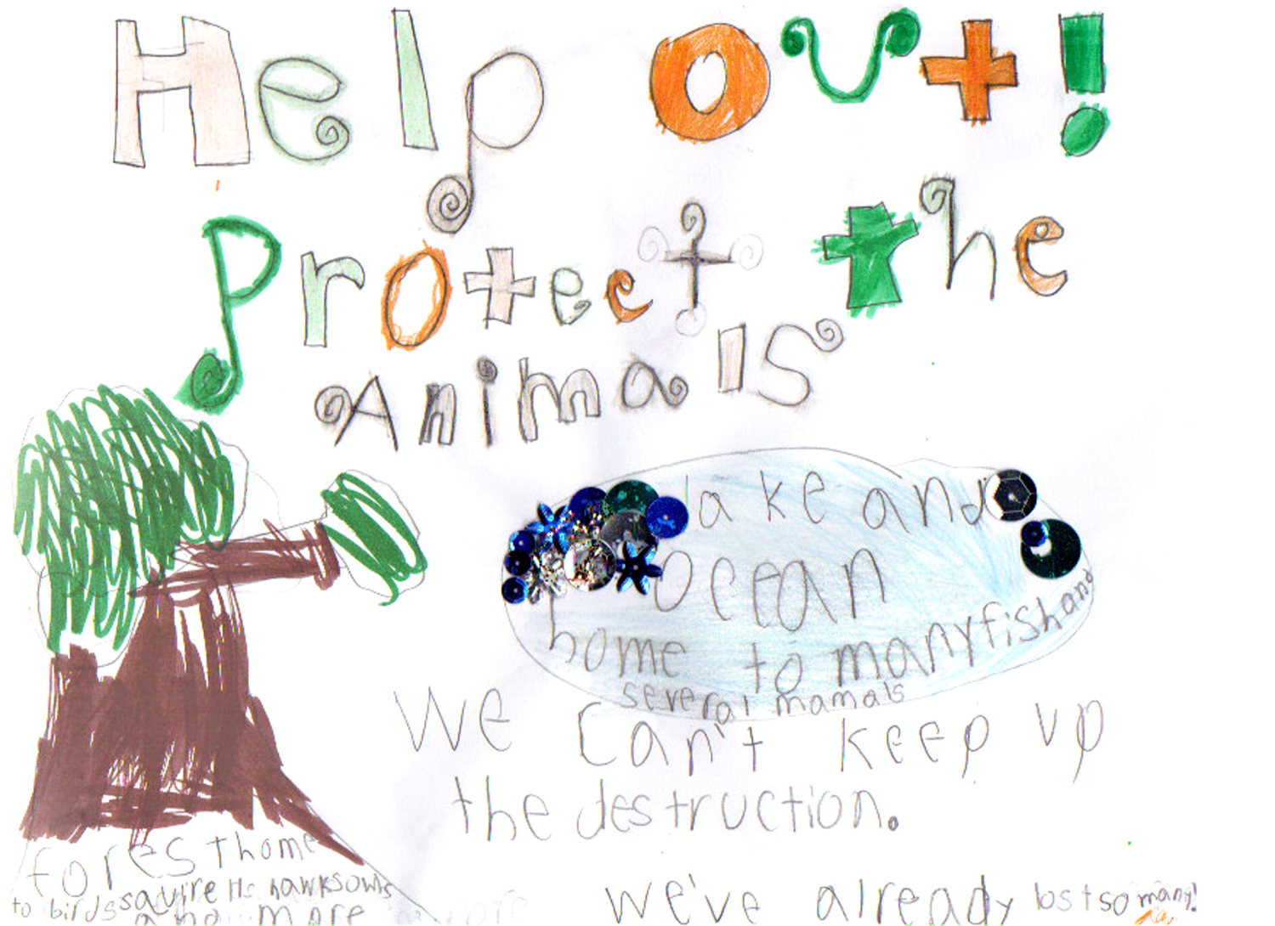
Protect wildlife habitats. Habitat loss is one of the biggest causes of extinction. Do your bit to preserve wildlife habitats. Volunteer to maintain a local nature reserve, campaign against deforestation or create a space for nature in your garden.

Slide 69
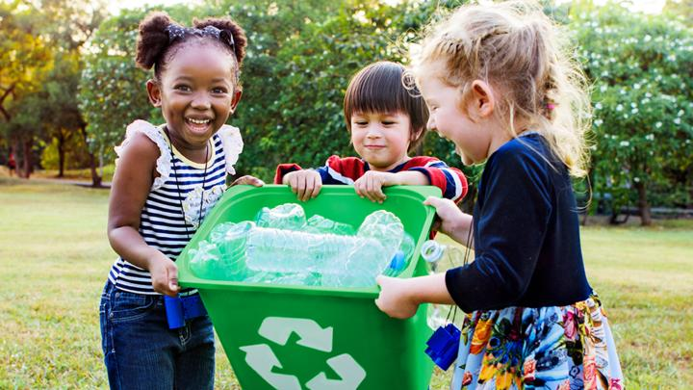
Recycle!

Slide 70
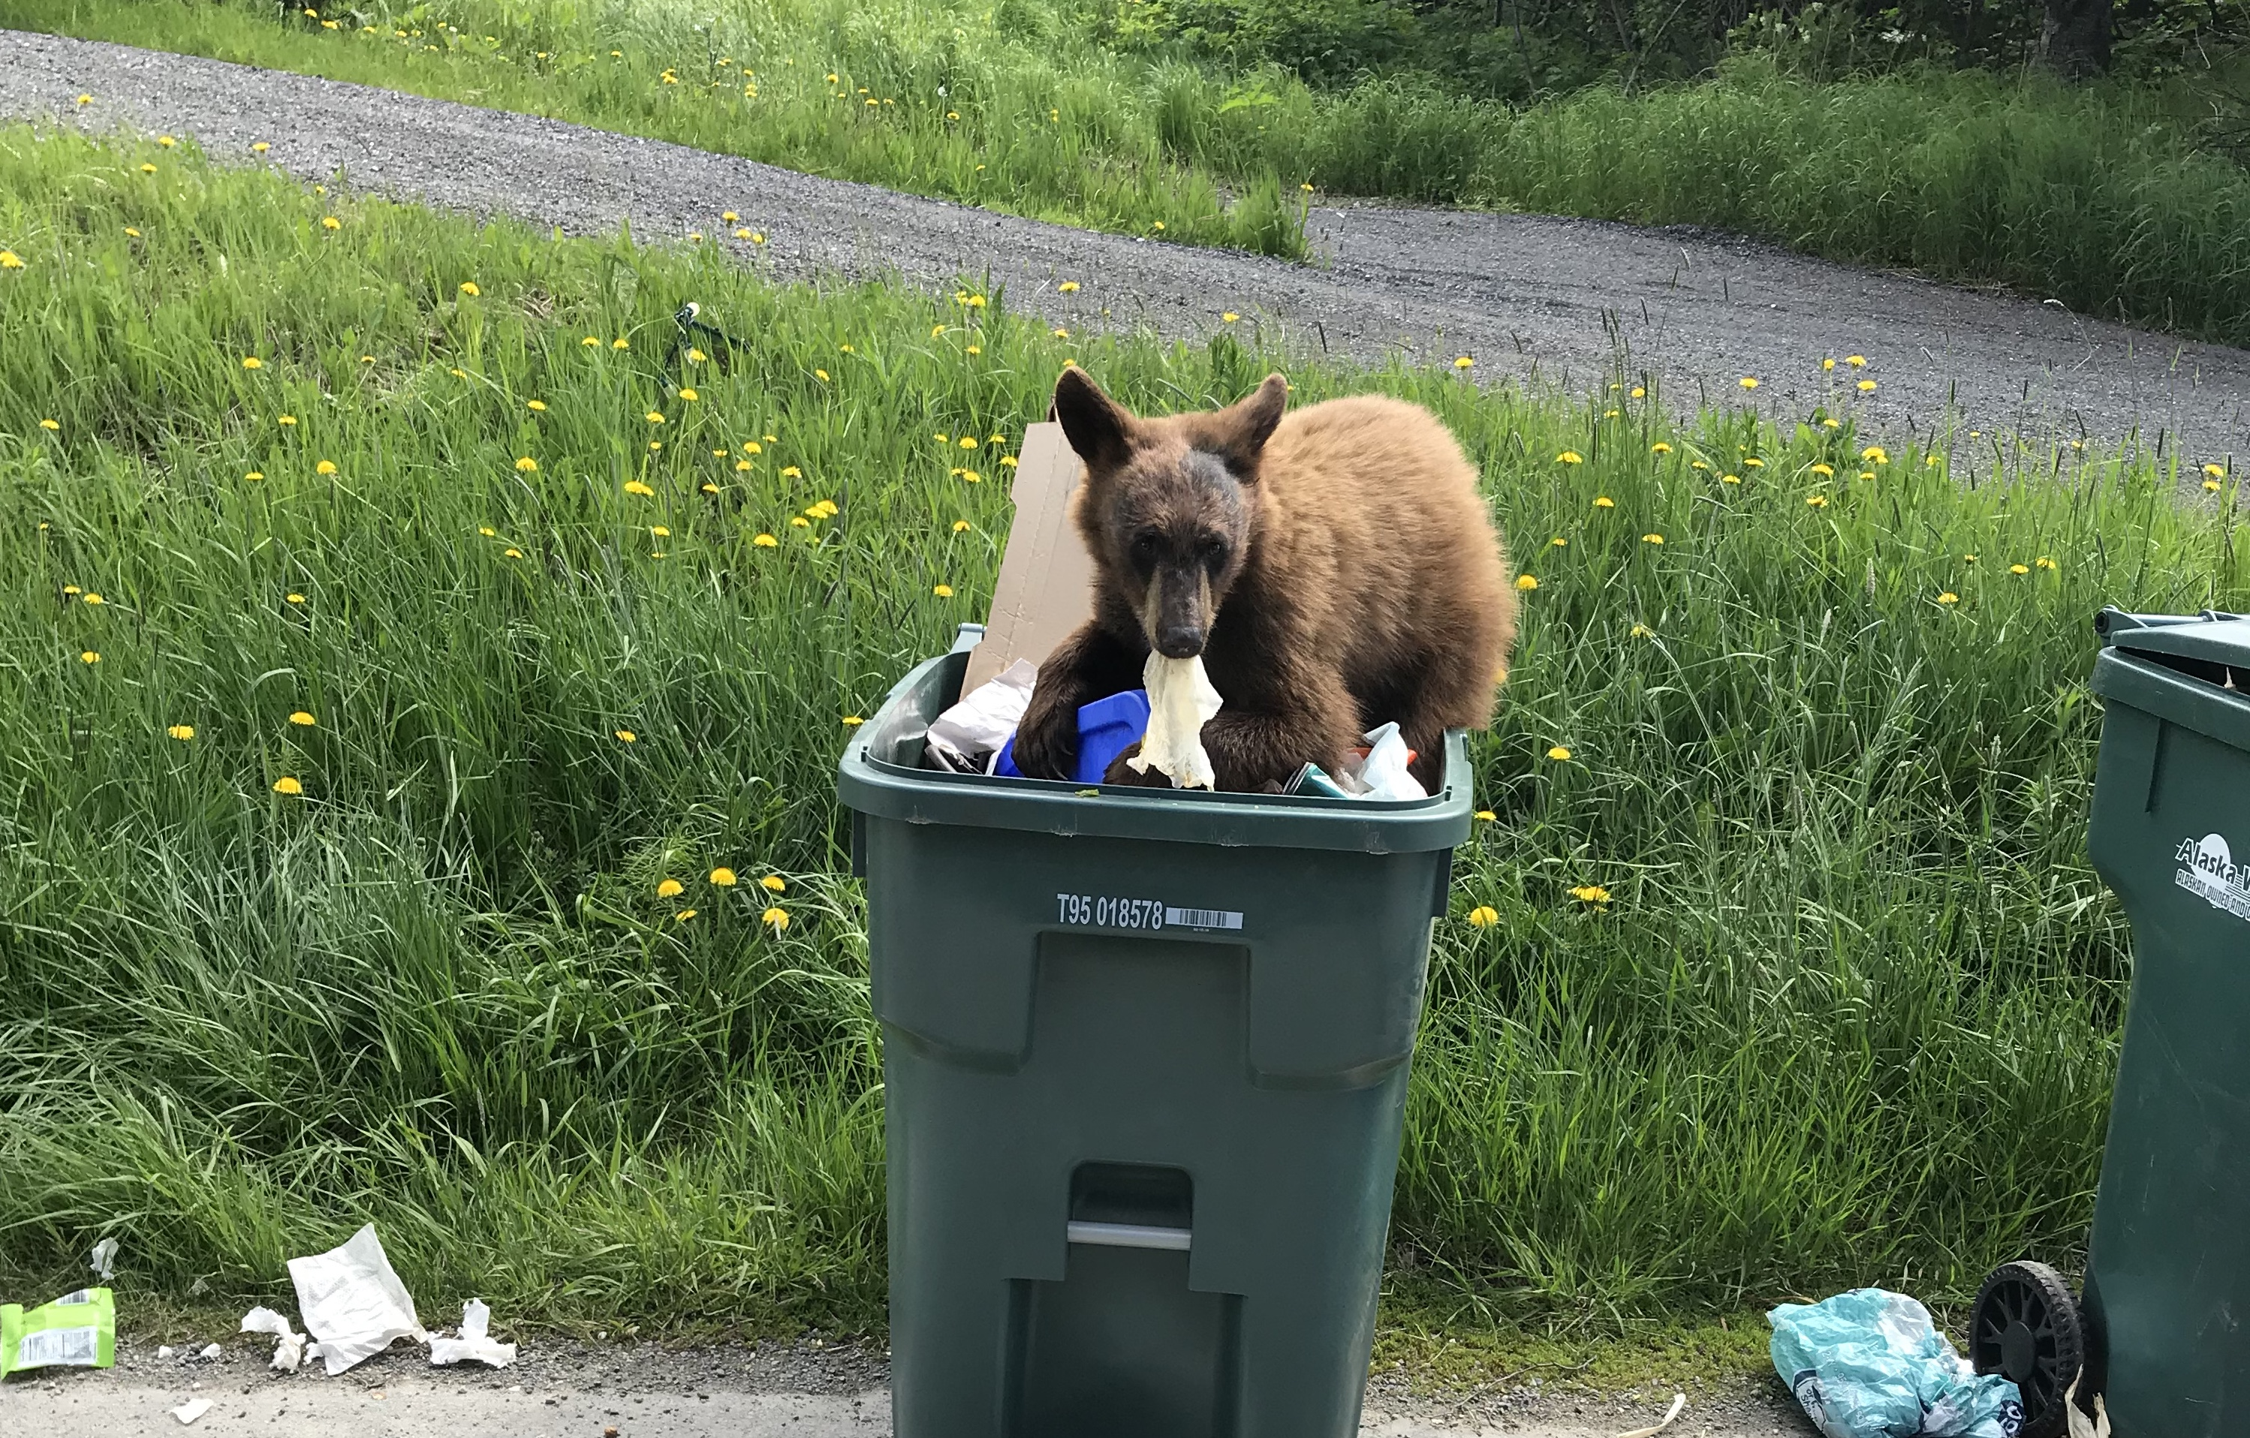
Make certain that your home is not a hazard to wildlife. The first thing you can do is to secure all of your trash so that animals can’t get to it.

Slide 71
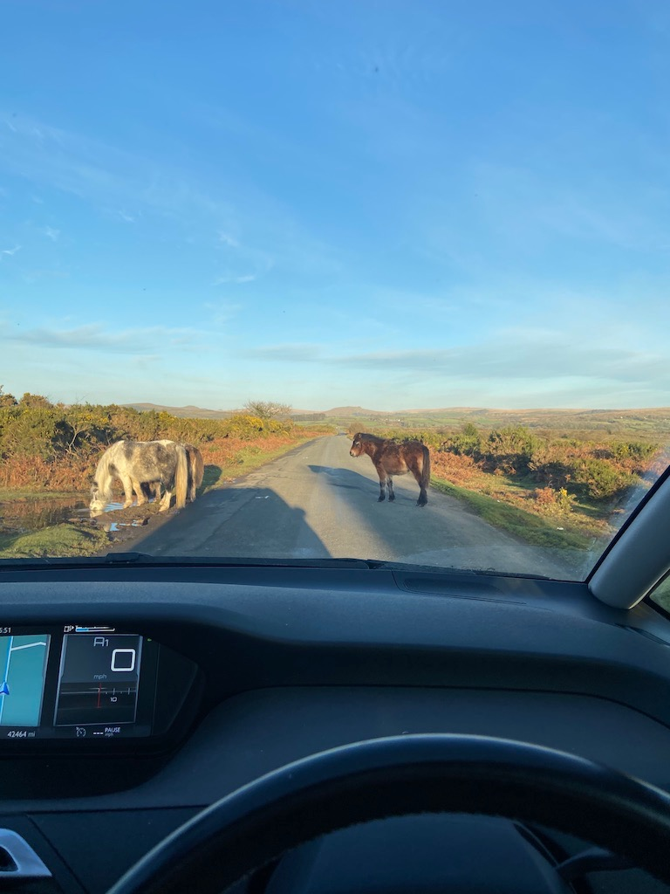
Watch the road and drive carefully. Particularly if you live or commute in a rural area, roads are one of the biggest hazards that animals face.

Slide 72
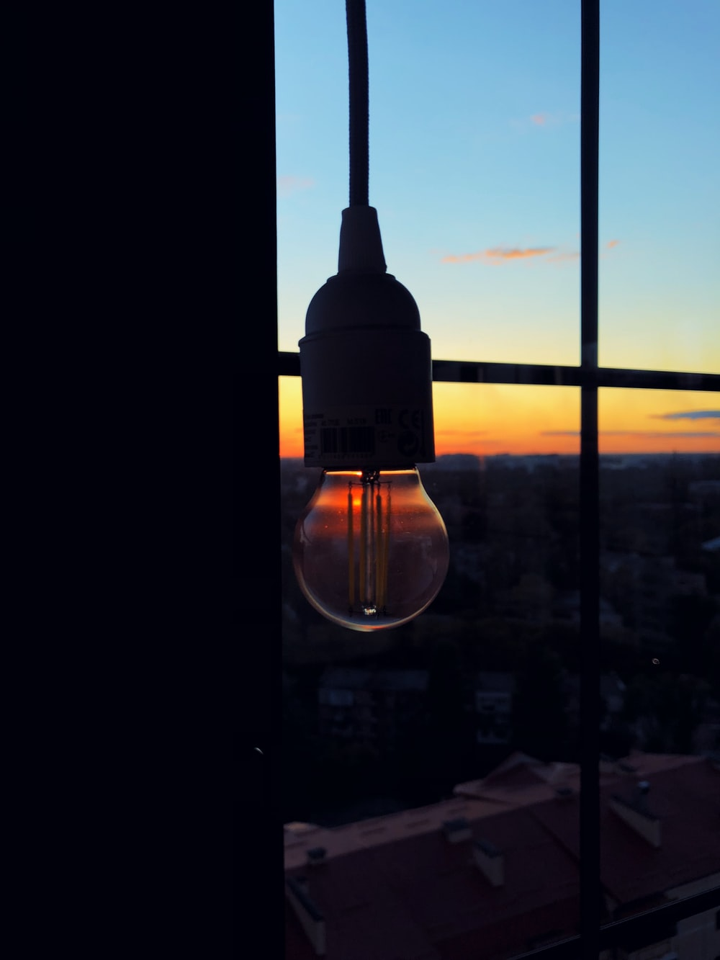
Turn off the lights. The more energy that is used, the more pollutants that are put into the environment. By limiting your energy consumption, you are limiting the amount of pollutants being put into the environment by power plants. It might seem as though one person can’t make a difference, but the more people that do this, the bigger impact it will have.

Slide 73
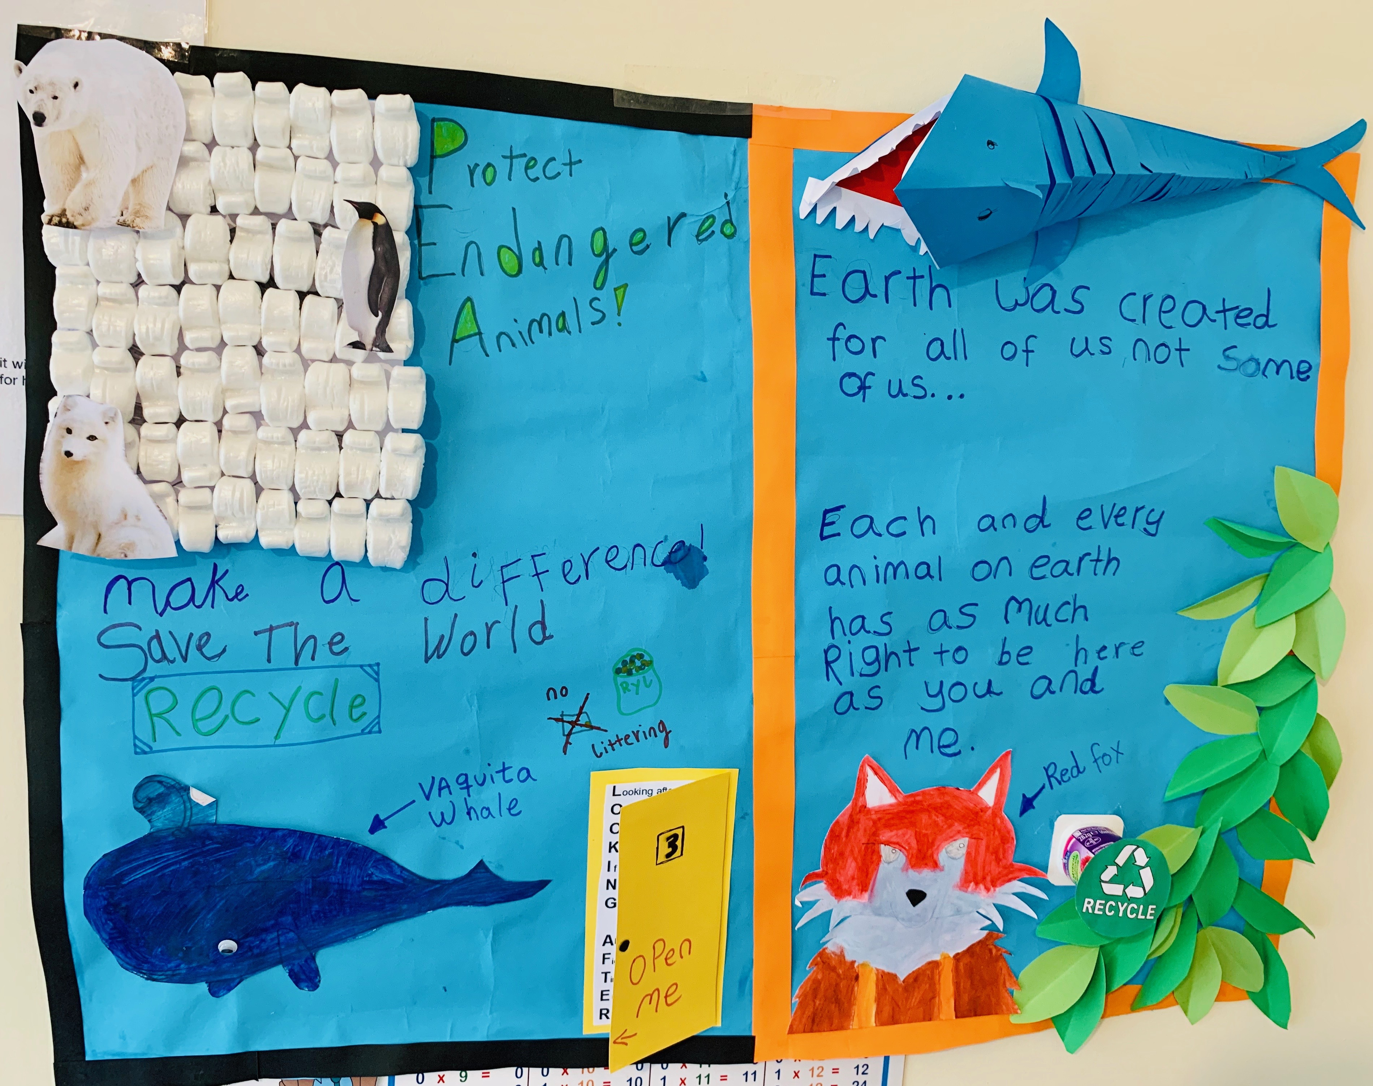
Make a poster or booklet encouraging people to save endangered animals. Show it to someone.

Slide 74
Memorize Proverbs 12:10 NKJV.
"A righteous man regards the life of his animal, But the tender mercies of the wicked are cruel. He who tills his land will be satisfied with bread, But he who follows frivolity is devoid of understanding. The wicked covet the catch of evil men, But the root of the righteous yields fruit."

