Slide 1
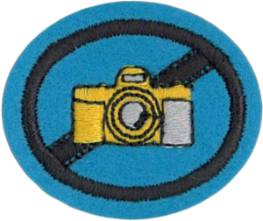
Photography

Slide 2
Explain the principles of camera construction

Slide 3
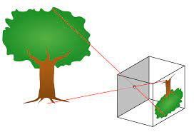
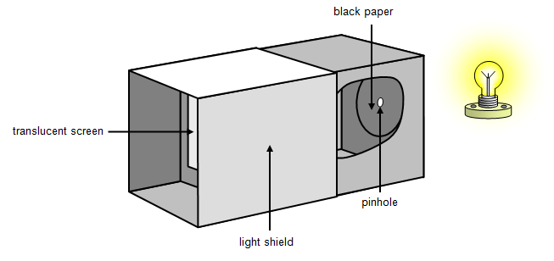
A pinhole camera is a simple camera without a lens but with a tiny aperture (the so-called pinhole)—effectively a light-proof box with a small hole in one side. Light from a scene passes through the aperture and projects an inverted image on the opposite side of the box, which is known as the camera obscura effect.

Slide 4
What the camera lens does ?

Slide 5
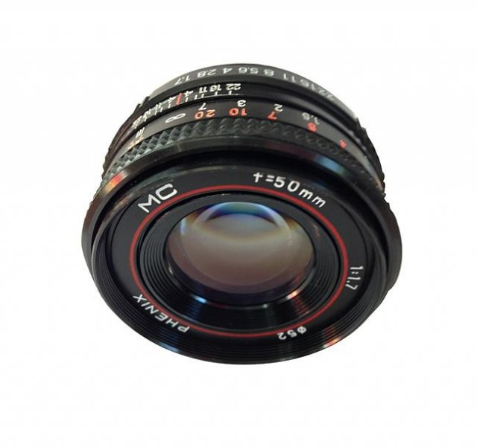
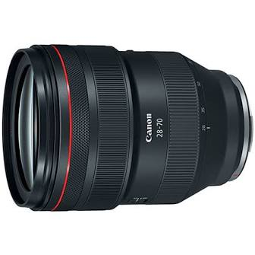
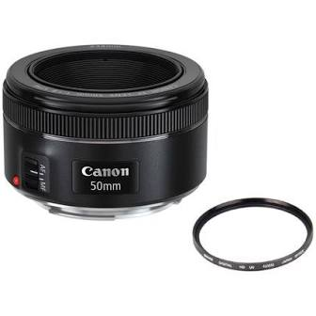
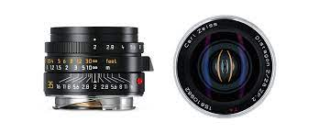
A camera lens usually has an aperture adjustment mechanism to control the amount of light that may pass. It also has a shutter, to control the length of time during which light may pass through the lens.

Slide 6
The effect of light on light-sensitive film

Slide 7
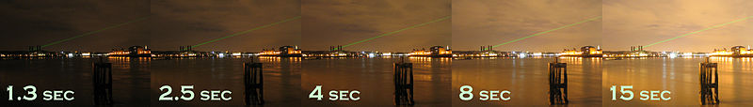

Photographic film is a sheet of plastic which is coated with an emulsion containing light-sensitive silver halide salts with variable crystal sizes that determine the sensitivity and resolution of the film. When the emulsion (in this film) is subjected to sufficient exposure to light it forms an invisible image.

Slide 8
The action of developers

Slide 9
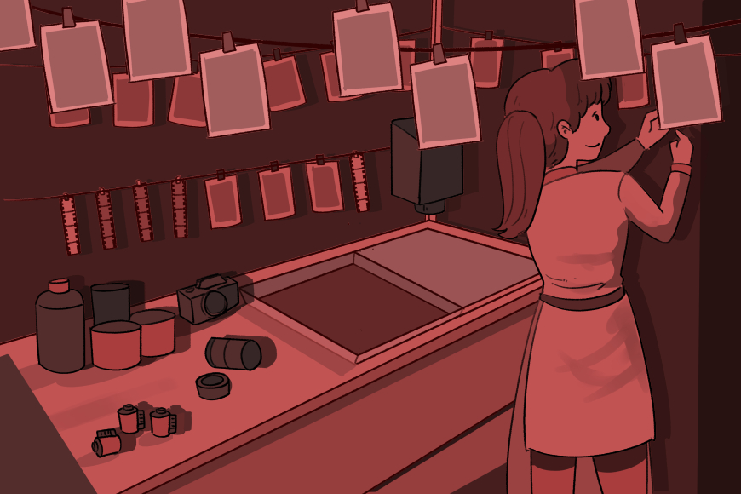
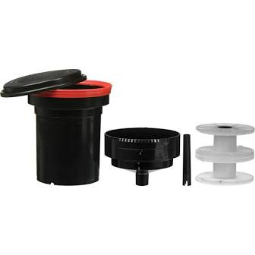
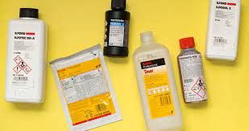
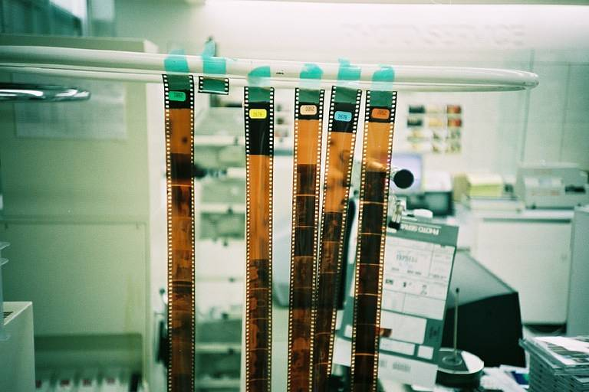
In film developing, photographic developer (or just developer) is a chemical that makes the latent image on the film (or print) visible. It does this by reducing the silver halides that have been exposed to light to metals of elemental silver in the gelatine matrix. As a generalisation, the longer a developer is allowed to work, the greater the degree of reduction of the silver halide crystals to silver and therefore the darker the image.

Slide 10


Slide 11
What is meant by the "speed” of the film

Slide 12
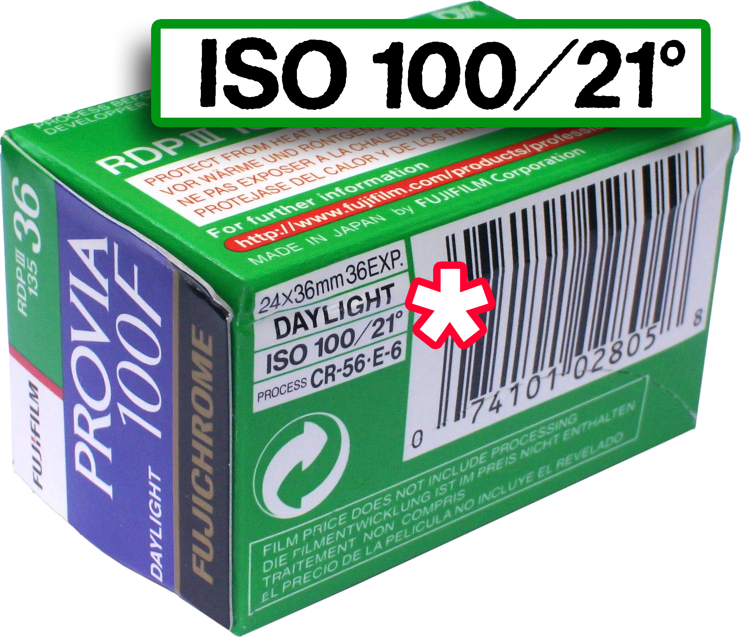
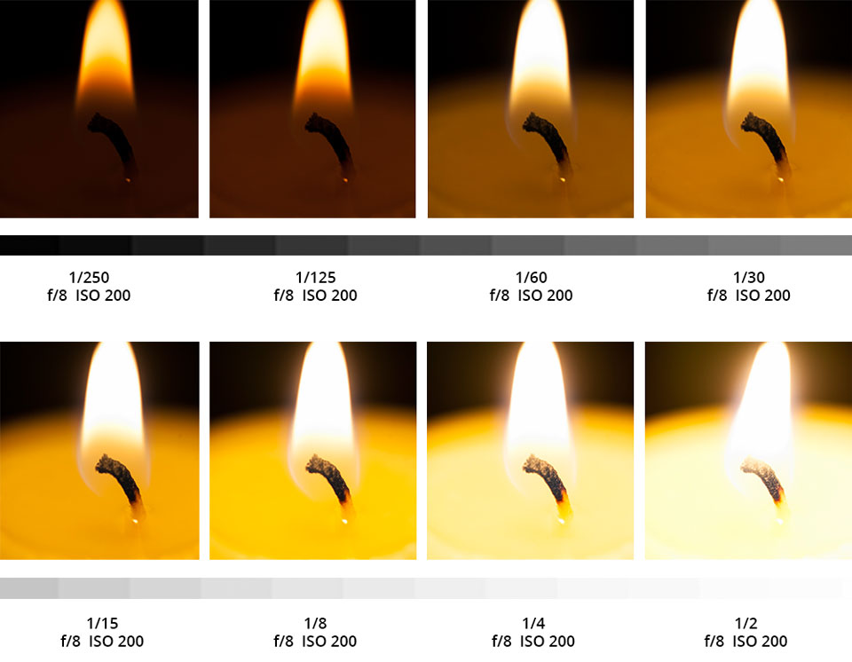
Film speed is the measure of a photographic film's sensitivity to light. Stock with lower sensitivity (lower ISO speed rating) requires a longer exposure and is thus called a slow film, while stock with higher sensitivity (higher ISO speed rating) can shoot the same scene with a shorter exposure and is called a fast film.

Slide 13
What does ASA/ISO mean?

Slide 14
The standard known as ISO 5800:1987 from the International Organization for Standardization (ISO) defines both a linear scale and a logarithmic scale for measuring film speed.
In the ISO linear scale, which corresponds to the older ASA scale, doubling the speed of a film (that is, halving the amount of light that is necessary to expose the film) implies doubling the numeric value that designates the film speed. In the ISO logarithmic scale, which corresponds to the older DIN scale, doubling the speed of a film implies adding 3° to the numeric value that designates the film speed. For example, a film rated ISO 200/24° is twice as sensitive as a film rated ISO 100/21°.

Slide 15
How are shutter speed, lens aperture, and film speed related?

Slide 16
Shutter speed is the time for which the shutter is held open during the taking of a photograph to allow light to reach the film or image sensor (in a digital camera). Combined with adjusting of the lens aperture, the shutter speed regulates how much light the camera will record.
Film speed is the measure of a photographic film's sensitivity to light.

Slide 17
Give the principal uses of photography.

Slide 18
Photography [fә'tɑgrәfi:],[foʊ'tɑgrәfi:] is the process of recording pictures by means of capturing light on a light-sensitive medium, such as a film or sensor. Light patterns reflected or emitted from objects expose a sensitive chemical or electronic medium during a timed exposure, usually through a photographic lens in a device known as a camera that also stores the resulting information chemically or electronically.

Slide 19
Take print or slide pictures illustrating at least eight of the following techniques.

Slide 20
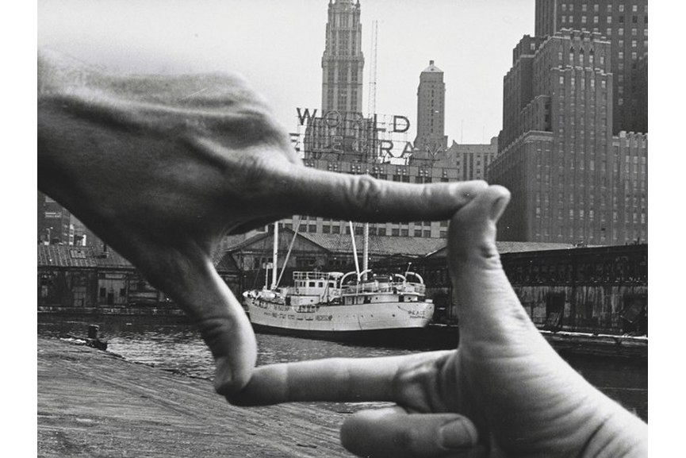

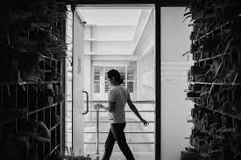

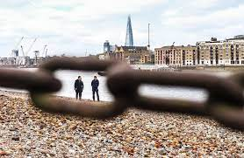
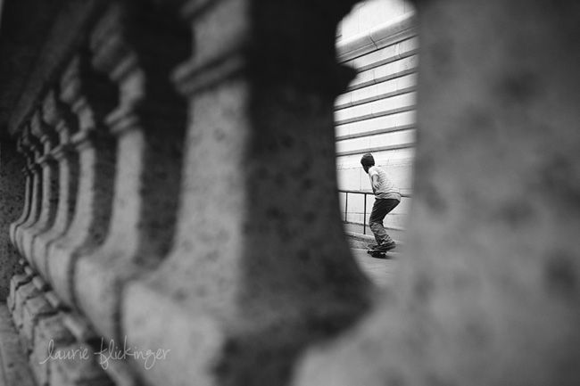
Framing

Slide 21
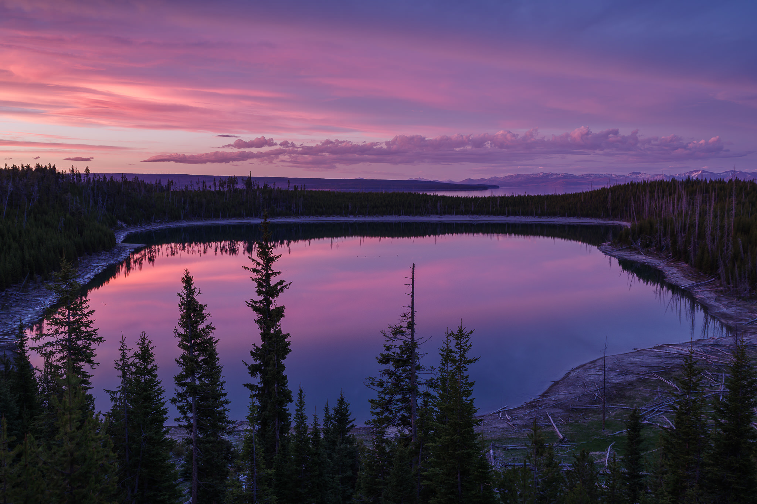
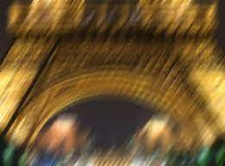
Camera steadiness

Slide 22


Direction of lighting - front, backlighting, side

Slide 23
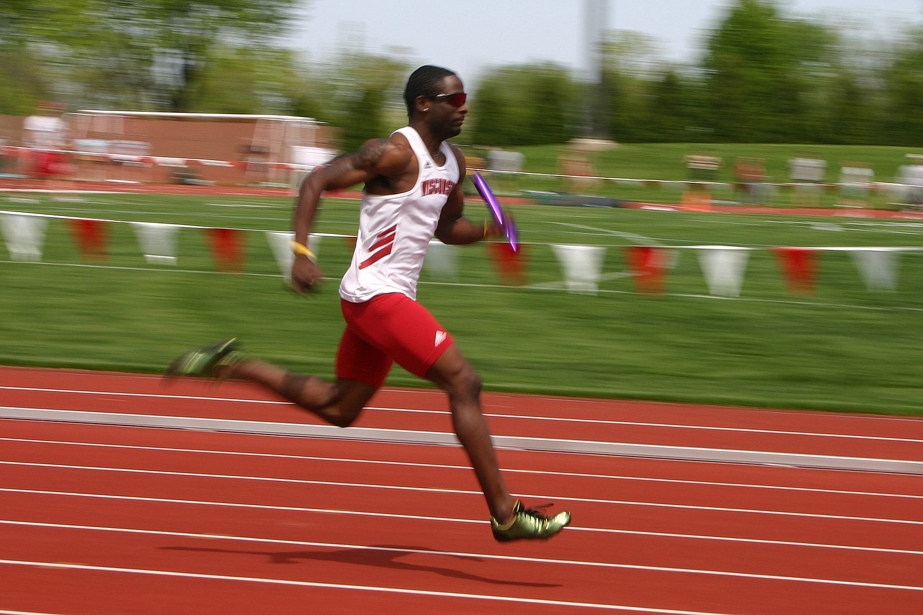
Panning - background blurred
with subject in focus

Slide 24
Rule of thirds

Slide 25

Angle - high level

Slide 26

Angle – eye level

Slide 27
Angle - low angle

Slide 28

Level horizon

Slide 29


Fill the frame

Slide 30
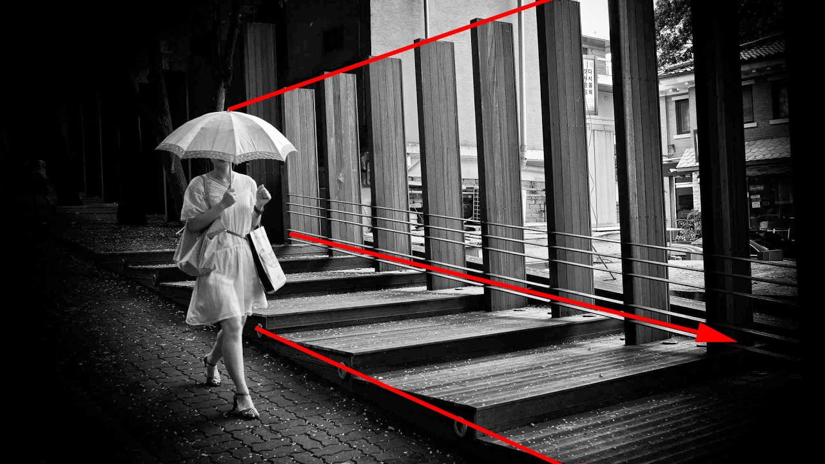
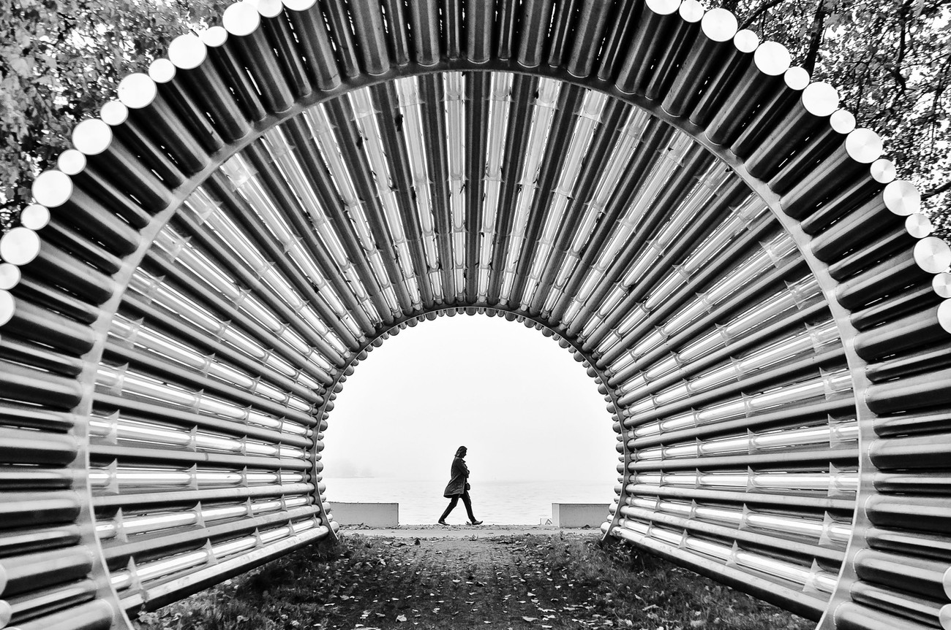
leading lines

Slide 31
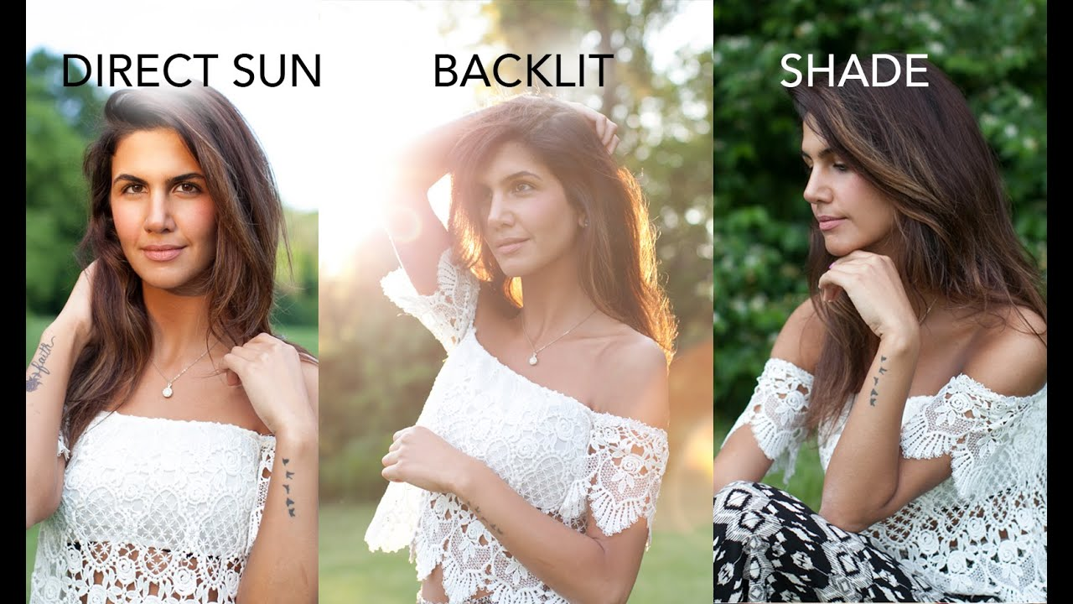
Quality of light

Slide 32
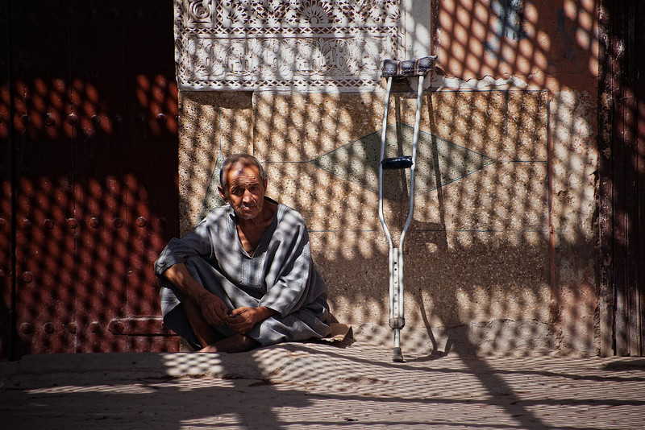
Quality of light - shade

Slide 33
Quality of light – Mid-Day

Slide 34

Quality of light - Sunset

Slide 35
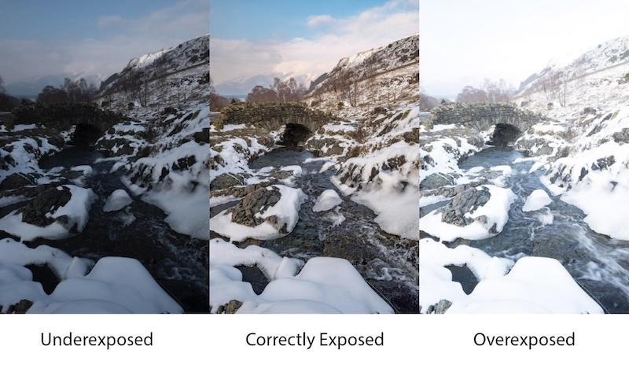
Correct exposure - underexposed, overexposed, and correctly exposed

Slide 36
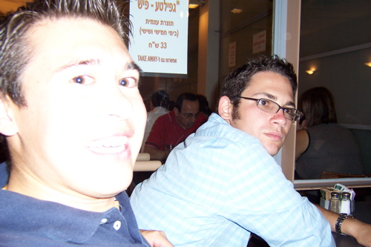
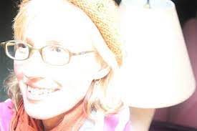
Use of flash - distance
and reflective objects

Slide 37
Use of flash - distance
and reflective objects

Slide 38
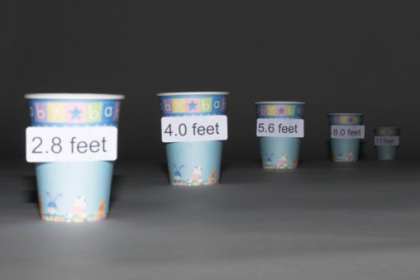
Use of flash - distance
and reflective objects

Slide 39
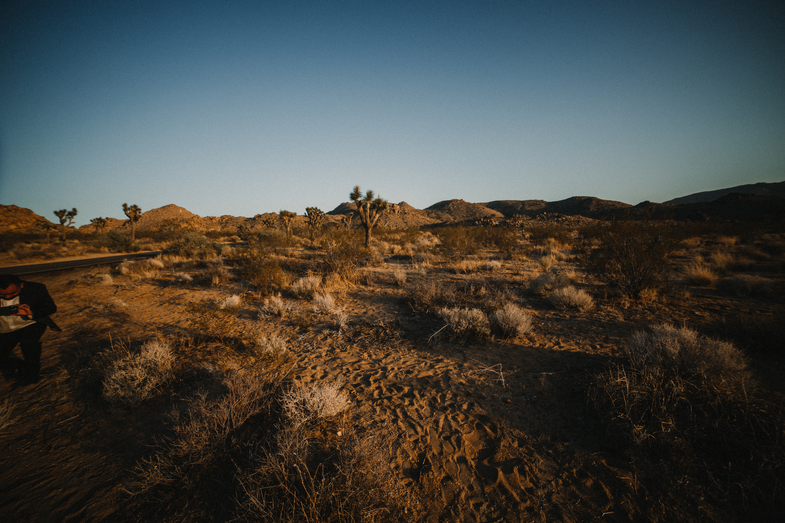
“You don’t take a photograph, you make it.”
Ansel Adams

Slide 40

@LUILLI2700

Slide 41
You made it!
thank you everyone

