Slide 1

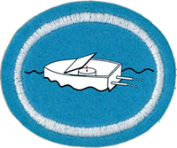
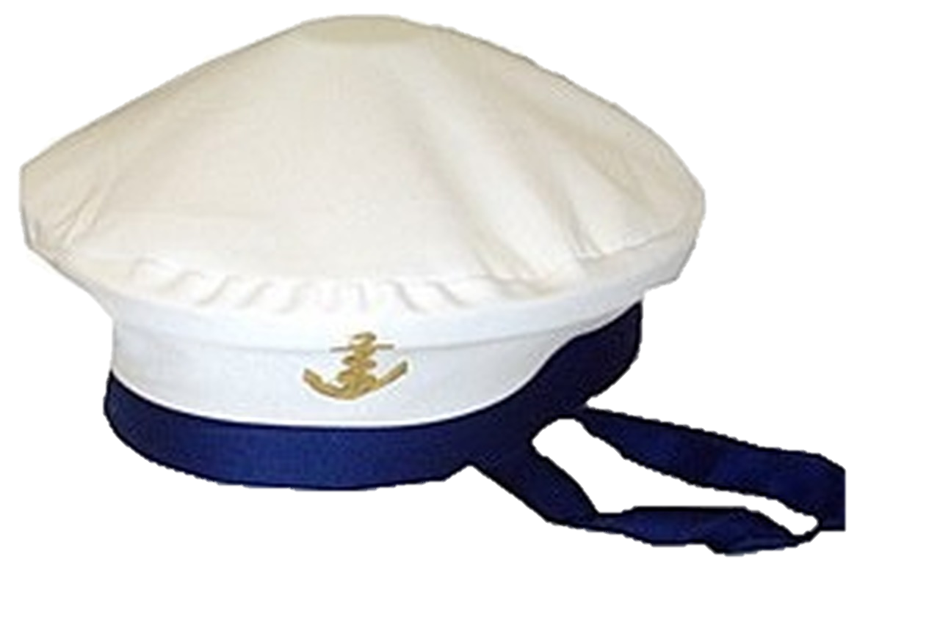

Toy Boat Regatta
Basic Honor
Glen Morrow- NAD

Slide 2
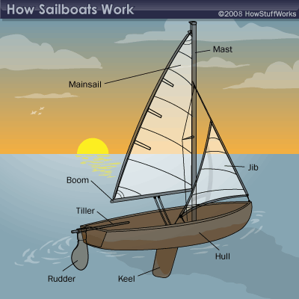
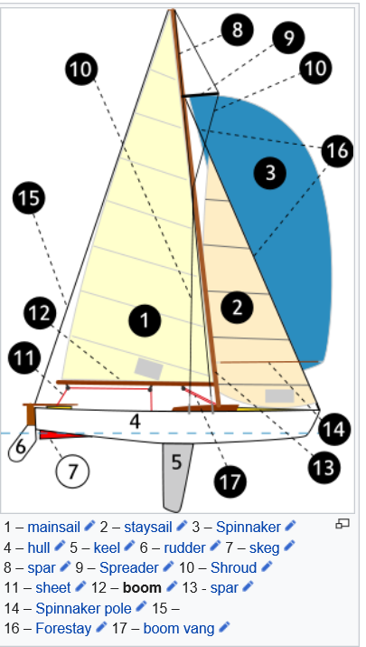

Slide 3
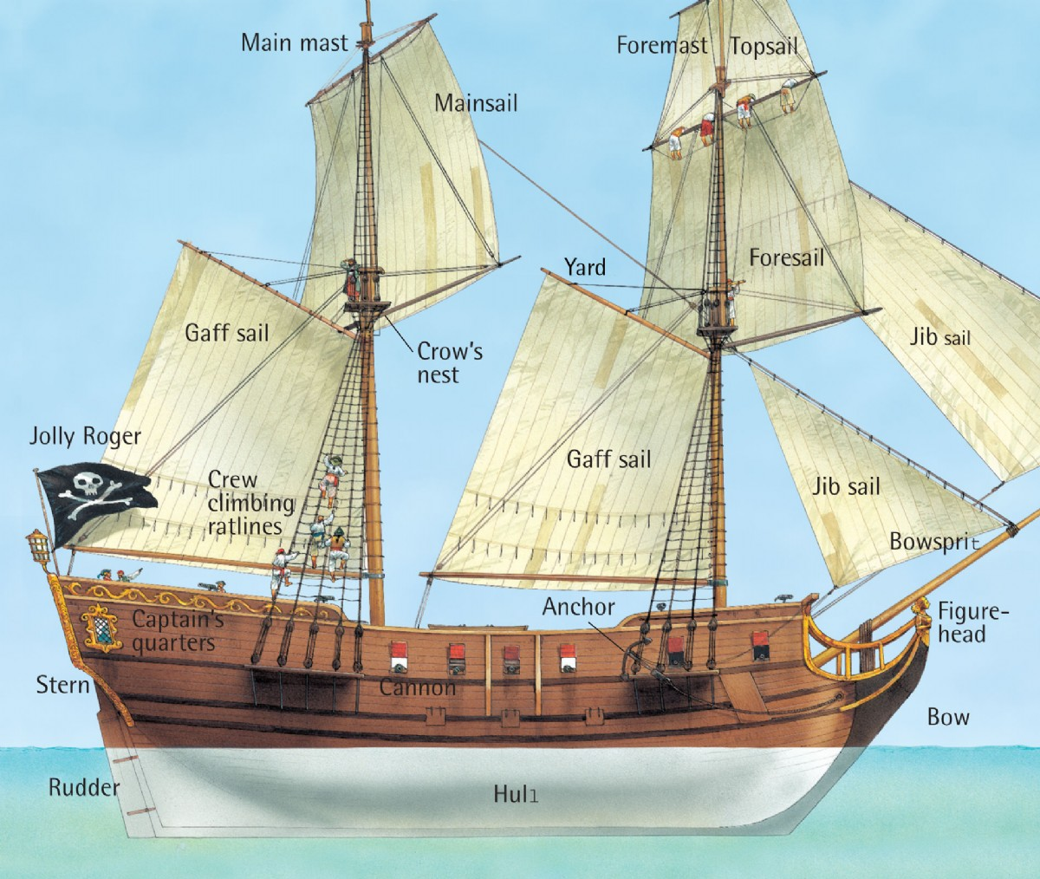
Boom
Tiller
Keel

Slide 4
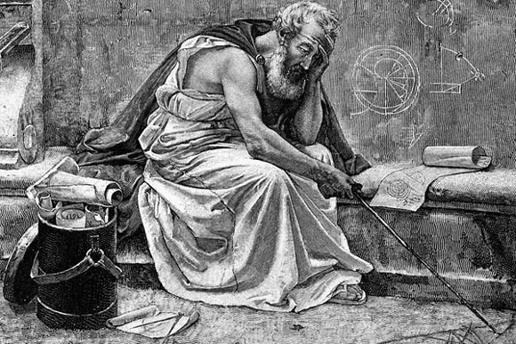
Archimedes
Born 287 B.C.
Greek
Dad was an Astronomer
Studied under Euclid (Geometry)
“Greatest Mathematician”
“Greatest Physicist”
Engineer
“Give me a lever long enough and a fulcrum on which to place it, and I shall move the world”

Slide 5
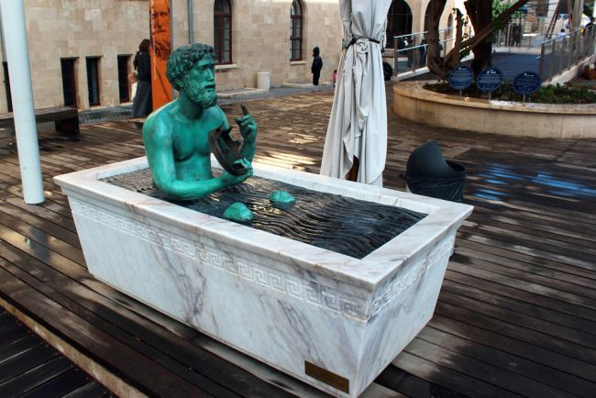
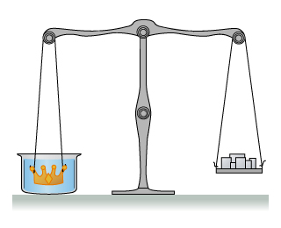
EUREKA!

Slide 6

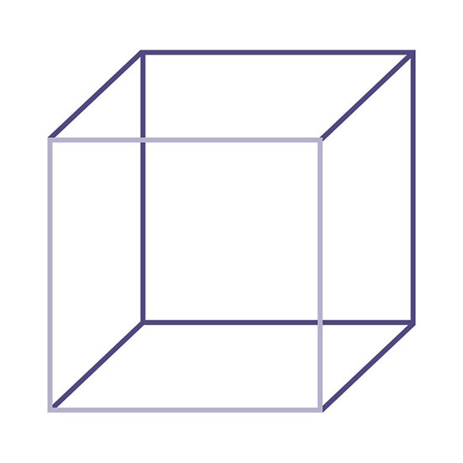
Archimedes' Principle of Buoyancy:
An upward buoyant force that is exerted on a body immersed in a fluid, whether fully or partially submerged, is equal to the weight of the fluid that the body displaces
< 62.4 lbs
12”
1 m
12”
= 62.4 lbs
1 m
= 998 kg
> 62.4 lbs
12”
1 m

Slide 7
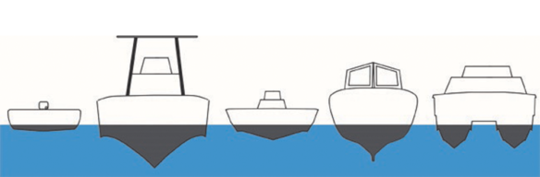
Weight of Boat + Cargo = Weight of Displaced Water
Weight of Boat + Cargo = Weight of Displaced Water
Displaced Water

Slide 8
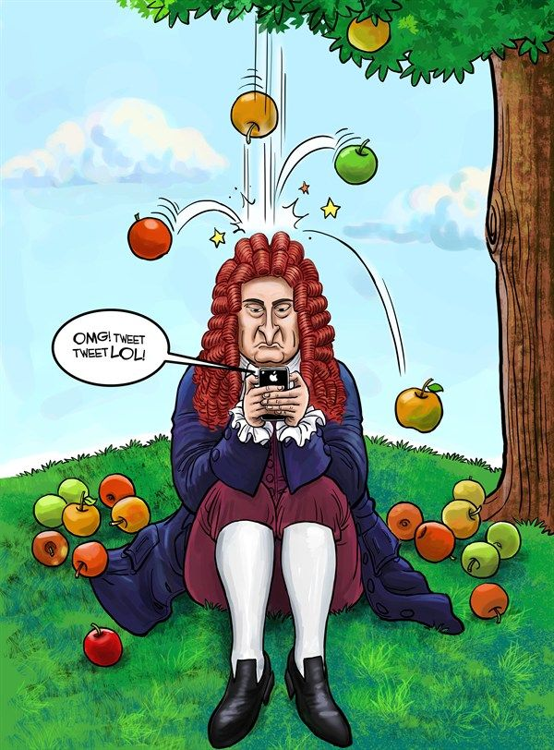
Sir Isaac Newton
Born 1642
English
Mathematician
Physicist
Astronomer
Theologian
Author (mostly Religion)
Started the Science Revolution

Slide 9
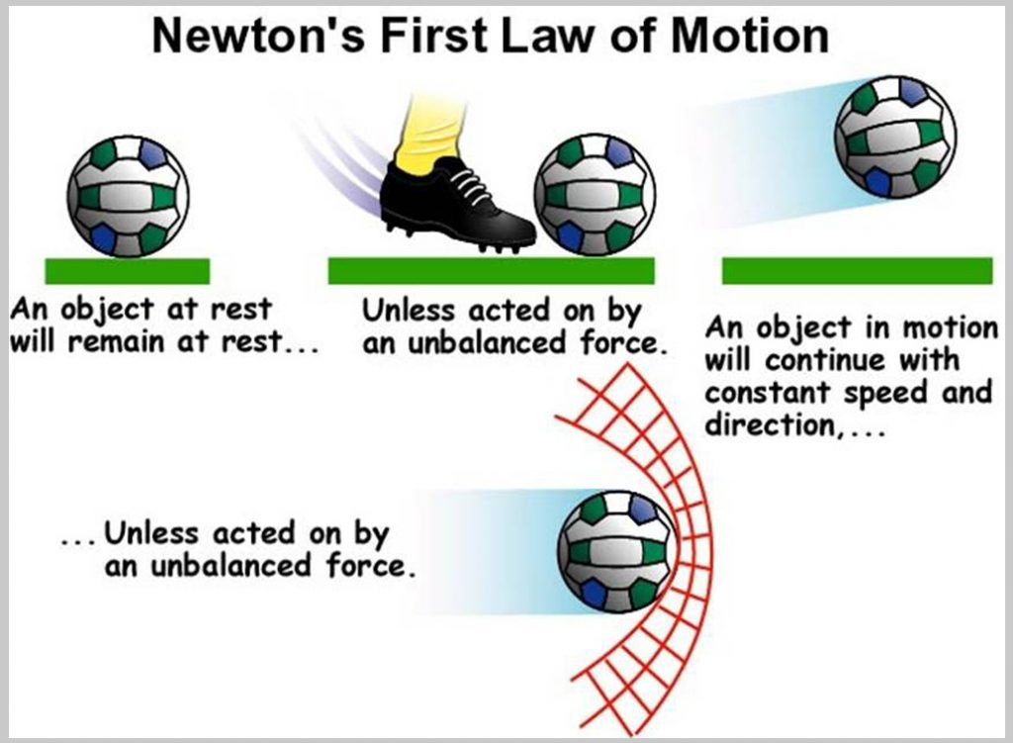

Slide 10
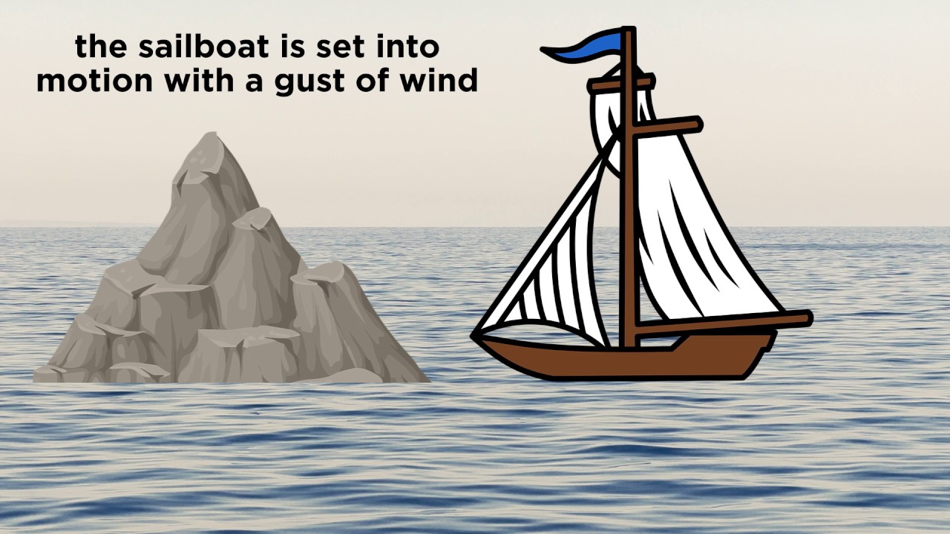

Slide 11
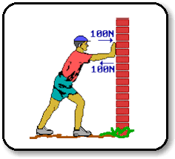
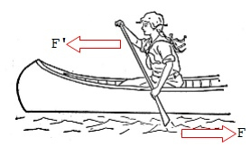
Newton’s Third Law of Motion
For Every action, there is an Equal and Opposite Reaction

Slide 12
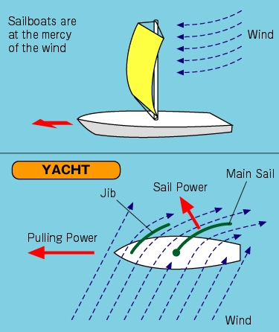
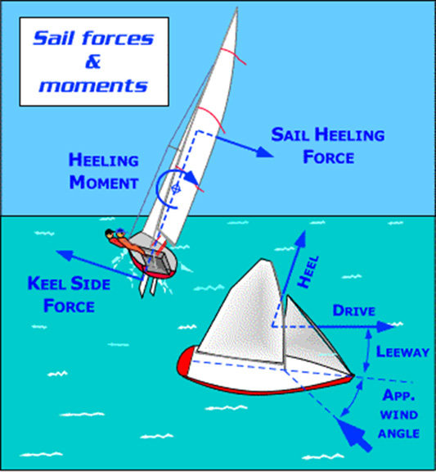

Slide 13
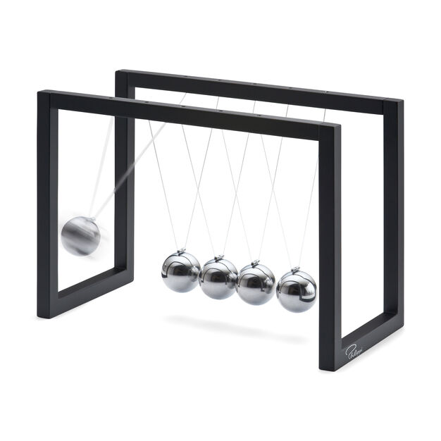
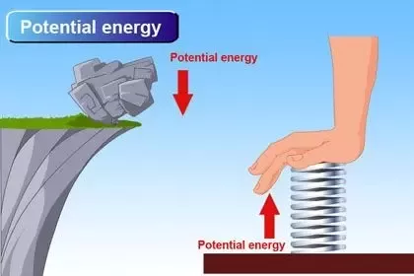
Potential verses Kinetic Energies
Potential
Kinetic
Energy because of relative position to other objects
Energy because of its motion

Slide 14
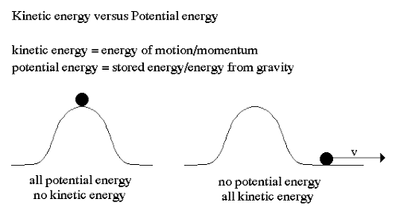
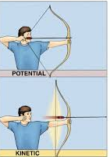

Slide 15


Slide 16

Archimedes' Principle of Buoyancy in the Bible
Follows Principal?
Defies Principal?

Slide 17
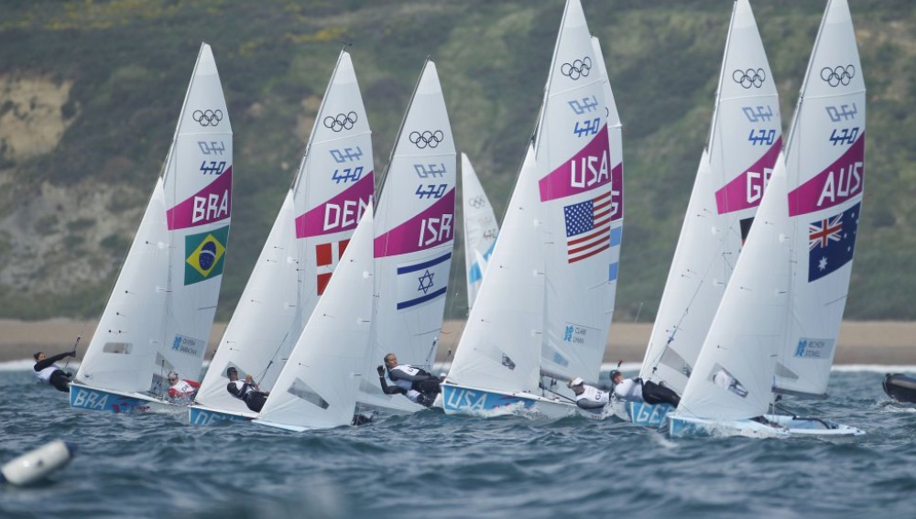
REGATTA
(RACE)
Edinburg TX Sailboat
Edinburg TX Rubber Band

Slide 18

Toy Boat Regatta
ADVANCED Honor
Glen Morrow- NAD

Slide 19
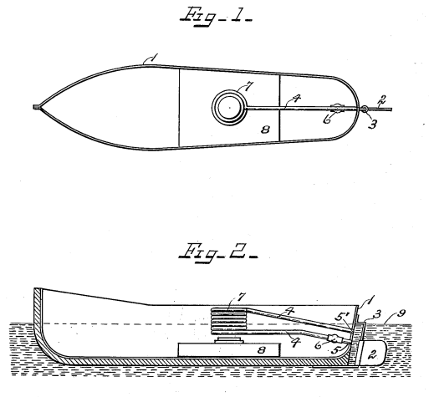
Pop-pop Boat
Boat Hull
Coil
Tube
Rudder
Check Valve
Looped Tubing Engine
Rudder Post
William Purcell 1920 Patent “Propelling Device”
Alternative to dangerous Steam Boats
No parts lubrication
“Rapid succession of pressure impacts”
Open Ends
Water Surface
Alcohol Lamp

Slide 20
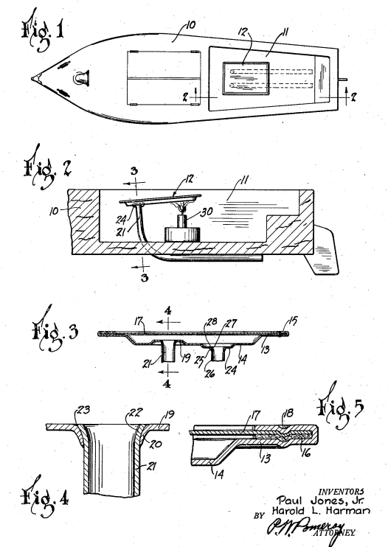
Pop-pop Boat
Diaphragm Engine
Paul Jones, Jr. and Harold Harmon
1934 Patent “Toy Boat”
Improved actuator
Larger volume of liquid than a tube

Slide 21
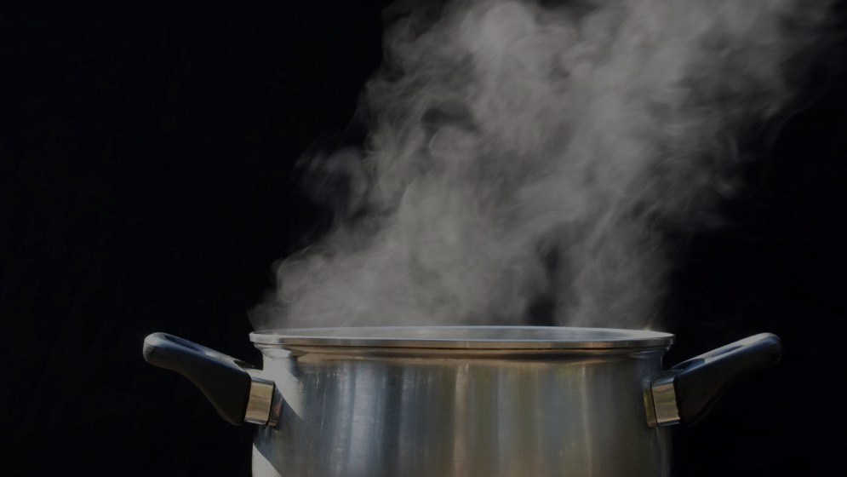
Water to Steam Ratio?
Depends on:
  temperature of liquid water
  Pressure of liquid water
  temperature of steam vapor
  Pressure of steam vapor
Answer:
  At most, 1 volume of water can make 1,600 volumes of steam

Slide 22

Analyze Data
Draw Conclusion
Compare speed before and after changes
Making X longer… made the boat go slower
Try Again
State Problem
Collect Data
Record speed before and after changes
Scientific Method
My boat isn’t going fast enough
Time speed before and after changes
If X was longer my boat would go faster
Design Experiment
Formulate Hypothesis

Slide 23
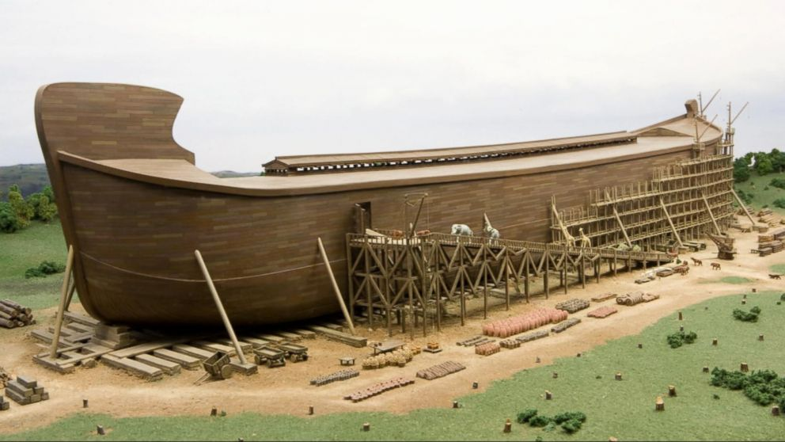
Noah’s Ark

