Slide 1
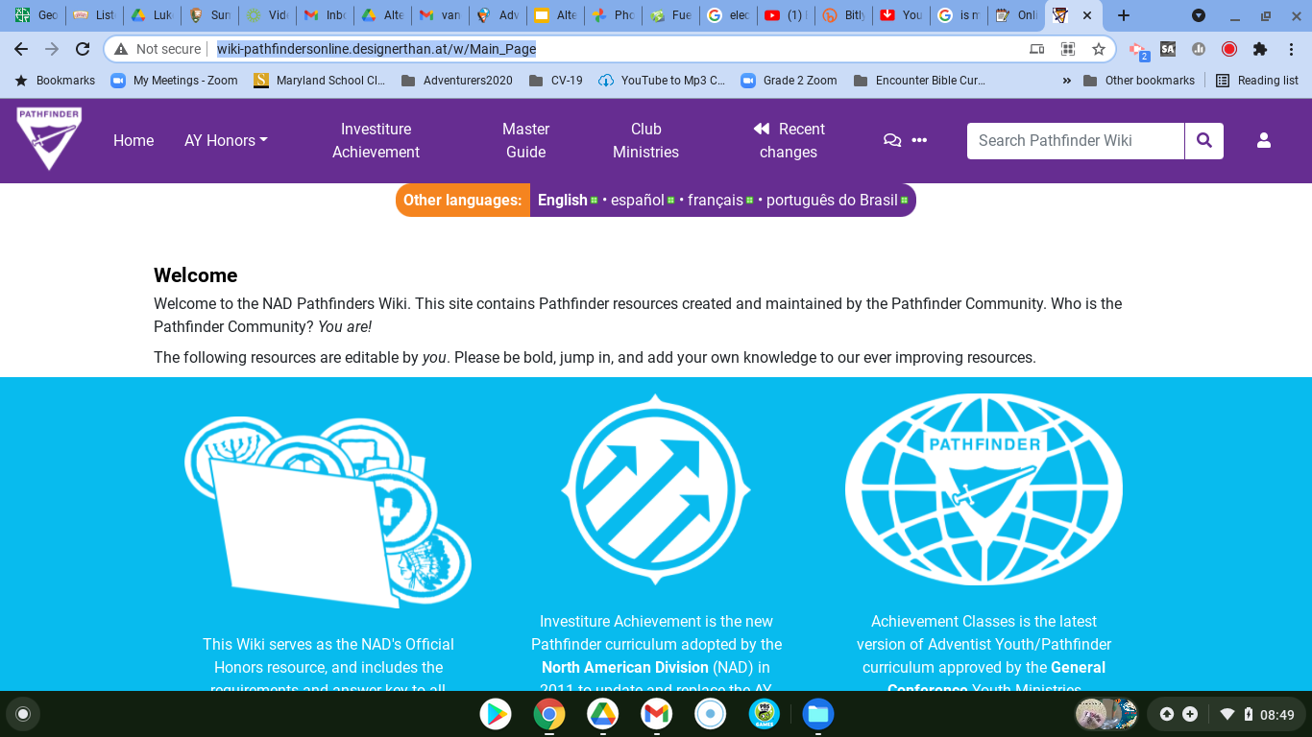
Coming SOON! NEW wiki.pathfindersonline.org

Slide 2
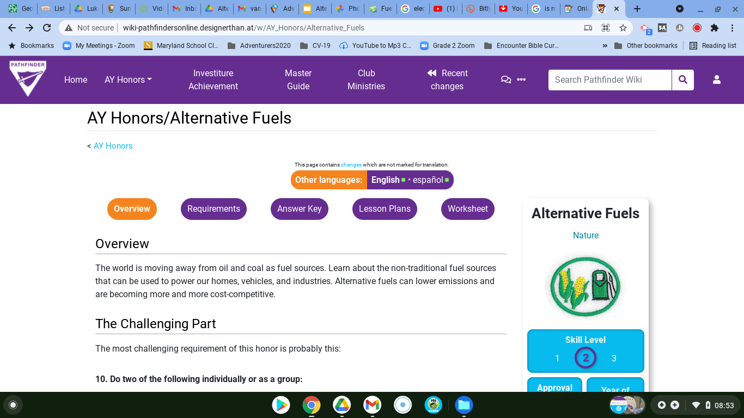

Slide 3
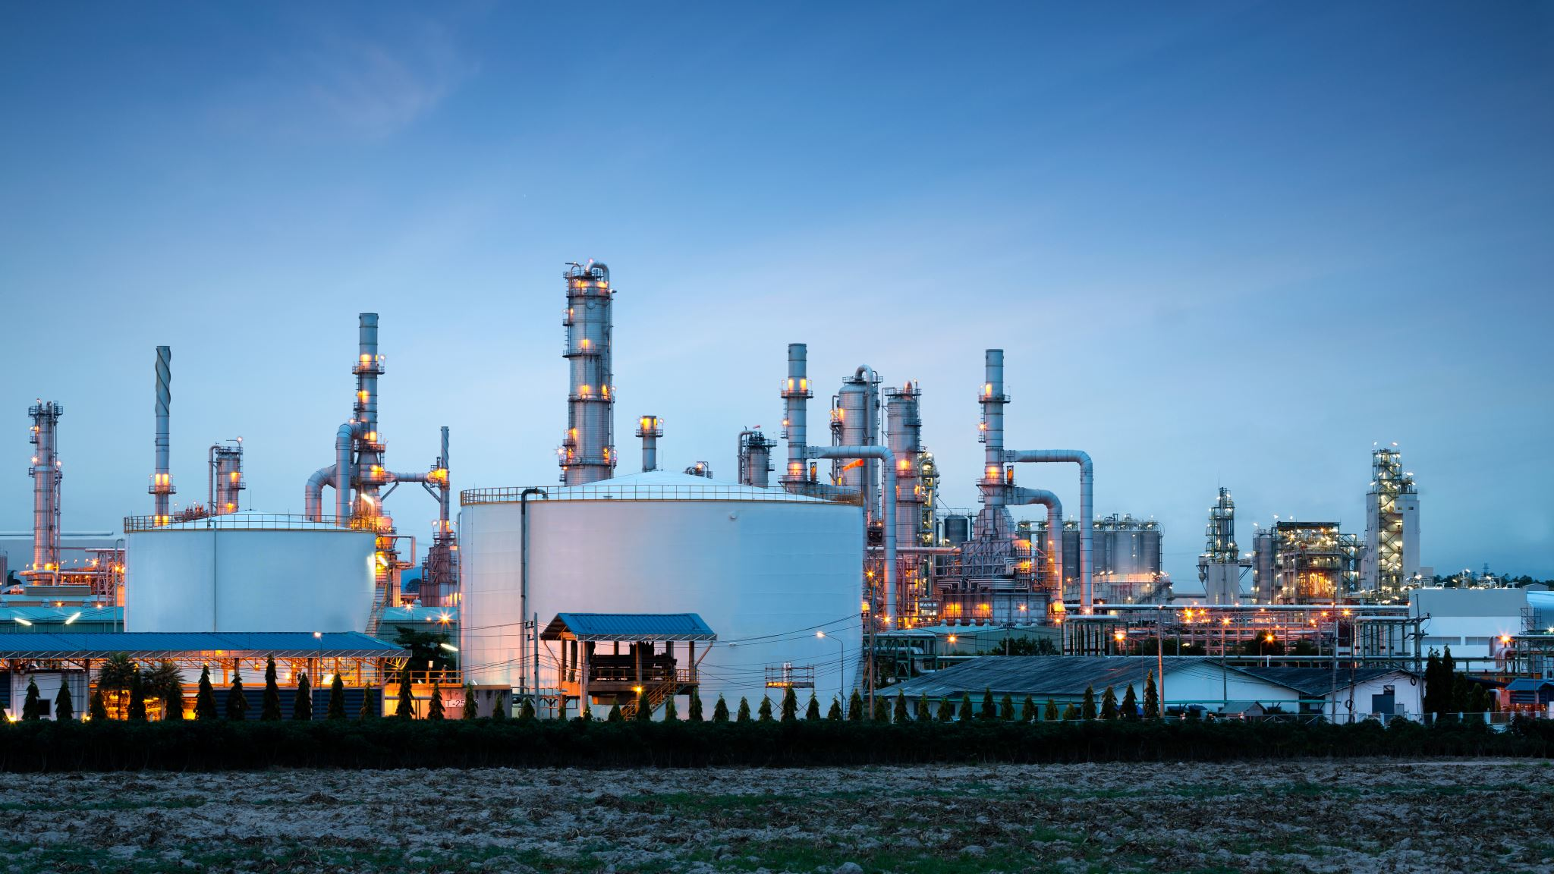


Alternative Fuels
Teacher: Luke Torquato

Slide 4
Alternative Fuels
Requirement #1
Explain the difference between a conventional fuel and an alternative fuel

Slide 5
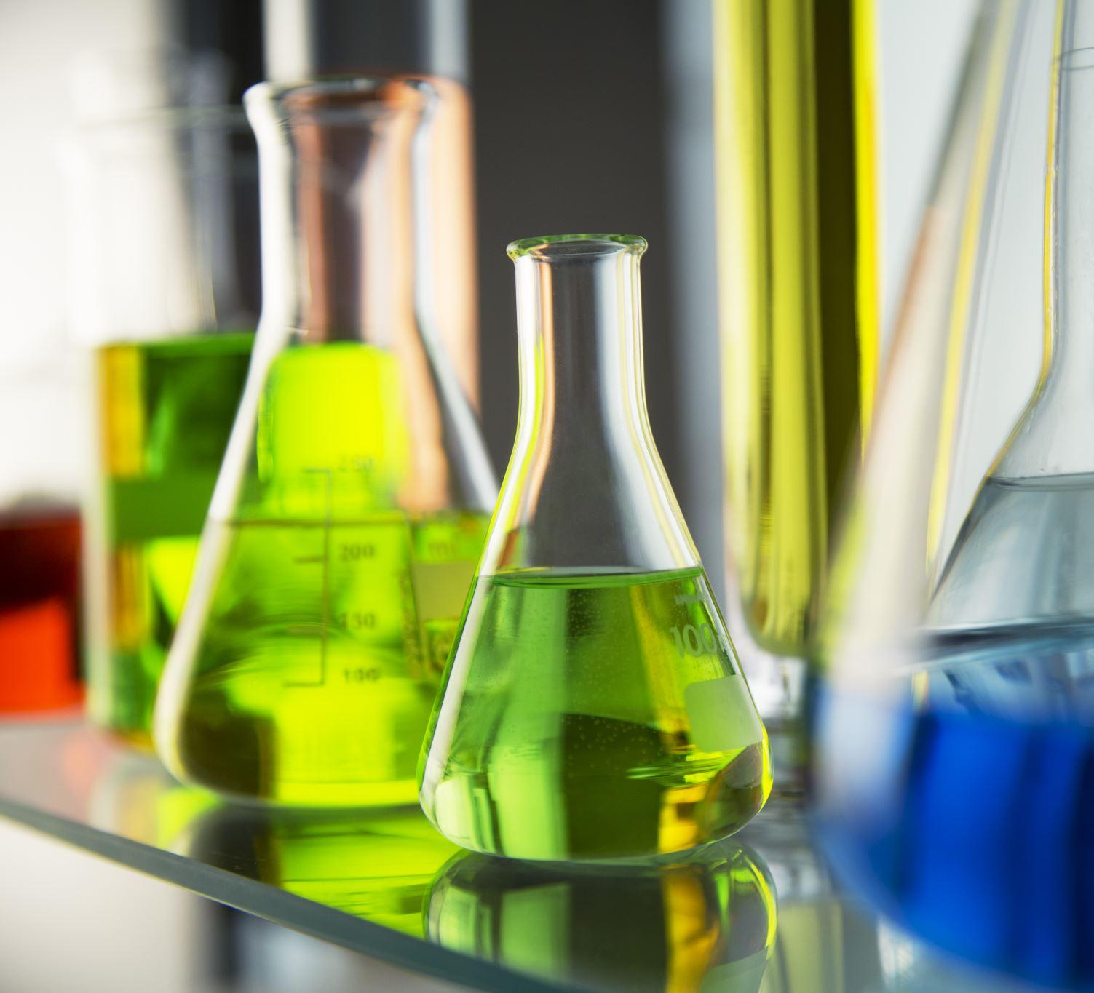
FUELS
Inform
A fuel is a substance that is changed in some way to produce heat, electricity, or other forms of energy.

Slide 6
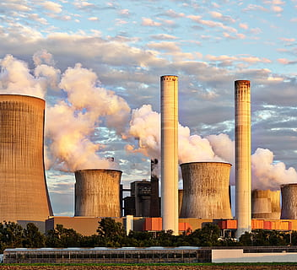
Conventional Fuels
Req #1
Hydrocarbon fuels have only hydrogen and carbon in them.
Hydrocarbon fuels like coal and oil that are extracted from the ground
Origin -- carbon-life forms that decomposed over a period of time
Not renewable
High global dependance
dirty to burn
Created as a result of the flood or as part of the earth’s crust at Creation

Slide 7
Conventional Fuels
Req #1
Coal
Crude oil
  Petroleum
  Kerosene
  airplane fuel
  diesel fuel
natural gas

Slide 8
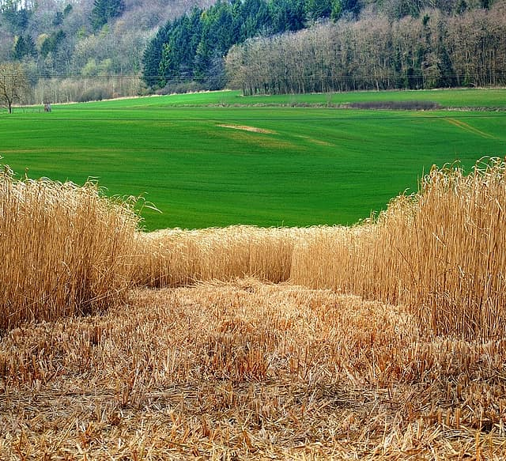
Alternative Fuels
Req #1
Materials or substances other than conventional fuels that can be used as fuel.
Come from plants, gases, or molecular fusion
Many are renewable or easily accessible
lower our dependence on conventional fuel sources
Clean energy
God created the building blocks for these fuel sources

Slide 9
Alternative Fuels
Req #1
Alternative fuels include gaseous fuels such as
  hydrogen
  natural gas
  propane
alcohols such as ethanol, methanol, and butanol;
vegetable and waste-derived oils
electricity
Biofuels
synthetic and paraffinic fuels

Slide 10
Alternative Fuels
Requirement #2
Briefly describe each of the following alternative fuels and their benefits:
a. Algae Based Fuels b. Bioalcohol
c. Biodiesel d. Hydrogen
e. Electricity f. Ethanol
g. Liquid Nitrogen h. Methanol
i. Natural Gas j. Non-fossil Methane
k. Nuclear Power l. Propane
m. Vegetable Oil

Slide 11
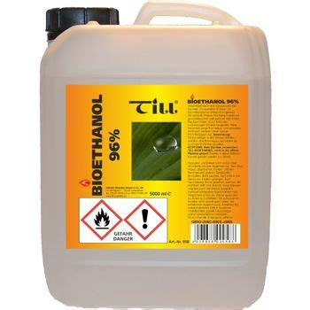
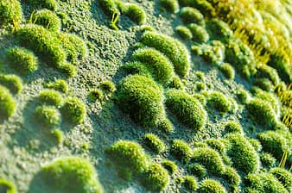
Alternative Fuels & Benefits
Algae Based
&
Bioalcohol
Req #2
Algae Based Fuels (B20)
Grown using land that is not appropriate for farming.
Uses ocean and waste-water.
Often mixed with fossil fuel 20% B20 and 80% fossil fuel
Bioalcohol
Alcohol as a fuel. Its use allows powering vehicles without burning fossil fuels.
Produced by plants and living things.
Renewable!
Renewable!

Slide 12

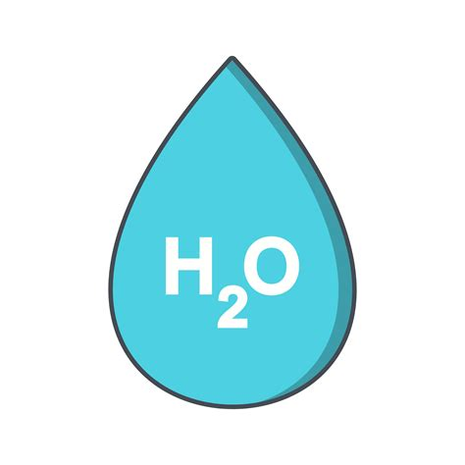
Alternative Fuels & Benefits
Biodiesel
&
Hydrogen
Req #2
Biodiesel –
Animal fat-based diesel fuel
used to power conventional diesel engines.
It can be used to heat as well
low-carbon producing agent.
Hydrogen –
Most abundant molecule in the universe
It can be used to power boats and airplanes.
produces zero emissions of carbon monoxide
Highly combustible in engines.
Renewable!

Slide 13


Alternative Fuels & Benefits
Methanol
&
Natural Gas
Req #2
Methanol –
Used in racing because of its high octane rating compared to traditional petrol
From methane, carbon dioxide, or synthetic gas
Costs less to make
Reduces carbon emissions
Natural Gas –
It can be used for heating, cooking and to generate electricity.
compressed or liquified forms can fuel automobiles
Made mostly of methane.
Very clean burning
Can Be Renewable!
Can Be Renewable!

Slide 14

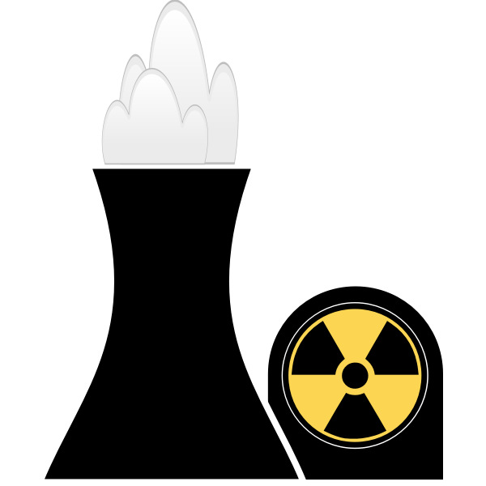
Alternative Fuels & Benefits
Non-Fossil Methane & Nuclear
Req #
Non Fossil Methane –
Generated from trash and wastewater
Generates heat while producing less carbon dioxide
Nuclear Power –
uses nuclear fission to release large amounts of energy.
Huge amounts of power with no carbon footprint.

Slide 15


Alternative Fuels & Benefits
Propane
&
Vegetable Oil
Req #
Propane –
by-product of natural gas processing.
reduced air pollution
good for items like golf carts, hot air balloons, lawn mowers, leaf blowers & even buses.
Vegetable Oil –
good for diesel engines and for heating oil.
Many current diesel engines can be converted to run on vegetable oil.
reuses cooking oils used in the fast food industry

Slide 16
Alternative Fuels
Requirement #3
Discover at least three reasons why alternative fuels are important

Slide 17
Why are alternative fuels important?
Req #3
1. Depletion – Oil is becoming more difficult to find and may run out
2. Political – Power created by countries that have oil over those that don’t
3. Economic - Investing in clean sources at home
4. Environmental – reduce pollution.

Slide 18
Alternative Fuels
Requirement #4
What are some advantages of alternative fuels? Disadvantages of alternative fuels?

Slide 19
Pros & Cons of Alternative Fuels
Req #4
Advantages
Reduces dependency on select resources.
Burns cleaner and more efficiently
reduces emissions
Environmentally Friendly.
DIsadvantages
More expensive to produce.
Some cannot be stored like traditional fuels.
Expensive to phase in (ex. create a “alternative fuels station network” for cars)

Slide 20
Alternative Fuels
Requirement #5
Illustrate through drawings, sketches, or photographs, the elements that make up natural gas.

Slide 21
How is Natural Gas formed:
Req #5
Natural gas forms when layers of buried plants, gases, and animals are exposed to intense heat and pressure over thousands of years. The energy that the plants originally obtained from the sun is stored in the form of chemical bonds in natural gas.

Slide 22



Natural Gas
Oil

Slide 23
Alternative Fuels
Requirement #6
Explain the difference between compressed natural gas and liquefied natural gas?

Slide 24
Compressed Gas
versus
Liquefied Gas
Req #6
Compressed (CNG)–
Natural gas
viable alternative to gasoline, diesel, or propane.
It Is colorless and tasteless.
economical to store and transport
1% of original volume
(100 loaves of bread crushed into 1 loaf equivalent)
Liquefied (LNG) –
Natural gas that has been formed into a liquid state.
similar to propane and ethanol
economical to store and transport
1/600th original volume (600 loaves of bread crushed into 1 loaf of equivalent)

Slide 25
Alternative Fuels
Requirement #7
Draw the steps or view an electronic animation that illustrates the alternate fuel conversion process as used in the automobile industry.

Slide 26

Req #7
View an electronic animation that illustrates the alternate fuel conversion process as used in the automobile industry.

Slide 27
Alternative Fuels
Requirement #8
Describe how a propane vehicle operates.

Slide 28
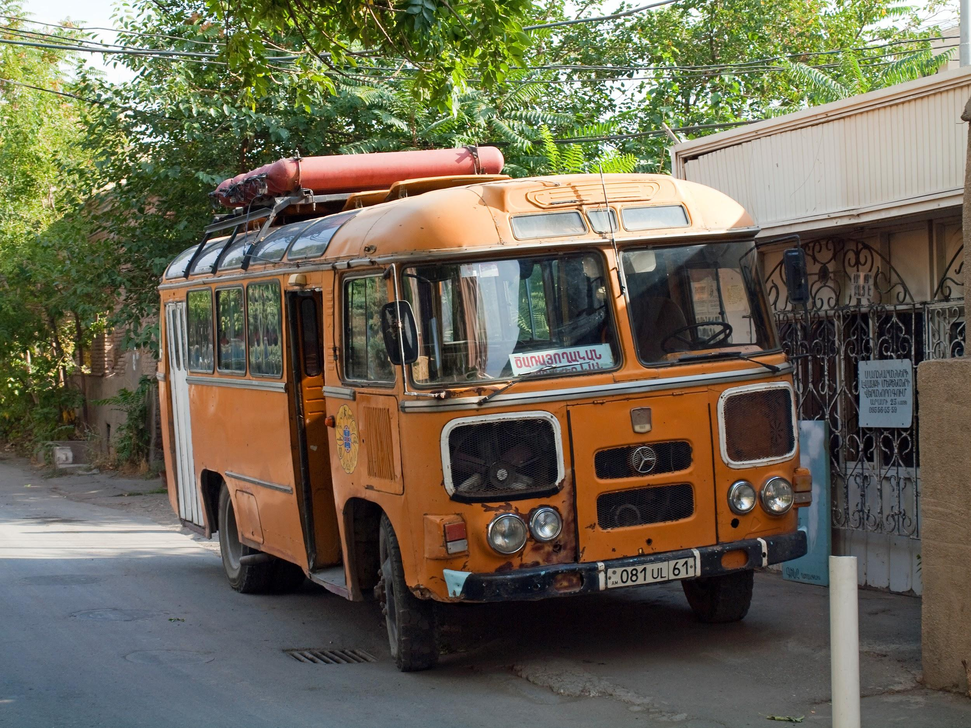
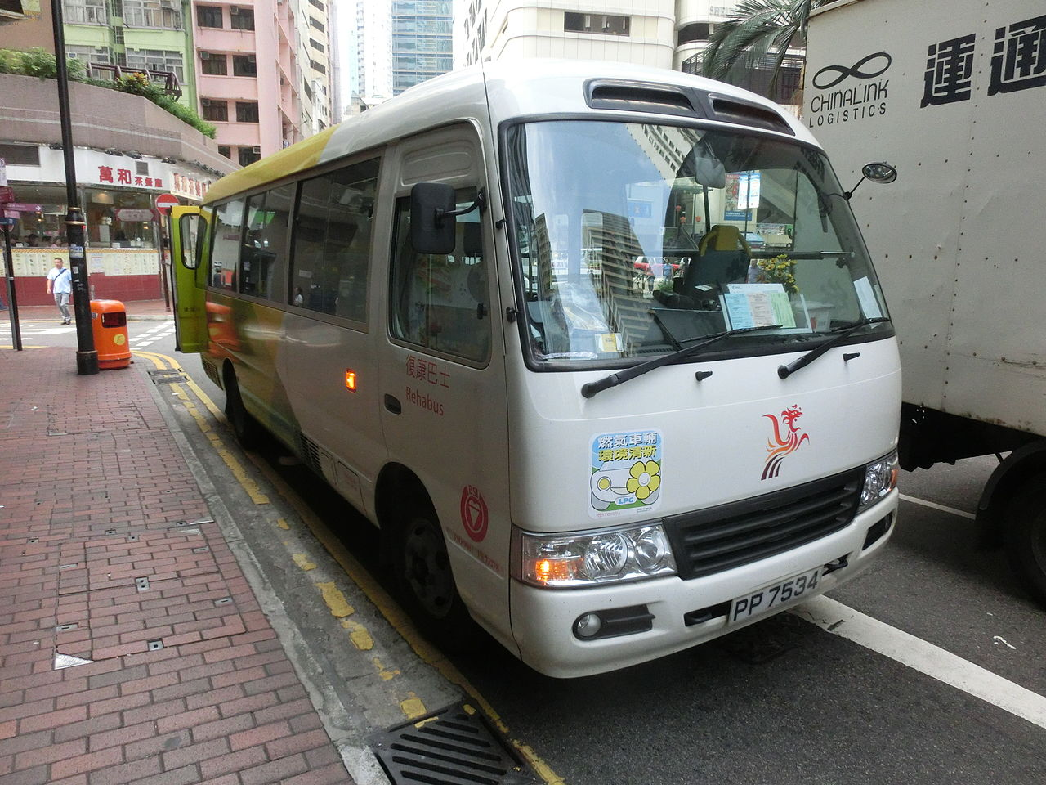
Propane Vehicles
Req #8
A propane vehicle is similar to a gasoline vehicle. The difference is that from its initial liquid state, the propane is converted to a gas. The gas is then moved through a line to a fuel-air mixture. Once mixed, it is then injected into a sequentially timed motor
Advantages:
lower maintenance
lower costs to run
cleaner energy
Disadvantages:
still a fossil fuel
no longer popular for regular autos

Slide 29
Alternative Fuels
Requirement #9
Discuss with a group the importance of finding alternative fuel methods.

Slide 30

Why is alternative fuel important?
Req #9
Type a reason in the chat why
YOU BELIEVE it is important!
Saving money is a big reason for the push to alternative fuel options.
It decreases harmful exhaust emissions.
These carbon neutral options help lead us to a happier, healthier planet!
God has asked us to take care of our planet -- using up all the fossil fuels isn’t very responsible and is ruining the planet God gave us!

Slide 31
Alternative Fuels
Requirement #10
Do two of the following individually or as a group:

Slide 32
Activity Options
Req #10
Covid Options:
b. Create a science project demonstration that illustrates how an alternative fuel can be used.
d. Calculate and demonstrate cost savings for modern alternative fuel/hybrid vehicles. Demonstrate your finding through a presentation, display or verbal report.
Non-Covid Options
a. Visit a facility that produces an alternative fuel of your choice. Prepare and give an oral presentation on your activity.
c. Have someone who works in the alternative fuels industry come and speak to you or your group.

Slide 33
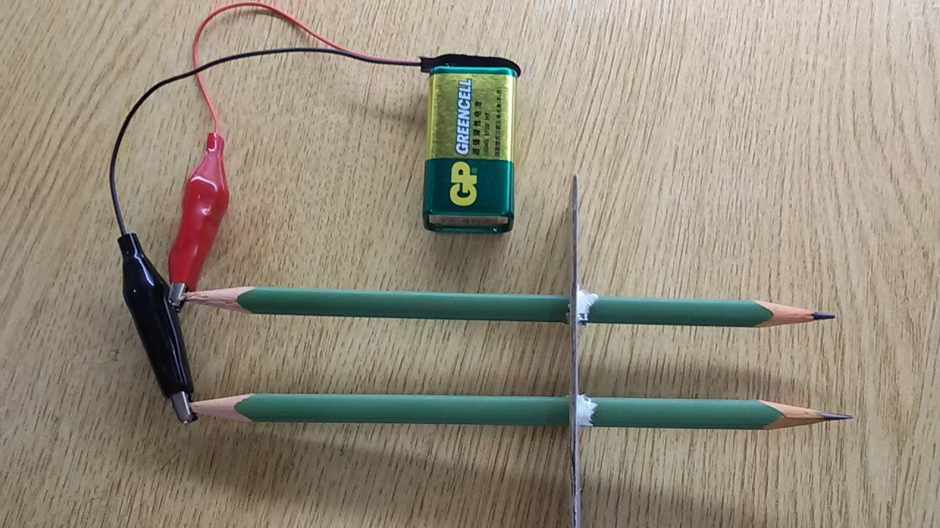
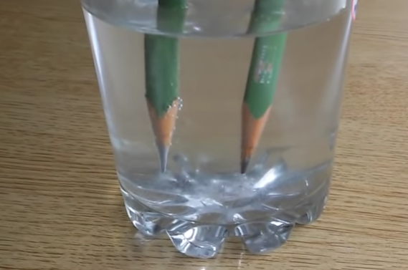
b. Science Project
Req #10
Use two pencils – sharpened at both ends, a glass of water, 9V - micro-clips connector, and a 9-volt battery.
Place one end of the pencils in a glass of water, the other ends of the pencils should be sticking out of the glass.
Use a piece of cardboard or paper with holes in them to secure the pencils.
Attach electrical wires to each pole of the battery and then attach the other end of the wires to each pencil tip.
Hydrogen bubbles will then collect around one of the pencil tips.
Experiment further by adding various foods or juices to the water to speed up the process of electrolysis (e.g. salt).
VIDEO LINK goto 2:16
Full video - http://bit.ly/
science-req10

Slide 34

b. Science Project
Req #10
VIDEO LINK goto 2:16
Full video - http://bit.ly/
science-req10

Slide 35
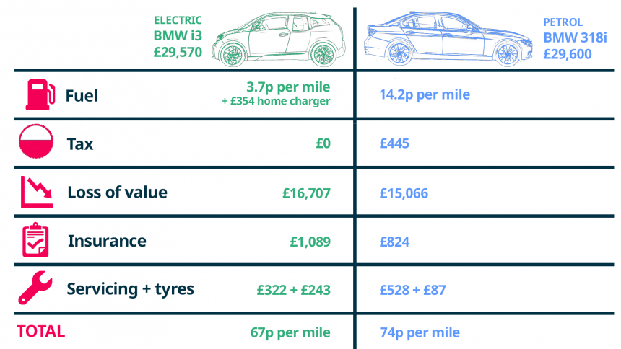
SAMPLE - Requirement requires you to calculate this with YOUR OWN choices of cars/situation!

Slide 36
Alternative Fuels
Requirement #11
Discuss with a group the following texts as they relate to alternative fuels.

Slide 37
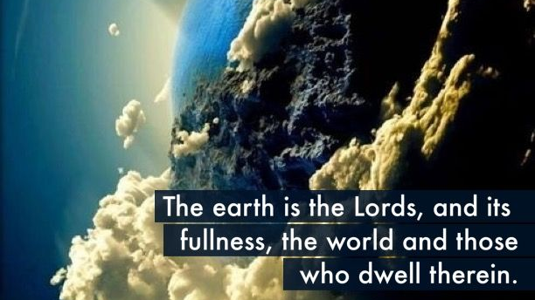
Req #11
Psalm 24:1 NKJV

Slide 38
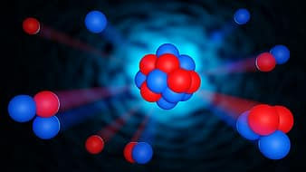
Req #11
God created everything through Him, and nothing was created except through Him.
John 1:3 NLT

Slide 39
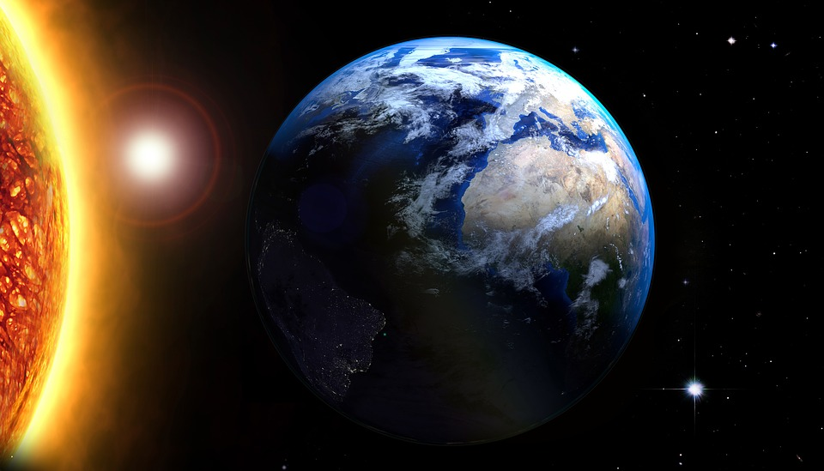
Req #11
For through him God created everything
in the heavenly realms and on earth.
He made the things we can see
and the things we can’t see—
such as thrones, kingdoms, rulers, and authorities in the unseen world.
Everything was created through him and for him. He existed before anything else,
and he holds all creation together.
Colossians 1:16-17

Slide 40
How many can you get right?
GAME!
Alternative Fuel used in racing...
a. Algae-based Fuel
b. Methanol
c. nuclear
A: b. Methanol

Slide 41
How many can you get right?
GAME!
Alternative Fuel made from trash or wastewater...
a. non-fossil Methane
b. Vegetable Oil
c. Hydrogen
A: a. non-fossil Methane

Slide 42
How many can you get right?
GAME!
Alternative Fuel made from the most abundant molecule in the universe...
a. Bioalcohol
b. Natural gas
c. Hydrogen
A: c. Hydrogen

Slide 43
How many can you get right?
GAME!
One of the disadvantages of Alternative Fuels is...
a. It is expensive to phase in (providing a network for).
b. It lowers emissions.
c. Burns cleaner and more efficiently.
A: a. expensive phase-in

Slide 44
How many can you get right?
GAME!
God created these fuel sources...
a. Conventional (fossil) fuels
b. Alternative Fuels
c. both of the above
A: c. both!

Slide 45
How many can you get right?
GAME!
Alternative Fuel is important because...
a. It is the only fuel available
b. It is the easiest and cheapest one to use
c. It helps us take care of the planet God gave us
A: c. Obey God!

Slide 46
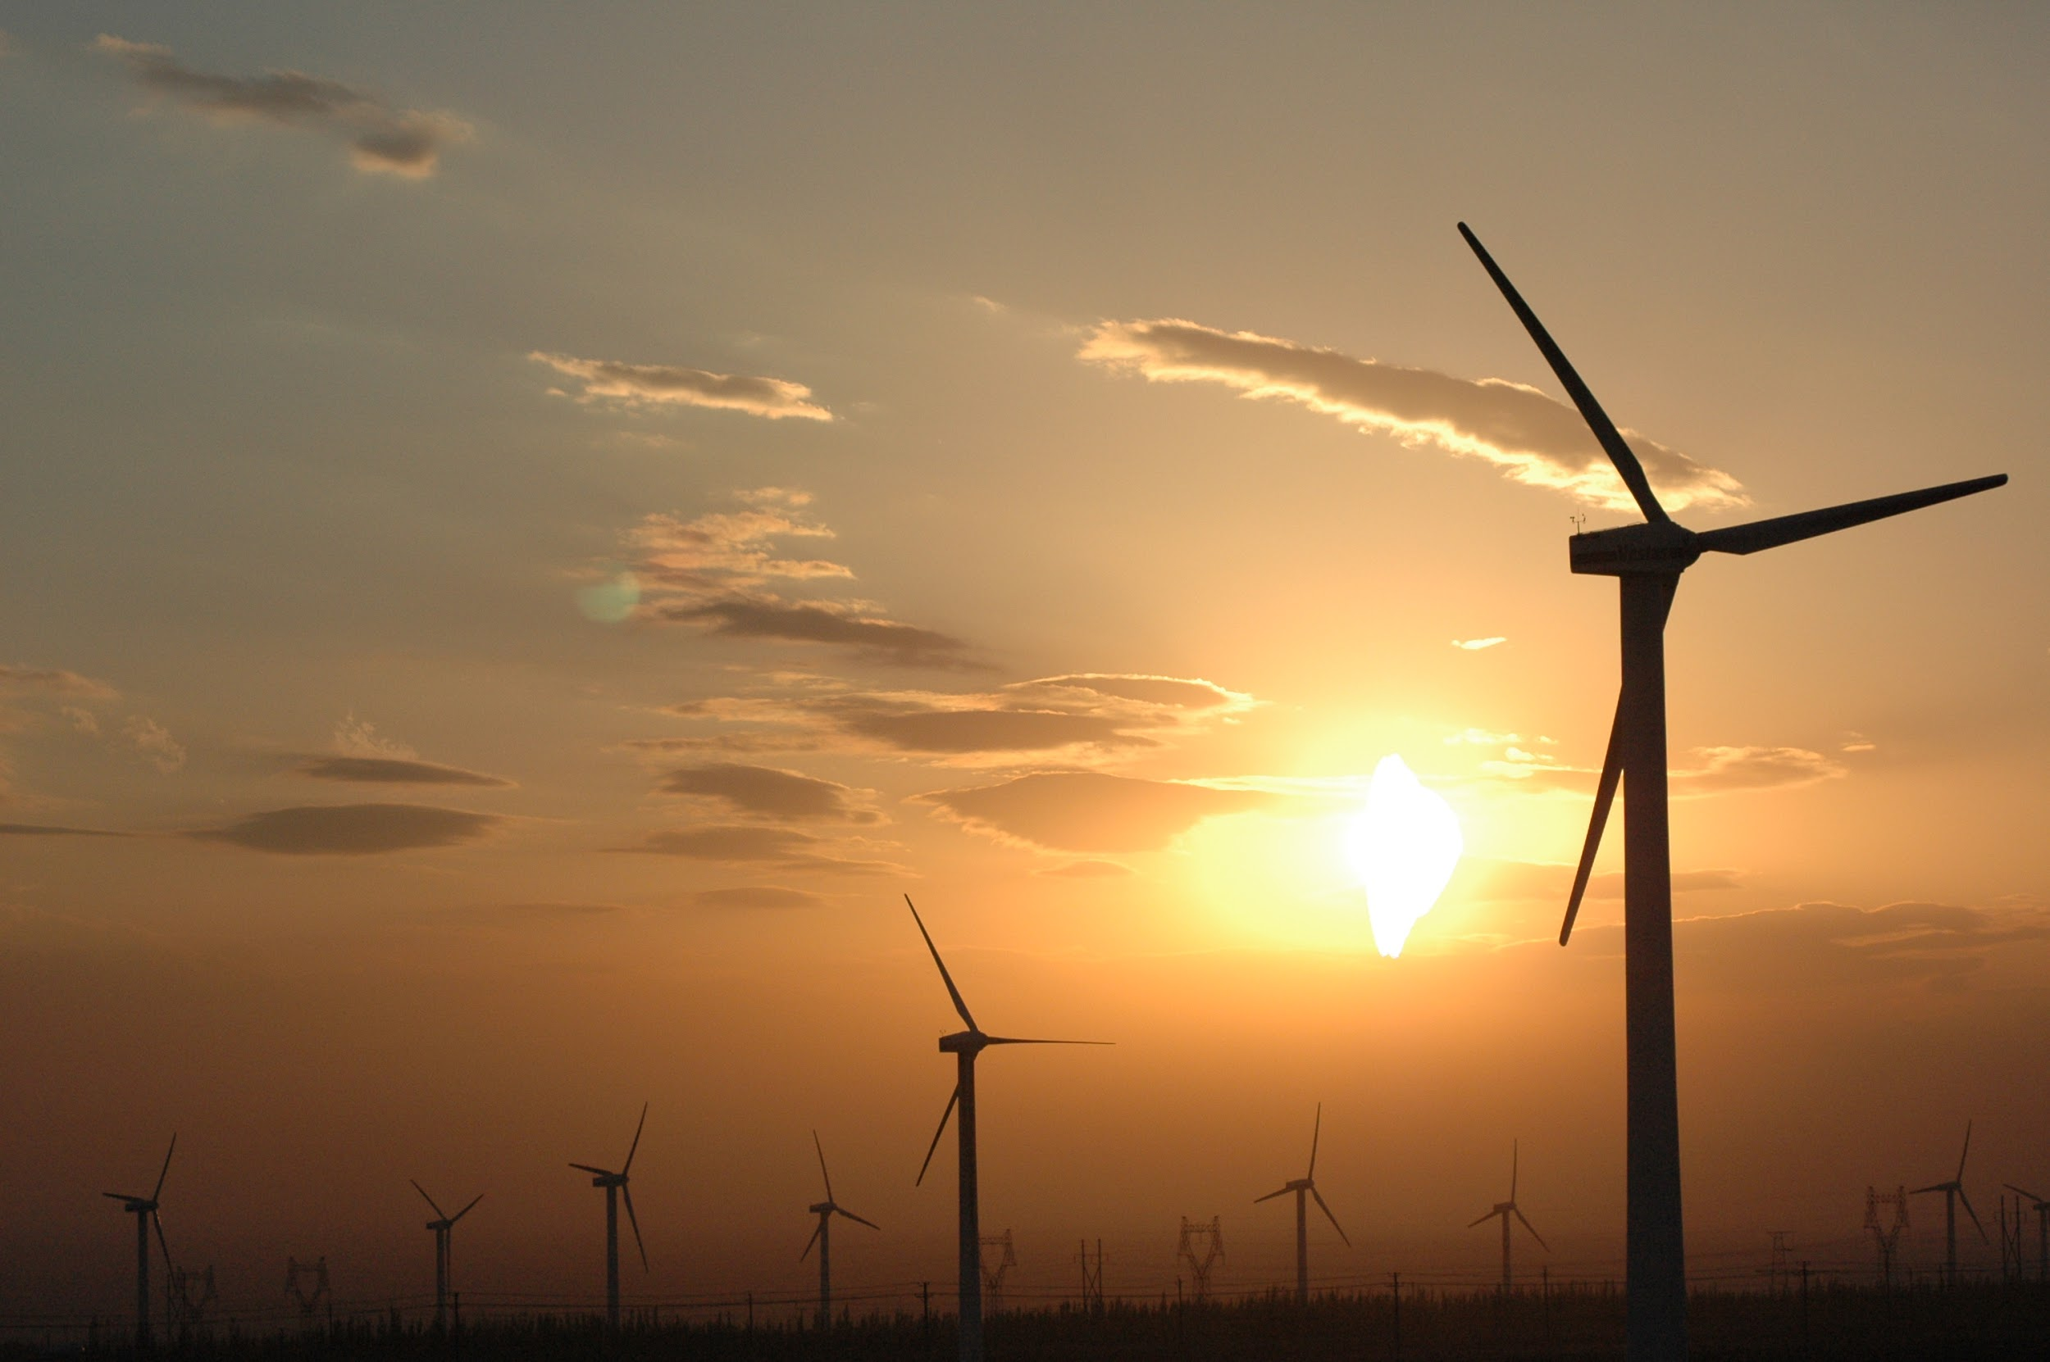

THANK YOU!
Resource:
Pathfinder Wiki wiki.pathfindersonline.org/w/Adventist_Youth_Honors_Answer_Book/Nature/Alternative_Fuels
Teacher: Luke Torquato

Slide 47
Coming SOON! NEW wiki.pathfindersonline.org

