Slide 1



LAUGHTER H N UR
😂
😂

Slide 2
REQUIREMENTS
1. Know the meaning of laughter
2. Know the meaning of Gelotology
3. Discuss what happens in the brain when we laugh
4. Discuss the difference between worldly joy and everlasting joy
5. Discuss whether there is place for Christian comedy?
6. Memorise and discuss the meaning behind Proverbs 17:22
7. Create a presentation for your club or church how laughter is good for our health.
8. Hand out 3 bible texts which encourages everlasting joy to your community.
9. Make a friend or family member laugh

Slide 3

1. Know the meaning of laughter
To express happiness, amusement, ridicule, or other feelings, by making sounds with the mouth and changing the face to an expression like a smile.

Slide 4
1. Know the meaning of laughter
Why do we laugh?
Laughter is triggered by sensations (hearing other people laugh, being tickled, thoughts and social cues.
Can we control laughter?
Laughter is the body’s involuntary response to humour (and so it involves a subjective appreciation of the humorous situation or stimulus)– so we cannot really control laughter.

Slide 5
1. Know the meaning of laughter
There are different types of laughs, here are a just a few:
A chuckle – laugh quietly or inwardly ( a quiet laugh)
Giggle - a silly or nervous laugh
Cackle - a loud laugh suggestive of a hen's sound after laying an egg
Belly laugh - a burst of deep loud hearty laughter

Slide 6
2. Know the meaning Gelotology
Gelotology, is the science and study of laughter.
The term Gelotology. originates from the Greek word gelos, which means laughter. Gelotology studies how laughing can affect human body and mind.
Gelotology was founded by William Finley Fry, Jr. (1924–2014), a former Associate Professor at Stanford University. He went on to found the International Society of Humour Studies (ISHS) in 1980.

Slide 7
2. Know the meaning Gelotology
A person who studies humour and laughter is called a
Gelotologist

Slide 8
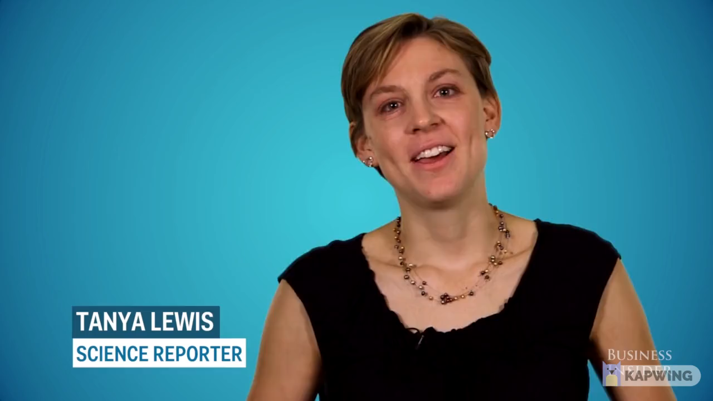
3. Discuss what happens in the brain when we laugh

Slide 9
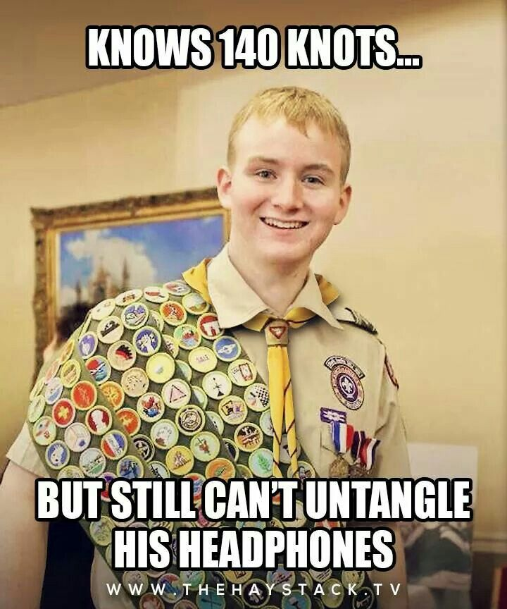
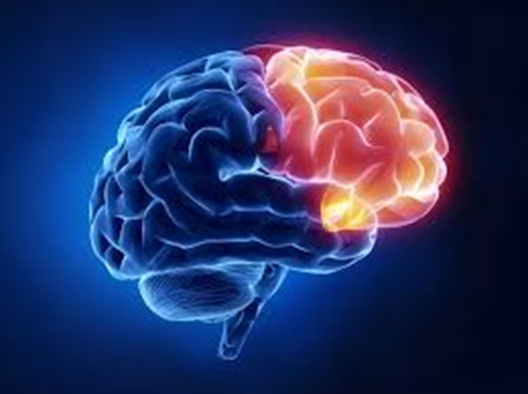
3. Discuss what happens in the brain when we laugh
Frontal lobe is responsible for emotional responses.

Slide 10
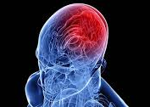
3. Discuss what happens in the brain when we laugh
Left side of the brain interprets the words and structure of a joke.

Slide 11
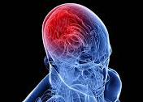
3. Discuss what happens in the brain when we laugh
The right side identifies the humour in the joke.

Slide 12
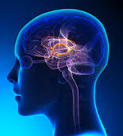
3. Discuss what happens in the brain when we laugh
Limbic system controls emotional responses you feel

Slide 13
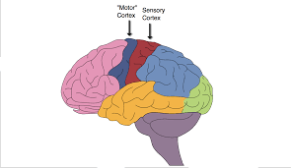
3. Discuss what happens in the brain when we laugh
Motor areas generate the physical action of laughing.

Slide 14
3. Discuss what happens in the brain when we laugh
The limbic system of the brain sets in motion the physical reaction of laughter.
The limbic system located beneath the cerebral cortex, gets the message from the frontal lobe that we need to laugh at something,
it then sends another message out, which sets the physical process of laughter in motion,
by stimulating the motor region of the brain to become active, and that’s what produces the physical reaction of laughing and the vocal expulsion of sound.

Slide 15
4. Discuss the difference between worldly joy and everlasting joy
IN MY OPINION THERE ARE 2 MAJOR DIFFERENCES

Slide 16
4. Discuss the difference between worldly joy and everlasting joy
1.
Worldly Joy is limited
Everlasting Joy lasts forever

Slide 17

4. Discuss the difference between worldly joy and everlasting joy
"But lay up for yourselves treasures in heaven, where neither moth nor rust destroys and where thieves do not break in and steal."
Matthew 6:20

Slide 18
4. Discuss the difference between worldly joy and everlasting joy
Matthew 6:20 shows us the first important difference between the happiness of the world and of God's kingdom: "But lay up for yourselves treasures in heaven, where neither moth nor rust destroys and where thieves do not break in and steal."
The joy that comes from God lasts for an eternity whereas the happiness of this world does not. It doesn't matter how having the latest smartphone will make you happy because it will only last as long as the next release. But God's joy has no limit. It starts with the joy of salvation and lives on to the age to come.

Slide 19
4. Discuss the difference between worldly joy and everlasting joy
2.
Worldly Joy is only Achieved
Everlasting Joy Freely Given

Slide 20
4. Discuss the difference between worldly joy and everlasting joy
"But God shows his love for us in that while we were still sinners, Christ died for us."
Romans
5:8

Slide 21
4. Discuss the difference between worldly joy and everlasting joy
God's joy is a gift freely given, not one duly earned. The world wants you to believe that happiness is to be pursued intently and vigorously. But God's joy was the one that came down from heaven as man—though He was God—to earth to give us life. Jesus made a way for us to experience His joy and gives it to us based not on our merit but on His faithfulness.
Christ's death, burial, and resurrection made a way for us to experience true and lasting joy.

Slide 22
5. Discuss whether there is place for Christian comedy?
There is nothing wrong with comedy in general, and Christians should be known for their laughter and joy in appropriate settings and context. We are free to enjoy comedy that does not dishonour God. In fact, we can bring glory to God by taking joy in the funny things of life and thanking Him for it.

Slide 23
5. Discuss whether there is place for Christian comedy?
"Let there be no filthiness nor foolish talk nor crude joking, which are out of place, but instead let there be thanksgiving."
Ephesians
5:4

Slide 24
5. Discuss whether there is place for Christian comedy?
Does God have a sense of humour?

Slide 25
5. Discuss whether there is place for Christian comedy?
So God created mankind in his own image, in the image of God he created them; male and female he created them.
Genesis
1:27

Slide 26

5. Discuss whether there is place for Christian comedy?
CAN YOU THINK OF SOME FUN CHRISTIAN ACTIVITIES IN CHURCH?

Slide 27

DANIEL MATTHEW’s
INCREDIBLE
FABULOUS
FANTASTIC
AMAZING
QUIZ

Slide 28
How many times on average do humans laugh per day?
17

Slide 29
True or False
The study of laughter and humour is called humourology.
TRUE
false

Slide 30
Solomon wrote: "A feast is made for laughter, and wine maketh merry: but money answereth all things." Which book is it in?
A. PSALMS
C. Ecclesiastes
D. SONG OF SOLOMON
B. PROVERBS

Slide 31
True or False
Unlike yawning, laughter is not contagious.
TRUE
false

Slide 32
Laughter is definitely contagious, that's why they use 'laugh tracks' during TV sitcoms.

Slide 33
Fill in the blank: He will yet fill your mouth with _______, and your lips with shouting Job 8:21
Laughter

Slide 34
6. Memorise and discuss the meaning behind Proverbs
17:22
“A merry heart doeth good like a medicine: but a broken spirit drieth the bones.”
As we see, laughter is medically good for us but also it shows us that that we should be joyful in life.

Slide 35

7. Create a presentation for your club or church about how laughter is good for our health.

Slide 36
8. Hand out 3 bible texts which encourages everlasting joy to your community.
PSALMS 16:11 You make known to me the path of life; in your presence there is fullness of joy;
at your right hand are pleasures forevermore.

Slide 37
9. Make a friend or family member laugh

Slide 38
As I bring this presentation to a close, I just want to leave you with some words of encouragement.
God designed us to enjoy the benefits of laughter.
The world is filled with pain and suffering, constant heartache, but we have hope in Jesus and His joy is within our reach.
The bible tells us that 'in His presence is fullness of joy' and that 'the joy of the Lord is our hope and strength'.
Joy is not just simply another emotion, it is a fruit of the Spirit, one of the best weapons to fight against discouragement, disappoint and defeat...
Remember laughter induces endorphins beneficial to our health, so...
Smile instead of scowl, giggle instead of grumble, belly laugh instead of belly ache.
Finally, Job 8:21 He will once again fill your mouth with laughter and your lips with shouts of joy.
Let us all look forward to that glorious day of everlasting joy and peace, but for now have a daily attitude of gratitude and praise and Thanksgiving. Laugh out loud more!

Slide 39


