Slide 1
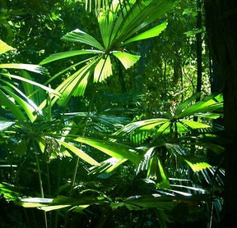
Rainforests
Pathfinder Honor

Slide 2

1. Describe a rainforest.

Slide 3
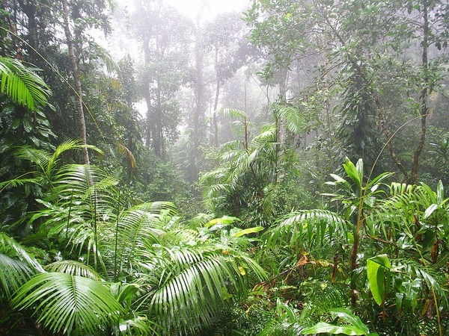
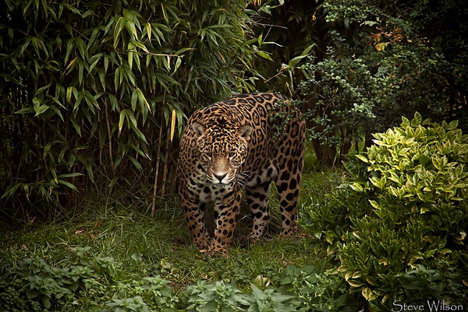
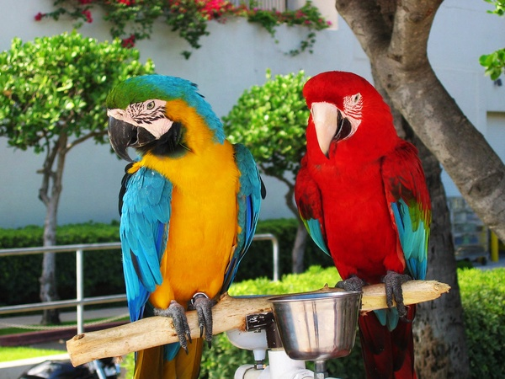
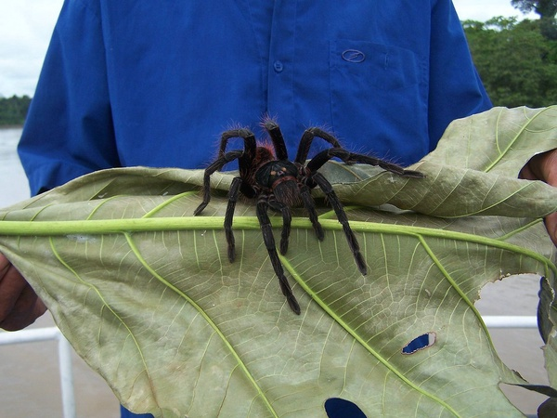

Slide 4
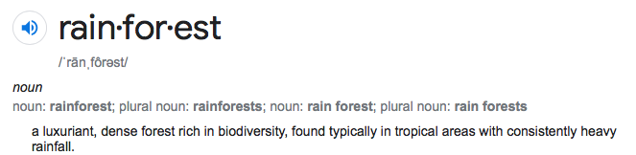
In other words:
  A forest habitat
  Heavy and consistent rainfall

Slide 5
Did you know:
  Half of all plant and land animal species live in rainforests!

Slide 6
2. State the two main kinds of rainforests and describe how they are different.
Diagram on a map locations of these two main kinds of rainforests identifying these types.

Slide 7

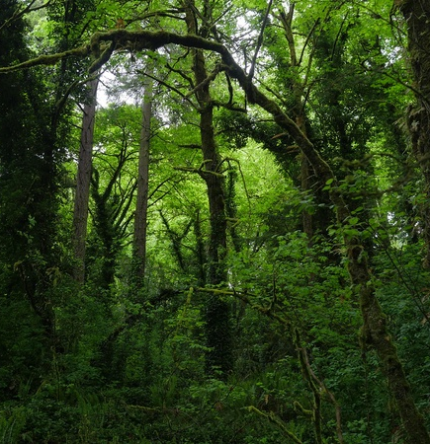
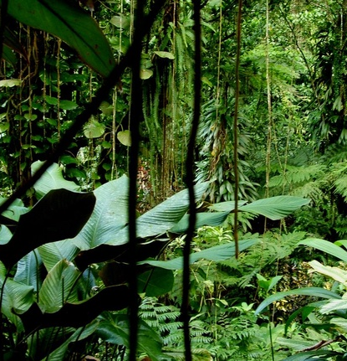

Tropical
Temperate

Slide 8
Tropical
Midway between the poles and the equator.
Fairly cool temperatures (0 – 27 •C or 32 - 80 •F)
Heavy fog and rainfall (about 100 in / 250 cm per year)
2 major seasons: wet and dry
Temperate

Slide 9
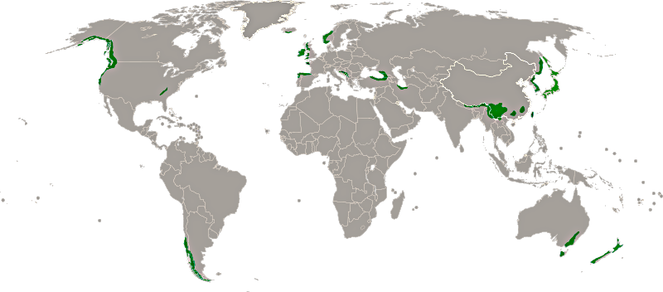

Slide 10
Grouped around the equator.
Warm temperatures (20 – 29 •C or 68 – 84 •F)
Heavy fog and rainfall (between 80 and 400 inches / 200 and 1,000 cm per year)
1 major season: hot and humid
Tropical

Slide 11
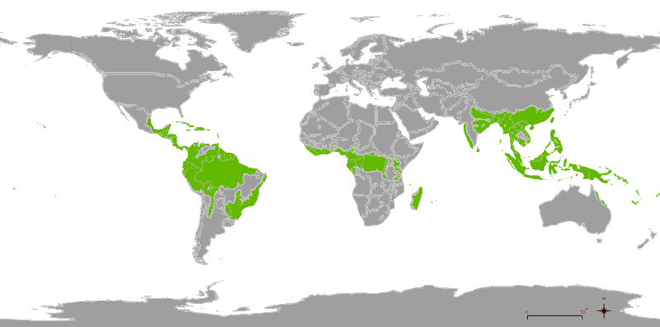

Slide 12
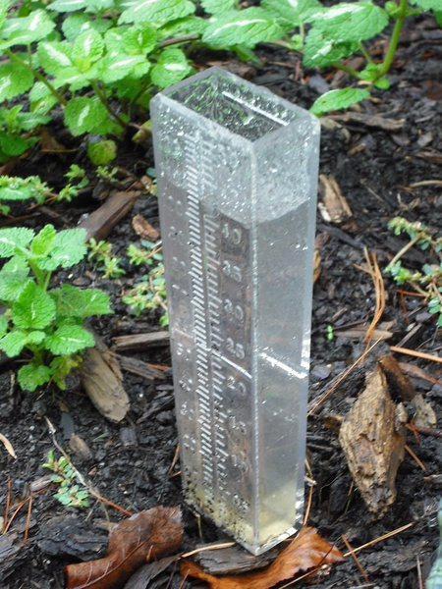

Tropical

Slide 13
3. Explain what causes so much rain to fall in rainforest biome areas.

Slide 14





Slide 15

SciencePrimer: https://youtu.be/ebjKyoQ6YoE

Slide 16
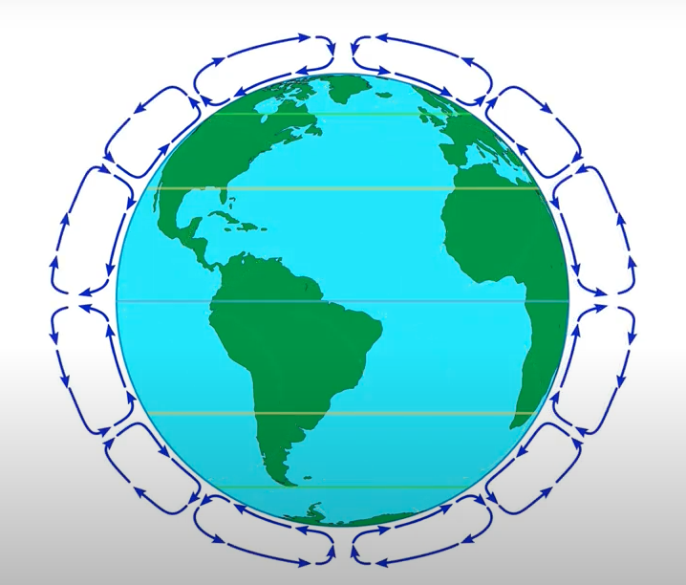
SciencePrimer: https://youtu.be/ebjKyoQ6YoE

Slide 17
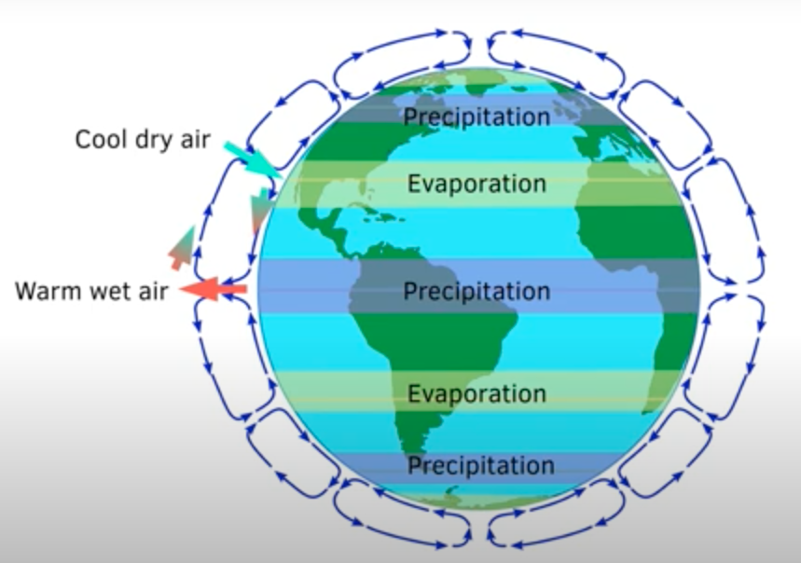
SciencePrimer: https://youtu.be/ebjKyoQ6YoE

Slide 18




Slide 19
4. Draw a diagram showing the vertical layers of plants in a tropical rainforest. Label them.

Slide 20
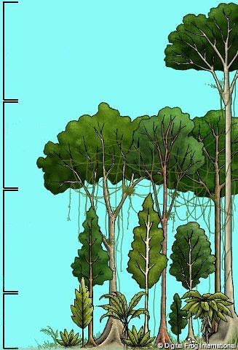
Emergent Layer:
Extra-tall trees that grow higher than the surrounding trees.
Comparatively sparse layer
Upward of 150 ft. (45m) tall
Canopy:
Tall trees that block most of the sunlight
from reaching the forest floor.
Most dense and diverse layer
Between 100 and 150 ft. (30-45m) tall
Understory:
Consists of small shrubs, vines, and
large-leafed plants.
Rarely taller than 10 to 12 feet tall.
High humidity because of the canopy
Forest Floor:
Consists of small plants and shrubs.
Not much sunlight.

Slide 21
5. Describe, draw, or use a hands-on demonstration to show how rainforests regenerate (replace lost or injured living organisms).

Slide 22




Slide 23


Slide 24
6. Be able to identify five birds that live in the tropical rainforest.

Slide 25
Scarlet Macaw

Slide 26
African Grey Parrot

Slide 27
Yellow-Billed Hornbill

Slide 28
Quetzel

Slide 29
Toco Toucan

Slide 30
Greater
Bird-Of-Paradise

Slide 31
Emperor Bird-Of-Paradise
Magnificent Bird-Of-Paradise
Wilson’s Bird-Of-Paradise

Slide 32
Cock-of-the-Rock

Slide 33
Potoo

Slide 34
7. Be able to identify ten animals that live in the tropical rainforest.

Slide 35
Orangutan

Slide 36
Okapi

Slide 37
Tiger

Slide 38
3-Toed Sloth

Slide 39
Tapir

Slide 40
Leopard

Slide 41
Anaconda

Slide 42
Mariana Fruit Bat

Slide 43
Capybara

Slide 44
Poison Dart Frog

Slide 45
Anteater

Slide 46
Sumatran Rhino

Slide 47
Gorilla

Slide 48
8. List the predominant vegetation in rainforests.

Slide 49
TROPICAL RAINFORESTS
Ceiba Tree
Cecropia Tree
Banana Tree
Rubber Tree

Slide 50
Sitka Spruce
Cottonwood
Western Hemlock
TEMPERATE RAINFORESTS
Red Maple

Slide 51
9. What is an epiphyte? Be able to identify from pictures three plant examples.

Slide 52
Epiphyte
Plant that grows on a host plant
Plant that grows on a host plant
Doesn’t harm the host plant
Gets its own nutrients from:
Compost host collects
The air
Rain
Harms the host plant by
stealing nutrients
Plant that grows on a host plant
Parasite

Slide 53
Tank Bromelaid
Lichen
Myrmecodia
Orchid

Slide 54
10. Learn about one invasive species that affects the rainforest.

Slide 55
Notes:
Pablo Escobar – Drug smuggler
Imported hippos into Columbia illegally
4 hippos were released into the wild after his death in 1993
They have no natural predators in South America
Estimated 60 and growing population

Slide 56
11. What are some renewable resources that rainforests provide for humans?

Slide 57
Food
Lumber*
Oxygen

Slide 58
12. List at least three ways that rainforests can be protected.

Slide 59
Be an advocate.
Tourism – Raises money for the local economy.
This encourages the local governments to
take care of it, since it benefits them.
Pets - Don’t buy exotic pets. This can encourage
illegal animal trafficking and alter the
natural balance
Consumption - Use products harvested
sustainably from the rainforest.
Money - Raise funds for conservation.

Slide 60
13. Prepare an object lesson about a plant, animal, or bird that lives in the rainforest. Share this lesson in a group setting such as a club/unit worship, children’s story in church, campfire, or vespers.

Slide 61
Preparing an Object Lesson:
Short
Specific
Something you find meaningful

Slide 62
Ask yourself one of two questions:
  What object do I wish to use to build the lesson (rocks, invasive species, flower, colored leaves, fresh green growth, tender flower)
  What lesson do I wish to share that I need to find an object for? (ex. God loves me )
What is the main point I wish to share (1 sentence)
  this is where you end your illustration. It often compares the object lesson to the truth shared
Find a fact or two about your object lesson that have PARALLELS with your Bible truth. Write out your Bible truth. Don’t tell too many details that are distractions.
Be sure you plan to END with that “main point” sentence and then STOP!

Slide 63
14. Do at least three of the following activities:
a. Visit an exhibit or conservatory of rainforest trees and/or plants.
b. Make a collection of at least three types of epiphytes.
c. Visit a zoo where there are animals typical of the rainforest biome.

Slide 64
d. Watch a video about the rainforest, or plants or animals that live there.
e. Draw or paint a picture of something you had fun learning about while studying the rainforest.
f. As a group, make a short video about a real life rainforest conservation project. Explain why this specific habitat should be saved.

Slide 65
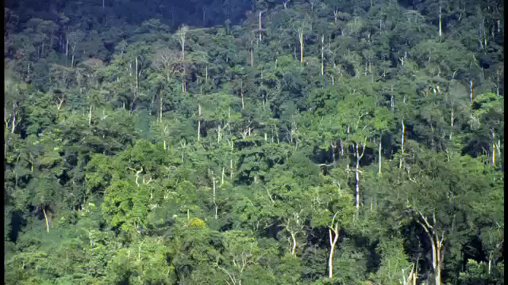
https://youtu.be/lv3W_YlDnOs

Slide 66

https://youtu.be/_Y-pFZd97Vs

Slide 67
The End!

