Slide 1

Christian Citizenship
presented by Natalie Bryan

Slide 2
Requirements
Describe the following flags: National, State of Provincial, AY, Pathfinder, Christian
Know how to display the national flag with two other flags under the following situations: Camp Out/Camporee, Fair, Pathfinder Day Programme, Parade
Demonstrate how to fold and salute your national flag. Mention when and how it should be displayed.
Explain the meaning of and reason for the National Anthem, and recite the words from memory.

Slide 3
Requirements
Give the rights and responsibilities of a citizen of your country.
Have an interview with a local, regional, or national official of your country, and learn about his/her duties.
Write a one-page essay or give a two-minute oral report about a famous person in your country. Mention what he/she has done to gain their recognition.

Slide 4
Requirements
Do one of the following:
  Make a list of ten famous quotations from leaders of your country.
  Make a list of ten famous historic places in your country.
  Make a list of ten famous historic events in your country.
Describe what you can do as a citizen to help your church and country.
Go through the steps of an individual acquiring citizenship in the country and learn how this is done.

Slide 5
Requirements
Know how to explain the process of government in your country.
Explain the meaning of this statement Jesus made in Matthew 22:21: “Render therefore unto Caesar the things which are Caesar’s, and unto God the things that are God’s.”
Explain why laws are established in your country.

Slide 6
What is Christian Citizenship?
What is a Christian?
A follower of Christ. We believe in Jesus and follow His teachings.
What is a Citizen?
A legally recognised subject or national of a state or commonwealth, either native or naturalised.
An individual who legally belongs to a country, either by birth or naturalisation and is therefore invested with the rights, responsibilities and protection of that country.

Slide 7
Requirement 1
Describe the following flags:
National, State of Provincial, AY, Pathfinder, Christian

Slide 8







National Flag
Union Flag (AKA Union Jack)
  Cross of Saint George (England)
  Cross/Saltire of Saint Andrew (Scotland)
  Cross/Saltire of Saint Patrick (Ireland)
Welsh representation?
  The original flag was designed in 1606
  The current design is from 1801
  Wales was part of the Kingdom of England until 1967

Slide 9


National Flag
Important to note correct orientation

Slide 10
State of Provincial Flag
The U.K. doesn't have provinces. The closest thing we have that would be comparable to a province are our constituent countries; England, Wales, Scotland and Northern Ireland.

Slide 11

AY Flag
The AY (Adventist Youth) Flag consists of two red and two white rectangles in alternating corners with the AY emblem in the centre
The gospel of Jesus is represented by the cross and is at the centre of our ministry. Colossians 1:17
The three angels message of Revelation 14:6-12, represents an urgent plea to the world.
The globe represents the world that should receive the three angels message - for every tongue, nation, kindred.
Blue represents loyalty. We must show and teach loyalty to God. Loyalty is defined as a reflection of the character of Jesus.
Yellow is the colour of sunshine. It’s associated with joy, happiness, intellect, courage and energy.

Slide 12

Pathfinder Flag
The Pathfinder Flag consists of two blue and two white rectangles in alternating corners with the Pathfinder emblem in the centre
RED (Sacrifice)
THREE SIDES (Trinity — Father, Son, Holy Spirit). Also mental, physical, spiritual development of our education
GOLD (Excellence)
SHIELD (Protection)
WHITE (Purity)
BLUE (Loyalty)
SWORD (Bible)
INVERTED TRIANGLE (Inverted order of importance Jesus taught)

Slide 13

Christian Flag
The "Christian Flag" is a white flag with a blue square in the upper corner (blue canton) and a red cross in it
It was first thought of by Charles C. Overton in 1897 but wasn’t designed until 1907 by him and Ralph Eugene Diffendorfer was not adopted until 1942
It represents protestants of all denominations
The cross symbolises the crucifixion of Christ
Red symbolises the blood of Jesus
Blue represents the waters of baptism as well as the faithfulness of Jesus
White represents Jesus' purity

Slide 14
Requirement 2
Know how to display the national flag with two other flags under the following situations: Camp Out/Camporee, Fair, Pathfinder Day Programme, Parade

Slide 15


Displaying Flags – Camporee
When the national flag is displayed on campouts or at a camporee, it should be placed to the left of those entering the camp and to the right of those who are camping.
When all flags are displayed on one pole, the national flag is at the top, then the AY flag and the Pathfinder flag.
In this image, which flag would be the national flag: yellow, red or blue?

Slide 16

Displaying Flags – Pathfinder Fair
When the national flag is displayed at a fair it should be placed on the booth's right (the visitor’s left). If the national flag is part of a group of flags, it should be in the centre and slightly forward or raised
At public fairs, flags may be put inside the booth, but the national flag is always on the viewer's left
I’ve added two flags to this image. Where would the national flag be placed?

Slide 17

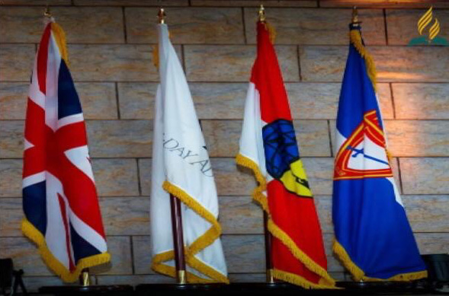
Displaying Flags – Pathfinder Day
For a Pathfinder Day programme, on a platform, the national flag should be displayed to the right of the speaker.
If the flags are displayed elsewhere, other than the platform or if there is no platform, the national flag should be displayed to the right of the audience as they face the platform/front. Other flags should be to the left of the audience.

Slide 18


Displaying Flags – Parade
The senior National Flag should always lead in a single file of flags.
When two or more flags are carried side-by-side, the senior National Flag takes the position of honour at the right-hand side of the line facing the direction of movement (the left of an observer watching the line approach).

Slide 19
Requirement 3
Demonstrate how to fold and salute your national flag.
Mention when and how it should be displayed.

Slide 20
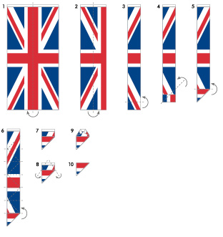
How to Fold the National Flag
Have two people stand on either end of the flag, holding a corner in each hand.
Fold the flag in half twice, length-wise.
Beginning at the fly end, fold one corner into the opposite side of the flag, forming a triangle.
Repeat this triangular folding until only the top edge of the flag shows.
Tuck this end into the triangle.
Be sure to keep the flag from touching the ground while folding.

Slide 21
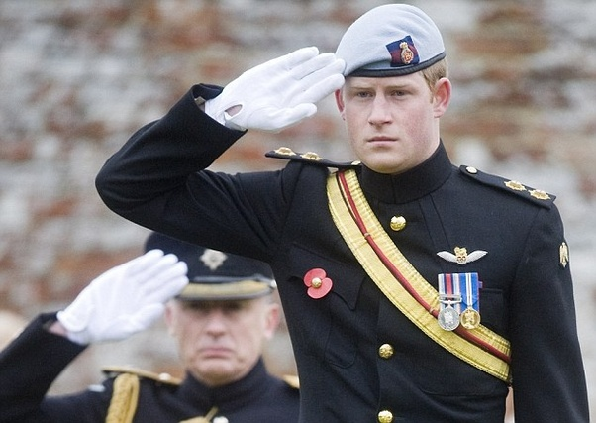
Saluting
The salute is a courteous exchange of greetings, with the junior member always saluting first. Upon saluting, the head and eyes are turned toward the Colours or person saluted.
When we salute we are paying the correct compliments to an Officer or Colours (Flags) in a smart uniformed manner.

Slide 22
Saluting the National Flag – Stationary
Full Dress Uniform (which includes beret):
Come to attention and salute when you hear the first note of the National Anthem
Field Uniform:
Come to attention and place your right hand over your heart (club salute)
No Uniform:
Stand at attention for the duration of the National Anthem

Slide 23
Saluting the National Flag – on Parade
Saluting to the Right:
“Saluting to the right, SALUTE.” Salute is called as your left heel strikes the ground; follow through with your right pace, then on your next left pace raise your right hand to the salute position whilst turning your head and eyes right holding this position for 5 paces with left arm by your side. Upon your right heel striking the ground, you simultaneously face the front and bring your arm to your side then continue marching full swing.
Eyes Right:
“Eyes Right.” Right is called as your left heel strikes the ground; follow through with your right pace, then on your next left pace turn your head and eyes right and continue marching until you hear “Eyes Front.” Front is called on the left.

Slide 24

When and How the Flag should be Displayed
The National Flags of the United Kingdom should be displayed only in a manner befitting the national emblems. They should not be subjected to indignity and should not be displayed in a position inferior to any other flag. The National Flags should always be flown aloft and free.
Flags are normally flown from sunrise to sunset. Flags may be flown by night as well as by day as long as they are properly illuminated at all times, preferably by spotlight.

Slide 25




When and How the Flag should be Displayed
Whenever any of the UK’s National Flags, or any other sovereign national flags, are displayed, due consideration should be given to flag etiquette and precedence.
If a purely decorative effect is desired it is better to confine the display to flags of lesser status; for example, house flags, pennants or coloured buntings.

Slide 26
Requirement 4
Explain the meaning of and reason for the National Anthem,
and recite the words from memory

Slide 27
National Anthem
Verse 1
God save our gracious Queen!
Long live our noble Queen!
God save the Queen!
Send her victorious,
Happy and glorious,
Long to reign over us,
God save the Queen.
Verse 2
Thy choicest gifts in store
On her be pleased to pour,
Long may she reign.
May she defend our laws,
And ever give us cause,
To sing with heart and voice,
God save the Queen.

Slide 28
National Anthem
Meaning and reason:
The national anthem, like other national symbols of a country, represents the tradition, history, and beliefs of a nation and its people. It helps evoke feelings of patriotism among the country's citizens and reminds them of their nation's glory, beauty, and rich heritage

Slide 29
National Anthem
'God Save The King' was a patriotic song first publicly performed in London in 1745. This came to be known as the National Anthem at the beginning of the nineteenth century. The words and tune are anonymous.
The words used today are those sung in 1745, substituting 'Queen' for 'King' where appropriate. Additional verses have been added down the years, but these are rarely used.
On official occasions, only the first verse is usually sung.

Slide 30
Requirement 5
Give the rights and responsibilities of a citizen of your country

Slide 31
Rights & Responsibilities
Rights
Responsibilities
Live permanently in the UK
Receive a British passport and unrestricted entry into the UK
No work restrictions
Own property
Right to vote
Stand for office
Free medical care
Free education up to age of 18
Paying taxes
Voting in elections
Obeying the law
Doing jury service
Respecting the rights of other citizens

Slide 32
Requirement 6
Have an interview with a local, regional, or national official of your country,
and learn about his/her duties

Slide 33
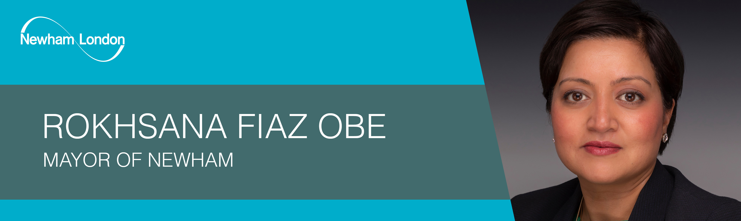
The Mayor of Newham

Slide 34
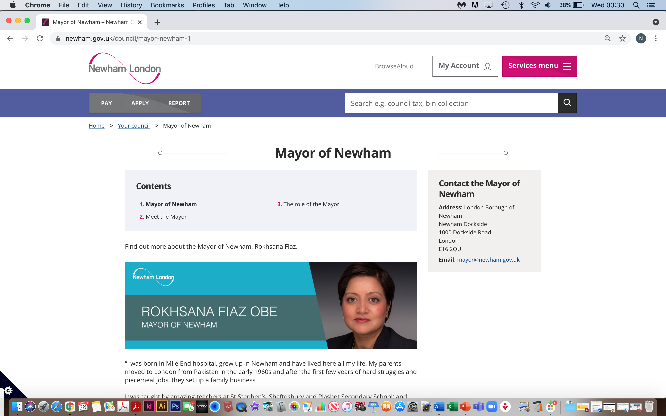
The Mayor of Newham

Slide 35
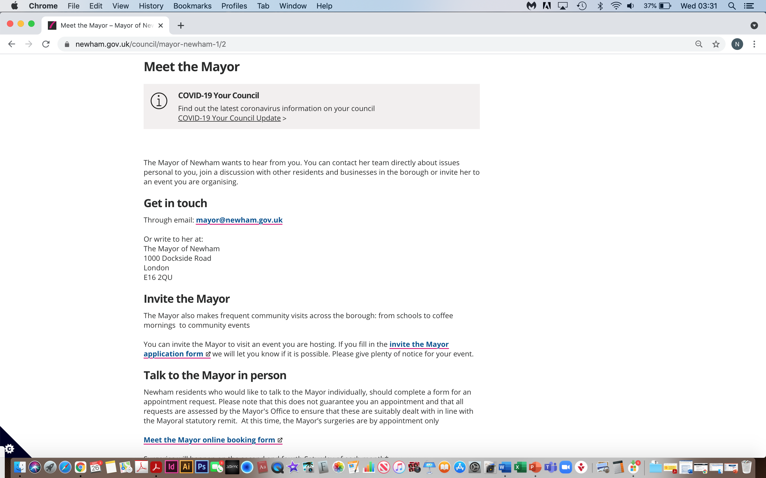
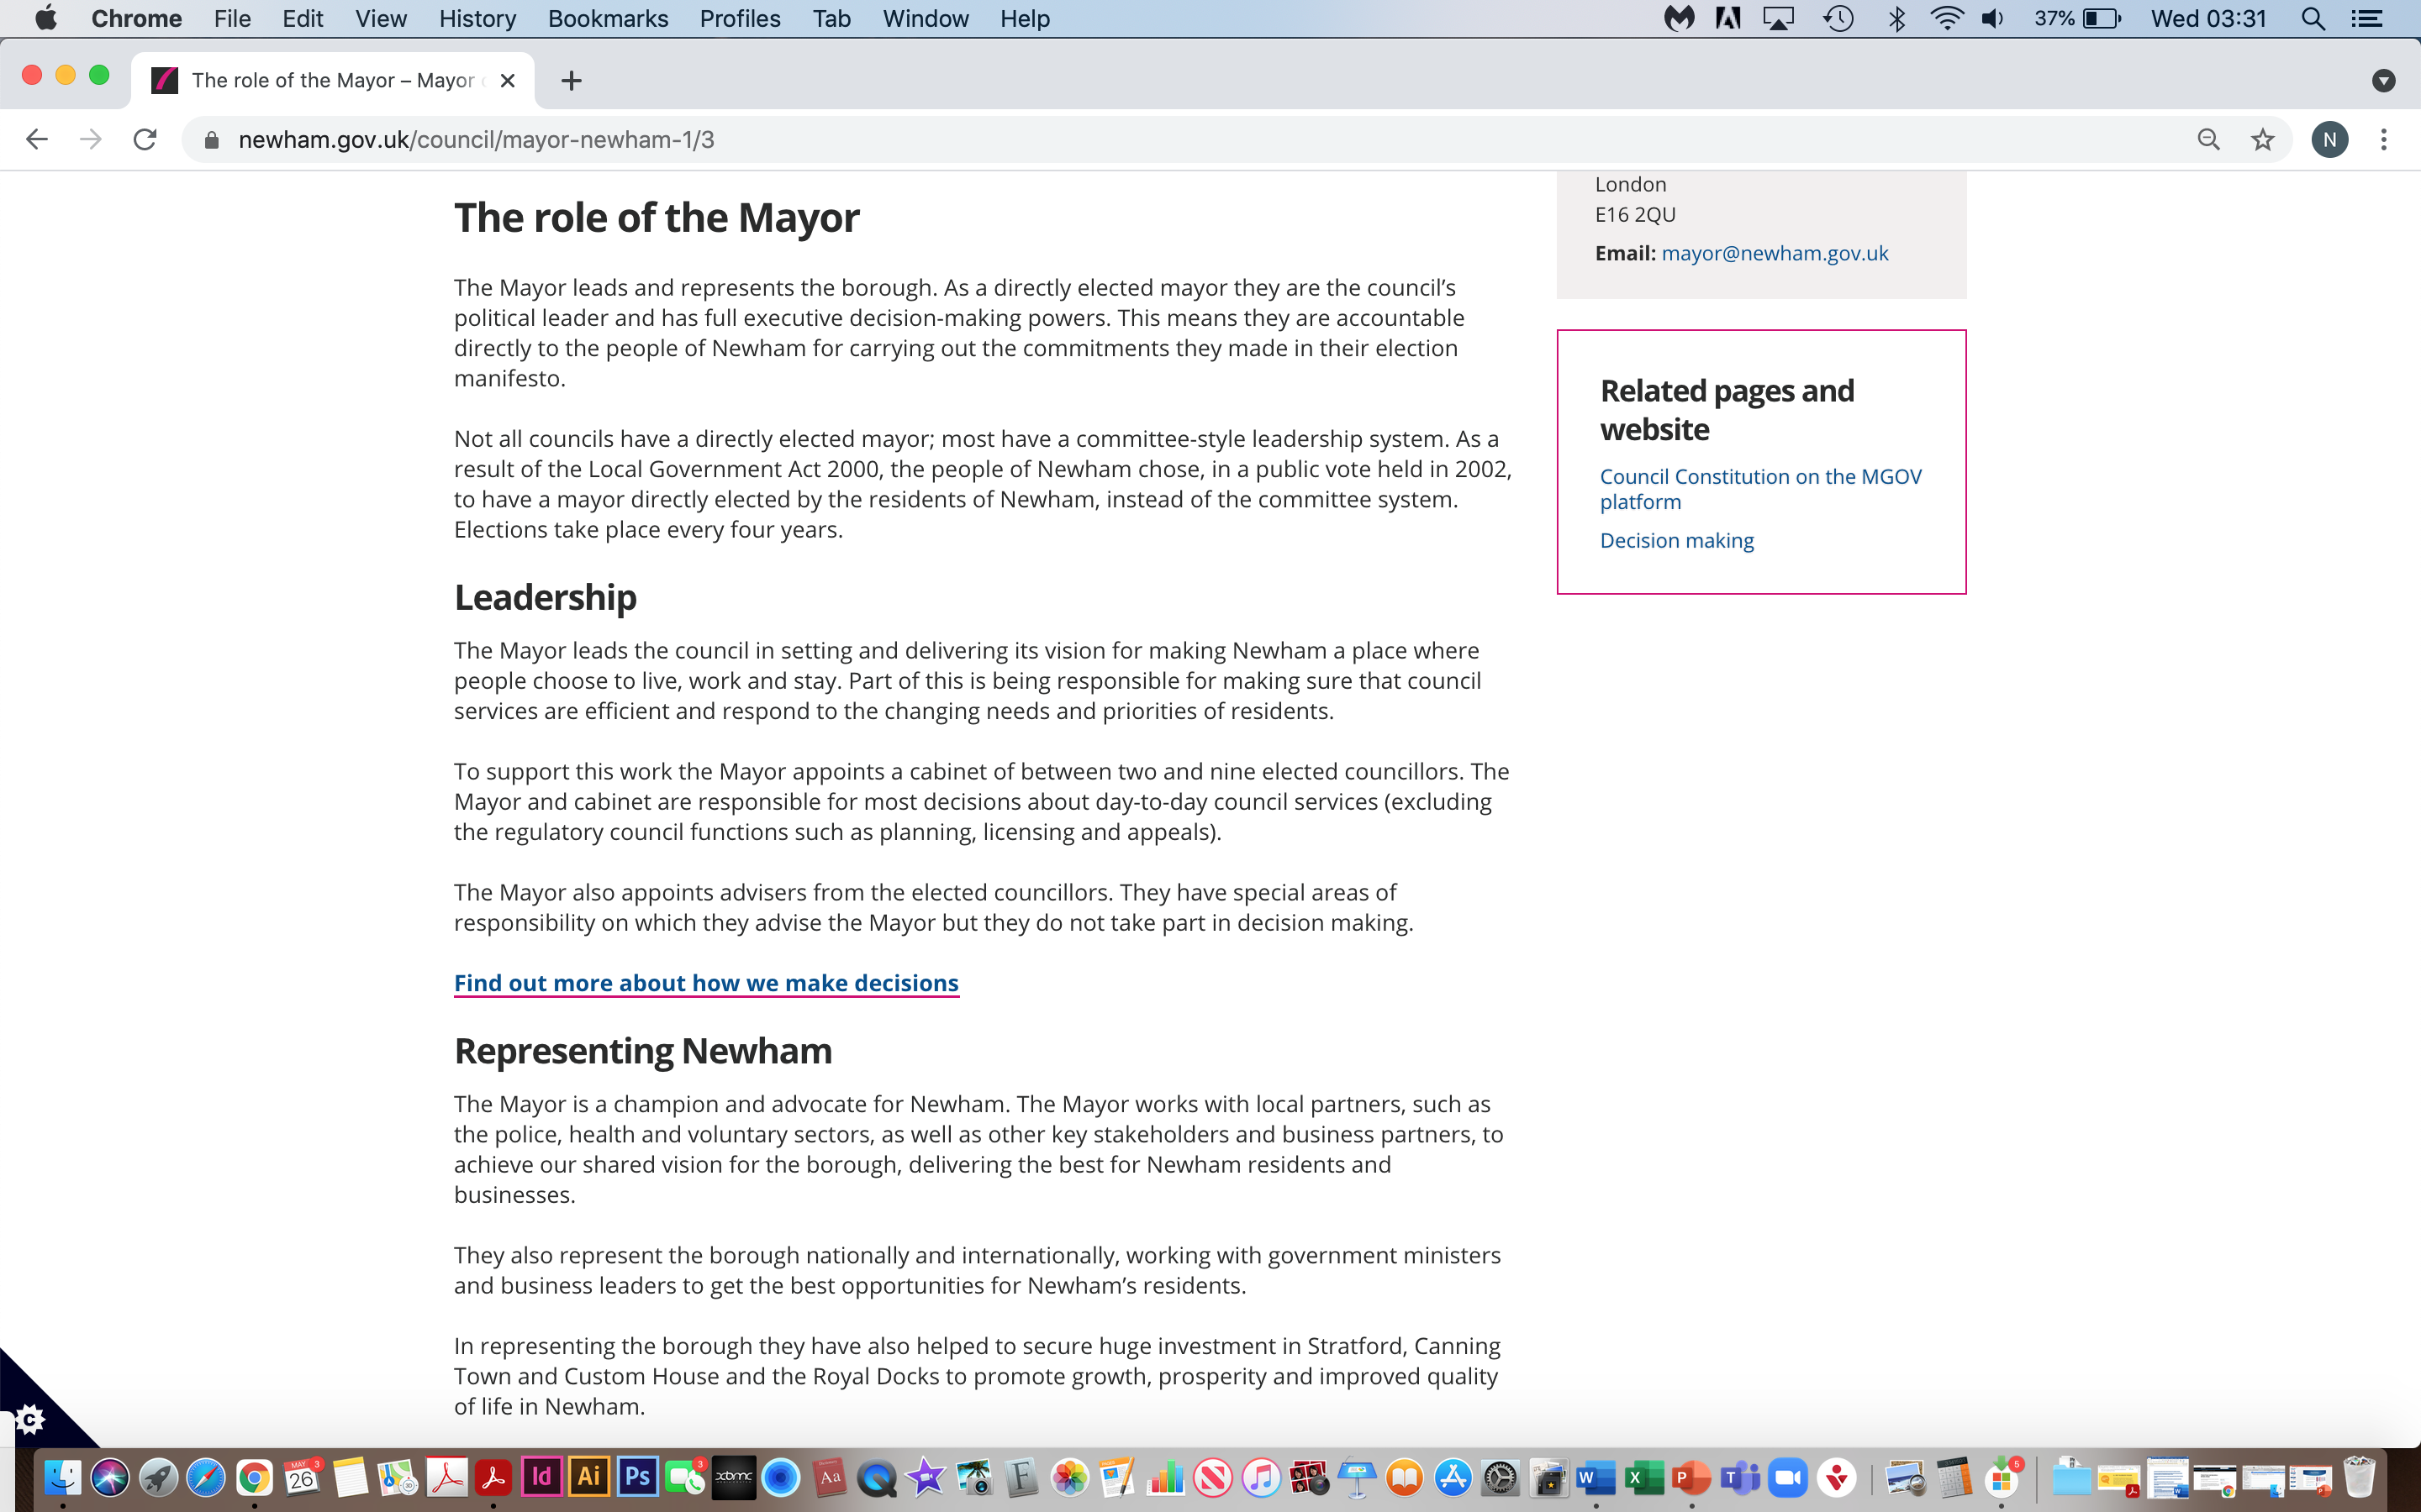
The Mayor of Newham
www.newham.gov.uk
Meet the Mayor
Get in Touch
Invite the Mayor
Talk to the Mayor in Person
The Role of the Mayor
Leadership
Representing Newham

Slide 36
The Mayor of Newham – Her Role
The Mayor leads and represents the borough
She is the council’s political leader and has full executive decision-making powers.
She is accountable directly to the people of Newham for carrying out the commitments made in her election manifesto
The Mayor leads the council in setting and delivering its vision for making Newham a place where people choose to live, work and stay.
The Mayor is a champion and advocate for Newham
The Mayor works with local partners, such as the police, health and voluntary sectors, as well as other key stakeholders and business partners, to achieve our shared vision for the borough, delivering the best for Newham residents and businesses.

Slide 37
Requirement 7
Write a one-page essay or give a two-minute oral report about a famous person in your country. Mention what he/she has done to gain their recognition

Slide 38
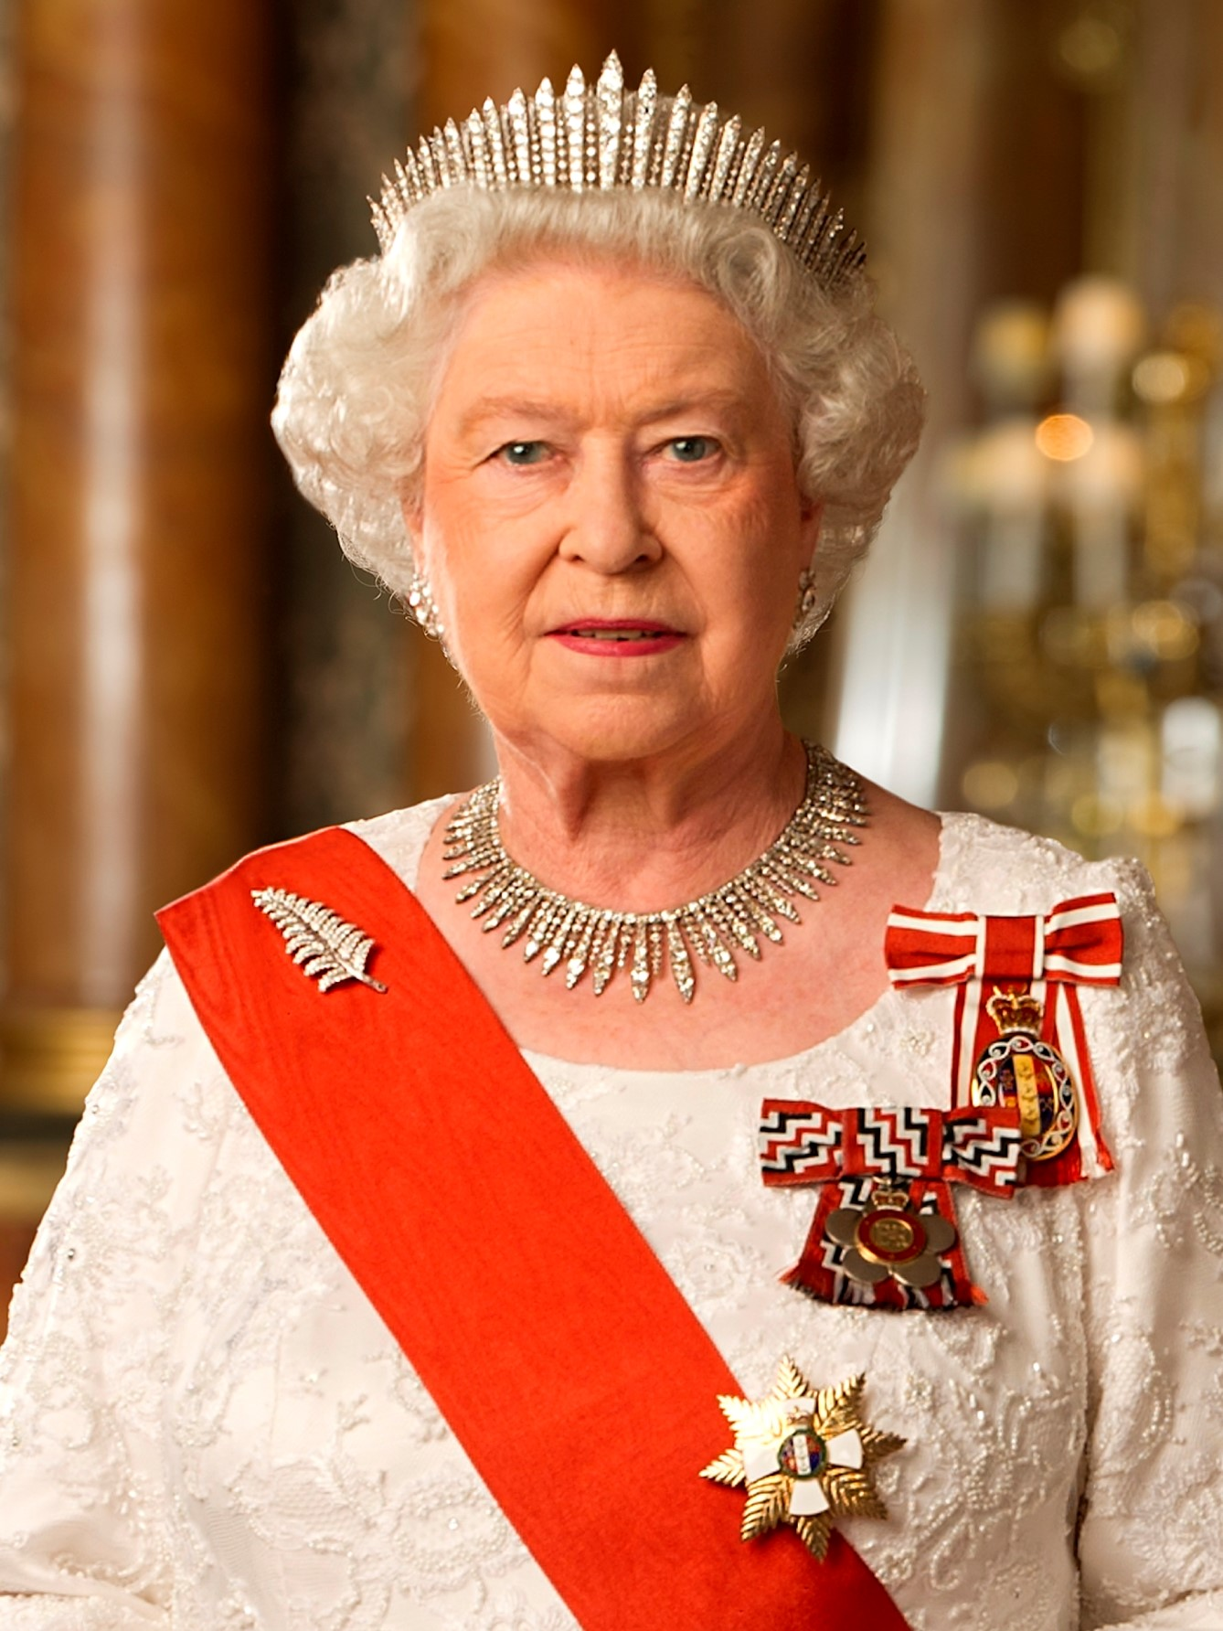
The Queen
Queen Elizabeth II (Elizabeth Alexandra Mary Windsor)
21st April 1926 (age 95)
Queen of the United Kingdom and 15 other commonwealth realms
Crowned on 2nd June 1953
Head of State
Longest lived and longest reigning British Monarch
Longest serving female Head of State in world history
The world’s oldest living monarch, longest reigning current monarch, longest serving current Head of State
Serves as an important symbol for national identity and pride

Slide 39
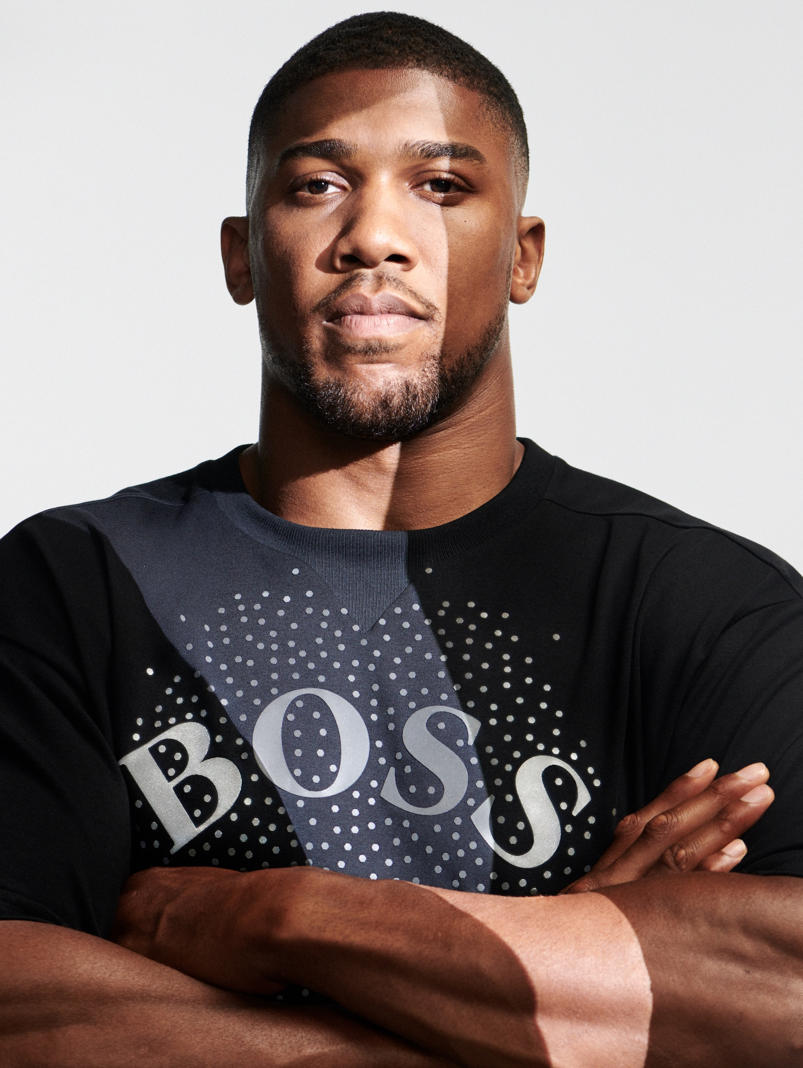
Anthony Joshua OBE
Anthony Oluwafemi Olaseni Joshua OBE
Born 15th October 1989 (age 31)
British professional boxer
Two-time unified World Heavyweight Boxing Champion having held the WBA, IBF, WBO and IBO titles since December 2019
Olympic Gold medalist at London 2012
Given an MBE in 2013
Held British and Commonwealth titles from 2014-2016
Given an OBE in 2018 for services to sport
Recognised as one of the 100 most influential Black Britons

Slide 40
Requirement 8
Do one of the following:
a. Make a list of ten famous quotations from leaders of your country
b. Make a list of ten famous historic places in your country
c. Make a list of ten famous historic events in your country

Slide 41
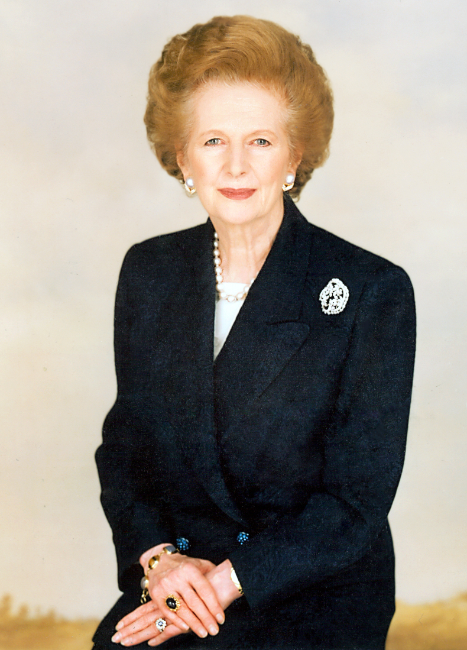
Quotes
Margaret Thatcher (Prime Minister 1979-1990)
“Don’t follow the crowd, let the crowd follow you.”
“If you want something said, ask a man; if you want something done, ask a woman.”
“You know, if you just set out to be liked, you would be prepared to compromise on anything, wouldn't you, at any time? And you would achieve nothing!”

Slide 42
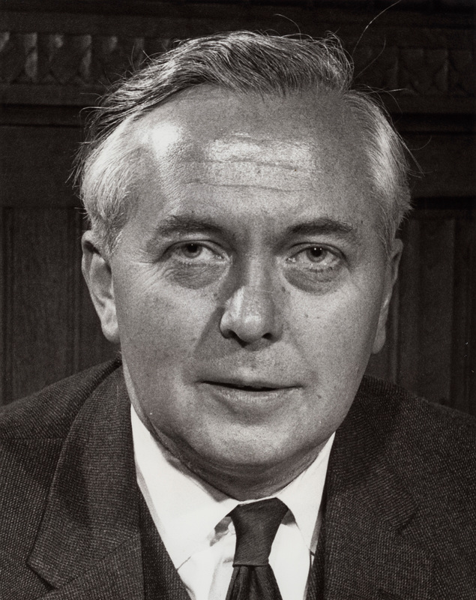
Quotes
Harold Wilson (Prime Minister 1964-70, 1974-76)
“I'm an optimist, but an optimist who carries a raincoat.”
“He who rejects change is the architect of decay.”

Slide 43
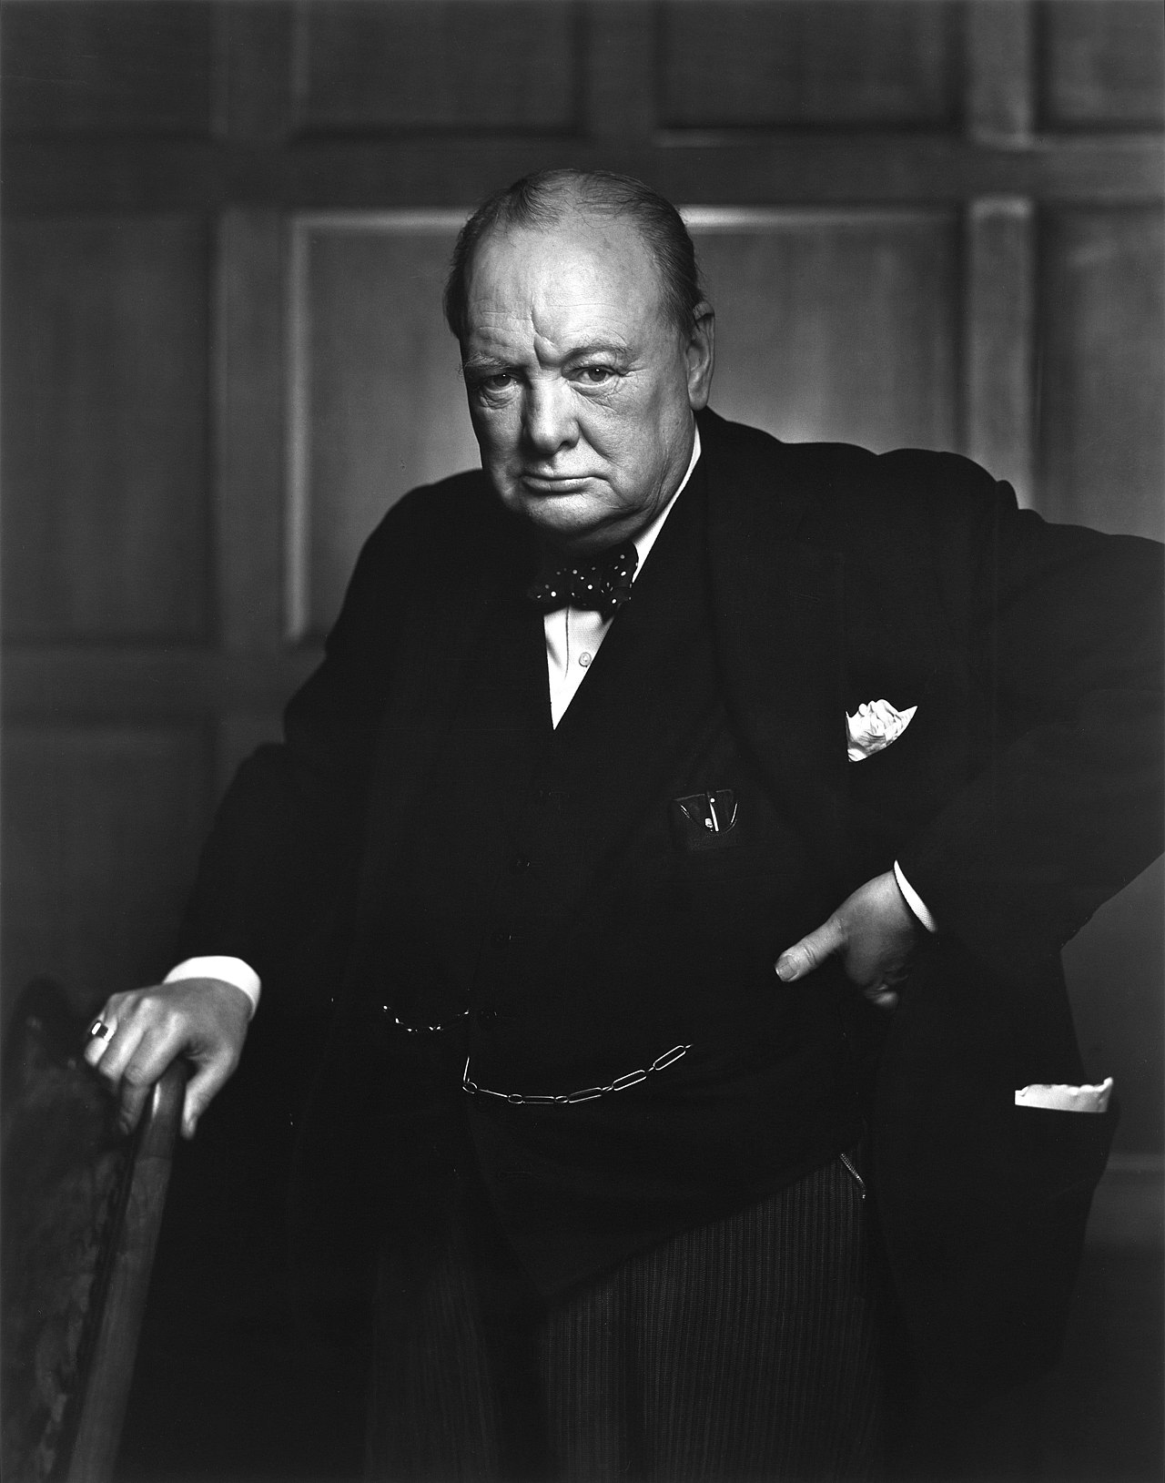
Quotes
Sir Winston Churchill (Prime Minister 1940-45, 1951-55)
“A pessimist sees the difficulty in every opportunity; an optimist sees the opportunity in every difficulty.”
“Success is not final, failure is not fatal, it is the courage to continue that counts.”
“Never in the field of human conflict was so much owed by so many to so few.”

Slide 44
Requirement 9
Describe what you can do as a citizen to help your church and country

Slide 45
Helping Your Church and Country
Helping Your Church
Helping Your Country
Attend services on a regular basis
Support it with your tithes and offering
Attend business meetings
Volunteer your services
If you see something that needs doing, do it
Engage with your community
Attend public meetings
Stay informed about local issues
Vote if you are eligible
Pay your taxes fairly and promptly

Slide 46
Helping Your Church and Country
“We rise by lifting others.” Robert Ingersoll
“The purpose of life is not to be happy. It is to be useful, to be honorable, to be compassionate, to have it make some difference that you have lived and lived well.” Ralph Waldo Emerson
“It’s the action, not the fruit of the action, that’s important. You have to do the right thing. It may not be in your power, may not be in your time that there’ll be any fruit. But that doesn’t mean you stop doing the right thing. You may never know what results come from your action. But if you do nothing, there will be no result.” Mahatma Gandhi
“The purpose of life is to contribute in some way to making things better.” Robert F. Kennedy

Slide 47
Requirement 10
Go through the steps of an individual acquiring citizenship
in the country and learn how this is done

Slide 48
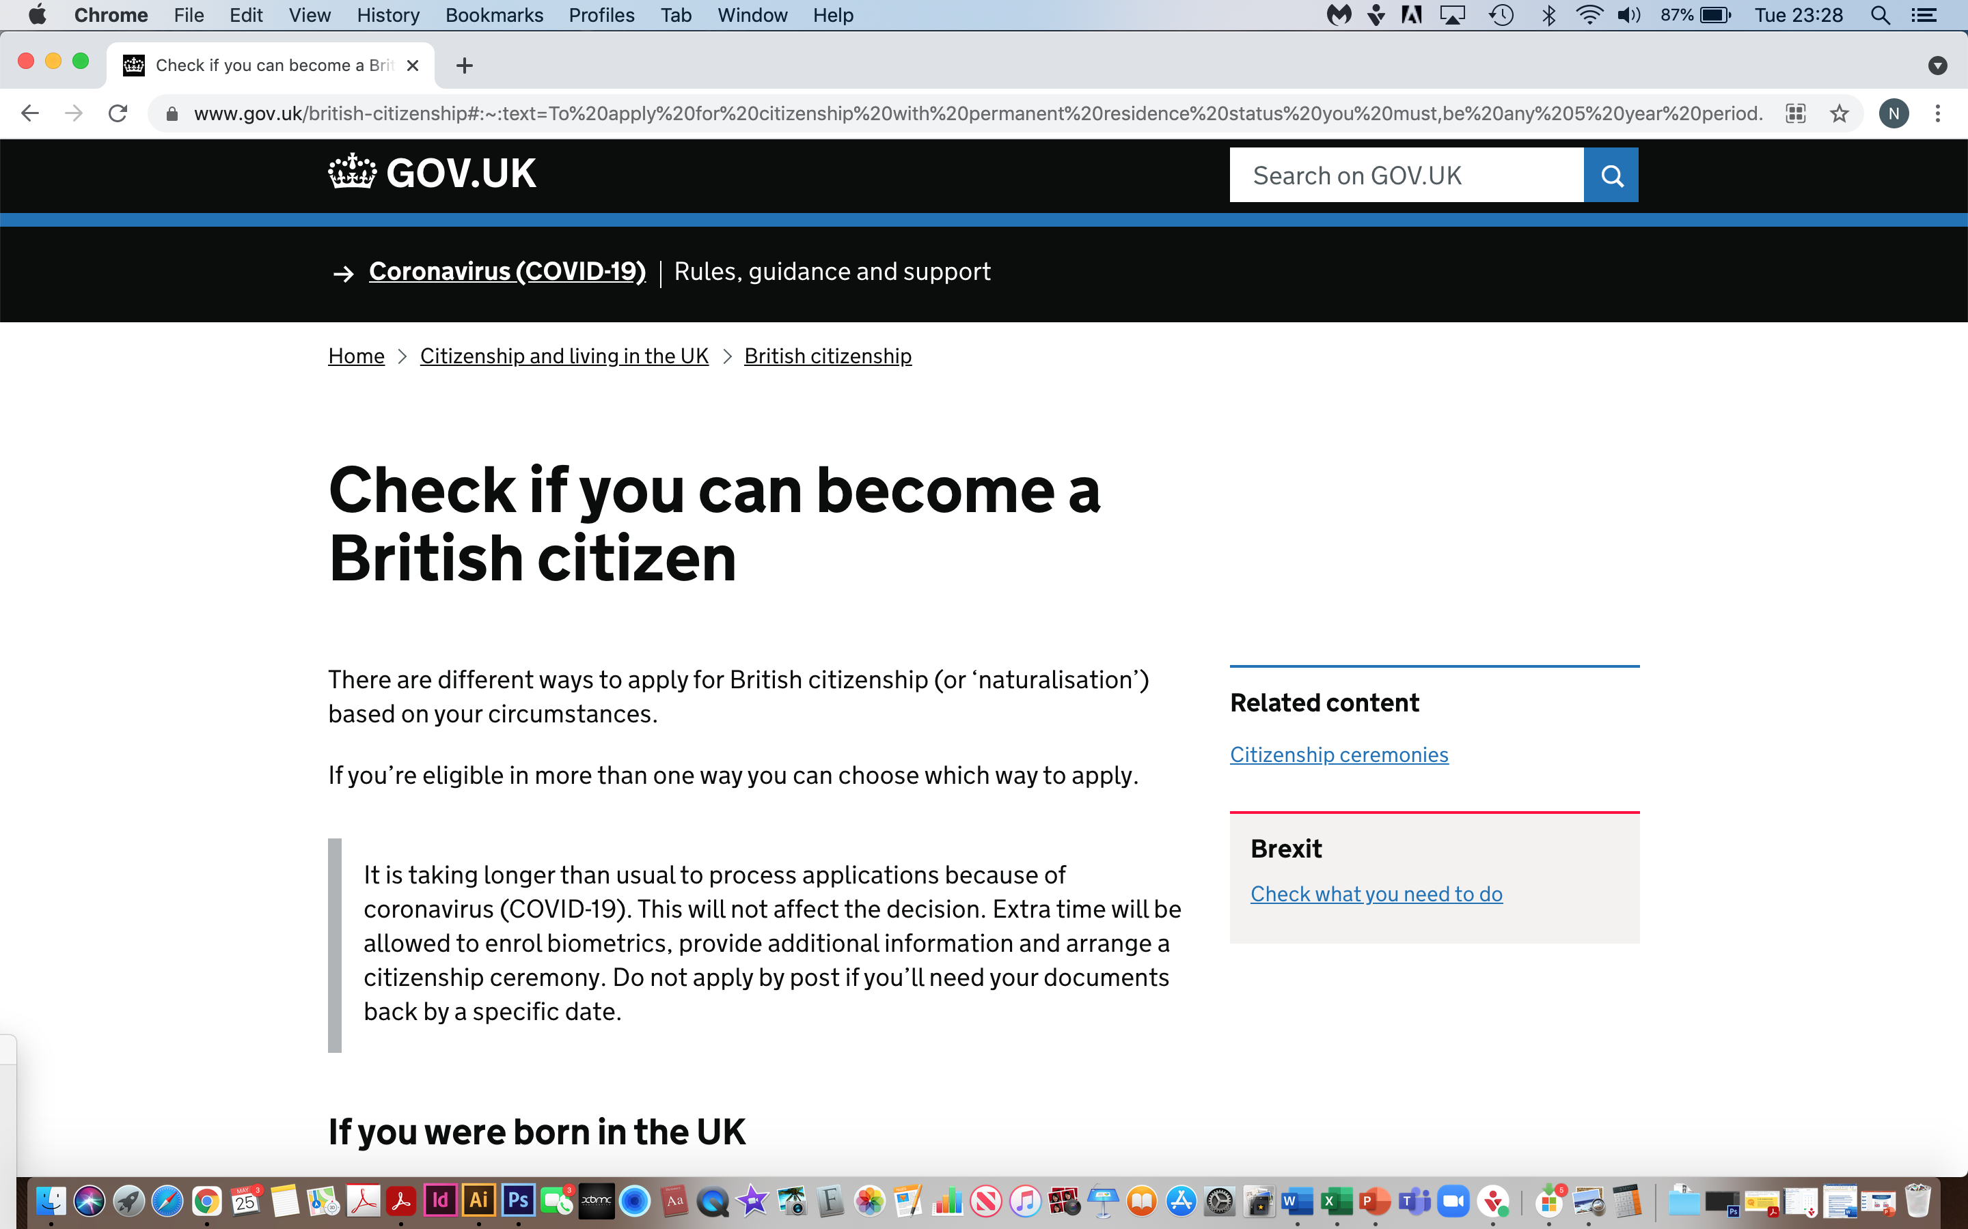
How to Acquire Citizenship
www.gov.uk

Slide 49
How to Acquire Citizenship
Applying for citizenship takes approximately 6 months and in some cases even longer
The application fee for citizenship by naturalisation is £1330
If your application is rejected the overall fee will be refunded less an administration fee of £25 per applicant

Slide 50
How to Acquire Citizenship
When you apply for citizenship through naturalisation, you’ll need to:
prove how long you’ve lived in the UK
pass the Life in the UK Test
prove you understand English
check you’re of ‘good character’ - this means showing you haven't recently broken the law or gone bankrupt
give the names of 2 people who can help prove your identity - these are called ‘referees’

Slide 51
How to Acquire Citizenship
When you apply for citizenship through naturalisation, you’ll need to:
Prove how long you’ve lived in the UK
3 years if you’re married to or in a civil partnership with a British citizen
5 years if you’re not married to or in a civil partnership with a British citizen
You also need to make sure you were in the UK on the same day 3 or 5 years ago as the day you’re applying.

Slide 52
How to Acquire Citizenship
When you apply for citizenship through naturalisation, you’ll need to:
Pass the Life in the UK Test
The test asks questions about UK laws and the legal system, working and other details of life in the UK.
You can do the test any time before you apply
You can do the test as many times as you need to - but you have to pay a fee each time.

Slide 53
How to Acquire Citizenship
When you apply for citizenship through naturalisation, you’ll need to:
Prove you Understand English
You need to prove you understand English, Welsh or Scottish Gaelic before you can apply for citizenship.

Slide 54
How to Acquire Citizenship
When you apply for citizenship through naturalisation, you’ll need to:
Check you’re of ‘Good Character’
The Home Office look at a range of things to decide this. For example, the Home Office might decide you’re not eligible if you have:
unpaid taxes in the UK
an NHS debt
been declared bankrupt
a serious or recent criminal record
broken any of the immigration rules in the last 10 years - for example if you’ve overstayed a visa, worked without permission or entered the UK illegally
been an EEA citizen in the UK without a right to reside

Slide 55
How to Acquire Citizenship
When you apply for citizenship through naturalisation, you’ll need to:
Give the names of 2 people who can help prove your identity
You’ll need to give the names of 2 referees on your application. These are people who know you and can help prove your identity.
Both of your referees should have known you personally for more than 3 years. They must not be:
  your relative
  your solicitor or agent
  employed by the Home Office
They can't be a referee if they've had a criminal conviction in the last 10 years, unless a certain period of time has passed. This is called the ‘rehabilitation period’. For example, the rehabilitation period for a fine is 1 year. You can find the rehabilitation periods on GOV.UK.

Slide 56
How to Acquire Citizenship
When you apply for citizenship through naturalisation, you’ll need to:
Give the names of 2 people who can help prove your identity
Your referees should include:
  a person who has 'professional standing' - for example, a civil servant of any nationality
  a person who is a British passport holder and either has professional standing or is over the age of 25
The Home Office has a list of people they accept as referees - they’re called ‘acceptable professional persons’.
Before you apply, check the list and the rest of the rules for referees in the nationality guidance on GOV.UK. The list of who can be a referee is under 'Commonly used terms'.

Slide 57
How to Acquire Citizenship
You need to attend a citizenship ceremony if you’re 18 or over and have successfully applied to become a British citizen.
Booking your ceremony
Your local council will organise your citizenship ceremonies. They are usually done in groups but you can ask for a private ceremony if you prefer.
You must take your invitation when you go to your ceremony.
You’re usually allowed to take 2 guests.

Slide 58
How to Acquire Citizenship
During the ceremony
You’ll have to make an oath of allegiance and pledge that you promise to respect the rights, freedoms and laws of the UK.
At the end of the ceremony you’ll be presented with your certificate of British citizenship and a welcome pack. If you attend a virtual ceremony, you’ll be sent a copy of the certificate afterwards.
Some local councils sell photographs or videos of the event.

Slide 59
Requirement 11
Know how to explain the process of government in your country

Slide 60
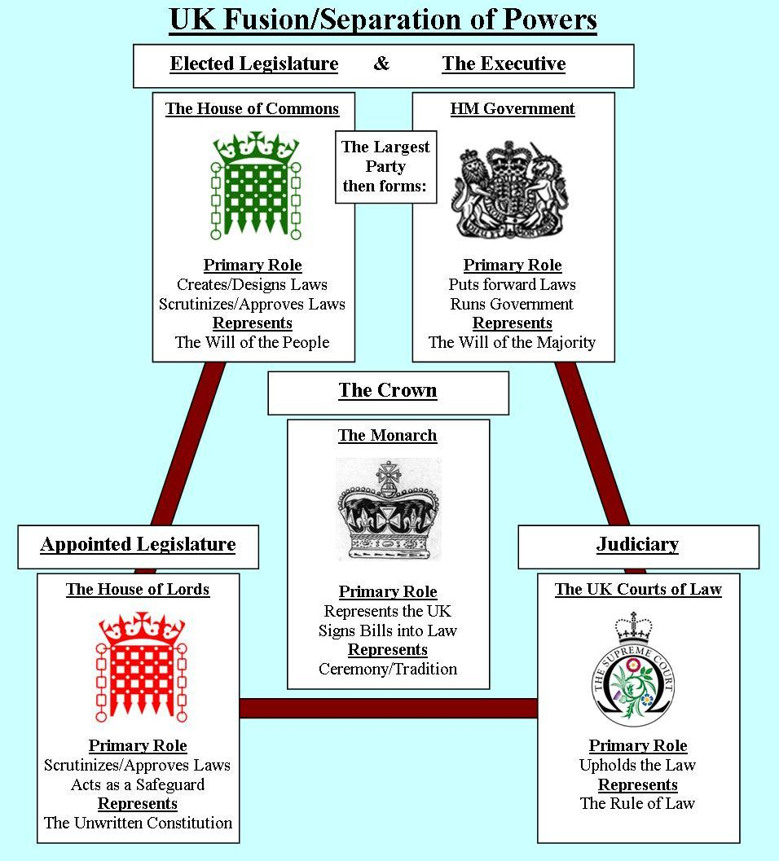
Process of Government
HM Government
The government of the United Kingdom domestically referred to as Her Majesty’s government, is the central government of the United Kingdom of Great Britain and Northern Ireland. The government is led by the Prime Minister who selects all the other ministers

Slide 61
Process of Government
The House of Commons
They are an elected body known as Members of Parliament (MPs)
Make laws (legislation)
Scrutinize/approve laws

Slide 62
Process of Government
The House of Lords
They are an appointed body
  Retired politicians
  Current senior judges
  Senior members of the armed forces
  Includes bishops and archbishops
Do not belong to any political party
Scrutinize/approve laws

Slide 63
Process of Government
The Crown/Monarch
The Queen plays a constitutional role in opening and dissolving parliament and approving bills before they become law

Slide 64
Process of Government
The Judiciary is the system of courts that interprets, defends and applies the law in the name of the state

Slide 65
Process of Government
The UK is a parliamentary democracy
Parliament is voted in by the people to act in their interest
The UK is also a constitutional monarchy although the queen has limited powers and is impartial
Parliament divided into two houses that make laws, scrutinize government and debate current issues
  House of Commons
  House of Lords
The two houses complement and balance each other

Slide 66
Process of Government
A political party that wins an overall majority in the House of Commons with 326 seats or more at a general election forms the new government and it’s leader becomes Prime Minister
If there is no clear party, one of the two biggest parties could make a formal deal with a smaller party to form a coalition and thus form the new government

Slide 67
Requirement 12
Explain the meaning of this statement Jesus made in Matthew 22:21: “Render therefore unto Caesar the things which are Caesar’s, and unto God the things that are God’s.

Slide 68
Matthew 22:21
“Render therefore unto Caesar the things which are Caesar’s, and unto God the things that are God’s.
This phrase has become a widely quoted summary of the relationship between Christianity, secular government, and society. The original message, coming in response to a question of whether it was lawful for Jews to pay taxes to Caesar, gives rise to multiple possible interpretations about the circumstances under which it is desirable for Christians to submit to earthly authority.

Slide 69
Requirement 13
Explain why laws are established in your country

Slide 70
Why Laws are Established in the UK
The law serves many purposes. Four principal ones are:
  establishing standards
  maintaining order
  resolving disputes
  protecting liberties and rights
These laws serve as a norm of conduct for citizens and act as a guidance of acceptable behaviour. We need the law to ensure equality and parity in communities. Many believe that a society without laws would be a society in a state of chaos.

Slide 71
Questions…

Slide 72
Important Things to Remember
Remember to display the national flag the correct way up.
How many countries make up the UK?
National flag on a platform – left or right of the speaker?
Salute with which hand?
How long must you have lived in the UK to apply for citizenship?
You can apply for citizenship through________ (name of legal process)
Name a famous leader from your country
What are the 5 components of government?
Name something you can do to help your church and/or country?

Slide 73
Useful Sites
www.gov.uk
www.royal.uk
https://www.gov.uk/government/publications/flying-flags-a-plain-english-guide/flying-flags-a-plain-english-guide
https://www.flaginstitute.org/pdfs/Flying_Flags_in_the_United_Kingdom.pdf

