Slide 1
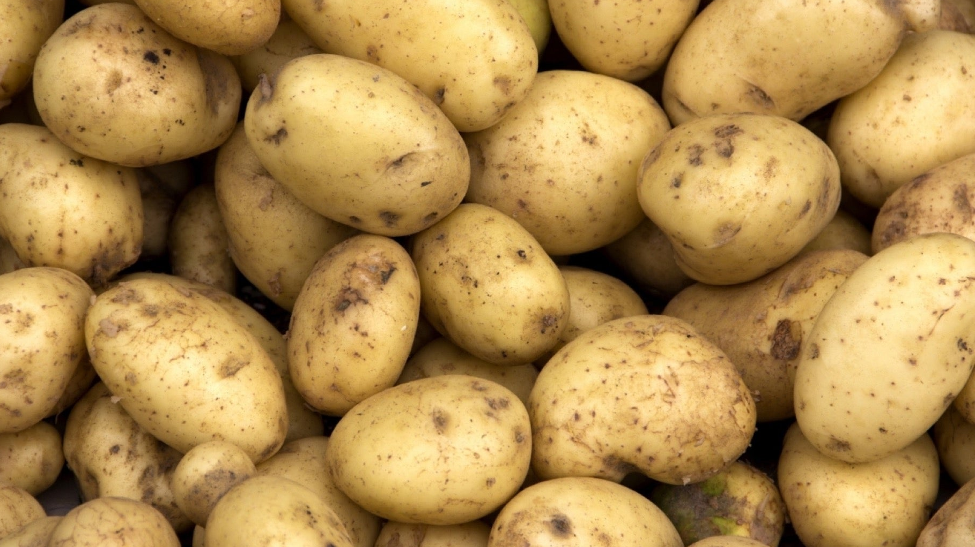
Potato
Adventurer Award

Slide 2
Requirements
Read and discuss Genesis 1:11-12, 29-30 and Ecclesiastes 3:2.
What are the nutritional benefits of potatoes?
The potato is the official food or vegetable of which states?
How do potatoes grow? What are the best growing conditions?
What are the different varieties of potatoes? Which varieties are available in your area?
When and how are potatoes harvested?
Do one of the following and share your experience: a. Plant a potato and watch it grow b. Help someone harvest potatoes.

Slide 3
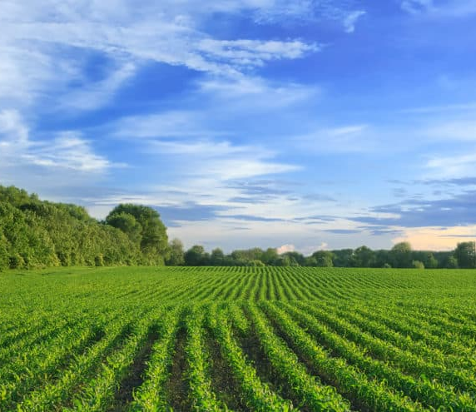
Genesis 1:11-12
¹¹ Then God said, “Let the land produce vegetation: seed-bearing plants and trees on the land that bear fruit with seed in it, according to their various kinds.” And it was so.

Slide 4
Genesis 1:11-12
¹² The land produced vegetation: plants bearing seed according to their kinds and trees bearing fruit with seed in it according to their kinds. And God saw that it was good.

Slide 5
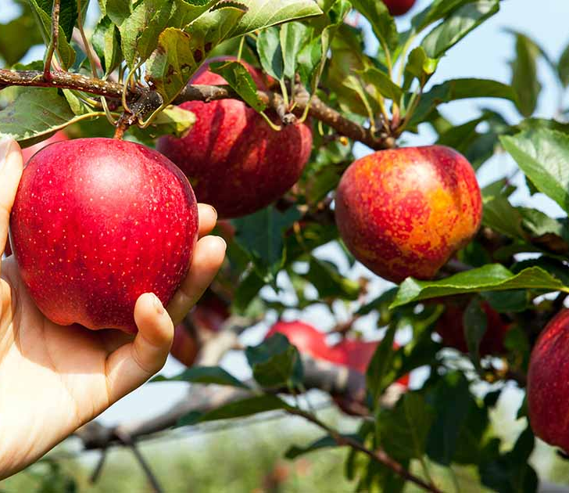
Genesis 1:29-30
²⁹ Then God said, “I give you every seed-bearing plant on the face of the whole earth and every tree that has fruit with seed in it. They will be yours for food.

Slide 6
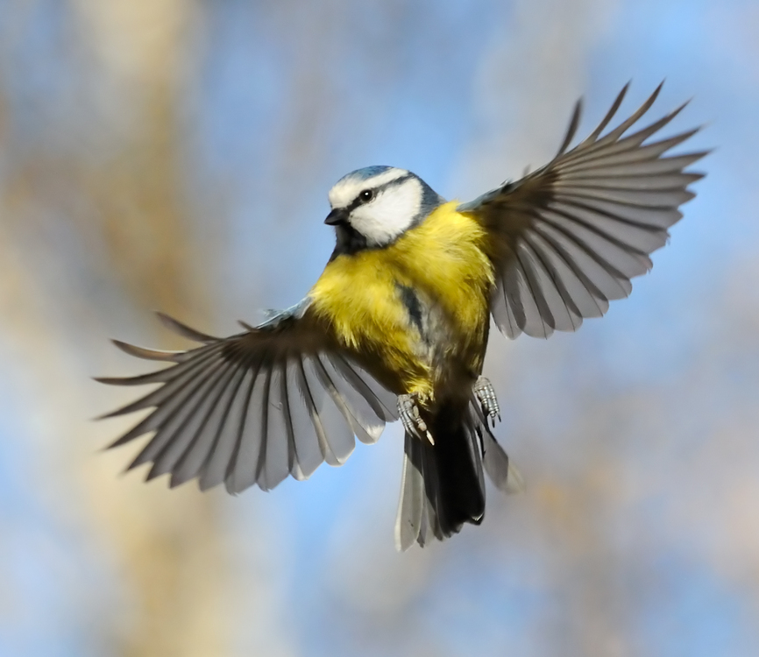
Genesis 1:29-30
³⁰ And to all the beasts of the earth and all the birds in the sky and all the creatures that move along the ground—everything that has the breath of life in it—I give every green plant for food.” And it was so.

Slide 7
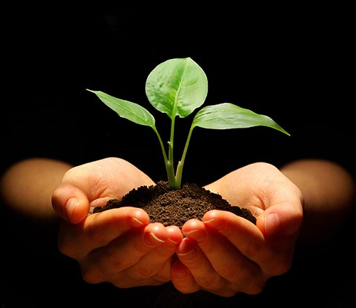
Ecclesiastes 3:2
a time to be born and a time to die,
a time to plant and a time to uproot,

Slide 8
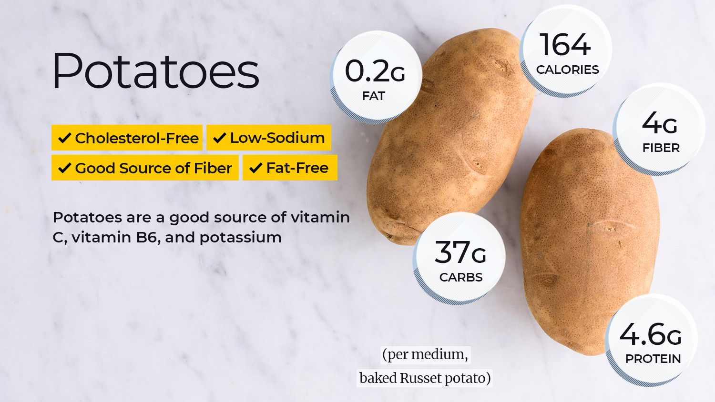
2. What are the nutritional benefits of potatoes?

Slide 9
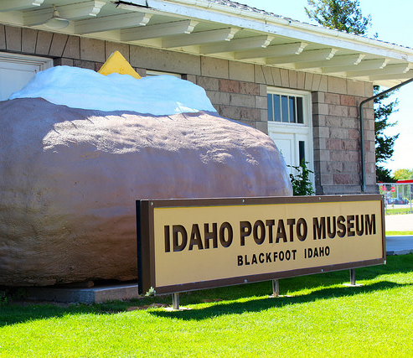
3. The potato is the official food or vegetable of which US states?
Idaho
State Food: Potatoes
Notes:
Potatoes are originally found in South America (Peru and Bolivia)
Arrived in Spain around 1570

Slide 10
New Hampshire: White Potato
Idaho:
Potatoes
North Carolina: Sweet Potato
Louisiana:
Sweet Potato
Notes:
Official vegetable of ….

Slide 11
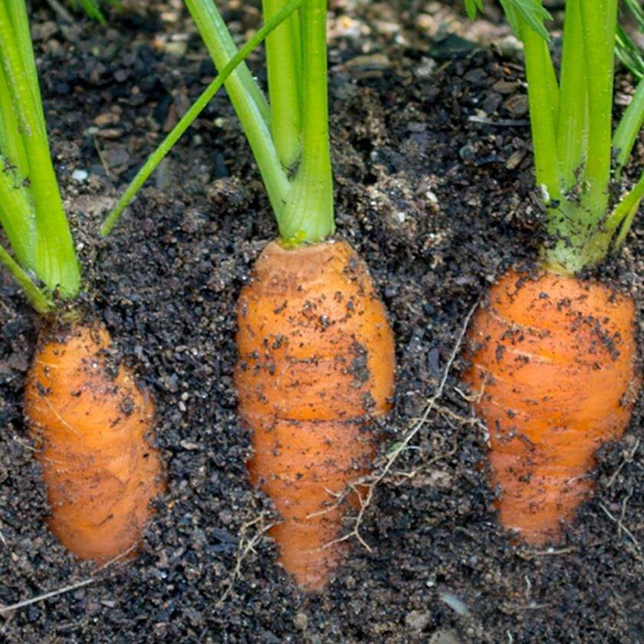
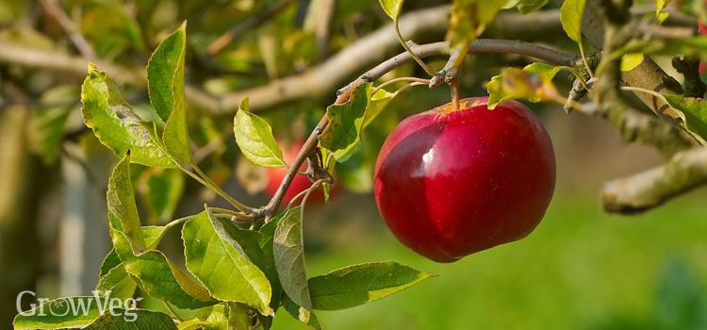
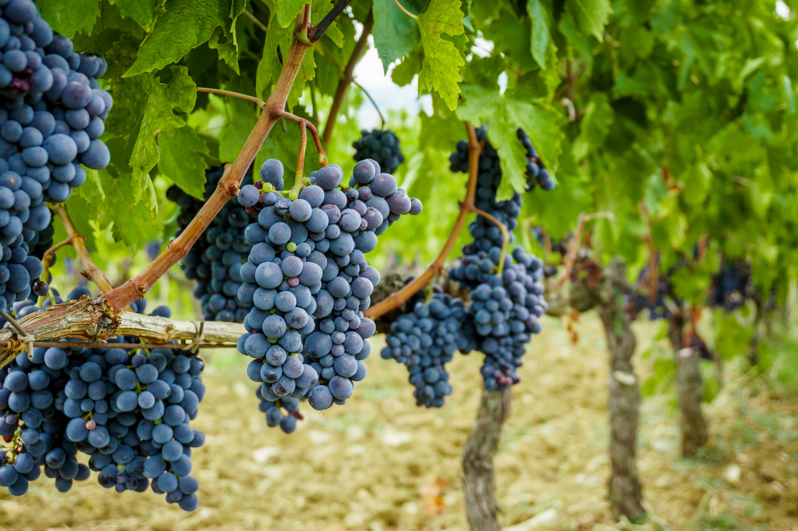
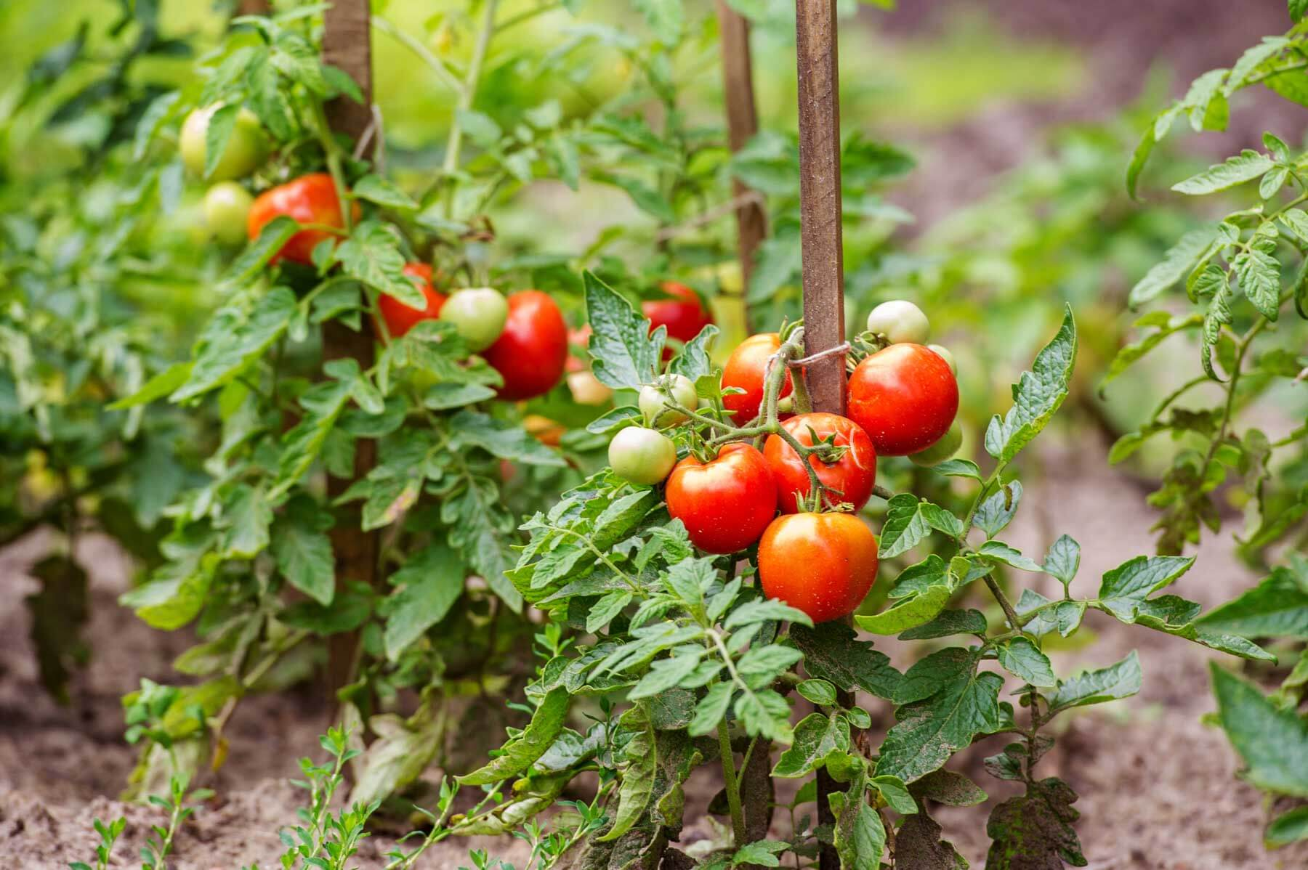
4. How do potatoes grow?
On a tree?
Underground?
On a vine?
On a plant?

Slide 12
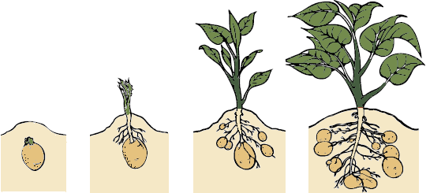
4. How do potatoes grow?

Slide 13
4. What are the best growing conditions?

Slide 14
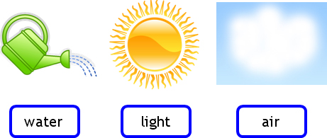
4. What are the best growing conditions?

Slide 15
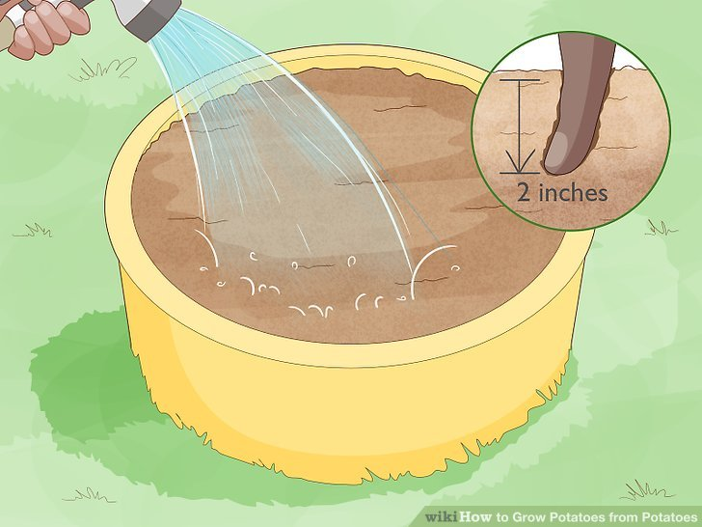
Notes:
Water your potatoes whenever the top 2 inches (5.1 cm) of soil become dry. The dryness of the soil will depend on the weather where you live, so test if it’s time to water by sticking one finger into the top of the soil. If it feels dry, it’s time to water again. Keep going until water begins to drain from the bottom of the pot.^{[11]}If you live in a hotter climate, your soil will get drier quicker and will need to be watered more often. Check twice a day.

Slide 16
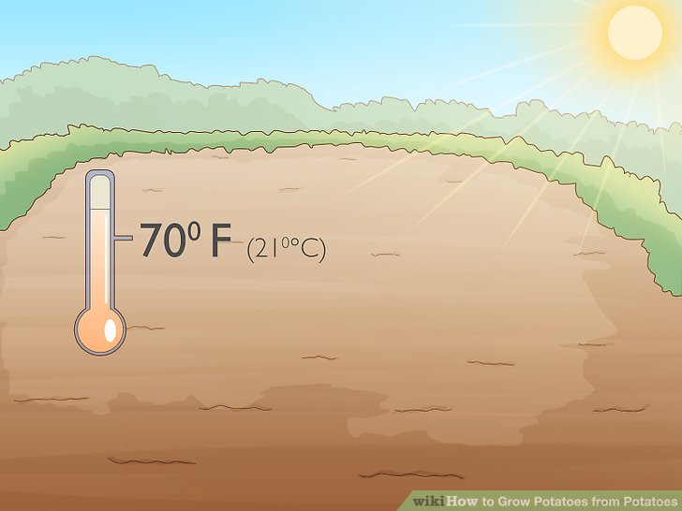
Notes:
Choose a spot where the pot will get lots of sun

Slide 17
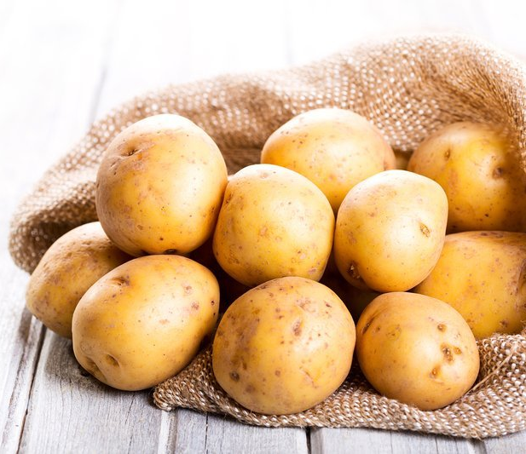
5. What are the different varieties of potatoes? Which varieties are available in your area?

Slide 18
Russet Potato Thick skin with light and fluffy center

Slide 19
Red Potato Thin skin and stays firm throughout cooking

Slide 20
Yellow Potato Buttery flavour with a creamy texture

Slide 21
Purple Potato Medium skin with an earthy flavour and vibrant colour

Slide 22
White Potato Thin skin with a nutty flavour and stays firm throughout cooking

Slide 23
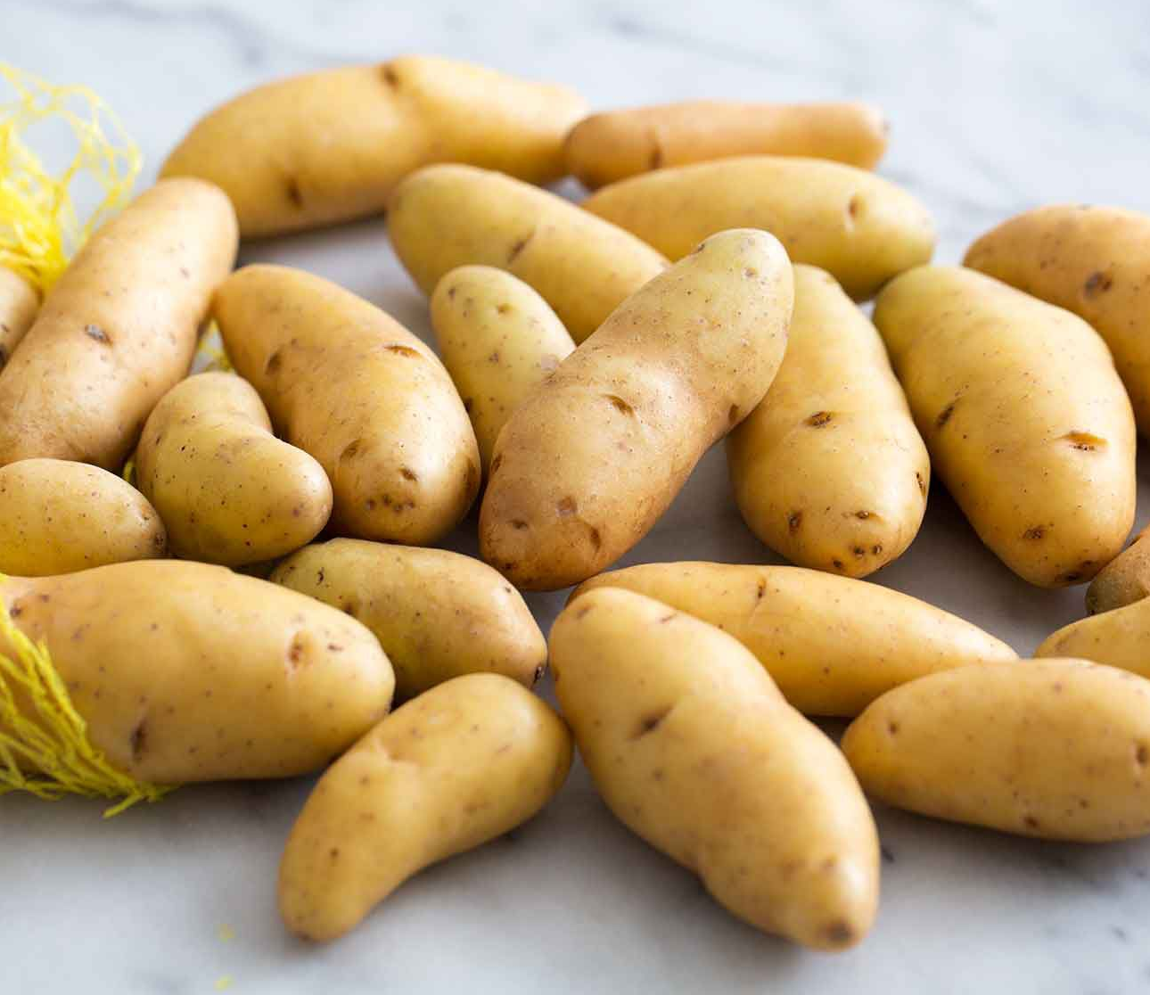
Fingerling Potato Nutty and buttery flavour with a firm texture

Slide 24
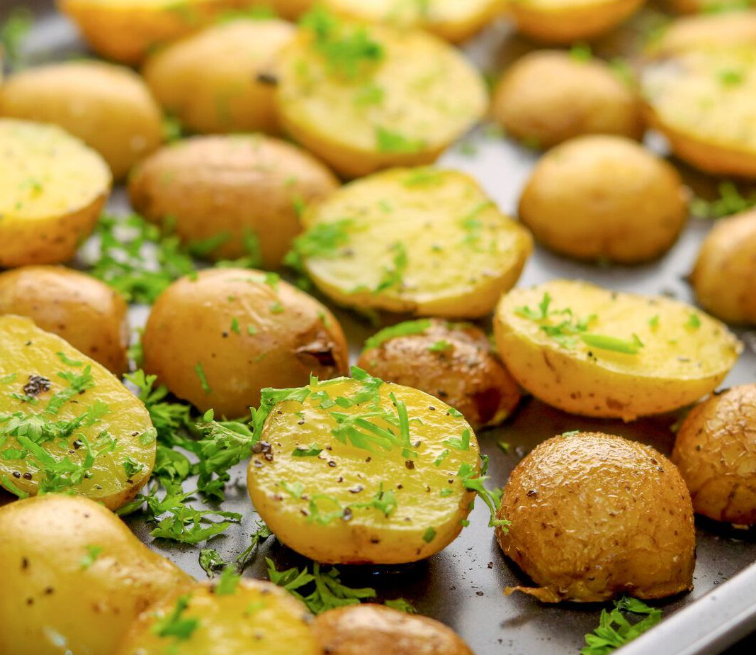
Petite Potato Similar in taste to their larger-sized cousins with more concentrated flavours

Slide 25
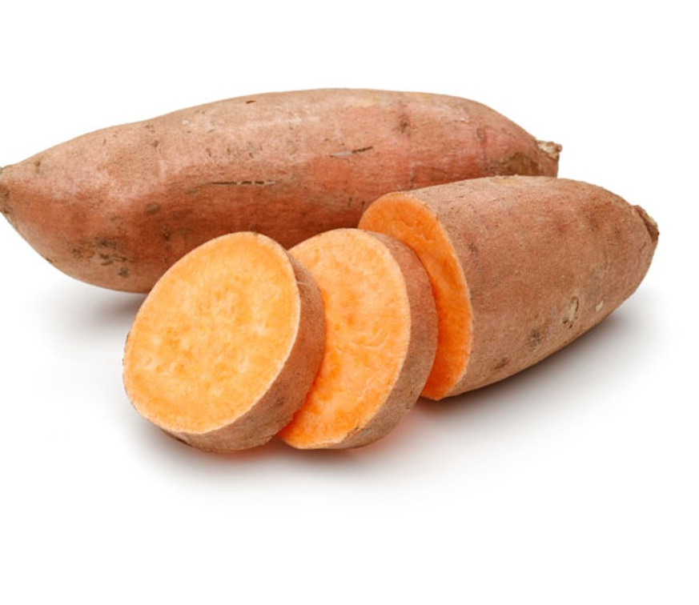
Sweet Potato

Slide 26
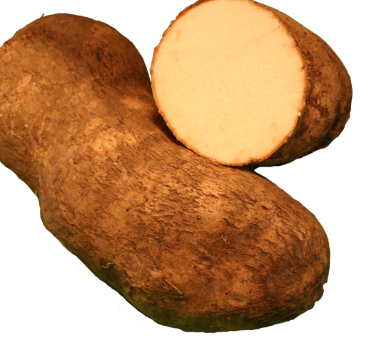
Yam

Slide 27
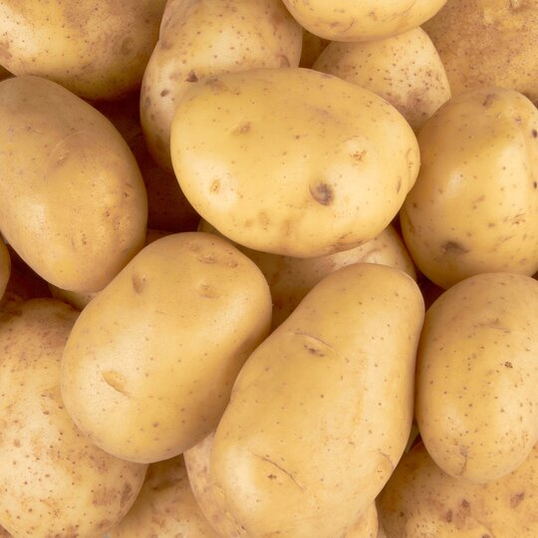
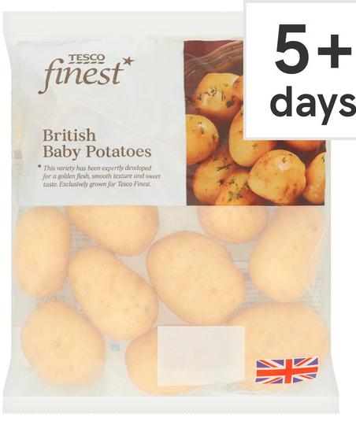
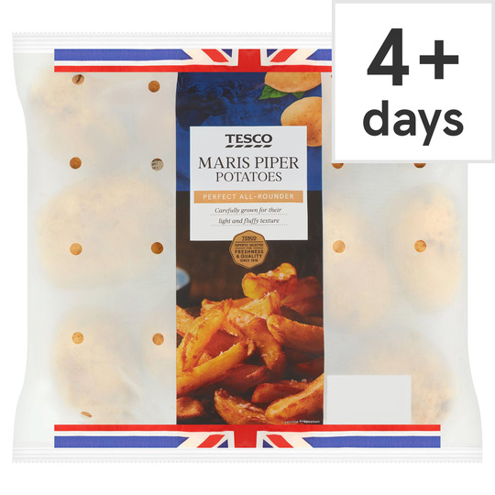
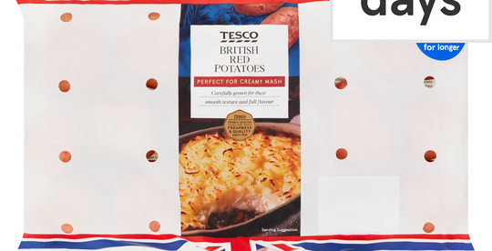
5. Which varieties are available in your area?

Slide 28
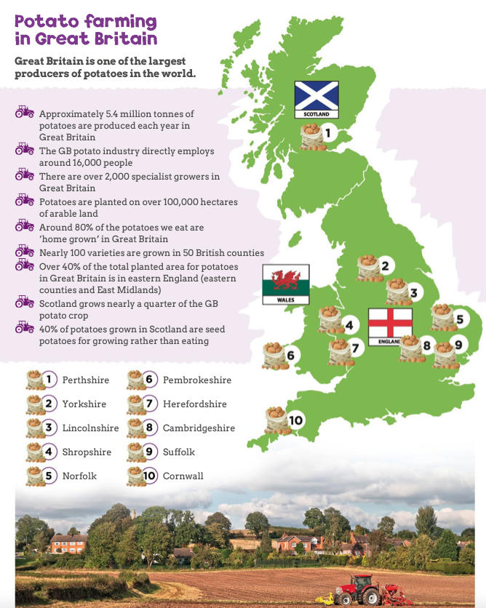
5. Which varieties are available in your area?

Slide 29
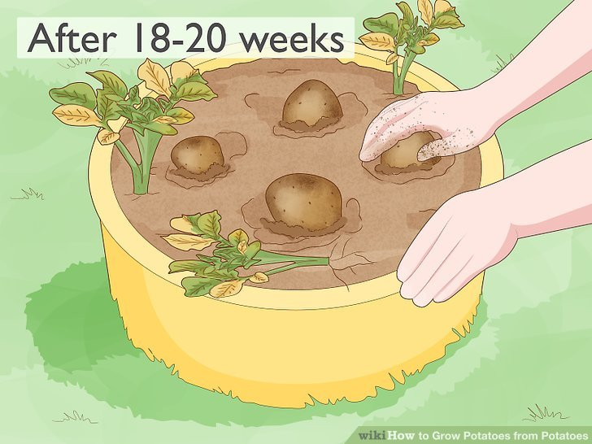
6. When are potatoes harvested? When their leaves turn yellow (Summer)

Slide 30
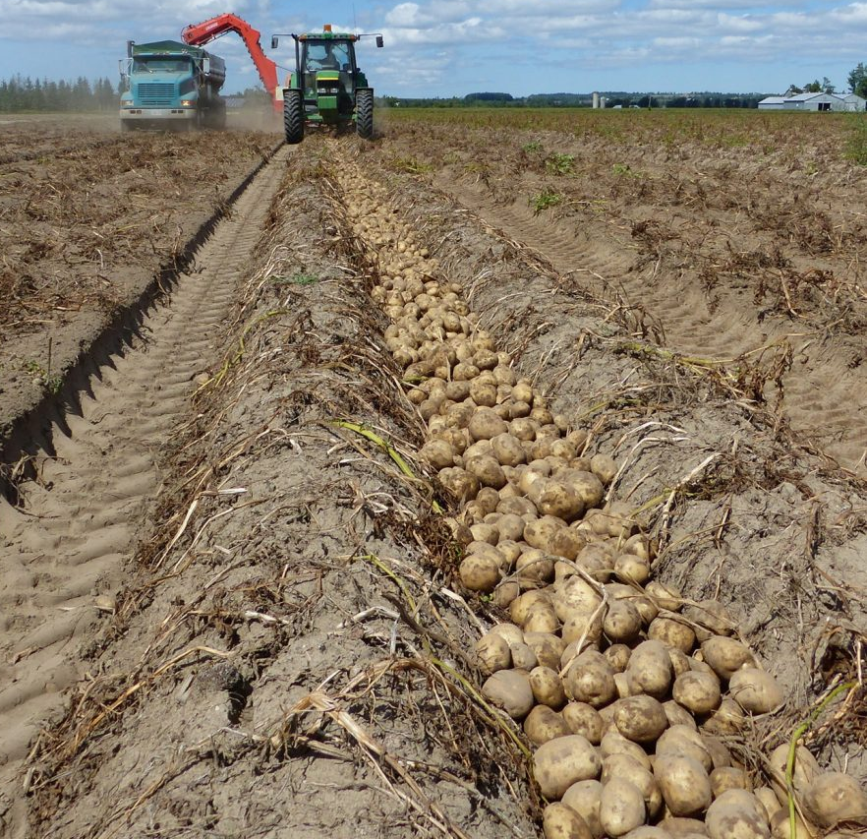
6. How are potatoes harvested?
With a tractor

Slide 31
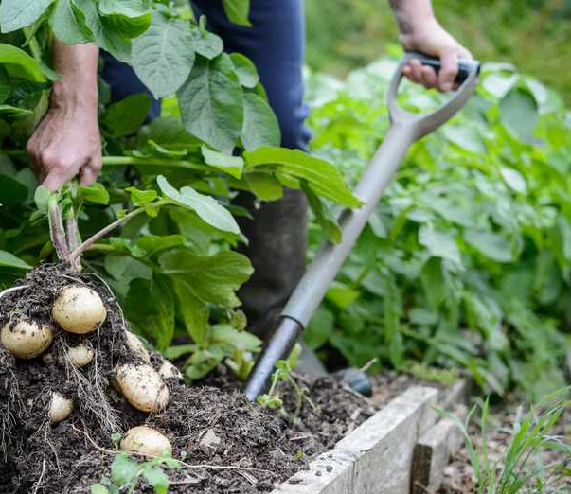
6. How are potatoes harvested?
By Hand - with a fork

Slide 32
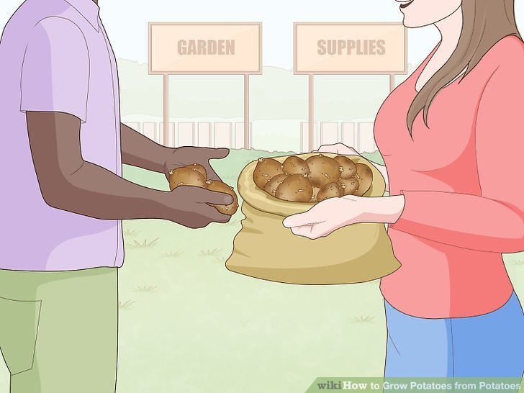
7. Plant a potato and watch it grow
Notes:
Buy seed potatoes from a garden supply store. The best way to grow potatoes is from potatoes, but not just any potato will do: they have to be specially-grown seed potatoes from a garden supply store. Regular potatoes from a grocery store are often treated with pesticides which can spread disease through your whole crop, so either order your seeding potatoes from a catalog or hit the garden store.^{[1]}Seed potatoes come in every variation—russet, Yukon, fingerling, you name it. Your garden supply store will have options for you to choose from, and they can order you any type of potato they don’t already have in the store.

Slide 33
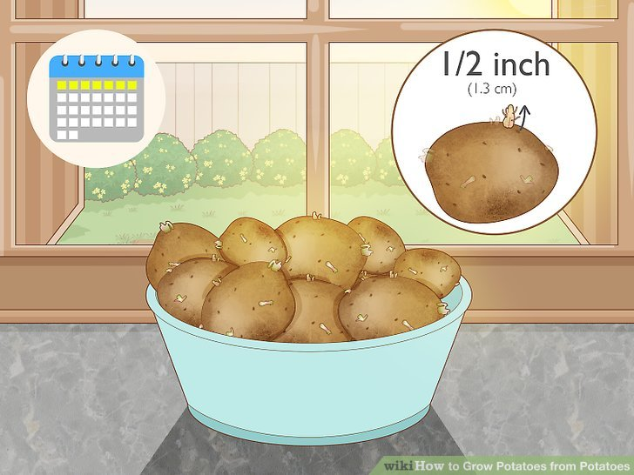
Notes:
3
Allow sprouts to grow for 1 week before planting. Unlike most grocery store potatoes, seed potatoes grow little protuberances called sprouts. These sprouts, once planted, form the buds of new potato plants—they are essential to the growing process! Place your seed potatoes in any warm, dry spot (a bowl on your kitchen counter where the sun shines will do) and leave them for a week.^{[2]}One week is ample time for your sprouts to grow between ¹⁄₄ inch (0.64 cm) and ¹⁄₂ inch (1.3 cm) in length. That means they’re almost ready to be planted.

Slide 34
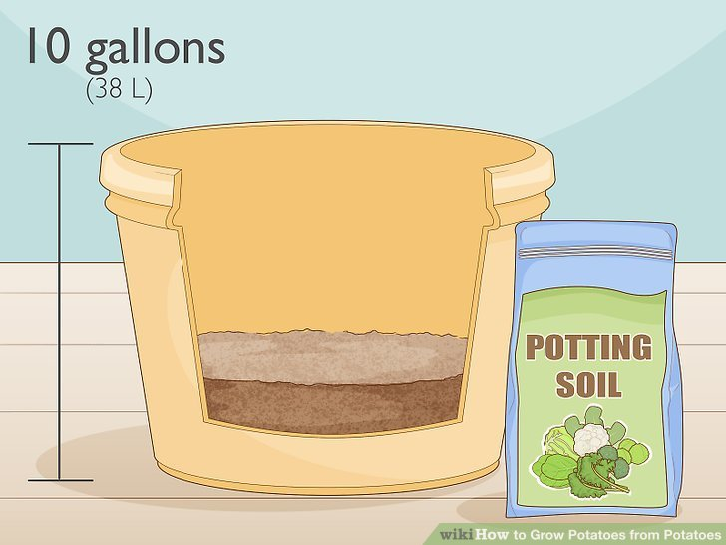
7. Plant a potato and watch it grow
Notes:
Fill 1/3 of a large, deep pot with potting soil. The bigger the pot, the better (potatoes need lots of room to grow), but at a minimum it should be 10 gallons (38 L) for 4-6 seed potatoes. If you plan to grow more than 6 seed potatoes, go for a barrel-sized pot.^{[9]}Your pot will also need to contain a sizable drainage hole. Black reusable plastic pots from the garden store work well for growing potatoes, as the black color holds in warmth and the bottoms have built-in drainage.

Slide 35
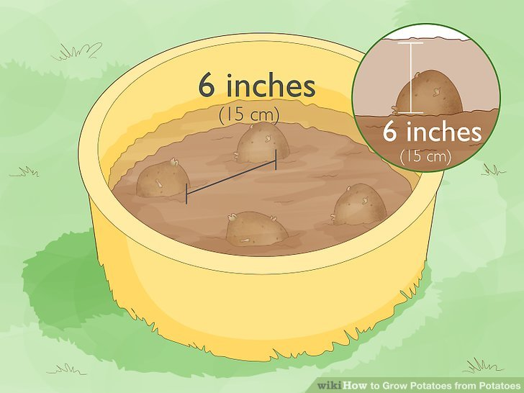
Notes:
Plant seed potatoes 6 inches (15 cm) apart with sprouts face up. Your potatoes should not be touching each other or the edge of the pot or their growth will be stunted. Once planted, cover them with 6 inches (15 cm) of potting soil. Water until the liquid begins to drain from the bottom. Leave the pot in a sunny, temperate spot on your front or back deck, where it will be exposed to 6-8 hours of sunlight per day.^{[10]}Don’t overcrowd the pot: 6 inches (15 cm) is the minimum amount of space in which your potato can still grow.

Slide 36
Notes:
Choose a spot where the pot will get lots of sun

Slide 37
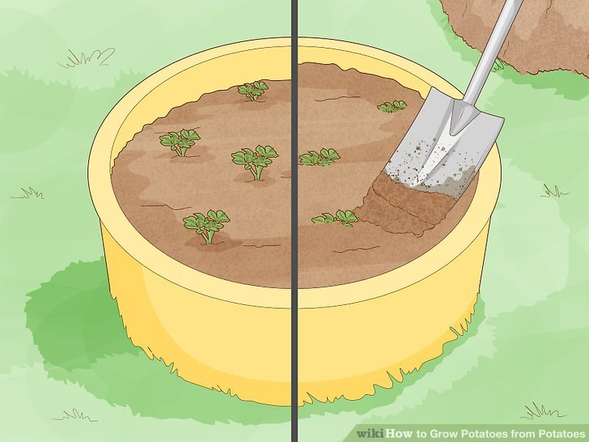
Notes:
Add potting soil as your potato sprouts shoot out of the soil. Only about 1 inch of the sprout should be exposed at any point in the growing process, so continue to add soil periodically. Mix your soil with fertilizer (a 5-10-10 commercial mixture from the garden store will do) for healthy, fast-growing plants.

Slide 38
Notes:
Harvest your potatoes when their leaves turn yellow. After 18-20 weeks your potted potatoes will reach maturity. Dig them out of the pot by hand or dump it out and root through the soil to harvest your tubers.^{[12]}Check the skin of each potato for white, mushy spots—these could signify fungus, in which case the potatoes are not safe to eat. They should be uniform in color with tight, firm skins.

Slide 39
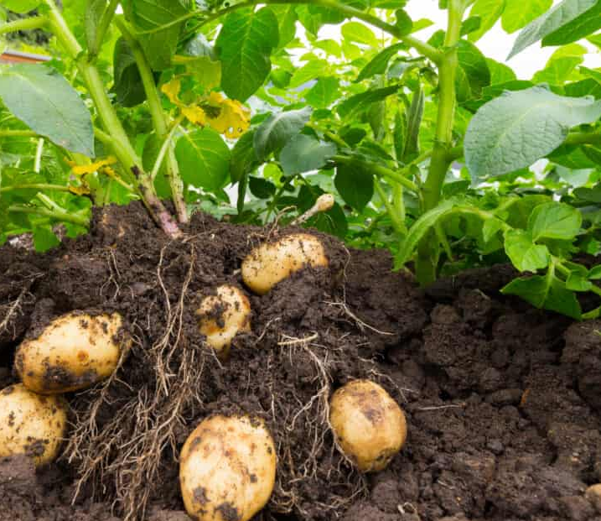
OR Help someone harvest potatoes.

Slide 40
Thanks for listening ☺

