Slide 1

Welcome Adventurers!!!

Slide 2
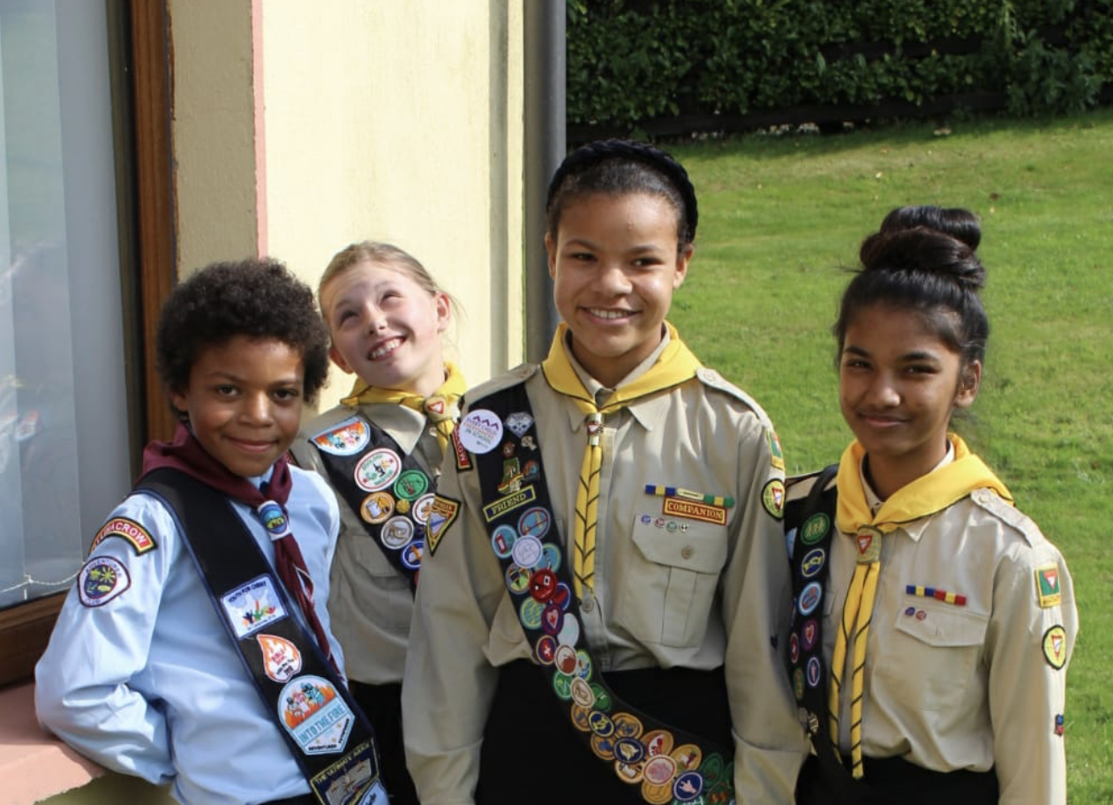
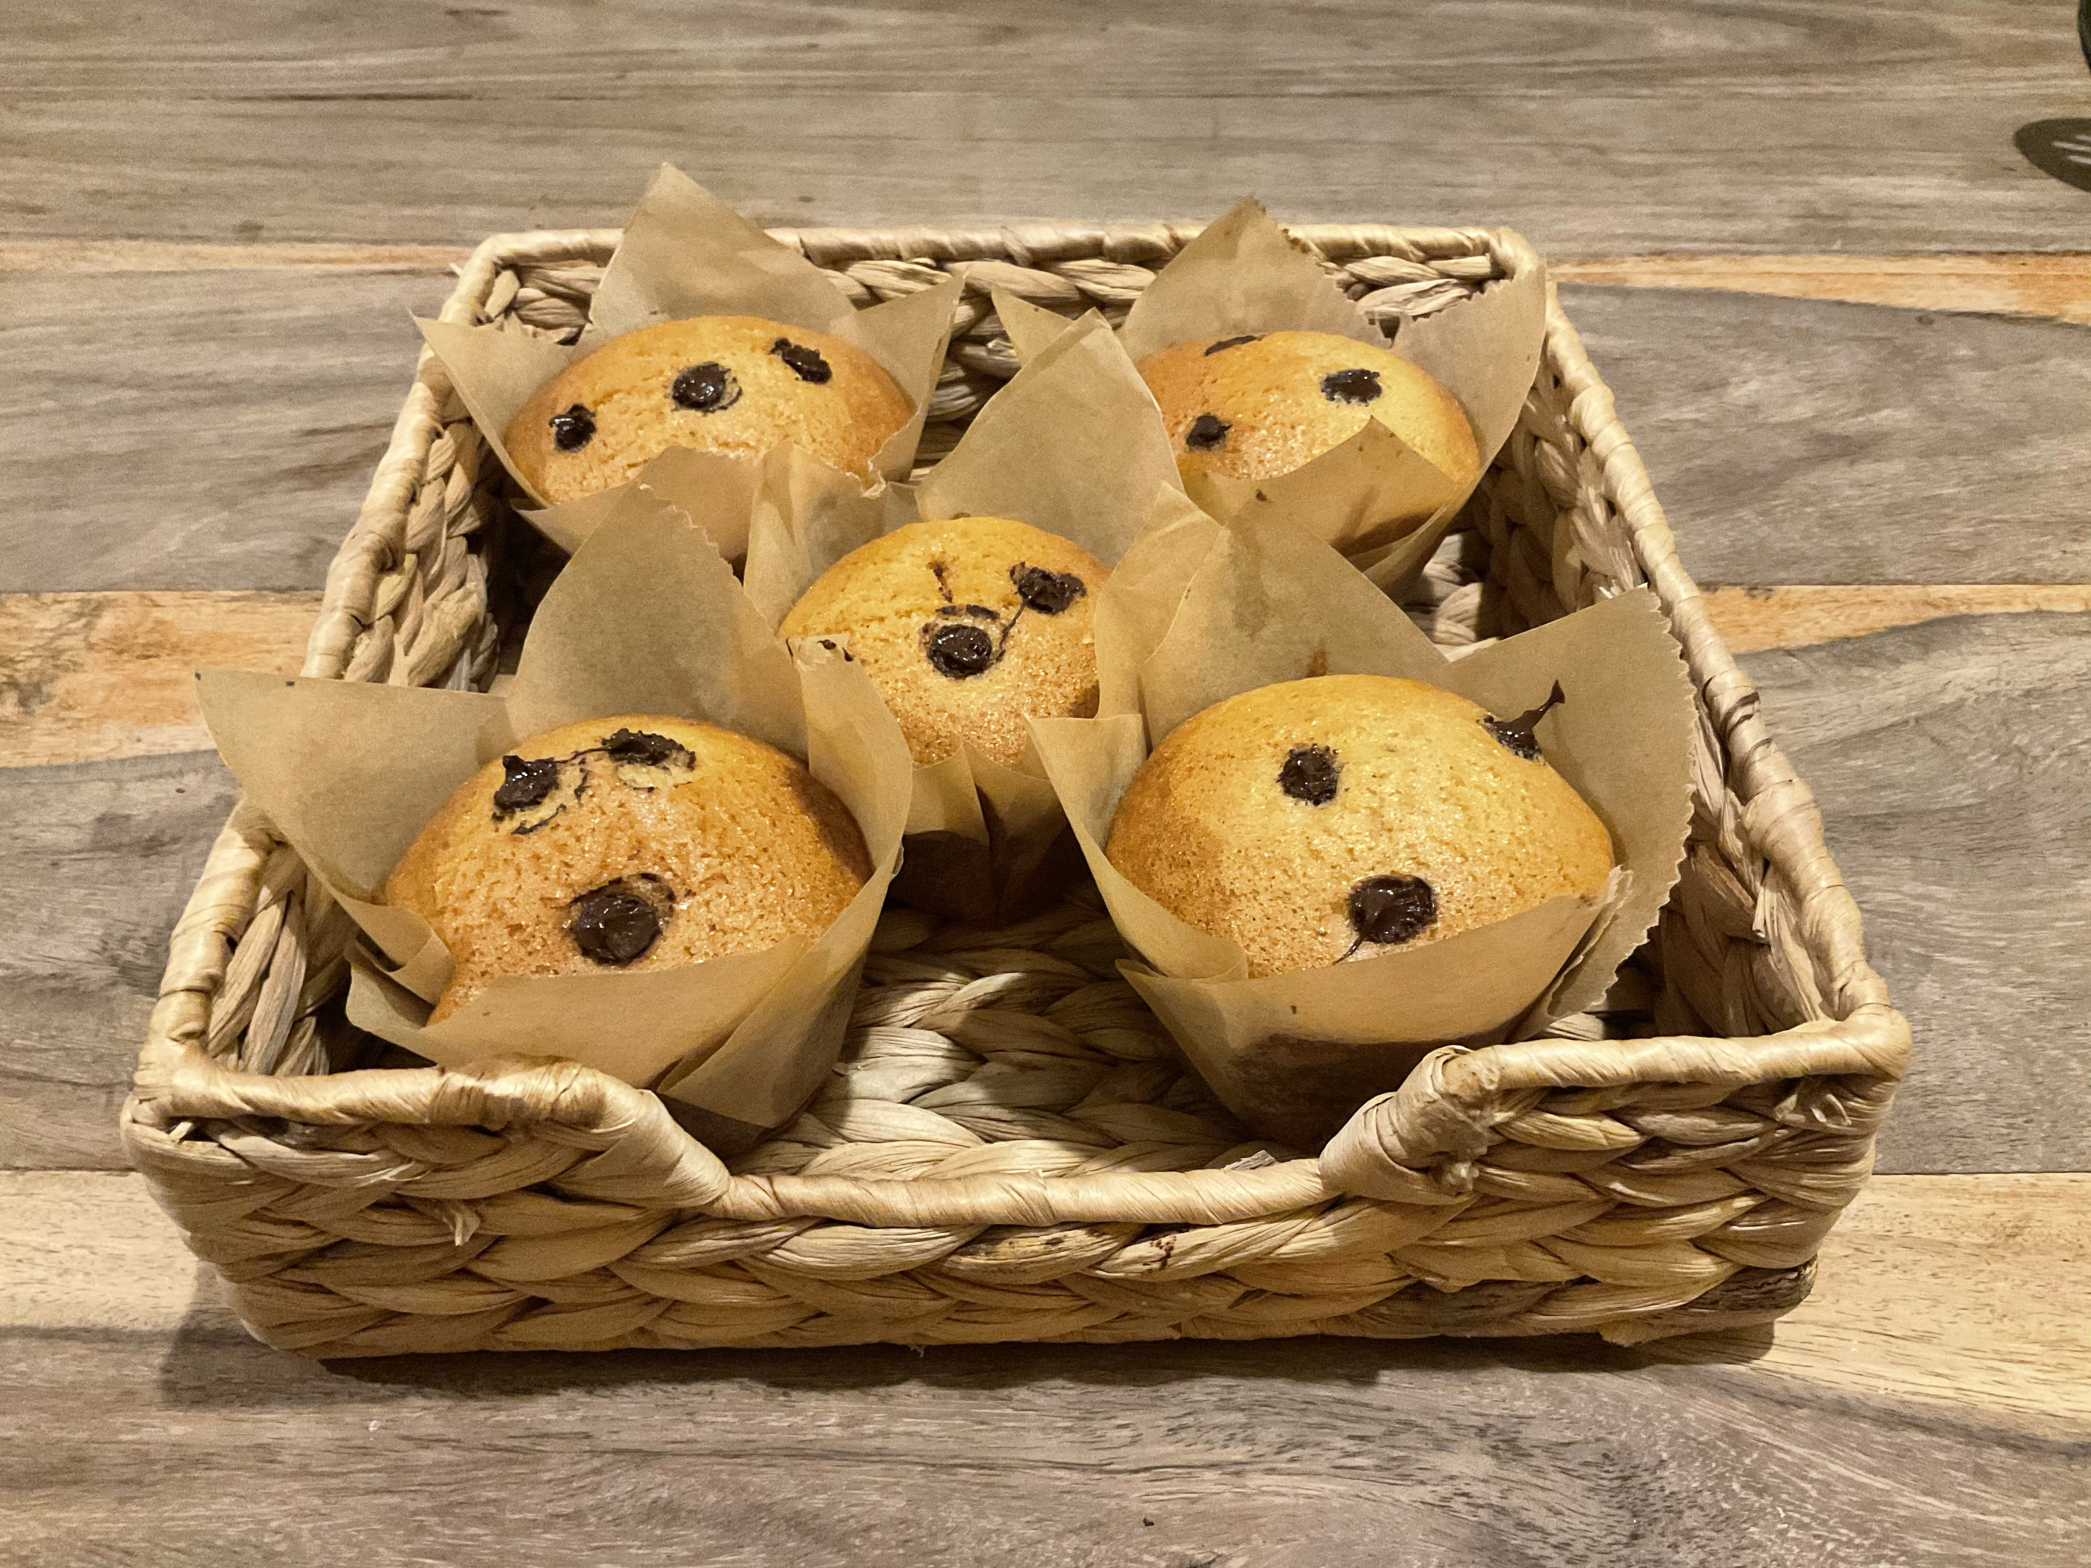
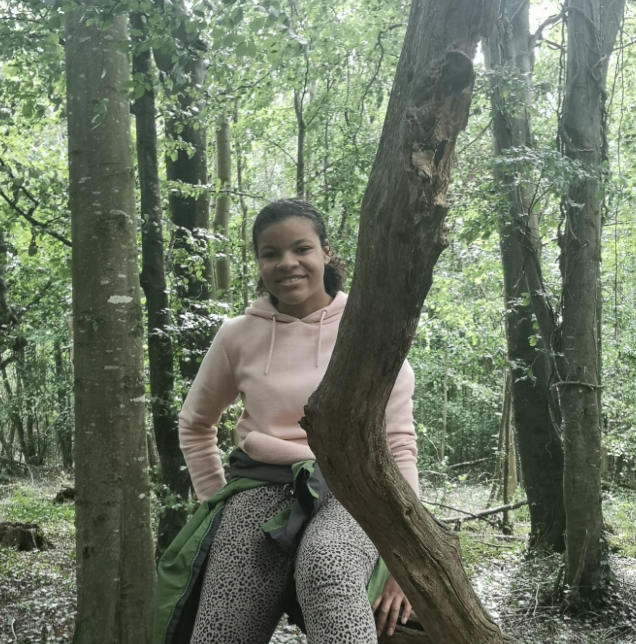
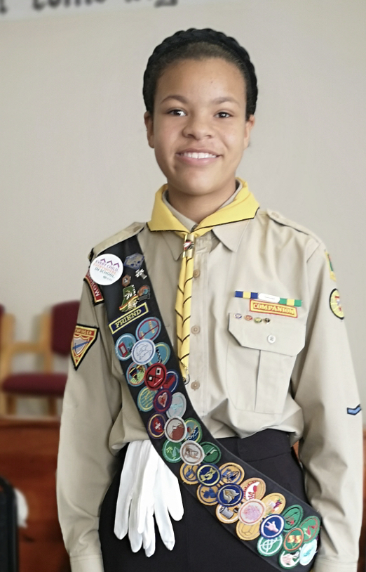
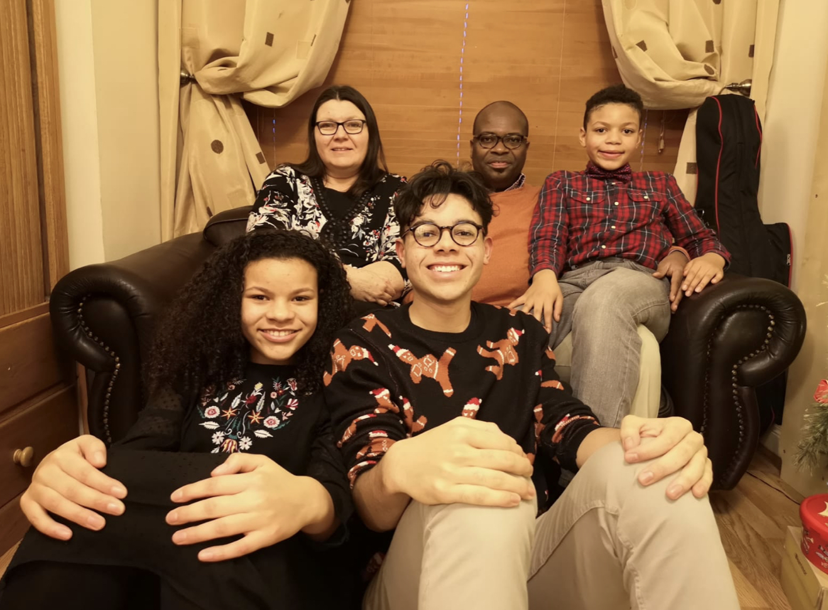

A little bit about me!!!

Slide 3
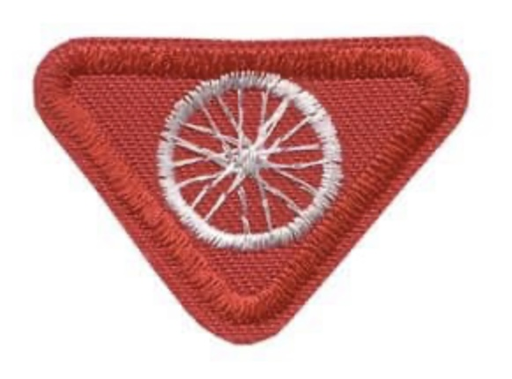
CYCLIST AWARD
Grace Ellis Gbessia

Slide 4
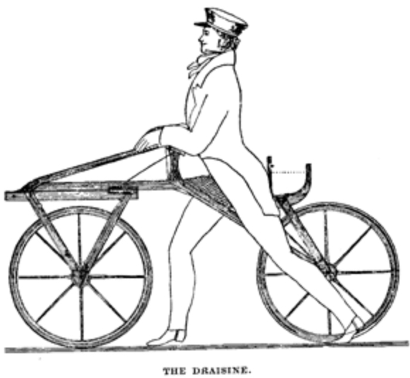
The Draisine
Karl Von Drais , who was a German baron created the “draisine” in 1817 it was made of wood and it had no pedals. You had to push it along with your feet! Yikes! At least it was still an improvement from travel by foot. The Draisine however was just a fad and the craze soon died out!!

Slide 5
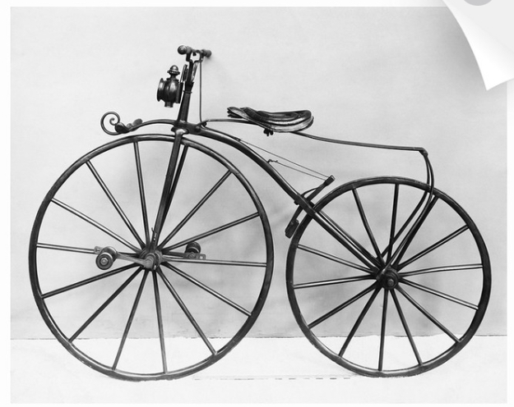
The Bone shaker
The bone shaker was first developed in France in 1860 by Pierre Michaux, Pierre Lallement, and the Olivier brothers. This bike had pedals but was dubbed the Boneshaker because of its steel wheels which meant it boasted a bumpy ride!!!

Slide 6
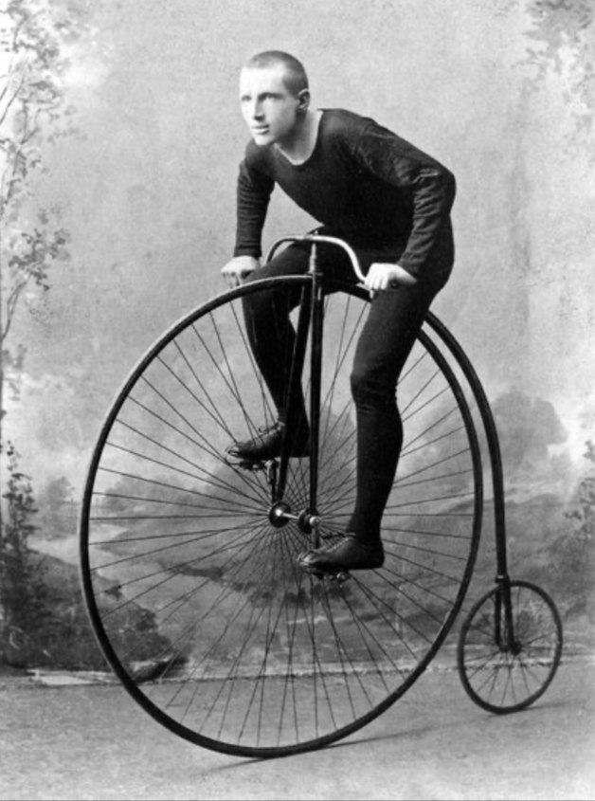
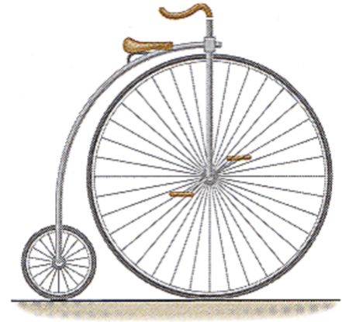
The penny-farthing
James Starley in England created a model with a much larger front wheel to increase stability . This was very popular in 1870s and 80s. Unfortunately though, since it was very high it was dangerous to mount and to ride. If you fell it was a loooong way down!!!

Slide 7
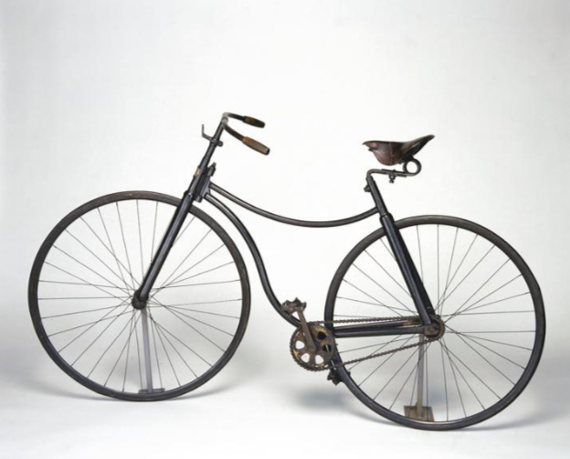
The Safety bike
Finally in 1885 the Englishman John Starley— James starley’s nephew— created the safety bike. This bike was much more comfortable to ride but was a whole lot safer. This bike is a whole lot similar to the bikes we have today but it still went through lots of changes!!

Slide 8
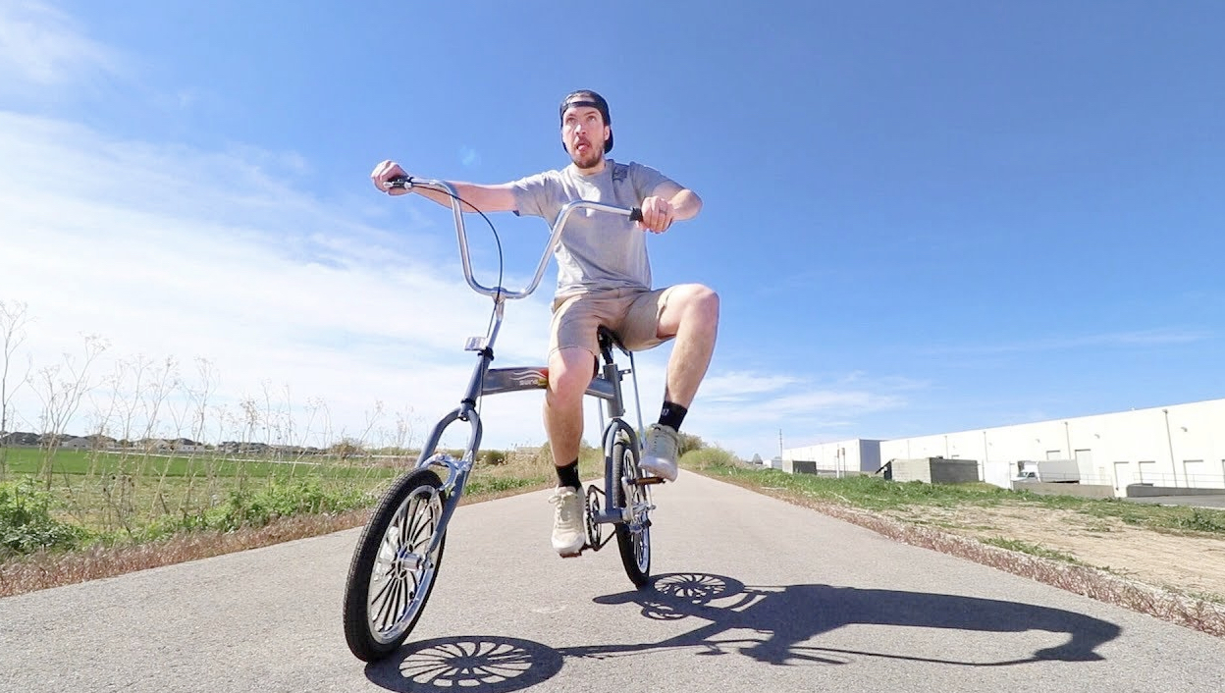
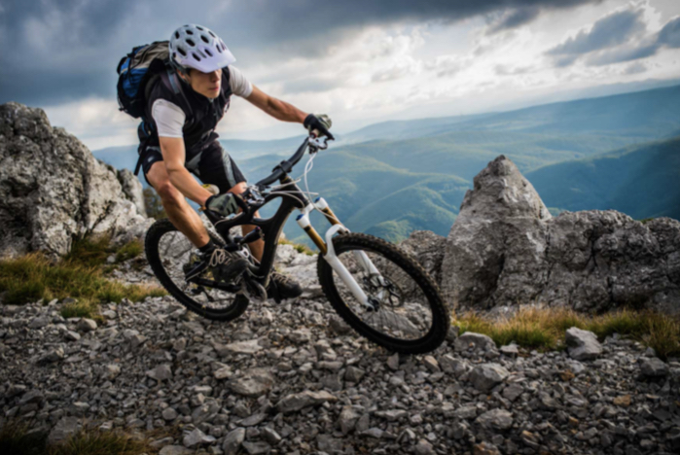
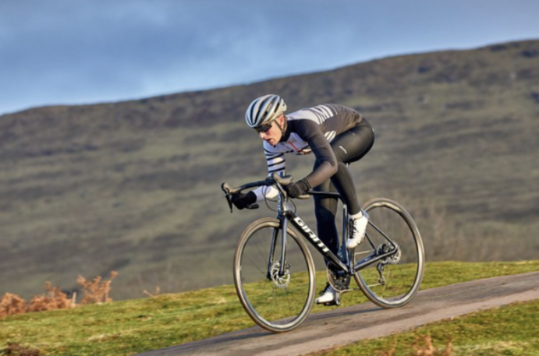
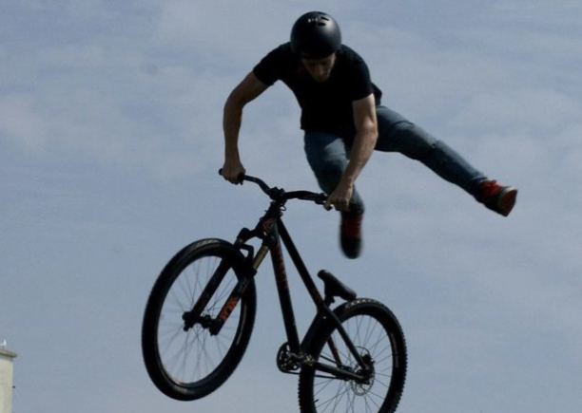
Bikes today!!
Today we have a variety of bikes to choose from, like racing bikes, mountain bikes, and bmx bikes. Bikes are a lot of fun and they continue to change. But boy, have they had a shaky history!!!

Slide 9
Requirements
Earn the Road Safety award.
Demonstrate: how to keep a bike clean, how to safely ride a bike,use hand signals while riding, how to take care of a bike.
Participate in a bike activity.
Do a five-mile bike ride.
Make a map of where you went.
With your family, use your map to retrace your route.

Slide 10
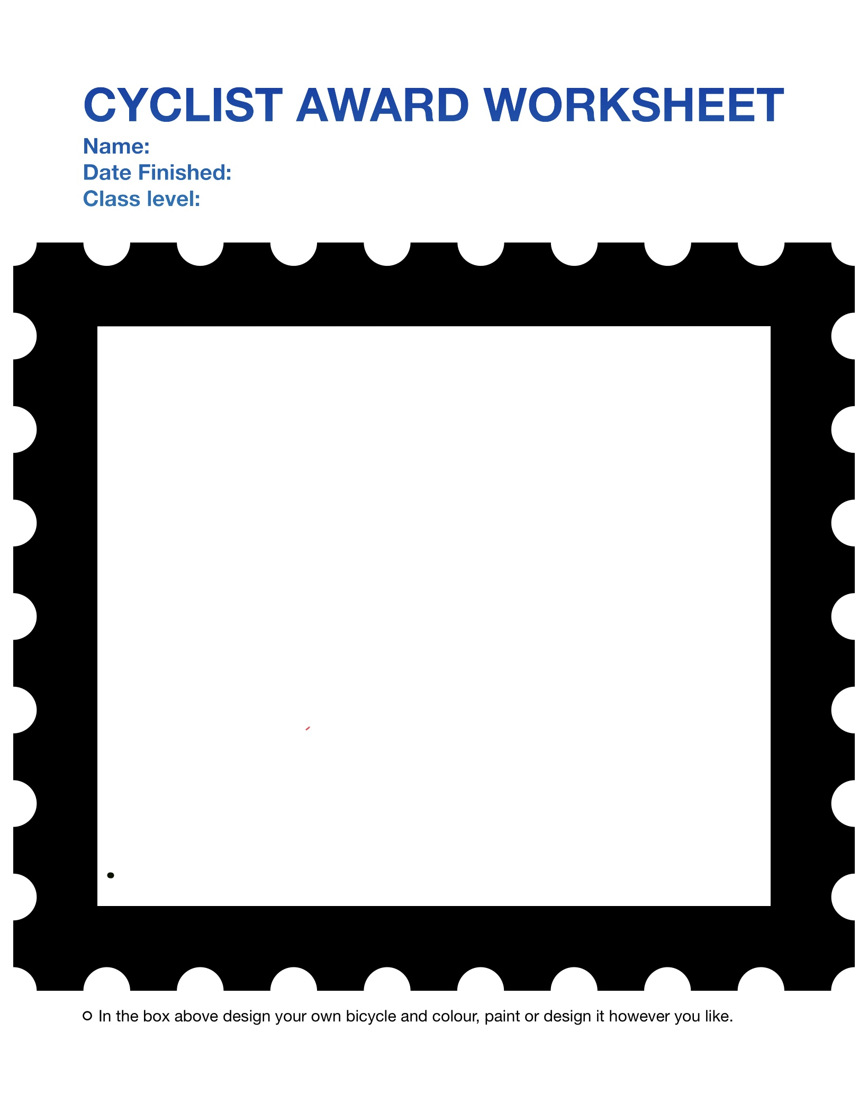
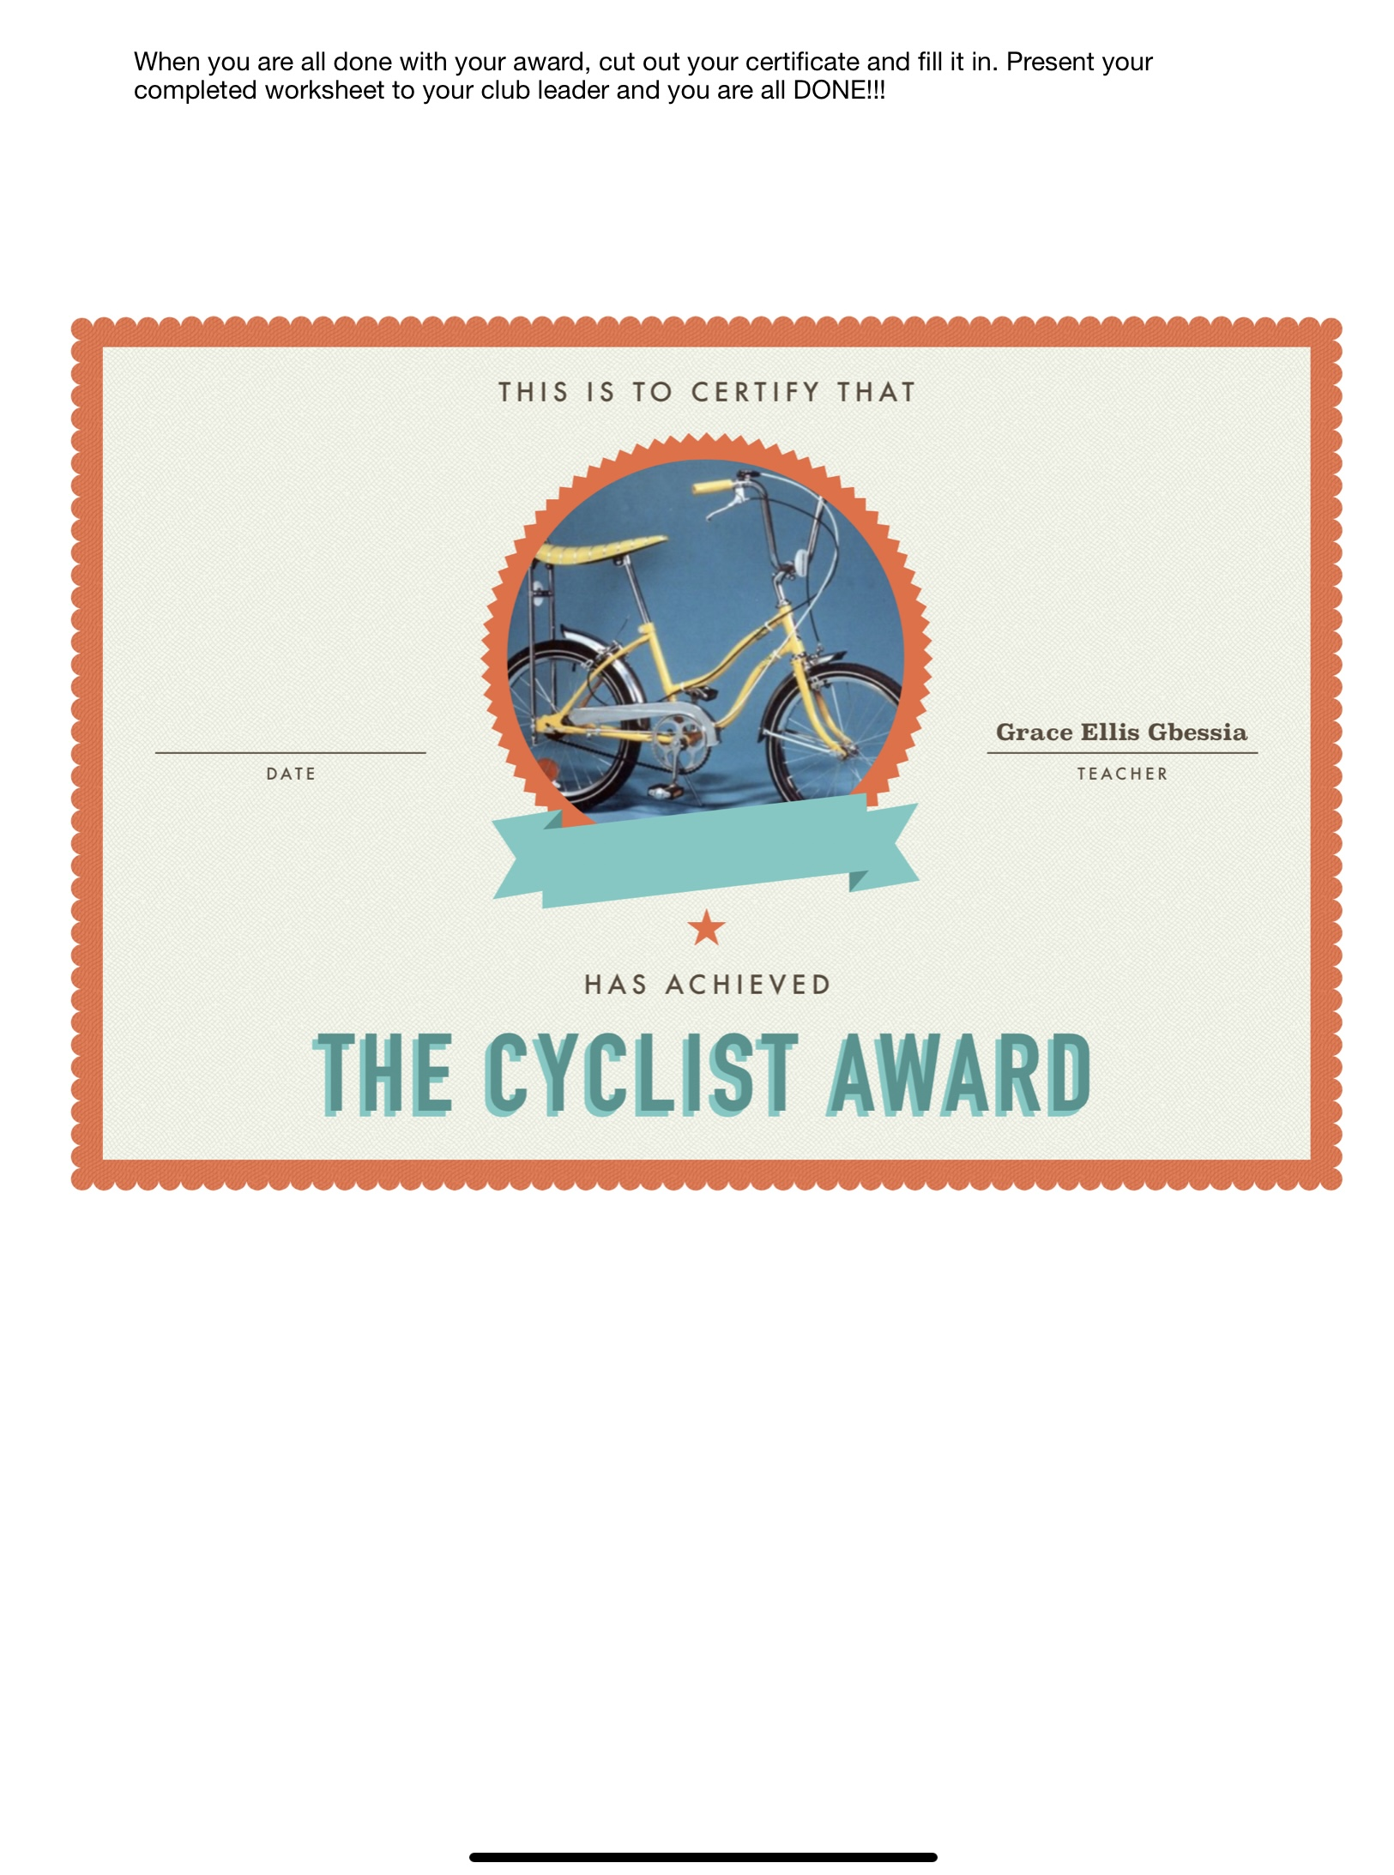
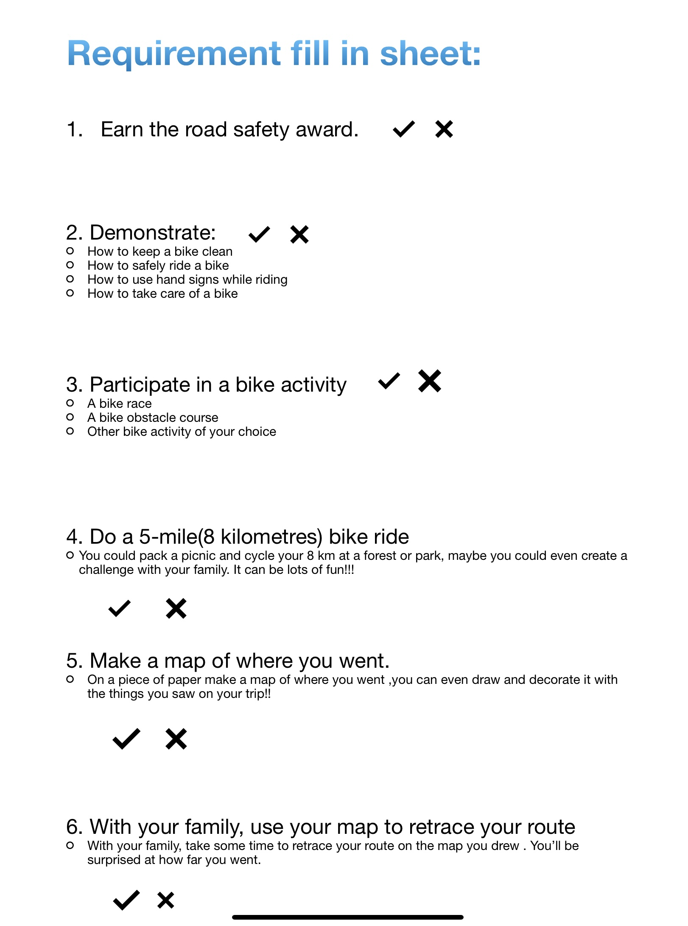

Slide 11
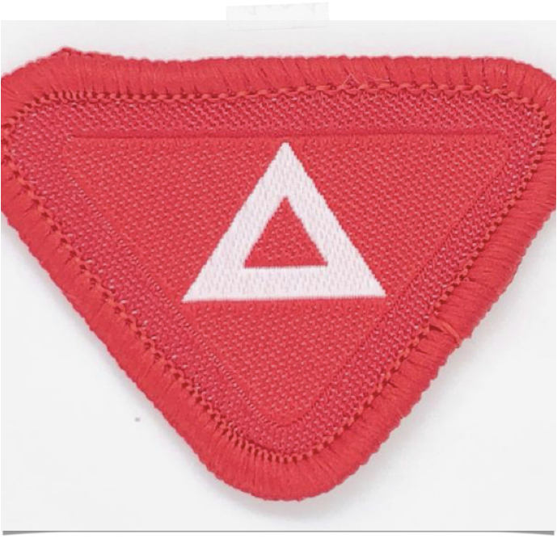
1. Earn the road safety award
When riding our bikes anywhere it is important that we know proper road safety.
This way we will stay safe and keep others safe too.
https://youtu.be/nafARvmAVXw
Watch the road safety award at the link above.

Slide 12
2. A few things to recognise and demonstrate.
How to keep a bike clean
How to safely ride a bike
How to use hand signals while riding
How to take care of a bike

Slide 13
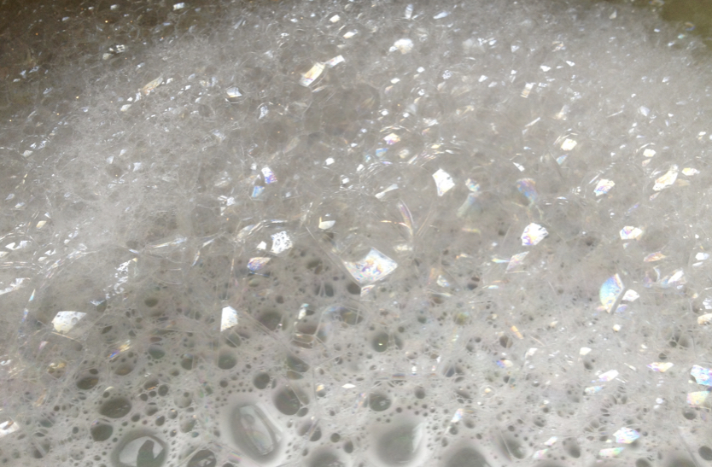
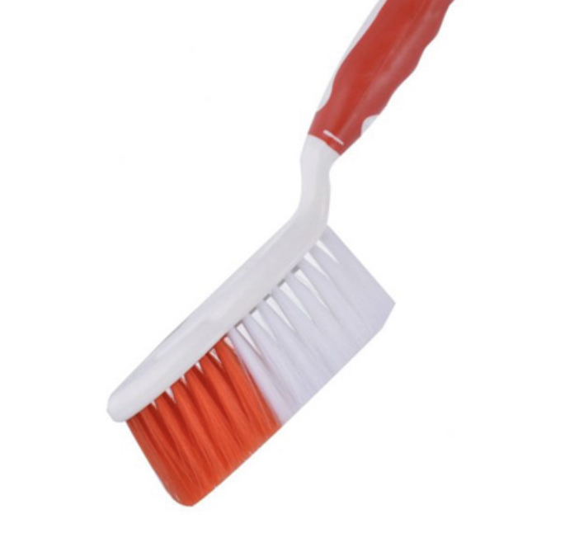
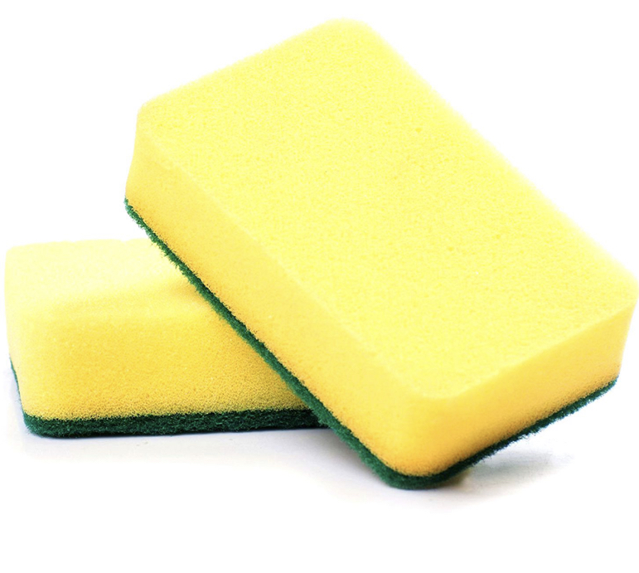
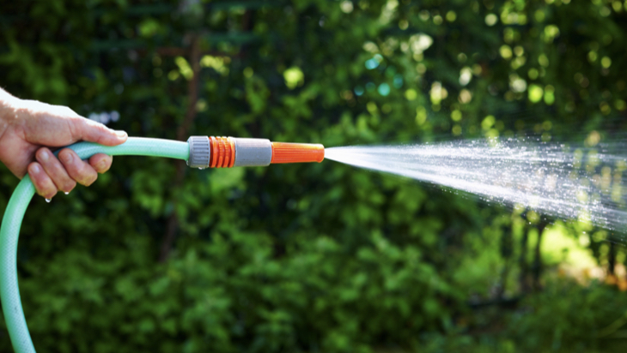
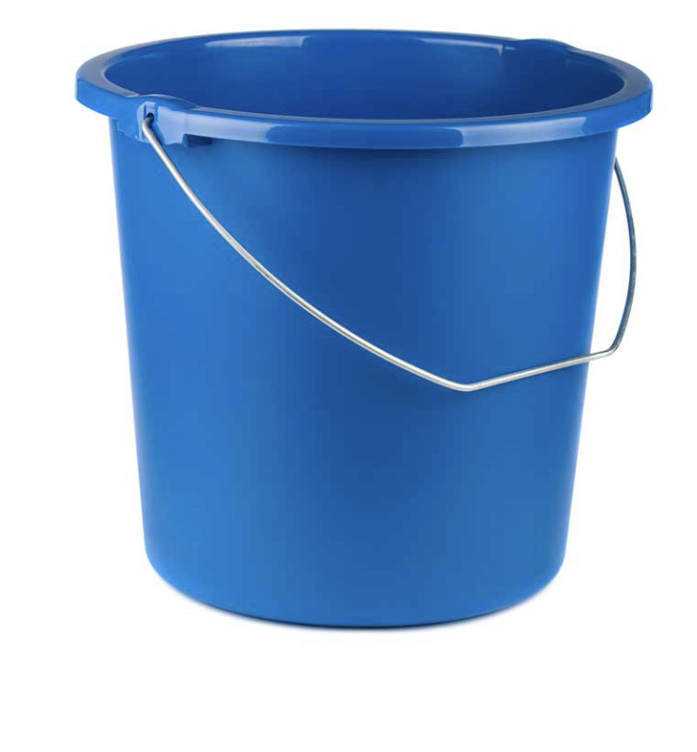
A. How to keep your bike clean
warm soapy water
A sponge
An old brush
A bucket
A cloth
A hose or large bottle

Slide 14
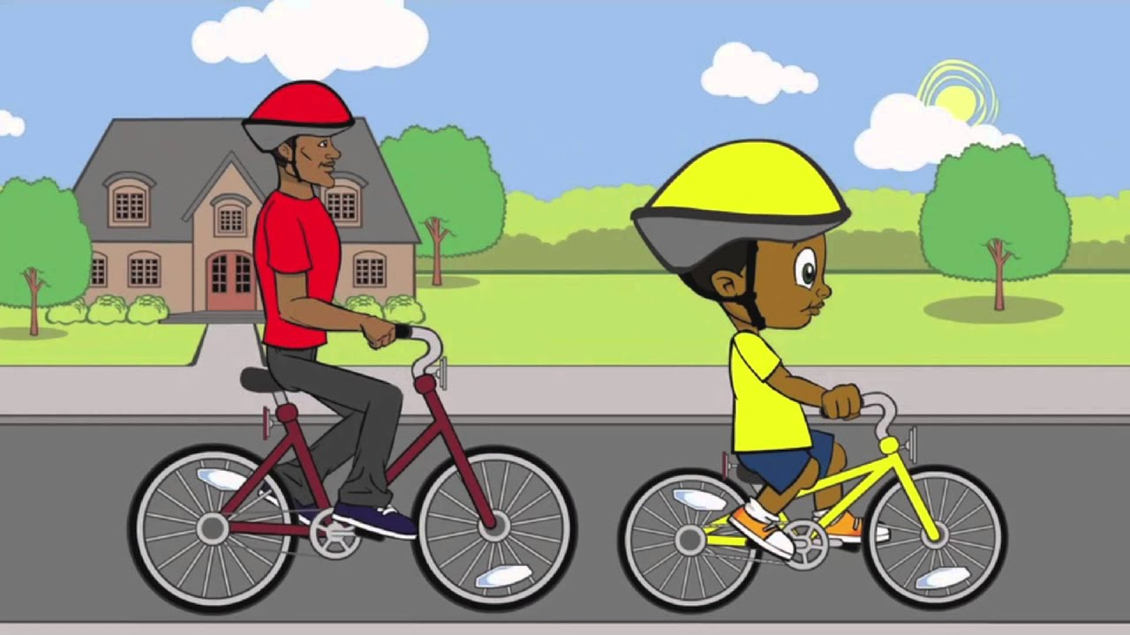
B. How to ride your bike safely
Go on your bike ride with your parent or older sibling and let them observe how you ride your bike safely and follow the rules. If you want they could take pictures and include it your worksheet.

Slide 15
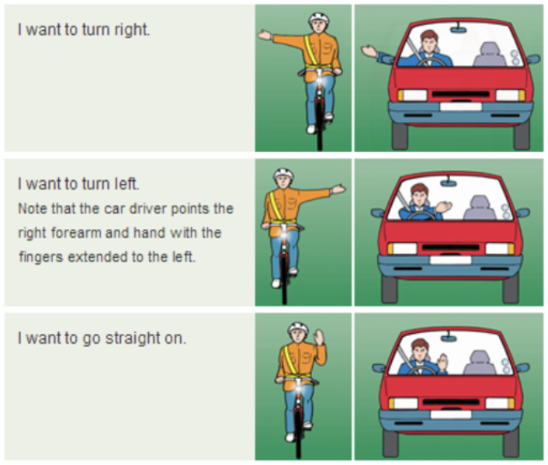
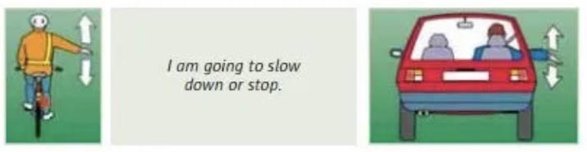
C. How to use hand signals while riding
Ask your mom or dad to help you and see how well you can do them.
Practice them and make sure you know them before going on your next cycle.
Have your mom or dad take a picture of you demonstrating your hand signs and include them with your worksheet.

Slide 16
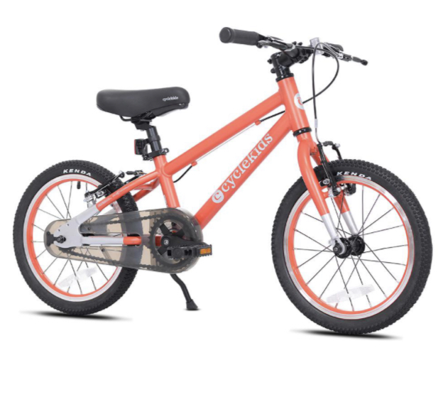
D. How to take care of a bike
Keep the bike clean
Protect the bike from weather
Make sure there is nothing wrong with your bike before you ride it.
Handle with respect

Slide 17
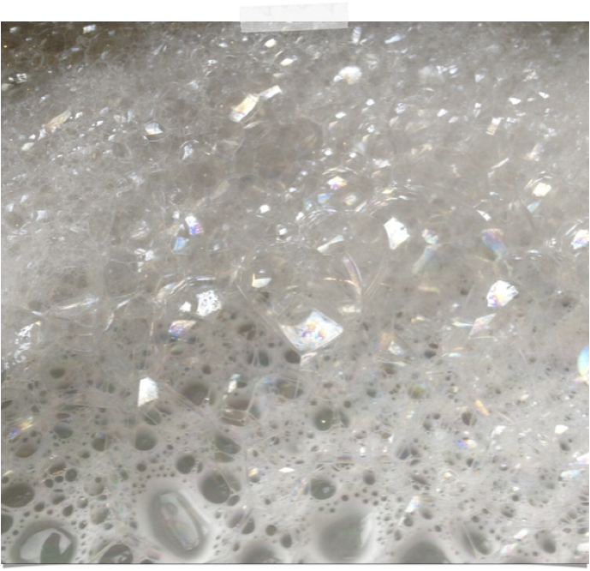
Keep the bike clean
Wash it when it is dirty!! You can do it when you come back from a long ride and you want to keep your bike clean and fresh.

Slide 18
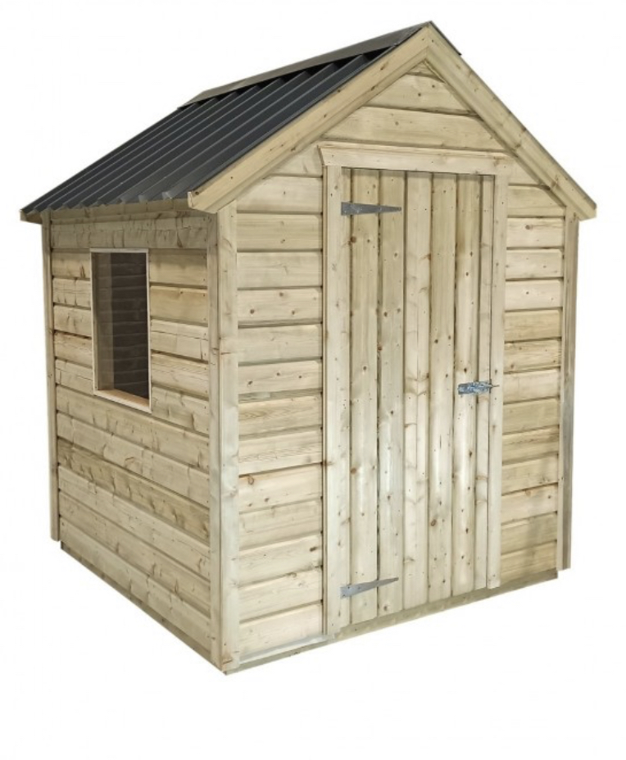
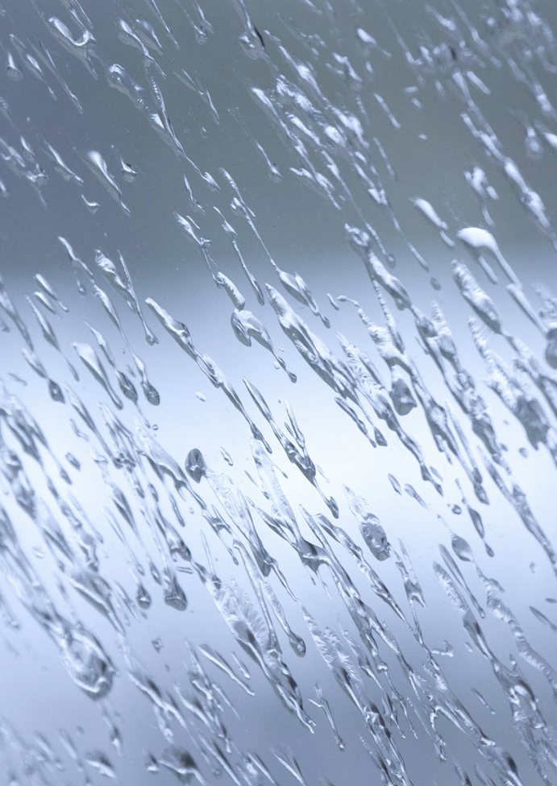
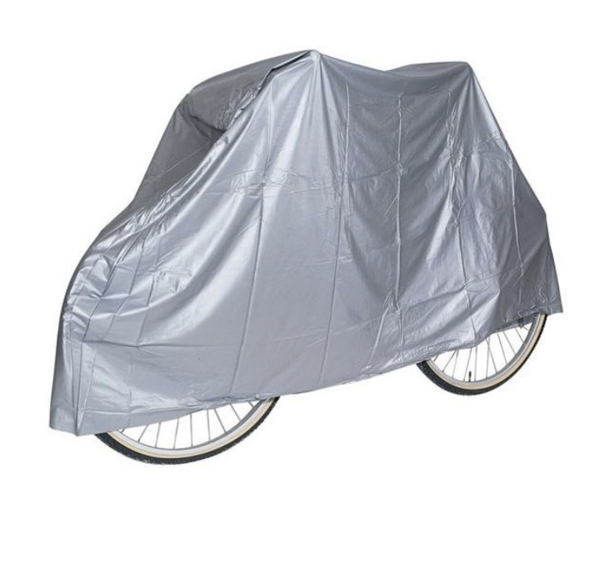
Protect the bike from bad weather!!
You don’t want your bike to be destroyed by snow, rain or wind, or hail make sure to put your bike in a protected area. You could leave it in a shed or under a bike cover. You can get bike covers at your local bike shop or on Amazon.

Slide 19
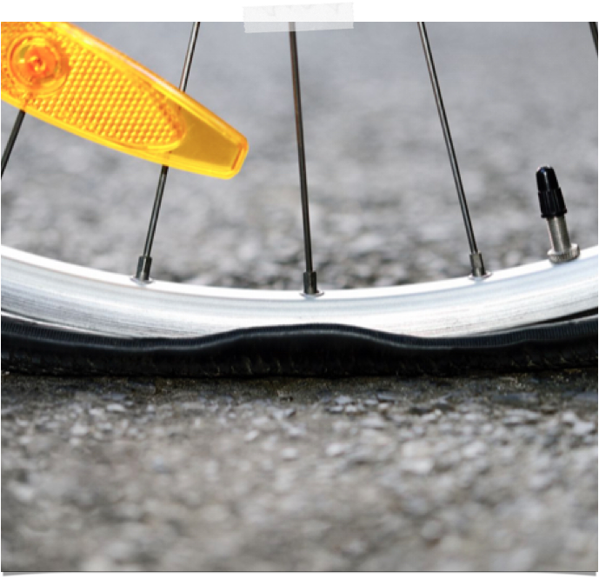
Make sure there is nothing wrong with your bike before you ride.
Before you cycle ask an adult to check if your tyres are pumped up and if the brakes are working . You shouldn’t ride if they aren’t.
You can even take your bike for a service every year to make sure it is running smoothly.
To prevent punctures, try not to ride on thorny areas or places with sharp rocks or broken glass, and try to avoid riding over curbs.

Slide 20
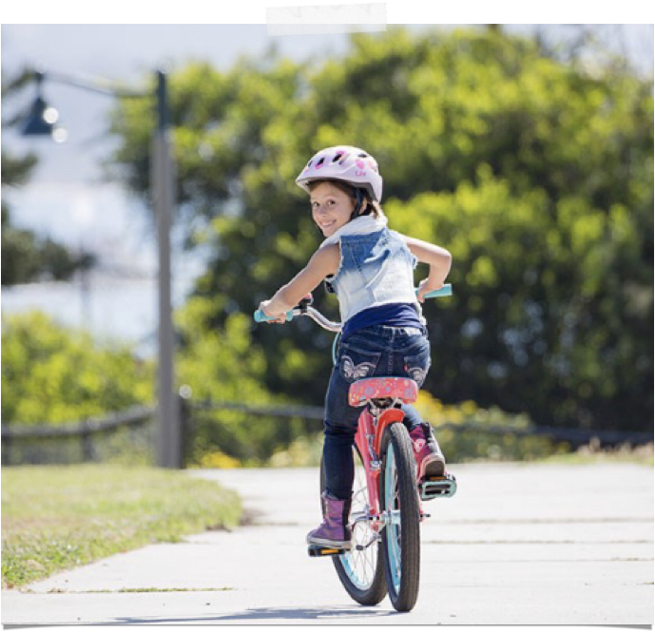
Handle with respect
Whether you got your bike for Christmas or for your birthday, you NEED to respect it!
Put your bike down gently
Don’t leave it out where it could get hit or stolen
Don’t throw it! This damages it!
Do use it in the proper way following the rules to have fun!!!

Slide 21
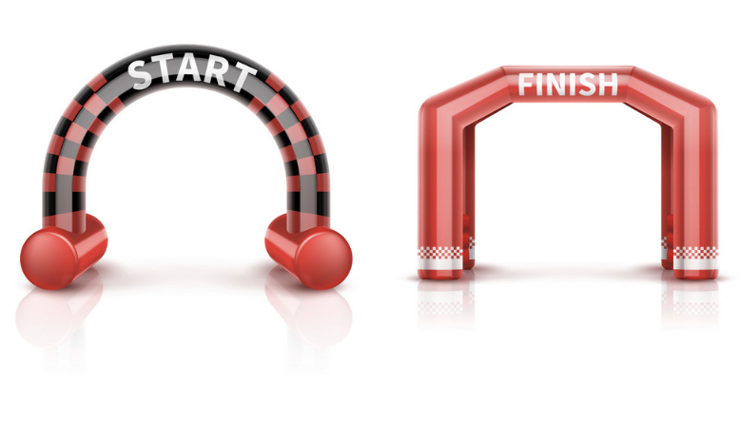
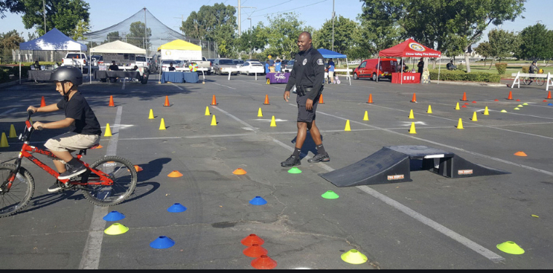
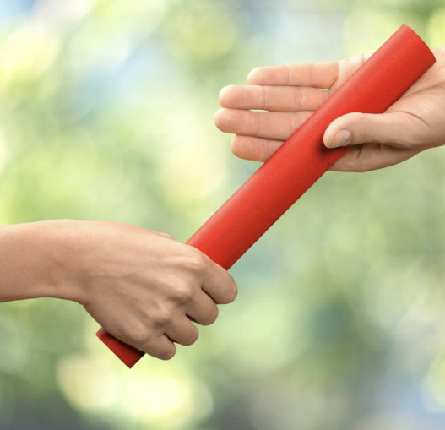
3. Participate in a bike activity
You can do this with your family and friends.
You can choose which activity you do but here are a few ideas!
A bike race or relay!
A bike obstacle course with cones, ramps, boxes etc.
You could even choose to do a bike hike!

Slide 22
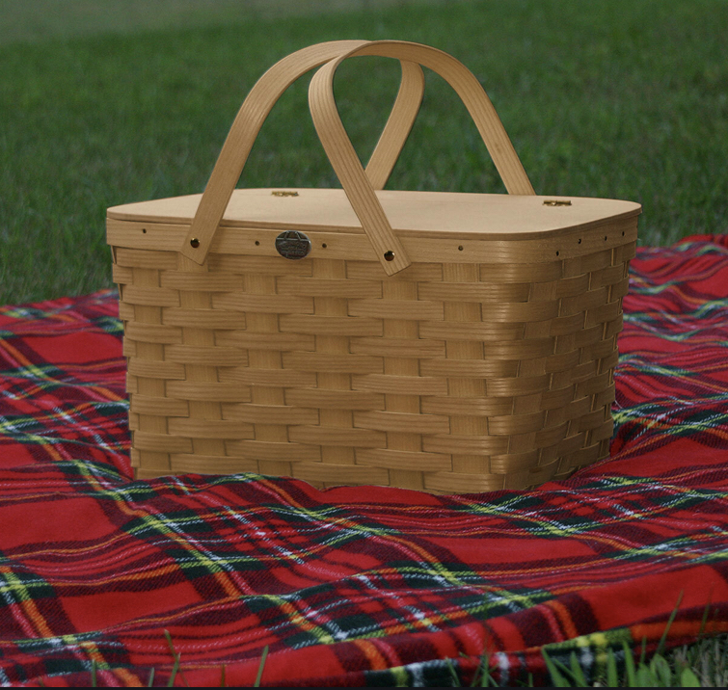
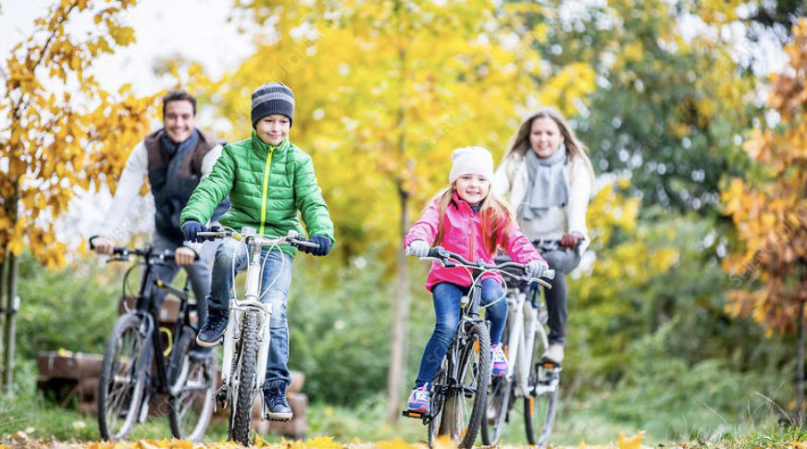
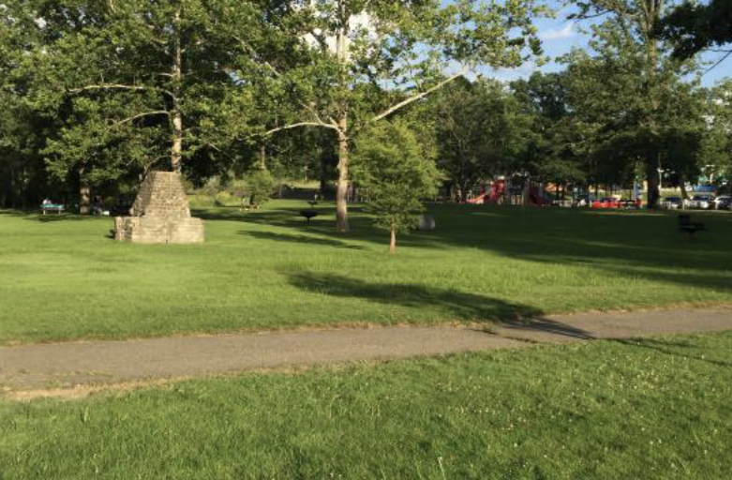
4. Do a five mile( 8km) bike ride
This can be a lot of fun!
You can pack a picnic and head out with your family to a forest or park to bike your 8 kilometres. You can make a day out of it. Cycle, stop to eat and enjoy the scenes around you.
At the end take a minute to think how far you’ve come!

Slide 23
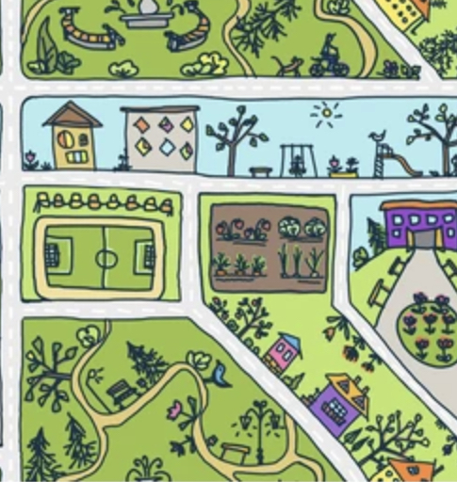
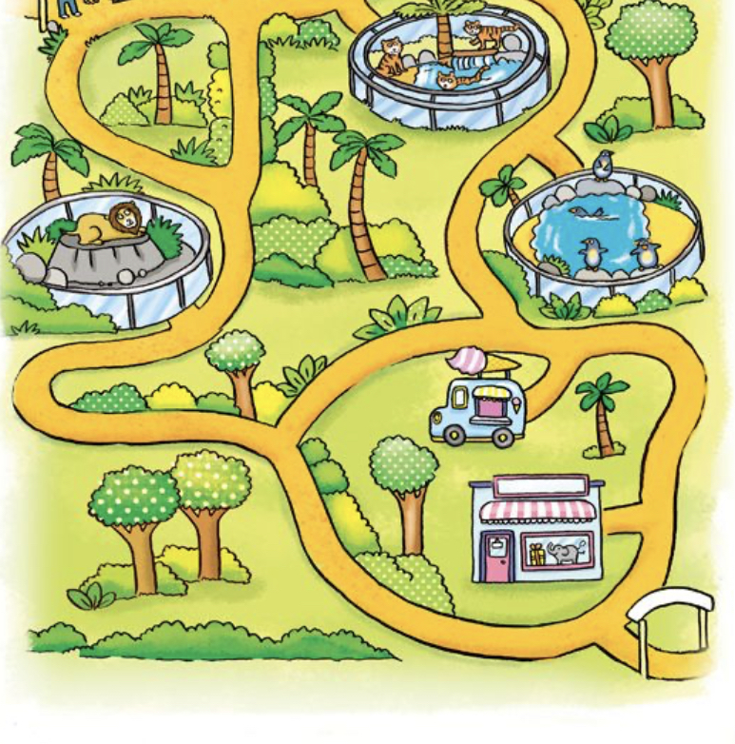
5. Make a map of where you went
This step can be a lot of fun.
When you get home, with your parent draw a map of where you went. You can decorate it, paint or even draw what you saw along the way.
Make it as creative as you like.

Slide 24
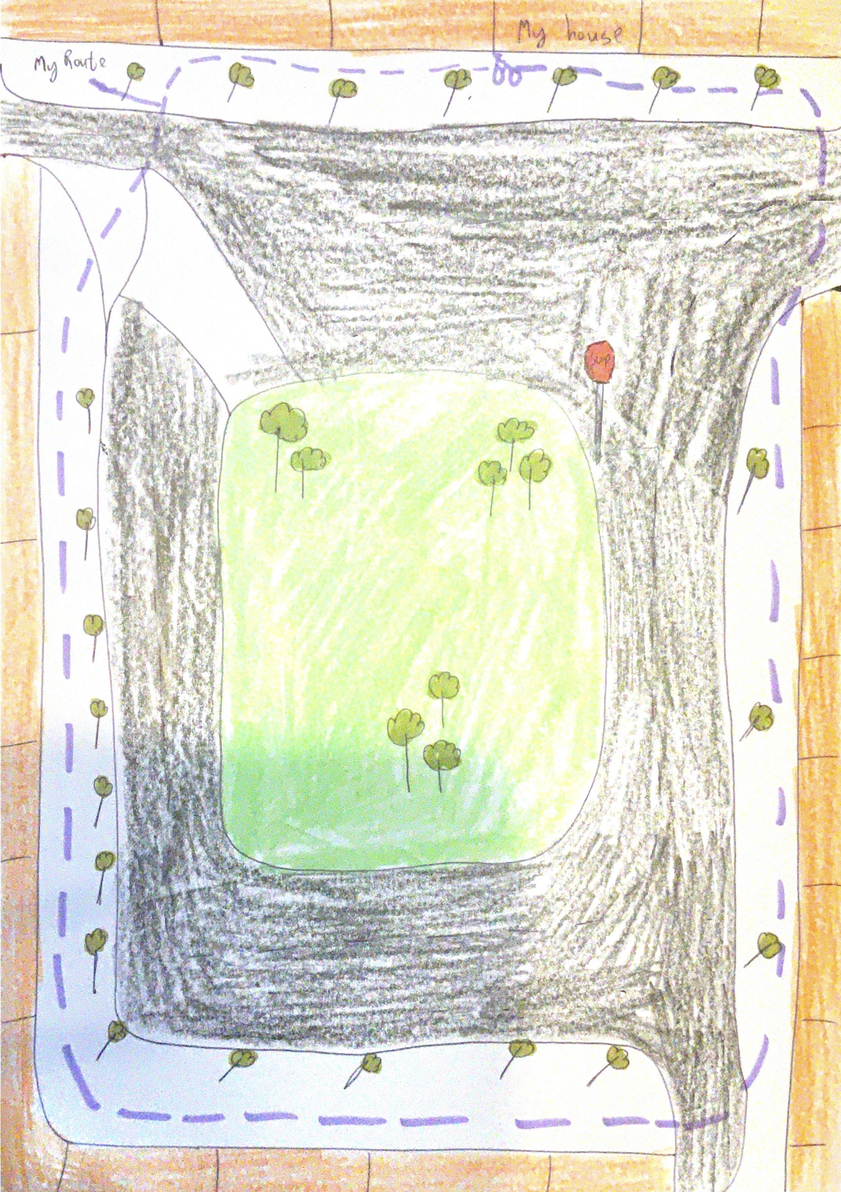
6. With your family use your map to retrace your route.
On the map you made, with the help of your family, see if you can retrace the route that you cycled!
You’ll be surprised at how far you went!!!

Slide 25
Your homework
Make sure to demonstrate how to keep your bike clean, how to ride safely, how to use hand signals and how to take care of a bike.
Make sure that you earn the road safety award
And complete the 5 mile ride activity
Your mom or dad can take pictures of your progress and you can include them with your worksheet.

Slide 26

You’re all finished!!
Once you have completed all your requirements fill in the certificate with your name under the picture and the date on the side. You can present your completed worksheet to your leader and You are all done!!

Slide 27
So what are you waiting for, get out there and cycle awaaaaay!!!
The end

