Slide 1
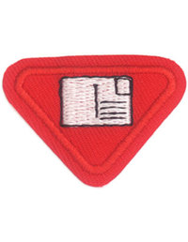
POSTCARDS AWARD
J.J. Martinez Jr.

Slide 2
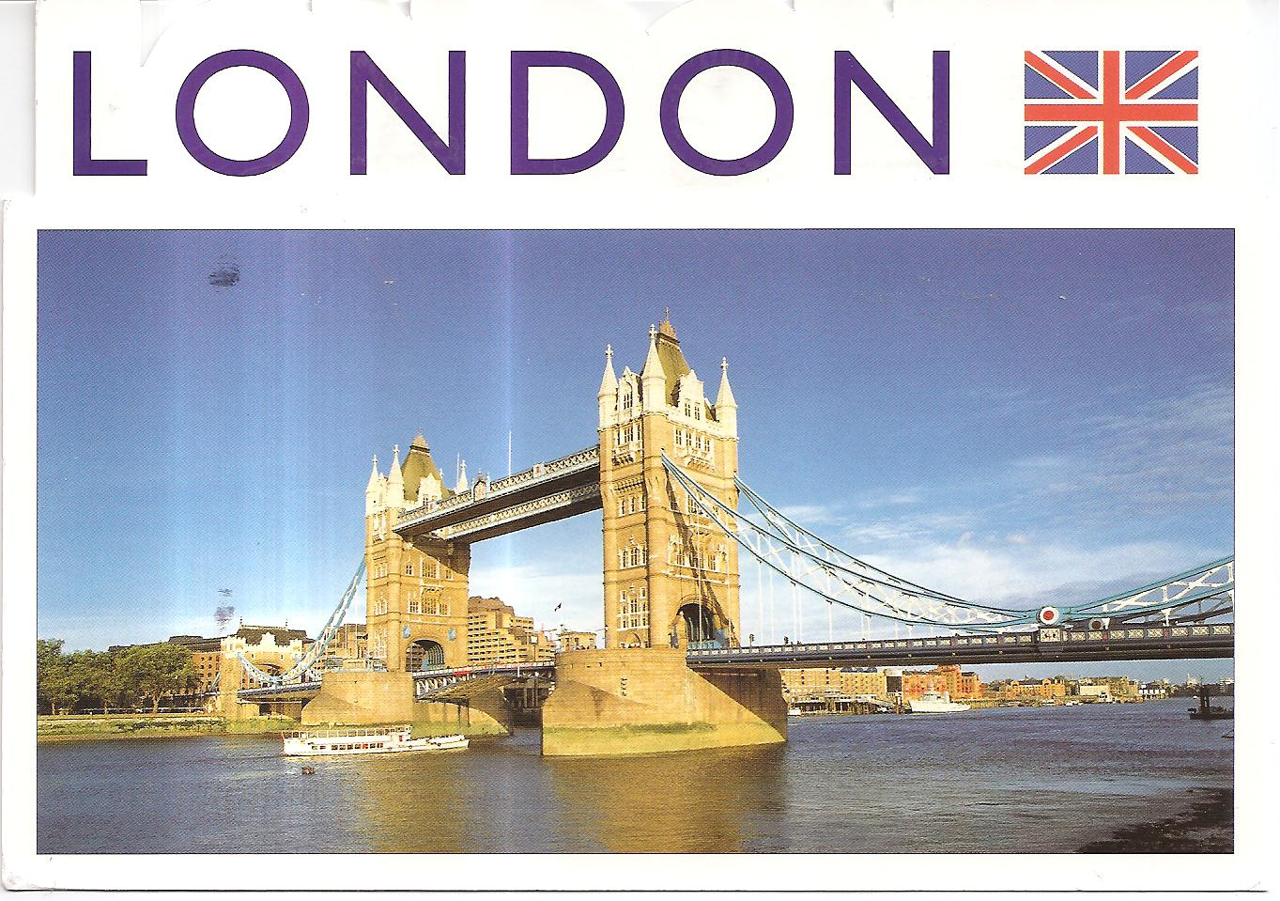
1 A. What is a postcard?
A postcard is a piece of thick paper or thin cardboard
Usually rectangular
used to write quick notes
no envelope!

Slide 3
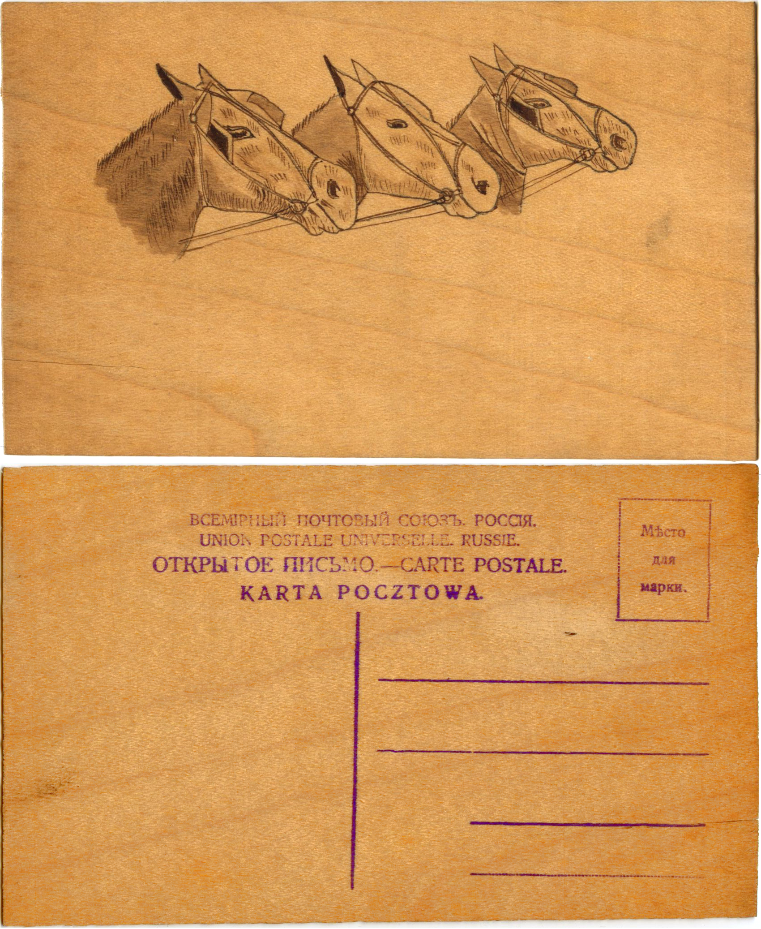
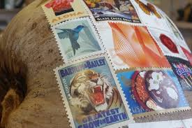
1 A. Types of postcards
Sometimes postcards are:
wooden postcards
copper postcards
coconut "postcards" from tropical islands. (https://en.wikipedia.org/wiki/Postcard)

Slide 4
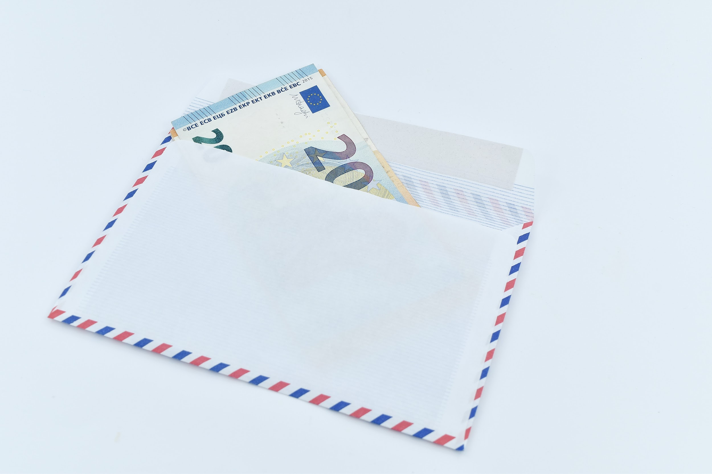
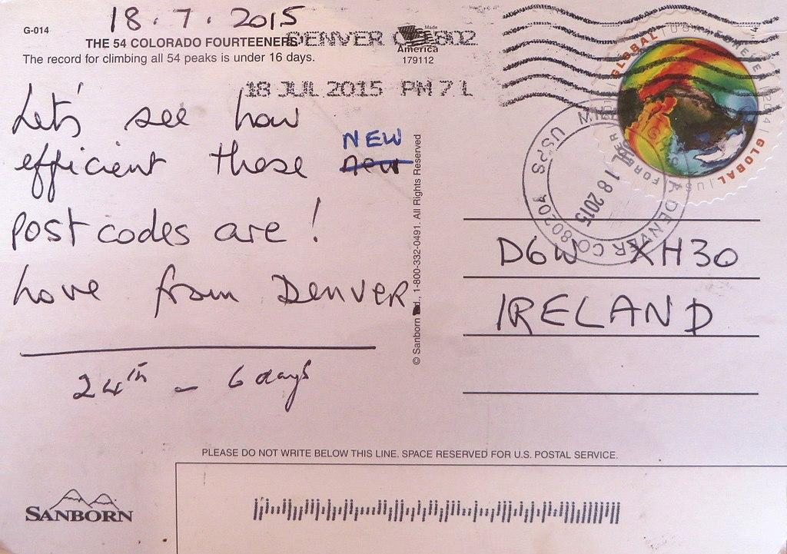
1 B. How is a postcard different from a letter?
Same: both send messages through the mail
Different: You open a letter; you don’t open a postcard!

Slide 5
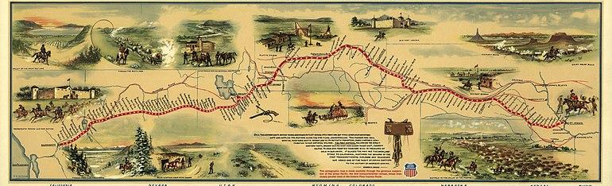
2. Tell about the Pony Express.
The Pony Express was a mail service delivering messages, newspapers, and mail using relays of horse-mounted riders that operated from April 3, 1860, to October 26, 1861, between Missouri and California in the United States of America.

Slide 6
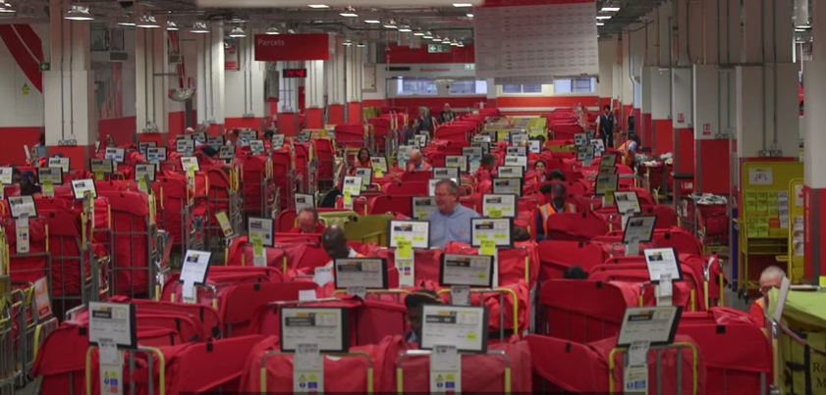
How does Mail Travel Now?
This video shows you how it travels!

Slide 7
2. Learn and tell someone three or four facts about postcards

Slide 8
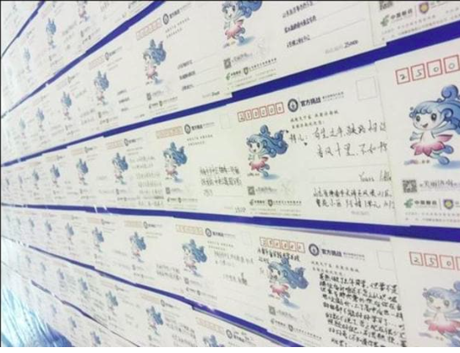
FACT -- The largest postcard 1,394 meters / 4,000 feet

Slide 9
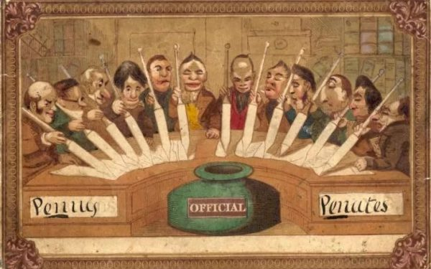
FACT -- The most expensive postcard
Penny Peanuts
(Value £31,759 = $45,000)
(first postcard ever)

Slide 10
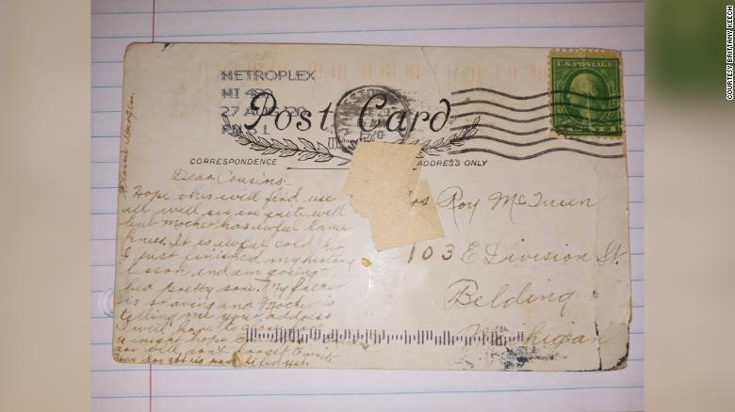
FACT -- Longest time for a postcard to arrive at its destination
100 years state of Michigan

Slide 11
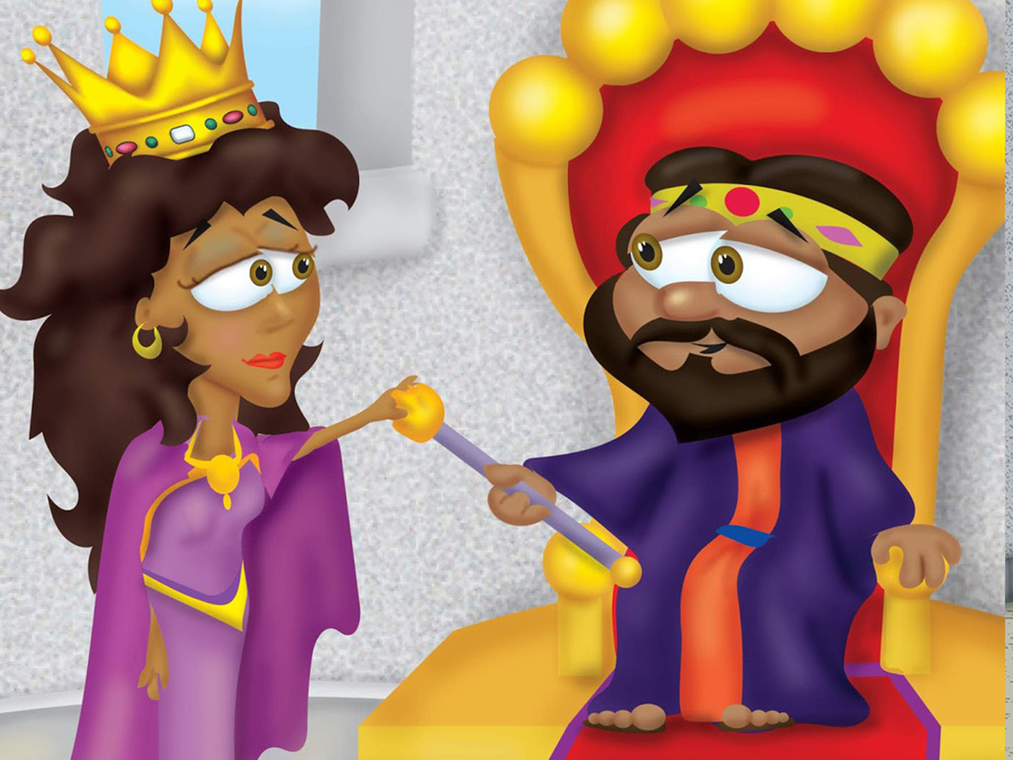
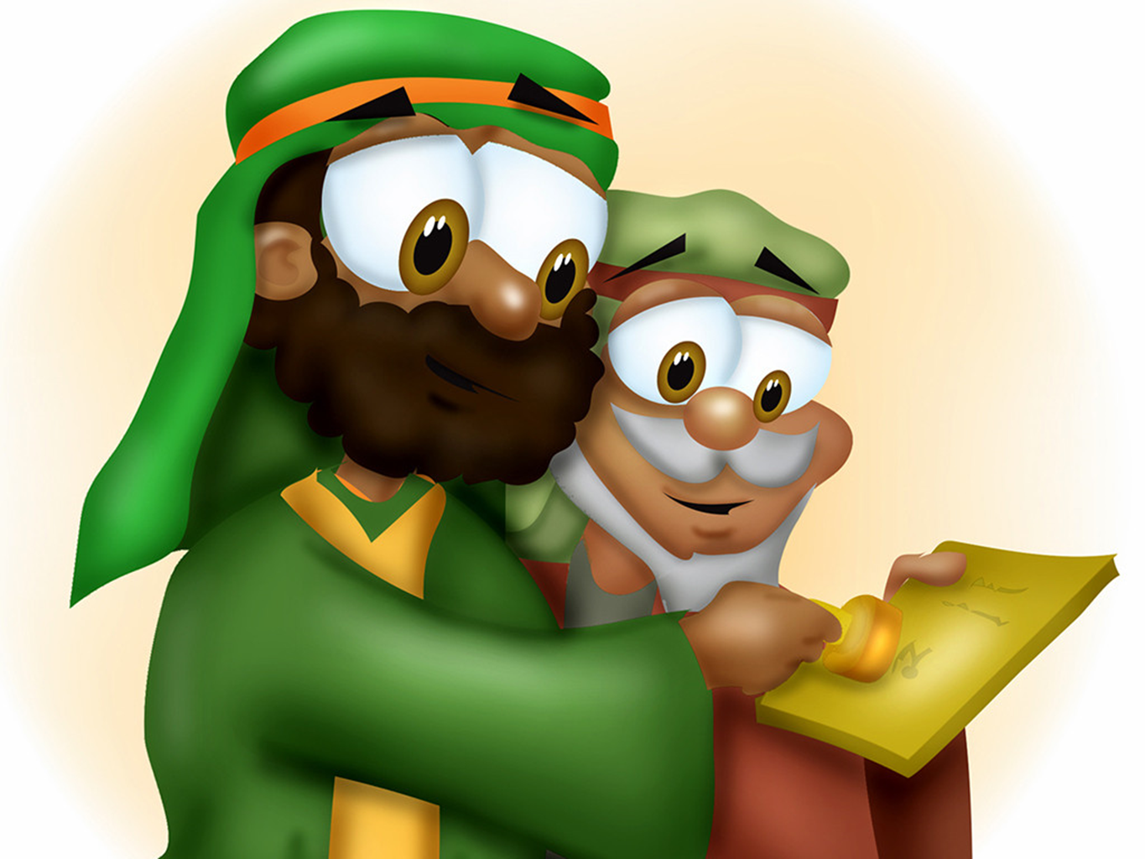
3 B Memorize the first part of Esther 3:13
“And the letters were sent by posts into all the king's provinces…”

Slide 12
4 A. How much did it cost to mail a postcard when it was first issued?
THEN
UK - Unknown
USA - 2 cents

Slide 13
4 B. How much does it cost to
send a postcard today?
Postcard UK prices: 66p Second class, 85p First class
Postcard US prices: 36 cents

Slide 14
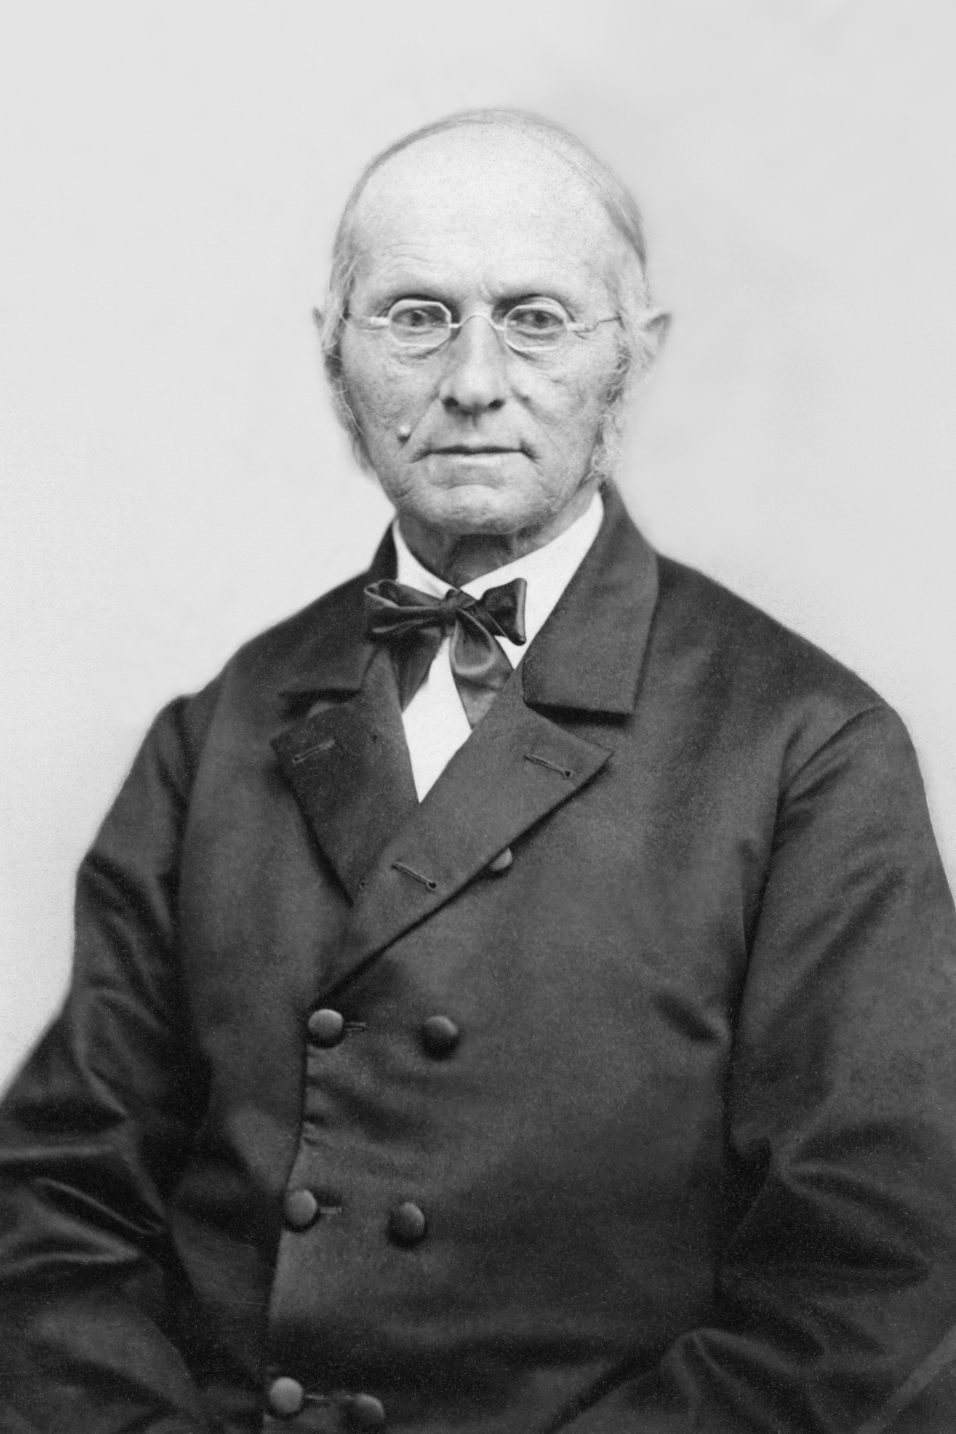
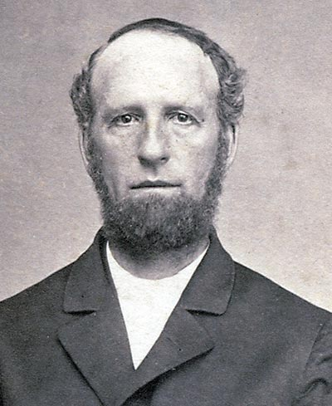
8. Learn the stories about Joseph Bates and James White’s visits to the post office.

Slide 15
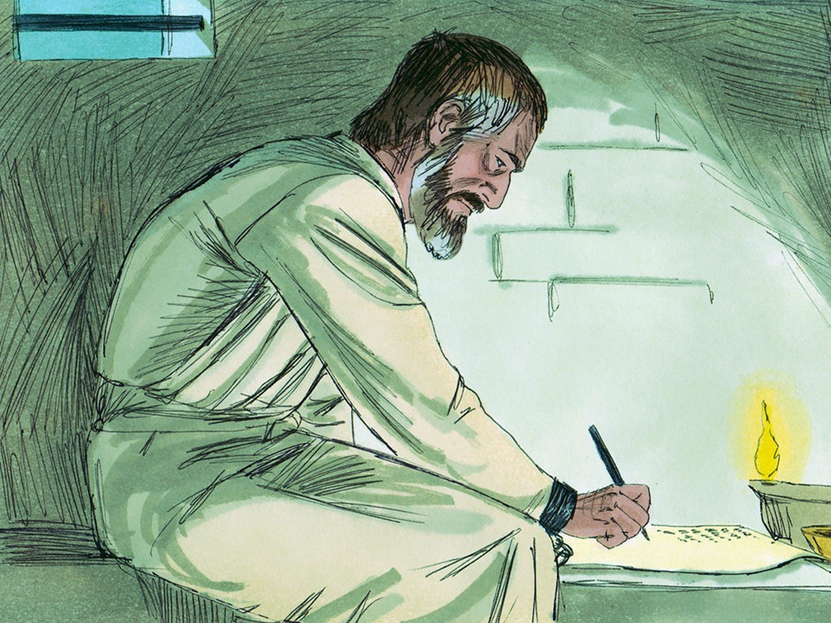
9 Read and discuss how to begin a greeting (1 Timothy 1:2, Philemon 1:1, Philippians 1:2)
1 Timothy 1:2 (TLB)
May God our Father and Jesus Christ our Lord show you his kindness and mercy and give you great peace of heart and mind.

Slide 16
9 Read and discuss how to begin a greeting (1 Timothy 1:2, Philemon 1:1, Philippians 1:2)
Philemon 1:1 (NIV)
Paul, a prisoner of Christ Jesus, and Timothy our brother,
To Philemon our dear friend and fellow worker…

Slide 17
9 Read and discuss how to begin a greeting (1 Timothy 1:2, Philemon 1:1, Philippians 1:2)
Philippians 1:2 (TLB)
May God bless you all. Yes, I pray that God our Father and the Lord Jesus Christ will give each of you his fullest blessings and his peace in your hearts and your lives.

Slide 18
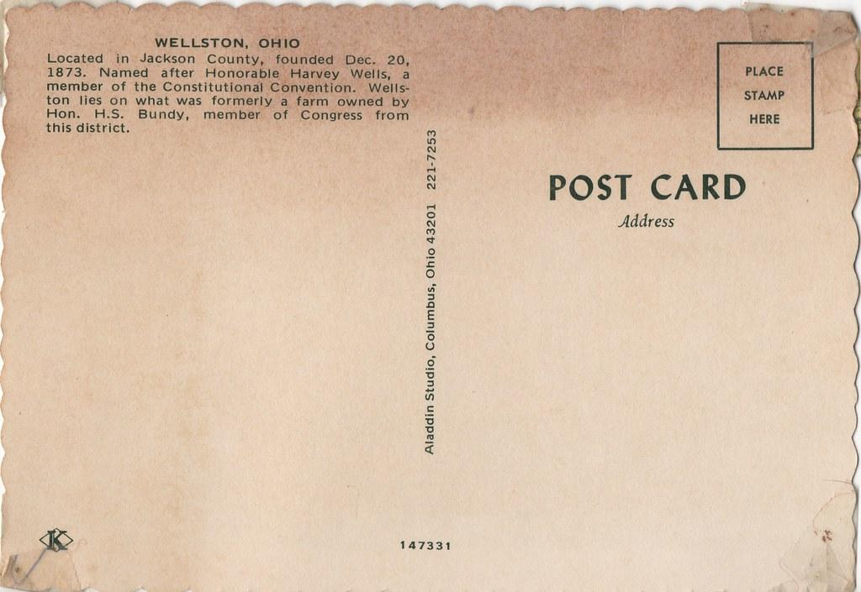
Types of greetings and salutations
Dear
Sir (Ma’am)
Mr. (Mrs., Ms.)
Hello
Good Morning ( Afternoon, Evening)
Beloved
To whom it may concern

Slide 19
If you were writing to someone which of these greetings or salutations would you use?
Writing to Grandma/Grandpa
Writing to teacher
Writing to classmate or friend
Writing to the Queen/ the President
Dear
Sir (Ma’am)
Mr. (Mrs., Ms.)
Hello
Good Morning ( Afternoon, Evening)
Beloved
To whom it may concern

Slide 20
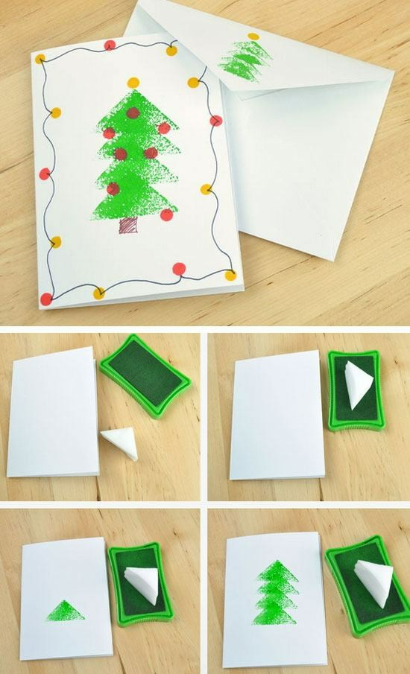
5 Craft:
Write and send four postcards to people you know.
Make, decorate, and send a card to a missionary school or church.
This Photo by Unknown Author is licensed under CC BY-ND

Slide 21
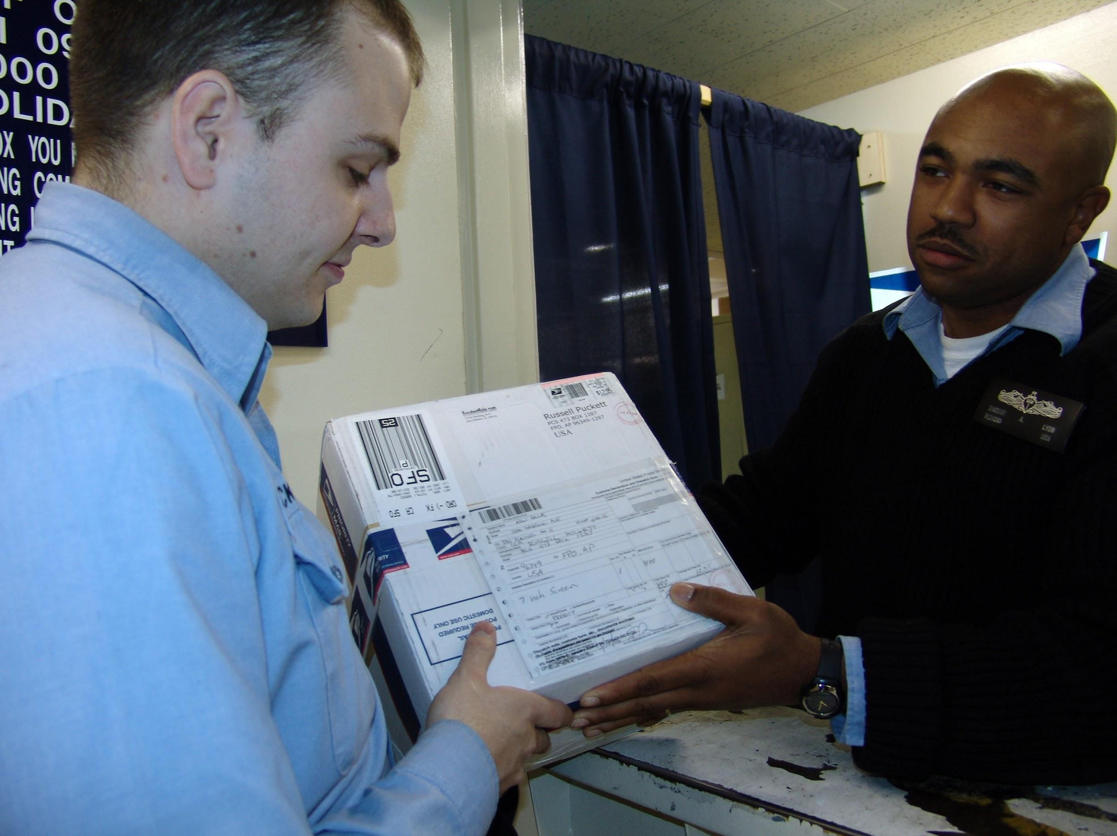
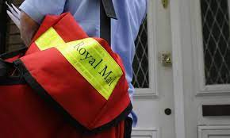
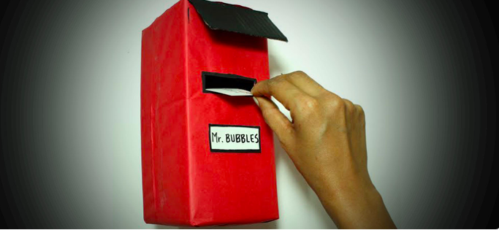
Do two of the following:
a. Visit a post office
b. Invite a post office employee to come and give a presentation
c. Make your own post office using shoe boxes or other mailbox dividers https://buzzingbubs.com/articles/diy-how-to-build-a-letterbox
d. Discuss what happens at a post office
e. Collect three antique postcards
f. Your choice

Slide 22
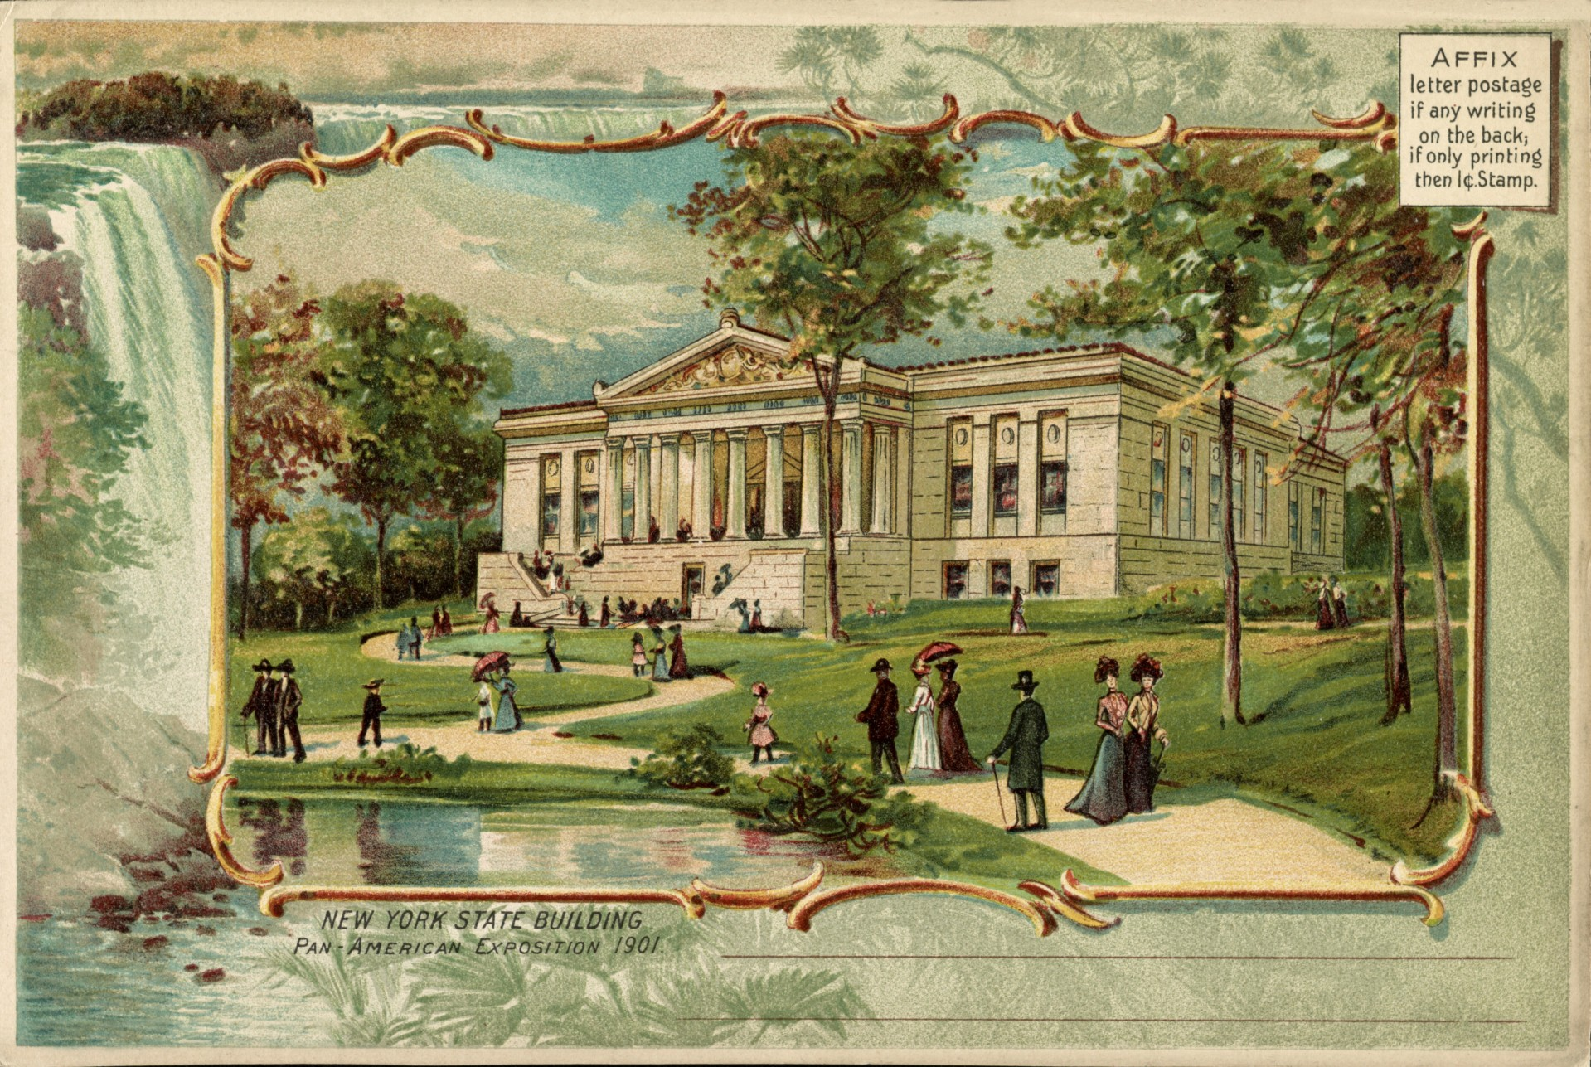
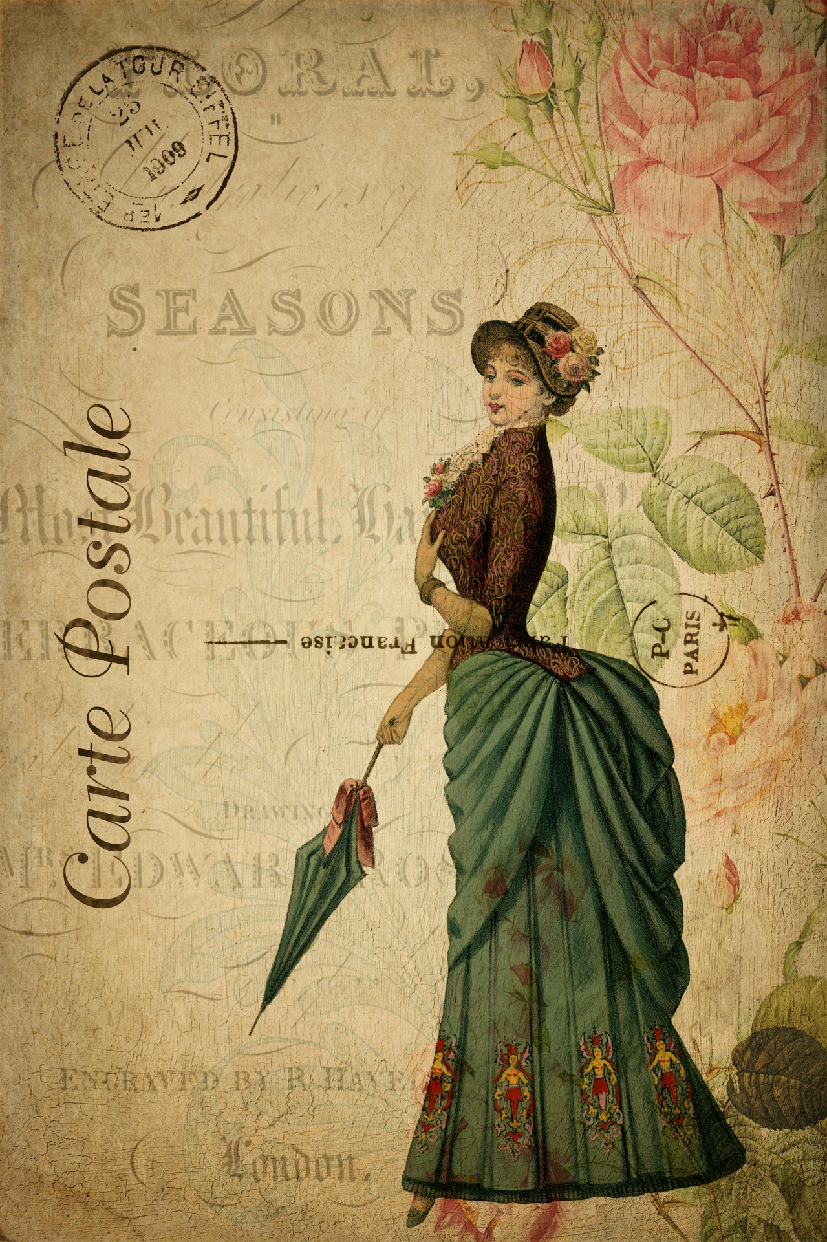
Do two of the following:
a. Visit a post office
b. Invite a post office employee to come and give a presentation
c. Make your own post office using shoe boxes or other mailbox dividers
d. Discuss what happens at a post office
e. Collect three antique postcards
f. Your choice

Slide 23
Do two of the following:
a. Visit a post office
b. Invite a post office employee to come and give a presentation
c. Make your own post office using shoe boxes or other mailbox dividers
d. Discuss what happens at a post office
e. Collect three antique postcards
f. Your choice
Ideas: Write a postcard to a neighbour or family member to share your favourite Bible verse.
Send a postcard to school to thank your teacher. Note how long it takes to reach them.
Ask your parents if there is someone they know in another part of the world that you could start corresponding with using postcards (a family member is ideal as they are known and safe to correspond with)?

Slide 24
We hope you enjoyed the Presentation!
J.J. Martinez Jr.

