Slide 1
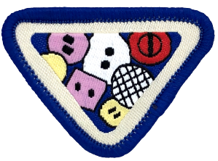
BUTTONS
BUC Adventurer Award

Slide 2
Buttons Award Requirements
Create and decorate a clothing button container
Start a collection of a variety of clothing buttons (at least 50 no.)
Do one or both of:
Decorate with buttons
Complete a button craft
Play the ‘Button, button, who has the button?’ game. Give brief description of game played
Have a Button Trade Night. Give brief description of how trading was done
Read and discuss Hebrews 13:16.

Slide 3
Button Uses Fastening Decoration Crafts Container

Slide 4
Use of Buttons
historicflyingclothing.com

Slide 5
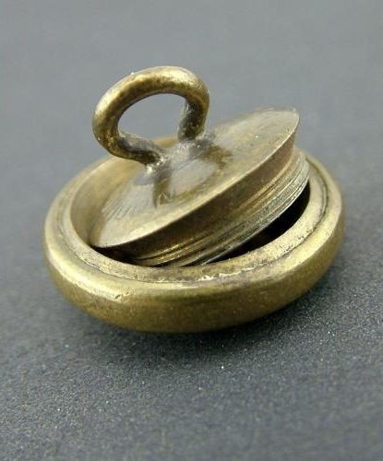
Container Buttons
historicflyingclothing.com

Slide 6
Miniature Compass
www.amazon.co.uk/Outdoor_Gear/Camping

Slide 7
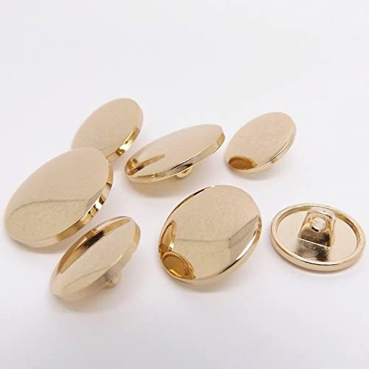
Materials for Making Buttons
Amazon.com
Wood Button - Round Star
Metal Buttons
Plastic Buttons

Slide 8
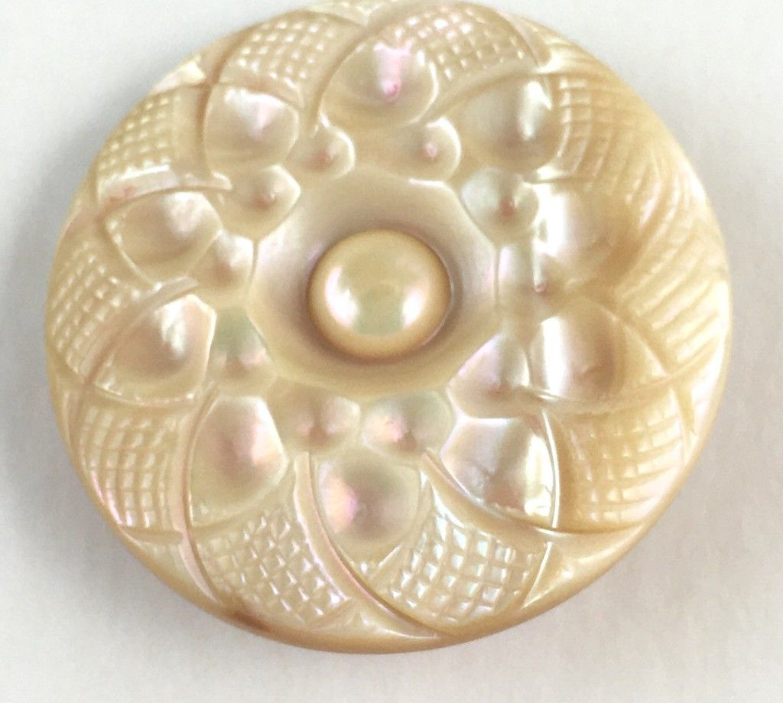
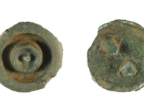
Shell Buttons Probably the oldest @5000years There are still modern shell buttons today
slate.com
Prrintest .com
oer2go.org

Slide 9
Requirement 1. Make & Decorate a Button Container
Pinterest

Slide 10
You will need A4 Paper Ruler Pencil Paint or Colouring pen Brush Container Silicone Glue

Slide 11
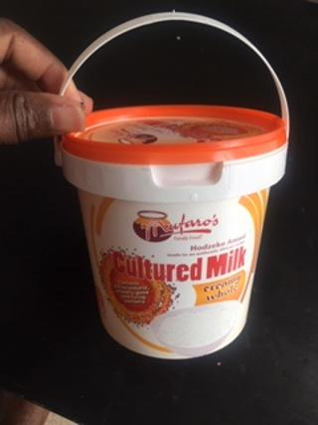
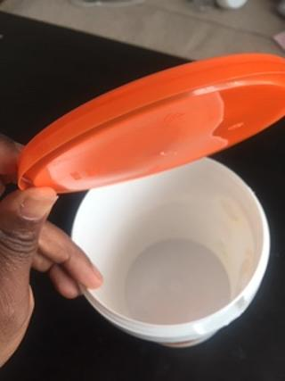
Choose or Make Your Button Container
Recycle a container that has been used at home
Wash and clean it thoroughly inside and out.
Use container with a lid
You can make your own container

Slide 12
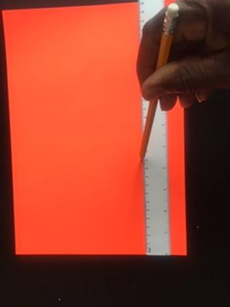
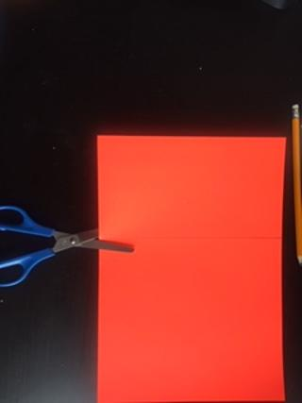
Measure container size, measure decoration paper, cut to size

Slide 13
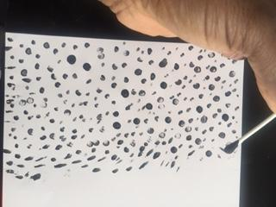
A4 paper can be coloured or white, it’s your choice. Use a coloring pen or paint to make a pattern that you like on the paper.

Slide 14
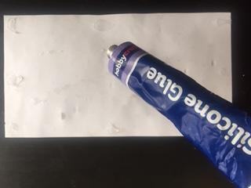
Cut the decorated paper to size, turn it upside down and apply a little glue to the reverse side

Slide 15
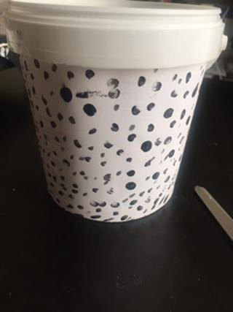
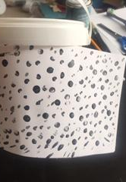
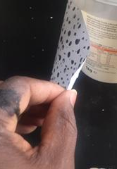
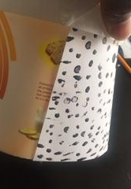
Stick the decoration on to the container. My container is named ‘spotted hyena’

Slide 16
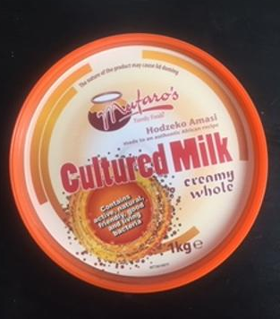
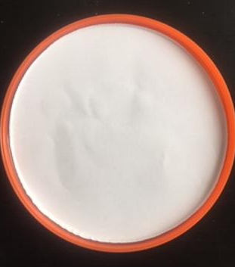
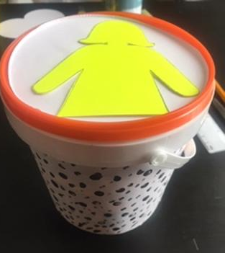
Decorate the lid as well
You can print your own photo, cut it to size and
Stick it onto the lid
Or make a nice decoration on the lid.

Slide 17
Requirement 2 Collect at least 50 Buttons (variety) Due to covid restrictions it may be easier to buy for now In addition, make a collection of button pictures and add to your Adventurer folder

Slide 18
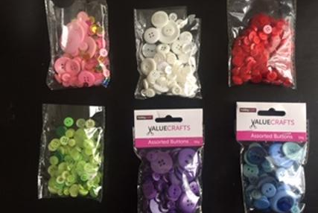
Select your favourite colour shade of buttons Select two colours if you want Store them in the button container you made

Slide 19
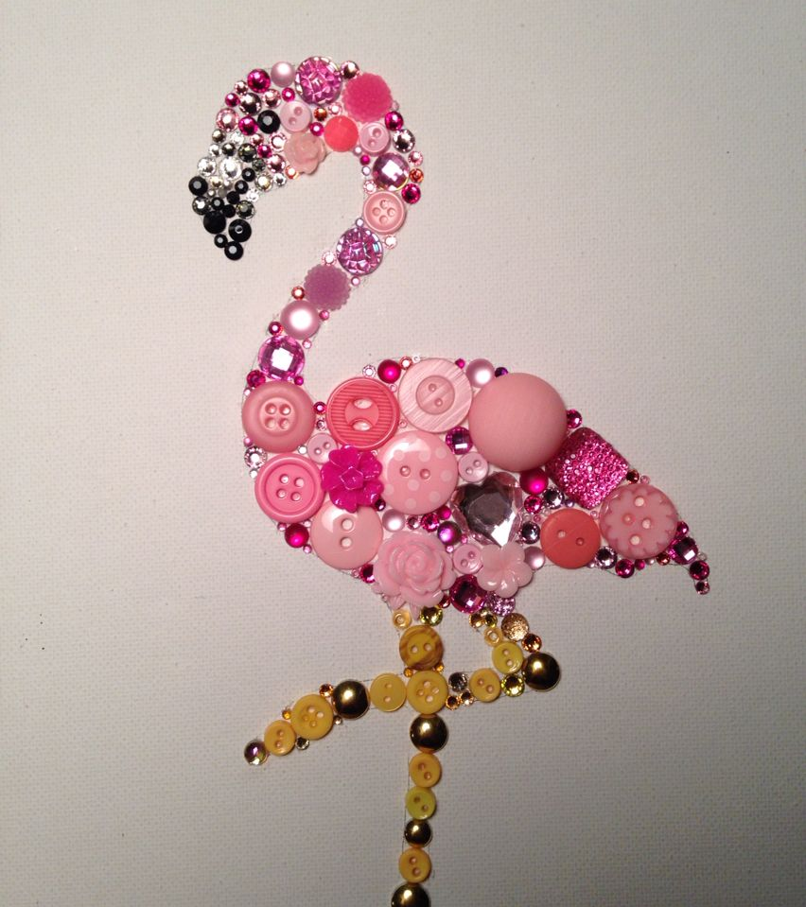
Requirement 3a. Decorate With Buttons Be imaginative but know your limits Don’t make it too hard
Pinterest

Slide 20
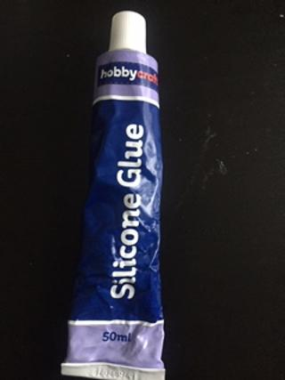
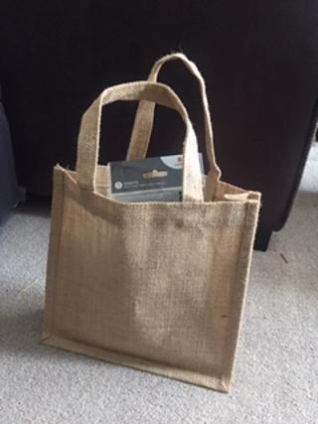
Select a fabric item that you want to decorate
Get GLUE
Buttons
Needle and thread may be used for older Adventurers under supervision

Slide 21
Place buttons in your preferred pattern, placing them first without glue

Slide 22
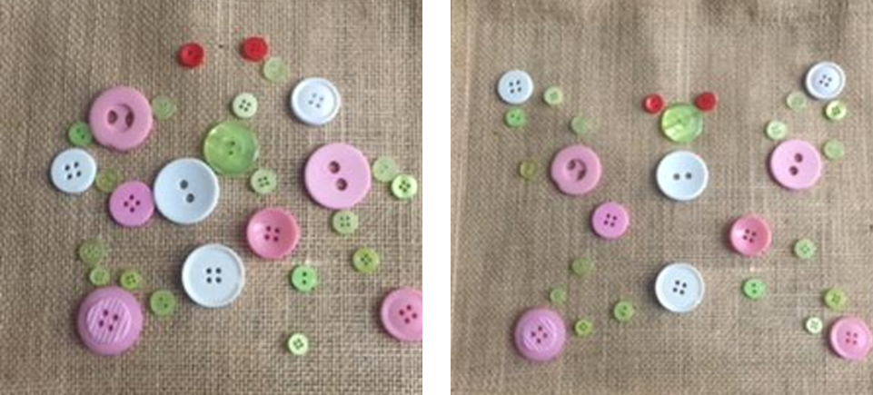
Add more buttons, don’t be afraid to move them around. Take a break and come back with new ideas.

Slide 23
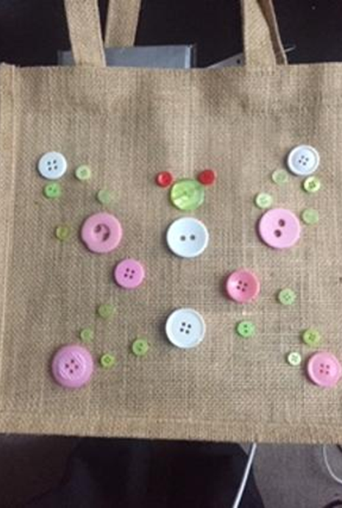
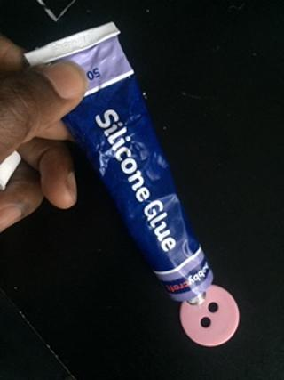
Glue it on
Once you’re happy with your design you can start gluing on the buttons
Take a photo of the design before you start gluing, just in case they move out of place. The photo will remind you how you had it set out
Silicon glue is recommended

Slide 24
My Share Bag Use to shop for items for the homeless To share gifts with others It reminds me to close the gap like a button by sharing with others It encourages me to brighten life like a decoration

Slide 25
Requirement 3b. Make a button craft Be imaginative but know your limits Don’t make it too hard
pinterest.es

Slide 26
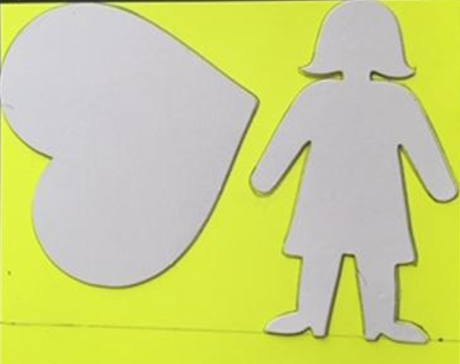
Select a backboard of your favourite colour
Use Card Shapes to mark up your backboard

Slide 27
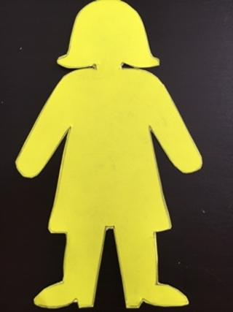
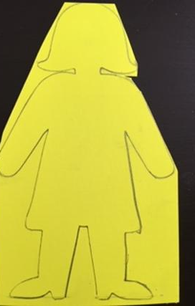
Use scissors to cut out your coloured back board

Slide 28
Select your favourite shape to use for the craft

Slide 29
Place buttons on coloured backboard Backboard colour should match your choice of button colour Start with the big buttons Smaller ones will fill the gaps

Slide 30
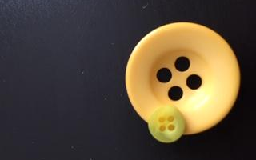
Buttons Working together
Stick smaller buttons onto larger ones to create a raised pattern and to cover gaps between large buttons
All buttons are useful and can be used together to achieve the results and close gaps

Slide 31
Add More Buttons to cover the whole space The more we work together the better

Slide 32
Complete your button craft Let the glue dry Show it (or a photo of it) to your class teacher

Slide 33
You may want to frame your button craft Take photos and add to your class folder Sign it and give it to someone as a gift (sharing) You can swap gifts with someone who has made a different craft

Slide 34
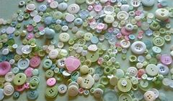
Requirement 4: Play the game: ‘Button, Button, who has the Button?’
This is an adapted version of the game due to covid restrictions
The original game can be played when restrictions are lifted

Slide 35
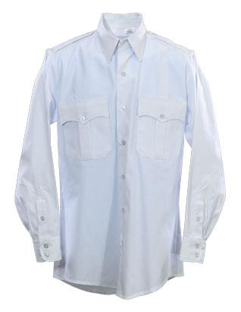
Have a fully-buttoned Adventurer shirt ready

Slide 36
Button Against The clock game.
Have a fully buttoned-up shirt or blouse ready (not one being worn by somebody) and wait for whistle.
On the whistle, undo all the buttons as quickly as possible
From your button container find buttons the same size and same number as those on the shirt / blouse.
Put on the shirt / blouse, button up, check alignment and all buttons done
Counsellor to record time for each stage and total time + take photo evidence
The quickest is the winner

Slide 37
Requirement 5: Have a ‘Button Trade Night’
The activity in here has been adapted due to current covid restrictions
The original activity may be done when restrictions are lifted
Medium

Slide 38
Button Trade Week (Homework)
Contact
Contact at least three Adventures from different households
Ask
Ask them for at least five buttons that you need for your craft
Exchange
In exchange they will ask you for five buttons that they need
Post
Place the buttons in a sealed envelope and ask your guardian to post
Record
Record who you posted to and when as well as who you received buttons from.
Check
Record if you did get what you asked for

Slide 39
Requirement 6: Read and Discuss
Hebrews 13:16: "Do not neglect to do good and to share what you have, for such sacrifices are pleasing to God.“
What is to neglect (who neglected something in the Bible)?
Did you neglect something this week?
Did you do some good this week (name a good person in the Bible)?
How do you feel when you share?
How do you feel when someone shares with you?

Slide 40
Buttons Award Requirements
Create and decorate
Create and decorate a clothing button container
Start
Start a collection of a variety of clothing buttons (at least 50 no.)
Do
Do one or both of:
Decorate with buttons
Complete a button craft
Play
Play the ‘Button, button, who has the button?’ Give a brief description of the game played
Have
Have a Button Trade Night. Give a brief description of how trading was done
Read and Discuss
Read and discuss Hebrews 13:16

Slide 41
GOODBYE ADVENTURERS
Club ministries.org
Notes:
Club ministries.org

