Slide 1

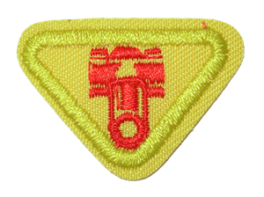
REPORTER ADVENTURER AWARD
presented by sue ndlovu

Slide 2
requirements
Give a report to your parents about an Adventurer function. Make a “Reporter” scrapbook of three Adventurer outings.
Look up information on a toy or musical instrument. Report to the group two things you discovered.
Listen to announcements and read the church bulletin.
a) Put bulletin announcements in your scrapbook.
b) Circle the events you were most interested in.
Talk with your pastor, Sabbath School or school teacher. In your scrapbook put:
a) a drawing of the person and where he/she works
b) a note describing what he/she likes best about his/her job
Keep your “Reporter” scrapbook for at least two months.
Name some reporters in the Bible and tell what they reported.

Slide 3
What is a reporter?

Slide 4
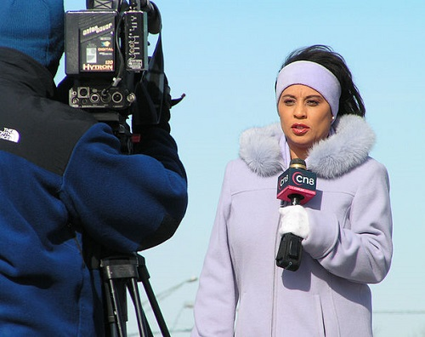
answer
A reporter is a person whose job is to discover information about news events and describe them for a newspaper or magazine or for radio or television.
~Cambridge dictionary~

Slide 5
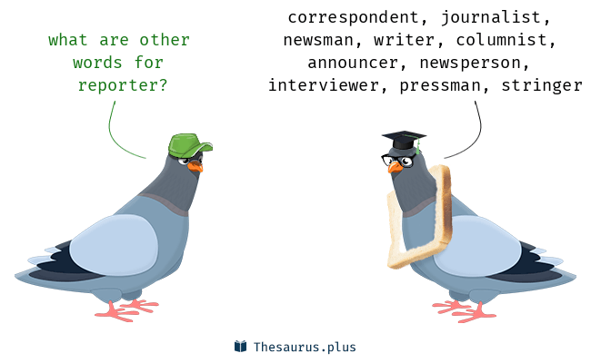
Reporters can sometimes be called….

Slide 6

Duties & responsibilities
The main goal for a reporter is to keep the public updated with all the local and global happening.
Cover a wide variety of stories.
Conduct and schedule interviews.
Plan, edit, and write stories and articles to be broadcasted.
Verify information provided by interviewees.
Keep up with deadlines as timeliness is extremely important.
Follow news events and other media sources to stay informed.

Slide 7

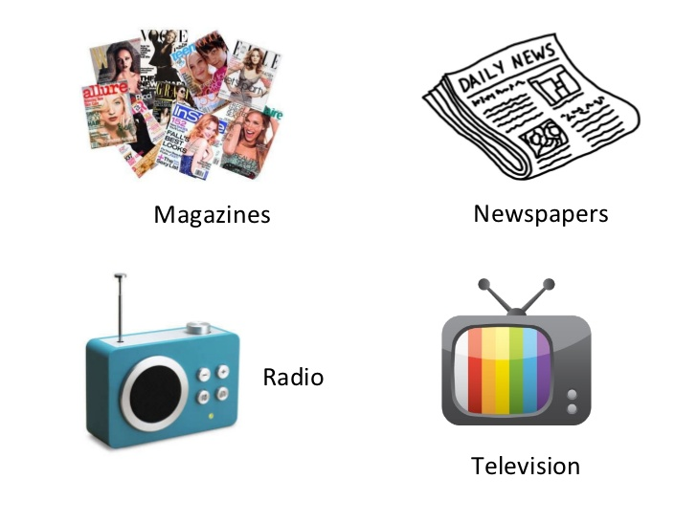
What is broadcast?
In general, to broadcast (verb) is to cast or throw forth something in all directions at the same time.

Slide 8
What makes up news?

Slide 9

news
News can be on weather, politics, sports, arts, culture, science and business.

Slide 10
Can you name the most popular TV news channels?

Slide 11

Most popular TV news channels

Slide 12

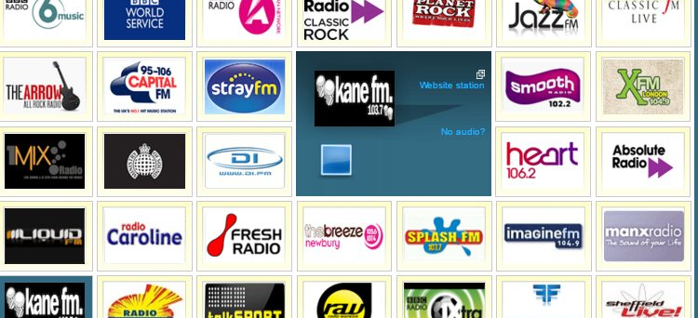

Radio, newspaper & magazines

Slide 13

Social media

Slide 14
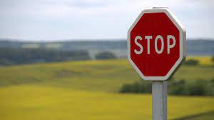

Grab viewers attention
It is important to grab the attention of your viewers as a reporter.
Your goal is to come up with exciting, informative and current headlines stories so as to drive traffic to your channel.

Slide 15
Do you know any Adventist channels?

Slide 16





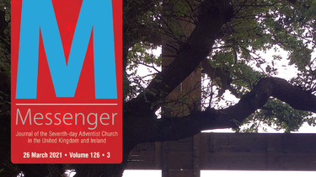
Adventist channels
The purpose of theses broadcasting channels is to report and spread the news about our Lord and Savior Jesus Christ.

Slide 17
What have we learnt so far?

Slide 18


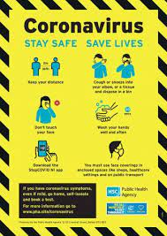

The importance of reporters
Keep us updated about the latest news.
Cover current and changing events around the world.
Inform us and create awareness, allowing us to spread the knowledge.
Help us become involved citizens in our community.

Slide 19
Ways reporters gather information

Slide 20

Research
Reporters use different sources to gather information.

Slide 21
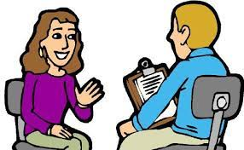
interview
Meeting people face to face.
However, before you begin interviewing someone, it is important to:
research the person you’re interviewing ahead of time.
find a good location for the interview.
Write down the questions you plan to ask in advance.

Slide 22
WHAT useful tools do you need as a reporter?

Slide 23
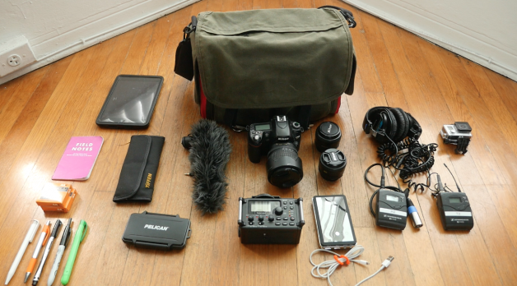
Useful tools
A folder for your papers and their materials i.e. scrapbook
Spiral notepad.
A pen (or two) .
A recording device (microphone, mobile phone, audio voice recorder, video recorder etc).
Headphones.
USB to back up materials.
Laptop.
A bag to keep it all in.

Slide 24
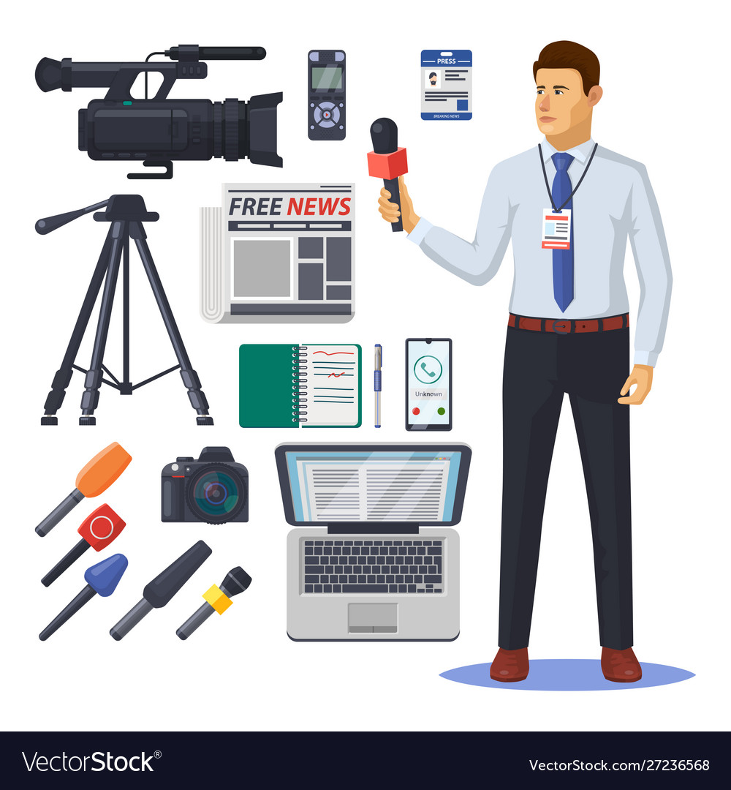
Professional reporters ….
Qualified and professional reporters will need more equipment to carry out their task.

Slide 25

for your requirements you only need these:

Slide 26
WHAT are the qualities of a good reporter?

Slide 27
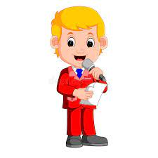
Qualities of a good reporter
Enjoys telling stories
Good listener
Curious, inquisitive and questioning
Pleasant
Courageous
Honest and seeks the truth
Smartness
Ability to communicate well through words, pictures, design or video.

Slide 28
requirements

Slide 29



Requirement 1
Give a report to your parents about an Adventurer function. Make a “Reporter” scrapbook of three Adventurer outings.
Questions asked by your parents may include:
What was the theme?
Who was the speaker?
What did you learn or benefit from that outing?

Slide 30
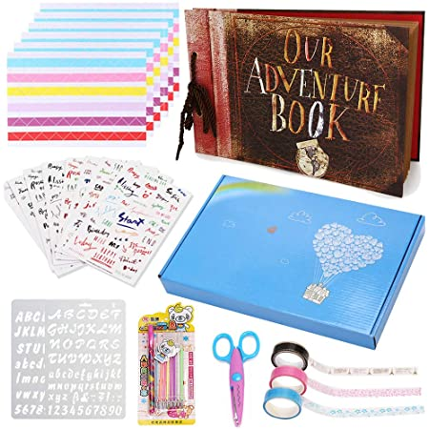
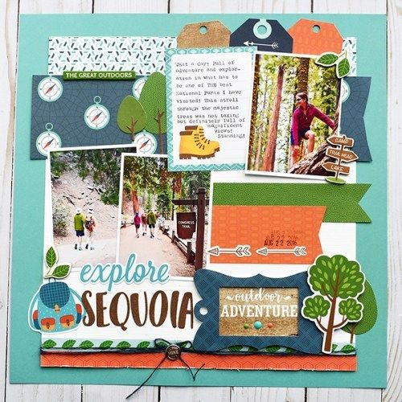
Requirement 1
Don’t forget to make your scrapbook of three Adventurer outings.

Slide 31
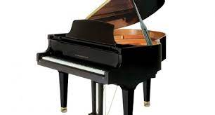
Requirement 2
Look up information on a toy or musical instrument. Report to the group two things you discovered.
Piano
The first piano was invented in 1709 by an Italian harpsichord maker Bartolomeo di Francesco Cristofori.
Most keyboards come with 66, 72, or 88 keys.

Slide 32
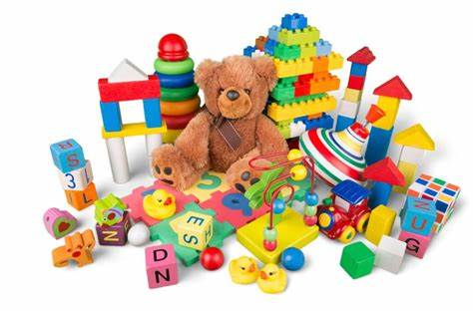
Requirement 2
Look up information on a toy or musical instrument. Report to the group two things you discovered.
Toys
Who created the toy?
Is this toy a prized possession or treasure?
Does this toy inspire open-ended play or creativity?

Slide 33
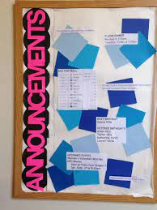


Requirement 3
Listen to announcements and read the church bulletin.
a) Put bulletin announcements in your scrapbook.
b) Circle the events you were most interested in.

Slide 34
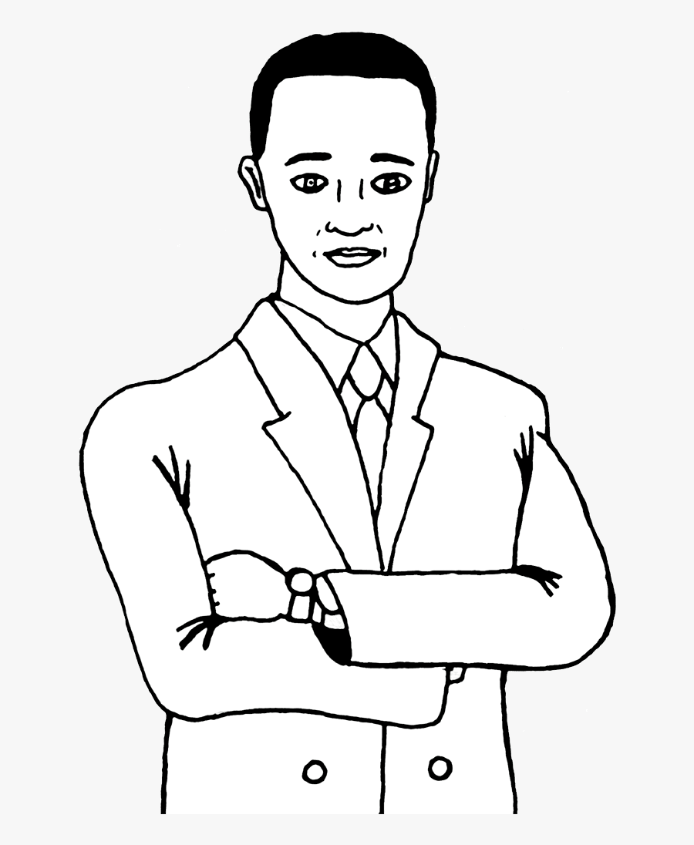
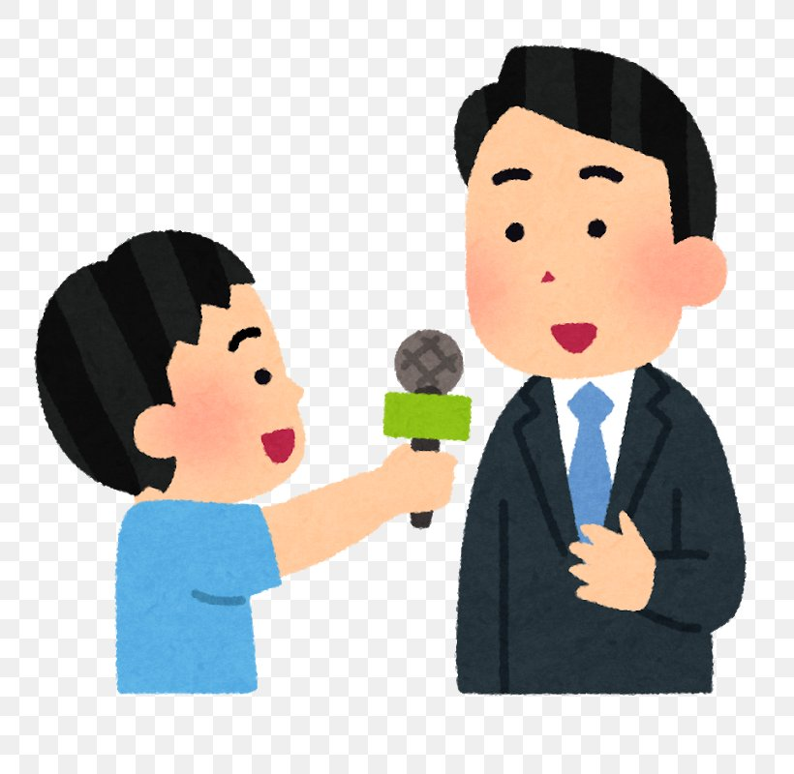

Requirement 4
Talk with your pastor, Sabbath School or school teacher. In your scrapbook put:
a) a drawing of the person and where he/she works
b) a note describing what he/she likes best about his/her job

Slide 35

Requirement 4
How old were you when you decided to be a pastor?
Where did you study?
What challenges did you face and how did you overcome them?
As adventurers, what advice can you give if one decides to be a pastor.

Slide 36
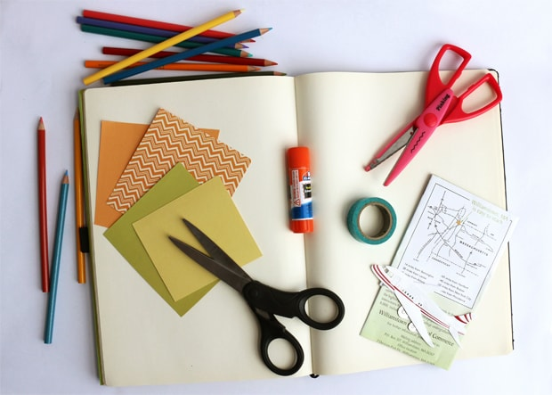
Requirement 5
Keep your “Reporter” scrapbook for at least two months.

Slide 37
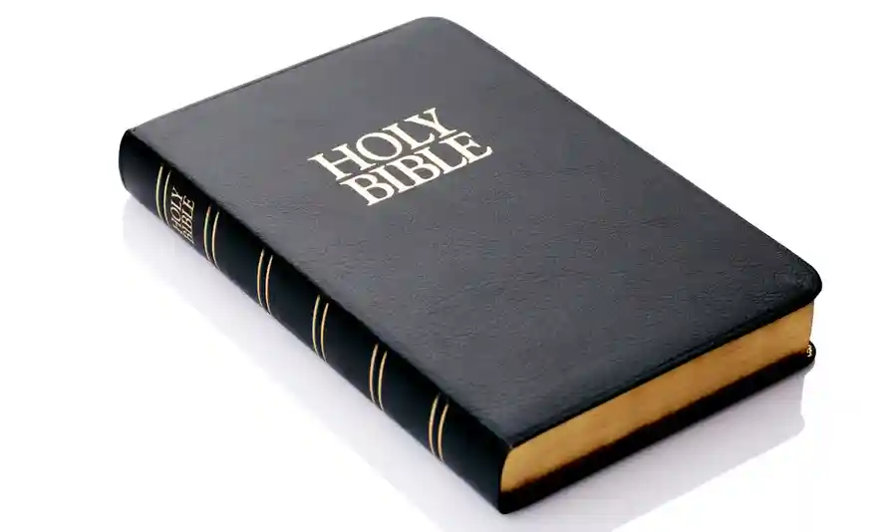
Requirement 6
Name some reporters in the Bible and tell what they reported.

Slide 38
Reporters in the bible

Slide 39
Guess the bible reporter
Moses sent 12 spies to scout the land of Canaan, but only two came back with a true report. Who were they?

Slide 40
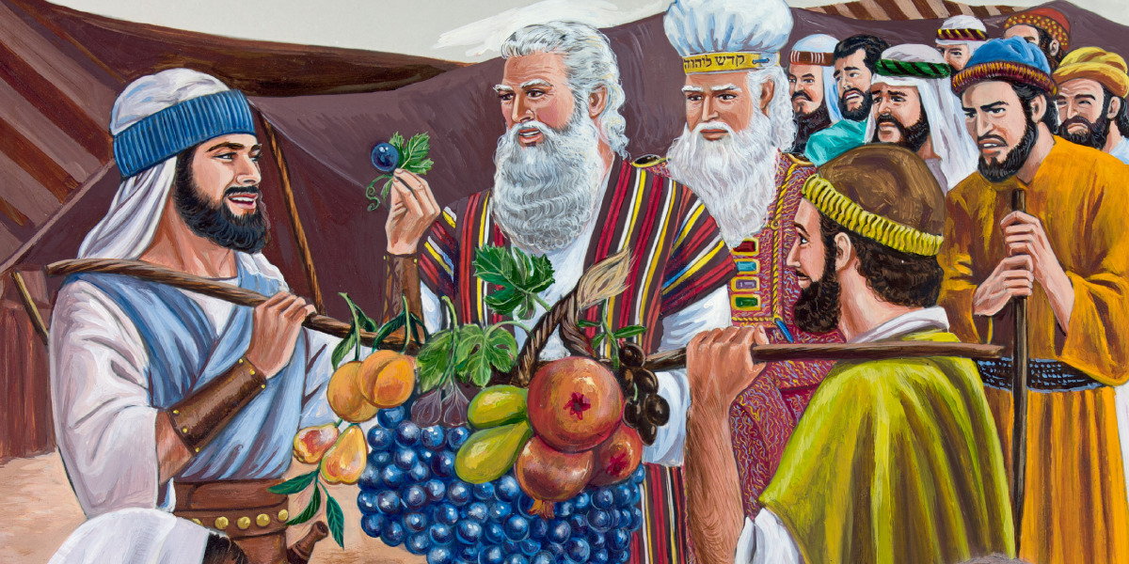
JOSHUA & CALEB
Numbers Chapter 13 & 14

Slide 41
The twelve spies
POSITIVE REPORT
Joshua and Caleb - They were the two spies who brought back a good report and believed that God would help them succeed. They were the only men from their generation permitted to go into the Promised Land after the time of wandering. They were full of courage, confidence, faith and an influence for good.
NEGATIVE REPORT
Ten spies - Brought back a bad report. They saw themselves as tiny, little grasshoppers who would be crushed by big giants. They were full of fear, pessimistic and a negative spirit.
As a result of their negative report, God was not happy. Hence, they wandered for 40 years in the wilderness and never entered the promised land.

Slide 42
Guess the bible reporter
. Who reported to Nehemiah about the vulnerable condition of Jerusalem?

Slide 43
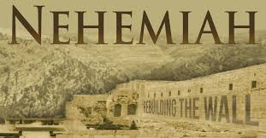
Hanani & men from judah
Nehemiah Chapter 1 & 2

Slide 44
HANANI
Hanani gave a true report of the situation in Jerusalem.
However, even though his report was true, he encountered both positive and negative responses.
POSITIVE RESPONSE FROM NEHEMIAH
When Nehemiah heard the report, he saw the great need, which burdened his heart. He wept, mourned, fasted and prayed for days about what he had heard. Later on, he went to rebuild the walls of Jerusalem.
NEGATIVE RESPONSES
Sanballat, Tobiah, and Geshem were three enemies of the Jews who made several attempts to stop Nehemiah from rebuilding the walls of Jerusalem.
However, Nehemiah had a vision of God’s purpose and a commitment to see it through in spite of many difficulties.

Slide 45
Guess the bible REPORTERS
Which four gospels reported on the life of Jesus Christ while He was on earth?

Slide 46
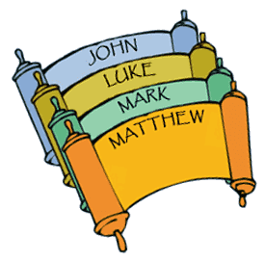
Matthew, MARK, LUKE & john

Slide 47
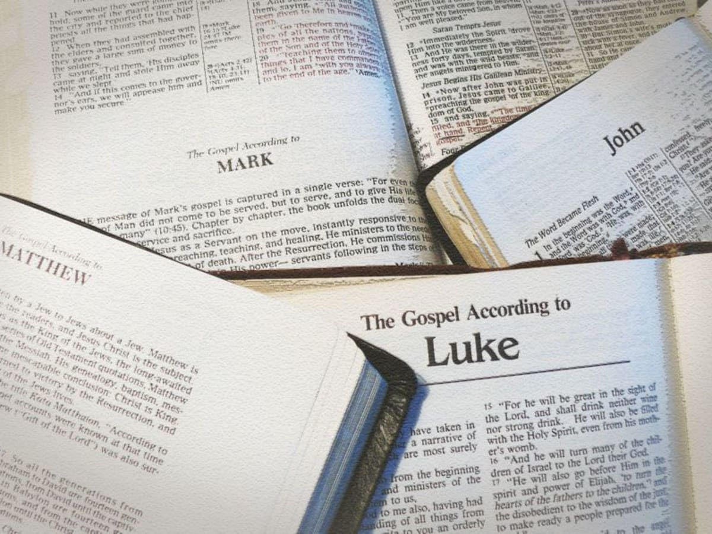
The four gospels
They reported Jesus’:
Birth
His life
Ministry
Crucifixion
Resurrection
Ascension to heaven.
All the four gospels have unique story on the life and ministry of Jesus Christ and they all speak of one person only Jesus who is the saviour of the Jews and the saviour of the world.

Slide 48

What is our mission?
Our role as Christian reporters is to spread the gospel of Jesus Christ and His soon coming.
Matthew 28:19-20, NKJV
“Go ye therefore and make disciples of all the nations, baptizing them in the name of the Father and of the Son and of the Holy Spirit, teaching them to observe all things that I have commanded you; and lo, I am with you always, even to the end of the age”. Amen..

Slide 49

What is our goal?

Slide 50
what is our prayer?
Our prayer as reporters , is to ask God to help us show:
Willingness
Commitment
Dedication
Obedience
Faithfulness
Devotion
Loyalty
Courage
Selflessness

Slide 51
requirements
Give a report to your parents about an Adventurer function. Make a “Reporter” scrapbook of three Adventurer outings.
Look up information on a toy or musical instrument. Report to the group two things you discovered.
Listen to announcements and read the church bulletin.
a) Put bulletin announcements in your scrapbook.
b) Circle the events you were most interested in.
Talk with your pastor, Sabbath School or school teacher. In your scrapbook put:
a) a drawing of the person and where he/she works
b) a note describing what he/she likes best about his/her job
Keep your “Reporter” scrapbook for at least two months.
Name some reporters in the Bible and tell what they reported.

Slide 52
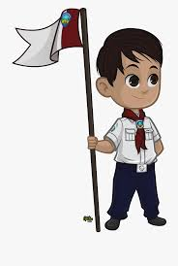
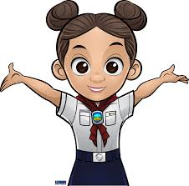
Conclusion
Our pledge says…..”Because Jesus loves me I will always do my best”.
Let us do our best and be the best Reporters for Jesus.

Slide 53
THANK YOU

