Slide 1
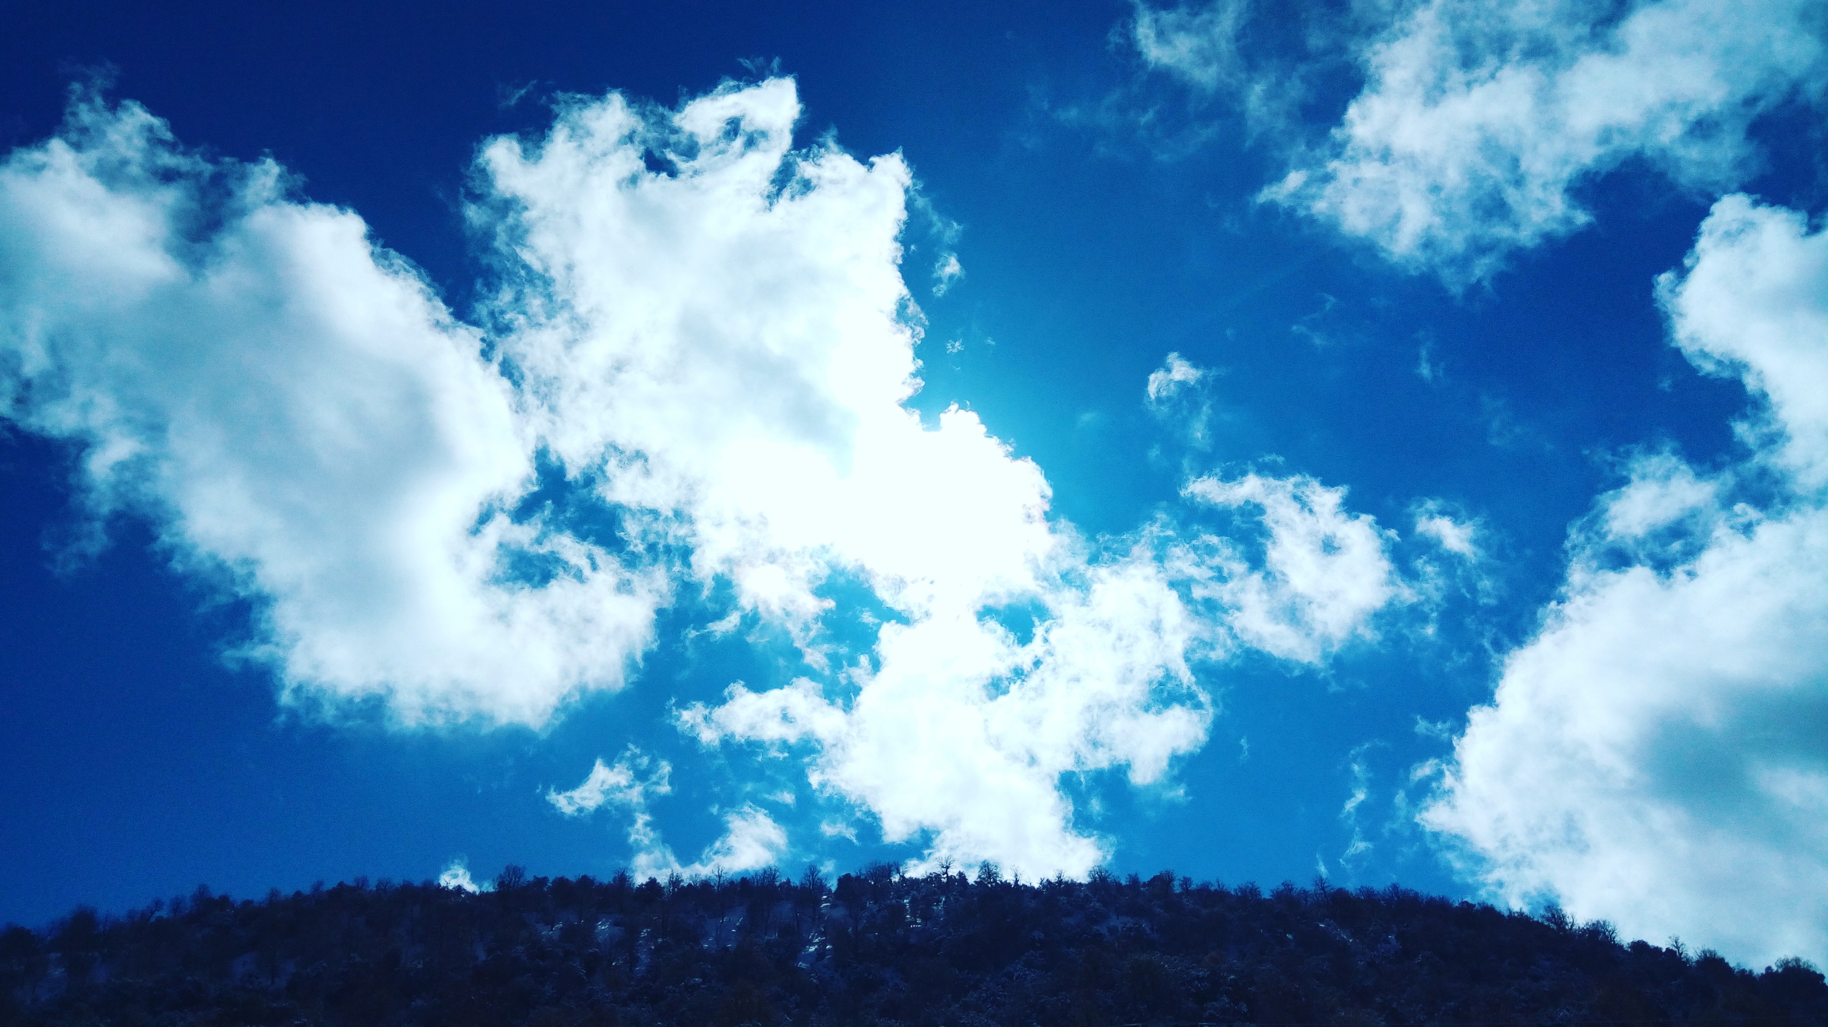
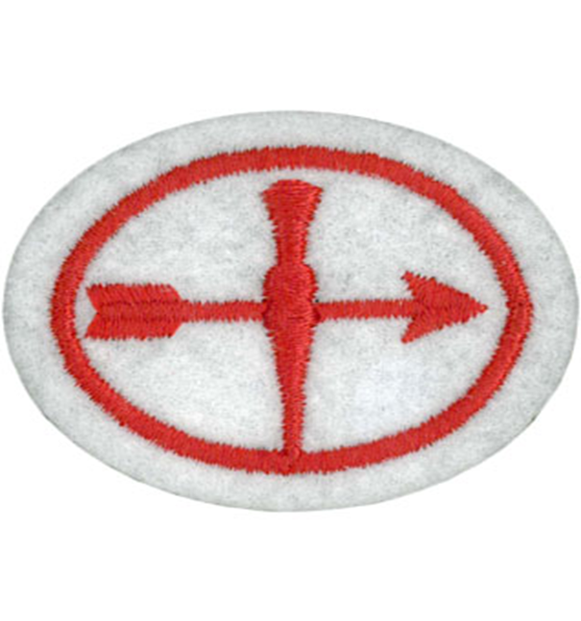
Weather Honour – Pathfinder Honour Nature
Presented by – MG Harriet Owusu-Afriyie
3rd April 2021

Slide 2
What is Weather?
Weather describes the day-to-day condition of the atmosphere. It might be sunny, hot, windy or cloudy, raining or snowing. The weather takes into account the temperature, precipitation, humidity and atmospheric pressure of the part of atmosphere (air) closest to the surface of the Earth.

Slide 3
Requirements
1. Explain how each of the following is formed.
2. Identify either in the sky or from pictures the following types of clouds: cirrus, cumulus, stratus, nimbus. What kind of weather is associated with each.
3. Explain the action of a mercury or spirit thermometer, a mercury barometer, an aneroid barometer, and a rain gauge.
4. Why is it possible to be rainy on one side of the mountain range and dry on the other? Give an illustration for your country or region. a. Why is it cooler and more moist in the mountains than in the lowlands? b. From which direction do rain and clear weather usually come in your locality?
5. Show with the help of a diagram how the earth's relationship to the sun produces the seasons.

Slide 4
Requirements – Continue
6. What causes lightning and thunder? What different kinds of lightning are there?
7. Show with the help of a diagram what a convection is. What is its relation to winds?
8. Explain how radar, satellites, and computers are used in weather forecasting.
9. Tell how the following can affect our weather.
10. Make a drawing showing the water cycle in weather.
11. Make a simple wind vane or rain gauge.
12. Keep a weather chart for one week and record readings at 12-hour intervals. Include the following:
a. Temperature
b. Moisture (dew, fog, rain, frost, or snow)
c. Cloud formation
d. Wind direction

Slide 5
Objectives
To be able to explain how the different weather are forms and types of clouds.
To look at what causes lightning and thunder.
To understand a Convection and its relation to winds.
To be able to explain how weather radar, Satellites, and computers are used in weather forecasting.
To know how Jet Stream and Volcano eruption can affect our weather.

Slide 6
Types of Weather
Please type your answers in the Zoom chat about the different types of Weather.

Slide 7
Requirement 1: Explain how each of the following is formed:
Fog
Rain
Dew
Snow
Sleet
Hail
Frost

Slide 8
Fog
Fog is moisture that gets squeezed out of the air when the temperature drops. This happens when humidity is 100% and the temperature drops,

Slide 9
Rain
Rain forms when separate drops of water fall to the Earth's surface from clouds.

Slide 10
Dew
Dew is water in the form of droplets that appears on thin, exposed objects in the morning or evening.

Slide 11
Snow
Snow - Snow is precipitation in the form of crystalline water ice, consisting of a multitude of snowflakes.
Snow is commonly formed when water vapor undergoes deposition high in the atmosphere at a temperature of less than 0 °C (32 °F).

Slide 12
Sleet
Sleet refers to snow that has partially melted on its fall to the ground, due to surrounding air that is sufficiently warm to partially melt it while falling, but not warm enough to fully melt it into rain.

Slide 13
Hail
Hail - Hail forms on condensation nuclei such as dust, insects, or ice crystals, when super cooled water freezes on contact. Hailstones are usually from the size of a pea to the size of a golf ball.

Slide 14
What is Hail?

Slide 15
Frost
Frost is a thin layer of ice on a solid surface, which forms from water vapor in an above-freezing atmosphere coming in contact with a solid surface whose temperature is below freezing.

Slide 16
Requirement 2: Identify either in the sky or from pictures the following types of clouds: cirrus, cumulus, stratus, nimbus. What kind of weather is associated with each.
Cirrus clouds are at the highest altitudes. They often appear thin and wispy. They are associated with fair weather
Cumulus - Cumulus clouds are usually puffy and often have very distinct edges and usually a noticeable vertical development
Stratus - Stratus is used to describe flat, featureless clouds of low altitude varying in colour from dark grey to nearly white. These clouds are essentially fog that is above ground level.
Nimbus - Nimbus clouds are dark, precipitous clouds. Nimbus is a Latin word meaning cloud or rain storm. These are commonly called "thundercloud.”

Slide 17
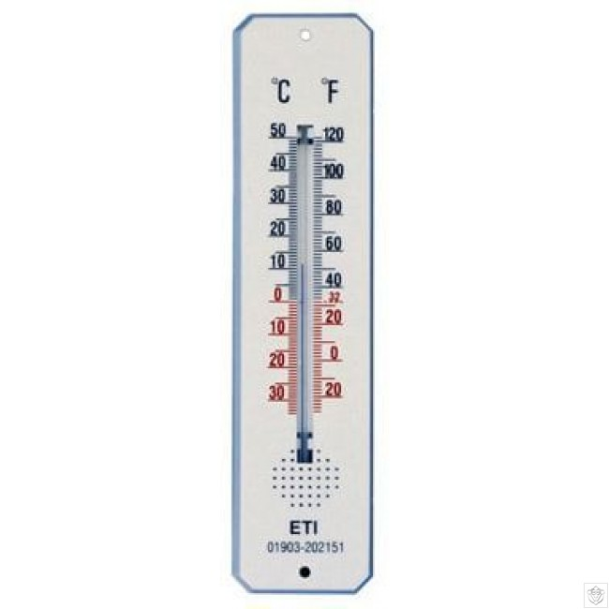
Requirement 3: Explain the action of a mercury or spirit thermometer, a mercury barometer, an aneroid barometer, and a rain gauge. Mercury or spirit thermometer:
Spirit thermometer - A spirit thermometer and a mercury thermometer work on the same principles.
A spirit or mercury thermometer expand and contract with temperature changes. When it's cold, they contract, and when it's hot, they expand.

Slide 18
Mercury barometer
Mercury in the tube adjusts until the weight of the mercury column balances the atmospheric force exerted on the reservoir. High atmospheric pressure places more downward force on the reservoir, forcing mercury higher in the column. Low pressure allows the mercury to drop to a lower level in the column by lowering the downward force placed on the reservoir.

Slide 19
Aneroid barometer
An aneroid barometer uses a small, flexible metal box called an aneroid cell. The evacuated capsule (or usually more capsules) is prevented from collapsing by a strong spring. Small changes in external air pressure cause the cell to expand or contract.

Slide 20
Rain gauge
Rain gauge is an instrument used by meteorologists and hydrologists to gather and measure the amount of liquid precipitation/rain over an area in a predefined period of time.

Slide 21
Requirement 4: Why is it possible to be rainy on one side of the mountain range and dry on the other?
Orographic lift occurs when an air mass is forced from a low elevation to a higher elevation as it moves over rising terrain. As the air mass gains altitude it expands and cools. This cooler air cannot hold the moisture as well as warm air and this effectively raises the relative humidity to 100%, creating clouds and frequently precipitation.

Slide 22
An illustration of Orographic lift
This wave cloud pattern formed off of the Île Amsterdam in the far southern Indian Ocean, due to orographic lift of an airmass by the island, producing alternating bands of condensed and invisible humidity downwind of the island as the moist air moves in vertical waves and the moisture successively condenses and evaporates.

Slide 23
Requirement 4 – Continue Give an illustration for your country or region. - A. Why is it cooler and more moist in the mountains than in the lowlands?
Why is it cooler and more moist in the mountains than in the lowlands?
It is because mountains receive more rainfall than low lying areas because the temperature on top of mountains is lower than the temperature at sea level. Winds carry moist air over the land, as the air rises, it cools, and because cool air can carry less moisture than warm air, there is usually precipitation (rain).

Slide 24
Why Is It Colder at the Top of a Mountain Than It Is at Sea Level?
Lower pressure at higher altitudes causes the temperature to be colder on top of a mountain than at sea level.

Slide 25
Requirement 4 – Continue Give an illustration for your country or region. – B. From which direction do rain and clear weather usually come in your locality? Where weather in the UK comes from.
The UK is on a latitude similar to Canada and Southern Russia but don’t experience such extremes of weather, so why is that?
The geographical siting of the United Kingdom is influenced by many factors that will determine if it is to be hot or cold, wet or dry and many variations in between.
Where weather comes from in the UK is determined by the country’s position in the world with a large area of the Atlantic Ocean to the west, the very cold Arctic to the north, a large land mass to the east and south.
When wind arrives in the UK from the north it will be cold as it originates from the vast area of ice and snow in the Arctic.
Winds from the east to the UK will have travelled over a large landmass that in summer gets very hot and during winter very cold. This thus dictates what weather will be experienced in the UK.

Slide 26
Requirement 5 - Show with the help of a diagram how the earth's relationship to the sun produces the seasons.
The Earth's tilt on its axis causes the seasons. When the axial tilt points a hemisphere away from the sun, it is winter, and when it points it towards the sun it is summer. This is not because the distance between that part of the Earth and the Sun varies, but rather, it is because the angle of the sunlight is either more direct, or less direct.

Slide 27
Requirement 6 - What causes lightning and thunder? What different kinds of lightning are there?
Lightning - Lightning is caused when electrical charges build up in clouds.

Slide 28
Requirement 6 - What causes lightning and thunder? What different kinds of lightning are there?
Thunder: The word thunder usually describes a sonic shock wave caused by the rapid heating and expansion of the air surrounding and within a bolt of lightning. The bolt changes the air into plasma, and it instantly explodes, causing the sound known as a thunderclap.

Slide 29
Requirement 6 - What causes lightning and thunder? What different kinds of lightning are there? - Kinds of Lightning
Intracloud lightning, sheet lightning, anvil crawlers - Intracloud lightning is the most common type of lightning, and occurs completely inside one cumulonimbus cloud; it is termed sheet lightning because the bolt is not seen, instead one sees the whole cloud light up from inside.
Cloud-to-ground lightning, anvil-to-ground lightning: - Cloud-to-ground lightning is a great lightning discharge between a cumulonimbus cloud and the ground initiated by the downward-moving leader stroke. This is the second most common type of lightning.
Cloud-to-cloud lightning: - Cloud-to-cloud or intercloud lightning is a somewhat rare type of discharge lightning between two or more completely separate cumulonimbus clouds.

Slide 30
Requirement 6 - What causes lightning and thunder? What different kinds of lightning are there? - Kinds of Lightning - Continue
Ground-to-cloud lightning - Ground-to-cloud lightning is a lightning discharge between the ground and a cumulonimbus cloud from an upward-moving leader stroke. These thunderstorm clouds are formed wherever there is enough upward motion, instability in the vertical, and moisture to produce a deep cloud that reaches up to levels somewhat colder than freezing. These conditions are most often met in summer.
Heat lightning or summer lightning: - Heat lightning (or, in the UK, "summer lightning") is nothing more than the faint flashes of lightning on the horizon or other clouds from distant thunderstorms. Heat lightning was named because it often occurs on hot summer nights. Heat lightning can be an early warning sign that thunderstorms are approaching.
Ball lightning:- Ball lightning is described as a floating, illuminated ball that occurs during thunderstorms. They can be fast moving, slow moving or nearly stationary. Some make hissing or crackling noises or no noise at all.

Slide 31
Are there any Bible verses that talks about thunder and lightning?
Answers!

Slide 32
Examples of Bible verses that talks about thunder and lightning.
In the Old Testament
In the new Testament
Exodus 19:16 Then it came to pass on the third day, in the morning, that there were thunderings and lightnings, and a thick cloud on the mountain; and the sound of the trumpet was very loud, so that all the people who were in the camp trembled.
Psalm 77:18 - The voice of Your thunder was in the whirlwind; The lightnings lit up the world
Daniel 10:6 – His (Jesus) body was like beryl, His face like the appearance of lightning, His eyes like torches of fire, His arms and feet like burnished bronze in colour, and the sound of His words like the voice of a multitude.
Matthew 24:27 - For as the lightning comes from the east and flashes to the west, so also will the coming of the Son of Man be.
Luke 17:24 - For as the lightning that flashes out of one part under heaven shines to the other part under heaven, so also the Son of Man will be in His day
Revelation 11:19 - Then the temple of God was opened in heaven, and the ark of [i]His covenant was seen in His temple. And there were lightnings, noises, thunderings, an earthquake, and great hail.

Slide 33
A sound of a thunder and lightning

Slide 34
Requirement 7: Show with the help of a diagram what a convection is. What is its relation to winds?
Convection in simple words means the action or process of conveying movement in a gas or liquid in which the warmer parts move up and the cooler parts move down convection currents.
What is the role of convection in weather patterns?
The heating of the Earth's surface and atmosphere by the sun drives convection within the atmosphere and ocean. This convection produces winds and ocean currents. The greater the pressure differences between a low-pressure area and a high-pressure area, the stronger the winds.

Slide 35
Requirement 7: Show with the help of a diagram what a convection is. What is its relation to winds?
Diagram showing convection currents
A diagram showing strong convection redistributes heat and moisture

Slide 36
Requirement 7: Show with the help of a diagram what a convection is. What is its relation to winds?
A rising body of air typically loses heat because it radiates heat. At some point the air becomes denser than the air underneath it, which is still rising. Since it cannot descend through the rising air, it moves to one side. At some distance its downward force overcomes the rising force beneath it and the air begins to descend. As it descends, it warms again through surface contact, conductivity, or compression, and the cycle repeats itself.

Slide 37
Requirement 8 - Explain how radar, satellites, and computers are used in weather forecasting.
Radar - A weather radar is used to locate precipitation, calculate its motion, estimate its type (rain, snow, hail, etc.), and forecast its future position and intensity.
Satellites - A weather satellite is a type of satellite that is primarily used to monitor the weather and climate of the Earth. These meteorological satellites, however, see more than clouds and cloud systems. City lights, fires, effects of pollution, auroras, sand and dust storms, snow cover, ice mapping, boundaries of ocean currents, energy flows, etc., are other environmental information collected from weather satellites.
Computers: Computers are largely responsible for the accuracy of today's weather forecasts. Various computers are used not only to collect weather data from thousands of sensors around the world, but also for running weather simulations, and for presenting the information to the public on television news broadcasts.

Slide 38
Requirement 9: Tell how the following can affect our weather.
Jet stream - Jet stream are relatively narrow bands of strong wind in the upper levels of the atmosphere. The winds blow from west to east in jet streams but the flow often shifts to the north and south. Jet streams follow the boundaries between hot and cold air.

Slide 39
Requirement 9: Tell how the following can affect our weather. Continue.
Volcano eruption - Volcano erupts when it sends incredible amounts of volcanic ash into the atmosphere enough to decrease the amount of sunlight that reaches the earth. The main effect on weather right near a volcano is that there is often a lot of rain, lightning, and thunder during an eruption.

Slide 40
Volcano Eruption in Iceland
In 2010, a volcano eruption in Iceland caused enormous disruption to air travel across western and northern Europe over a period of six days in April.
The volcano eruption threw out so much ash into the atmosphere that all flights were grounded in Europe for some time.
From 14–20 April 2010, ash from the volcanic eruption covered large areas of Northern Europe. About 20 countries including the UK closed their airspace to commercial jet traffic and it affected approximately 10 million travellers.

Slide 41
Different types of Clouds can indicate different types of weather.

Slide 42
Home Work – Requirements 10,11,12
10. Make a drawing showing the water cycle in weather.
11. Make a simple wind vane or rain gauge.
12 Keep a weather chart for one week and record readings at 12- hour intervals. Include the following:
Temperature
Moisture - (Dew, Fog, Rain, Frost or Snow)
Cloud formation
Wind direction

Slide 43
Requirement 10: Make a drawing showing the water cycle in weather - What is the water cycle?
The water cycle is the process by which water is continuously transferred between the surface of the earth and the atmosphere.

Slide 44
Example of the water cycle in weather

Slide 45
Requirement 11: Make a simple wind vane or rain gauge. How To Make Wind Vane

Slide 46
Requirement 12:Keep a weather chart for one week and record readings at 12- hour intervals. Include the following:
Temperature
Moisture - (Dew, Fog, Rain, Frost or Snow)
Cloud formation
Wind direction

Slide 47
Weather Chart Template
Day/Hour | Temperature | Moisture | Cloud Formation | Wind Direction

Slide 48
Summary
What we’ve covered:
The different weather forms and types of clouds.
Causes of lightning and thunder.
Convection and its relation to winds.
The use of weather radar, satellites, and computers in weather forecasting.
How Jet Stream and Volcano eruption affect our weather.

Slide 49
Questions?

Slide 50
Finally, a summary of what you need to complete in order to be awarded the Pathfinder Weather Honour badge.
Explain how each of the following is formed.
Identify either in the sky or from pictures the following types of clouds: cirrus, cumulus, stratus, nimbus. What kind of weather is associated with each.
Explain the action of a mercury or spirit thermometer, a mercury barometer, an aneroid barometer, and a rain gauge.
Why is it possible to be rainy on one side of the mountain range and dry on the other? Give an illustration for your country or region. a. Why is it cooler and more moist in the mountains than in the lowlands? b. From which direction do rain and clear weather usually come in your locality.
Show with the help of a diagram how the earth's relationship to the sun produces the seasons.

Slide 51
Finally, a summary of what you need to complete in order to be awarded the Pathfinder Weather Honour badge.
6. What causes lightning and thunder? What different kinds of lightning are there?
7. Show with the help of a diagram what a convection is. What is its relation to
winds?
8. Explain how radar, satellites, and computers are used in weather forecasting.
9. Tell how the following can affect our weather
10. Make a drawing showing the water cycle in weather
11. Make a simple wind vane or rain gauge.
12. Keep a weather chart for one week and record readings at 12-hour intervals.
Include the following: a. Temperature b. Moisture (dew, fog, rain, frost, or snow) c. Cloud formation
d. Wind direction

