Slide 1
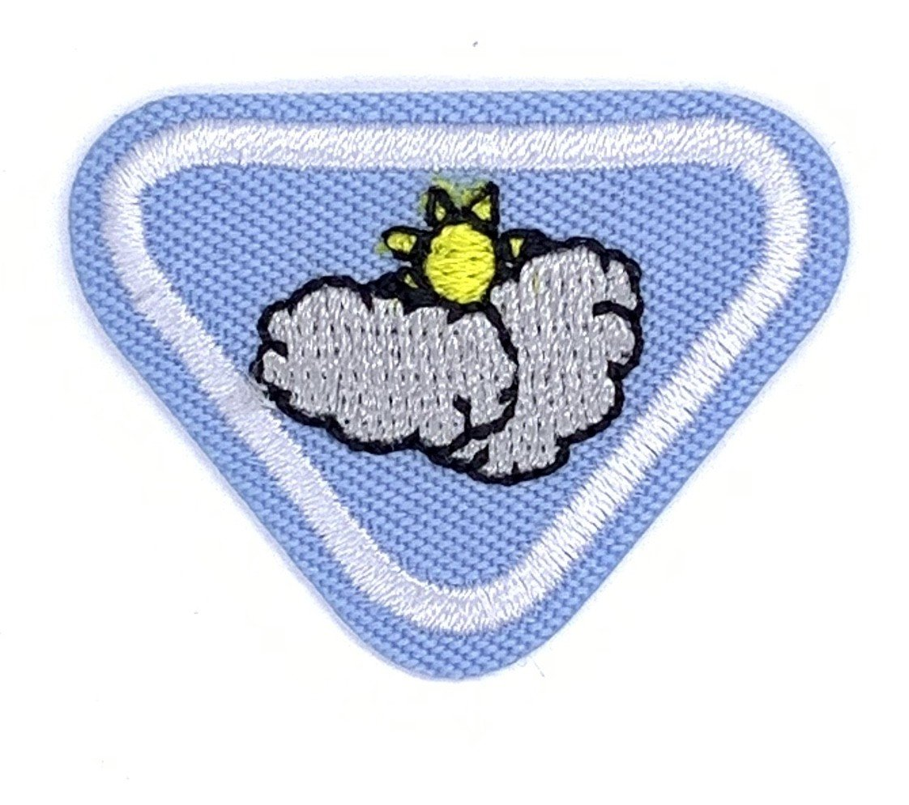
ADVENTURER AWARD WEATHER (HH) by MG P Munawa

Slide 2
Requirements
Define weather
Describe the following : wind, clouds, fog, rain, sunshine, atmosphere
Identify three instruments used to predict weather
Learn how the water cycle works and why it is important to us
Describe how temperature is measured
Find and read about the day God created the air(firmament)
Read Mark 4 : 38-39 and tell what Jesus did
Observe the actual weather for one day. Chart it and compare it to the weather report for that day
Make a pinwheel

Slide 3
What is weather?
Weather is the condition of the atmosphere at a particular time and place
It can change drastically in a 24 hour period
It is an important part of our lives and one that we cannot control
Instead the weather often controls how and where we live, what we do, what we wear and what we eat
Weather is described by factors such as temperature, wind, fog, humidity, rain, sunshine, atmosphere

Slide 4
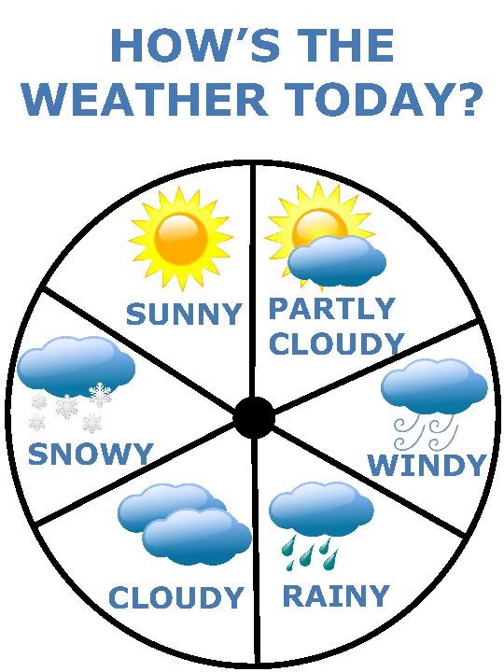

Slide 5
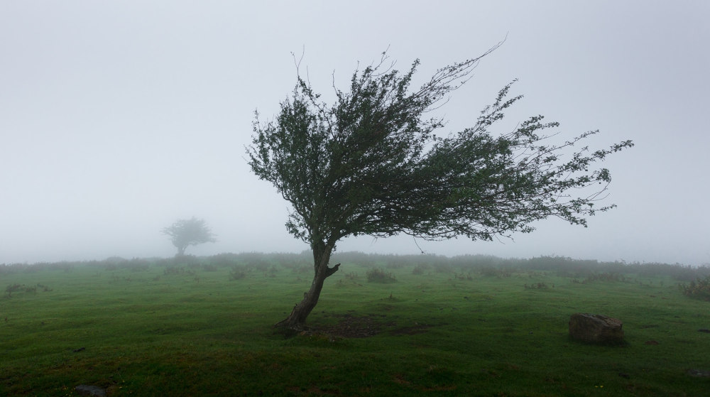
WIND

Slide 6
Wind is air in motion produced by the uneven heating of the earth’s surface by the sun
Since the earth’s surface is made of various land and water formations, it absorbs the sun’s radiation unevenly
Two factors are necessary to specify wind: speed and direction

Slide 7
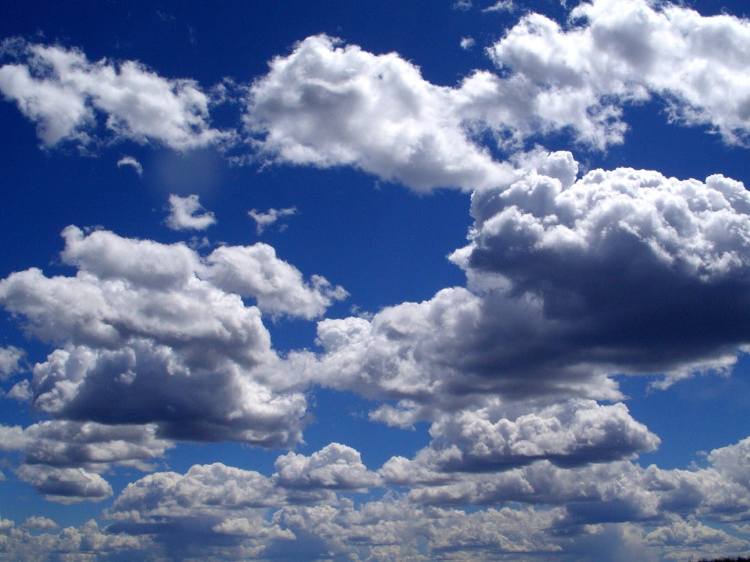
Clouds

Slide 8
A cloud is a large collection of very tiny droplets of water or ice crystals
The droplets are so small and light that they can float in the air

Slide 9
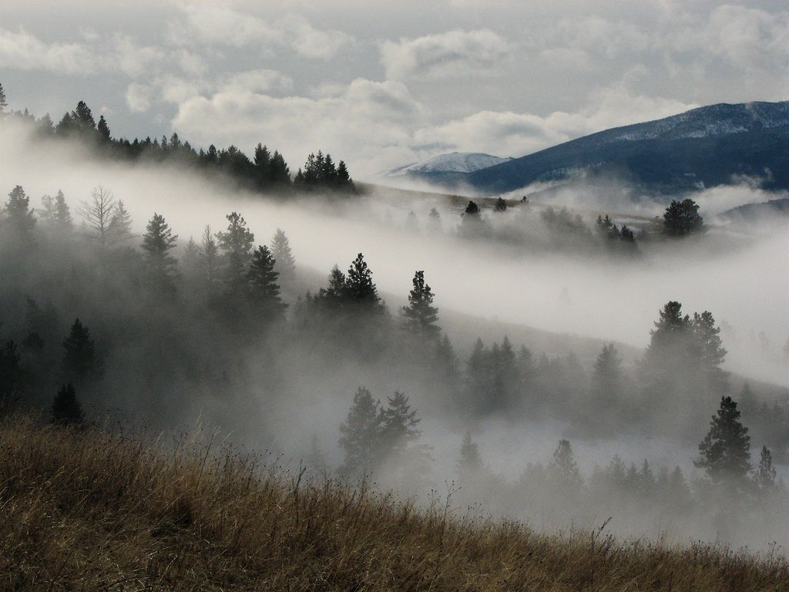
Fog

Slide 10
There are many different types of fog
Mostly formed when southerly winds bring warm, moist air into a region possibly ending a cold outbreak.
As the warm moist air flows over much colder soil or snow, dense fog often forms
Warm , moist air is cooled from below as it flows over a colder surface
If the air is near saturation, moisture will condense out of the cooled air and form fog
With light winds, the fog near the ground can become thick and reduce visibilities to zero

Slide 11
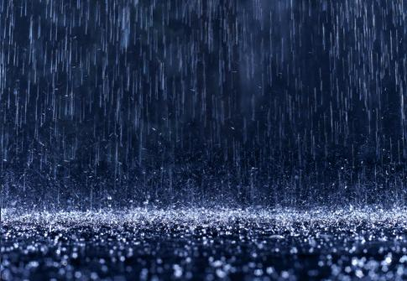
Rain

Slide 12
Water droplets form from warm air
As the warm air rises in the sky it cools
Water vapour(invisible water in the air)always exists in our air
Warm air holds quite a bit of water
For example, in summer it is usually humid
When enough of these droplets collect together, we see them as clouds
If the clouds are big enough and have enough water droplets, the droplets bang together and form even bigger drops
When the drops get heavy, they fall because of gravity and you see and feel rain

Slide 13
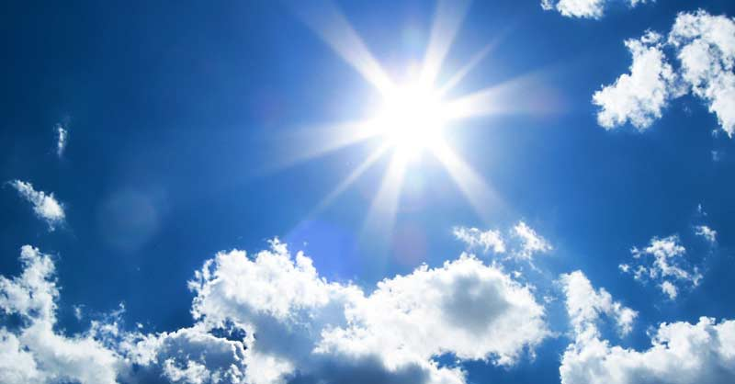
Sunshine

Slide 14
The light and heat that comes from the sun
Direct sunlight unbroken by cloud especially over a comparatively large area
The radiation that the sun gives off
On a clear and cloudless spring day, you can go outside and enjoy the sunshine

Slide 15
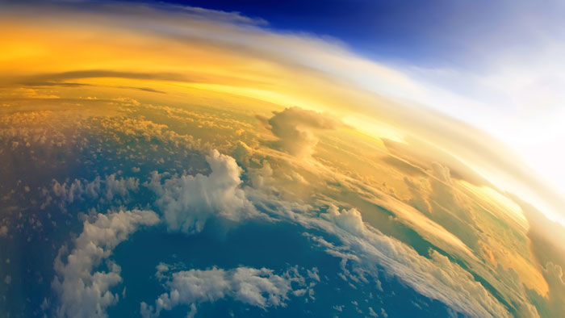
Atmosphere

Slide 16
The atmosphere covers the Earth
It is a thin layer of mixed gases which make up the air we breathe
The thin layer also helps the Earth from becoming too hot or too cold

Slide 17
Three instruments used to predict the weather

Slide 18
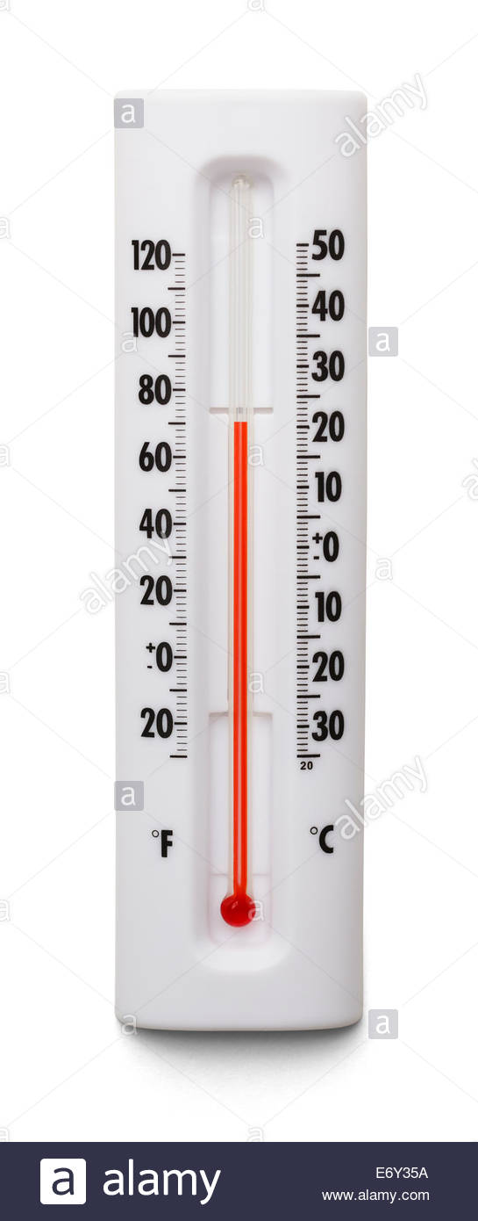
Thermometer

Slide 19
Measures the air temperature
Most thermometers are closed glass tubes containing liquids such as alcohol or mercury
When the air around the tube heats the liquid the liquid expands and moves up the tube
A scale then shows what the actual temperature is

Slide 20
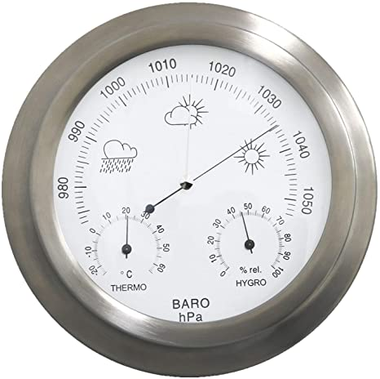
Barometer

Slide 21
Measures air pressure
It tells you whether or not the pressure is rising or falling
A rising barometer means sunny and dry conditions
A falling barometer means stormy and wet conditions
An Italian scientist named Torricelli built the first barometer in 1643

Slide 22
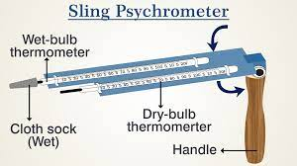
Sling Pyschrometer

Slide 23
Measures relative humidity using the cooling effect of evaporation
Two thermometers are used in a sling psychrometer
Wet the cloth of one of the thermometers and swing the psychrometer around a few times
Water evaporates from the cloth, causing the temperatures on that thermometer to be lower than the other

Slide 24
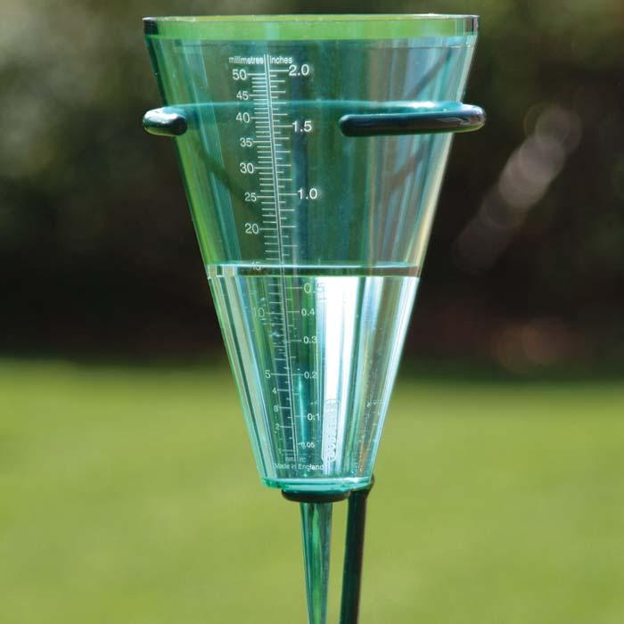
Rain Gauge

Slide 25
Measures the amount of rain that has fallen over a specific time period

Slide 26
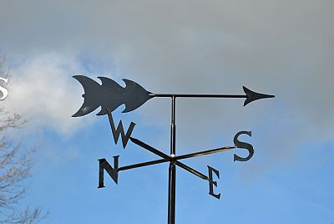
Wind Vane

Slide 27
Determines the direction from which the wind is blowing

Slide 28
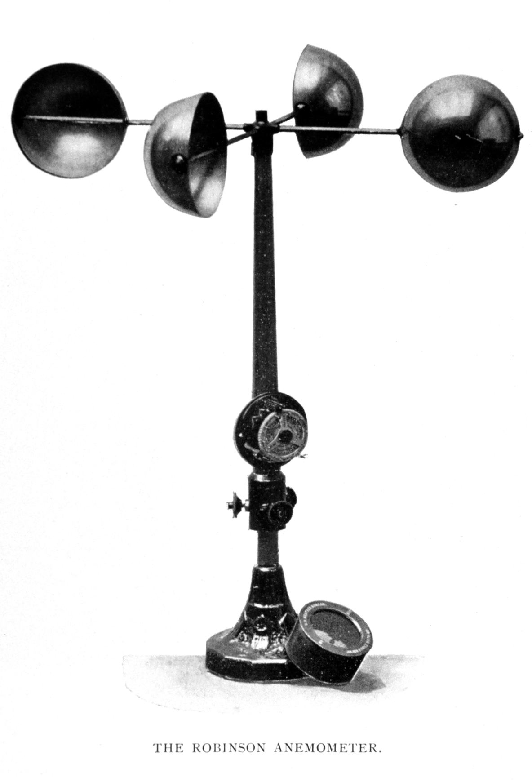
Anemometer

Slide 29
Measures wind speed
The cups catch the wind turning a dial attached to the instrument
The dial shows the wind speed

Slide 30
How the water cycle works and why it is important to us

Slide 31
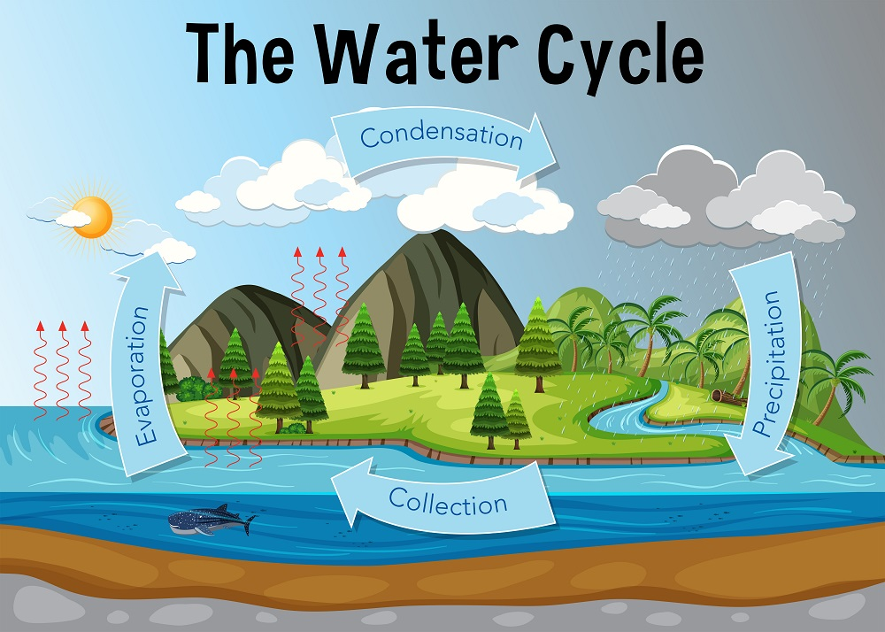

Slide 32
Water keeps moving in an endless cycle called the water cycle
Water itself is the only substance that exists in liquid, gas, and solid form- the keys to the water cycle
Water evaporates from oceans, rivers and lakes (water in liquid form) and rises into the atmosphere( water in its gas form) where it condenses to form clouds
Precipitation then falls to the earth in the form of rain(water in its liquid) or snow(water in solid form) where it flows into oceans, rivers and lakes and the process begins again

Slide 33
Measuring temperature
Temperature is a degree of hotness or coldness that can be measured using a thermometer
Its also a measure of how fast the atoms and molecules of a substance are moving
Temperature is measured in degrees on the Fahrenheit, Celsius and Kelvin scales

Slide 34
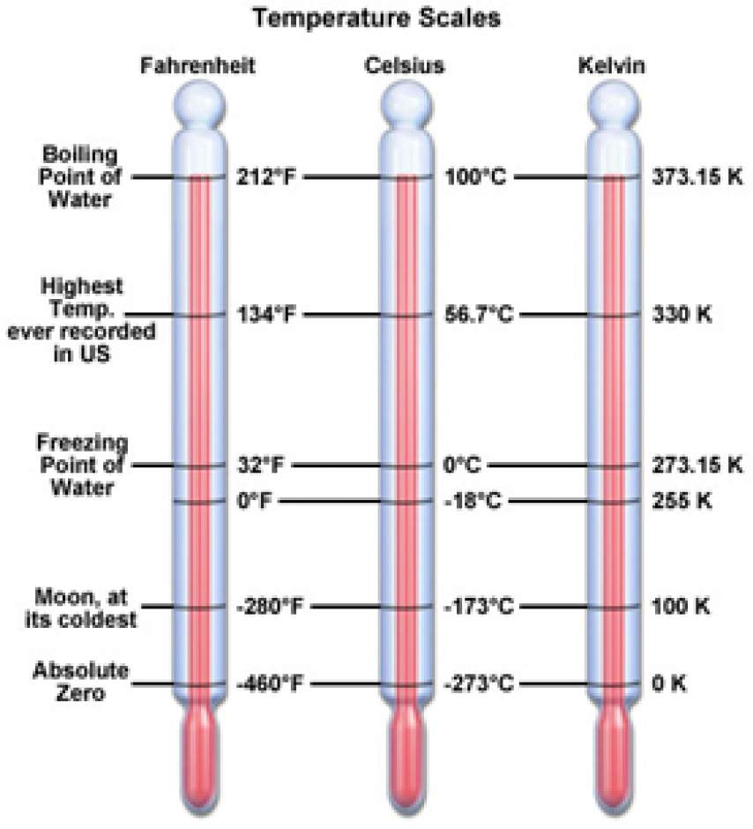
Temperature scales

Slide 35
Genesis 1:6-8
Then God said, ”Let there be a firmament in the midst of the waters and let it divide the waters from the waters.” Thus God made the firmament and divided the waters which were above the firmament and it was so. And God called the firmament Heaven. So the evening and morning were the second day

Slide 36
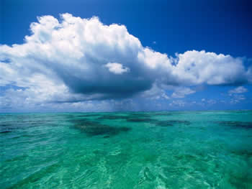

Slide 37
Mark 4:38-39
Jesus was in the stern, sleeping on the cushion. The disciples woke him and said to him “Teacher, don’t you care if we drown?” He got up, rebuked the wind and said to the waves, “Quiet! Be still!” Then the wind died down and it was completely calm.

Slide 38
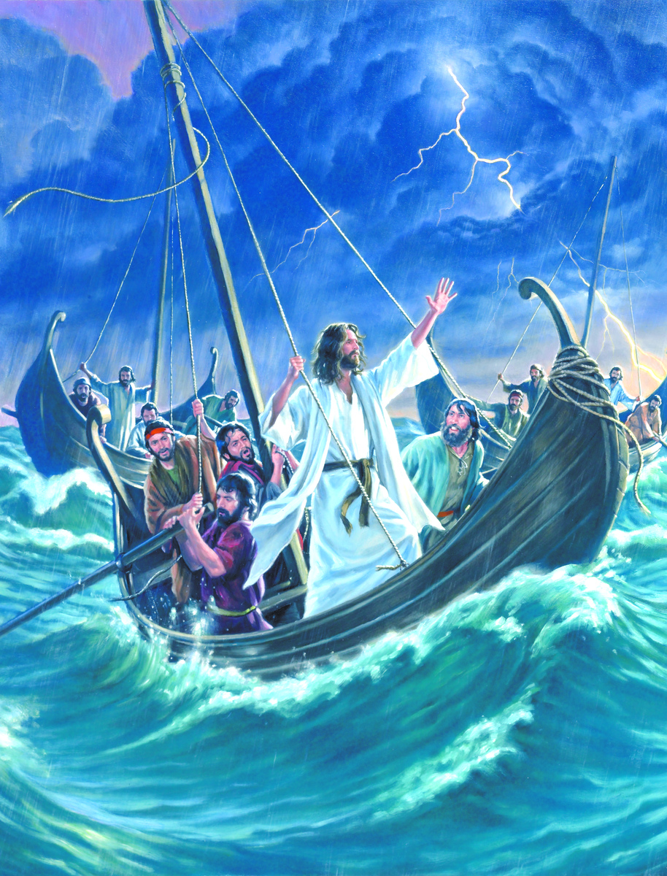
Jesus talked to the waters and they obeyed him

Slide 39
Fun activity
Observe the actual weather for a day. Chart it and compare with the weather report for the day

Slide 40
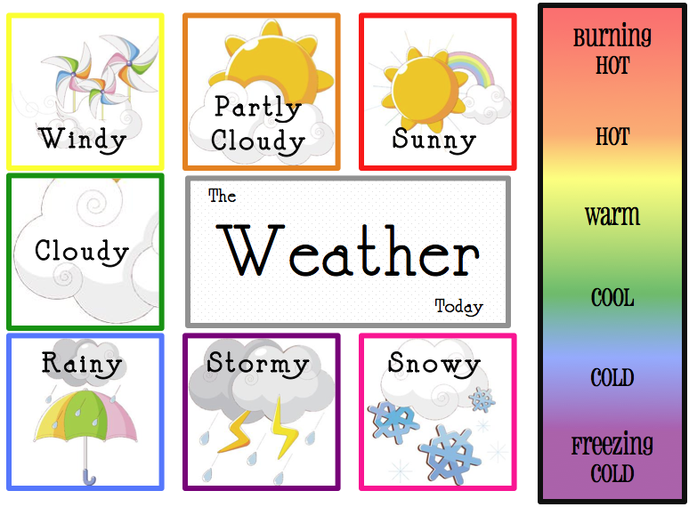
Parents can help too

Slide 41
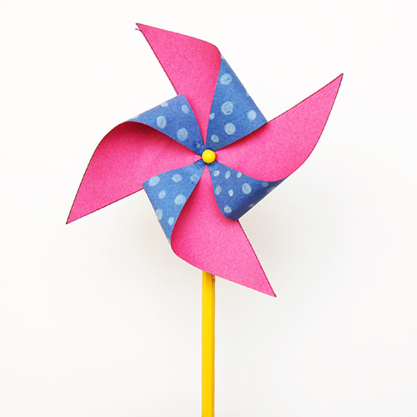
Making a wind pin wheel

Slide 42
Materials
Paper or card stock
Scissors
Glue stick
Pencil with eraser
Push pin
Bead (optional)
Crayons or markers (optional)

Slide 43
Instructions
1. Start out by cutting two identical squares from paper or card stock. If you are keen on using templates, you can choose from any (online) pinwheel templates and print them out on Letter or A4 size paper or card stock.
2. You can leave the squares plain or colour and draw some patterns or designs.
3. Cut out both paper squares.
4. Glue the undecorated sides of the squares together. Remember to apply glue not just along the edges, but on the entire back area of the squares.
5. Cut along the 4 diagonal dotted lines.
If you're not using templates, cut the square halfway to the centre.

Slide 44
6. Gather the four corners towards the centre without creasing the paper. You may glue the ends in place or just hold them together with your hand as you do the next step.
7. Insert a push pin at the centre. If you did not glue the ends of the paper in Step 6, the push pin should hold all four ends together. Wiggle the push pin around to make the hole a bit larger.
8. Push the pin onto a pencil's eraser. Don't push on too tight to allow the pinwheel to spin more freely.
As an option, you may put a bead or small button between the paper and the eraser. This helps the pinwheel rotate better and prevents the pin's point from going through the other side of the eraser.
9. Finally, try blowing at the edges of the pinwheel to make it spin. Loosen the pin a bit if the blades do not rotate well. Enjoy!

Slide 45
Alternative Safe pin wheel
( pinless)

Slide 46
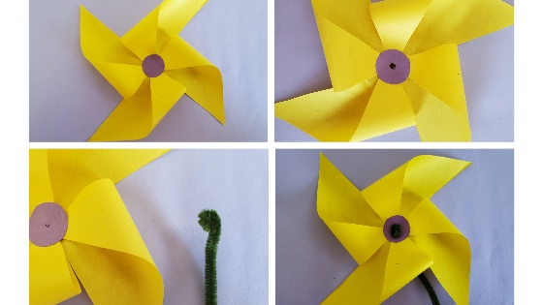

Slide 47
Materials
Paper
Straws that bend or flex
Pipe cleaner
Glue

Slide 48
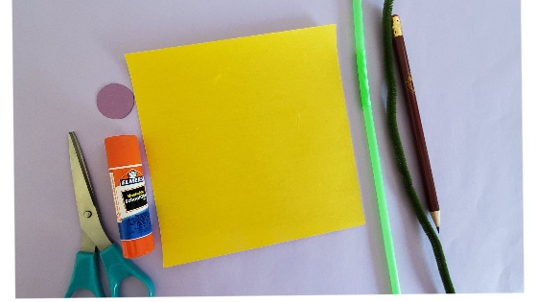

Slide 49
Instructions
Take a square piece of paper (preferably a 6 by 6 square), decorate it if you would like to
Fold it diagonally corner to corner so that it makes an X crease on the paper

Slide 50
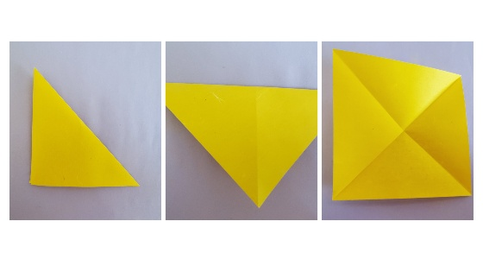

Slide 51

Cut all the four diagonal lines starting from the corners going up halfway up to the centre

Slide 52
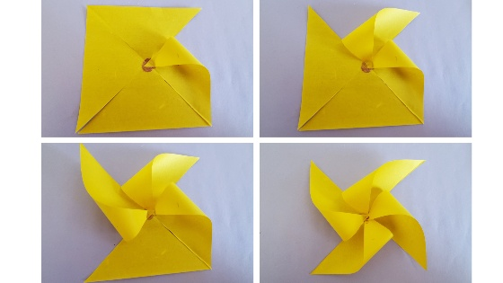
Gently fold every other corner point and glue it to the centre of the paper

Slide 53
You might need to hold and press them for sometime so that they stick together
Cut a small circular piece of paper and glue it at the centre of the pinwheel
Punch a hole in the centre of the pinwheel
Roll one of the ends of the pipe cleaner and thread it through the pinwheel hole so that it doesn’t come off from the pinwheel
Put the pipe cleaner through the straw from the flexible side
Make sure the straw is not touching the pin wheel and there is room for the pinwheel to rotate

Slide 54
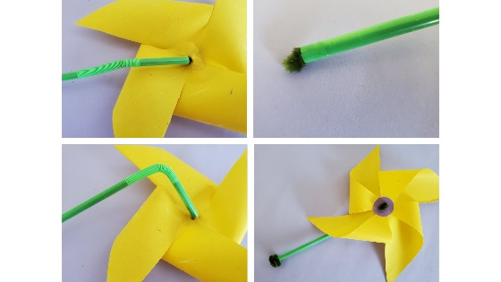

Slide 55
Wrap the loose end of the pipe cleaner around the end of straw
Bend the straw and blow some air on it and watch it spin
A pinwheel without a pin which is safe and spins freely is ready to use
And so fun to make

Slide 56
No flexible straw, no problem
Cut a small piece from a regular straw
Bead the paper pinwheel and then the small piece of straw through the pipe cleaner
Make a small slit near one end of another straw
Put the pipe cleaner through that slit and wrap the pipe cleaner to the other end of the straw

Slide 57
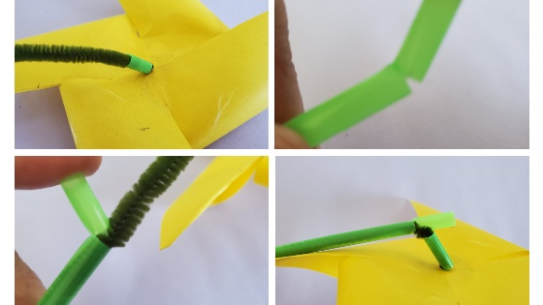

Slide 58
SUMMARY
We have learned what weather is and described wind, fog, rain, sunshine, atmosphere
We have identified three instruments used to predict weather
We have learnt how the water cycle works and why it is important to us
We can now describe how temperature is measured
We have read about the day God made the air(firmament)
Now I pray that you will be able to observe the weather for a day, chart and compare it with the actual weather report
Enjoy making your wind pinwheel
May God continue to bless you all as you grow in His Ministry. Blessings

