Slide 1

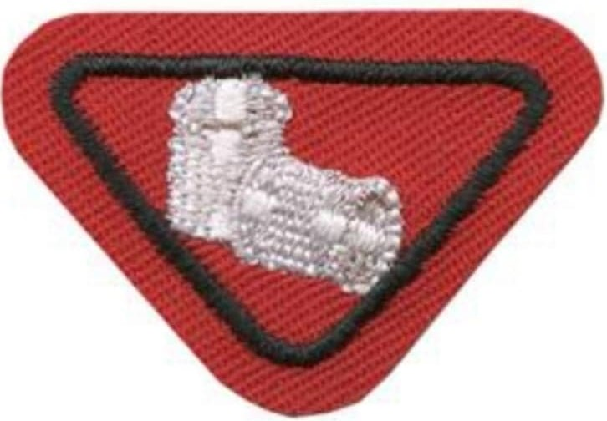
Adventist Adventurer Award
Tin Can Fun
Presented by: MG Rona Ymballa
3rd of April 2021

Slide 2

Requirements:
What is the earliest known use of tin and how is it used today?
Play "Mystery Can Fun" game.
Keep a record of how many cans your family uses this next week.
How were things preserved in Jesus' day?
How was tin used in Bible times?
Make a telephone or stilts with tin cans.
7 Bring three cans of food to donate

Slide 3

What is the earliest known use of tin and how is it used today?
World Map & Iraq

Slide 4
Keep a record of how many tin cans your family will use this next week.
Write the recordings of how many tin cans the whole family uses for the whole week on your worksheet and submit this to your Adventurer leader to confirm that you have completed the recording.

Slide 5
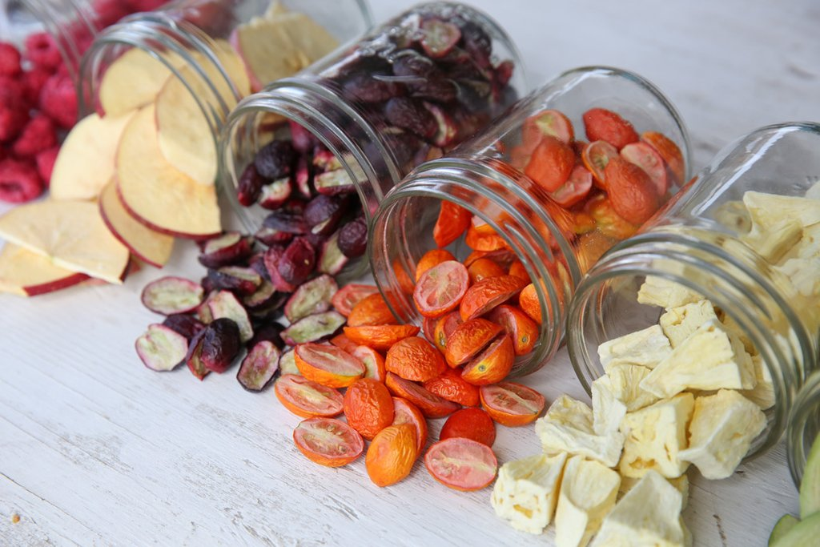
How were things preserved in Jesus’ day?
Things were preserved by drying them out with salt. Dried fish, figs, and other fruits were common. Today most of the “tin plate” is used to coat the steel cans to give them an attractive appearance and protect the cans from rust. These cans are for packing food and other items that would quickly spoil.

Slide 6
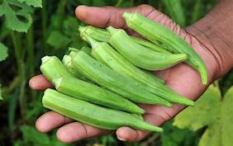
The first example of preserving food in the time of Jesus is pickled okra.
Source reference; Writer and food blogger Emily Paster

Slide 7
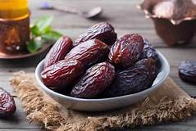
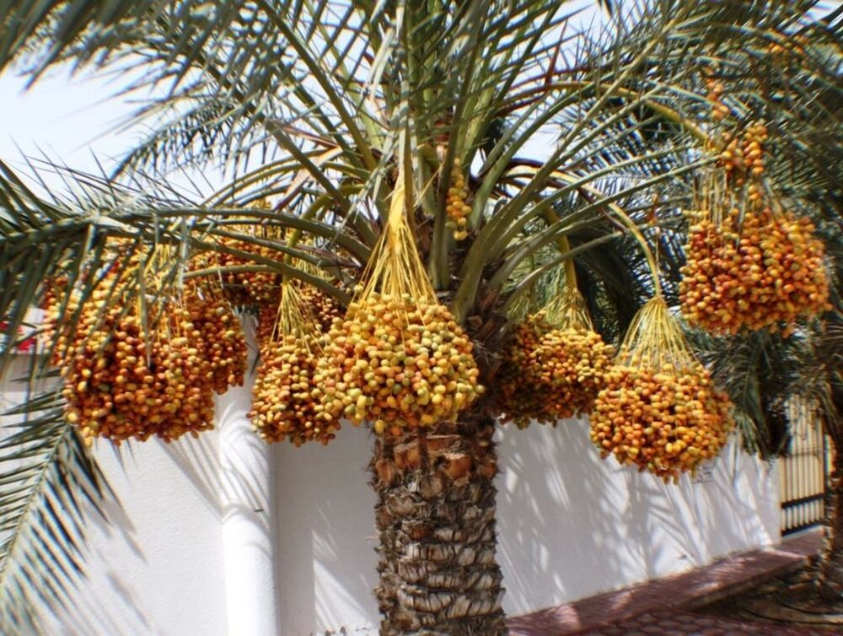
People have been preserving food for hundreds of years, particularly in Bible lands. It was important for their survival. The weather was generally hot for most of the year and they could not store food in a refrigerator. The first preserved food was probably dates.
Reference: Emily Paster blog

Slide 8
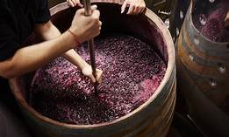
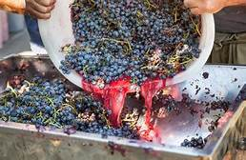
Fruit preservation is a form of preserving dating back thousands of years. A classic example is preserving grapes.
As Jewish families began to move out of desert areas, the way they preserved food changed.
Reference: Emily Paster blog

Slide 9
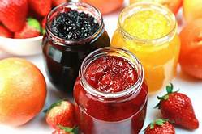
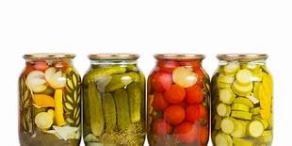
When Jews went north into the cold places, preserving food became a life-saving technique. It is going to be very difficult to get through winter unless you preserve fruits in jam — root vegetables, cucumbers, carrots, beets pickled or jam.
Reference: Emily Paster blog

Slide 10
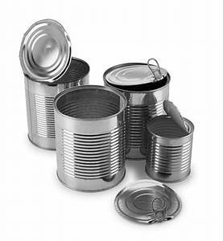
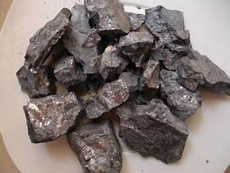
How was tin used in Bible times?
In Numbers 31:22, tin was found in the city of Midian. The city of Tyre had markets where tin was sold as mentioned in Ezekiel 27:12. Tin was also used as plummets as recorded in Zechariah 4:10.
Smith's Bible Dictionary:

Slide 11
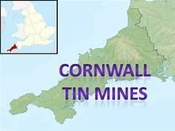
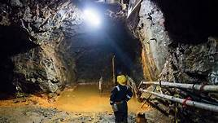
There are three countries known to contain tin: Spain, Portugal and England mainly Cornwall and Devonshire.

Slide 12
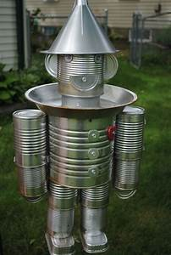
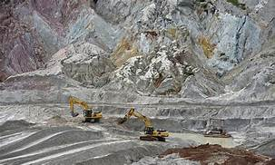
The tin found in Biblical countries most likely came from Britain.

Slide 13
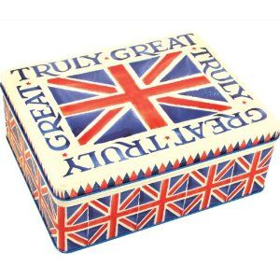
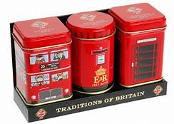
Easton's Bible Dictionary suggests:
The people of Tyre and Sidon seemed to get their supplies of tin from the British Isles. In Ezek. 27:12 it is said to have been brought from Tarshish.

Slide 14
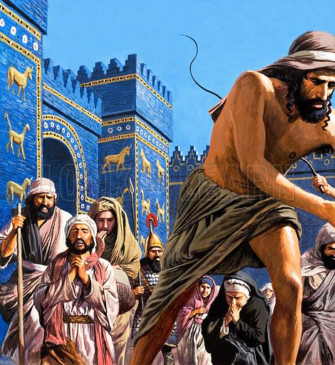
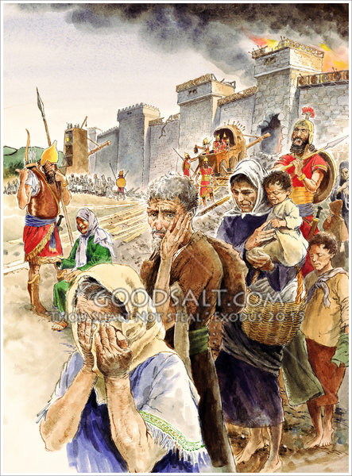
Tin was mentioned in Isaiah 1:25 when the people of Israel were reminded about the results of their sin.

Slide 15
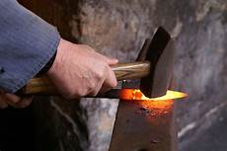
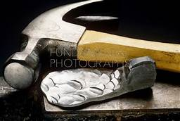
Webster's Revised Unabridged Dictionary explains:
Tin is a malleable substance at ordinary temperatures, but brittle when heated. Tin foil is used to coat iron in order to protect it from rusting.

Slide 16
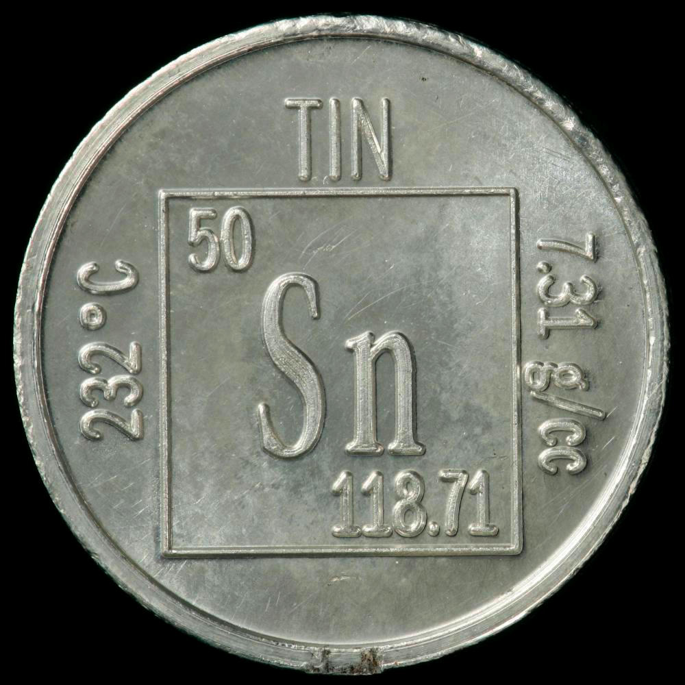
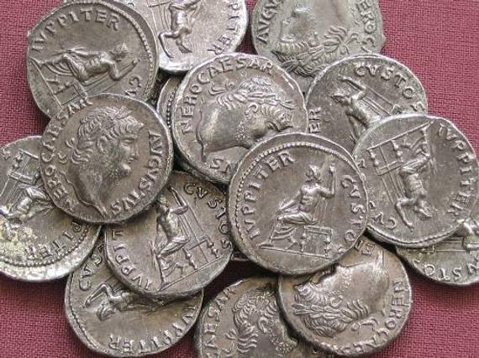
Tin compounds are identified as stannous, or stannic. Symbol Sn (Stannum):
Thin plates of iron covered with tin; tin plate.
Money.
To cover with tin or tinned iron, or to overlay with tin foil.

Slide 17
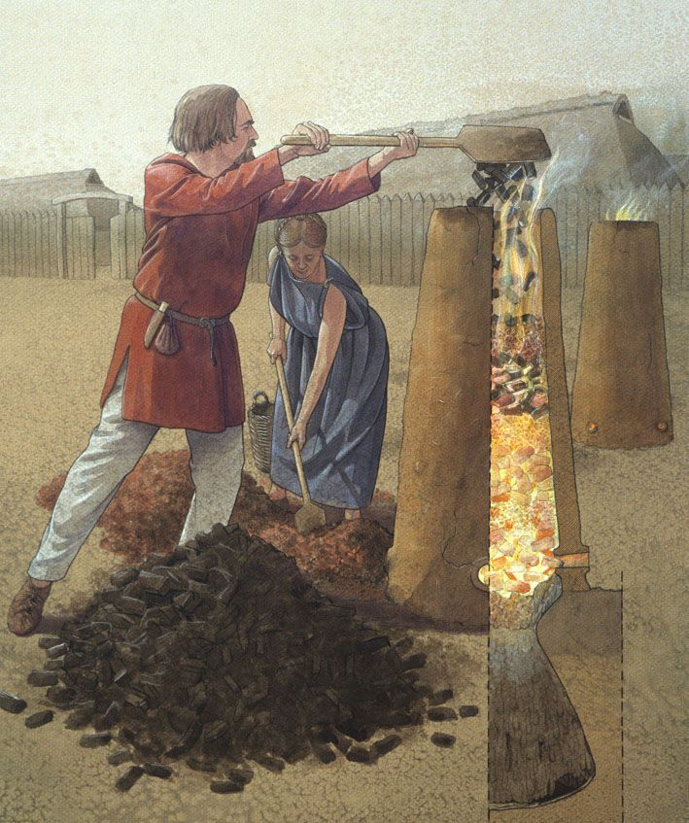
Tin is mentioned with brass, iron and lead in Numbers 31:22 & Ezekiel 22: 18, 20. Ezekiel mentions tin along with silver, iron and lead as being imported into Tyre from Tarshish.
International Standard Bible Encyclopedia

Slide 18
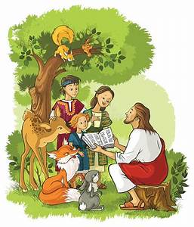

Time to participate:
Dear Adventurers,
please have your Bible with you as I will need you to read one out of the 5 Bible verses where tin or alloy is mentioned in the Bible. The Adventurer who is first to read the Bible verse will receive £2 towards your tin can food donation e-Award requirement. If you win today, please ask your Adventurer leader to contact me tomorrow on how to claim your prize. Please find your Bible now. I will count 20 seconds then we will start…

Slide 19
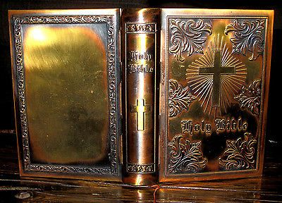
Concordance:
Let us run through a quick concordance where tin is mentioned in the Bible.
Numbers 31:22
however the gold, and the silver, the brass, the iron, the tin, and the lead…

Slide 20
Isaiah 1:25
and I will turn my hand on you, thoroughly purge away your dross, and will take away all your tin. KJV

Slide 21
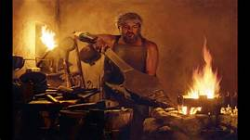
Ezekiel 22:18
Son of man, the house of Israel is become dross to me: all of them are brass and tin and iron and lead, in the midst of the furnace; they are the dross of silver.

Slide 22
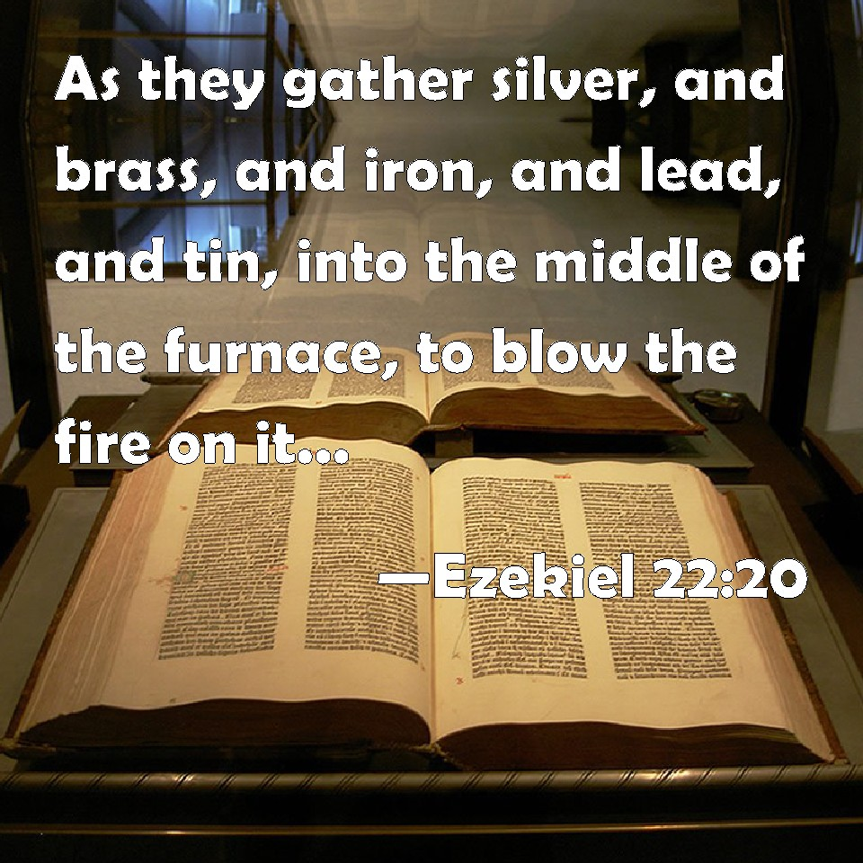
Ezekiel 22:20
As they gather silver and brass and iron and lead and tin into the midst of the furnace, to blow the fire on it, to melt it; so will I gather you in my anger and in my wrath, and I will lay you there, and melt you.

Slide 23

Ezekiel 22:20
As they gather silver and brass and iron and lead and tin into the midst of the furnace, to blow the fire on it, to melt it; so, will I gather you in my anger and in my wrath, and I will lay you there, and melt you.

Slide 24
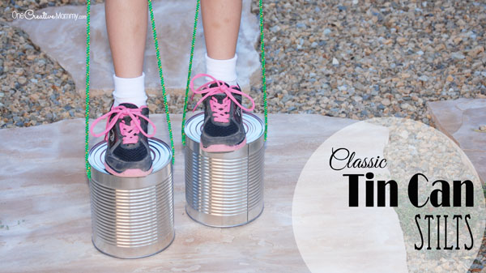
Make a telephone or stilts with tin cans.

Slide 25
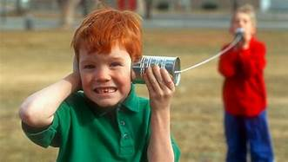
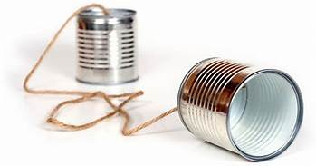
Make a telephone or stilts with tin cans.

Slide 26
To make a telephone: Poke a small hole in the bottom of two empty (and clean) cans. Put one end of a long string into each can end and tie a knot. Stretch the string tight and talk. One person will talk while the other person listens to create a “telephone.” God communicates with us like the telephone. We cannot see Him, but He is always ready to listen and help us. To make stilts: Poke a small hole on the two sides at the top of two cans. Tie a string to each can to create “stilts.” For stilt safety, use cans no smaller than 20 oz. and always wear shoes. “And walk in love...” (Ephesians 5:2).

Slide 27

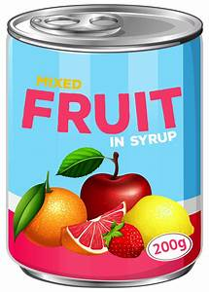
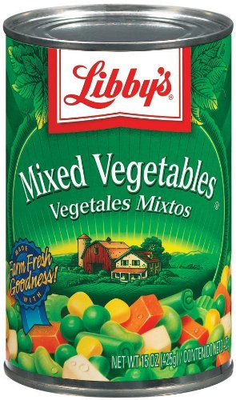
Submit 3 tin cans of food to your Adventurer leader. This will be donated to the food bank following the government guidelines on lockdown.

Slide 28







Now, we are moving on to the last requirement of our Tin Can Fun Adventurer Award…

Slide 29
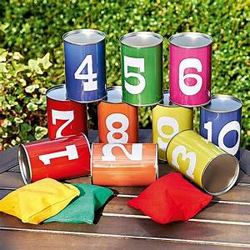
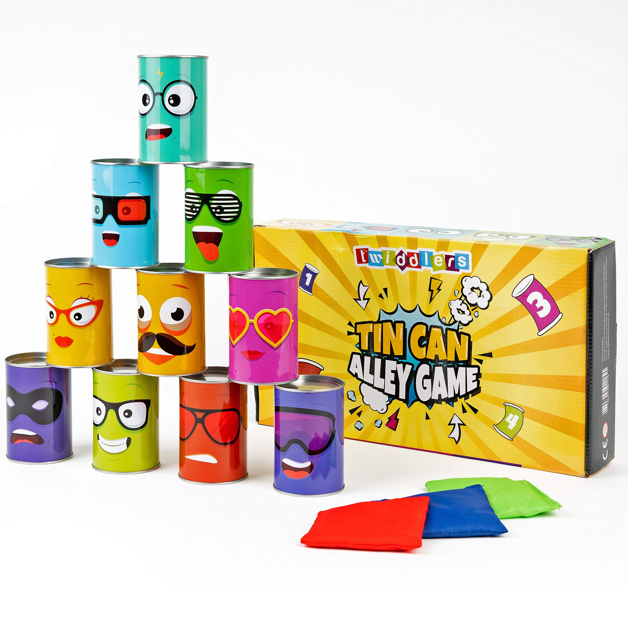
Play the "Mystery Can Fun" game.

Slide 30

I will show you one example of a Mystery Can Fun Game. You have to give your full attention. You can try this at home or you can create your own tin can fun game…

Slide 31
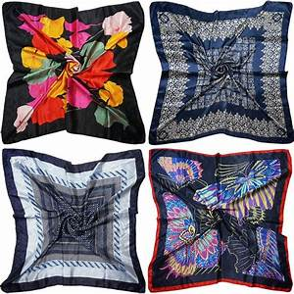
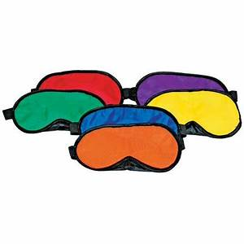
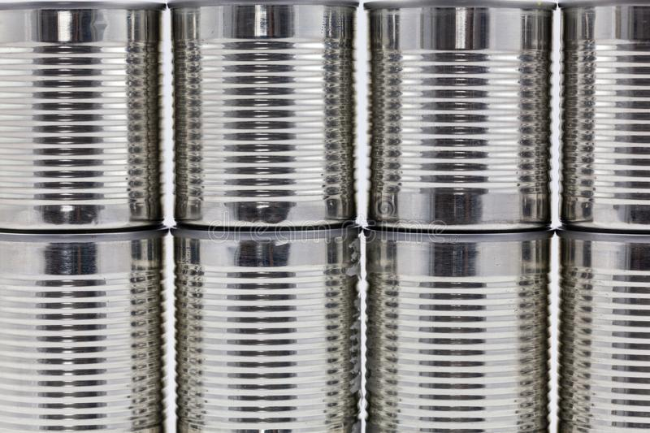
We need the following items:
Tin cans of food labels removed (at least 6 – the more the better) that are of different variety (ie: fruit, vegetable, etc.)
Blind folds x 2
3. Scarf x 2

Slide 32


Demo part:
Please watch and pay attention…

Slide 33
Tin Can Mystery Fun Game Instructions/Mechanics:
Blindfold at least 2 participants to the mystery tin can fun game.
Cover the participants nose with a scarf.
3. Instruct the participants not to sniff the opened tin can.
4. Open 2 unlabelled tin cans of food.
Let each participant have a spoonful of the food from the tin can.
Let the participants take a guess and shout out the answer at the count of three.
Continue the game by opening the next tin can of food.
8. You can have more tin cans and more participants according to your preference.

Slide 34
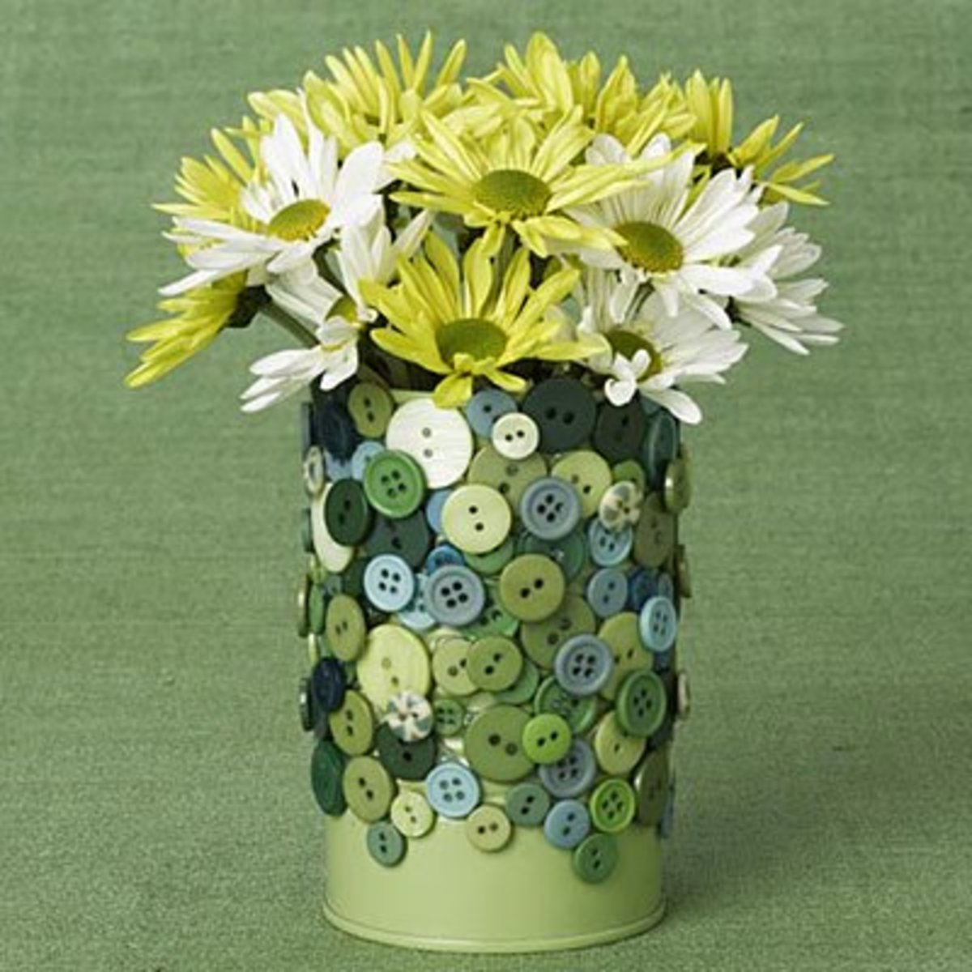
Here are some button covered tin can ideas:
Glue buttons on the can in vertical or horizontal rows. You can do rows of different colours or vary the size of buttons in each row.
Do a sort of 'potpourri' covering of buttons- different sizes, shapes and colours
Draw a design on the can with a sharpie with swirls, etc. Use different buttons to fill in the design.

Slide 35
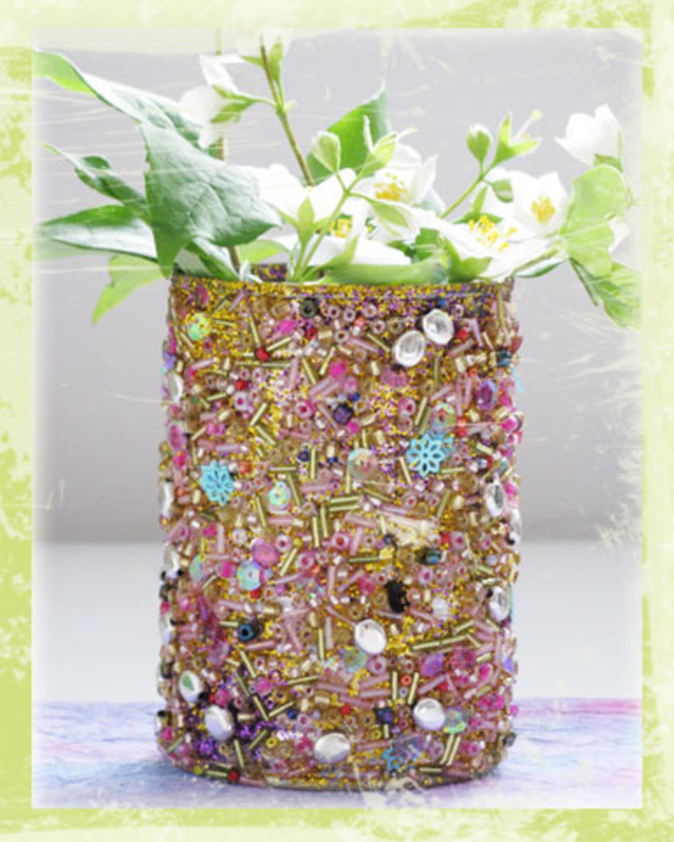
Seed Bead Embellished Tin Can Planter
You can apply them in a pattern or do a sprinkling of different colours and shapes like on this can. There are lots of different colours to choose from when it comes to seed beads. You could also make these cans to use for decoration in your home for each and every holiday if you wanted.. just throw in some flowers and you have a cute vase, put a candle in it or use it as a pencil/pen holder. You could also use these cans to hold napkins, utensils, etc for summer parties and picnics.

Slide 36
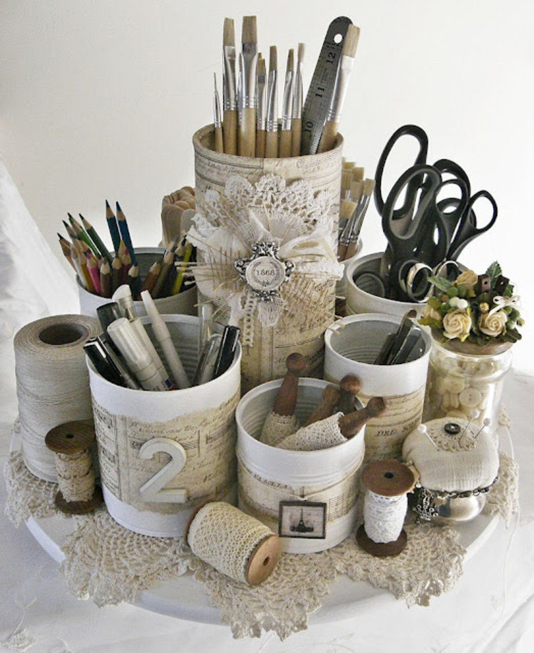
This is one of those that you can really have fun and get creative with. If you like this particular caddy, it looks some handwritten letter gift wrap were used to cover most of the tin cans. The trinkets and flower were used to decorate them with.

Slide 37
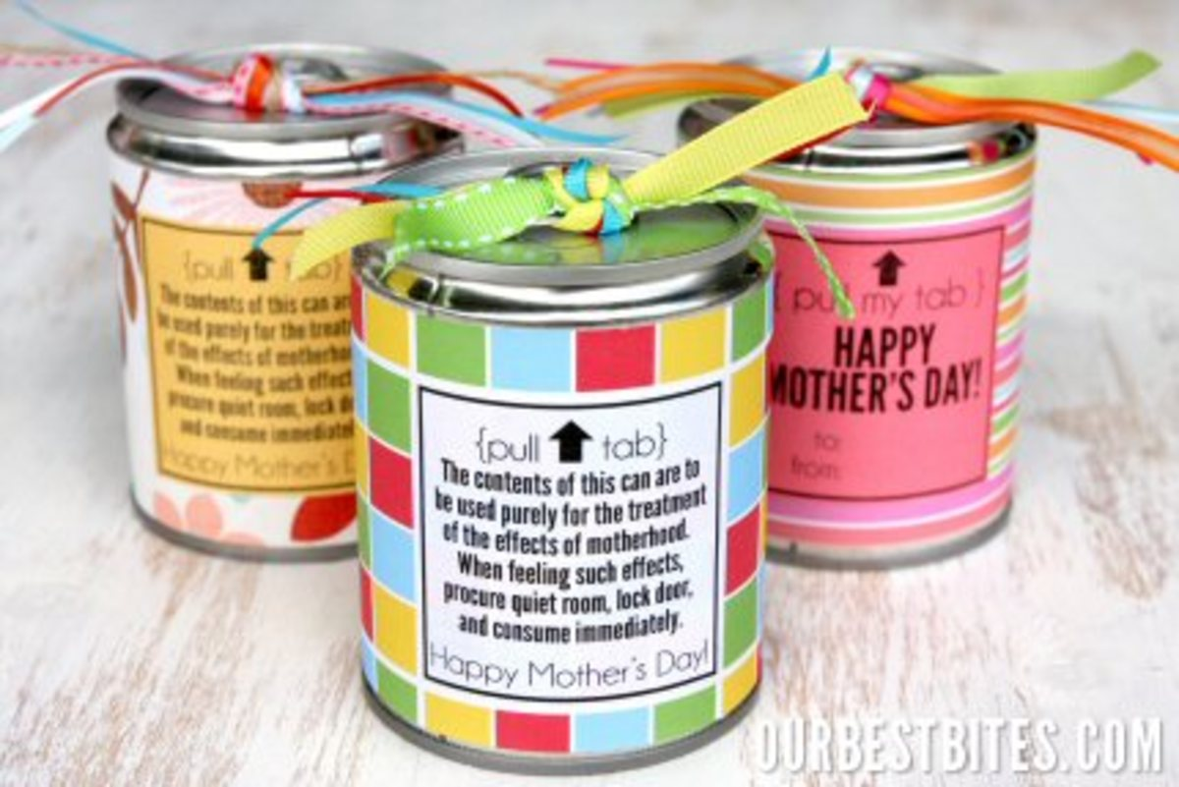
Tin Can Treats
It's little tin cans full of candies/goodies but you can only get to the goodies by pulling off the tab on top. They are actually those small Del Monte canned fruits with the pull tab tops. Basically, you just open the other end/bottom of the can with a can opener, pour out the fruit to save and eat later, decorate the can and fill with candies and goodies, glue the bottom back on and give them away as gifts! To get to the goodies the recipient will have to open the pull tab on top.
Reference:
https://feltmagnet.com/crafts/cute-clever-tin-can-craft-projects

Slide 38

That concludes our Tin Can Fun Adventurer Award this afternoon.

Slide 39


Thank you everyone for participating. Congratulations for earning the Adventurer Award today! Well done! God bless.

