Slide 1
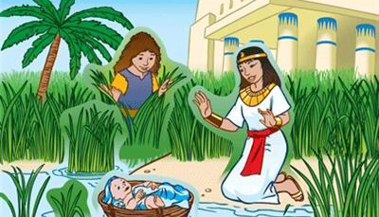
Child care: Babysitting
By Sinqobile Volo-Sibanda

Slide 2

How well do you know your Bible?

Slide 3




Clue
My father was a slave
I had 2 brothers
I was very brave

Slide 4
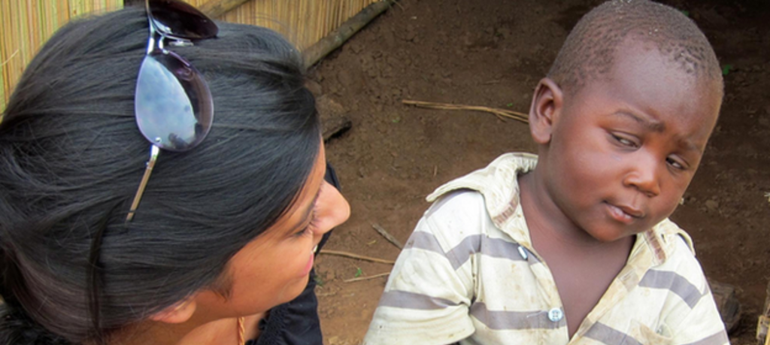

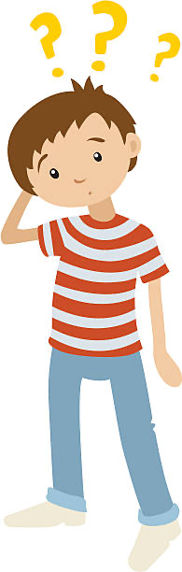
Why Baby sitting?

Slide 5

It could be used as a way of reaching out to your neighbours, relative, or friend or visitors in your local church. A church that ministers well to children will attract and retain their parents as members.

Slide 6

Helping hand at home so mum can take a break.

Slide 7

Parents appreciate the opportunity to get away from the baby for a few hours (date night💃🏽, pamper night 🧖🏾‍♀️🧖🏾‍♀️)

Slide 8
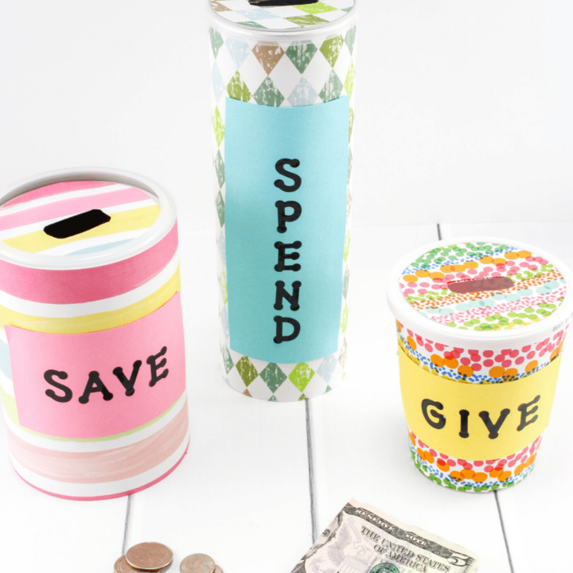
A way of raising funds for ADRA 😜, pocket 💰 , holidays, gifts etc

Slide 9




REQUIREMENTS

Slide 10
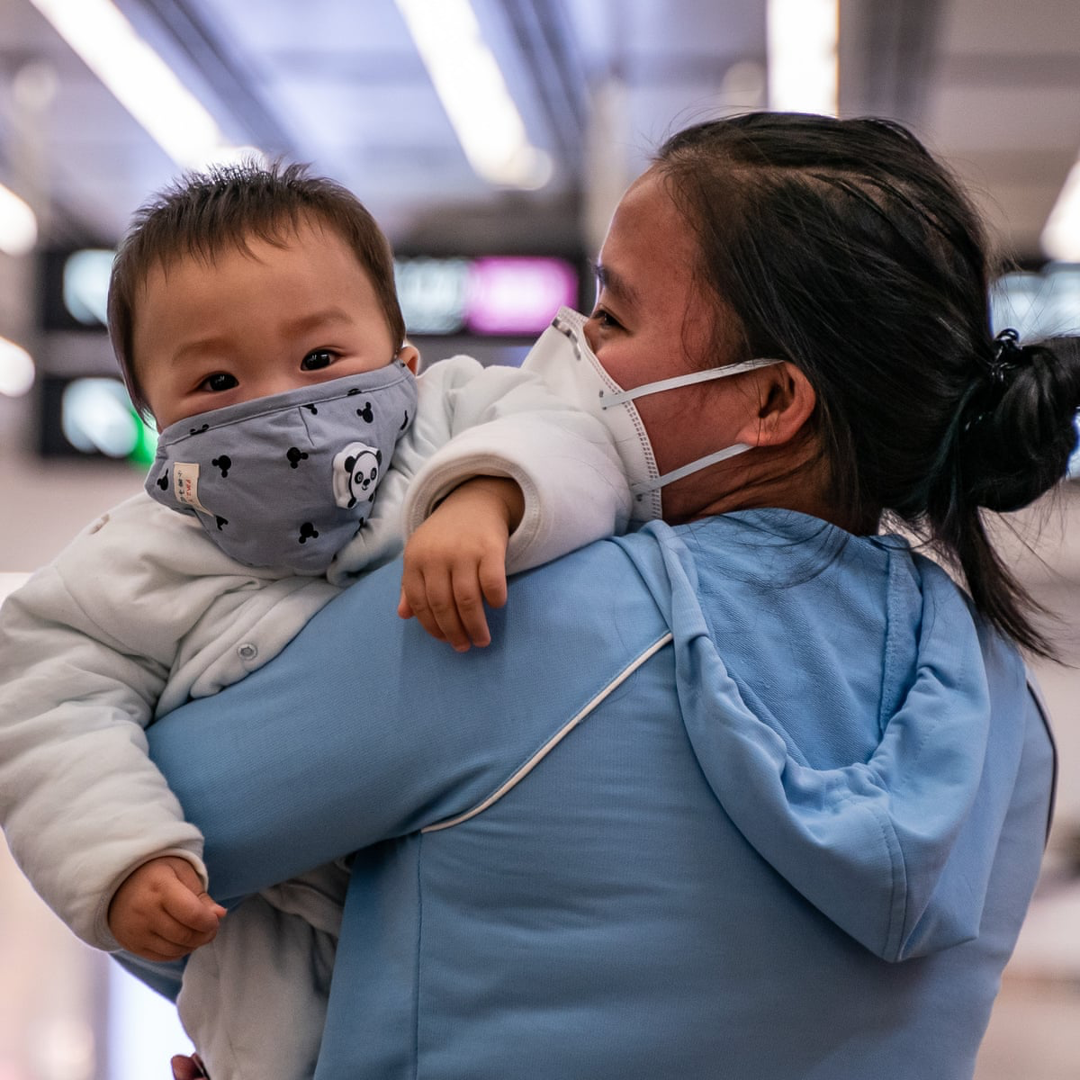
R
After studying the other requirements in this honour, and after taking care of a baby while its mother is present, you will be ready to take care of a baby in its mother's absence. Offer to watch the baby of a relative, friend, neighbour, or church member. They may offer to pay you, but if you do it for free, you can count time spent watching the baby as community service or outreach.

Slide 11
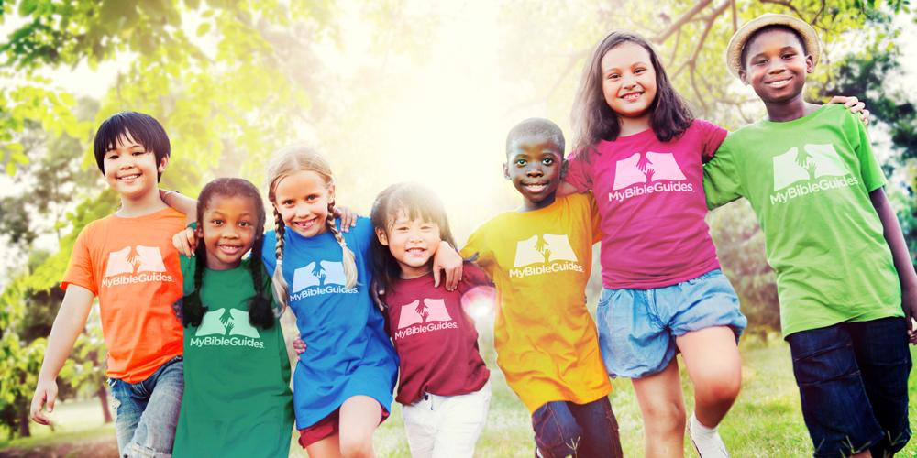
There are many outreach opportunities for meeting this requirement. If your church is conducting an evangelistic seminar, you can offer your services in the nursery, junior sabbath school, weddings or seminars the list is endless.

Slide 12


Slide 13

Can/not!!!
Understand Your Abilities and Limitations. Make sure that you’re comfortable babysitting a toddler before you volunteer your services!!!

Slide 14

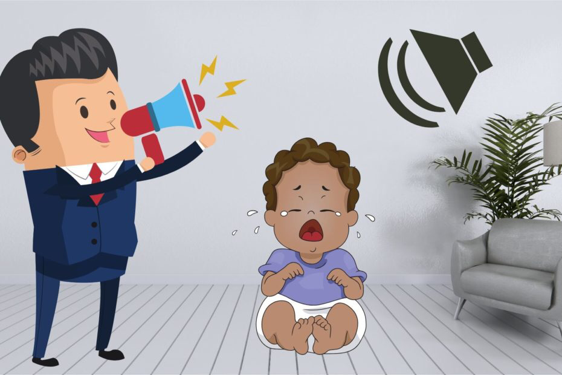
How well do I know the baby?
Make sure you’re well informed:- toddlers have very special needs that are quite different from children of other age groups. Be aware of them so that you’ll be able to keep the child that you’re watching safe.

Slide 15
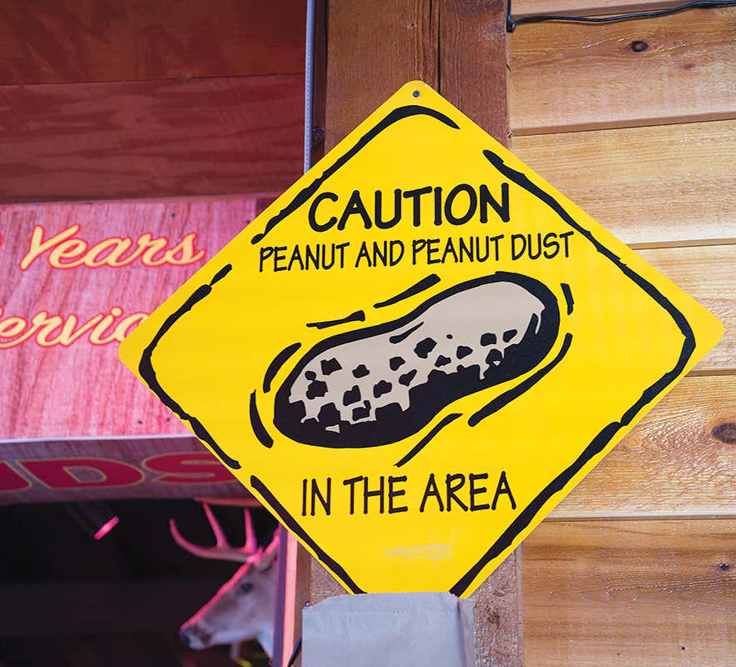
Be aware of what the baby is allergic to, it could be cat hairs, or even the remains from your Snickers bar.

Slide 16
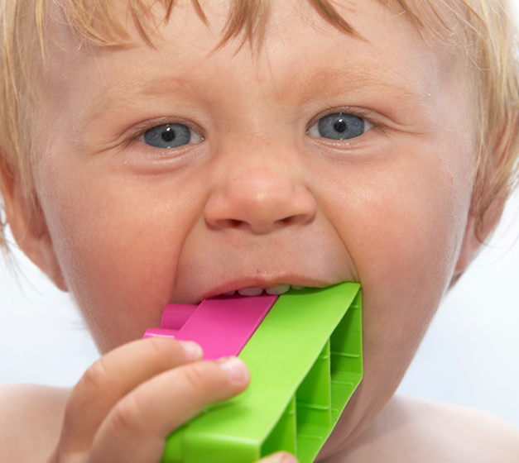
Check for small objects that can choke a child. make sure the environment or the playroom is clutter free of small objects a child could reach out and grab.

Slide 17
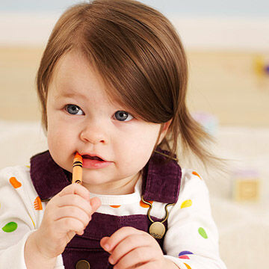
Pens and pencils or anything with a point or sharp edge, that could cut or blind a child.

Slide 18
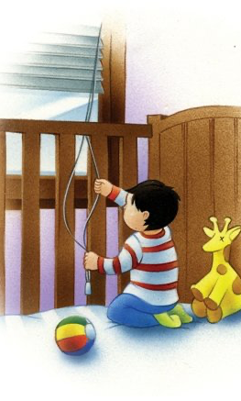
Be alert when a baby is sleeping in a baby cot, to make sure they do not wake up and try to get out. This is very important if the child can walk

Slide 19
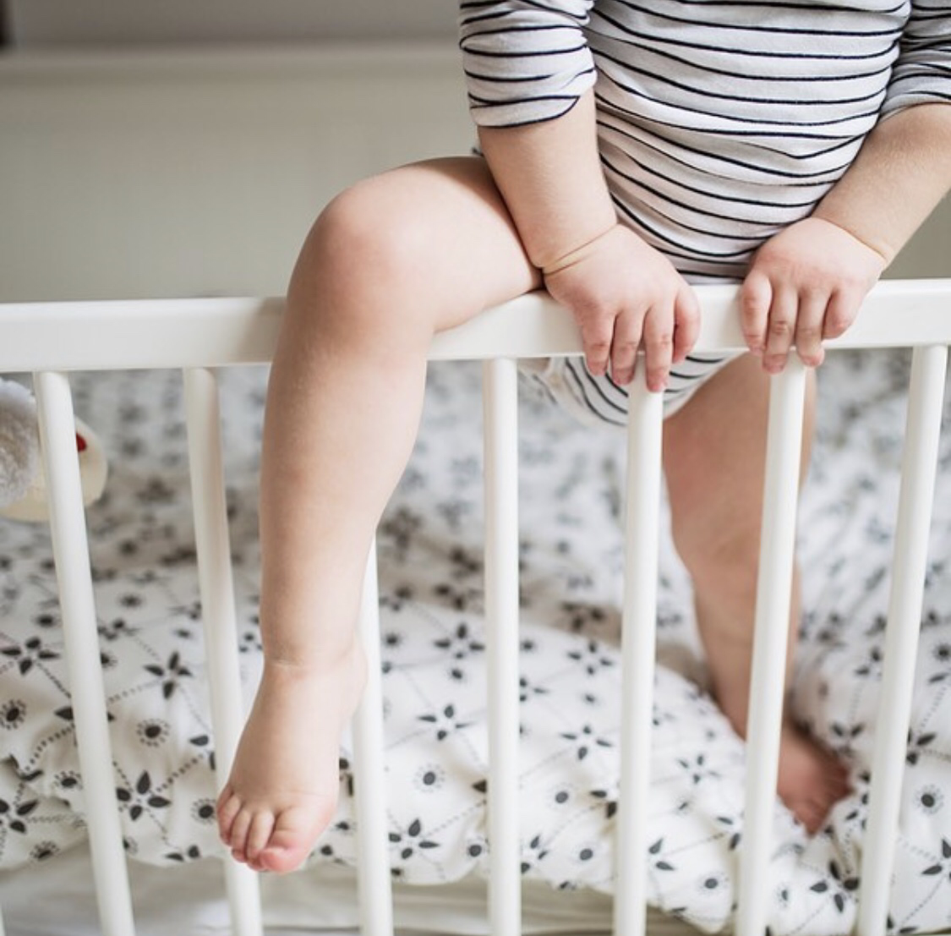
Be alert when a baby is sleeping in a baby cot, to make sure they do not wake up and try to get out. This is very important if the child can walk

Slide 20
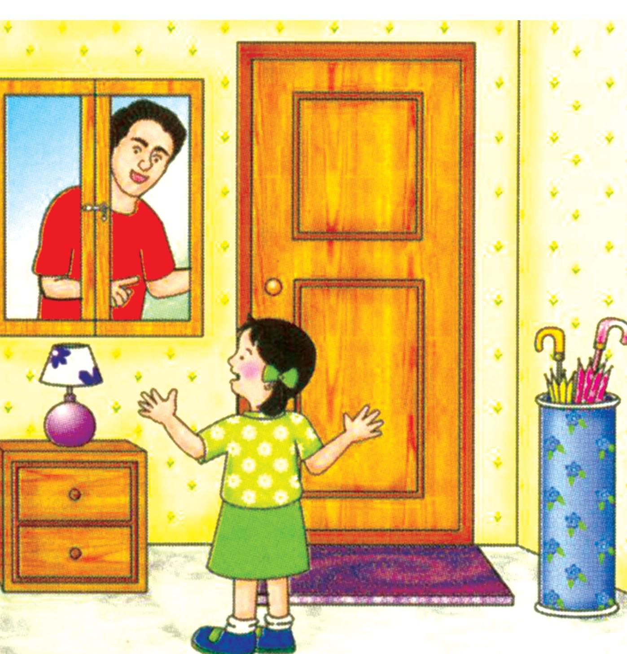
Never open the door to anyone except the parents while you are babysitting.

Slide 21
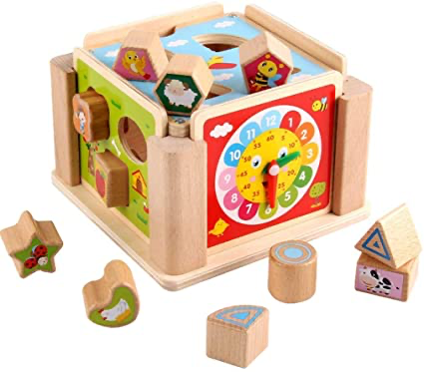
Keep them occupied at all times
Play sorting games or a Lego game or any other game that really gives that toddler’s brain a workout!!!

Slide 22
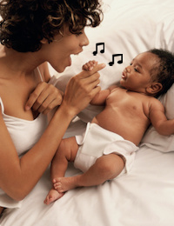
Sing them songs, just like babies, toddlers love when you sing them a song. It could be Twinkle twinkle little star, Jesus love the little ones, Wheels on the bus, Old MacDonald’s and similar songs are tried and tested favorites for young children.

Slide 23
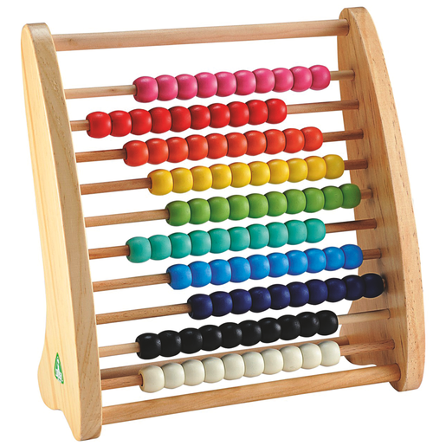
Play sorting games or a Lego game or any other game that really gives that toddler’s brain a workout!!!

Slide 24
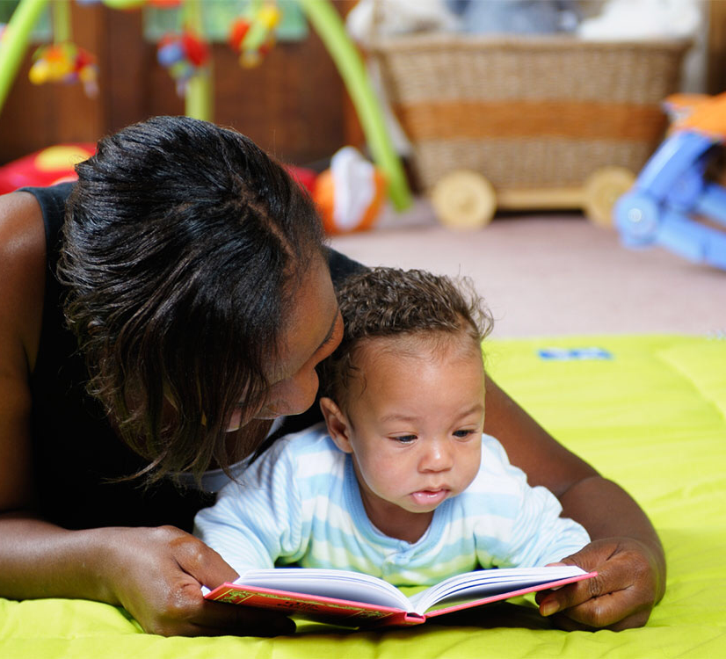
Read a book for them- most children love to have books read to them. It can even be a good way to calm down very active toddlers and get a bit of a break from chasing them around. Engage them, get them to point out different animals to you and ask them what noises each animal makes, how it moves and even what it likes to eat.

Slide 25

Try counting games and teach them colours

Slide 26
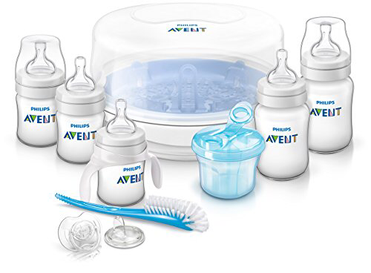
Preparing Milk
Make sure the bottle is clean
Mother’s will usual clean the bottles in advance.

Slide 27
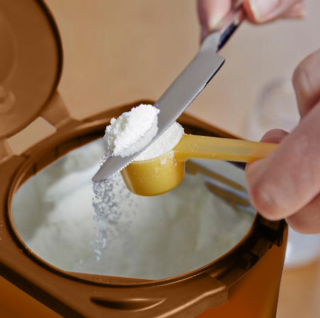
If using formula, make sure you mix it according to the directions.
If using milk, put only as much as the baby needs in the bottle. The baby's usual care-giver should be able to tell you how much and how often the baby should be fed.

Slide 28
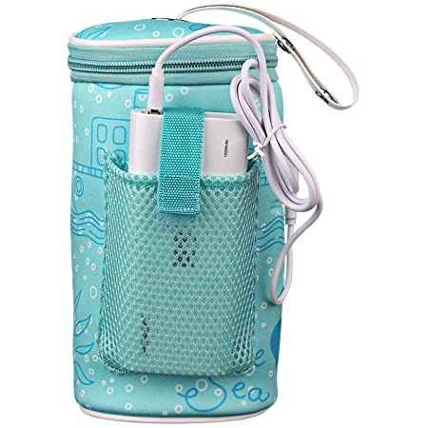
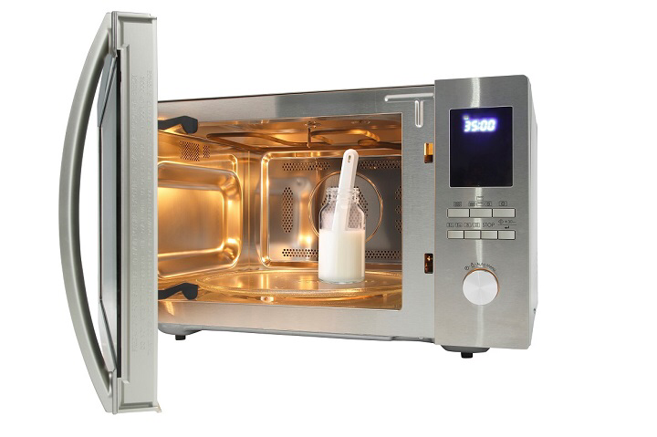
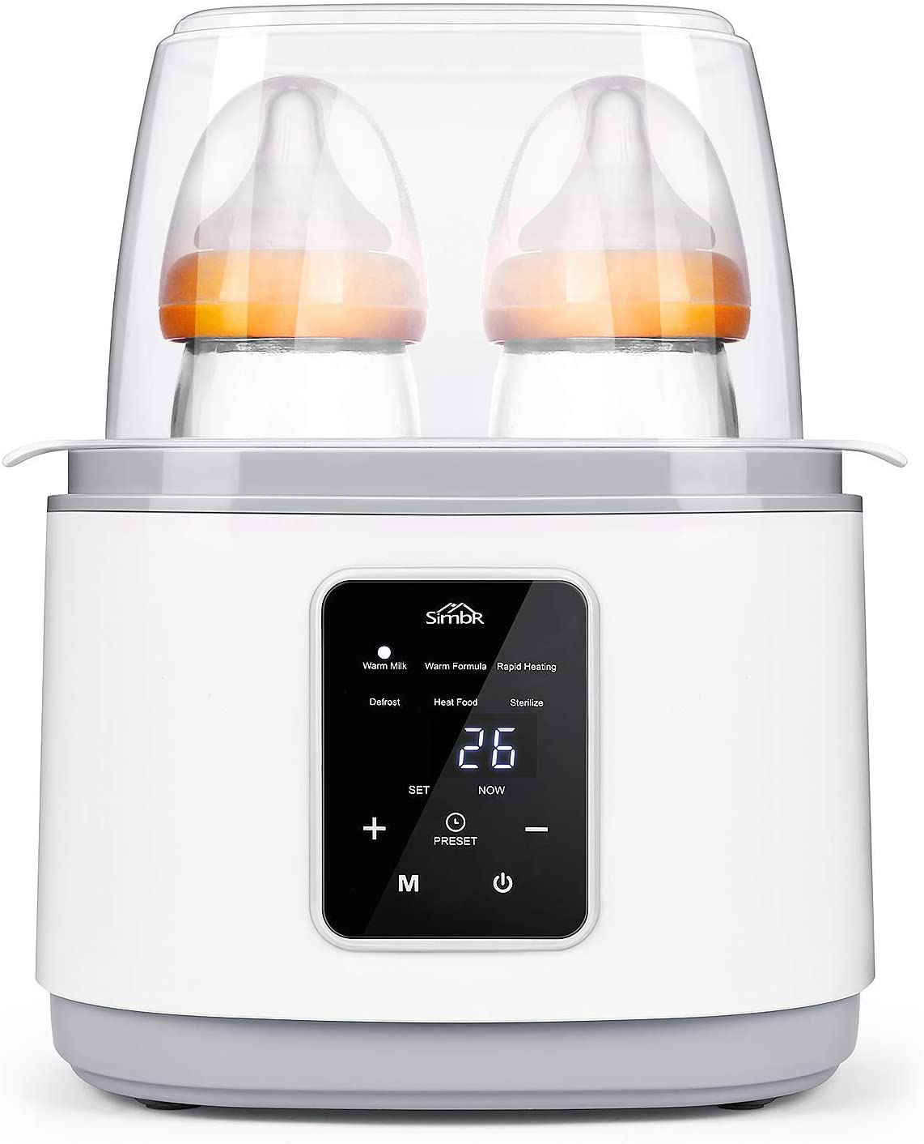
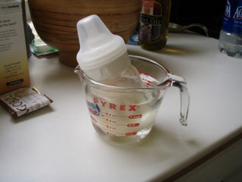
Ways of warming baby milk…
The problem with heating milk in a microwave is that it heats the milk unevenly. There may be pockets of milk that are hot enough to burn the baby's mouth, while other parts of the milk are still cold. Shake the milk vigorously after removing it from the microwave.

Slide 29

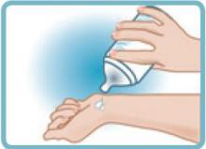
Hot!!!
  Before giving heated milk to a baby, always check its temperature by squirting some on your wrist or on the soft side of your forearm. These areas of your body are sensitive to heat. If the milk feels hotter than your skin, do not give it to the baby. Instead, mix up some more and try heating it less, or put it in the refrigerator until it cools down to body temperature.

Slide 30
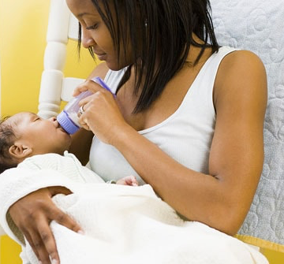
A very young baby does not have sufficient strength in her neck muscles to support her head. In this case, you must support the baby’s head while feeding her.
Be sure to hold the bottle such that milk the milk always covers the nipple. If you quit paying attention and the bottle slips around causing the baby to suck air instead of milk, the baby will swallow the air and get a tummy ache.

Slide 31
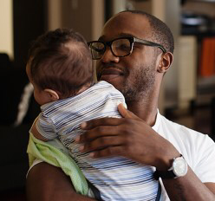
Burping the baby
When the baby finishes drinking the milk, take away the bottle. Then burp the baby. This is done by holding the baby against your chest with her head over your shoulder. Lightly pat the baby on the back until she burps. She may discharge some of the milk on your shoulder when she burps be prepared for that with a cloth.

Slide 32
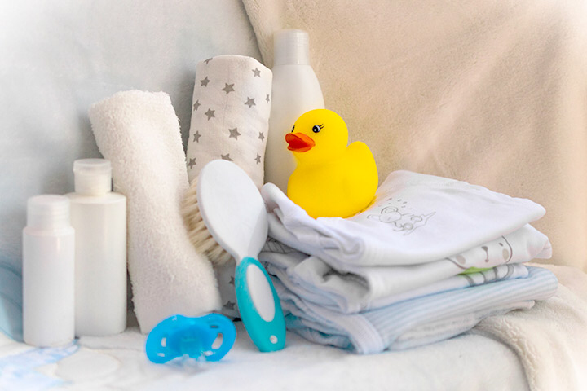
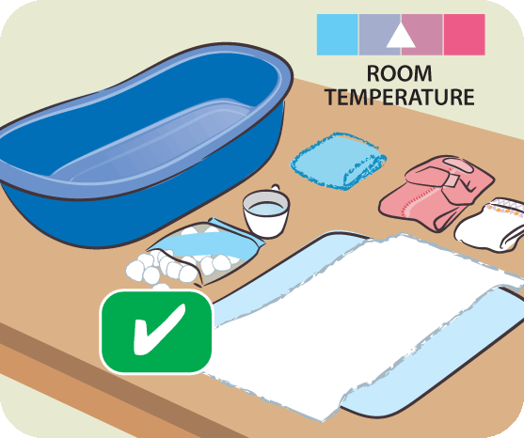
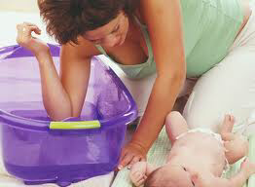
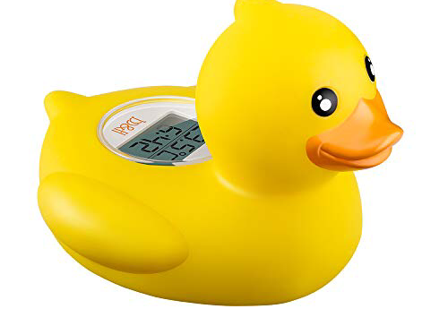
Babies cannot tell you if the water is too hot, so you must be careful to ensure that the temperature is right. Fill the tub with about two inches (5 cm) of awater, and check that the temperature is comfortable. You do not want it to be too hot, nor should it be too cold. You must not leave the baby unattended even for a few seconds while she is in the tub. Therefore, bring everything you will need for the bath to the tub before you bring the baby in.
Bathing the baby

Slide 33
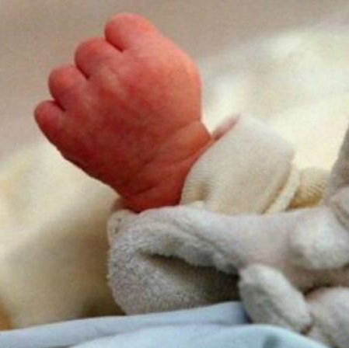
A burn injury is for life. The scars are physical as well as psychological and can present life-long challenges for the individual and their families.
At least 30 babies and toddlers attend Accident and Emergency services due to burns. [extracted from the Supporting National Burn Awareness Day 2019]

Slide 34
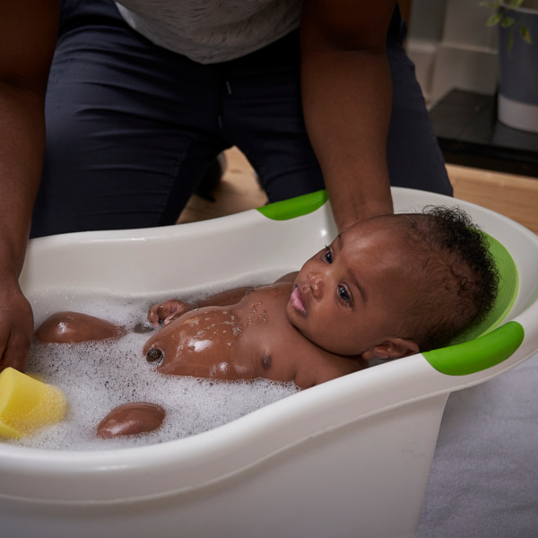
Bathing the baby
You must always stay with the baby when it is in the tub. A baby can easily drown in even half an inch of water. If the phone rings, do not leave the baby so you can answer it. Let it ring or take the baby with you (wrap her in a towel so she does not get cold) when you go to answer it. The same goes for the doorbell, or any other distraction.
First wash the baby's face, starting with the area around her eyes. Do not use soap on her face - a wet wash cloth will do nicely. It is better to wet the washcloth from the faucet rather than from the tub, because the baby may have urinated in the water. You wouldn't wash your own face in that, so don't wash the baby's face in it either. The reason you start with the eyes is because they are susceptible to infection. Use one corner of the washcloth on one eye, and a different corner of the washcloth on the other eye. This will prevent spreading an existing infection from one eye to the other. After you are finished washing the baby's face, you can wash her hair.

Slide 35
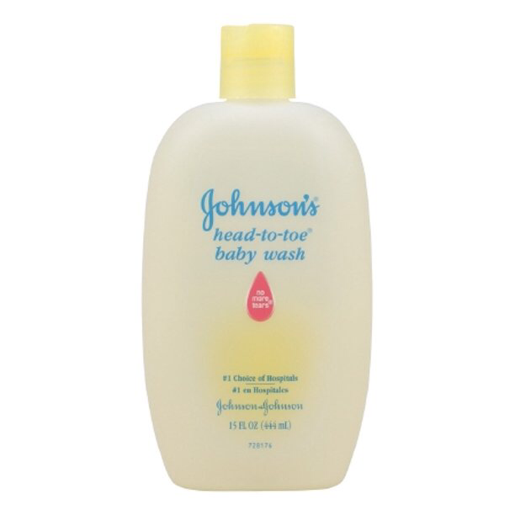
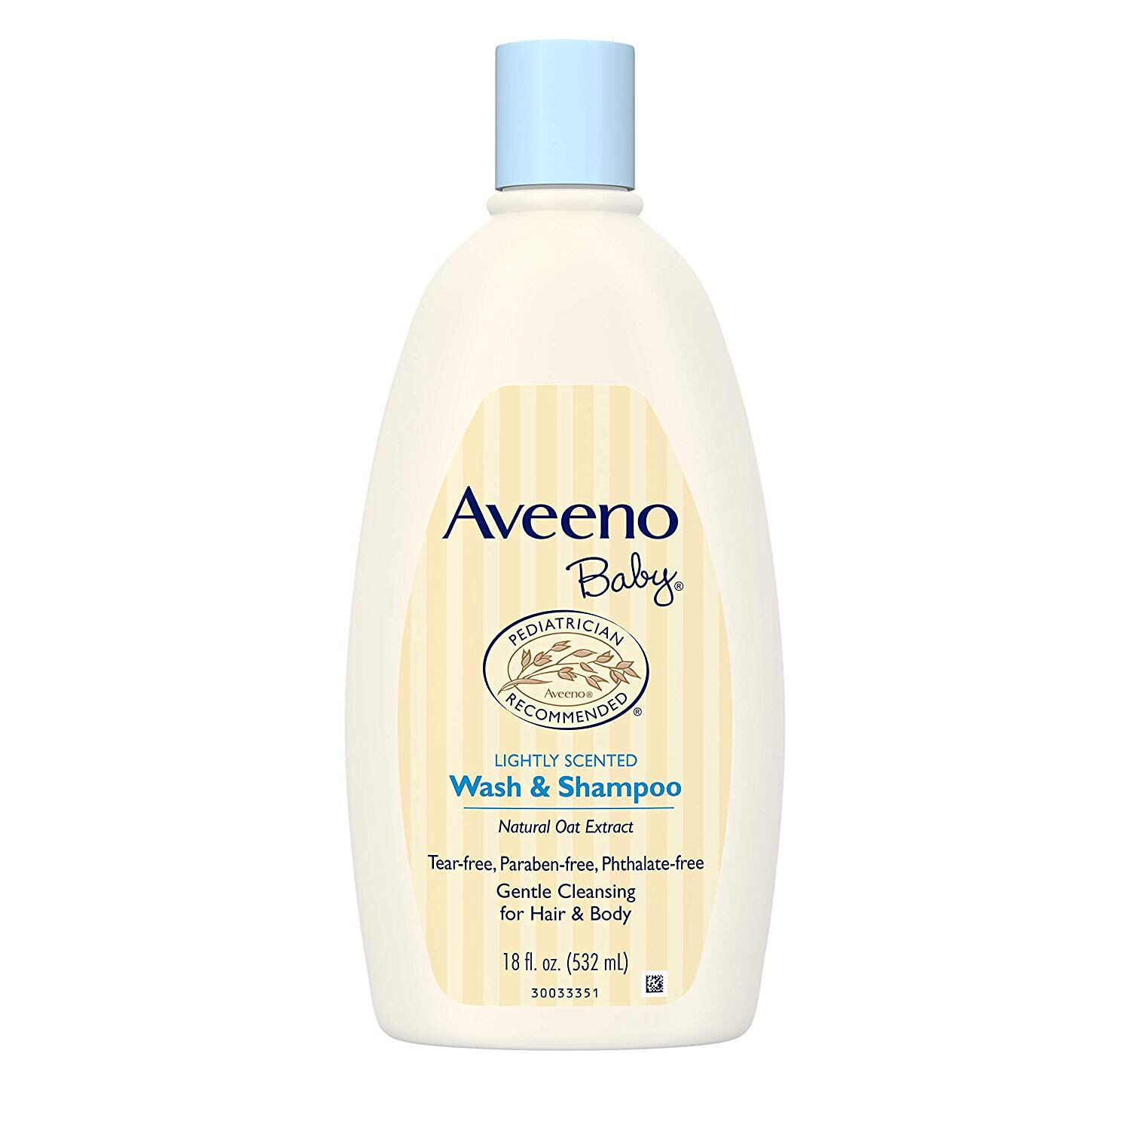
Baby soap
Use a gentle soap and shampoo on the baby. Babies' skin is more sensitive than yours, so you must use extra gentle soap. Also, be careful to not get any soap or shampoo in the baby's eyes. Baby shampoo and soap will not damage the baby if it does get in the eyes, but it may hurt, and the baby may cry. Some babies do not like to get water on their faces, even if the soap doesn't make her eyes sting. You can buy a visor to put around the baby's head to divert the water away from her face when rinsing shampoo out of her hair. Otherwise, you can tilt her head way back (support it with your hand!), and carefully rinse her head that way.

Slide 36
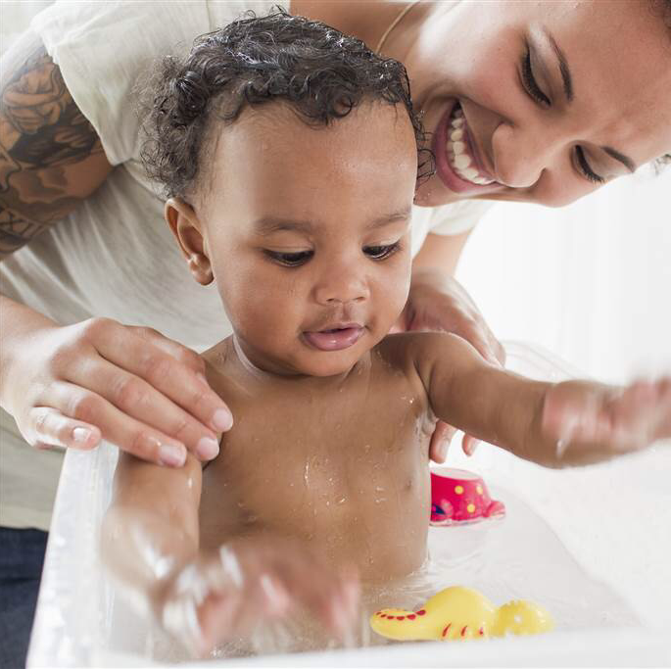
Finally, you are ready to wash the baby's body. Start with the neck, chest, tummy, back, and arms, then move to the legs and feet. Wash the nappy/diaper area last, as that area is most likely to pick up germs.

Slide 37
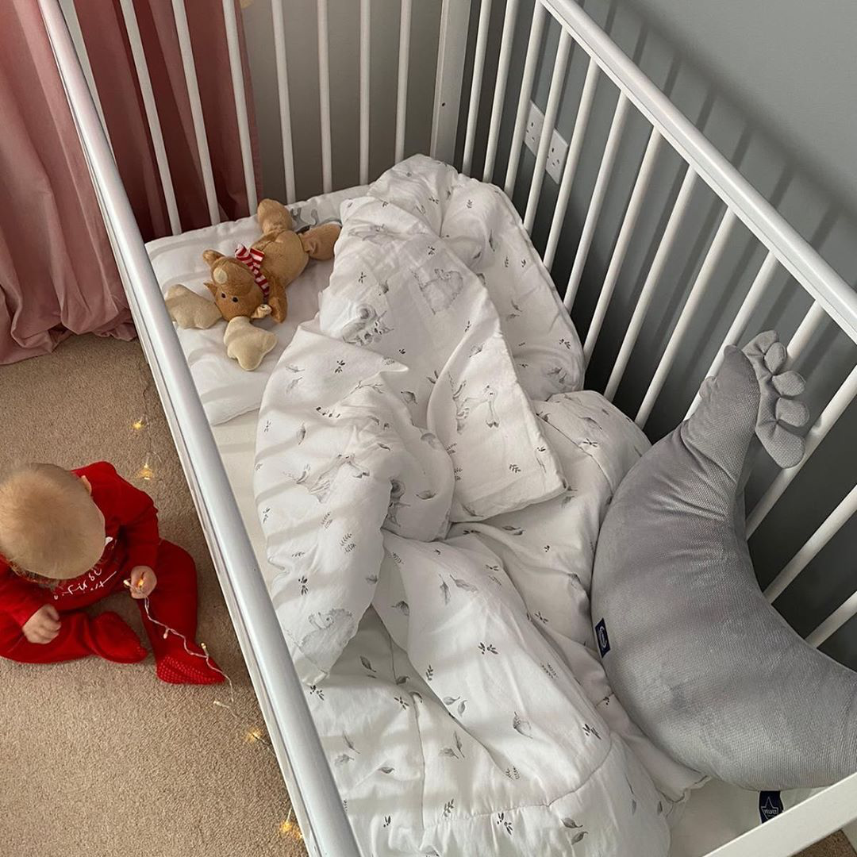
Prepare the bed
Babies soil their sheets more often than other people, so it is important to check that the sheet are clean before putting the baby to bed. Sometimes a baby will need to have its sheets changed more than once in a day. We will not go into all the things that a baby can do to soil the sheets. A Pathfinder can well imagine the possibilities without help from this presentation.

Slide 38

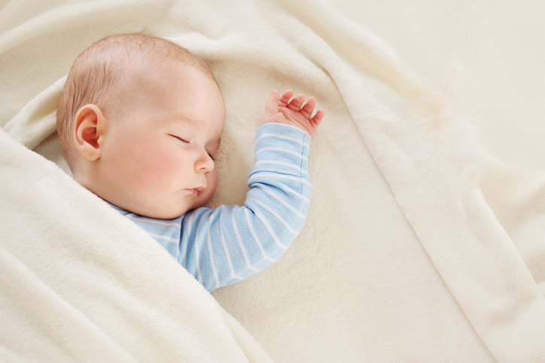
Sleeping positions
Child-rearing experts frequently debate the proper way to lay a baby down for sleep. Some say to lay them on their tummies so that if they spit up they will not choke on the sputum. Others say to lay them on their backs so they do not bury their faces in the soft mattress or blanket and suffocate (this has happened). This can be addressed by using only a firm mattress in the baby's bed, and by not having a lot of blankets and other items in the bed with the baby. Comforters should also be avoided until the baby is able to turn herself

Slide 39
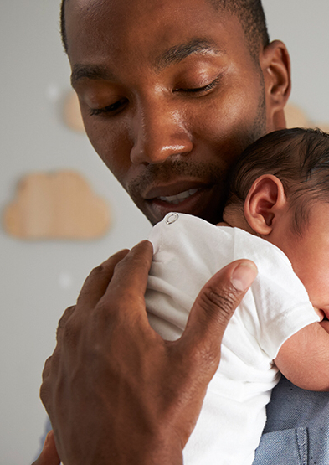
4. Prepare the baby’s bed and put it to bed before night
Some parents will wait until the baby falls asleep and then carefully put them to bed. Others are able to put the baby in bed when it is awake. Try to find out how the baby is used to being put to bed before you have to do it yourself.

Slide 40
Sudden infant death syndrome (SIDS) – sometimes known as "cot death" – is the sudden, unexpected and unexplained death of an apparently healthy baby. In the UK, more than 200 babies die suddenly and unexpectedly every year

Slide 41
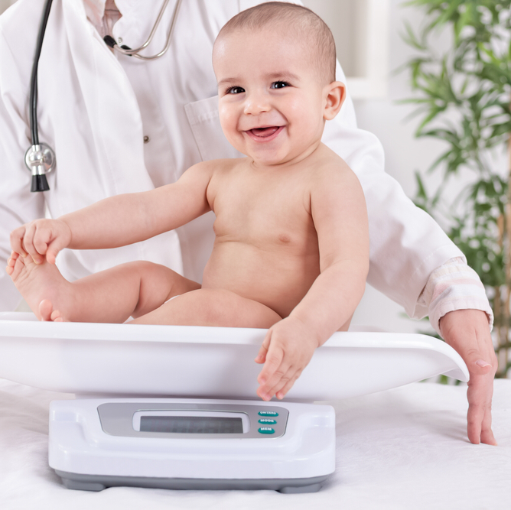
5. Know how to weigh a baby and to fill in the weigh schedule

Slide 42

Tip!!!
Unless you have a baby scale, this is going to present an easily-overcome difficulty. Babies cannot stand until they are 8 months old or so, and then they are not steady. By the time they gain steadiness, they are not interested in standing on a scale while you try to get a reading. The easy way to deal with this is to weigh both yourself and the baby, and then subtract your weight.

Slide 43
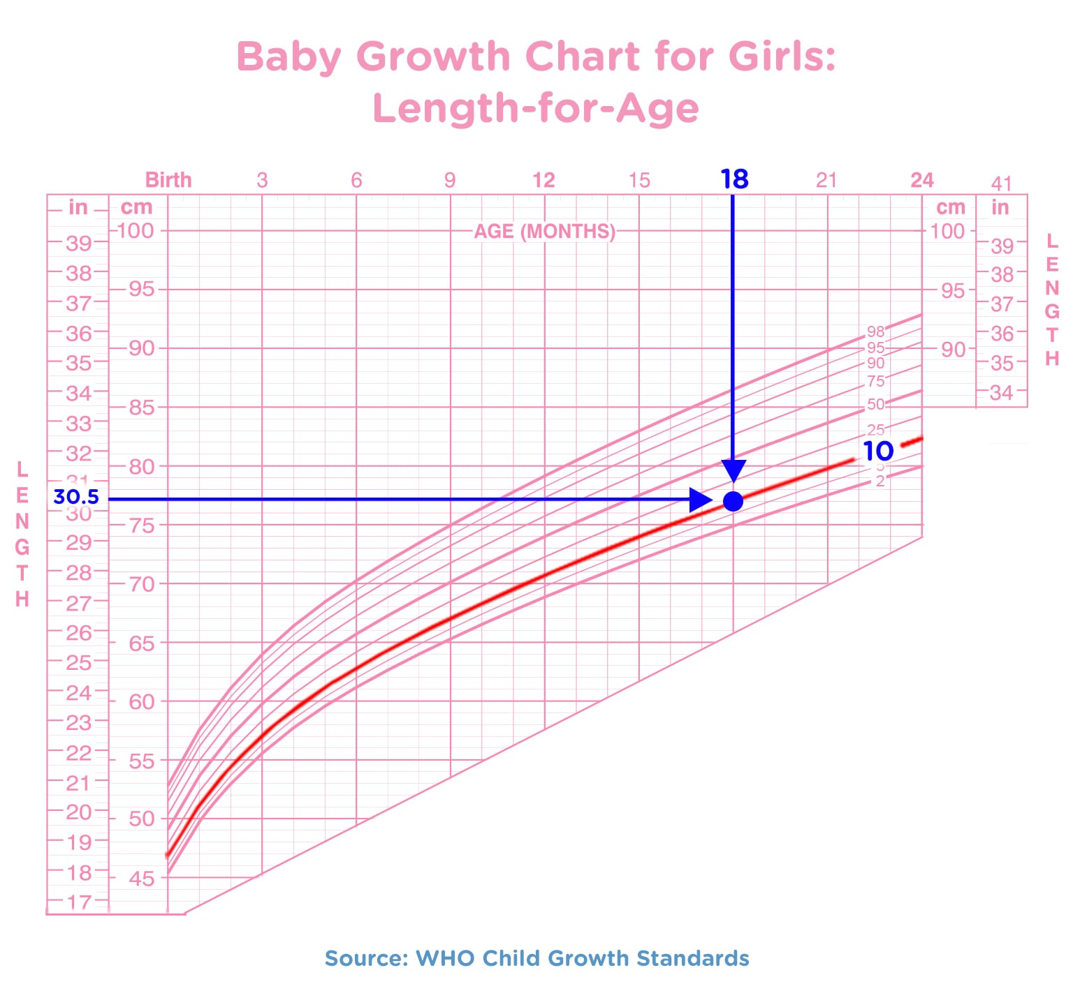
The weigh schedule form is a chart that compares a child's height, weight, and head circumference to that of children of the same age and gender. In Europe (where this honour originates), this data is plotted on a chart to detect development abnormalities.

Slide 44
5. Know how to weigh a baby and to fill in the weigh schedule form
The weigh schedule form
for height, it means that he is taller than 60% of children of the same age and gender.
In places where these forms are not filled out at home, it should be sufficient to understand that these measurements can be compared to national averages to track a child's development.

Slide 45
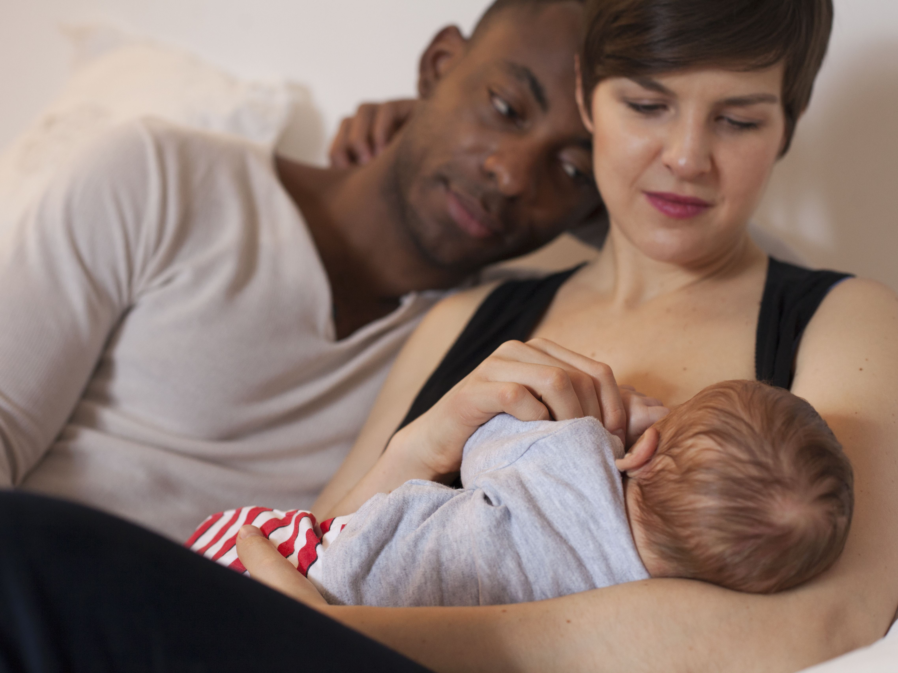

Breastfeeding benefits
The benefits of breastfeeding are both physical and psychological for both mother and child. Nutrients and antibodies are passed to the baby while hormones are released into the mother's system. The bond between baby and mother can also be strengthened during breastfeeding

Slide 46
6. Explain why breast feeding is superior to bottle feeding
Breast milk, when fed directly from the breast, is immediately available with no wait and is at body temperature. Breast-fed babies have a decreased risk for several infant conditions including sudden infant death syndrome (SIDS). The sucking technique required of the infant encourages the proper development of both the teeth and other speech organs. Sucking also has a beneficial role in the prevention of obstructive sleep apnea.
The many health benefits of breastfeeding have been well documented. According to the American Academy of Pediatrics policy statement, "Extensive research, especially in recent years, documents diverse and compelling advantages to infants, mothers, families, and society from breastfeeding and the use of human milk for infant feeding. These include health, nutritional, immunologic, developmental, psychological, social, economic, and environmental benefits."

Slide 47
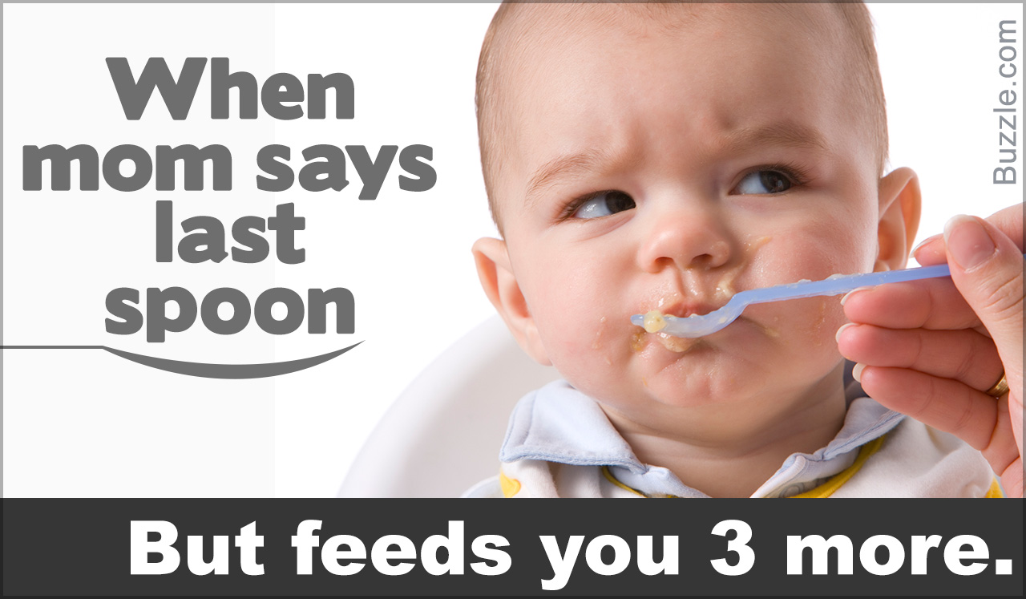
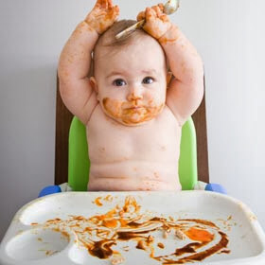
7. What is weaning?
Weaning is the process of gradually introducing the infant to what will be its adult diet and withdrawing the supply of milk. The infant is considered to be fully weaned once it no longer receives any breast milk and begins to rely on solid foods for all its nutrition.

Slide 48

THE END….

