Slide 1
Migration
Honour
Luke Torquato

Slide 2
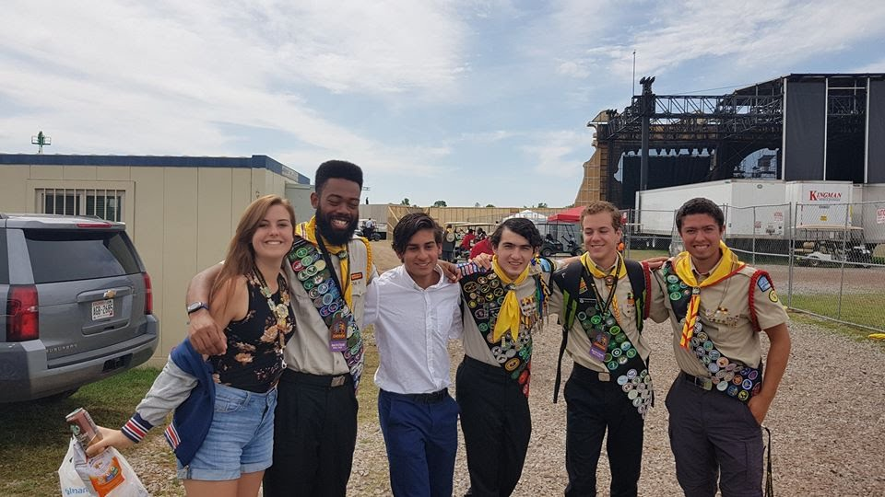

Slide 3
Requirement 1:
What is migration?
Give a short history of how
humanity’s understanding of
animal migration has grown

Slide 4

Definition
Migration is the seasonal movement of animals from one place to another
a migrating animal usually moves into a different environment for a specific purpose, be it food, a mate, a change in temperature, etc.
People migrate -- but usually not seasonally

Slide 5
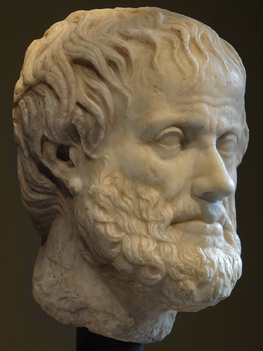
History of Understanding
Mankind has been AWARE of animal migration for centuries

Slide 6

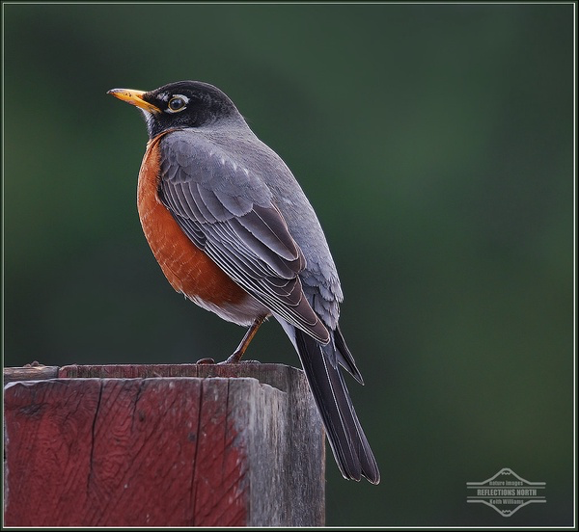
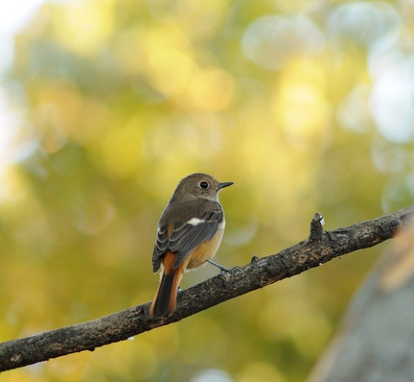
Example

Slide 7

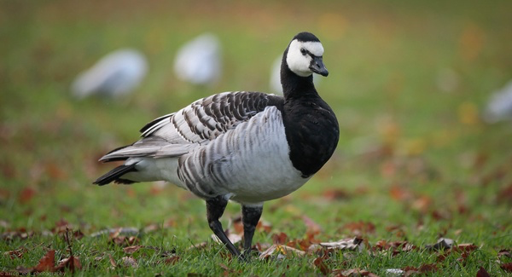
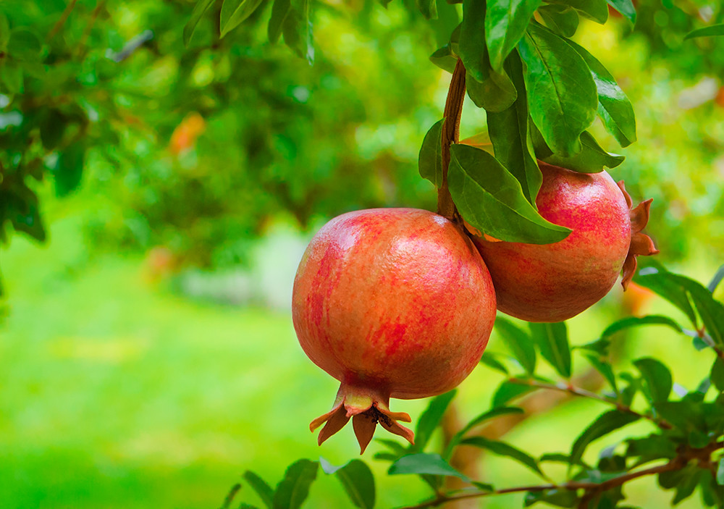
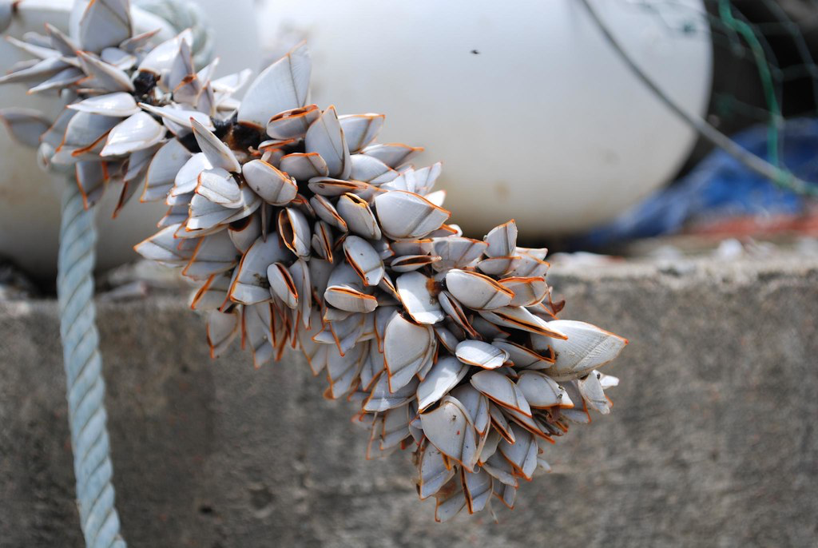
Example
Seasonal migration following food sources

Slide 8
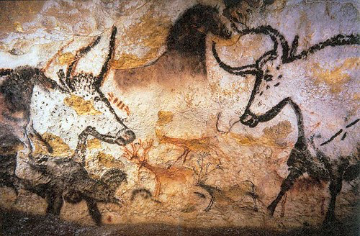
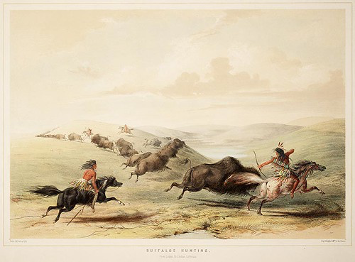
Native Americans have been migration experts!

Slide 9
Requirement #2
Why do Animals Migrate?

Slide 10




Reasons to Migrate

Slide 11
Requirement #3
What are some ways that animals know when and where to go?

Slide 12




Scientists’ Guesses

Slide 13
Requirement #4
What species of animals migrate? List two examples of each of the following:
a. Birds b. Fish c. Mammals
d. Insects e. Amphibians f. Reptiles
g. Crustaceans

Slide 14
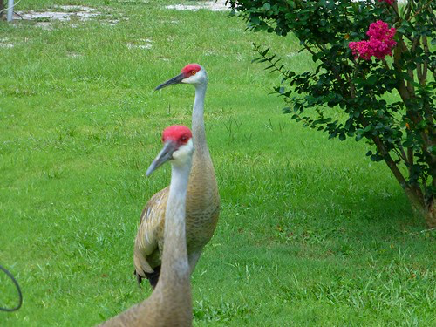
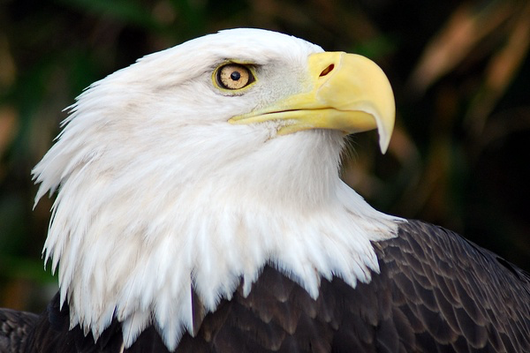
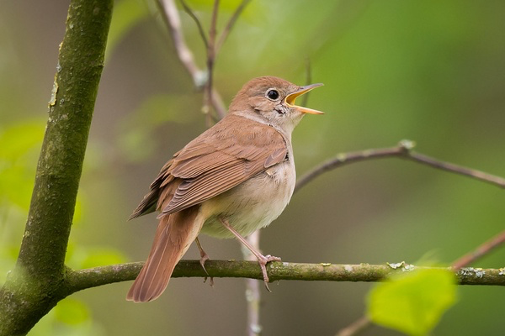
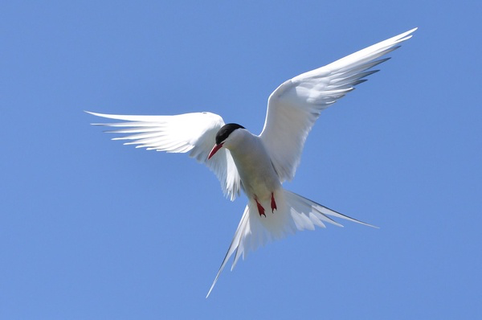
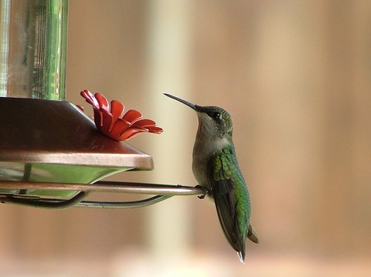
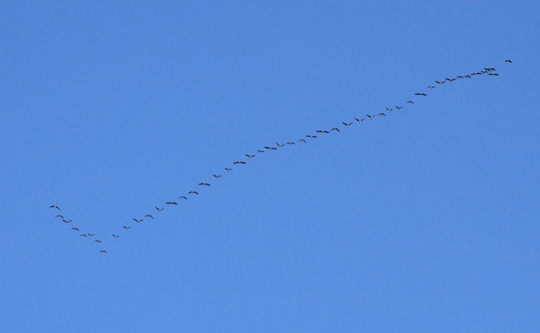
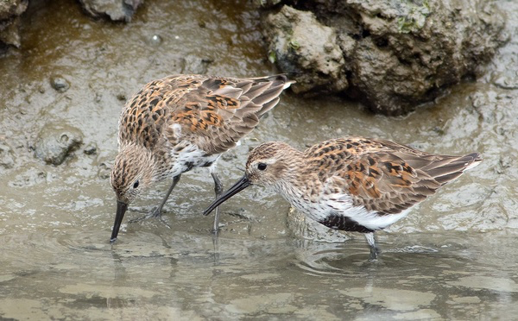
BIrds
Names of Birds here

Slide 15
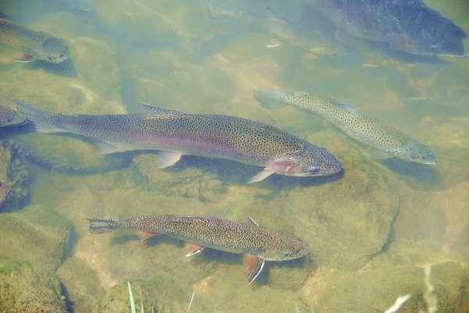
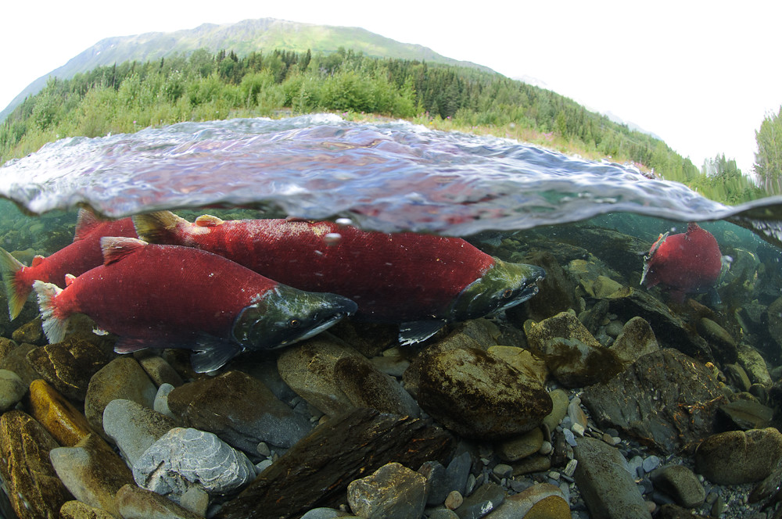
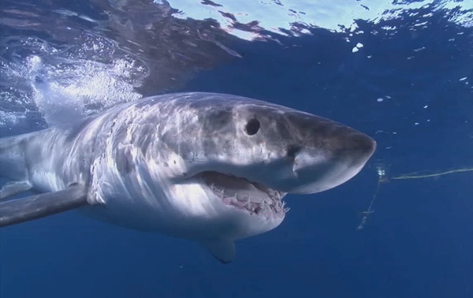
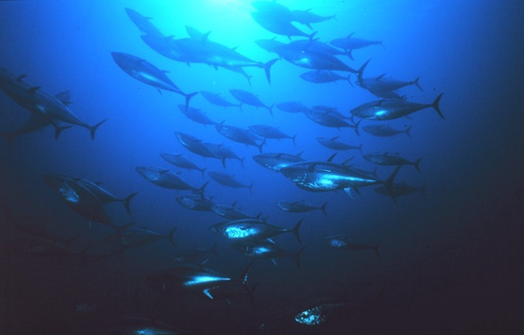
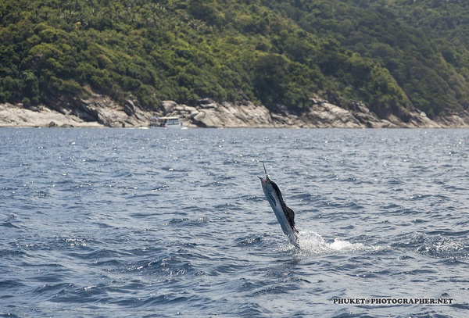
Fish
Names here

Slide 16
Mammals
Names here

Slide 17
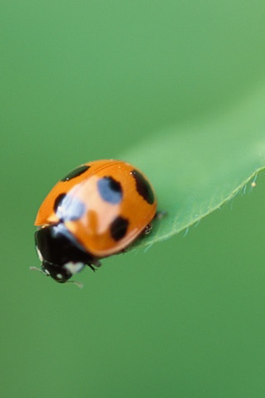
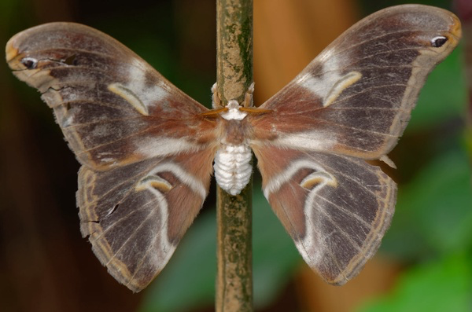
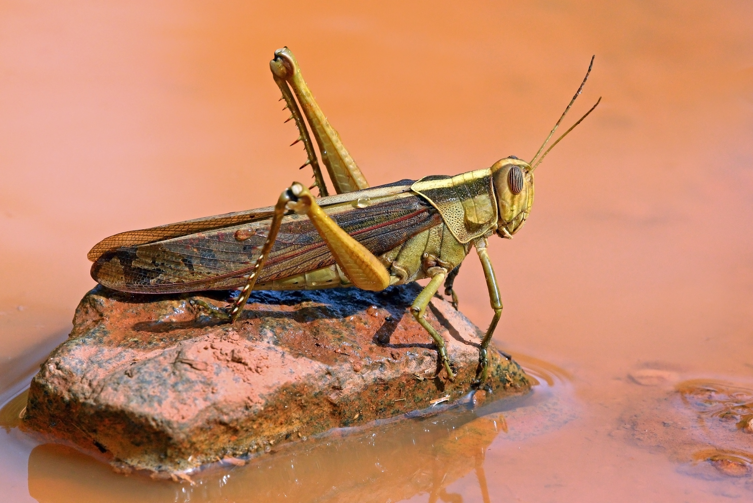
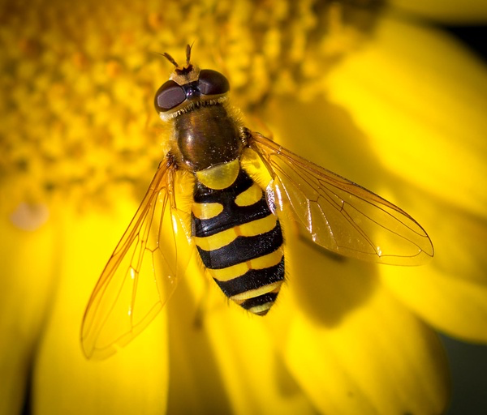
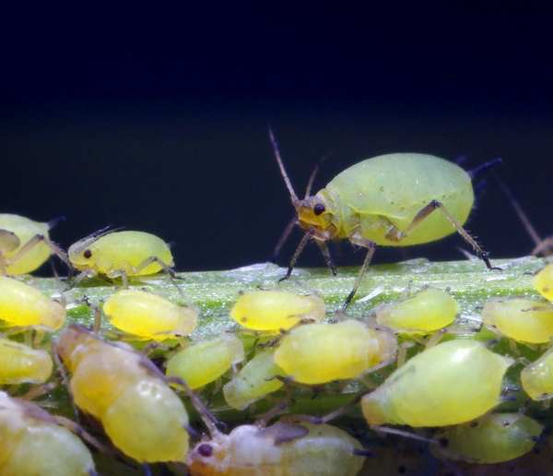
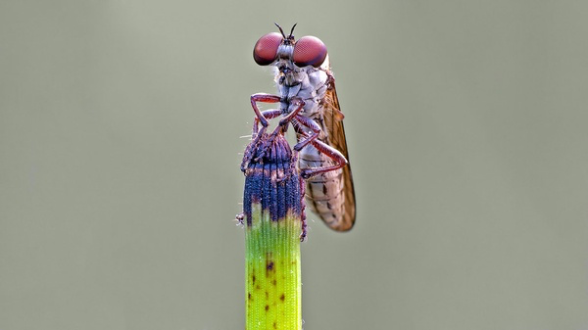
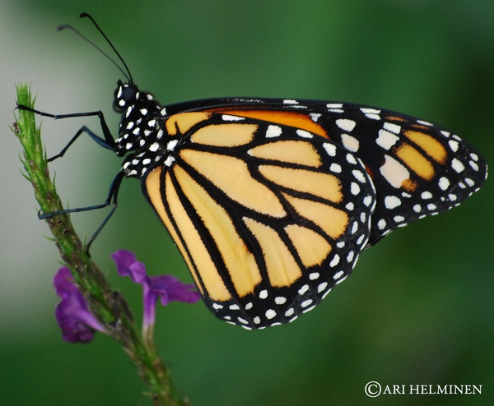
Insects
Names here

Slide 18
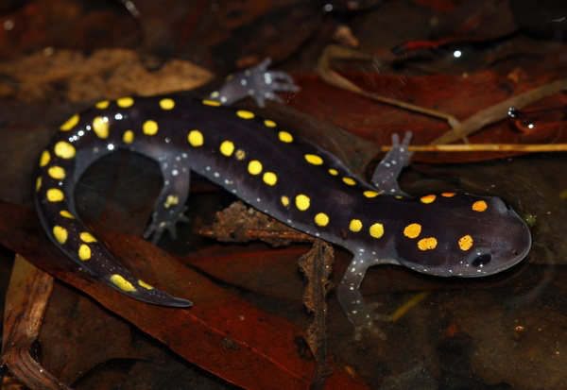
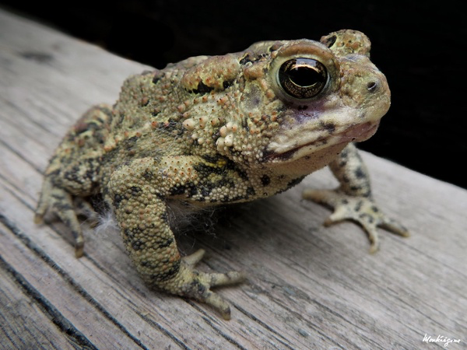
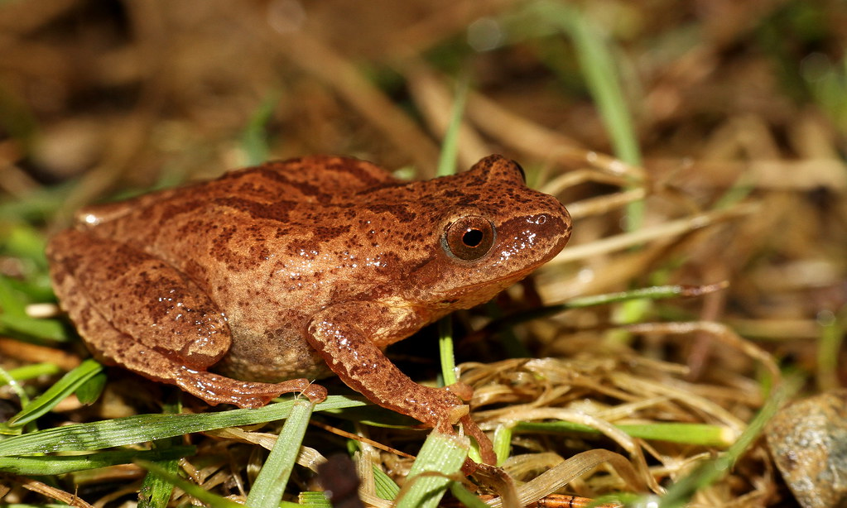
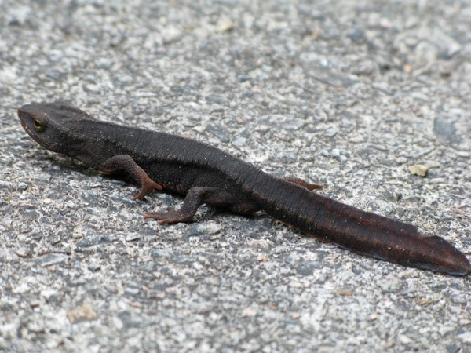
Amphibians
Names here

Slide 19
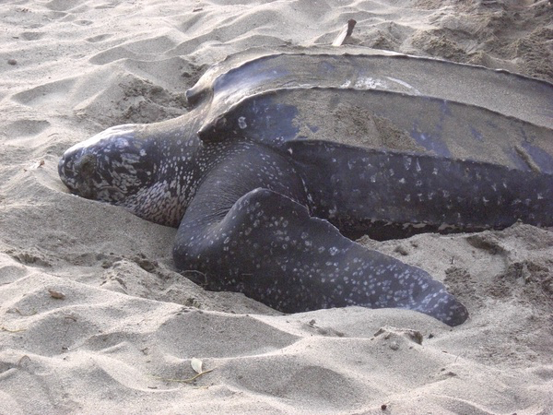
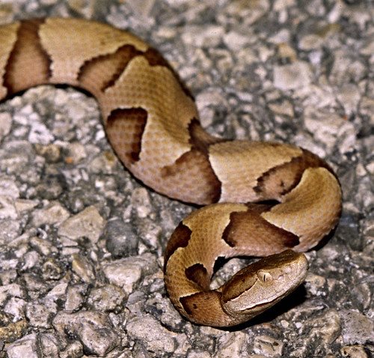
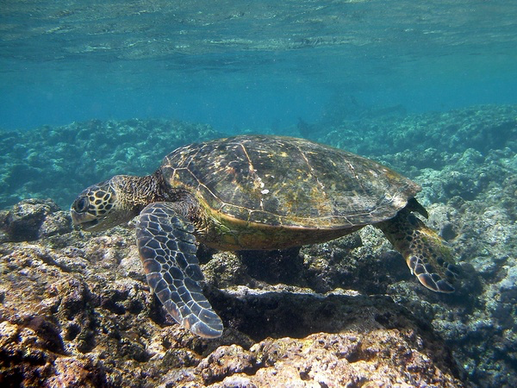
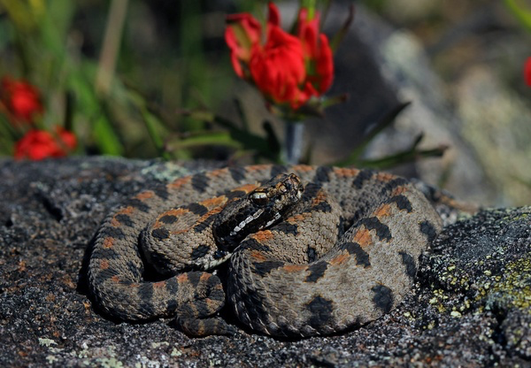
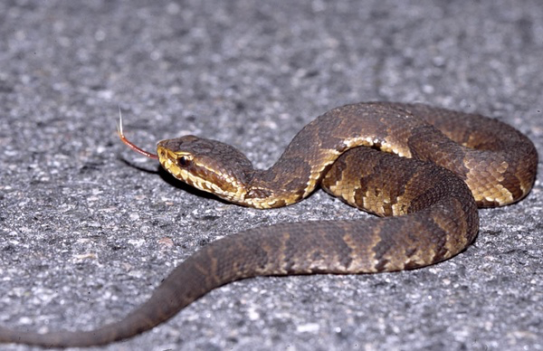
Reptiles
Names here

Slide 20
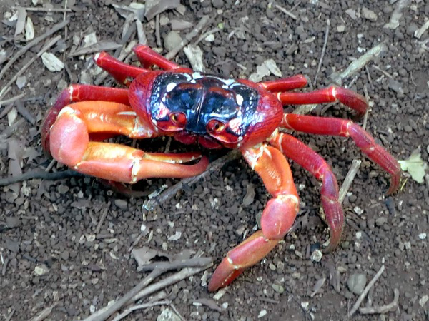
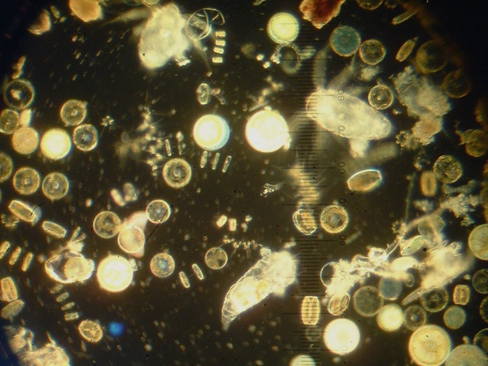
Crustaceans
Names here

Slide 21
Requirement #5
What are some dangers that migrating animals experience?
Explain how the species of animals named above might encounter dangers in their migrations.

Slide 22




Human’s BIggest Impacts

Slide 23
Dangers for Migrators
Buildings
Lights
Highways
Lost habitats
Aircraft
Fans
Dams
Hunters (man an beast)

Slide 24
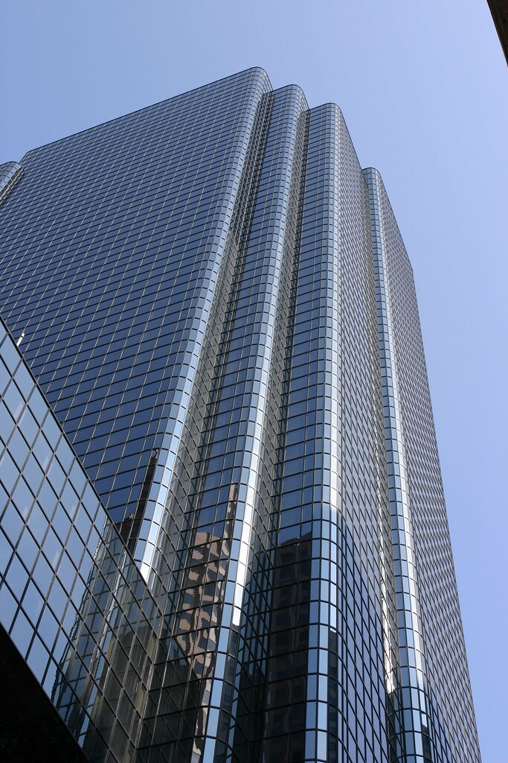
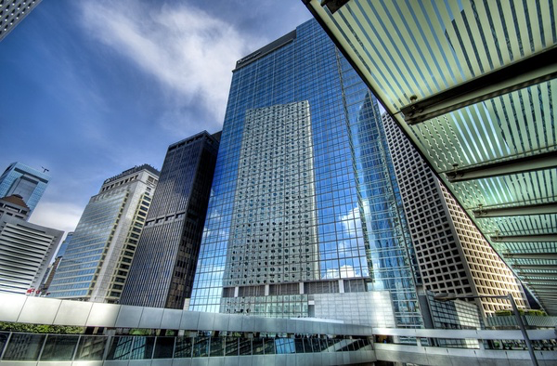

Slide 25
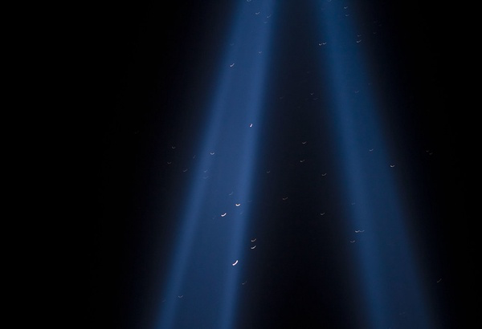
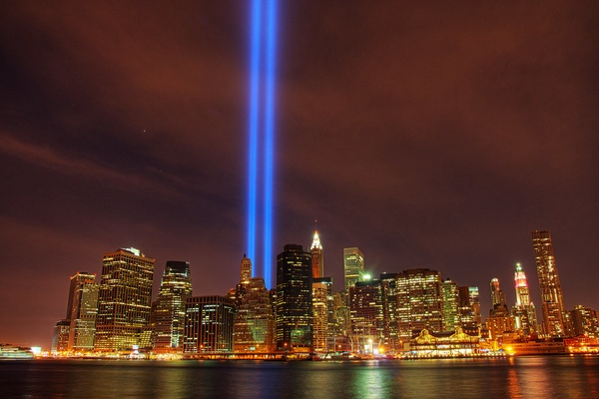

Slide 26
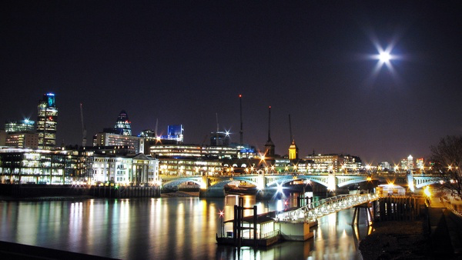

Slide 27
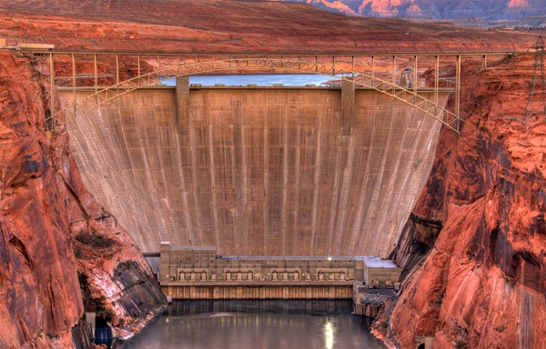
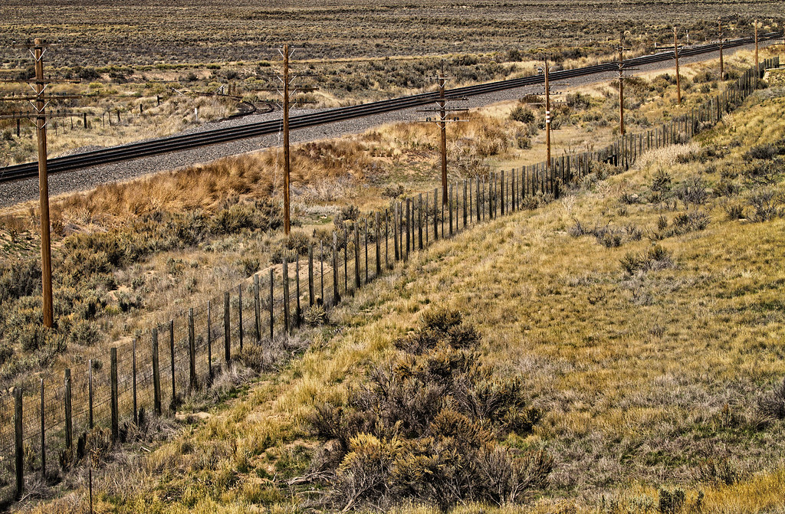

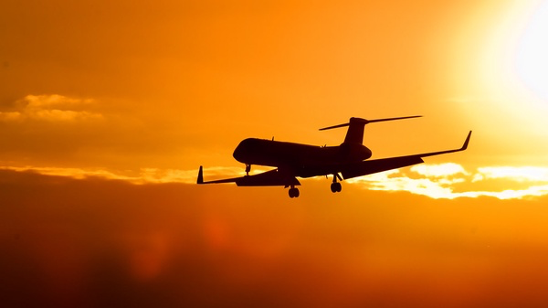
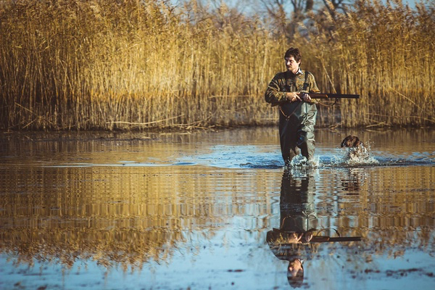
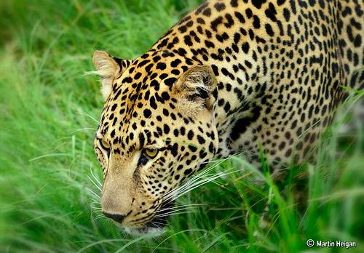

Slide 28
Application:
Which dangers that we’ve listed that could pose the most problem for:
Migrating Fish
Buffalo / Caribou migration
Monarch butterfly

Slide 29
Requirement #6
State the difference between a complete, partial, and nomadic migration and identify species that practise each type.

Slide 30

Complete
Canadian Geese

Slide 31



Incomplete
Monarch Butterfly

Slide 32
Nomadic
American Bison

Slide 33
Requirement #7
Describe at least three ways that humans can affect or disrupt animal migration patterns. What can be done to help solve these problems?

Slide 34




Challenges
Buildings
Hunting
Vehicles
Fences

Slide 35
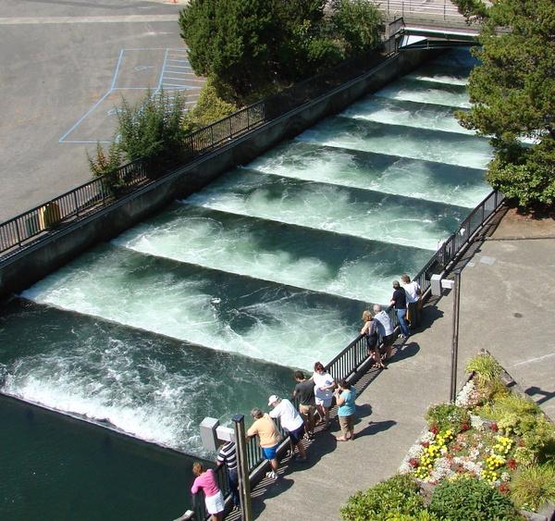



Answers
Fish elevators flyways Animal highways No hunting areas Habitat

Slide 36
Requirement #9
How are migrating animals studied today? Give examples of three ways migrating animals can be tracked.

Slide 37

Studied / Tracking
GPS Tracking Systems
GPS collar or tag
Bird bands
Radio collars
Cameras

Slide 38
Requirement #10
How are human migrations similar to animal migrations and how are they different?

Slide 39
Similarities Differences
Are unusually long trips
Often in search of food or other basic needs
Often travel together with people or animals they know
May face dangers along the way
People rarely return from their migrations – one way migration
Animals don’t rely on man-made transportation
Human migration is often motivated by violence
Animal migration is instinctive, human migration is a decision

Slide 40
Requirement #11
Choose two Bible stories that mention a migration and discuss the purpose of the migration with your instructor.

Slide 41
Requirement #11
a. Noah
b. Moses and the Exodus
c. Abraham
d. Joseph
e. Babylonian capture
f. Joseph & Mary as they fled to Egypt
g. Acts 8 Christian dispersion
h. Another of your choosing

Slide 42
On Your Own
Requirements to complete

Slide 43
Requirement #8
Choose either the Arctic Tern, Caribou, Salmon,
Monarch Butterfly, Great Migration, or other significant migration and collect the following information:
a. Common name and scientific name
b. Migration route (draw a diagram of the route taken and the estimated number in the migration)
c. Migration distance d. Reasons for migration
***Creatively present what you have discovered. ******

Slide 44
References:
Noah: Genesis 6 - 8
Moses: Exodus 1 – 40
Abraham: Genesis 12 – 25:11
Joseph: Genesis 37, 39 – 50
The Babylonian Captivity: 2 Kings 24, 15; 2 Chronicles 36; Ezra; Nehemiah
Joseph and Mary Flee to Egypt: Matthew 2:13-23
Acts 8 Christian Dispersion: Acts 8

Slide 45
Requirement #12
Do two of the following:
a. Participate in a conservation project that would make a positive impact for migratory animals.
b. Talk to your group, write about, or create a video describing your experience on the conservation project completed in option a. Be sure to include information about the animals your efforts will affect.
c. Watch a video about migration and share what you learned with your instructor.

Slide 46
Requirement #12
(continued…)
d. Visit a zoo, animal park, or aquarium where there are migratory animals on display. Learn three things about one of the migratory animals you observed.
e. Take photographs of at least five migratory animals in the wild or captivity and share with your group.
f. Visit a common resting spot of migrating animals and identify as many different species as possible.

Slide 47


Participate in a
conservation project
that would make a
positive impact for
migratory animals.
https://www.froglife.org

Slide 48

For migrating birds:
Put out fresh food and water
Build shelters for known migrating species
Turn off lights at night to help birds navigate
Make windows obvious, so birds don’t try to fly through them

Slide 49
For all migrating animals:
Limit traffic through known migration routes, both vehicles and hikers
Clean up trash that hungry animals might eat
Advocate for the protection of migrating animals

Slide 50


