Slide 1
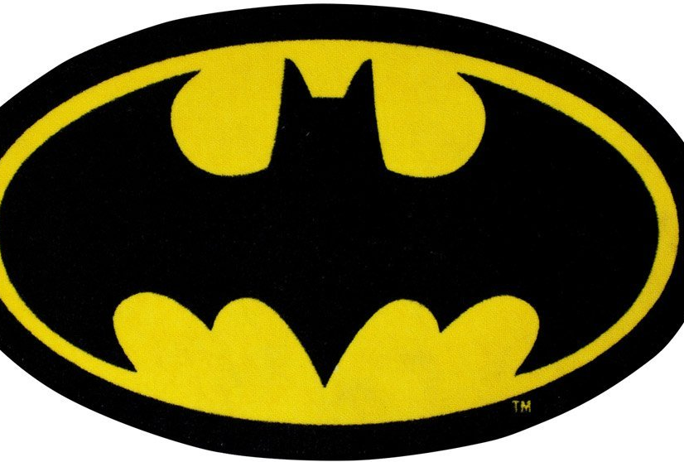

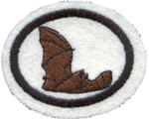
Rate Joke A (1-10)
And Joke B (1-10)
Da da da da da da da da da da da da da da da da da
Batman!

Slide 2
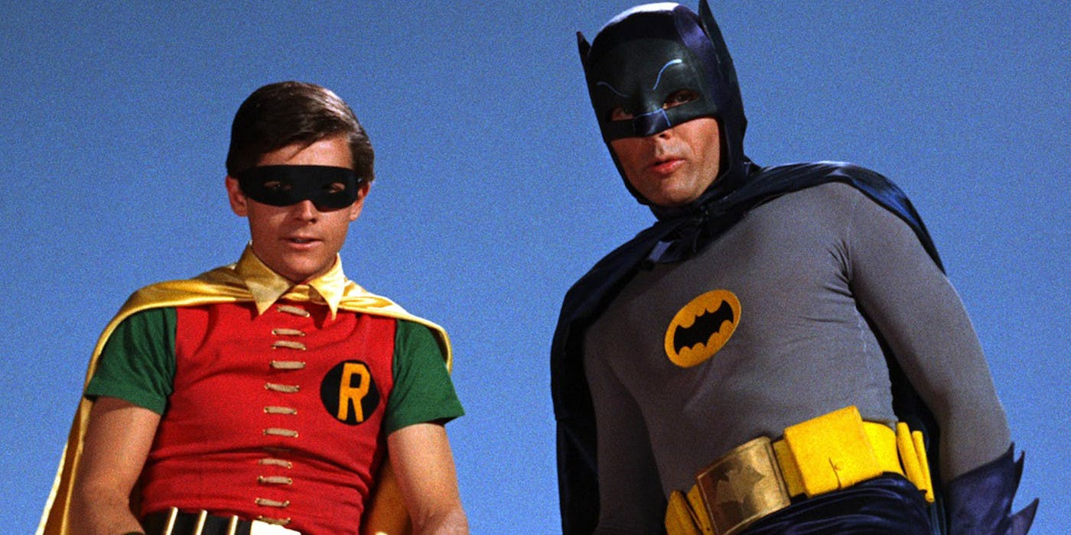

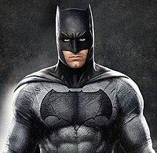
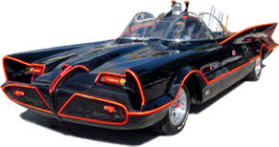

Slide 3

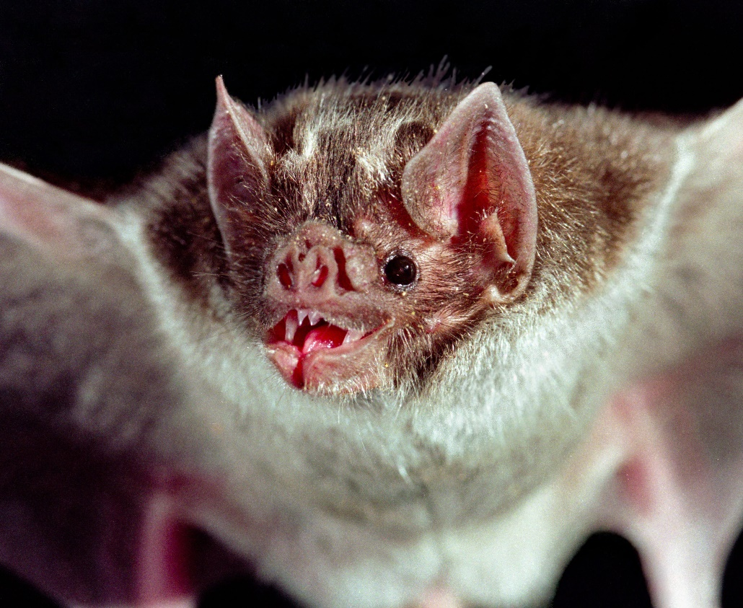
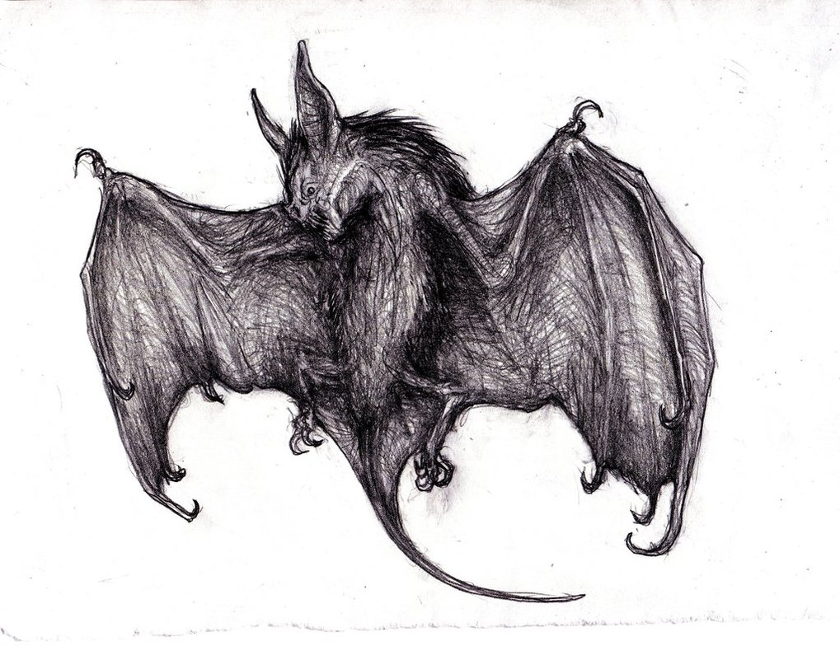
Vampire Bat / Dracula gave all bats a bad name…

Slide 4
Bat True/False
Most Bats have rabies
  FALSE ½ of 1% of Bats have rabies
Being around Bats can give you rabies
  FALSE Must be bitten
Bats need blood to live
  FALSE European bats don’t drink blood
  Vampire bats in Mexico, Central and South America
Dogs and Cats shouldn’t be around bats
  FALSE No evidence that bats infect cats and dogs
Bats are dirty animals
  FALSE Bats are good groomers

Slide 5
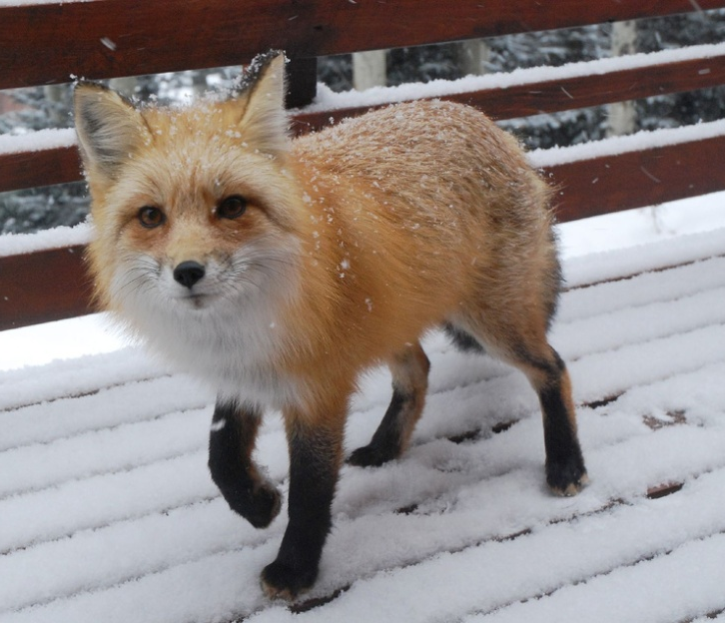
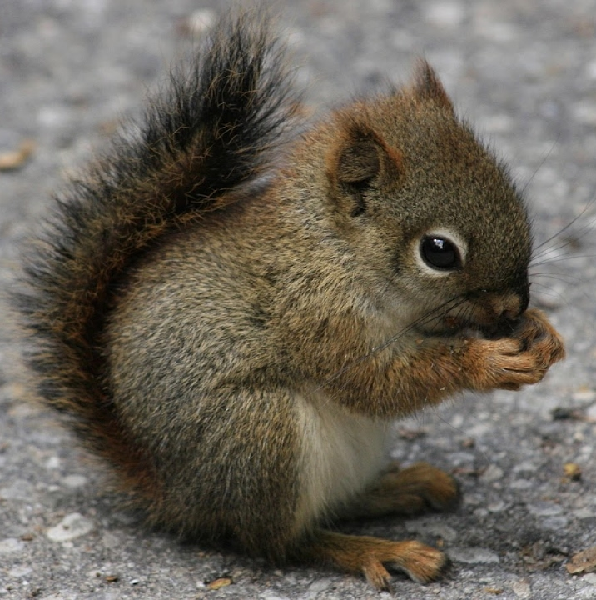
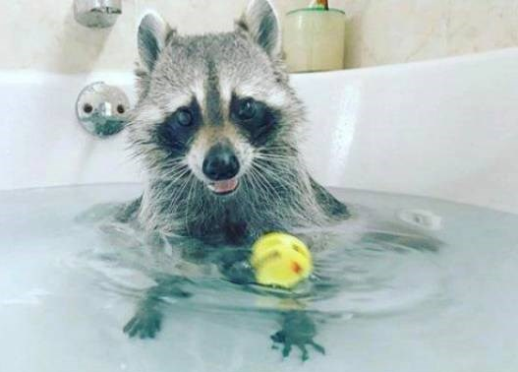

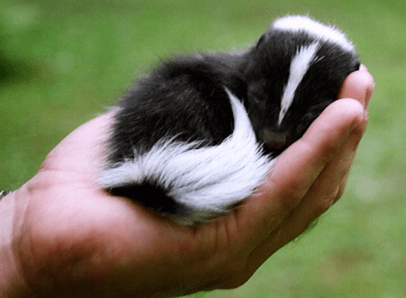
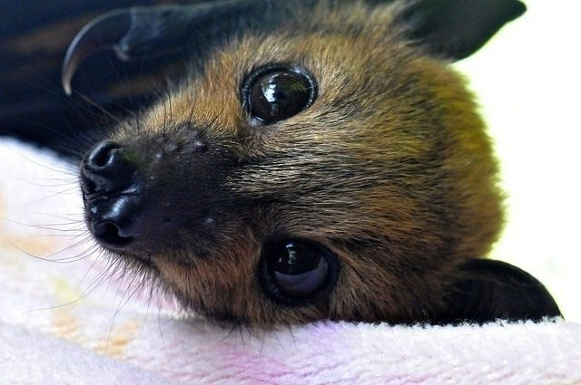

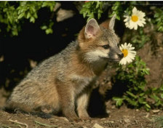
Vote: Who is the Cutest?

Slide 6
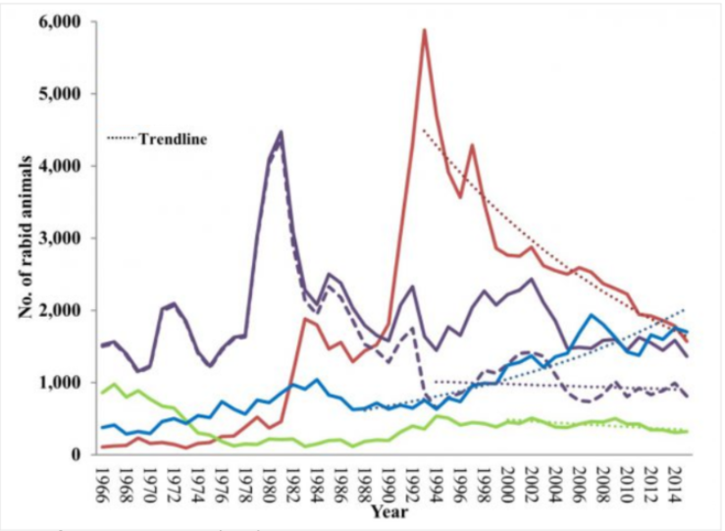
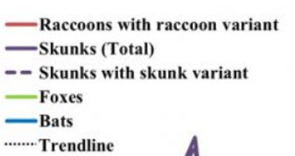
Rabies- Wild Animals
Centers for Disease Control and Prevention

Slide 7

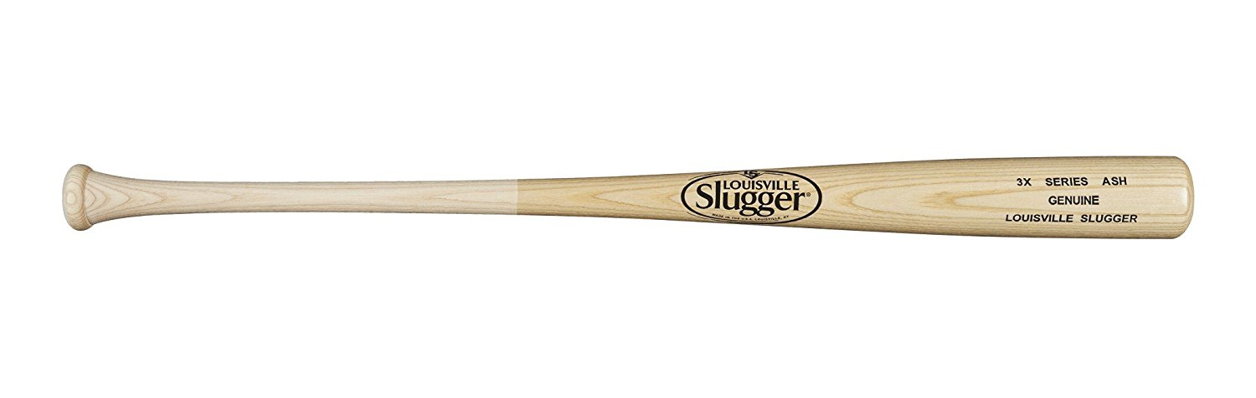
What is a Bat?
Is it a bird?
Is it a plane?
Is it Superman?
Is it a mammal?

Slide 8
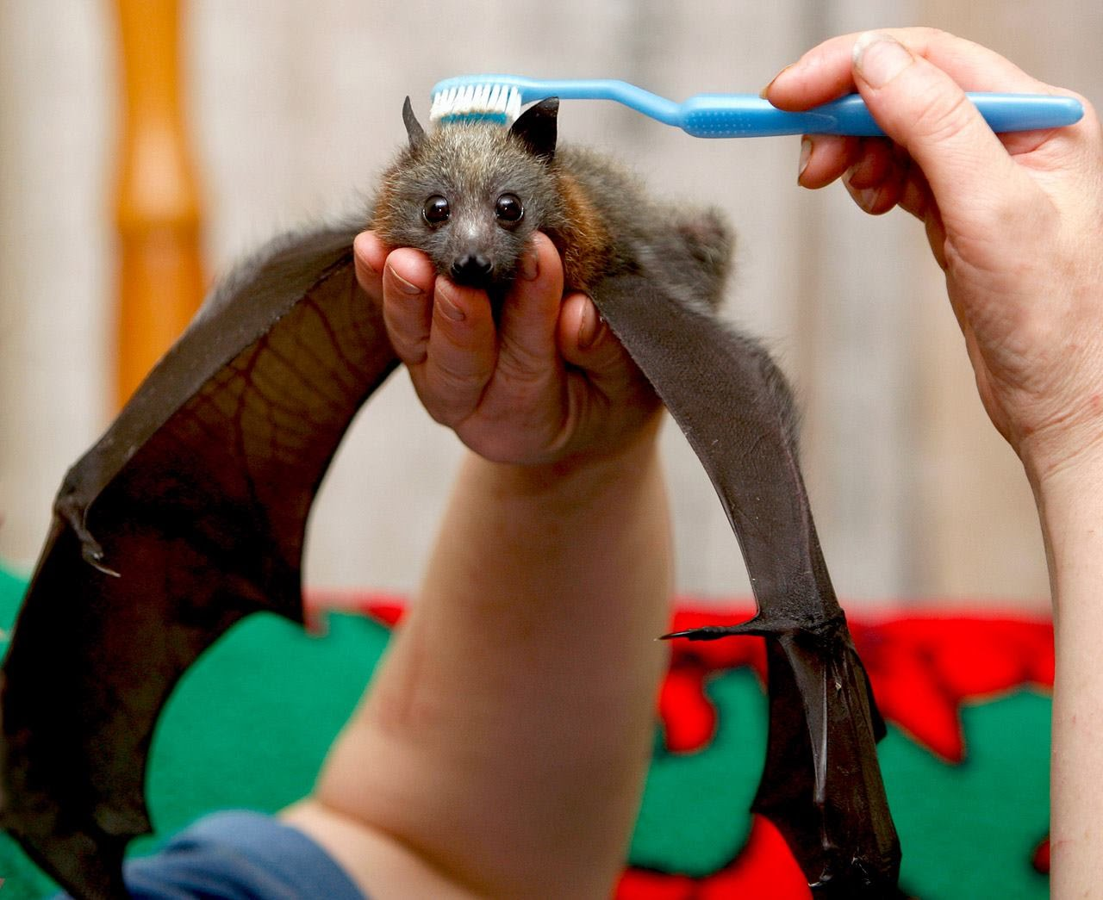
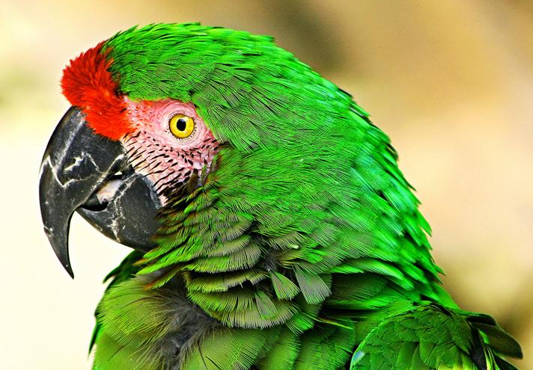
Mammals have Hair
Birds have Feathers
Bats
Birds

Slide 9
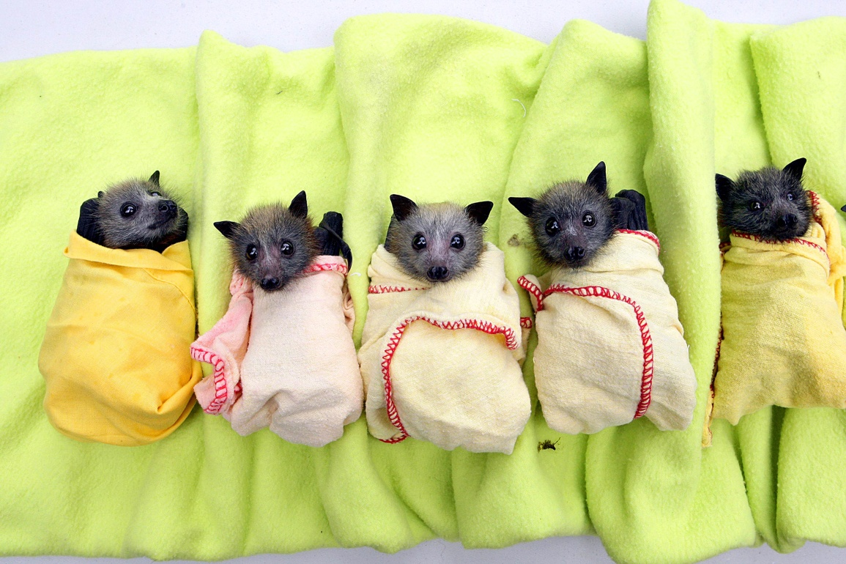
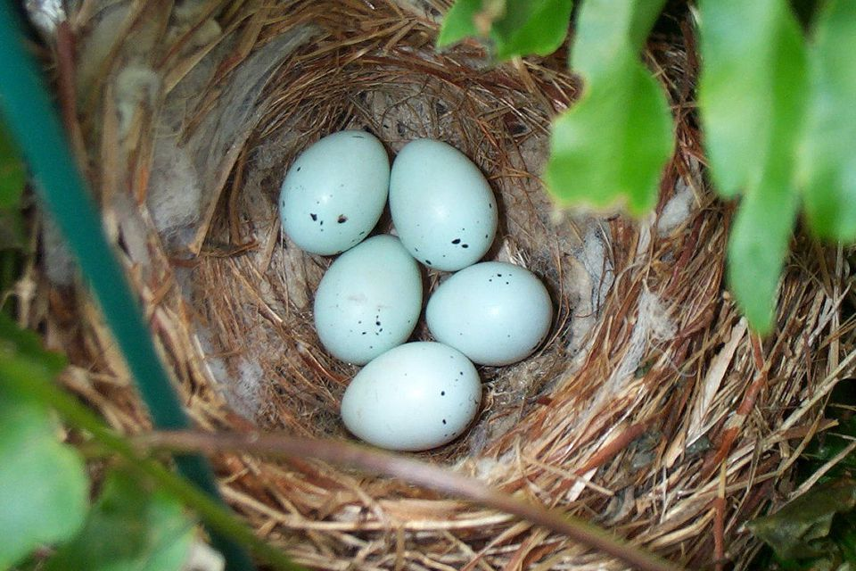
Mammals have Babies
Birds have Eggs

Slide 10
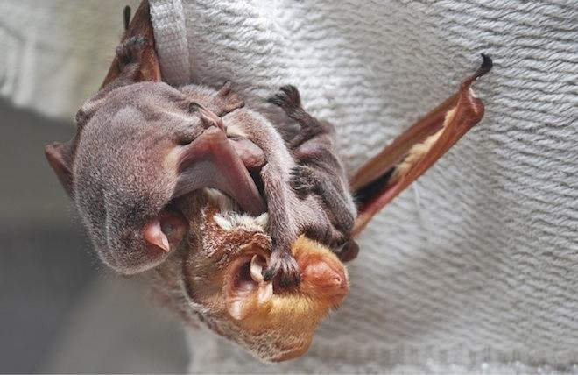
Mammal’s Babies Nurse

Slide 11
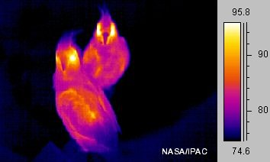
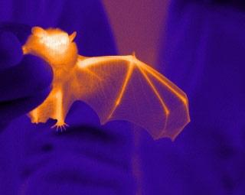
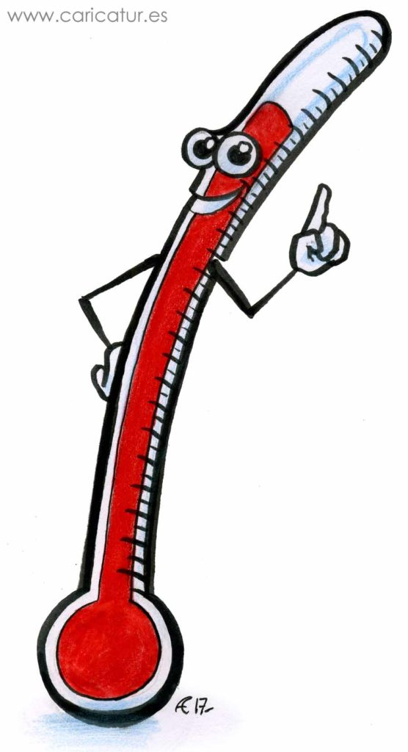
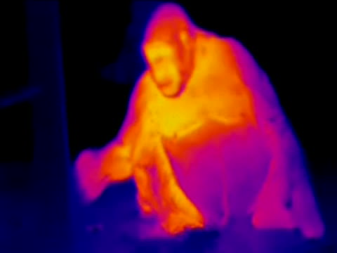
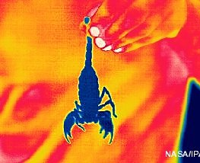
Birds and Mammals are Warm Blooded
bat

Slide 12
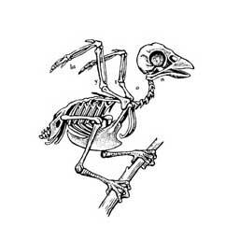
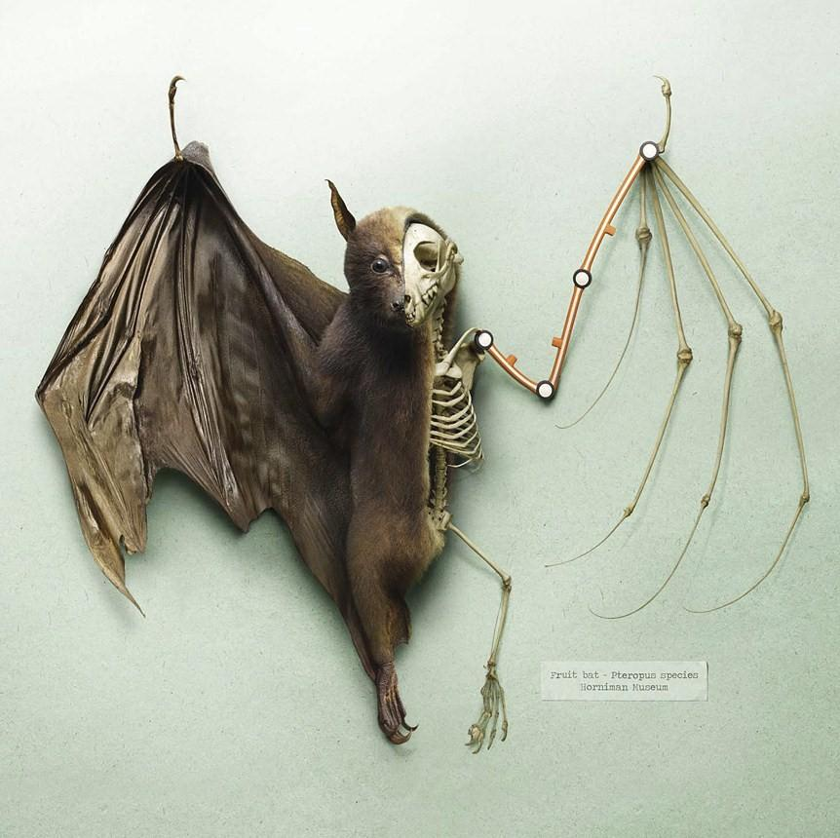
Hands and Feet? Or Wings?

Slide 13


Is a Bat a Mammal or Bird?
Mammals
Birds:
Have fur or hair
Have live young (except platypus)
The babies nurse from their mother
They are Warm-blooded
Have four legs often with toes and/or "hands" and "feet"
Have feathers, not fur or hair
Hatched from eggs
Babies are fed from mom's mouth
They are Warm-blooded
Have wings, but not hands and fingers

Slide 14
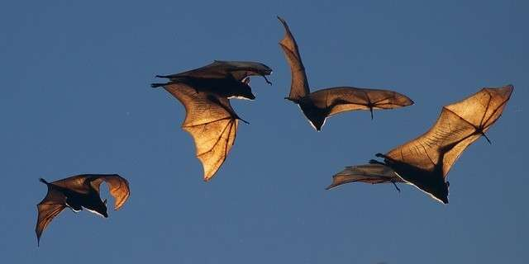
Bats are the only mammals that can…

Slide 15
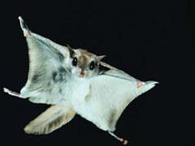
What about the “flying squirrel”?

Slide 16
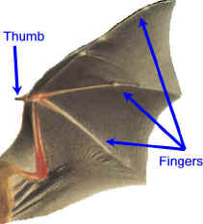
Order: Chiroptera
Greek:
Cheir=hand
Pteron=wing

Slide 17
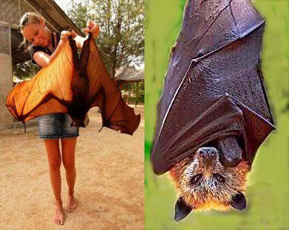
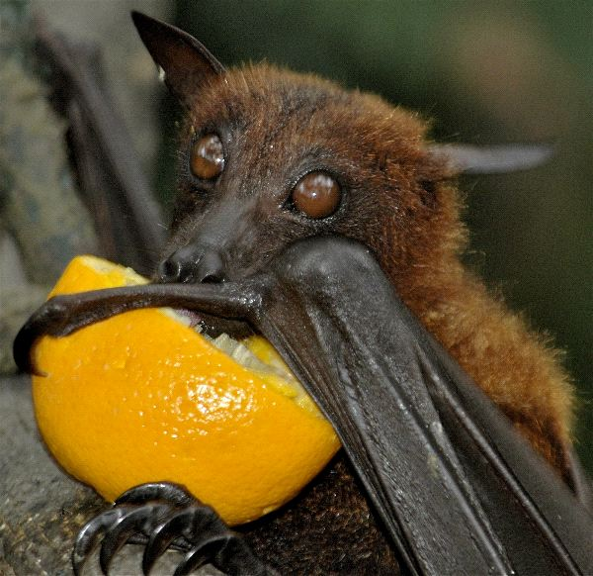
Flying Fox / Fruit Bat
lives in Asia and Australia.
17.7 inch Length
5 ft 7 in wingspan
Notes:
Largest Bat

Slide 18
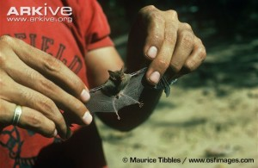
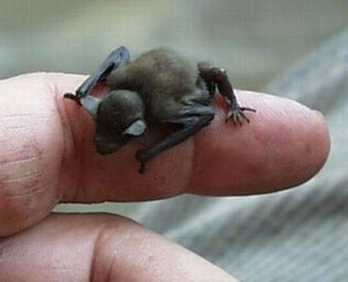
Kitti's Hog-Nosed Bat / Bumblebee Bat
Lives in Thailand
Weighing less than a penny
5 inch wingspan
Notes:
Smallest bat

Slide 19
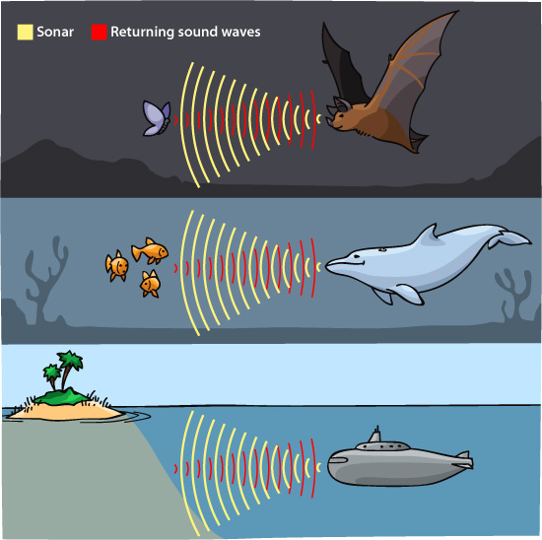
Order Chiroptera
Mega-chiroptera- Megabats
Use eyesight
Micro-chiroptera- Microbats
Use echolocation

Slide 20
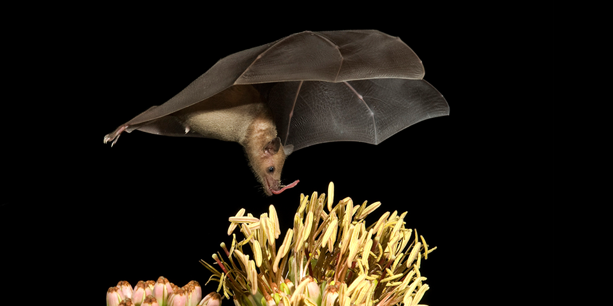
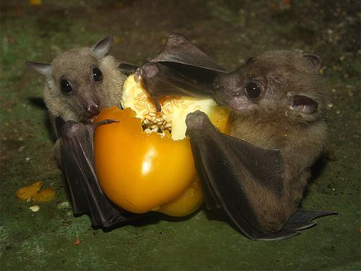
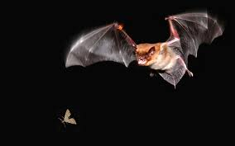
Order Chiroptera
Mega-chiroptera- Megabats
Micro-chiroptera- Microbats
eat fruit, nectar, and pollen
generally insect-eating, although they tend to have a much more varied diet than the megabats. Besides Insects, microbats eat anything from nectar and fruit like megabats, fish, small mammals and birds, and even blood.

Slide 21
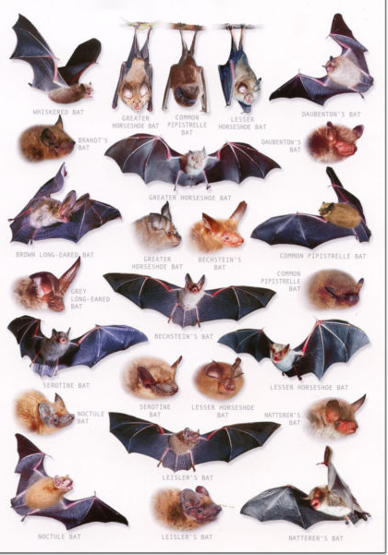
Order Chiroptera
Mega-chiroptera- Megabats
175 species
Micro-chiroptera- Microbats
825 species
Over 1,000 species that are identified!

Slide 22
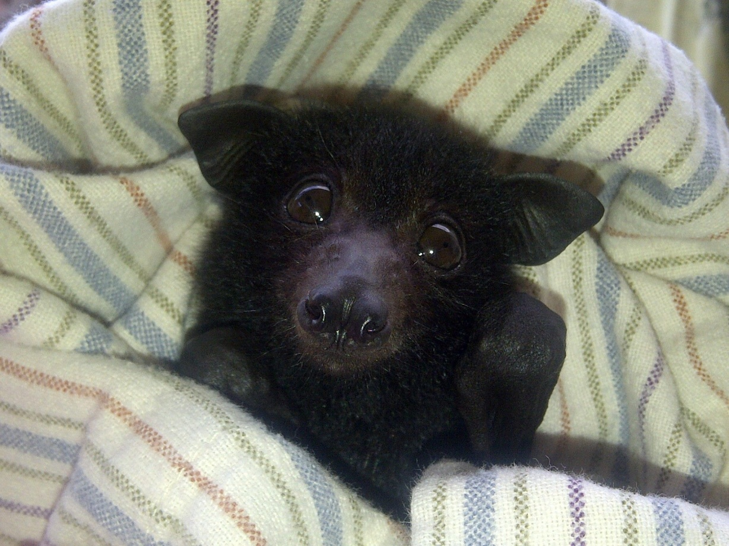
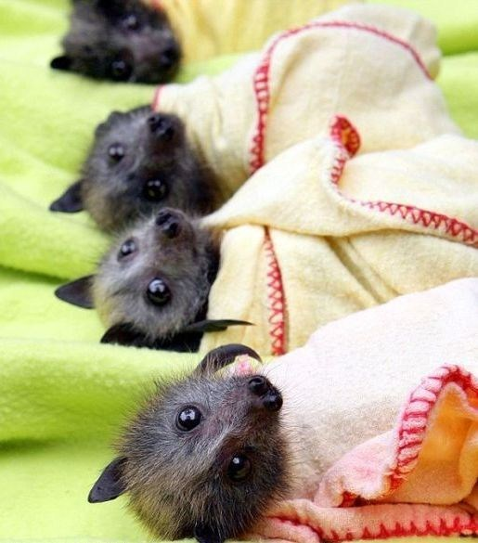
1 Pup per year- typical

Slide 23
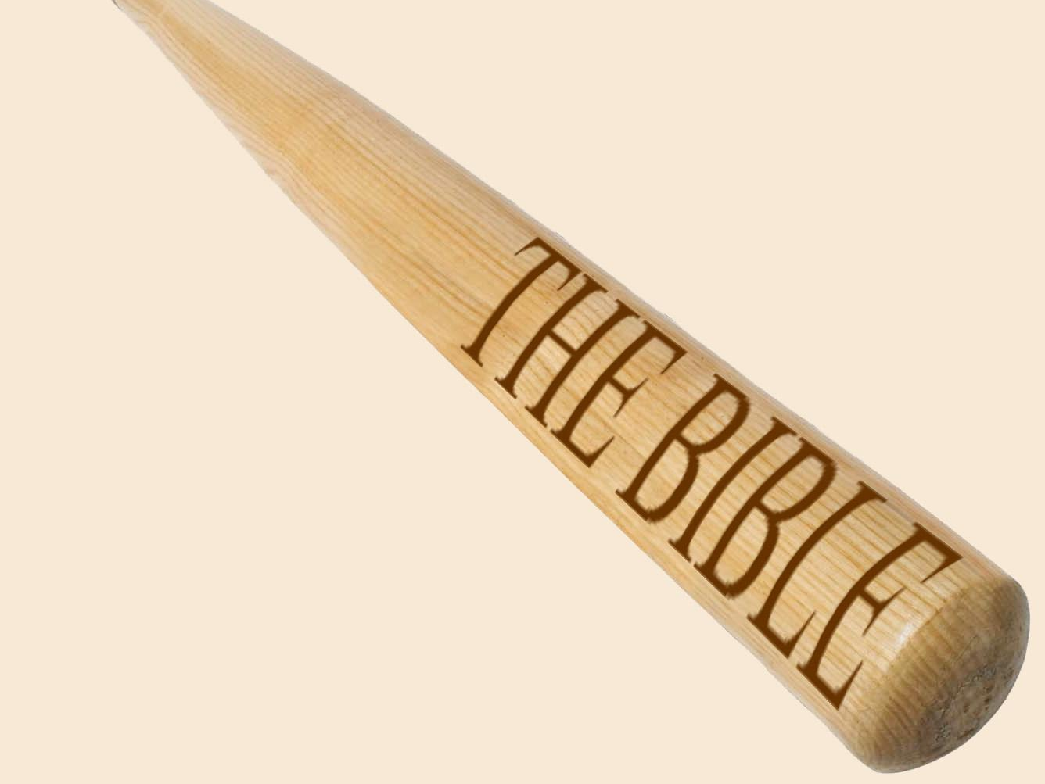
Leviticus 11: 13-19: These are the birds you are to regard as unclean and not eat because they are unclean: the eagle, the vulture, … the stork, any kind of heron, the hoopoe and the bat [?].
Deuteronomy 14:11-18 : You may eat any clean bird. But these you may not eat: the eagle,…. and the bat [?]

Slide 24
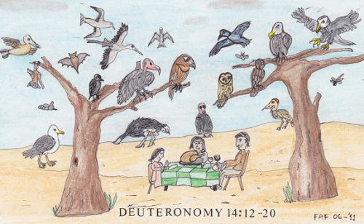
Did the Bible Blunder?
Linnean classification was not available in the time of the writing of Leviticus and Deuteronomy
The Hebrew word for bird is actually owph which means “fowl/winged creature”

Slide 25
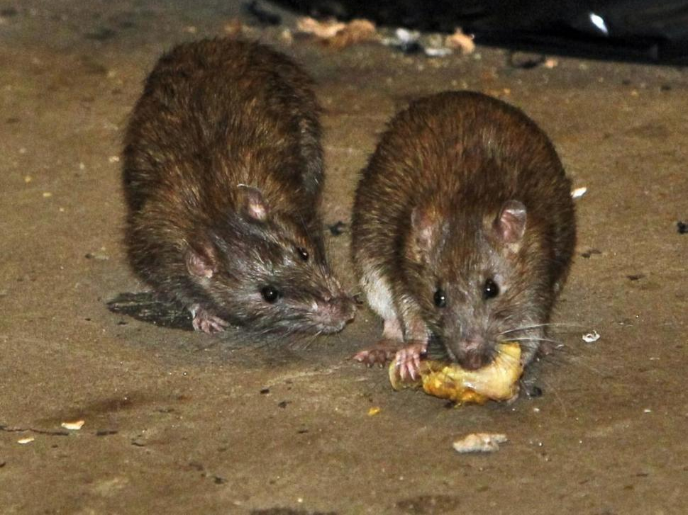
Isaiah 2:20: In that day men will throw away to the rodents and bats their idols of silver and idols of gold, which they made to worship.

Slide 26
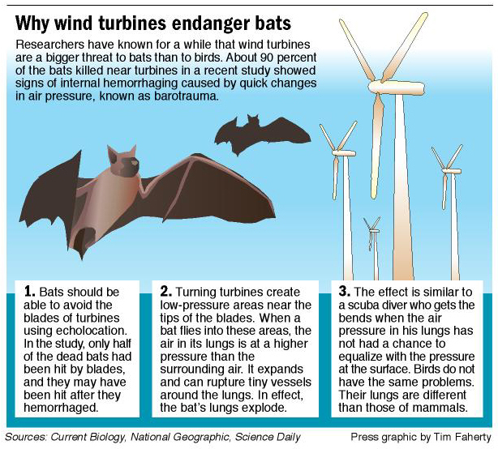
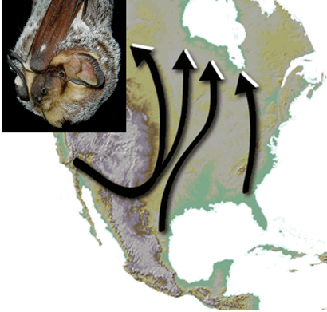
Hibernate and migrate

Slide 27
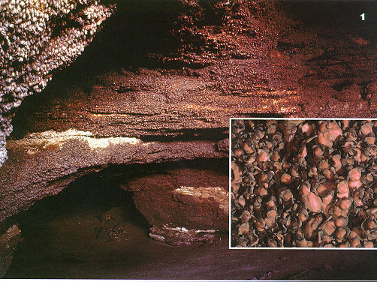
Bracken Cave in Central Texas
Summer home to the largest colony of bats in the world.
An estimated 20 million Mexican Free-tailed Bats roost in the cave from March to October
The largest known concentration of mammals

Slide 28
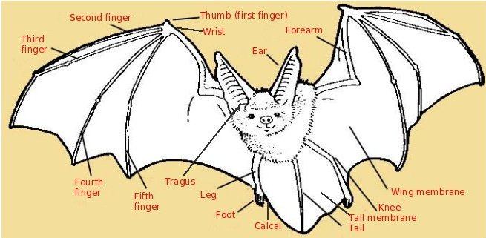
Parts of the bat
Second Finger
Thumb (first finger)
Wrist
Forearm
Third Finger
Ear
Tragus
Wing Membrane
Fourth Finger
Fifth Finger
Leg
Knee
Foot
Tail Membrane
Calcar
Tail

Slide 29
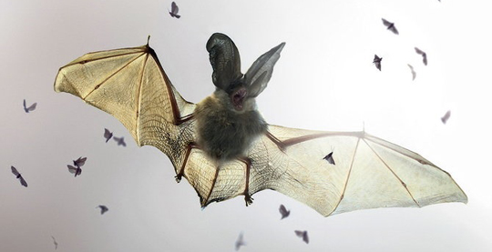
Benefit to Man
Eat insects. A single brown bat can eat 1,200 insects per hour (3,000 - 7,000 per night). Bats eat such harmful insects as cockroaches, mosquitoes, and gnats. Large colonies of bats can consume many insects that would otherwise harm farmers' crops.

Slide 30

Benefit to Man: Pollinate and spread seeds. Bats serve as food plant pollinators.

Slide 31

Benefits to Man
Provide outlet for medical research. Their echolocation skills have been studied to help medical professionals help the blind. A chemical agent in the saliva of the common vampire bat, Draculin, is being tested for use in helping stroke victims.

Slide 32

17 species of Bat in UK
Bats are a protected and very important part of the UK’s ecosystem.
Bat surveys

Slide 33


Common/Soprano Pipistrelles
Most Common British Bats (75% of all bat sightings)
Wide range of habitats
Weighs 5 grams
Eats 3,000 insects per night
Common / Soprano difference is frequency of echolocation calls

Slide 34

Noctule
Large bat emerges before sunset
Flies like a Swift bird
Steep dive to catch insects

Slide 35

Leisler’s Bat
'hairy-armed bat’
similar to the noctule but smaller with longer fur.

Slide 36


Brown Long-Eared Bat
Flight like a butterfly – slow and hovering
Common but hard to see- after dark and in vegetation

Slide 37


Daubenton’s Bat
Commonly seen skimming the water of a river or lake
Use their feet to grab the insects off the surface of the water.

Slide 38



Greater / Lesser Horsehoe Bat
Horseshoe bats possess a distinctive horseshoe-shaped noseleaf.
Lesser is able to wrap its wings completely around its body while at rest, differing from the greater horseshoe bat whose face can usually be seen

Slide 39

Where to Place A Bat House?
Hot! Hot! Hot!
Under Eaves
12-20 feet ideal
Sunny Location (East or South)
No lights
Guano Area
Along Forest or Water Edges
Within ¼ mile of water
Away from Trees

Slide 40



Bat Honor
Glen Morrow gmorrowpe@gmail.com
Thanks to Bob Moore- Berrien Springs, MI

