Slide 1
ASTRONOMY
PRESENTED BY : YENORY GAYLE
OAV FOR THE FLORIDA CONFERENCE OF THE SDA CHURCH

Slide 2
REQUIREMENTS
1-Name several stargazers of the Bible.
2- Identify one planet, two stars, and three constellations in the sky at night and give their correct names.
3- Make a constellation using marshmallows.
4- Explain the difference between a planet and a star.
5- Observe planets and stars in the night sky.
6- Make the Solar System using playdough.
7- Find three texts in the Bible that refer to the heavens.

Slide 3
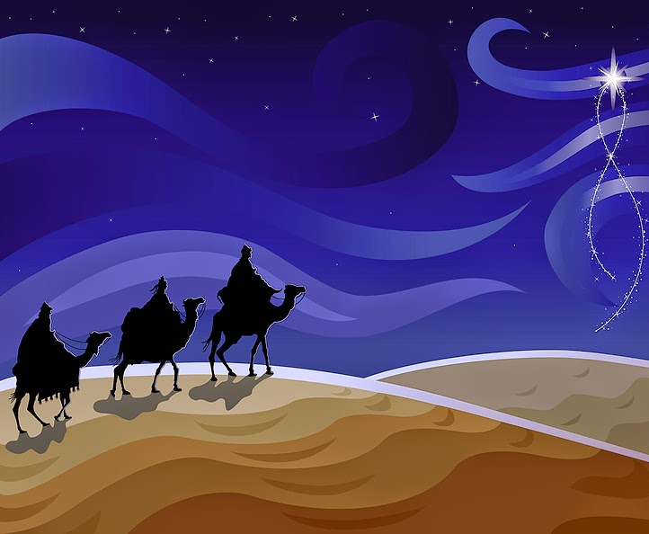
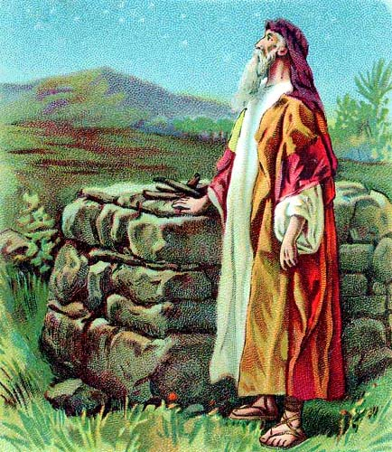
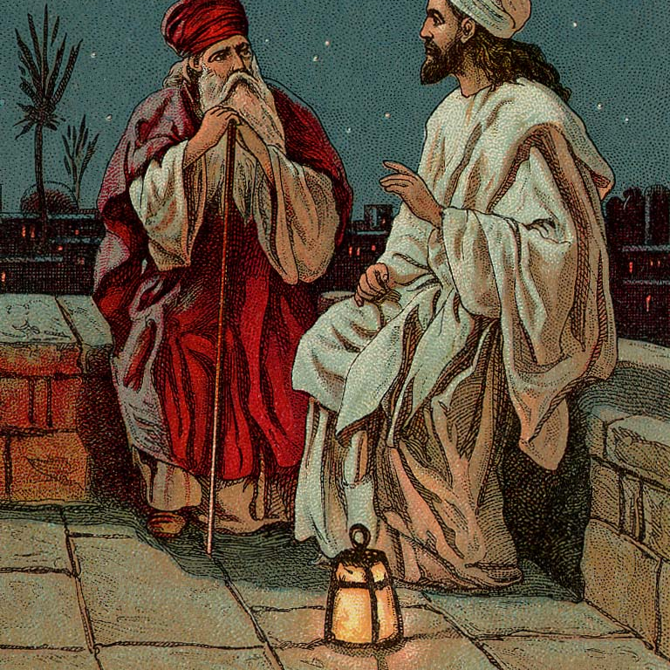
NAME SEVERAL STARGAZERS OF THE BIBLE
Adam and Eve (Education, page 21)
Abraham (Genesis 15:5)
Joseph (Education, page 52)
Jesus (SDA Bible Commentary, Volume 5, page 1117)
Moses (Patriarchs & Prophets, page 475)
Wise Men (Matthew 2:2)
This Photo by Unknown Author is licensed under CC BY

Slide 4
IDENTIFY ONE PLANET, THE PLANETS IN OUR SOLAR SYSTEM
Starting from closest to the Sun:
Mercury,
Venus,
Earth,
Mars,
Jupiter,
Saturn,
Uranus,
Neptune

Slide 5
IDENTIFY ONE PLANET, THE PLANETS IN OUR SOLAR SYSTEM
Here’s a “Memory Device” to help you remember!
“My Very Educated Mother Just Served Us Noodles”

Slide 6
IDENTIFY ONE PLANET, THE PLANETS IN OUR SOLAR SYSTEM
YOUR TURN!
“M_______ V_______ E_________ M_________ J_________ S_________ U_________ N_________”

Slide 7
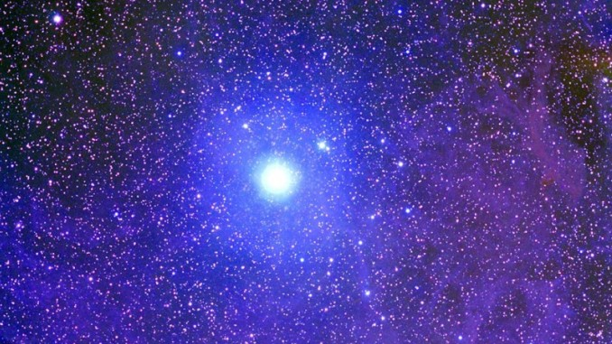
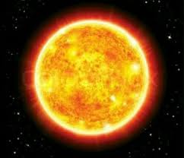
TWO STARS
The sun is the nearest star to Earth.
Polaris also known as the North star.
Polaris is a yellow-white supergiant star located around 430 light-years away in the constellation Ursa Minor

Slide 8
Constellations Video

Slide 9
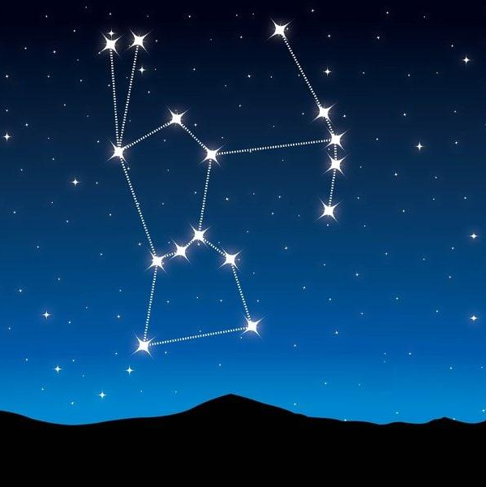
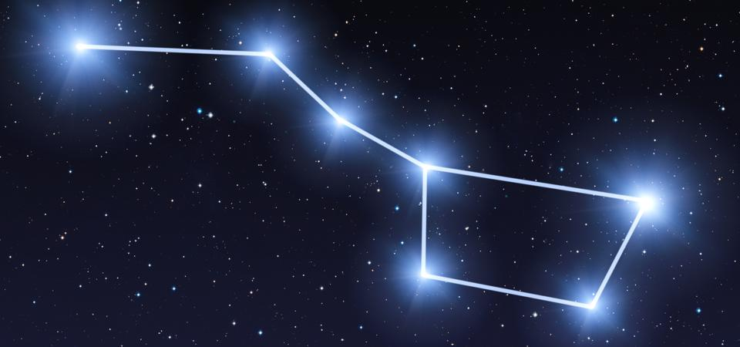
NAME THREE CONSTELLATIONS IN THE SKY AT NIGHT AND GIVE THEIR CORRECT NAMES.
URSA MAJOR , ORION AND BIG DIPPER

Slide 10
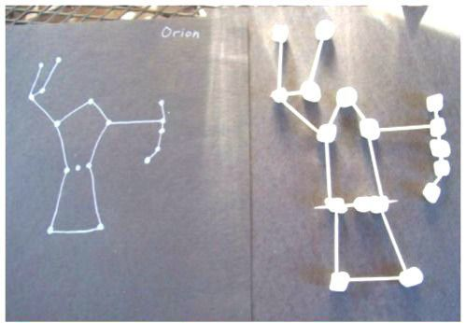
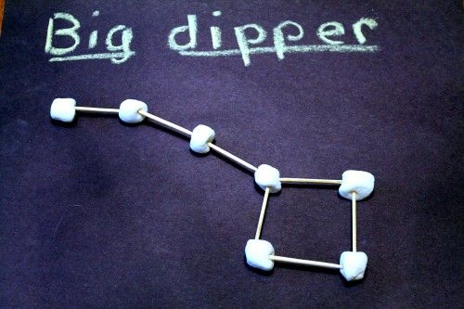
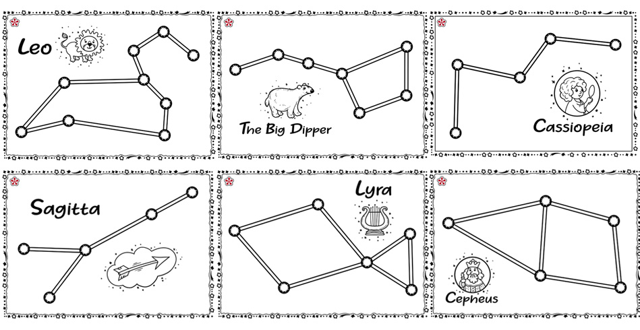
LET’S MAKE A CONSTELLATION USING MARSHMELLOWS
Materials: a box of toothpicks or pretzel sticks, a bag of mini marshmallows and black construction paper.

Slide 11
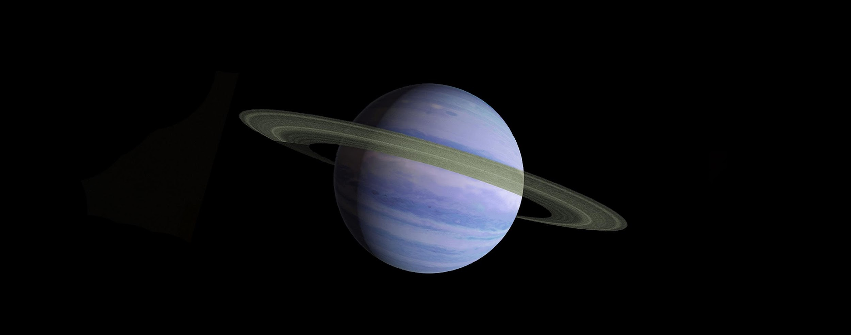
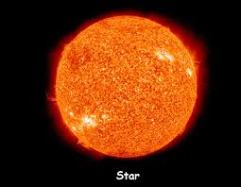
WHAT IS THE DIFFERENCE BETWEEN A PLANET AND A STAR?
STARS
PLANET
Planets are large natural objects that orbit, or travel around, stars.
Stars are giant spheres of superhot gas made up mostly of hydrogen and helium. Stars get so hot by burning hydrogen into helium in a process called nuclear fusion. This is what makes them so hot and bright. Our Sun is a star.
.

Slide 12
CREATING A SOLAR SYSTEM WITH PLAYDOUGH
https://youtu.be/XczGXdLRcts
List of materials: Playdough all different colors
Black poster board
Pencil
Bowls of different sizes.
Cord or string.

Slide 13
BIBLE VERSES THAT TALK ABOUT HEAVENS
Isaiah 13:10 (NIV)
The stars of heaven and their constellations will not show their light. The rising sun will be darkened and the moon will not give its light..
Deuteronomy 10:22 (NIV)
Your ancestors who went down into Egypt were seventy in all, and now the Lord your God has made you as numerous as the stars in the sky.
Genesis 1:16 (NIV)
God made two great lights—the greater light to govern the day and the lesser light to govern the night. He also made the stars..
Genesis 1:16 (NIV)
God made two great lights—the greater light to govern the day and the lesser light to govern the night. He also made the stars..

Slide 14
WORDS FOR PARENTS AND DIRECTORS
Dear parents and directors: Take the children outside during a clear night for them to see the moon, stars and constellations.
This will complete this award.

