Slide 1
Manners Fun

Slide 2
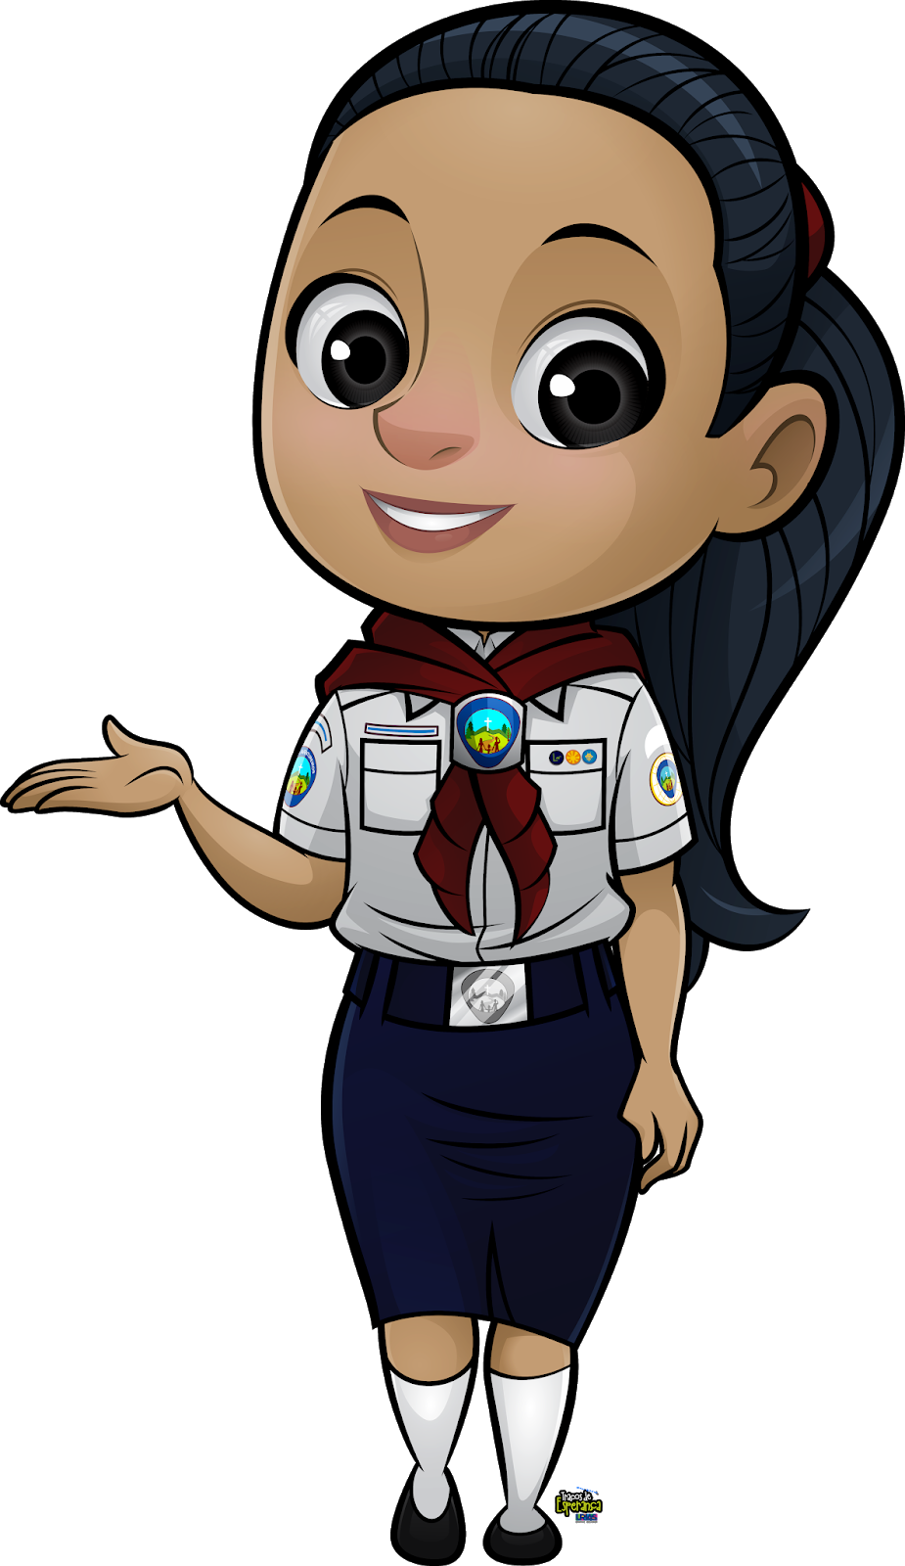
Manners Fun
1. Learn the Golden Rule (Matthew 7:12)
2. What are the five magic words?
3. Draw or cut and paste pictures to illustrate one of the magic words.
4. Play a game using the five magic words.

Slide 3
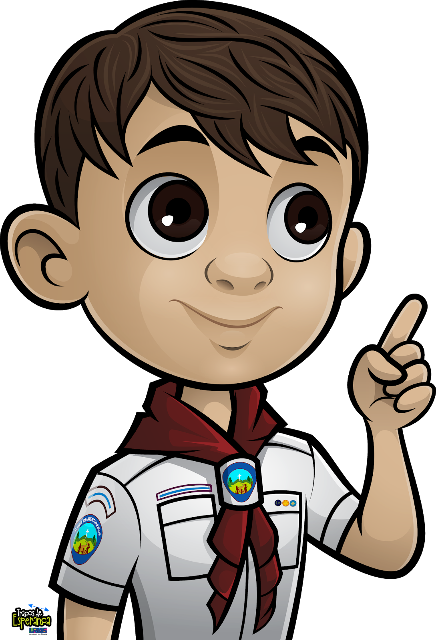
HOLD ON!!
What Are Manners?

Slide 4
Manners Fun
The way we behave
towards others

Slide 5
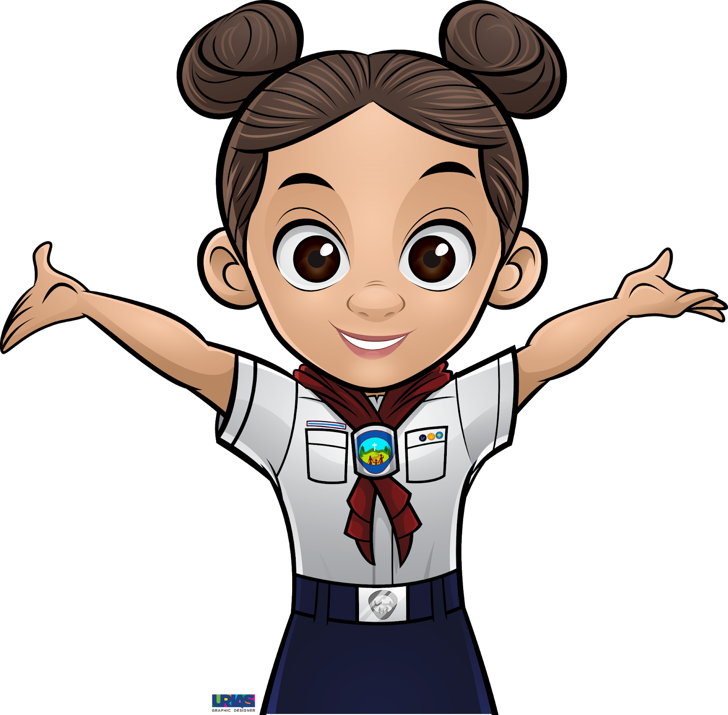
Question!!
So, there are good manners and bad manners?

Slide 6
If we make someone feel appreciated = Good manners
If we make someone feel not appreciated = Bad manners

Slide 7
LETS CHAT
Examples of GOOD MANNERS

Slide 8
PLEASE
Examples of GOOD MANNERS

Slide 9
PLEASE
Examples of GOOD MANNERS
THANK YOU

Slide 10
PLEASE
Examples of GOOD MANNERS
THANK YOU
EXCUSE ME

Slide 11
I AM SORRY
PLEASE
Examples of GOOD MANNERS
THANK YOU
EXCUSE ME

Slide 12
I AM SORRY
PLEASE
YOU ARE WELCOME
Examples of GOOD MANNERS
THANK YOU
EXCUSE ME

Slide 13
JESUS TAUGHT US GOOD MANNERS

Slide 14
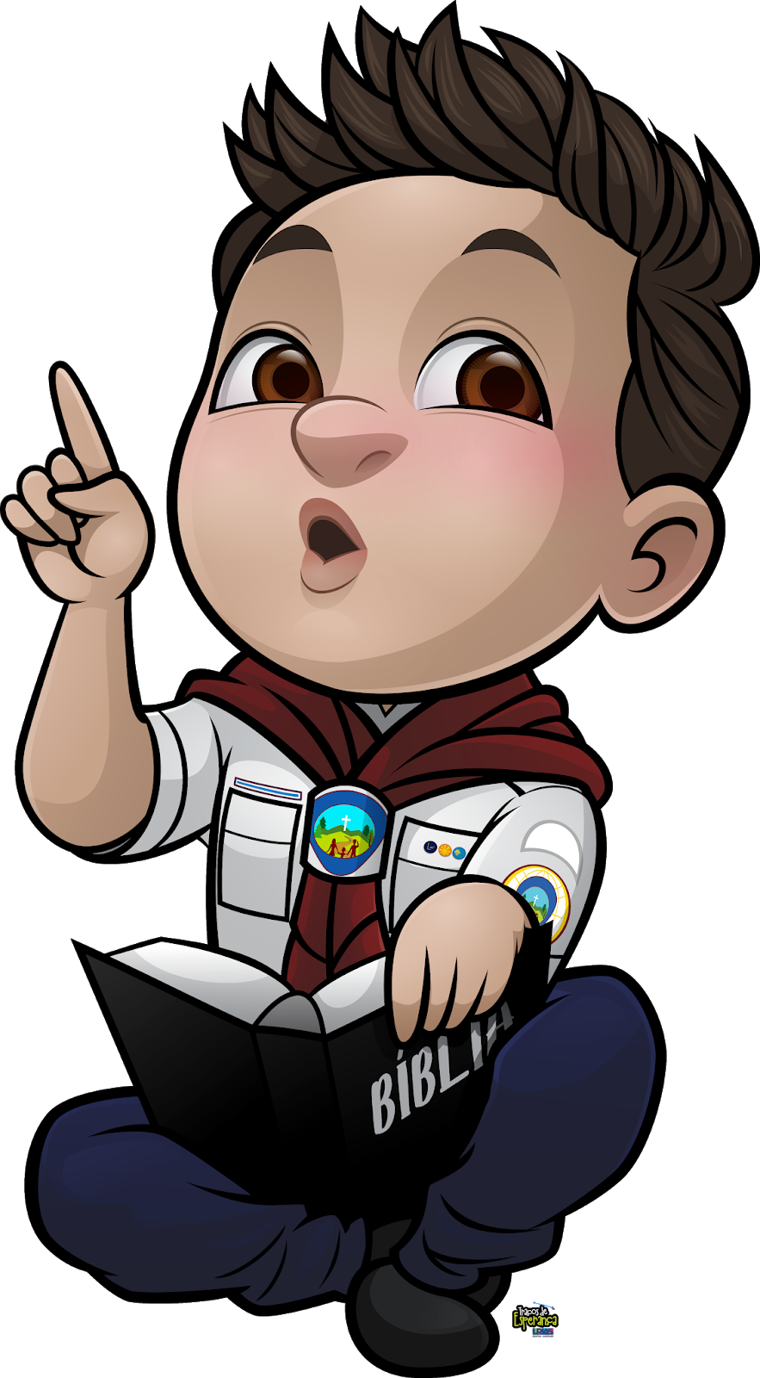
MATTHEW
7:12

Slide 15
So, in everything, do to others what you would have them do to you, for this sums up the Law and the Prophets.

Slide 16
What do we call it today?

Slide 17
We call it
‘THE GOLDEN RULE’

Slide 18
Shall we learn a song to memorise this?

Slide 21
HOW DO YOU FEEL?
PLEASE

Slide 22
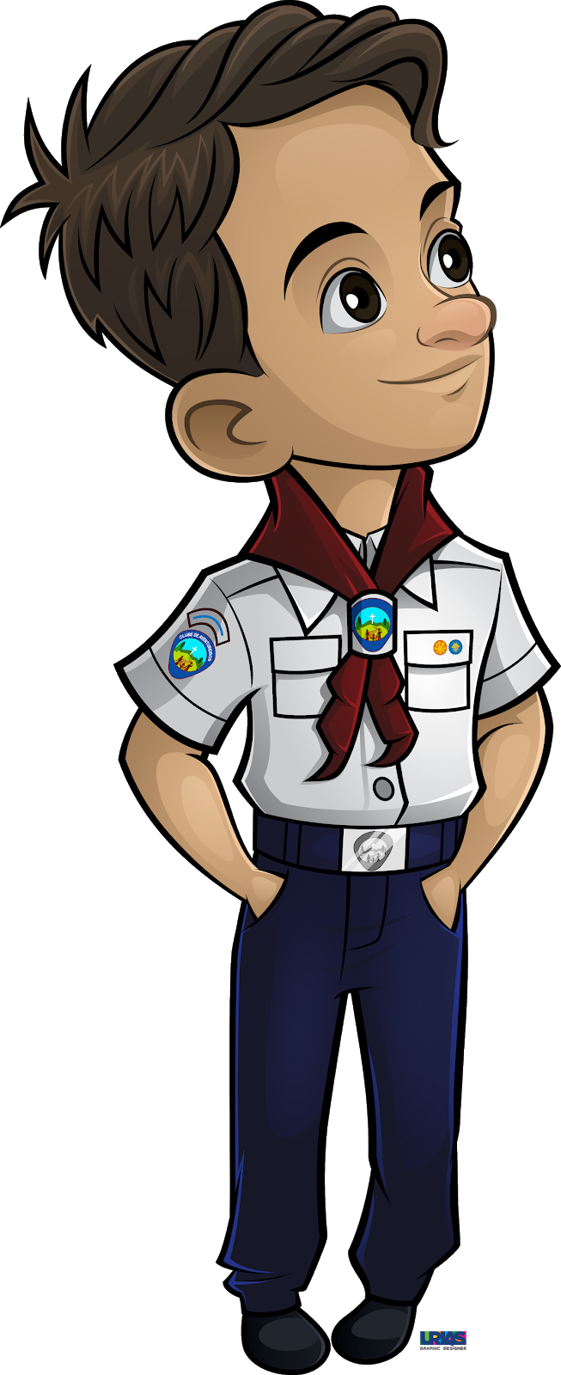
It does not feel like it’s my job or I’m being taken for granted.
PLEASE

Slide 23
WHO IS LIKELY TO APPRECIATE THIS PARTICULAR GESTURE?
PLEASE

Slide 24
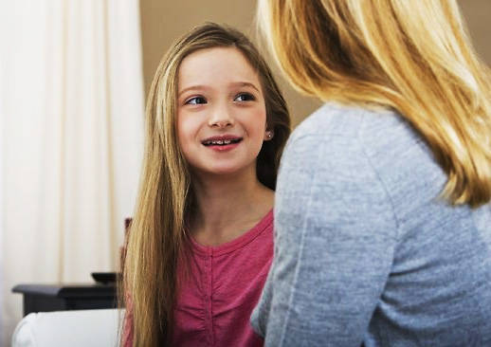
MOM

Slide 25
HOW DO YOU FEEL?
THANK YOU

Slide 26
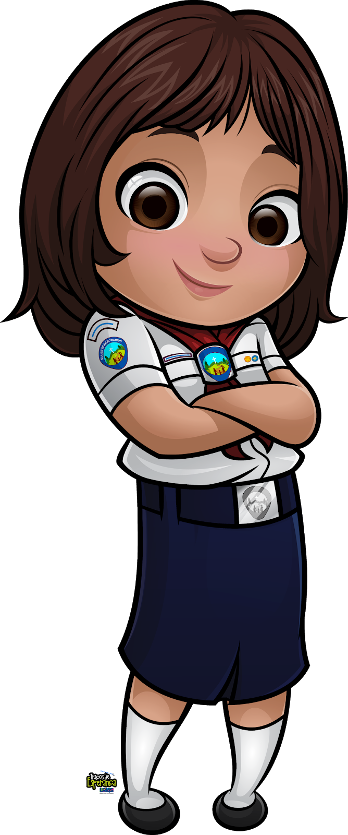
I feel like someone appreciates what I did for them and they value me
THANK YOU

Slide 27
WHO IS LIKELY TO APPRECIATE THIS PARTICULAR GESTURE?
THANK YOU

Slide 28
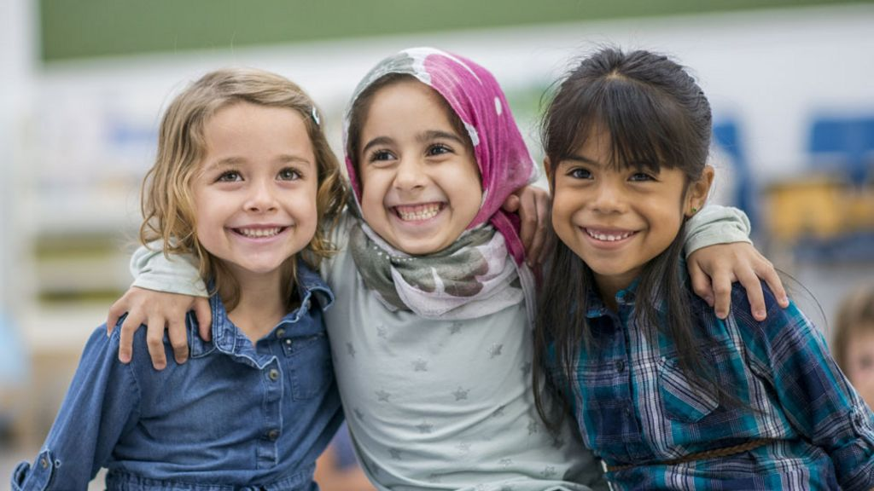
FRIENDS

Slide 29
HOW DO YOU FEEL?
EXCUSE ME

Slide 30
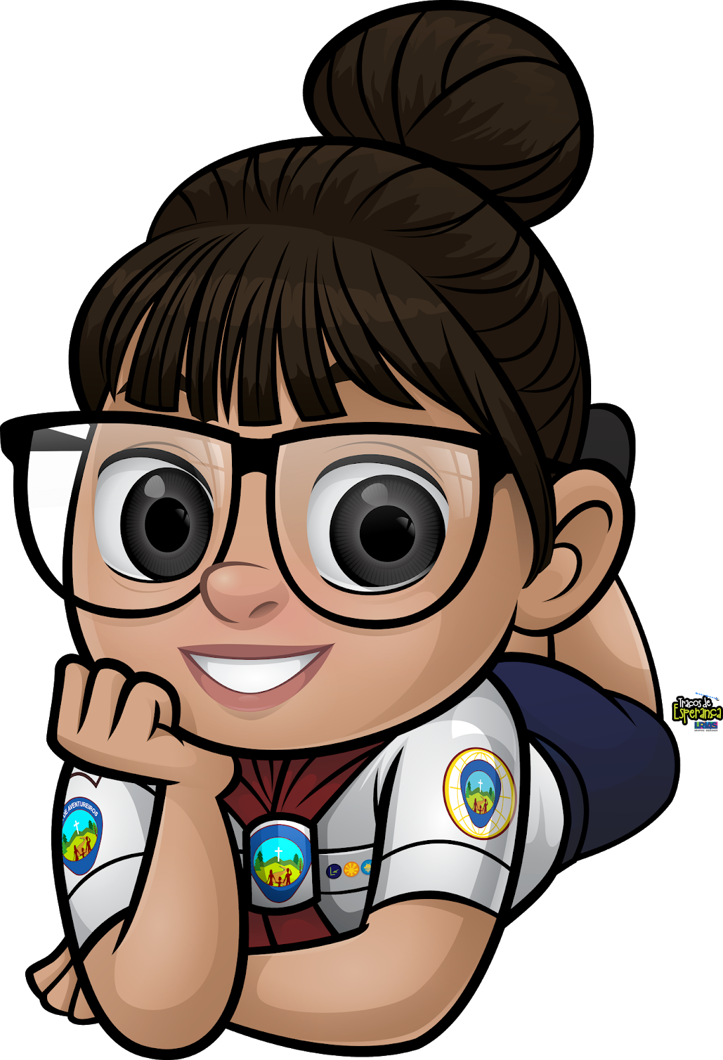
I feel like the person values and respects my presence.
EXCUSE ME

Slide 31
WHO IS LIKELY TO APPRECIATE THIS PARTICULAR GESTURE?
EXCUSE ME

Slide 32
Someone who is in our way when we are trying to do something or go somewhere.
EXCUSE ME

Slide 33
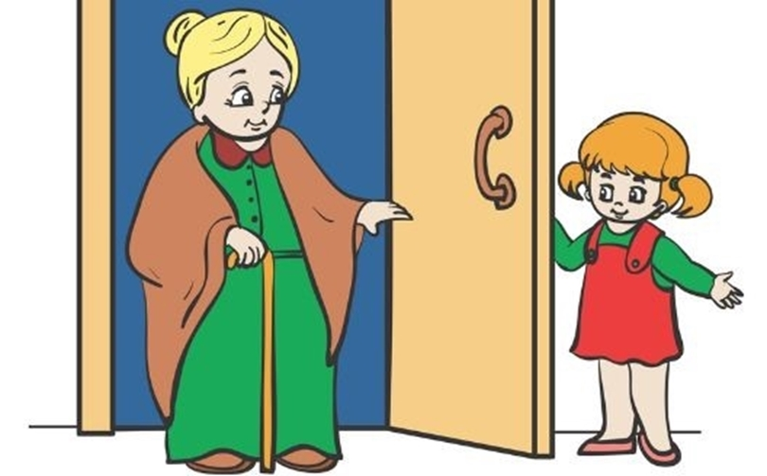
EXCUSE ME

Slide 34
HOW DO YOU FEEL?
I AM SORRY

Slide 35
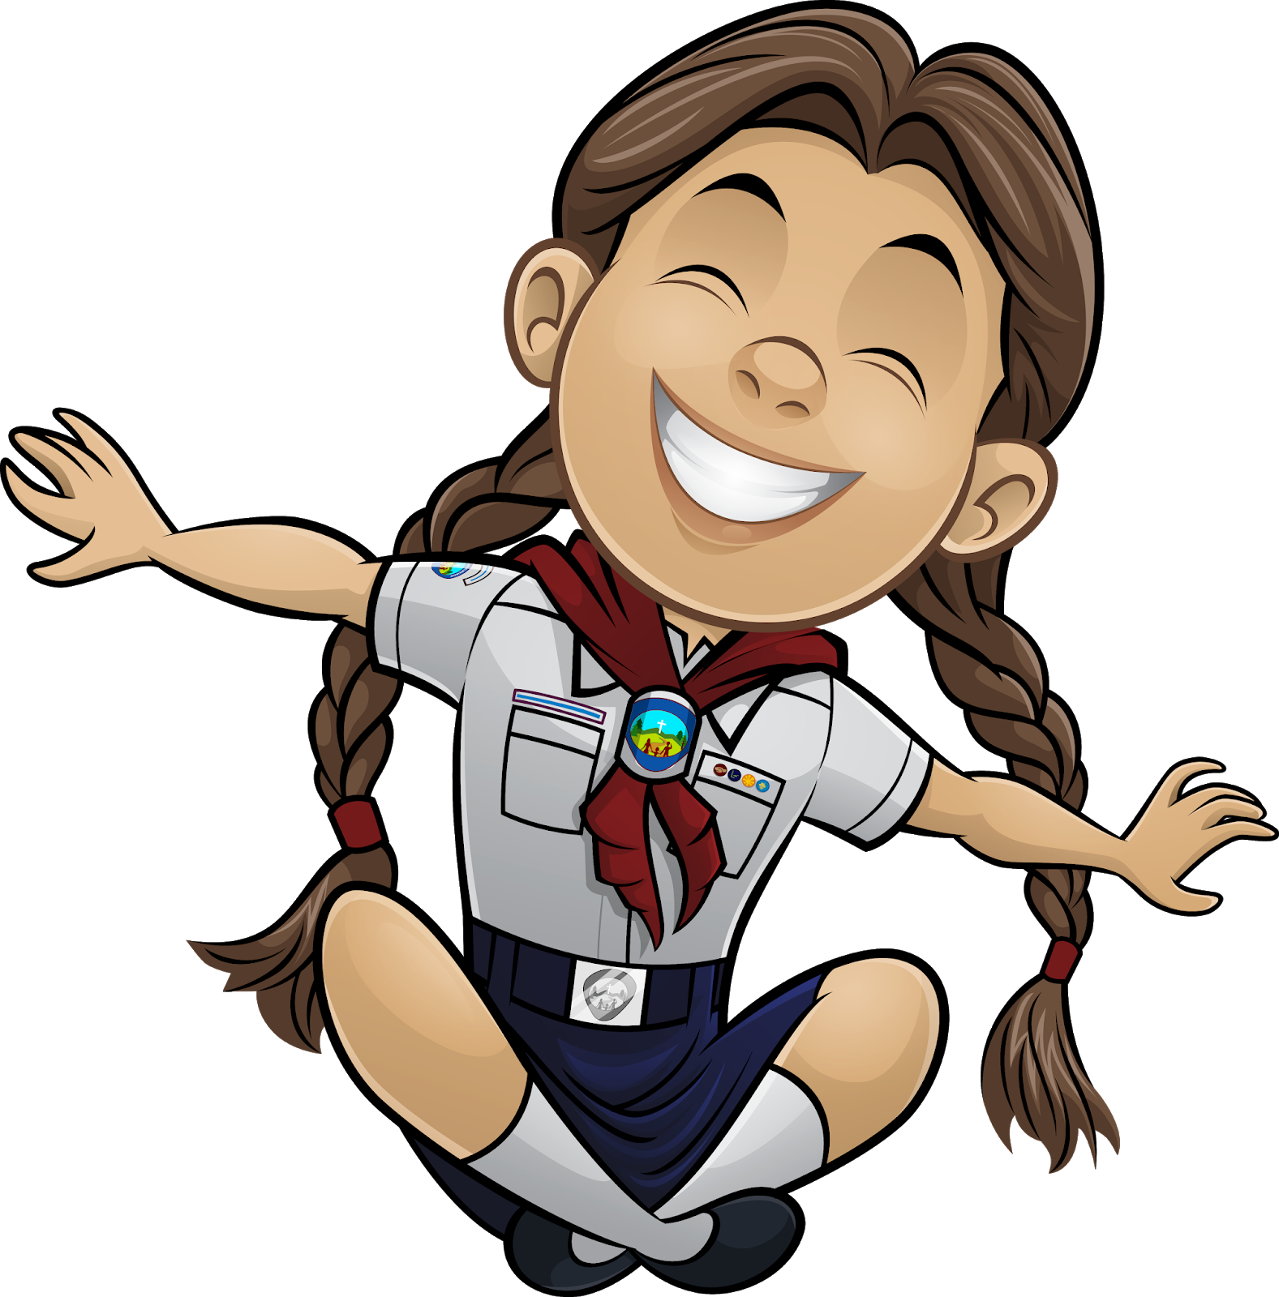
I feel like someone values my friendship because they want to be with me
I AM SORRY

Slide 36
WHO IS LIKELY TO APPRECIATE THIS PARTICULAR GESTURE?
I AM SORRY

Slide 37
Someone who makes us angry.
I AM SORRY

Slide 38
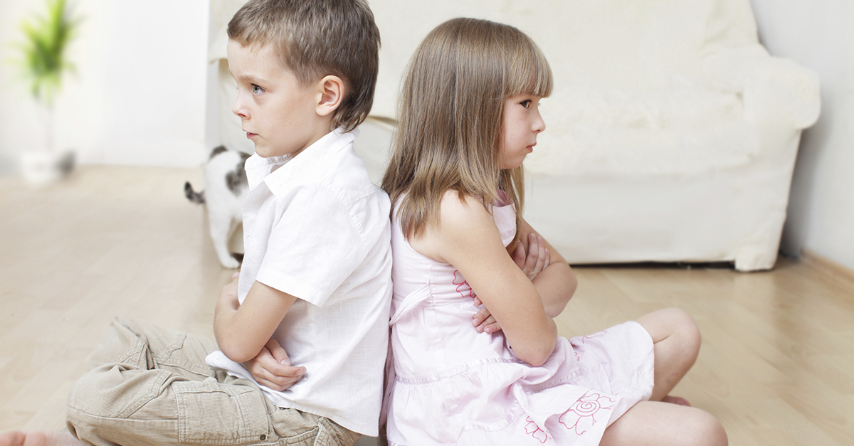
I AM SORRY

Slide 39
HOW DO YOU FEEL?
YOU’RE WELCOME

Slide 40
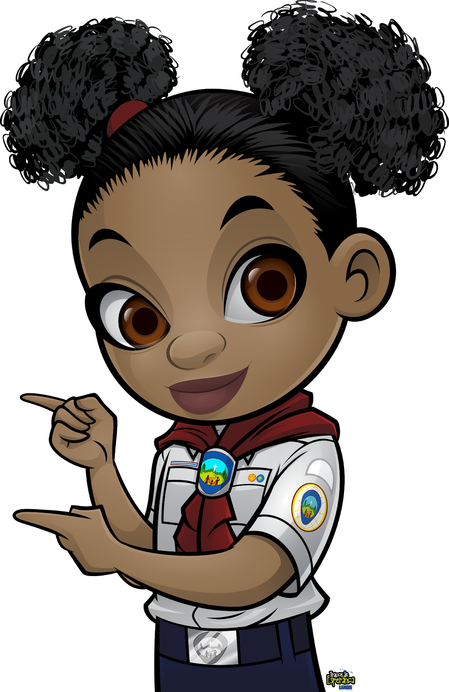
I feel like my friend appreciates my thank you, my appreciation, and it was a pleasure for that person to do the job.
YOU’RE WELCOME

Slide 41
WHO IS LIKELY TO APPRECIATE THESE PARTICULAR WORDS?
YOU’RE WELCOME

Slide 42
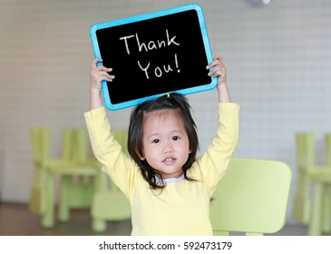
YOU’RE WELCOME

Slide 43
Let’s play a game

Slide 44
What language is this?
What are they saying?

Slide 45
POR FAVOR

Slide 46
POR FAVOR
Language - SPANISH

Slide 47
POR FAVOR
Language - SPANISH
It means - PLEASE

Slide 48
ASANTE SANA

Slide 49
ASANTE SANA
Language - SWAHILI

Slide 50
ASANTE SANA
Language - SWAHILI
It means – THANK YOU

Slide 51
EXCUSEZ-MOI

Slide 52
EXCUSEZ-MOI
Language - FRENCH

Slide 53
EXCUSEZ-MOI
Language - FRENCH
It means – EXCUSE ME

Slide 54
HET SPIJT MY

Slide 55
HET SPIJT MY
Language - DUTCH

Slide 56
HET SPIJT MY
Language - DUTCH
It means – I AM SORRY

Slide 57
CU PLACERE

Slide 58
CU PLACERE
Language - ROMANIAN

Slide 59
CU PLACERE
Language - ROMANIAN
It means – YOU’RE WELCOME

Slide 60
CREATIVE WAYS TO HAVE MANNERS

Slide 62
AN OLD VIDEO SAYING THANK YU

Slide 63
CREATIVE WAYS TO HAVE MANNERS

Slide 64
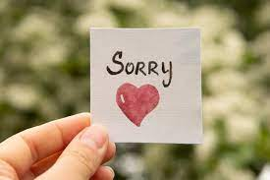
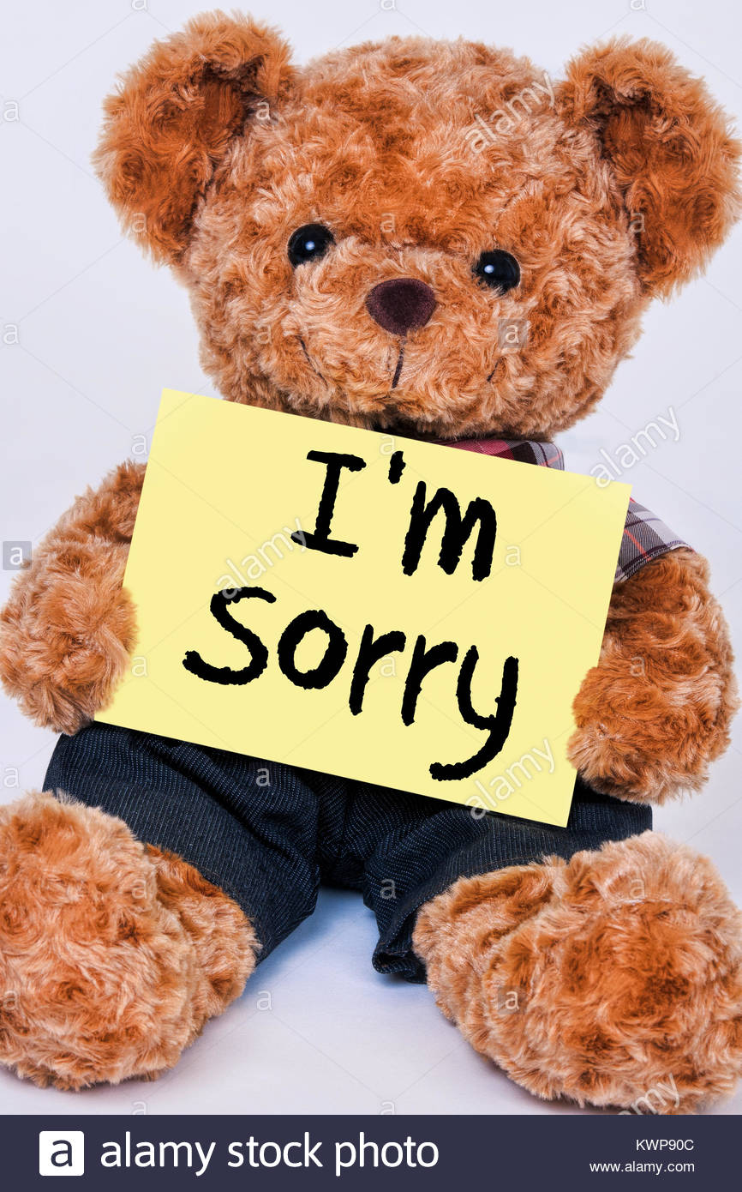
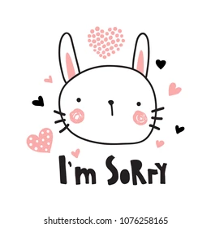
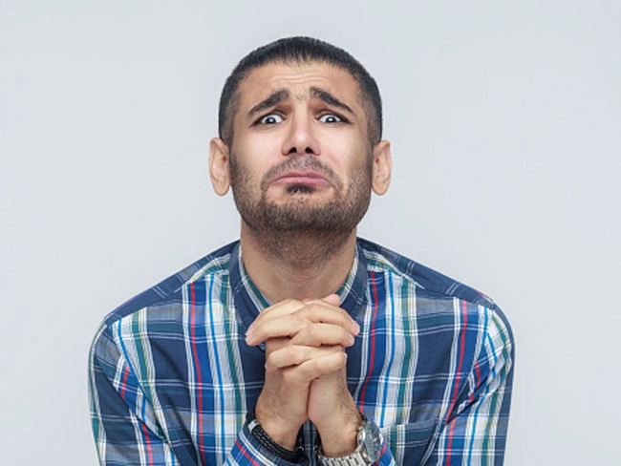
MY I’M SORRY – PICTURE BOARD

Slide 65
Manners Fun

