Slide 1
Creationism Basic
Bogdan Stan
IM Pathfinder Department

Slide 2
Requirements
1. Define the scientific model and theory
2. List 3 differences between creationist and evolutionist models
3. Read and comment 1 Timothy 6:20 - 21 and Genesis 1 - 2
4. Quote 5 passages from Patriarchs and Prophets about earth young age
5. Investigate “The Creation”
6. Genesis Ch 6 – 9 analysis
7. Attend a Creationism meeting
8. Investigate and demonstrate how to argue in favour of creationism
9. Project – “Why be a creationist?”
10. Organise a debate
11. Report of the diversity and wonder in God’s creation

Slide 3
1. Define the scientific model and theory
Definition
In science, the term “model” refers to the schematic description of a system (or set of phenomena) that accounts for its observed and inferred features as well as its origin and history.
It's a scenario that offers reasonable explanations for the entire scope (origin to ending) of a particular system, as well as for its relationship to other natural phenomena.

Slide 4
1. Define the scientific model and theory
Using a model approach supplies researchers with enough detail to assist in further study. It offers explanations for how, when, where, and why the phenomena (or system) occurs.
It anticipates, or “predicts,” discoveries that could either verify or falsify the model's explanation(s).
The best models also yield specific suggestions for how near-future research may help improve understanding of the systems or phenomena they attempt to explain.

Slide 5
2. List 3 differences between Creation and evolution
Creation
God created life and universe
All creation was done in 6 literal days (6 working days)
Earth with life is 6 000 years old
God created the adult animals and humans (chicken first)
God created human kind as the crown of the creation and is depredating as species from generation to generation
Evolution
Life and universe came from nowhere
Life appeared in billions of years
Earth with life is very old (billions of years)
Evolutionist don’t know yet what was first, the chicken or the egg
Human kind came from monkeys and is evaluating to a better species from generation to generation

Slide 6
3. Read and respond to the following:
a. 1 Timothy 6:20, 21. What relation can exist between this passage and the evolutionism?
1 Timothy 6:20 - O Timothy! Guard what was committed to your trust, avoiding the profane and [f]idle babblings and contradictions of what is falsely called knowledge
1 Timothy 6:21 - by professing it some have strayed concerning the faith.

Slide 7
3. Read and respond to the following:
a. 1 Timothy 6:20, 21. What relation can exist between this passage and the evolutionism?
The only relation between the two is that people professing it some have strayed concerning the faith.

Slide 8
3. Read and respond to the following:
b. Genesis 1, 2. Can someone disagree with these texts and remain a member of the remnant? Justify the response
If you disagree with what God inspired Moses to write about the report of creation, it means you don’t believe God and you can’t remain a member of the remnant.
By disagreeing you have no other option then believing the evolution theory for which, from my perspective, you need a lot more faith
Note: Read and analyse the Biblical Report from Genesis and answer to the above question with your thoughts.

Slide 9
4. Quote 5 passages from Patriarchs and Prophets about earth young age
Note 1: Read Patriarchs and Prophets and take notes on the passages you find about the young age of the earth
Example
“But the assumption that the events of the first week required thousands upon thousands of years, strikes directly at the foundation of the fourth commandment. It represents the Creator as commanding men to observe the week of literal days in commemoration of vast, indefinite periods. This is unlike His method of dealing with His creatures. It makes indefinite and obscure that which He has made very plain. It is infidelity in its most insidious and hence most dangerous form; its real character is so disguised that it is held and taught by many who profess to believe the Bible. PP 111.3”

Slide 10
4. Quote 5 passages from Patriarchs and Prophets about earth young age
Note 1: Read Patriarchs and Prophets and take notes on the passages you find about the young age of the earth
Note 2: Book is available for free here:
https://m.egwwritings.org/en/book/84/toc
Or
EGW WRITING 2 APP IN PLAYSTORE

Slide 11
5. Investigate “The Creation”
Investigate “The Creation” as the fundamental belief of the Seventh-day Adventist Church. Demonstrate the base of this fundamental belief through the Bible, finding, from memory, at least five passages that talk about this idea.
Note: The second good Biblical reference is found in the book of Job Ch. 38 and 39

Slide 12
6. Genesis Ch 6 – 9 analysis
Read chapters six through nine of Genesis. Afterwards, do one of the following activities:
Investigate and elaborate a detailed schedule about a theory accepted by scientific creationists about how the events occurred.

Slide 13
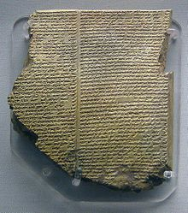
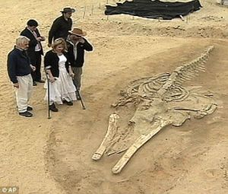
6. Genesis Ch 6 – 9 analysis
b. Make a list with at least 3 biblical mentions of the flood and give at least 3 historical and scientific evidences of a global flood.
Biblical
Historical
Scientific
Genesis 7:17
Genesis 9:28
Psalms 29:10
Mathew 24: 38-39
2 Peter 3:5
Epic of Gilgamesh, composed about 1800 BC.
A complete fossil whale skeleton in the Chilean desert.

Slide 14
6. Genesis Ch 6 – 9 analysis
b. Make a list with at least five biblical mentions of the flood and give at least five historical and scientific evidences of a global flood.
Biblical
Historical
Scientific
Genesis 7:17
Genesis 9:28
Psalms 29:10
Mathew 24: 38-39
2 Peter 3:5
Note: More examples here:
https://www.pbs.org/independentlens/blog/a-flood-of-myths-and-stories/
To be completed by Pathfinder
Note:
Check for errors in Carbon14 measuring tool. This will give you Scientific evidence that the dating of the fossils and age of the earths is not real.

Slide 15
7. Attend a meeting on creationism
a. Prior to your attendance, write some of the anticipated doubts that people may have about a scientific presentation from a Creationist viewpoint. If possible, present them to a speaker or participant so they can clarify responses from a biblical and/or scientific basis.

Slide 16
7. Attend a meeting on creationism

Slide 17
7. Attend a meeting on creationism
b. As you debrief the meeting, share at least fifteen objections that can be made by the evolutionists from a creationist’s viewpoint. Share some of the biblical and scientific ways that you can refute objections.

Slide 18
7. Attend a meeting on creationism
Evolutionists Objections
Objection possible answers
Earth age is not 6000 years old
After sea life evolved, hundreds of millions of years ago, somehow they came to land and evolved in different species, then the bird evolved somehow from dinosaurs
Note:
Rest to be completed by the Pathfinder and please use the links from the last slide
The method used to date certain things is not accurate. Same method dated dinosaurs to be 50000 years old.
God created the birds and all the sea life in the same day, the 5th day
Note:
Rest to be completed by the Pathfinder and please use the links from the last slide

Slide 19
8. Investigate and demonstrate how to argue in favour of creationism using 3 of:
a. From the biological point of view, what are the systems of irreducible complexity?
b. From the geological point of view, investigate and draw a geological column of creationism and compare it with the evolutionary model. Explain how the gaps in both models are completed with philosophical bases (not scientifically checked)
c. From the oceanography point of view, how can we know, through oceanic sedimentation, that the oceans are “young”?

Slide 20
8. Investigate and demonstrate how to argue in favour of creationism using 3 of:
d. From the astronomical point of view, how does the progressive distance of the moon, in relation with the gravitational centre of the earth (take into account the “limit of Roche”) indicate a “young” earth and moon?
e. From the archaeological point of view, what are the transitional fossils? How does their absence argue in favour of creationism?

Slide 21
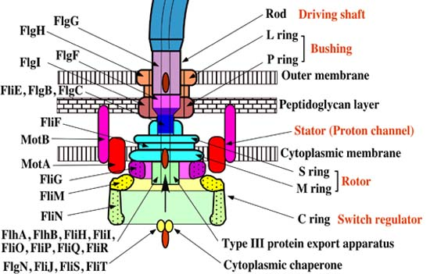
8. Investigate and demonstrate how to argue in favour of creationism using 3 of:
a. From the biological point of view, what are the systems of irreducible complexity?
Irreducible complexity is a term used to describe a characteristic of certain complex systems whereby they need all of their individual component parts in place in order to function.
In other words, it is impossible to reduce the complexity of (or to simplify) an irreducibly complex system by removing any of its component parts and still maintain its functionality.

Slide 22
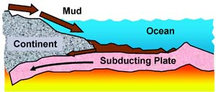
8. Investigate and demonstrate how to argue in favour of creationism using 3 of:
c. From the oceanography point of view, how can we know, through oceanic sedimentation, that the oceans are “young”?
Not enough mud on the sea floor:
Each year, water and winds erode about 20 billion tons of dirt and rock from the continents and deposit it in the ocean.
This material accumulates as loose sediment on the hard basaltic (lava-formed) rock of the ocean floor
Source: https://www.icr.org/article/evidence-for-young-world/

Slide 23
8. Investigate and demonstrate how to argue in favour of creationism using 3 of:
e. From the archaeological point of view, what are the transitional fossils? How does their absence argue in favour of creationism?
To be Completed by the Pathfinder

Slide 24
9. Project – “Why be a creationist?”
Based on what you have learned in this honour and from other sources, present a project titled “Why be a creationist?” through one of the following:
Electronic presentation
Written paper
Video
Storyboard / poster

Slide 25
10. Organise a debate
With the instructor as the mediator, have a debate about how it is possible to have science and faith in harmony.
Note:
To be done in a club meeting, Sabbath School class

Slide 26
11. Report of the diversity and wonder in God’s creation
Visit one of the following and give your club director a report of the diversity and wonder of the things you saw of God’s creation:
a. Zoo
b. Aquarium
c. National/State/Provincial Park
d. Nursery
e. Gardens
f. Equivalent location.
Alternative:
Watch Wonders of Creation
https://www.youtube.com/watch?v=XB1XWV7-VtA

Slide 27
11. Report of the diversity and wonder in God’s creation
What should you include:
List of some animals/ sea life or birds which impressed you
Why are you impressed by them
Why do you think the were created and why you think they did not evolved

Slide 28
Creationism - Resources:
Debate 1 - https://www.youtube.com/watch?v=OghwjQDUiCM
Debate 2 - https://www.youtube.com/watch?v=SdEvXK91B58
Debate 3 - https://www.youtube.com/watch?v=JJyd6F5c4v0
Documentary –
Seminars - https://www.youtube.com/watch?v=Cv9vu4l7LmA
Book - https://www.amazon.com/Flood-Evidence-Reasons-Still-Matter/dp/0890519781

Slide 29
Creationism
Thank You

