Slide 1

Taiga
Presenter: Jim Thomas
Wiki.pathfindersonline.org

Slide 2

Area Coordinator
Jim Thomas
Creator and Maintainer of the NAD Pathfinder Wiki
Wiki.pathfindersonline.org

Slide 3
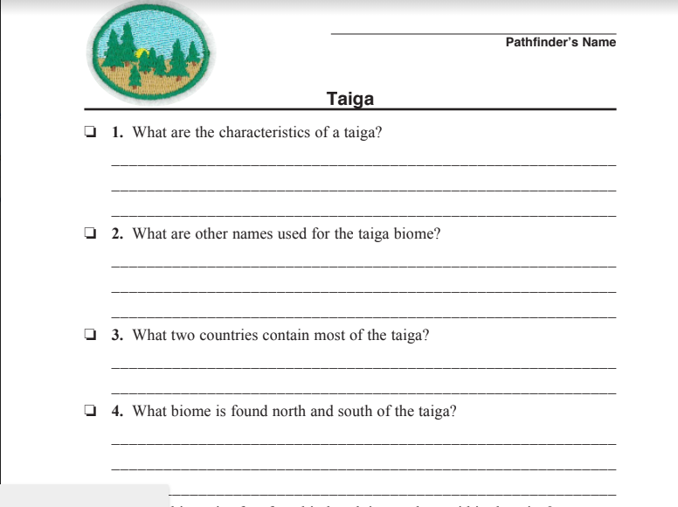
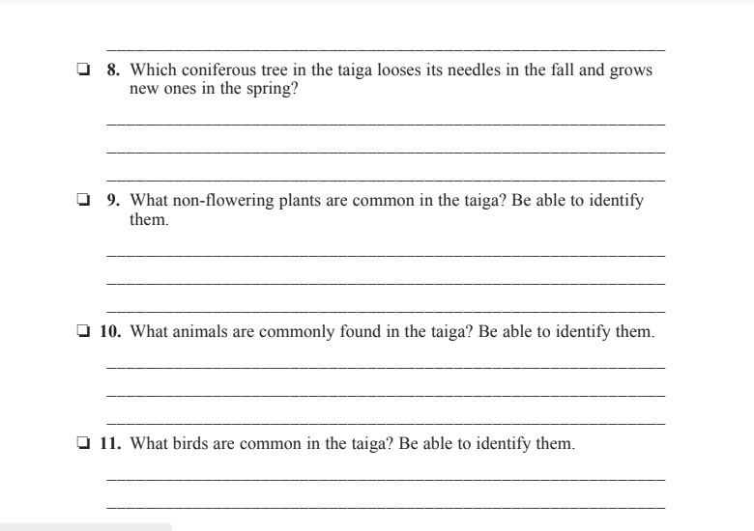
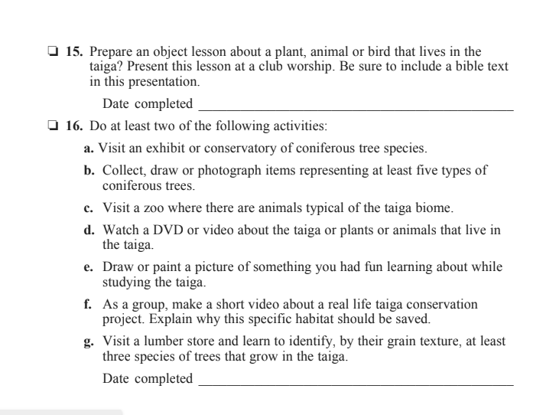
Did You Download & Print?
http://bit.ly/TaigaWorksheet
3 pages

Slide 4
Requirement #1
What are the characteristics of a taiga?

Slide 5
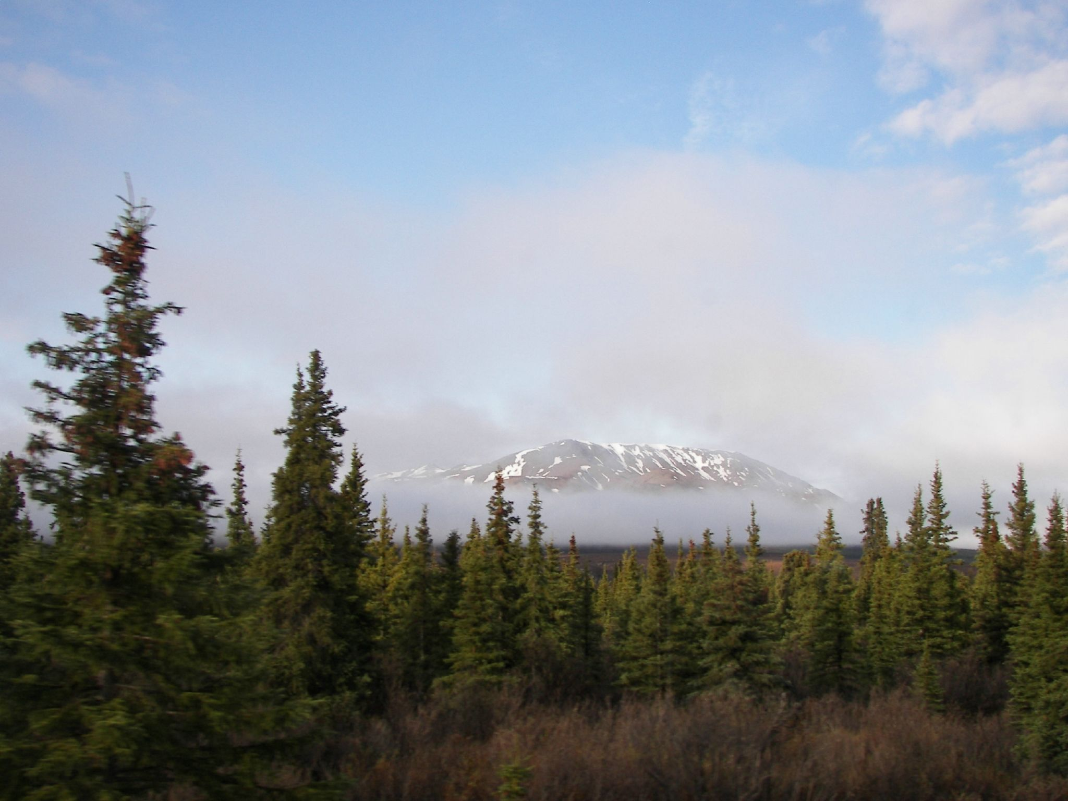
Definition
Taiga is a sub-arctic biome found in the northern parts of the world.
There is no taiga in the southern hemisphere.
Image credit: kyleandkelly from Alaska - Flickr

Slide 6
Characteristics
It is dominated by cone-bearing trees and cold-hardy fauna.
The taiga gets extremely cold in the winter.
Largest terrestrial biome on Earth, covering 29% of the landmass.
Image credit: kyleandkelly from Alaska - Flickr

Slide 7

Requirement #2
What other names are used for the taiga biome?

Slide 8
A rose is a rose is a rose.
Taiga is also known as:
Boreal Forest
Snow Forest
North Woods

Slide 9
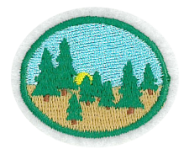
Requirement #3
What two countries
contain most of the taiga?

Slide 10
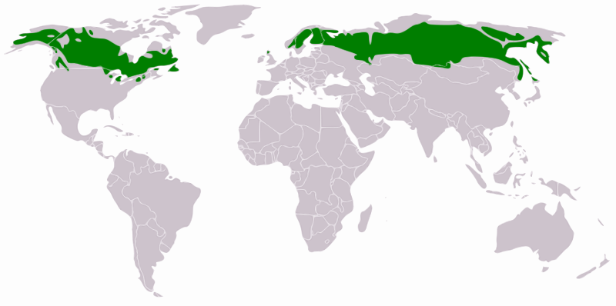
What two countries contain most of the taiga?
Canada
Russia (Siberia)
(but also, Scotland(!!!) Scandinavia and the USA)
Image credit: Mark Baldwin-Smith

Slide 11
Requirement #4
What biome is found north and south of the taiga?

Slide 12
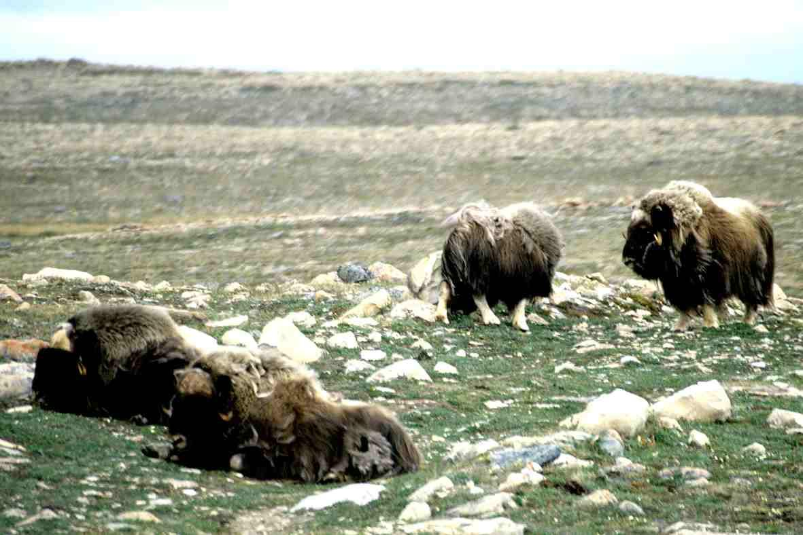
North of the Taiga is the Tundra
Image credit: Ansgar Walk

Slide 13
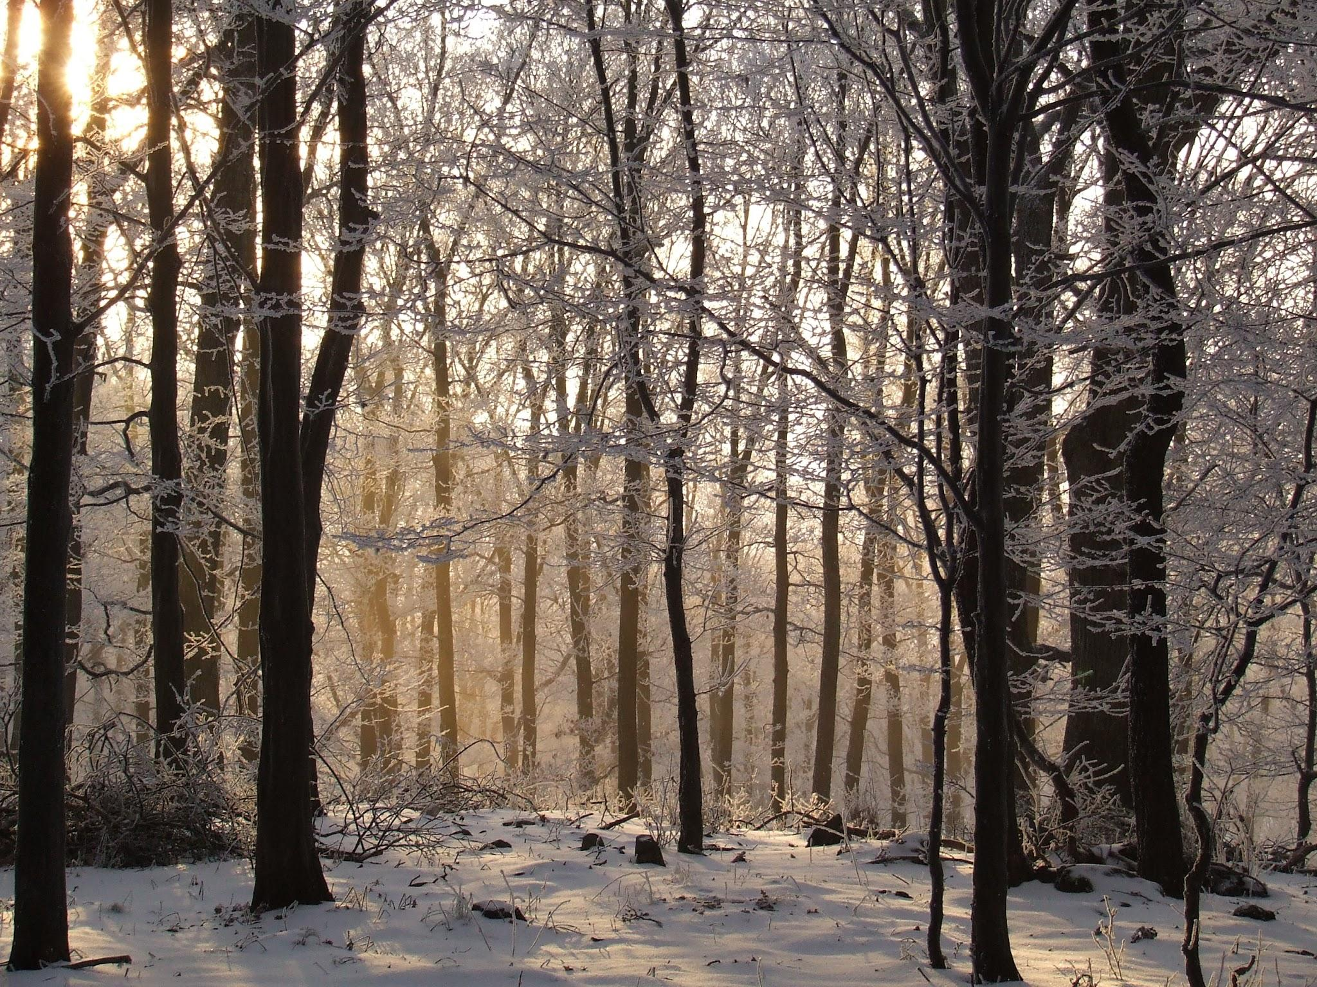
South of the Taiga is the Temperate Deciduous Forest
Image credit: Susulyka -

Slide 14
Requirement #5
What biome is often found in low-lying pockets within the taiga?

Slide 15
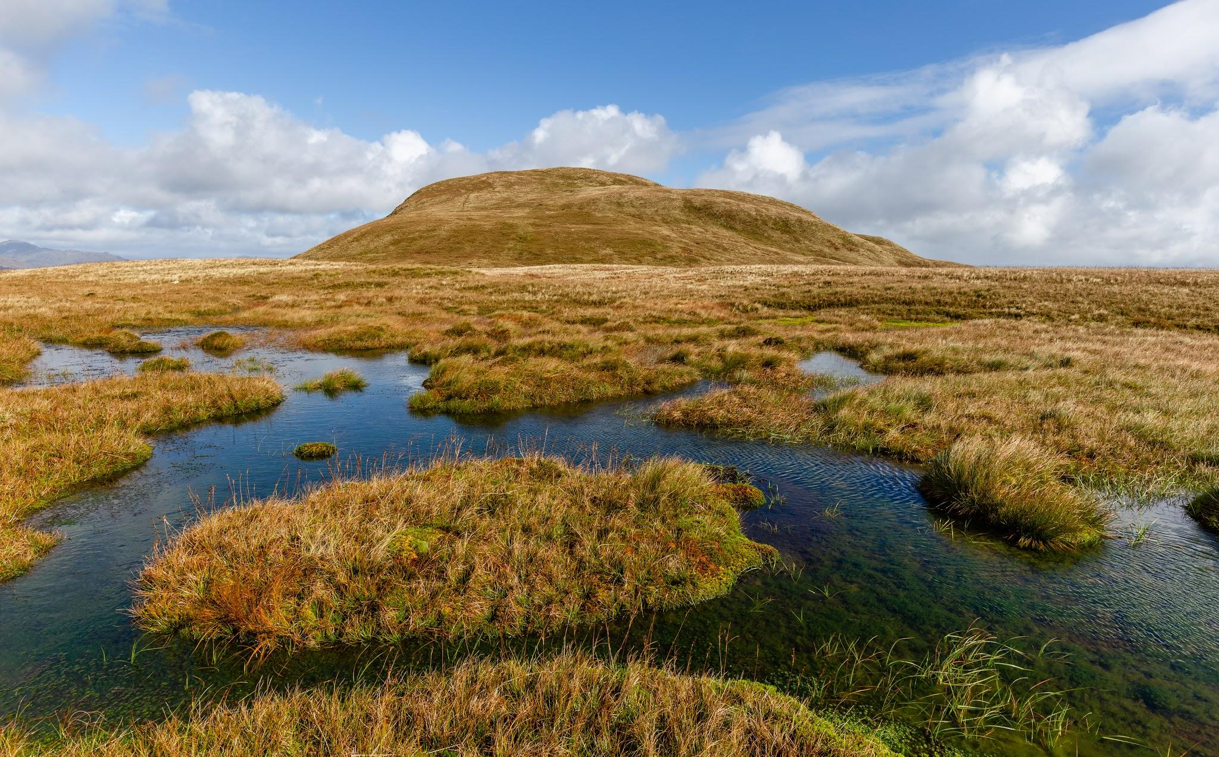
Bogs and Fens are common in low-lying areas of the Taiga
Image credit: Michal Klajban

Slide 16
Requirement #6
What is permafrost and where can it be found?

Slide 17
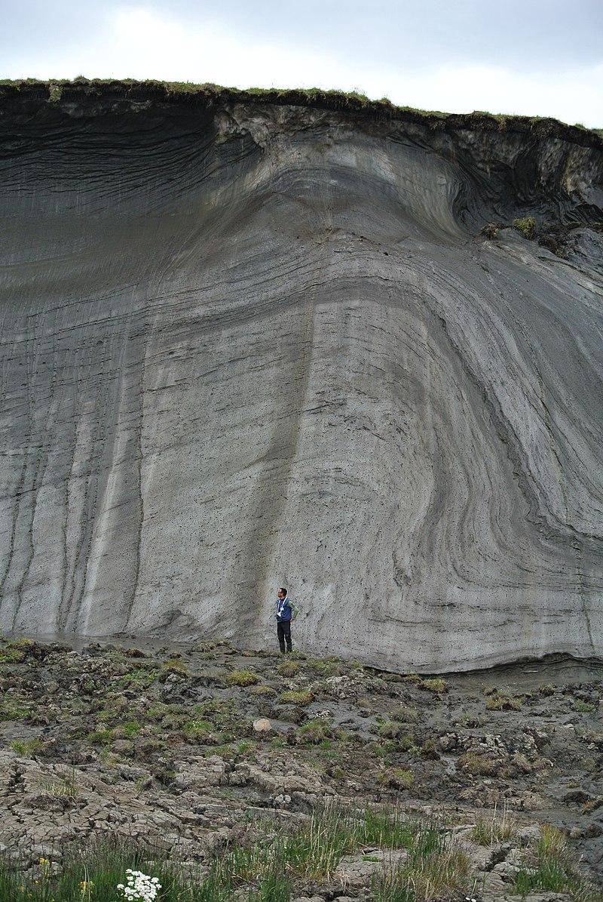
Requirement #6
Permafrost is a condition where the ground remains frozen year-round. Even though the upper layers may thaw, it remains frozen down deeper.
The Inuit take advantage of this to refrigerate their food. It’s like a root cellar on steroids.
Image credit: By Boris Radosavljevic - https://www.flickr.com/photos/139918543@N06/24460126809/, CC BY 2.0, https://commons.wikimedia.org/w/index.php?curid=80427888

Slide 18
Requirement #7
What trees are commonly found in the taiga? Be able to identify them.

Slide 19
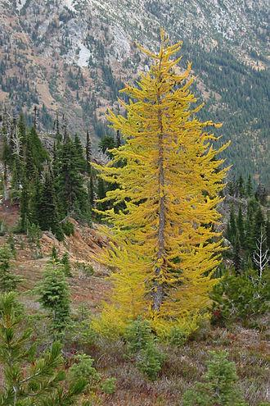
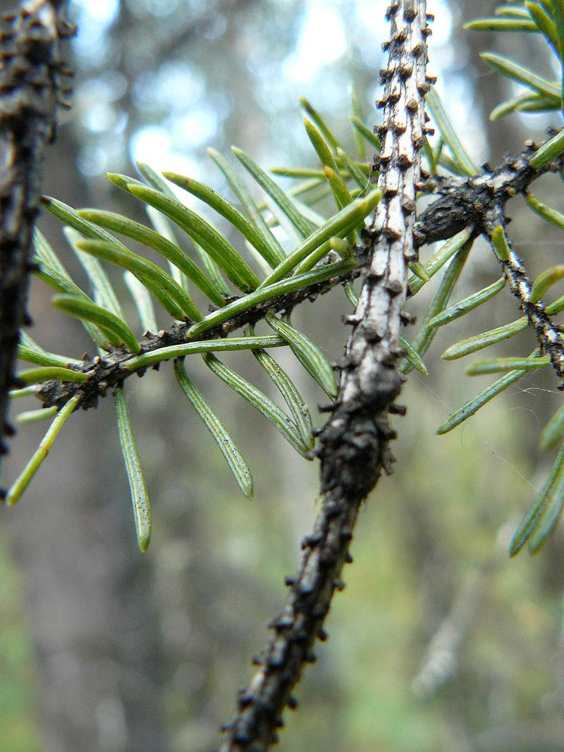
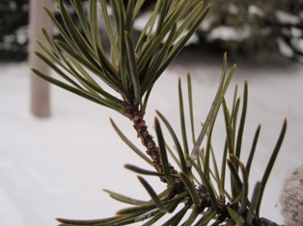
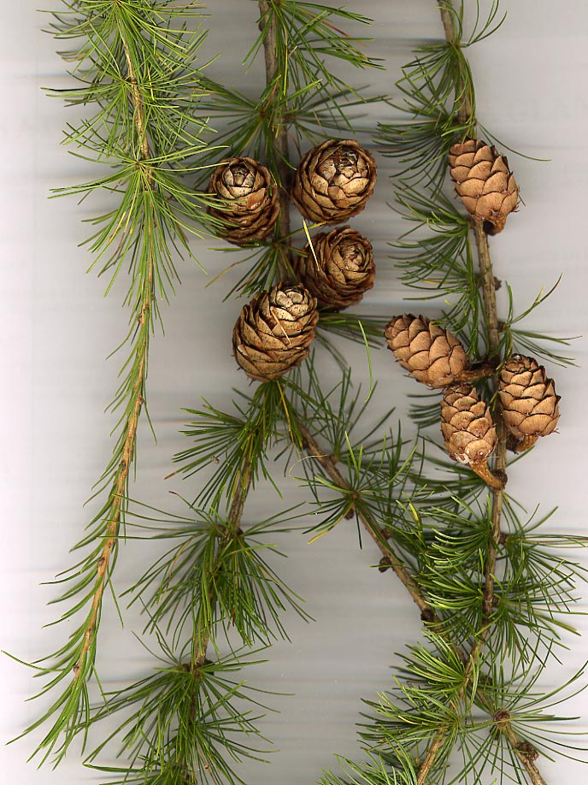
Common trees in the Taiga:
Pines
Spruces
Larch (aka Tamarack)
Larch
White Spruce
Jack Pine
White Spruce
Image credits: Dawn Endico, Hugo MC, MPF , Walter Siegmund

Slide 20
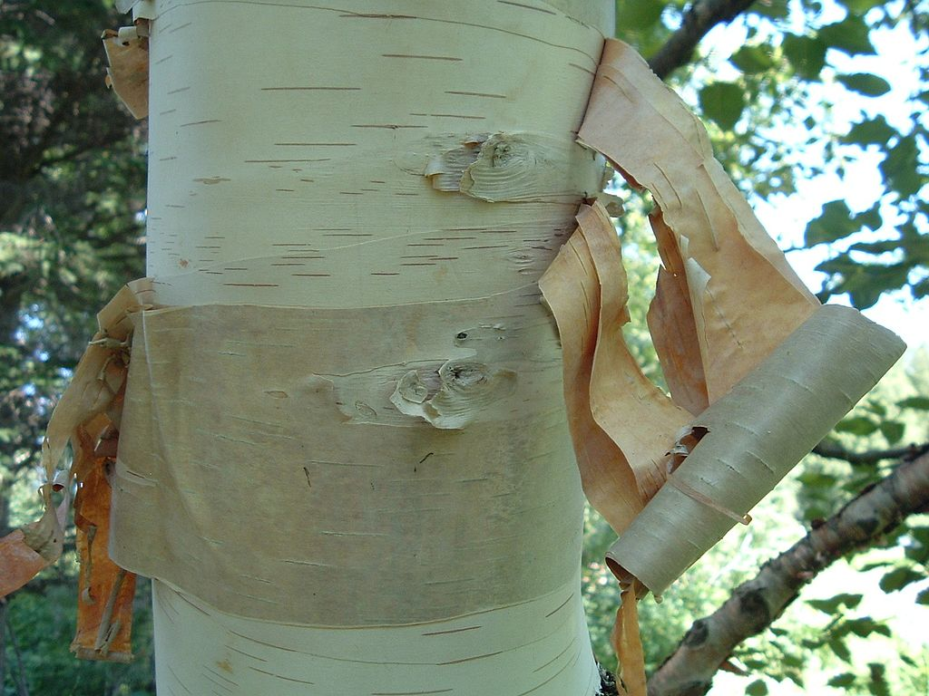
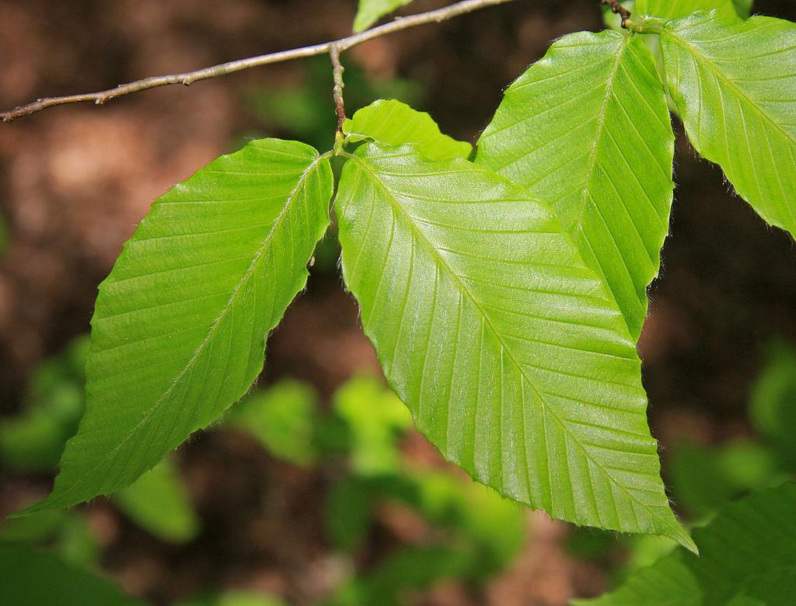
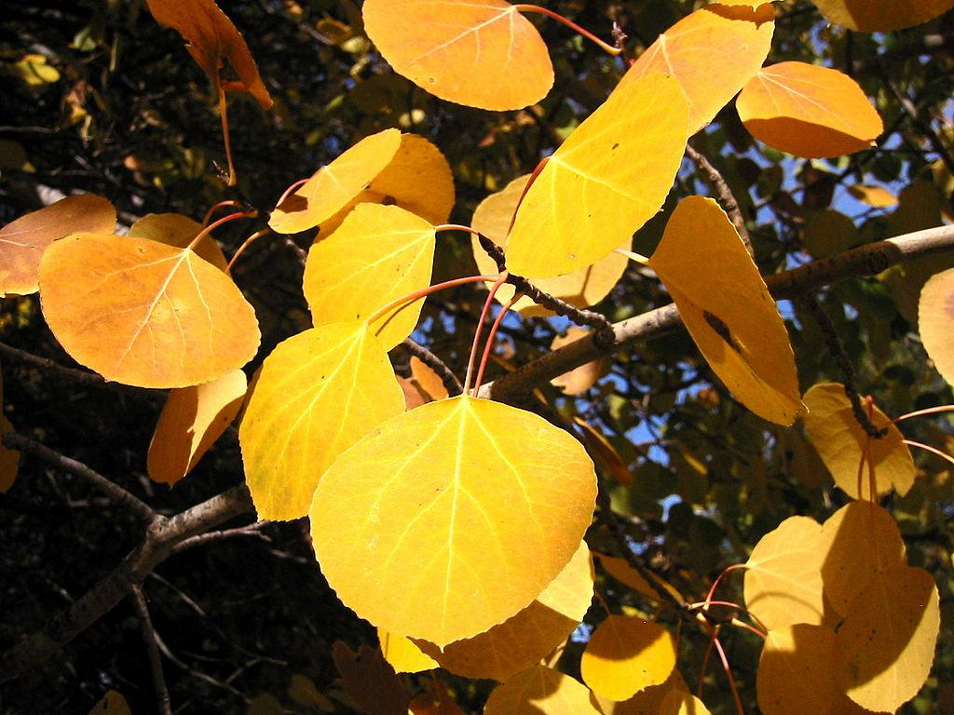
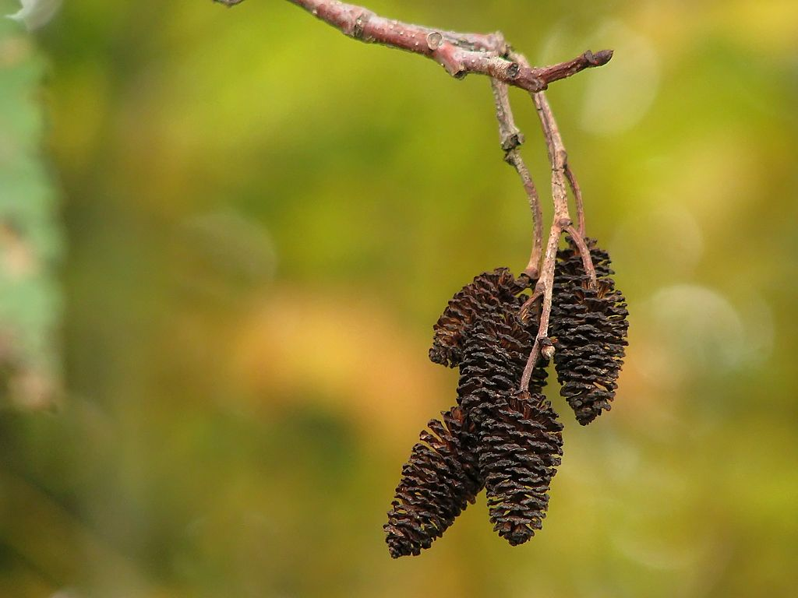
Less common, but not uncommon:
Birch, alder, beech, aspens/poplars
Paper Birch
Beech
Alder
Quaking
Aspen
Image credit: Dhatier, Noël Zia Lee, Dcrjsr , Walter Siegmund

Slide 21
Requirement #8
Which coniferous tree in the taiga loses its needles in the fall and grows new ones in the spring?

Slide 22
The Larch (aka Tamarack) loses its leaves in autumn
Larch
Image credits: MPF , Walter Siegmund

Slide 23
Requirement #9
What non-flowering plants are common in the taiga? Be able to identify them.

Slide 24
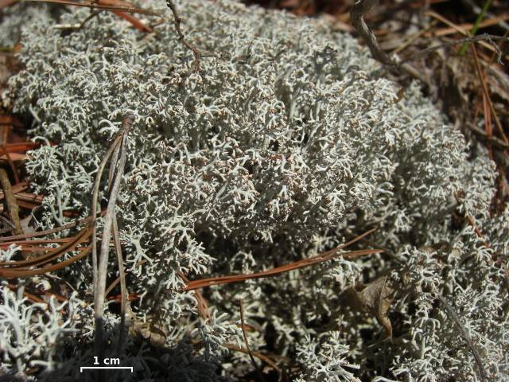
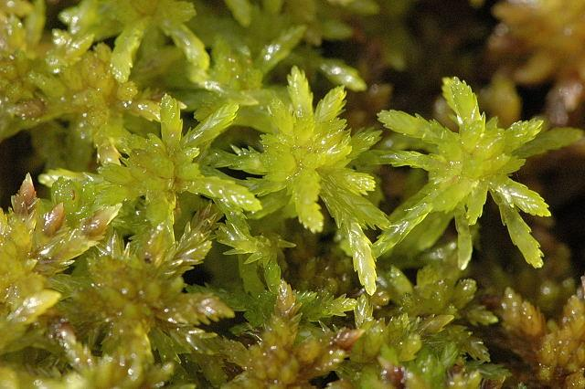
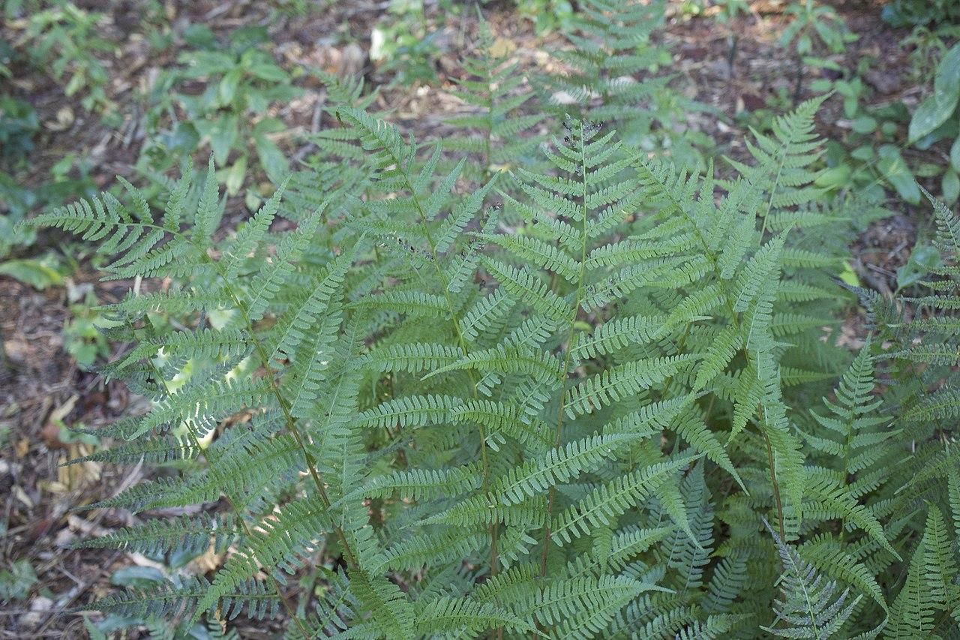
Common non-flowering plants:
Moss, Lichen, and Ferns
Reindeer Lichen
Lady Fern
Peat Moss
Image credits: Jason Hollinger , Shawn Taylor, James Lindsey

Slide 25
Requirement #10
What animals are commonly found in the taiga? Be able to identify them.

Slide 26
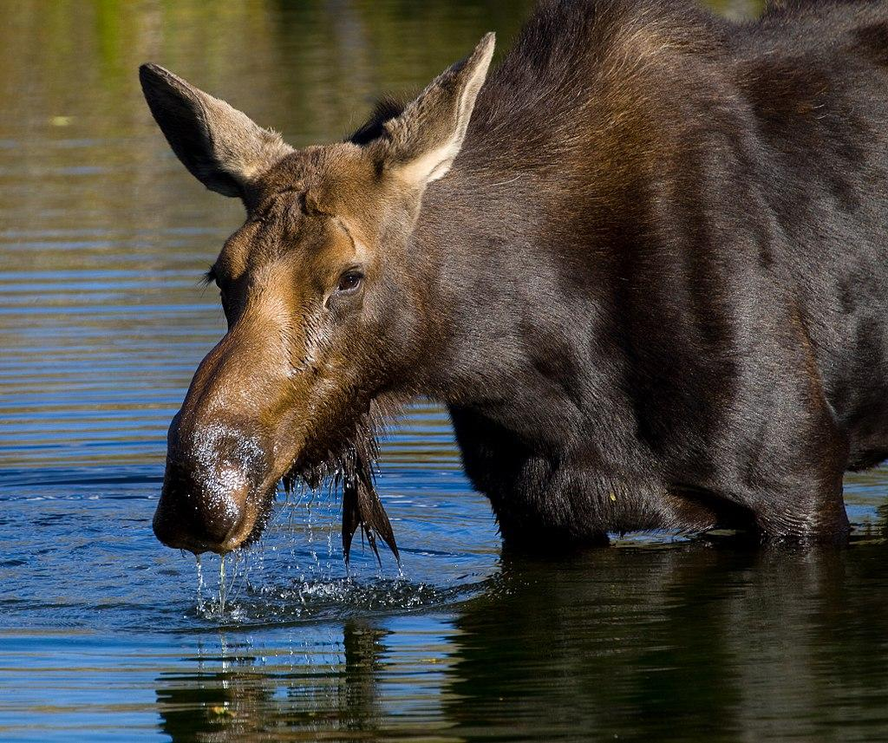
Moose
Image credits: Tony Hisgett from Birmingham, UK

Slide 27
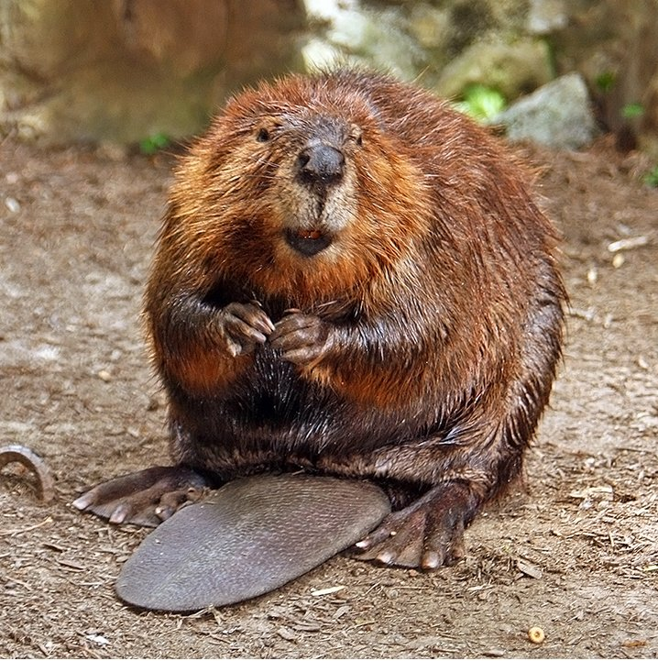
Beaver
Image credits: Steve from washington, dc, usa

Slide 28
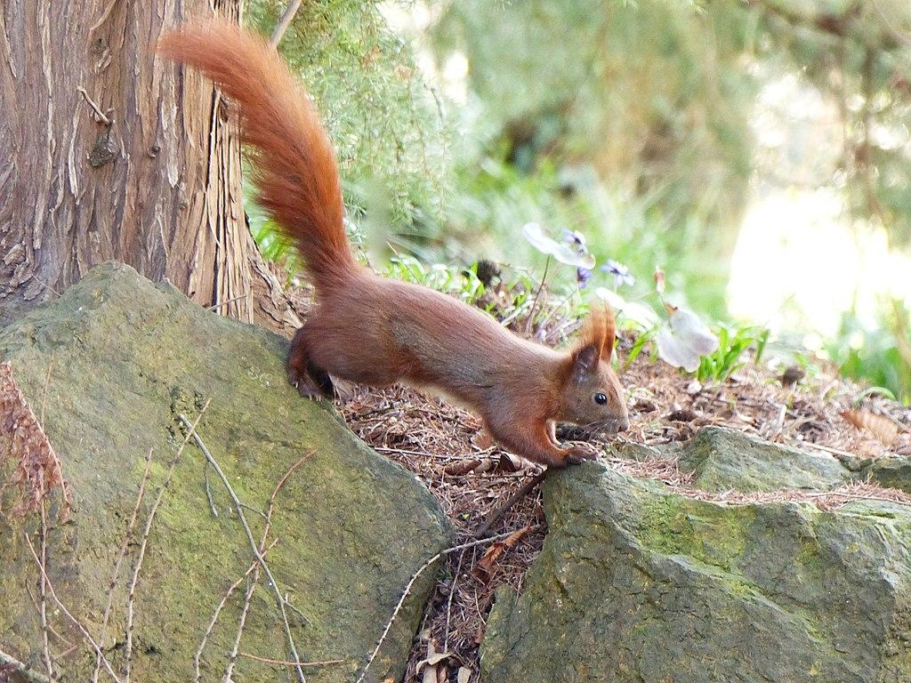
Red Squirrel
Image credits: https://evas-naturfotografie.de

Slide 29
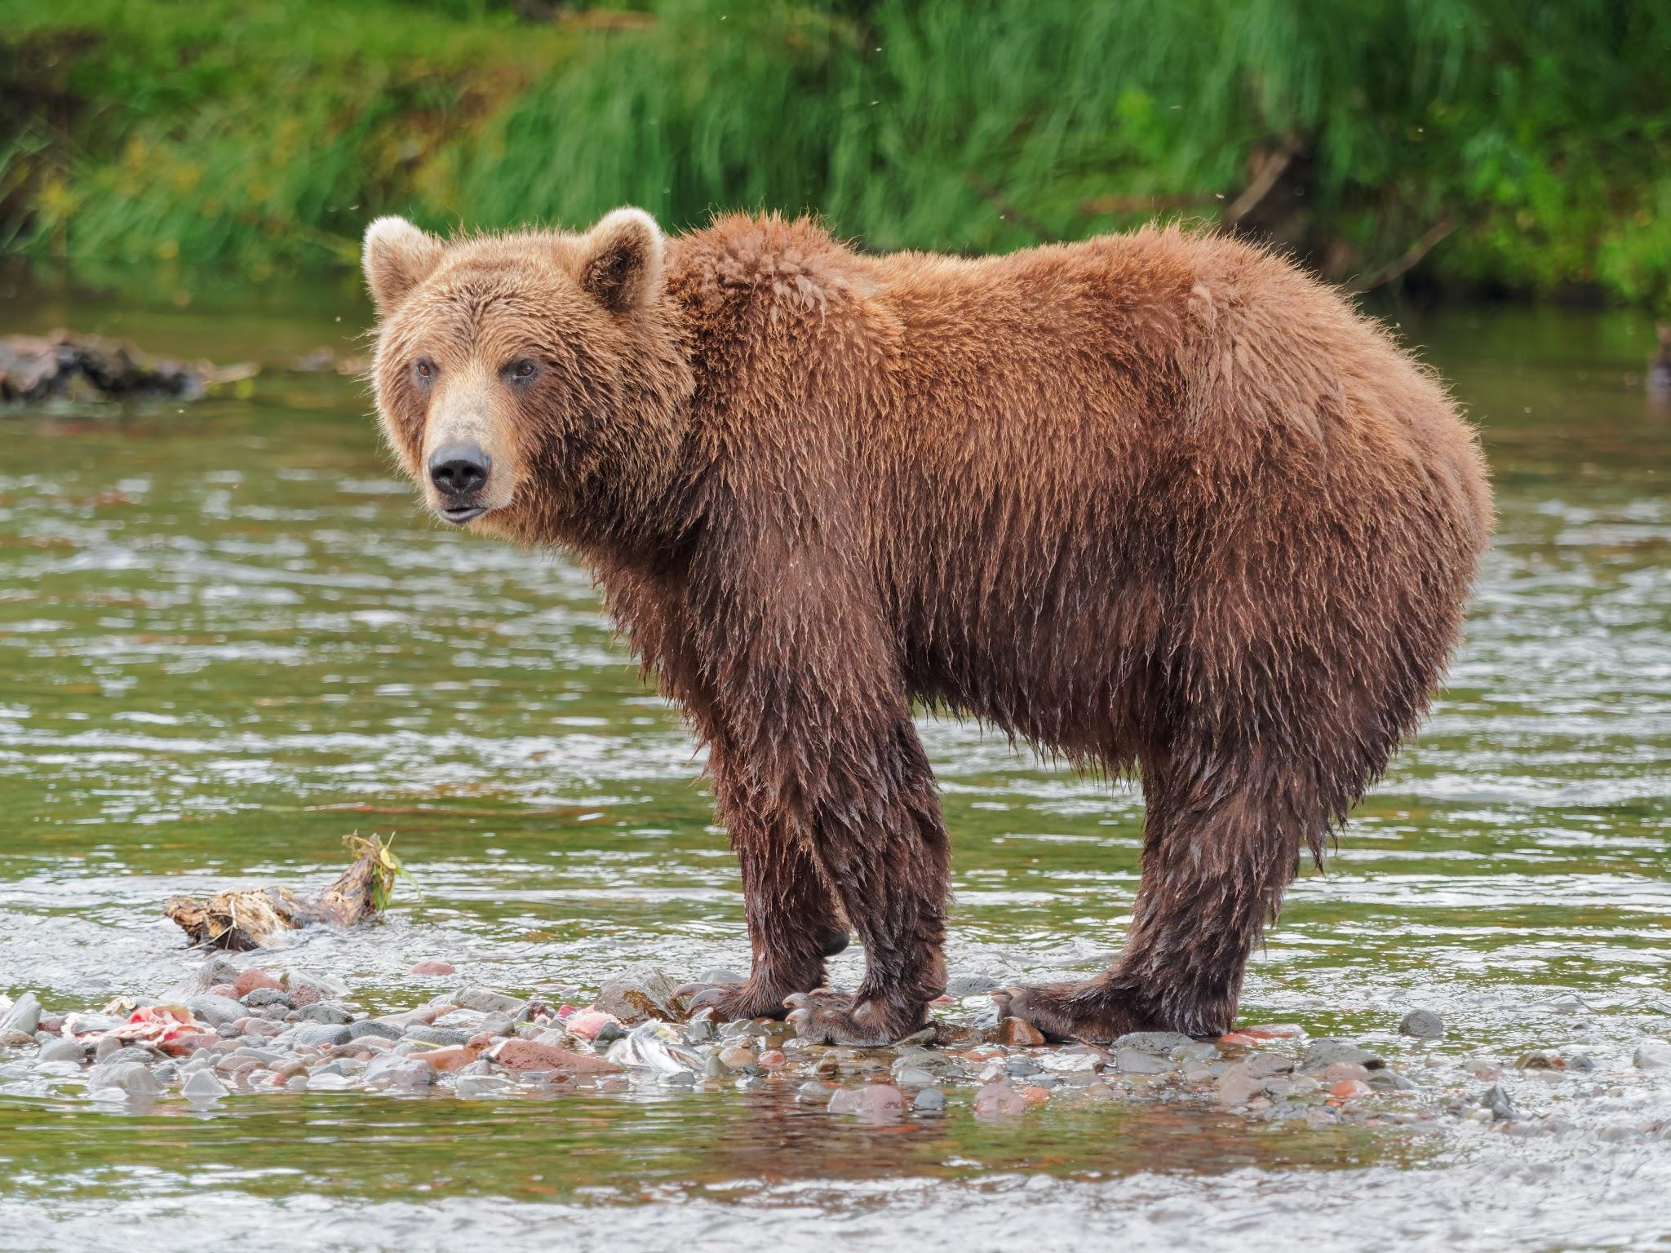
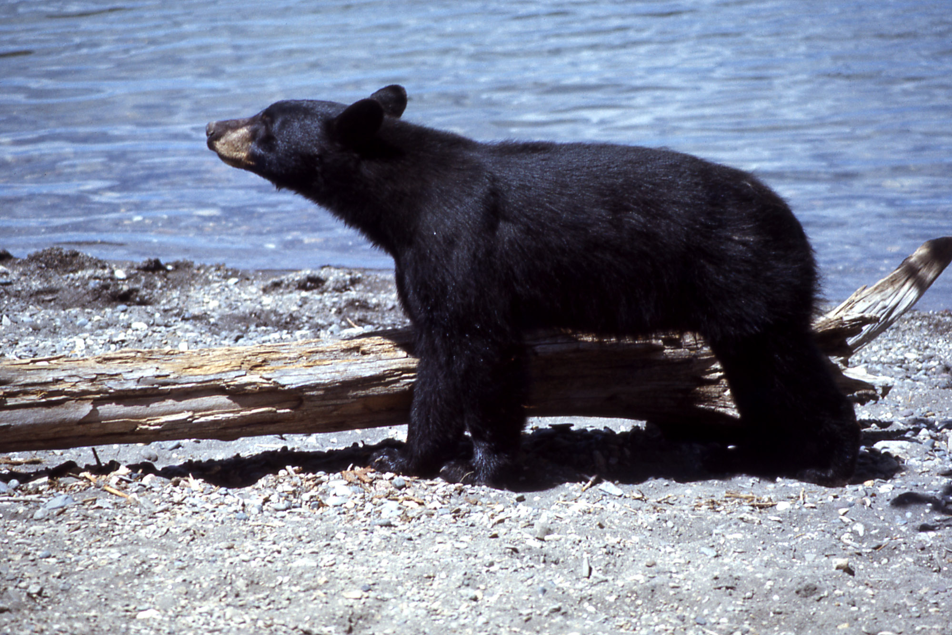
Brown Bears
Black Bears
Image credits: Robert F. Tobler, w:Harlan Kredit - NPS

Slide 30
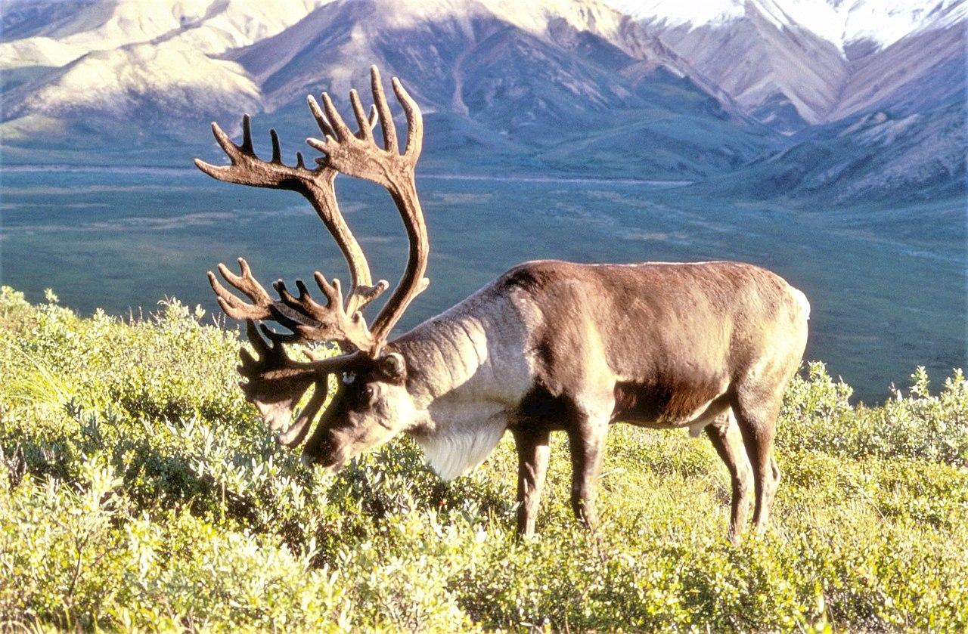
Caribou
Image credits: Dean Biggins (U.S. Fish and Wildlife Service) - US FWS

Slide 31
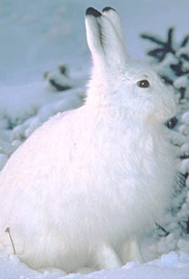
Snowshoe Hare

Slide 32
Requirement #11
What birds are common in the Taiga? Be able to identify them.

Slide 33
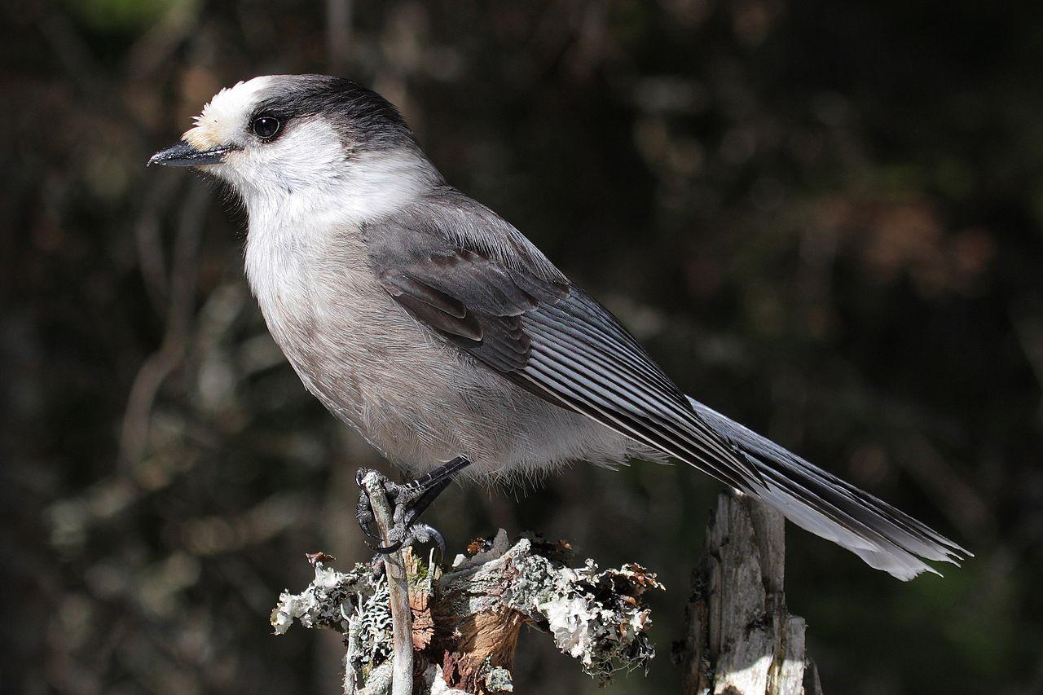
Canada Jay
Image credits: Cephas

Slide 34
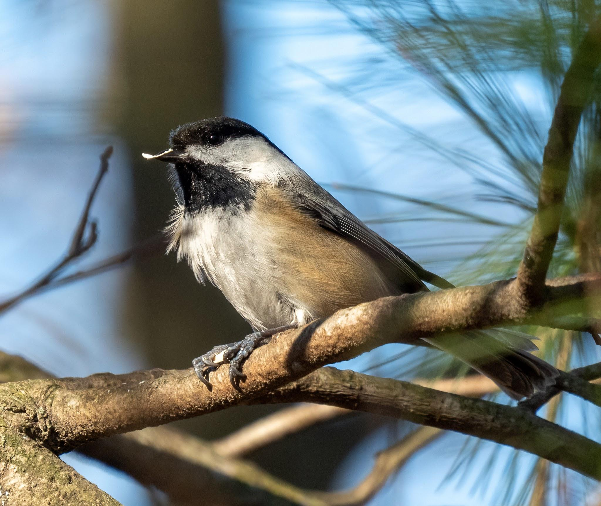
Chickadee
Image credits: Rhododendrites

Slide 35
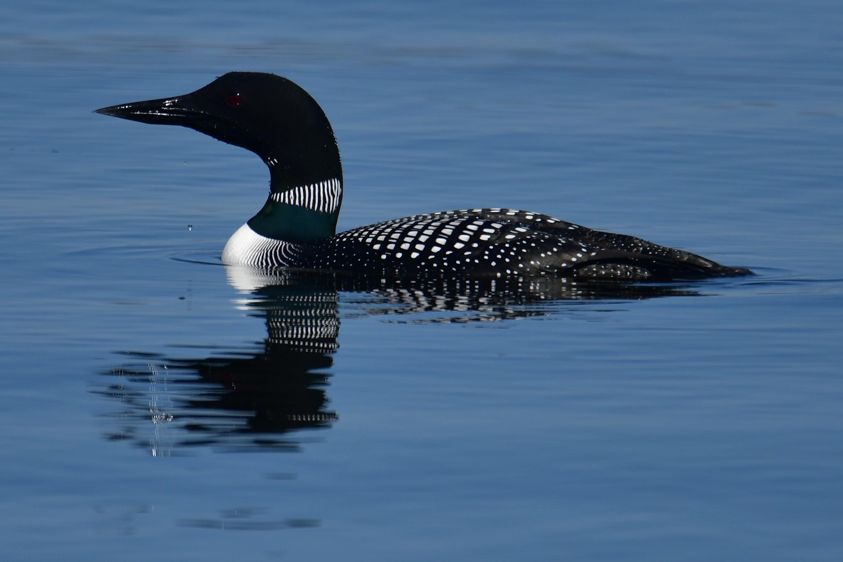
Common Loon
Image credits: August Schwerdfeger

Slide 36
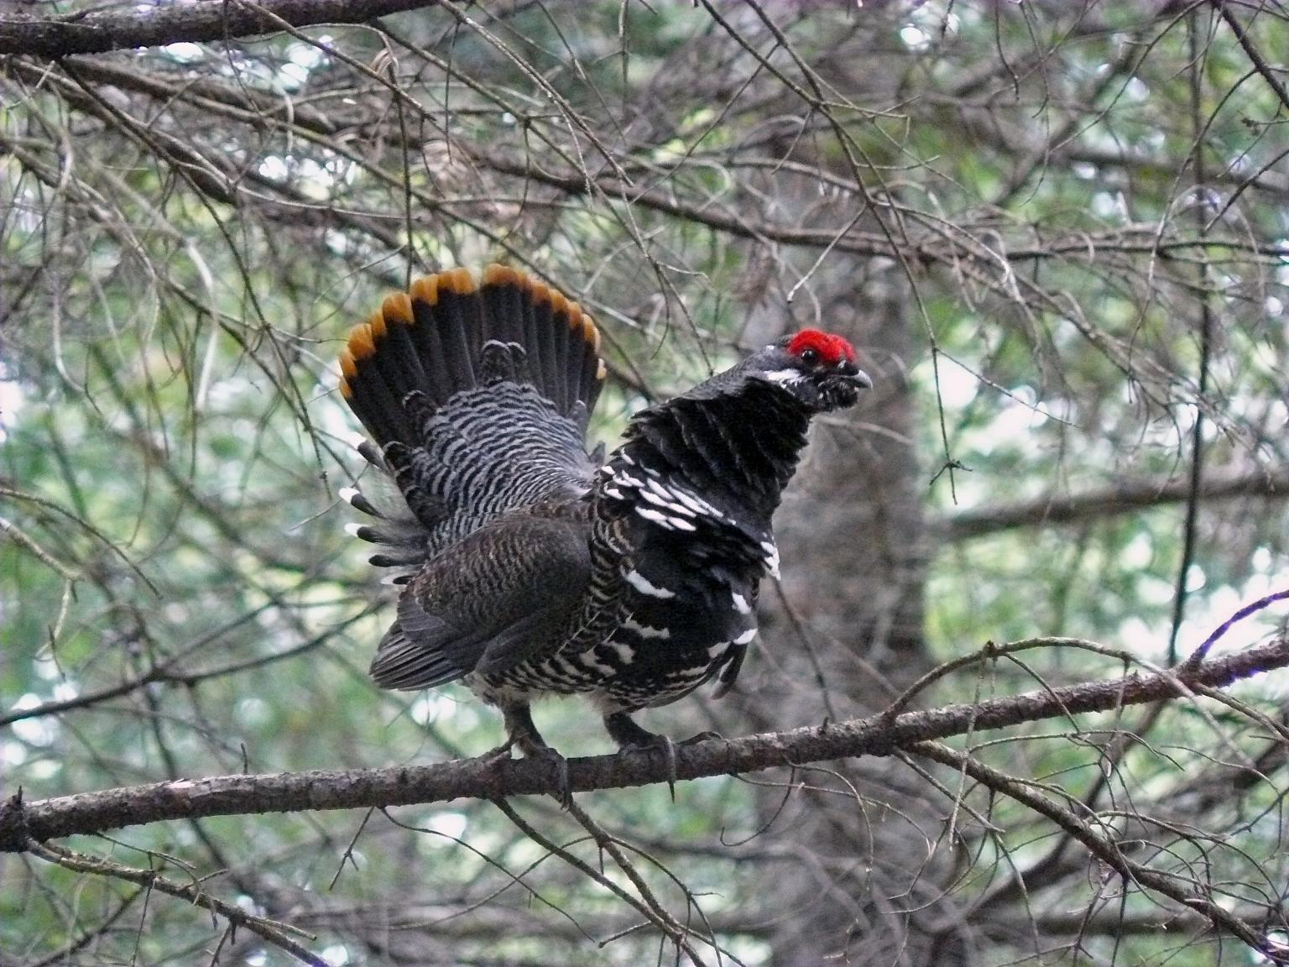
Spruce Grouse
Image credits: U. S. Fish and Wildlife Service - Northeast Region

Slide 37
Requirement #12
How does fire affect the taiga?

Slide 38
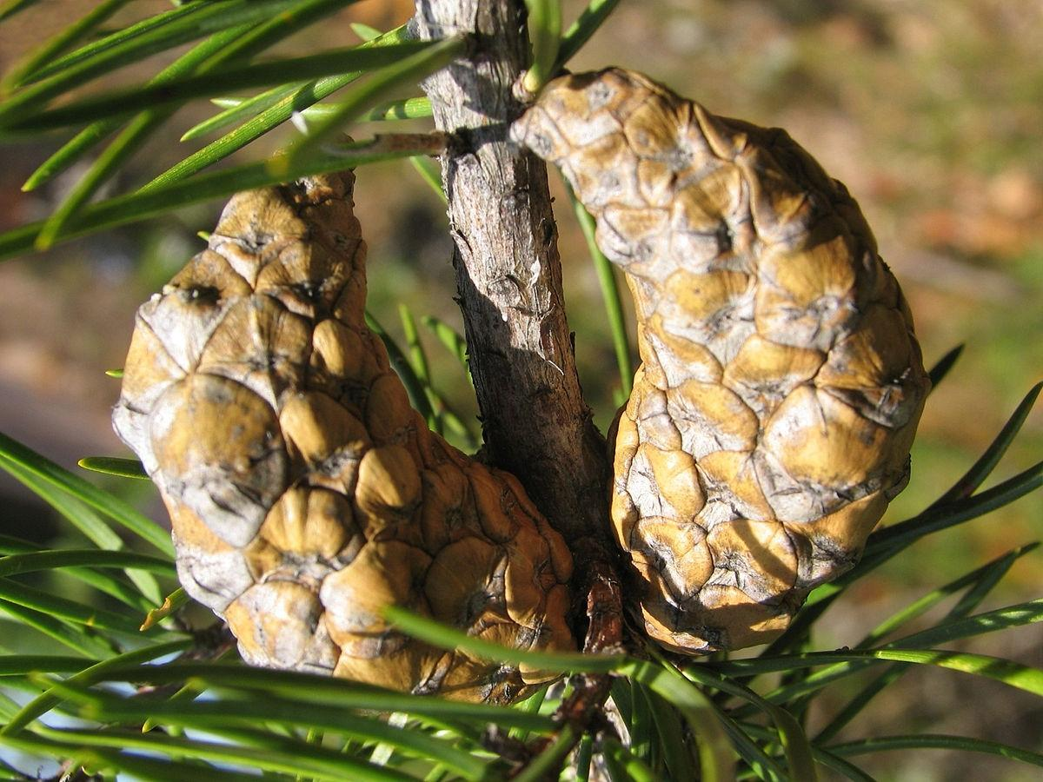
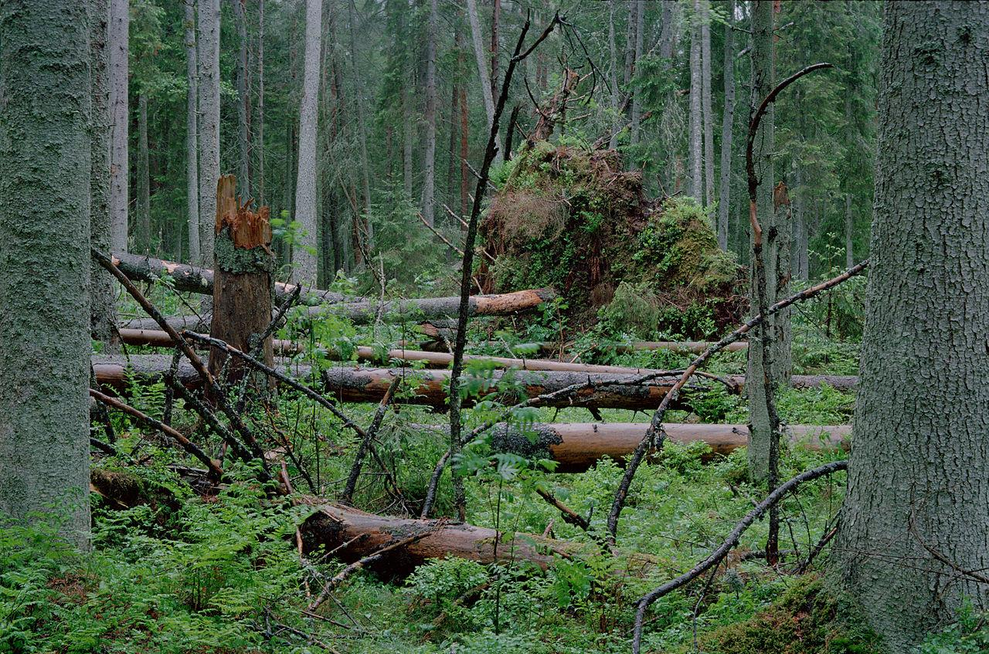
Requirement #12
Fire is required for some taiga plants to reproduce.
This is a cone from the Jack Pine - it is tightly closed and will not open unless it goes through a fire.
Fires naturally occur on a 70-90 year cycle in the taiga.
Fires clear out “blowdown”
Image credit: By Boris Radosavljevic, Margus6

Slide 39
Requirement #13
What two important resources are provided to us by the taiga?

Slide 40
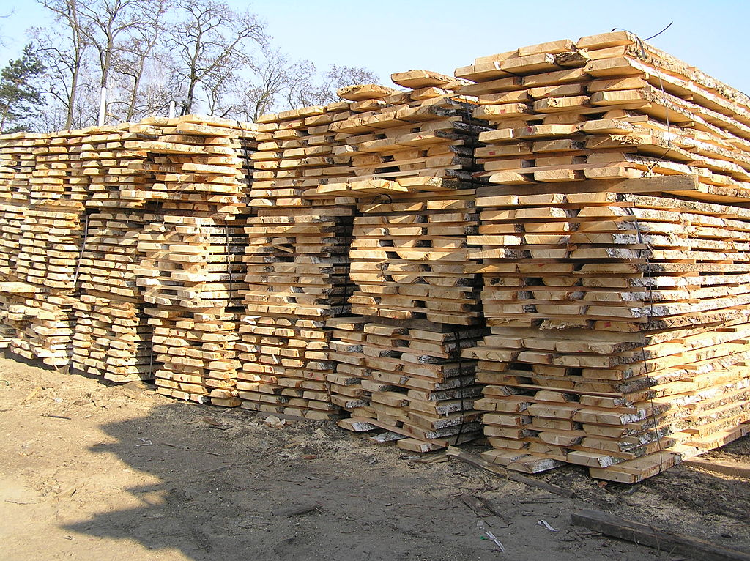
Timber
Image credits:Tartakizbica - http://www.tartakizbica.pl/index.php?page=tarcica-suszona

Slide 41
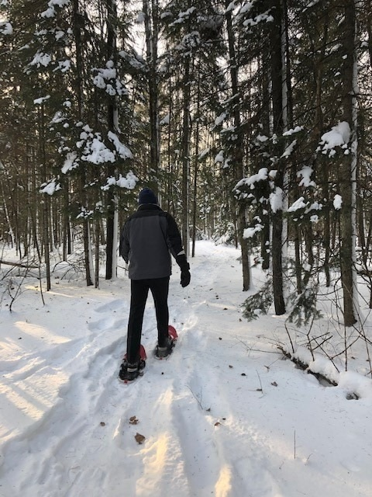
Recreation
Image credits:US Forest Service Northern Research - https://twitter.com/usfs_nrs/status/1353338010876567556/photo/1

Slide 42
Requirement #14
Learn about one invasive species that affect the taiga.

Slide 43
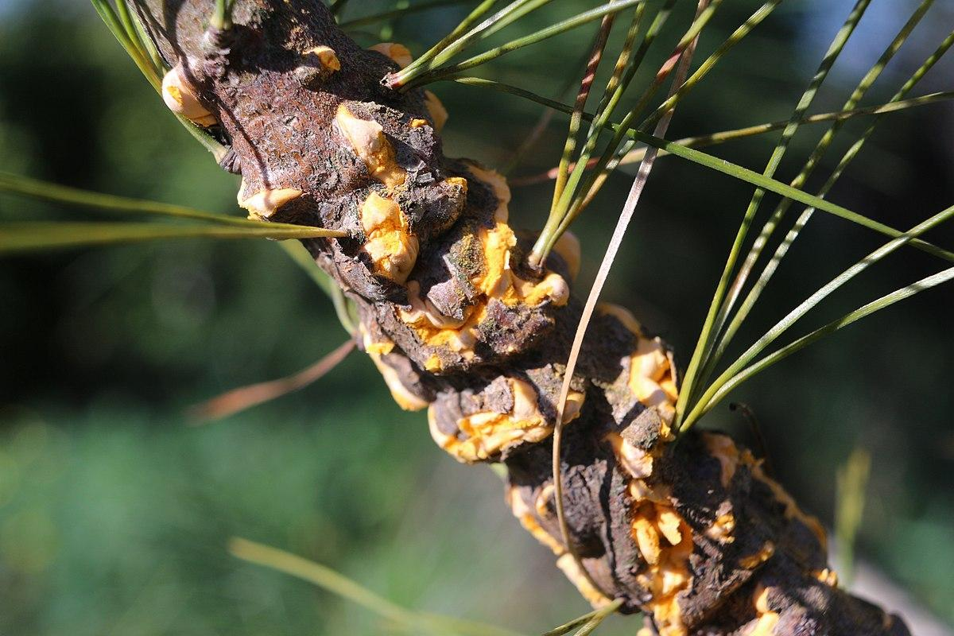
Cronartium ribicola on a white pine branch causing
White Pine Blister Rust
Image credits:Marek Argent

Slide 44
Requirement #15
Prepare an object lesson about a plant or animal or bird that lives in the taiga. Tell this lesson at a club worship. Be sure to include a bible text in this presentation.

Slide 45
Requirement #16
Do at least two of the following activities:
a. Visit an exhibit or conservatory of coniferous tree species
b. Make a collection of at least 5 types of coniferous tree leaves.
c. Visit a zoo where there are animals typical of the taiga biome.
d. Watch a DVD or video about the taiga or plants or animals that live in the taiga.
(page 2 →)

Slide 46
Requirement #16
(continued)
e. Draw or paint a picture of something you had fun learning about while studying the taiga.
f. As a group, make a short video about a real life taiga conservation project. Explain why this specific habitat should be saved.
g. Visit a lumber store and learn to identify by their grain texture at least 3 species of trees that grow in the taiga.
h. Visit the Taiga and take pictures of some of the plants and animals.

Slide 47
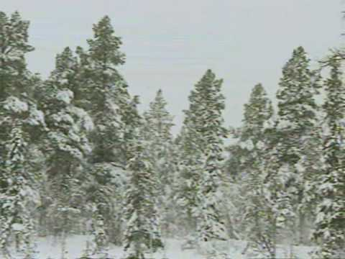

Slide 48
Requirement #16
Recommended COVID-19 options:
b. Make a collection of at least 5 types of coniferous tree leaves.
e. Draw or paint a picture of something you had fun learning about while studying the taiga.

Slide 49
Now Complete the “Doing” Requirements
Go for the Advanced honor challenge!

Slide 50

Worksheet for this honor http://bit.ly/TaigaWorksheet
This slideshow download:
http://bit.ly/TaigaSlideshow
Wiki.pathfindersonline.org

