Slide 1

Thankful Heart
Juliette steele
Florida Conference

Slide 2


Tell me about one of the best gifts you have ever received
Were you excited or were you sad when you received it?
What did you say to the person who gave you the gift?

Slide 3


Thankful Heart!

Slide 4
Psalms 136:1-4
1Give thanks to the Lord because he is good.
His love continues forever.
2Give thanks to the God over all gods.
His love continues forever.
3Give thanks to the Lord of all lords.
His love continues forever.
4Only he can do great miracles.
His love continues forever.
What can we be thankful for?
God’s Goodness
God’s Love
God’s Miracles

Slide 5
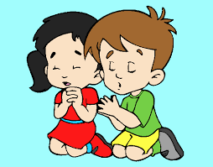

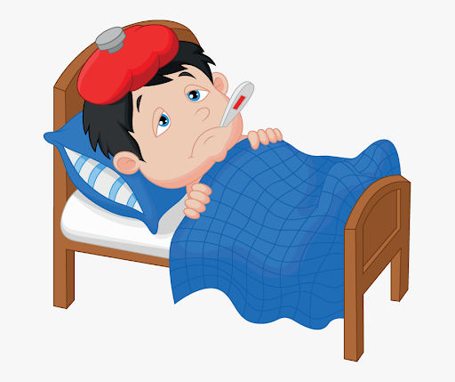
Colossians 4:2
2 Continue praying and keep alert. And when you pray, always thank God.
What are some of the things you ask God for when you pray?

Slide 6
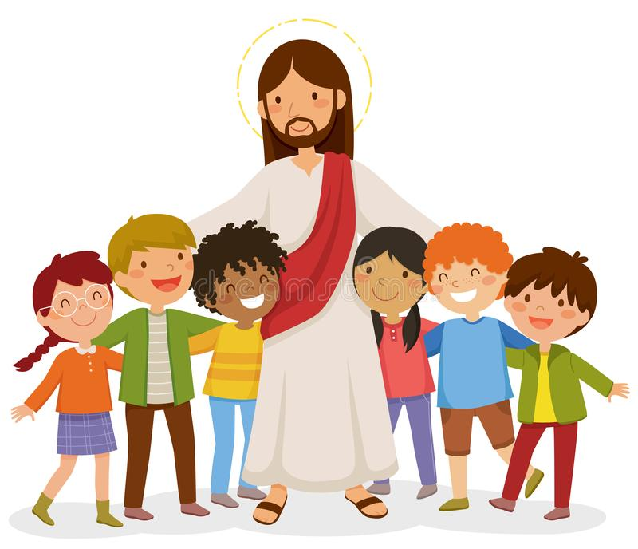
I Thessalonians 5:18
8 Give thanks whatever happens. That is what God wants for you in Christ Jesus.
Who are we thankful for?

Slide 7

What day of the week should we be most thankful for?

Slide 8

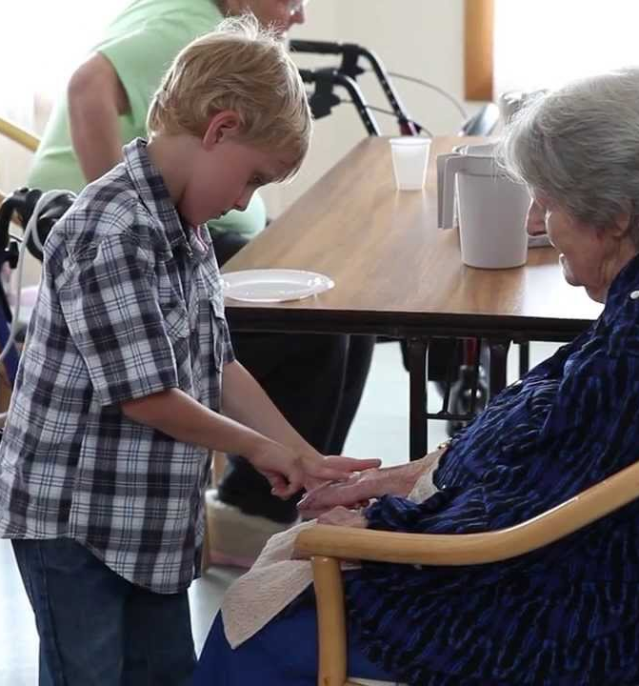
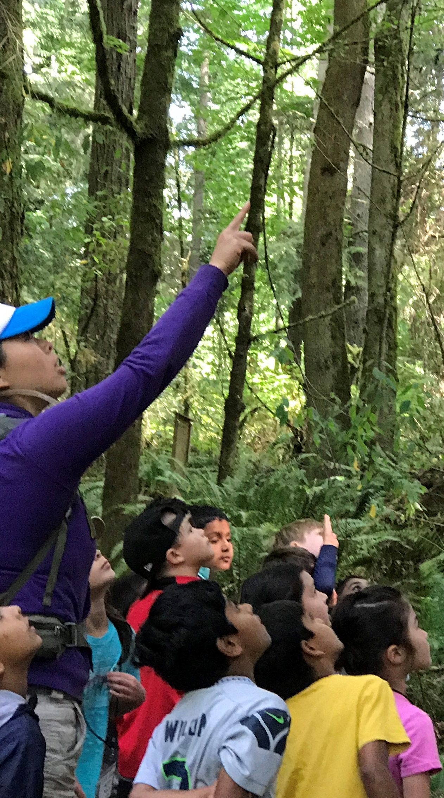
How can we make Sabbath special?

Slide 9
Jesus and the 10 Lepers
Luke 17: 11 - 19

Slide 10
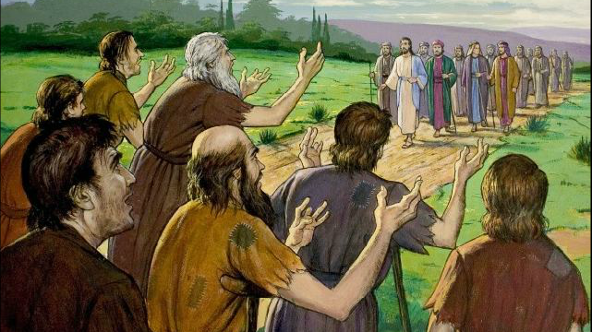

Slide 11
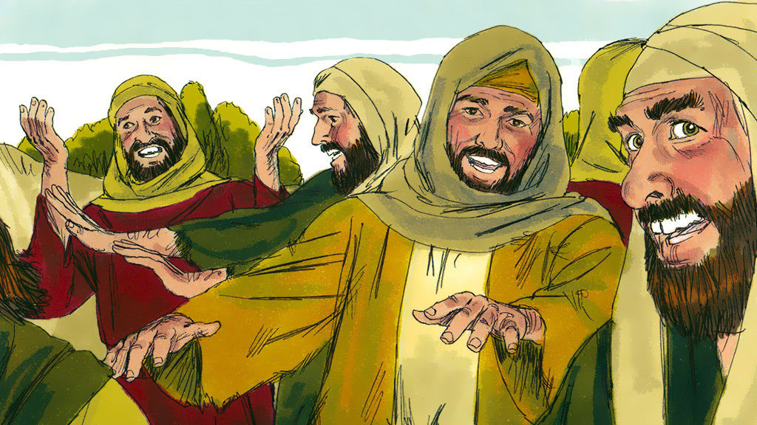

Slide 12
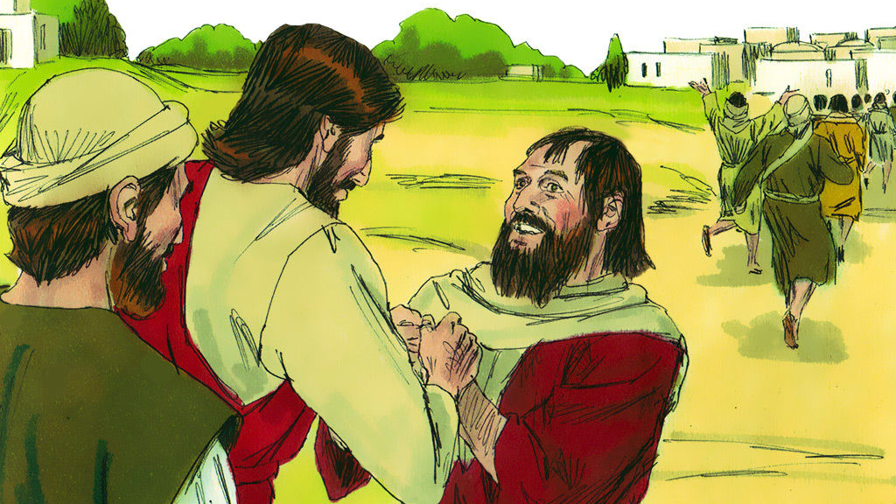

Slide 13

Craft

