Slide 1
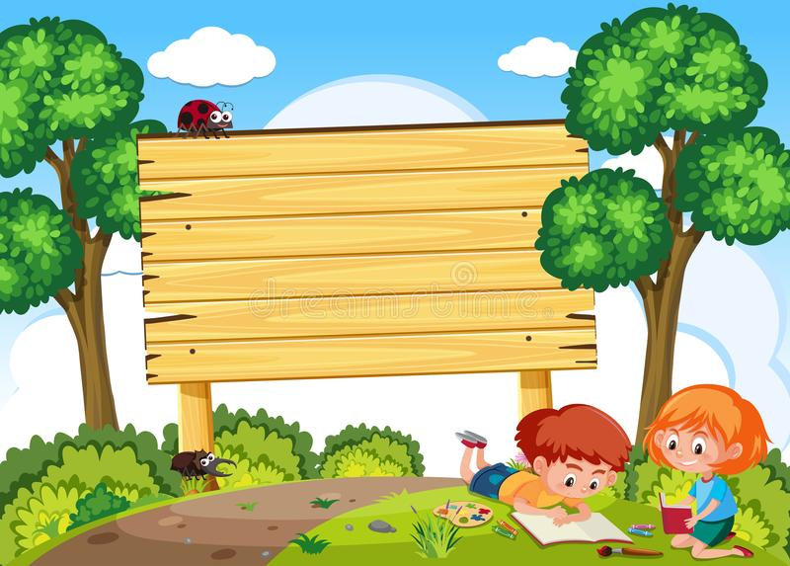
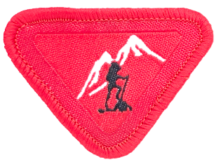

Outdoor
Explorer

Slide 2


Adventurers
…..Love God, love people, love nature
…..take care of each other – older/stronger ones take care of younger/weaker ones
……..loving nature. This is something crucial.

Slide 3
What are some ways to explore nature ?
Hike
Kayaking, canoeing
Go to the beach
Bird-watching
Foraging: collect edible fruits, plants, or mushrooms
Jump into a pile of leaves
Nature scavenger hunt

Slide 4
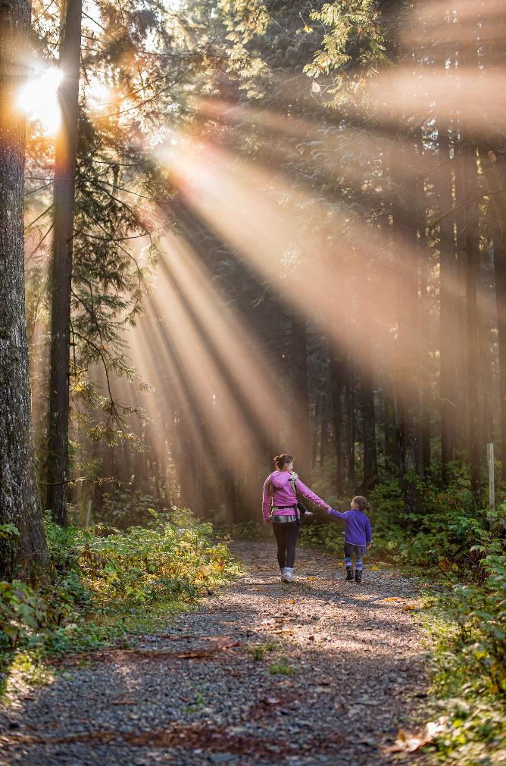
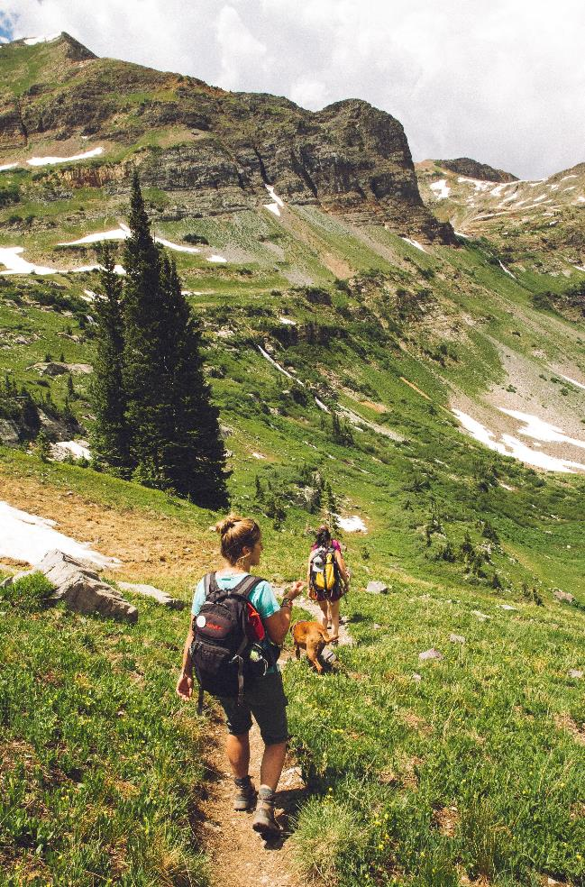
Ways to explore nature: HIKING
Photos by https://unsplash.com/

Slide 5
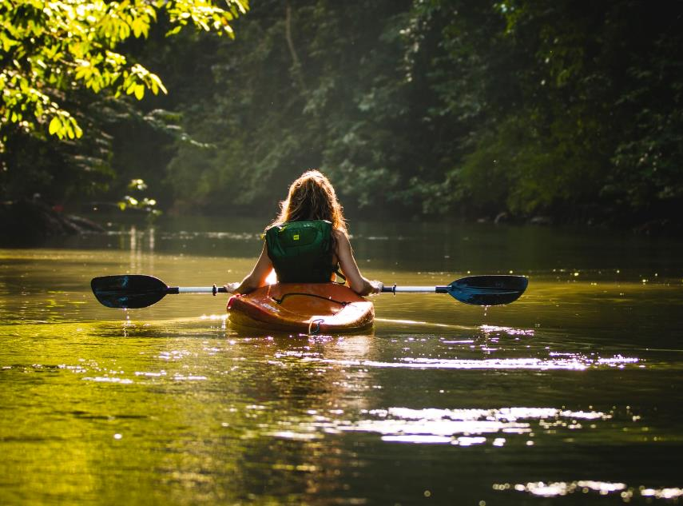
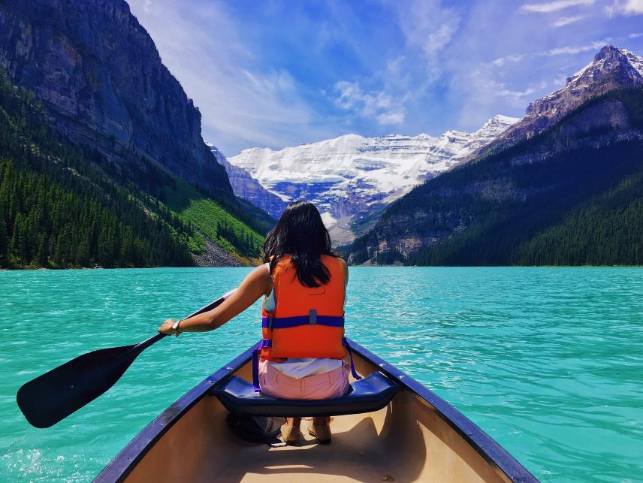
Ways to explore nature:
KAYAKING, CANOEING
Photos by https://unsplash.com/

Slide 6

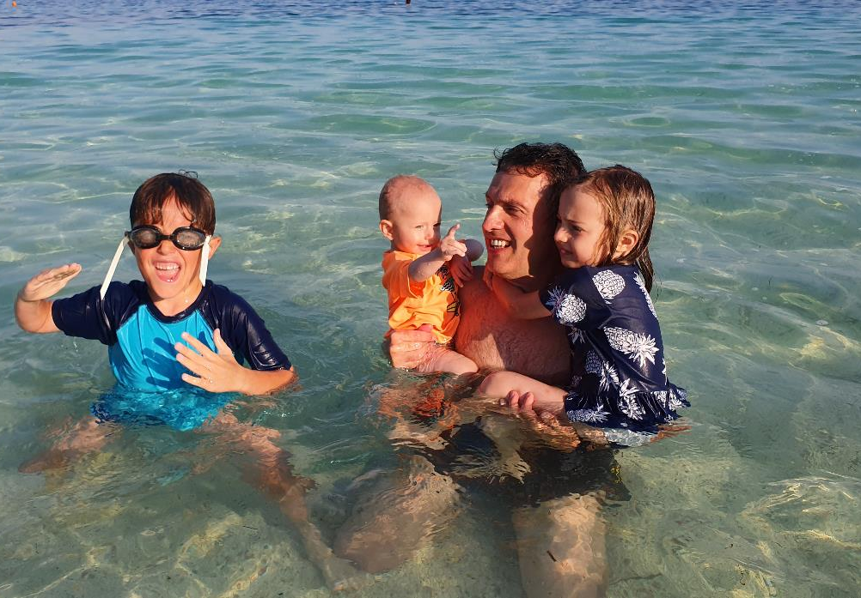
Ways to explore nature:
GO TO THE BEACH
Photo by https://unsplash.com/

Slide 7
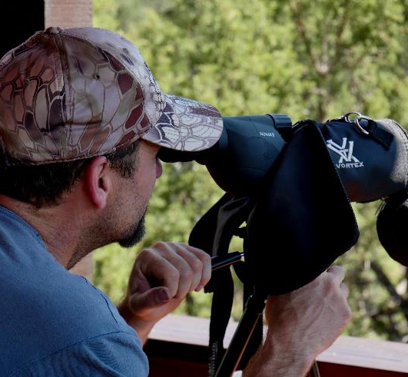
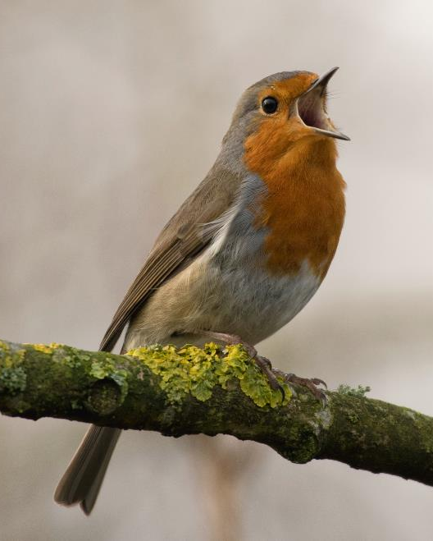
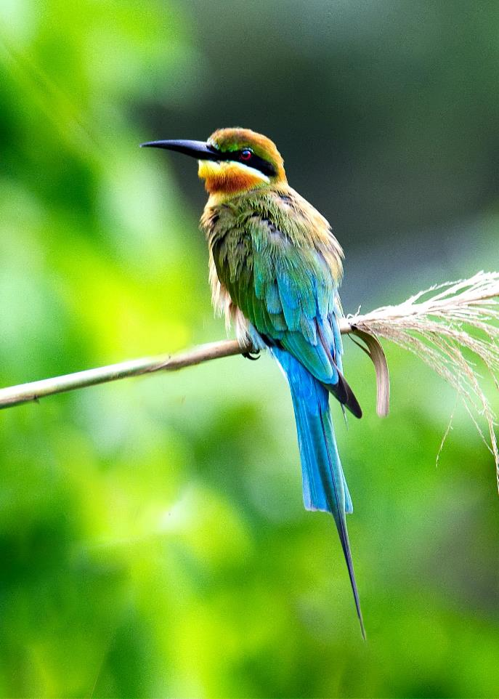
Ways to explore nature: BIRD-WATCHING
1.
2.
Photos by https://unsplash.com/

Slide 8
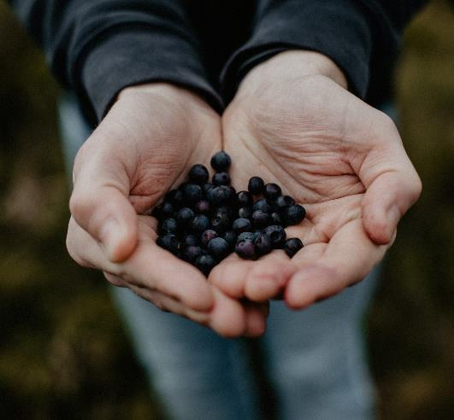
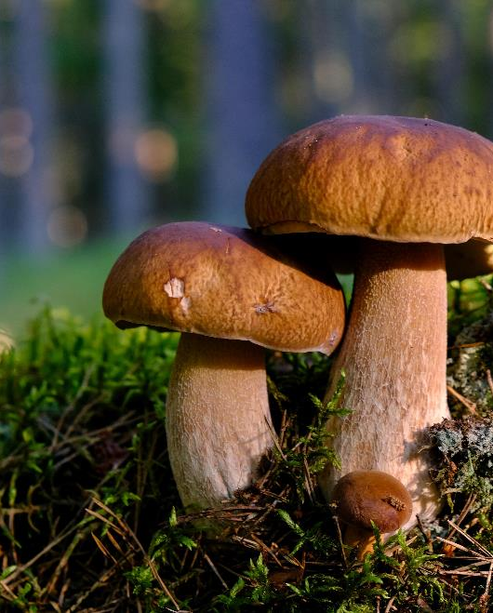
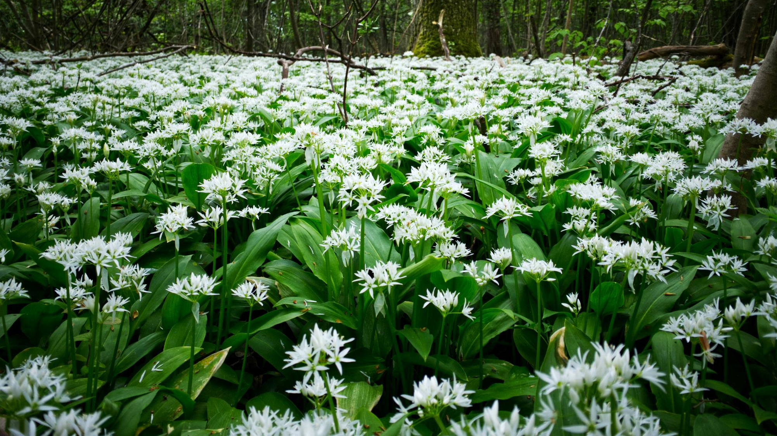
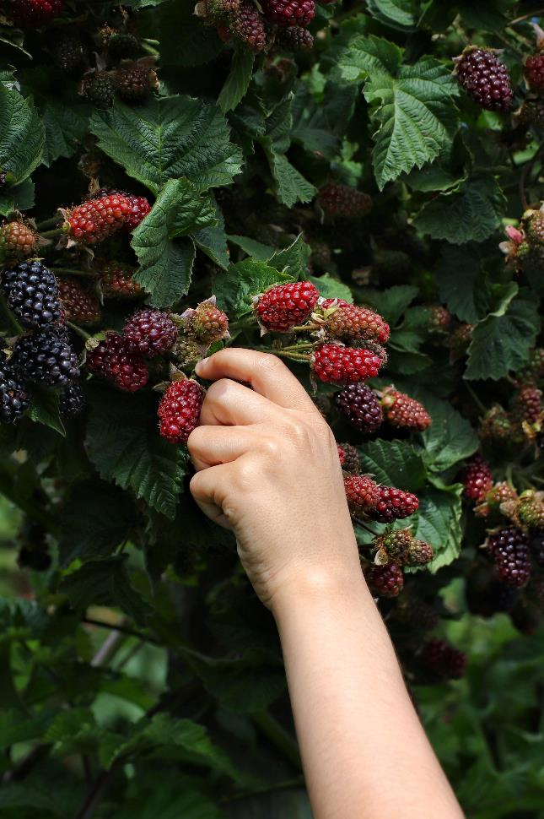
Ways to explore nature: FORAGING
Photos by https://unsplash.com/
3.
2.
1.
4.

Slide 9
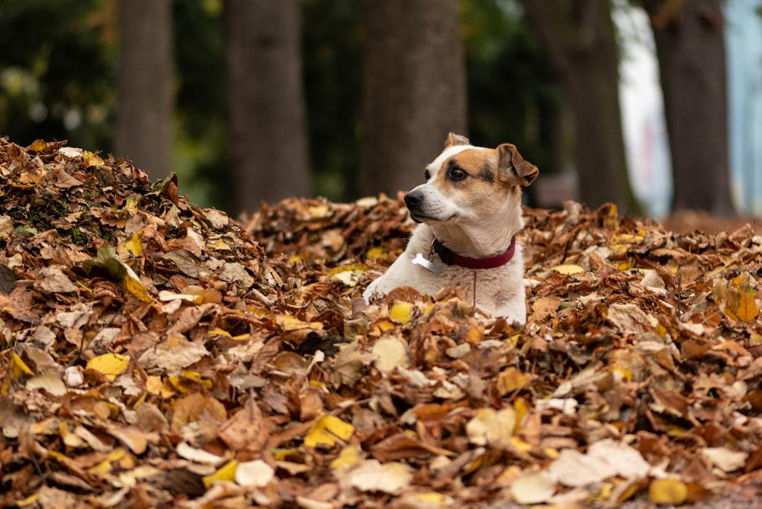
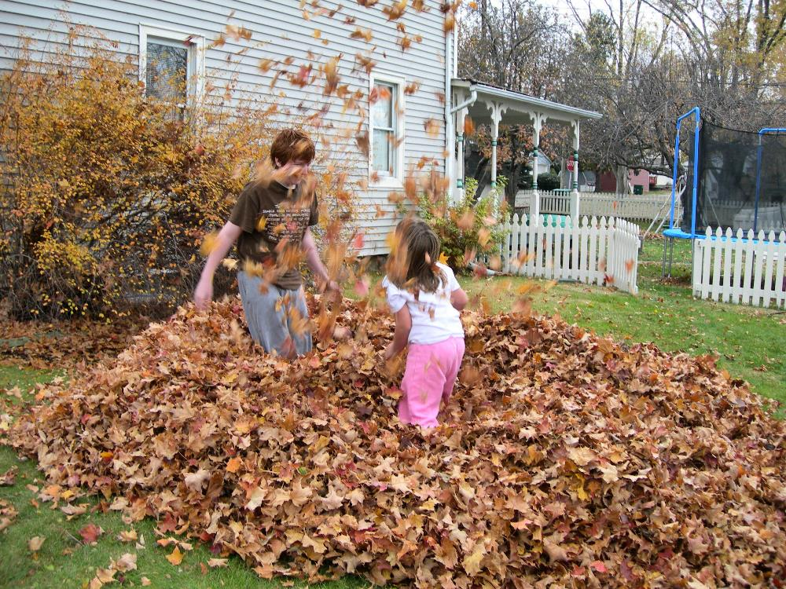
Ways to explore nature:
JUMP INTO A PILE OF LEAVES
Photos by https://unsplash.com/

Slide 10
What are some ways to explore nature ?
Hike
Kayaking, canoeing
Go to the beach
Bird-watching
Foraging: collect edible fruits, plants, or mushrooms
Jump into a pile of leaves
Nature scavenger hunt

Slide 11
What are some ways to explore nature ?
Camp out in your garden or close to home
Create rock art
Make a bird feeder
Take a picnic
Collect parts of nature (e.g. stones, feathers, shells, leaves, acorns...)
Take photos

Slide 12
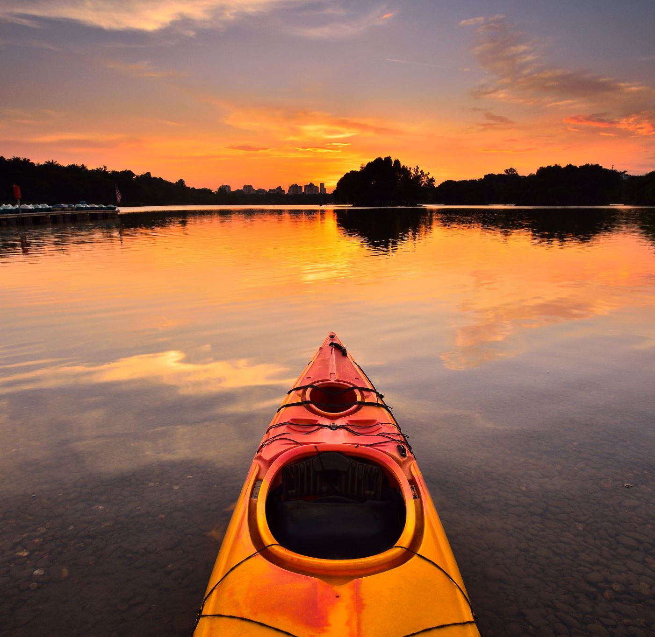
What is your favourite way to explore nature ?

Slide 13
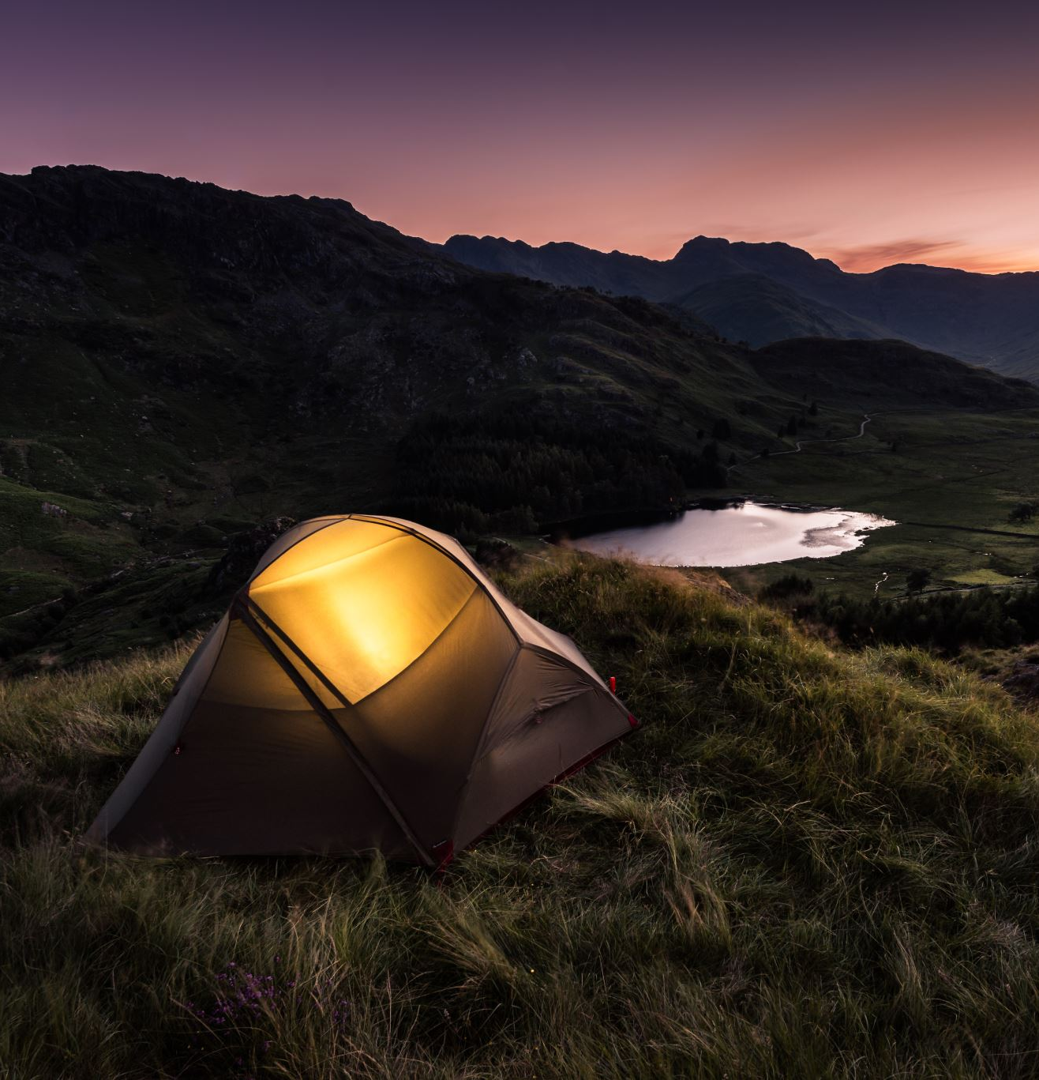
Where can you hike?
Forest, mountain, seaside, river or lake
Local park
Anywhere in nature (countryside)

Slide 14
Video

Slide 15

Requirements
1. Take a nature walk and collect:
a. A leaf and tell what tree or plant it comes from
b. A feather and discover what bird it is from
c. A rock and learn what type it is
d. A seed and identify the plant it comes from
2. Learn and recite the following golden rules for hiking:
a. Never cut trees
b. Never pull up live plants
c. Do not remove any type of markers
d. Stay off “No Trespassing” property
e. Ask permission before walking on private property
f. Don’t litter

Slide 16
3. Tell what side of the road to walk on and explain why
4. Hike 1/2 mile (1 km) to a picnic area, carry your own lunch, and eat lunch at that area
5. Take two walks of at least one mile each. One may be with the club and one with your family. Do the following as you walk together:
a. Find nature items for ABC’s such as:
A = Acorn; B = Butterfly; C = Caterpillar, etc.
b. Talk about what you see and tell on what day each was created
6. Learn and recite the following five safety rules for walking:
a. Always walk with at least one partner
b. Carry water when going for a walk
c. Wear comfortable walking shoes
d. Wear proper clothing
e. Watch where you walk so you won’t become lost

Slide 17

Requirement 1

Slide 18




1. Take a nature walk and collect:
A leaf and tell what tree or plant it comes from
A feather and discover what bird it is from
A rock and learn what type it is
A seed and identify the plant it comes from

Slide 19
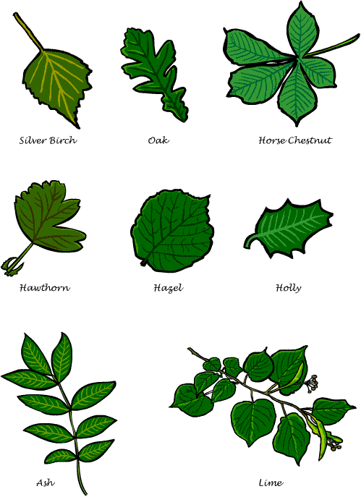

Do you know which tree these leaves come from ?
1.
3.
2.

Slide 20
4.
Do you know which tree these leaves come from ?
6.
5.

Slide 21
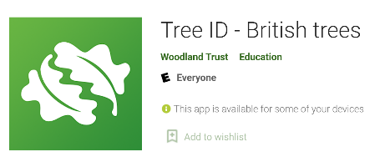
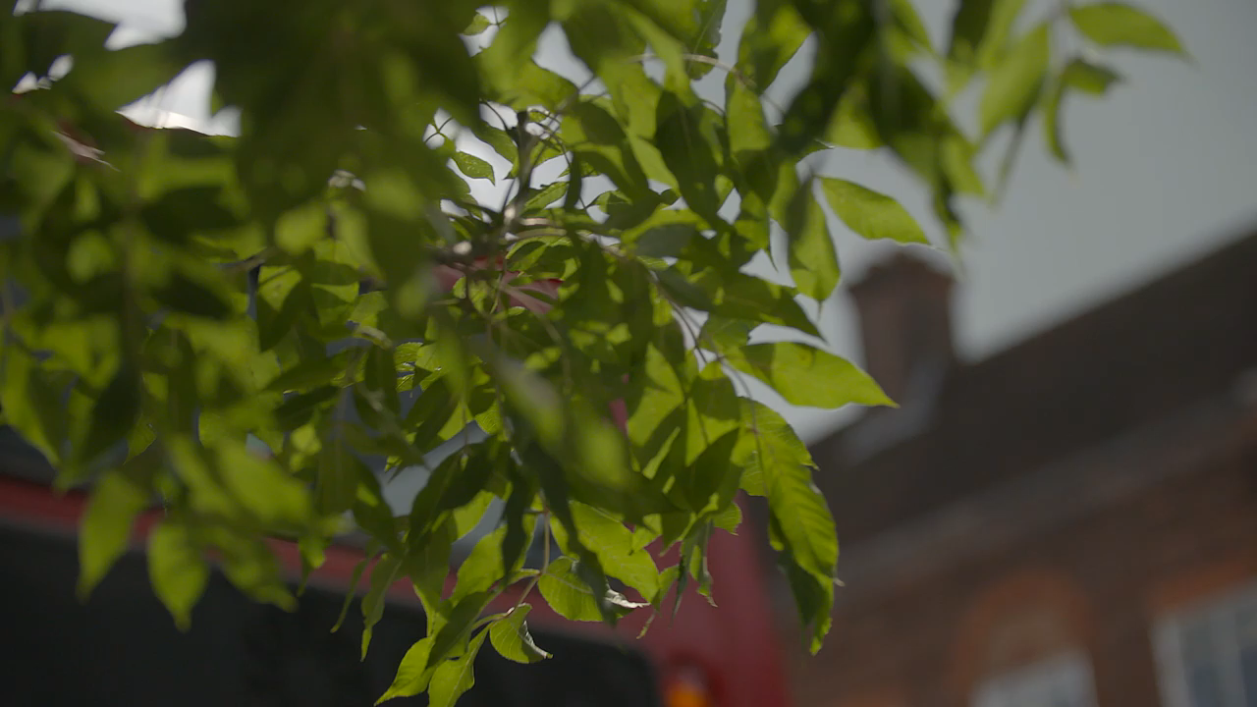
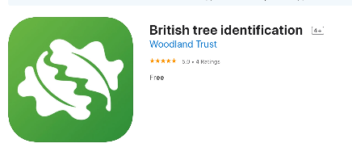
Identify trees with Woodland Trust Tree ID app

Slide 22
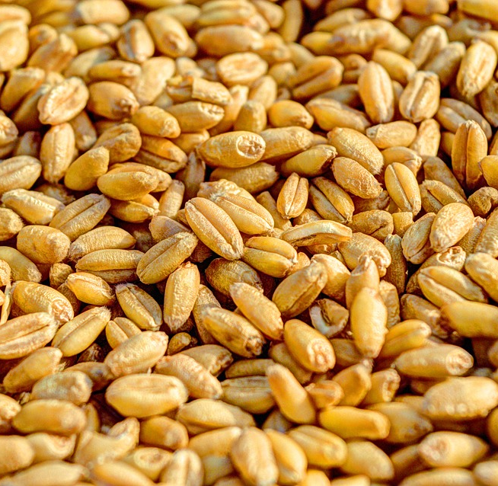
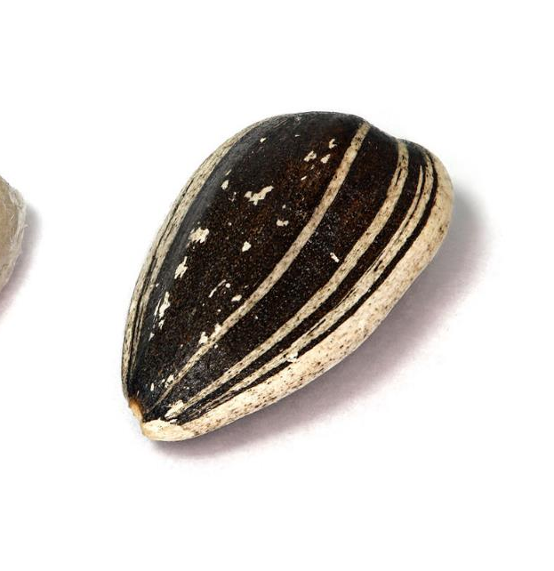
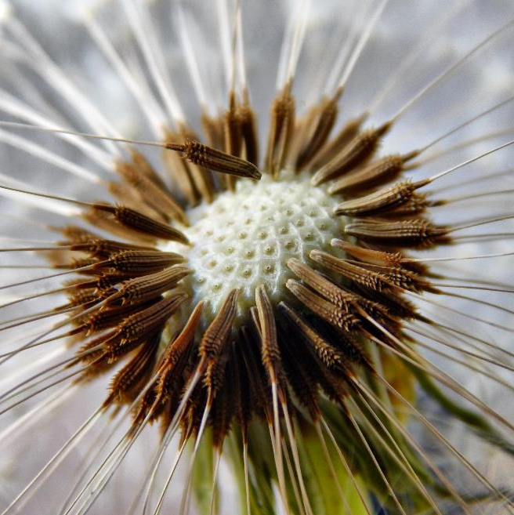

2.
1.
Wheat seed
Sunflower seed
Dandelion seed
3.
What about these seeds?
This Photo by Unknown Author is licensed under CC BY-SA

Slide 23
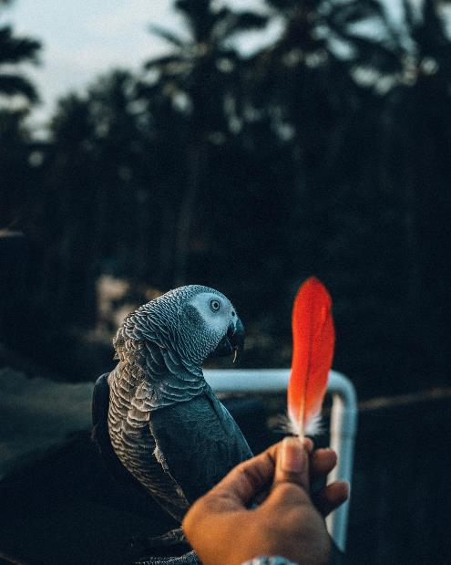
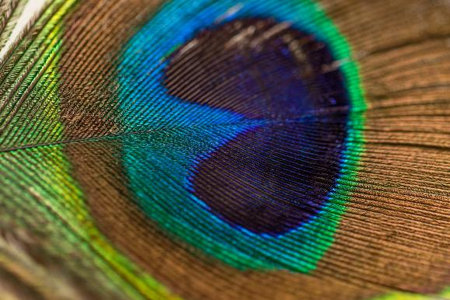
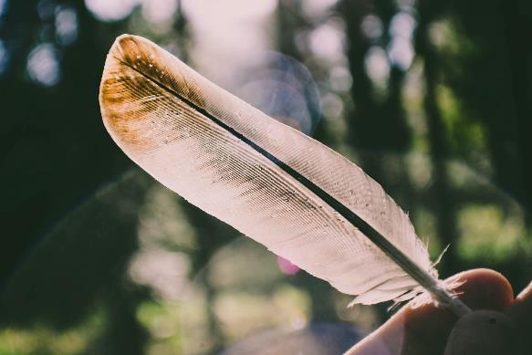
What about these feathers?
Photos by https://unsplash.com/
1.
2.

Slide 24
Requirement 2

Slide 25

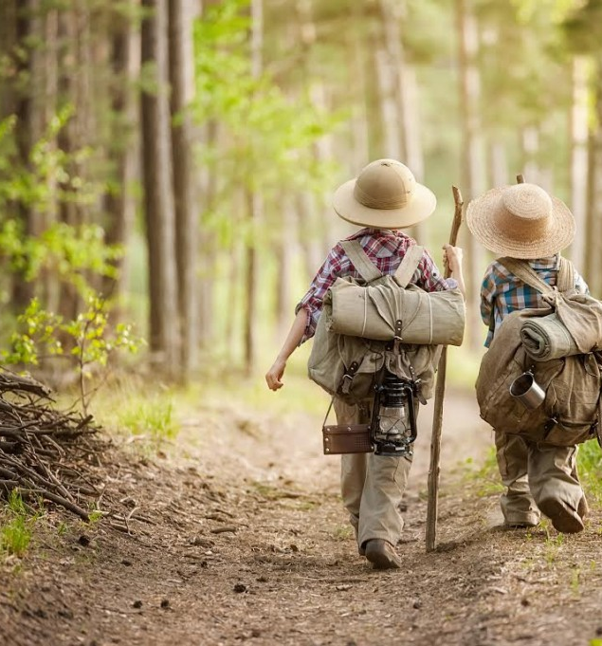
2. Learn and recite the following golden rules for hiking:
Never cut trees
Never pull up live plants
Don’t remove any type of markers
Stay off “No Trespassing” property
Ask permission before walking on private property
Don’t litter

Slide 26
Requirement 3

Slide 27
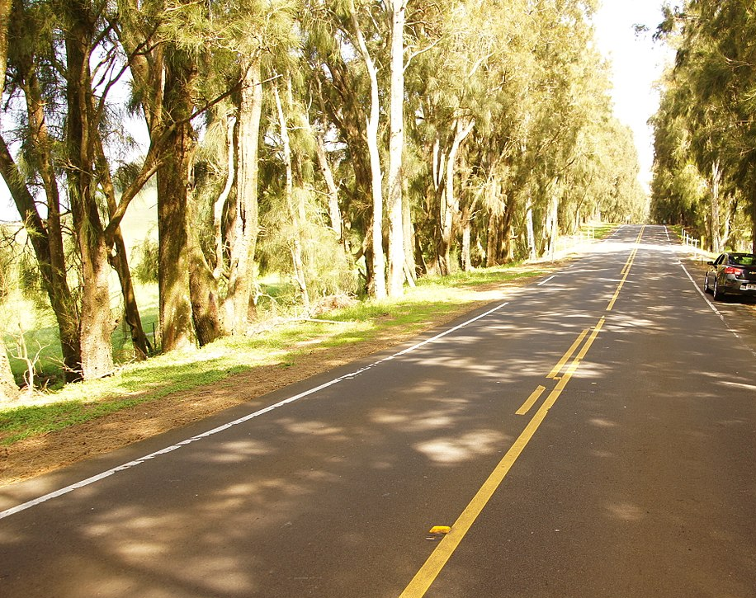
3. Tell what side of the road to walk on and explain why ?
What do you do if you are walking in a group ?
This Photo by Unknown Author is licensed under CC BY-SA

Slide 28
Requirement 4

Slide 29
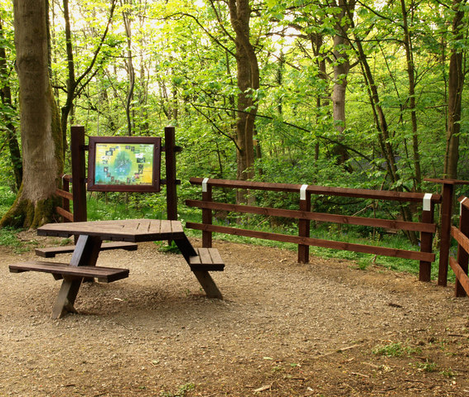
4. Hike 1/2 mile (1 km) to a picnic area, carry your own lunch, and eat it at that area
What would you take for your picnic ?

Slide 30
Requirement 5

Slide 31










5. Take two walks of at least one mile each. One may be with the club and one with your family.
Do the following as you walk together:
a. Find nature items for ABC’s such as:
A = Acorn
B = Butterfly
C = Caterpillar etc.
b. Talk about what you see and tell on what day each was created

Slide 32
Requirement 6

Slide 33


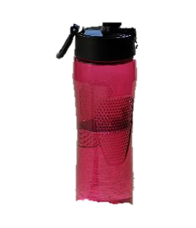
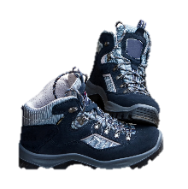
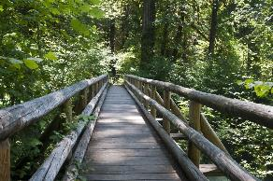
6. Learn and recite the following
safety rules for walking:
a. Always walk with at least one partner
b. Carry water when going for a walk
c. Wear comfortable walking shoes
d. Wear proper clothing
e. Watch where you walk so you won’t become lost

Slide 34

Nature in the Bible

Slide 35
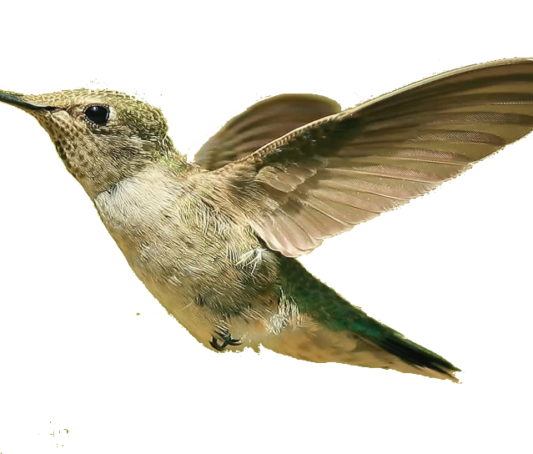
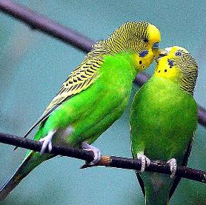


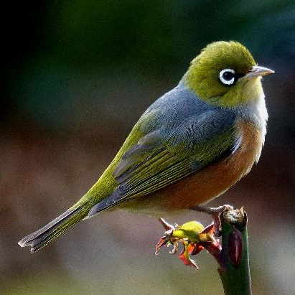
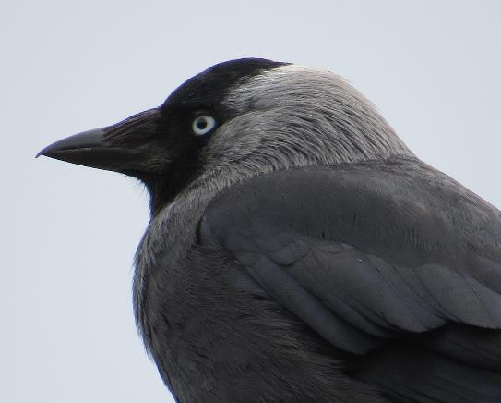
Quiz
Are these birds mentioned in the Bible ?
Raven
Cuckoo
Eagle
Hummingbird
Pigeon
Robin
Sparrow
Peacock
This Photo by Unknown Author is licensed under CC BY-SA
This Photo by Unknown Author is licensed under CC BY-NC-ND
This Photo by Unknown Author is licensed under CC BY-NC

Slide 36
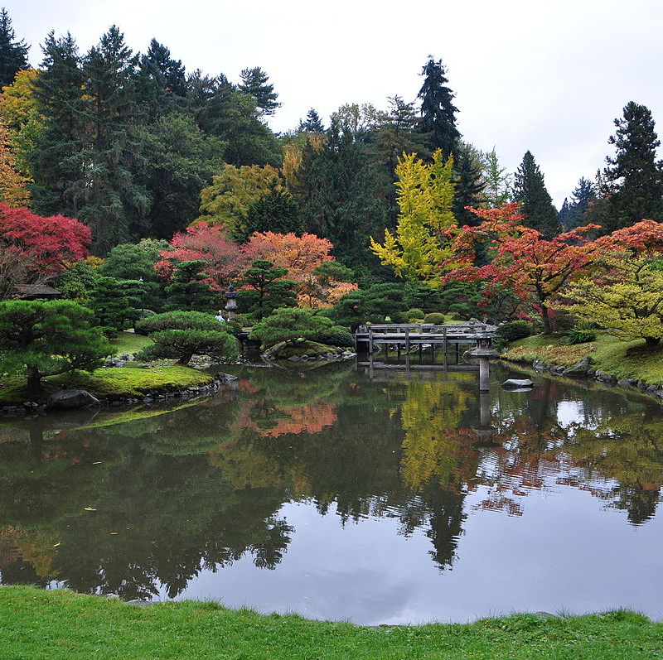
Quiz
What was the work of Adam & Eve? Clue: Gen 2:15
This Photo by Unknown Author is licensed under CC BY-SA

Slide 37

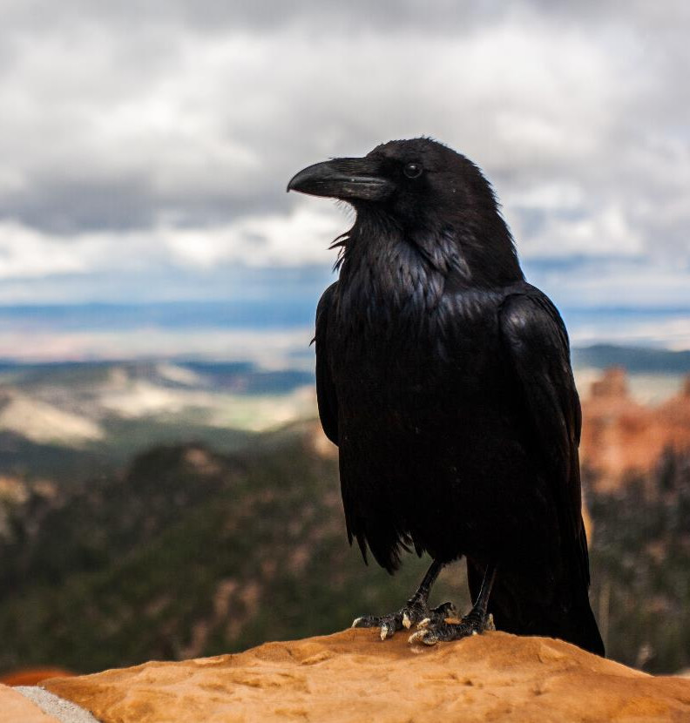
Quiz
Elijah needed to run away from the evil queen and king. Where did God want him to hide ?
Clue: 1 Kings 17:2 NKJV
In the temple
In his friend’s house
By the brook Cherith
In the wilderness
Photo by https://unsplash.com/

Slide 38
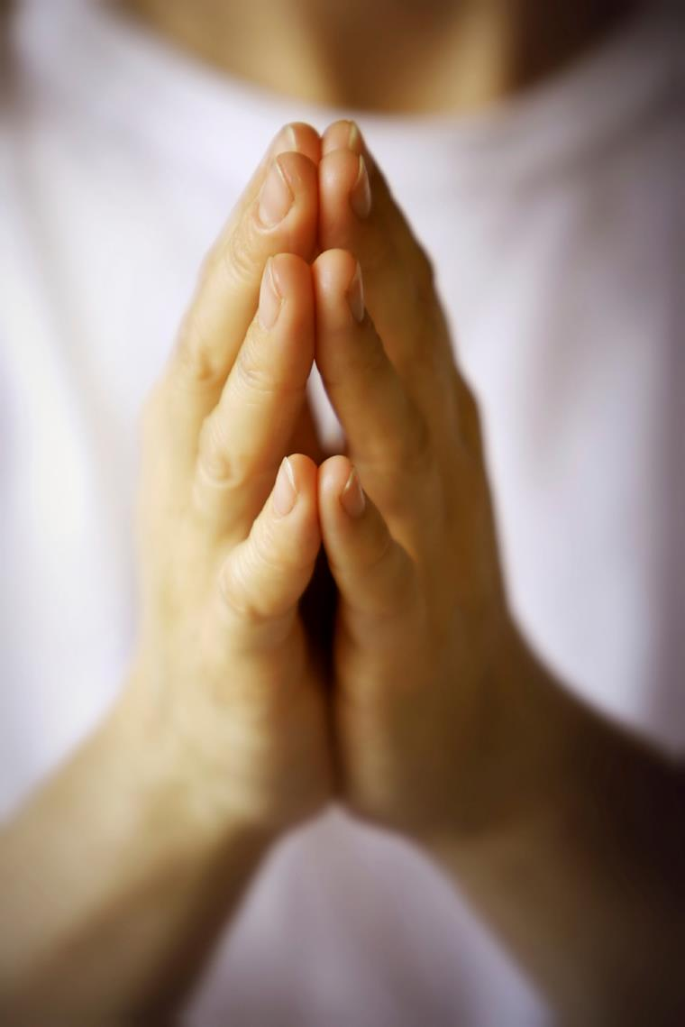
Quiz
Where did Jesus sometimes go to pray?
River
Shopping centre
Town centre
Mountain
Clue: Matt 14:23
This Photo by Unknown Author is licensed under CC BY-NC-ND

Slide 39
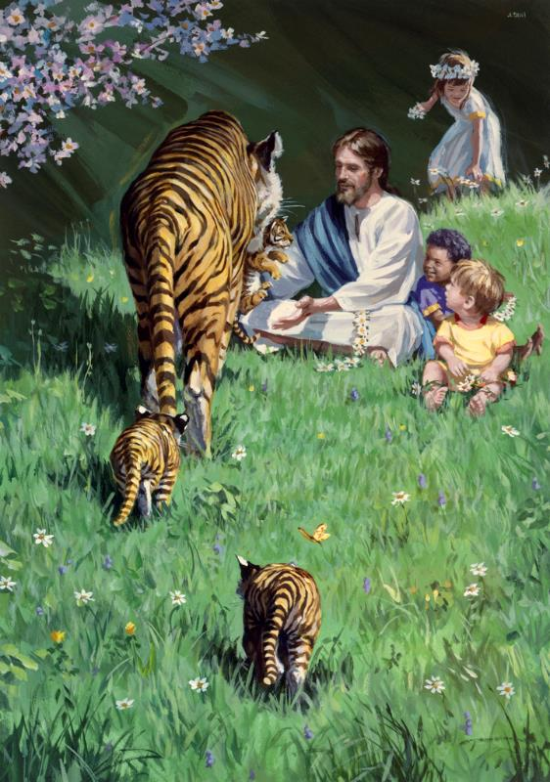
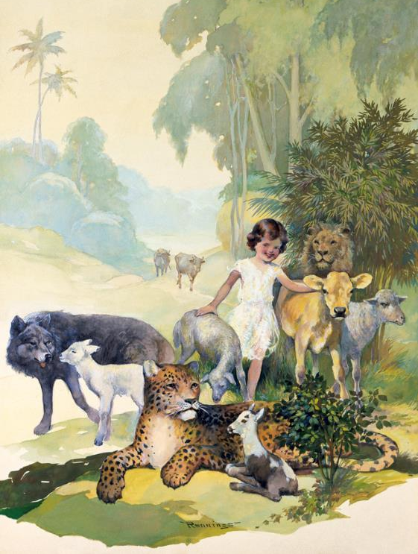
Quiz
„They shall not hurt nor destroy in all My holy mountain.” (Is 65:25)
According to the book of Isaiah, which living beings will eat and play together on New Earth?
Wolf and lambs
Cow and bear
Cobra and child
Jaguar and tiger
Illustrations: GoodSalt.com (projection licence)

Slide 40
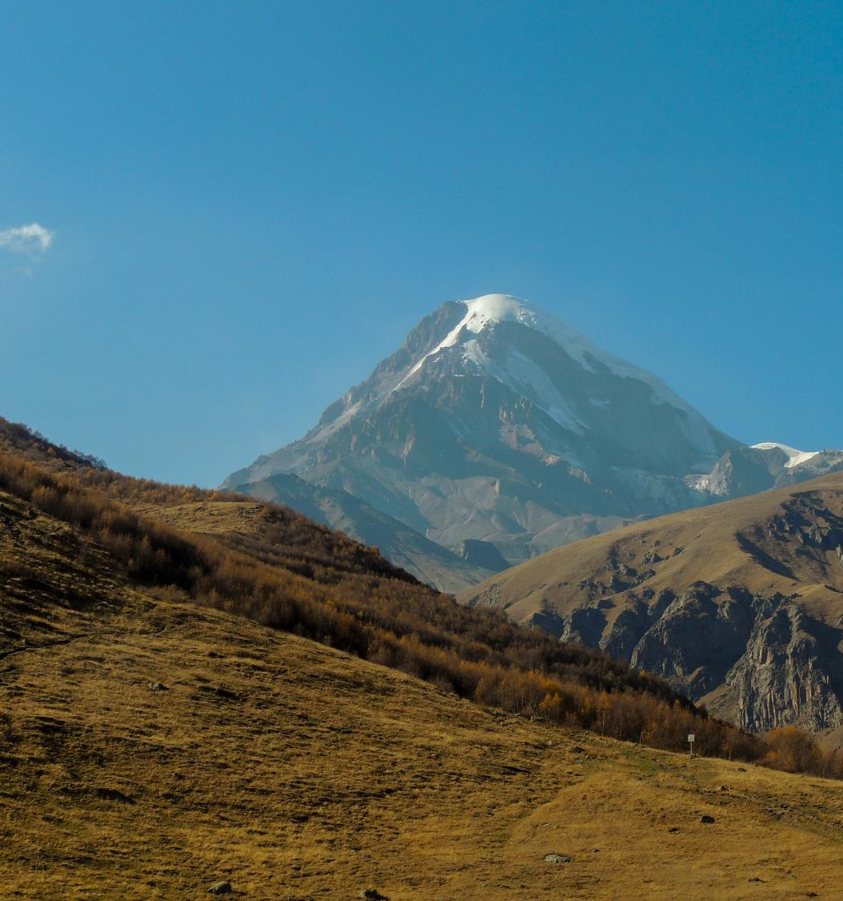
Mountains are mentioned more than 500 time in the Bible. God often reveals himself on a mountaintop or does something significant there.
Quiz
Photo by https://unsplash.com/

Slide 41
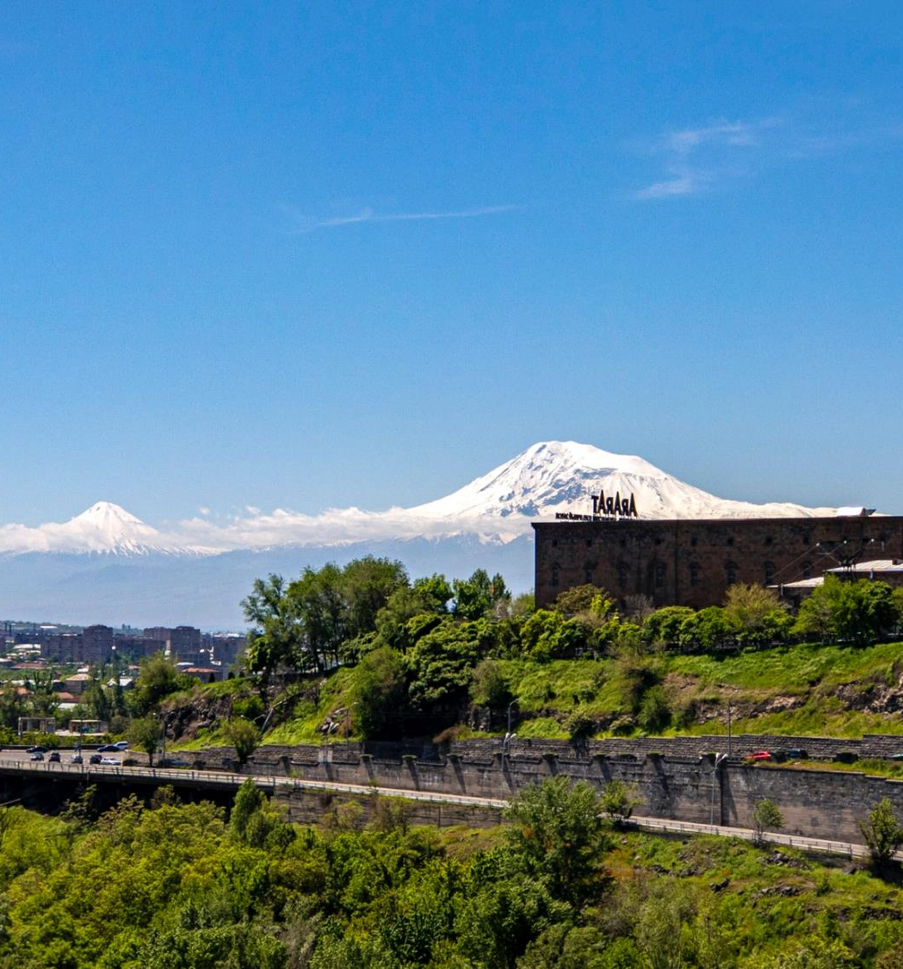
Photo by https://unsplash.com/
Quiz
Noah’s ark rests here after the flood.
Clue: Genesis 8:1-5
Mount Ararat (16,845 ft/ 5,165 m)

Slide 42
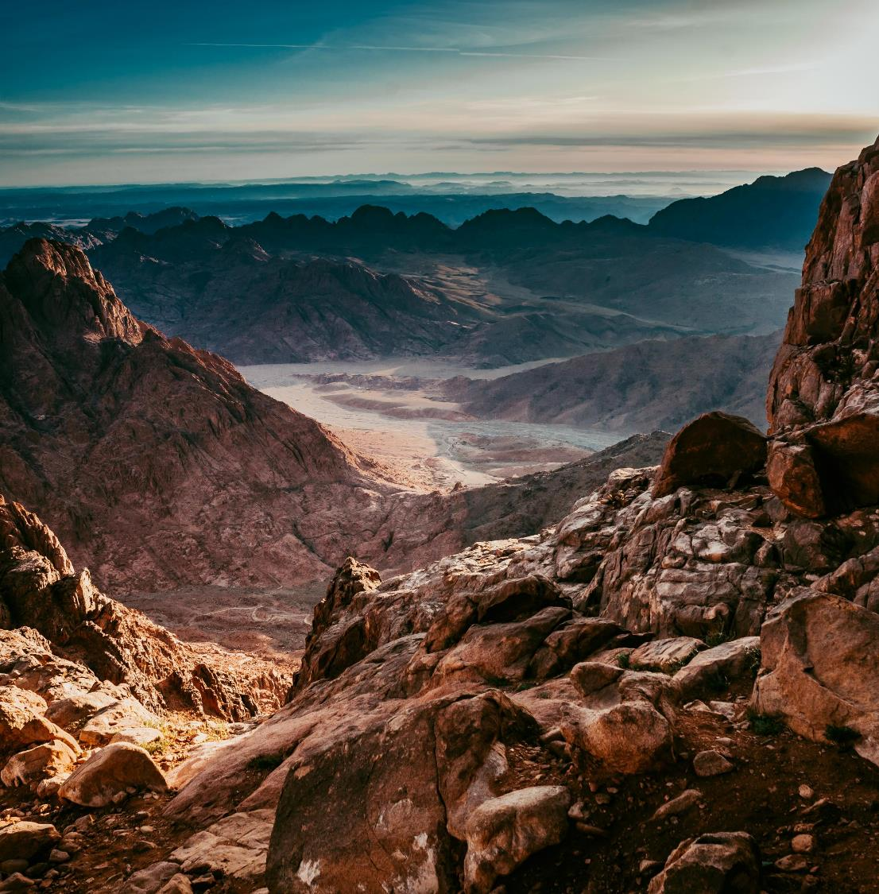
Quiz
Moses receives the Ten Commandments here, a symbol of God’s Covenant with Israel
Clue: Exodus 19-20, 24
Mount Sinai (7,497 ft/ 2,285 m)
Photo by https://unsplash.com/

Slide 43
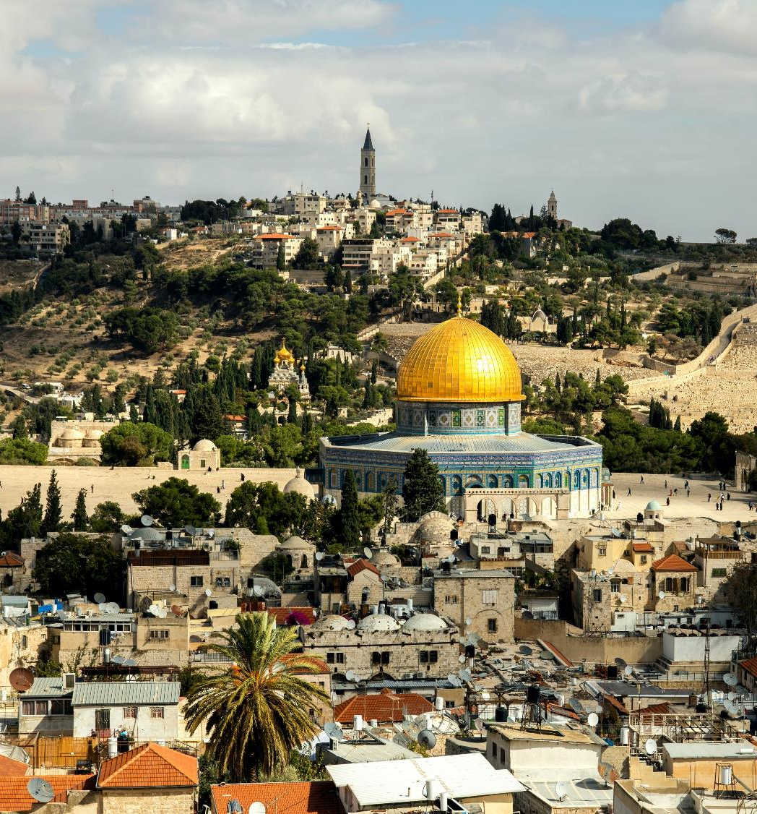
Photo by https://unsplash.com/
Quiz
Jesus prays here before his arrest and cruci-fixion. Later he ascend from here into heaven.
Clue: Luke 22:39-49; Acts 1:9-12
Mount of Olives (2,710 ft/ 827 m)

Slide 44
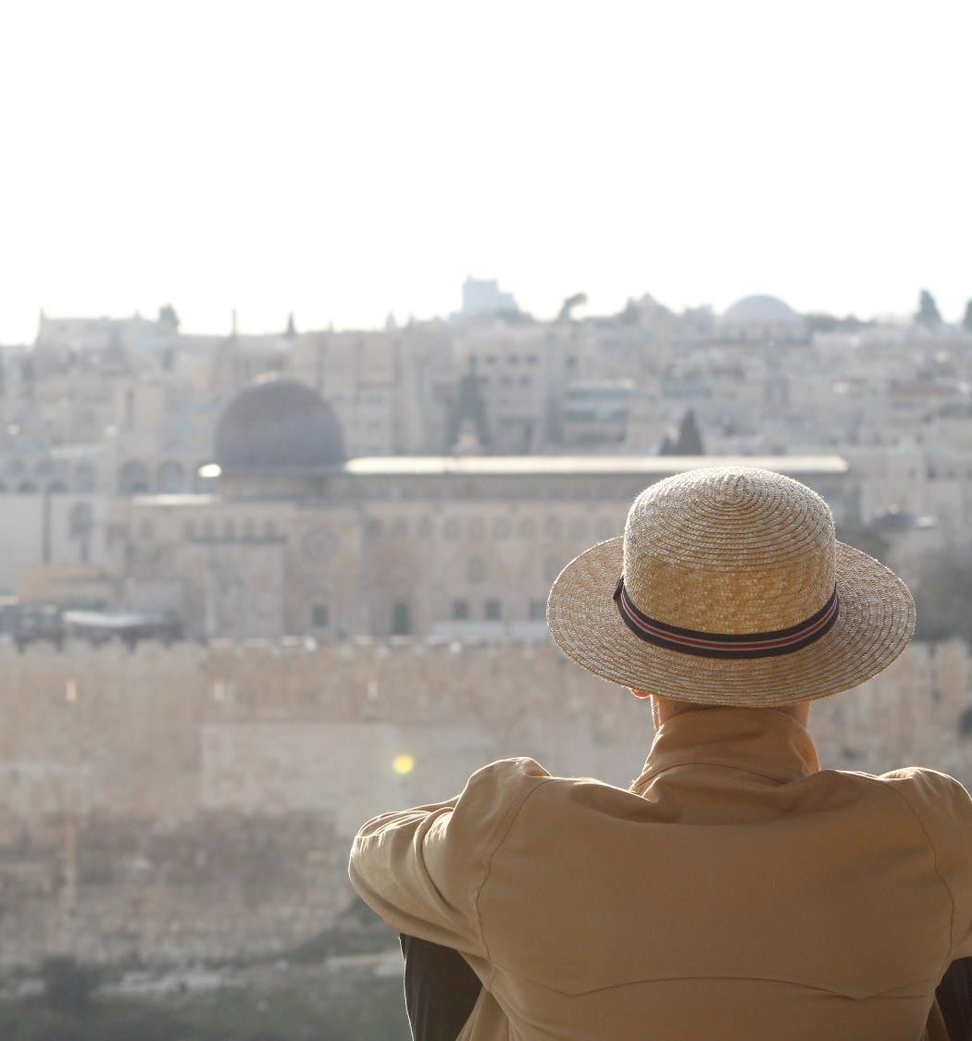
Quiz
David captures the area and it becomes the City of David, later the location of Solomon’s Temple
Clue: 2 Sam 5:1-10; 1 Ki 8:1
Mount Zion (2,510 ft/ 765 m)
Photo by https://unsplash.com/

Slide 45
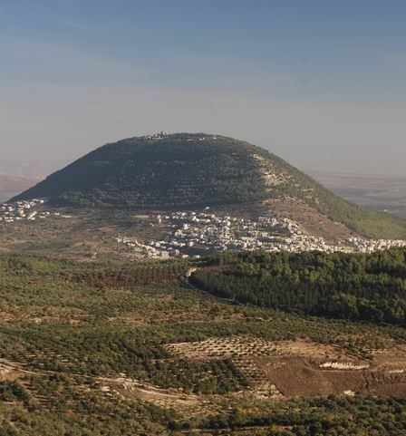
Quiz
Before the disciples’ eyes, Jesus is transfigured, next to Moses and Elijah (mountain veterans).
Clue: Mt 17; Mk 9; Lk 9
Mount of Transfiguration (Tabor 1,886 ft; or Hermon 9,232 ft)

Slide 46
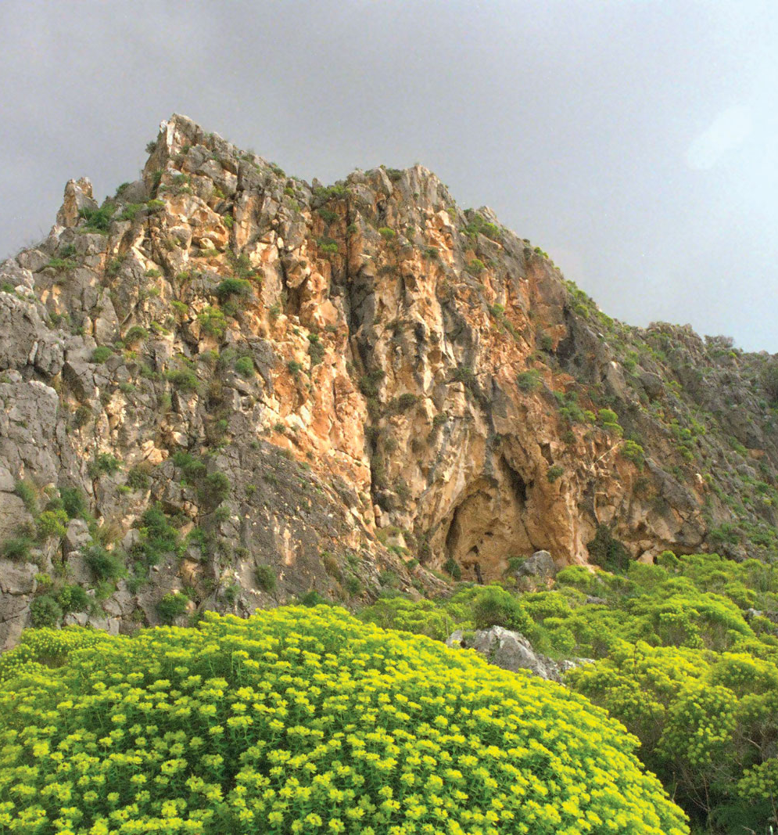
Quiz
Elijah calls God to light a sacrifice on fire, proving to the Prophets of Baal that he is the one true God
Clue: 1 Kings 18
Mount Carmel (1,724 ft; 526 m)
Photo by https://unsplash.com/

Slide 47
Resources:
British trees ID app: https://www.woodlandtrust.org.uk/trees-woods-and-wildlife/british-trees/tree-id-app/
Footpath signs : https://www.simplyhike.co.uk/blogs/blog/a-guide-to-footpath-signs-in-england-and-wales
Ideas to explore nature:
https://www.naeyc.org/our-work/families/ideas-exploring-outdoors
https://www.familyminded.com/s/get-outside-15-ways-to-explore-nature-with-your-kids-e622466b20464664
Packing essentials for hiking: https://www.rei.com/learn/expert-advice/ten-essentials.html
Edible plants: https://www.youtube.com/watch?v=uF-RQSRwnl4
Hiking with kids: https://kids.kiddle.co/Hiking
Best apps for hiking: https://trekaddict.co.uk/blog/the-best-apps-for-hiking-in-2020/

Slide 48
Outdoor
Explorer

