Slide 1
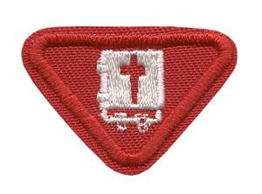
Bible 2 award

Slide 2
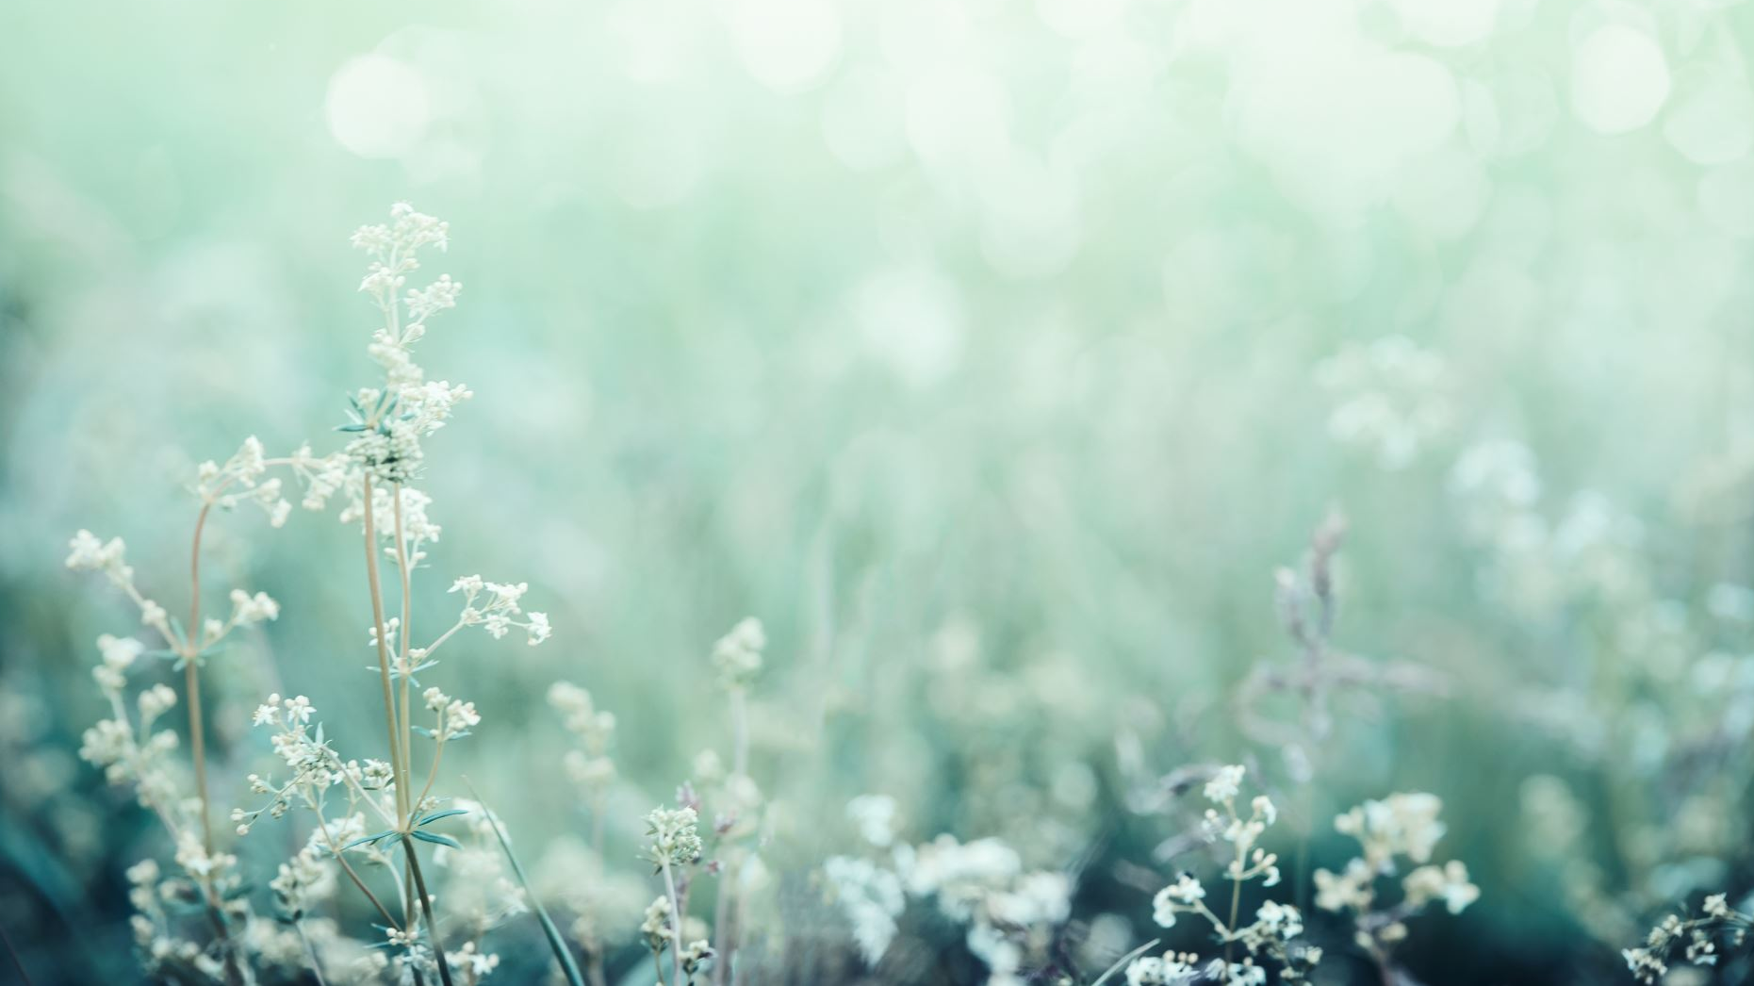
Hi all,
My name is Bianka and I am in the Friends class (Stanborough Park Pathfinders). I will be doing the Bible II award with you today.

Slide 3
To get this award you will do the following:
You need to have done the Bible 1 award
Name the 2 major parts of the Bible and name the 4 books that are known as the gospels
Recite the new testament books
Have listened to or read 4 Bible stories
Read or listen to the first 9 chapters of Genesis
Memorise and explain 3 verses about giving your life to Jesus
Play a game to help you remember the Bible stories

Slide 4
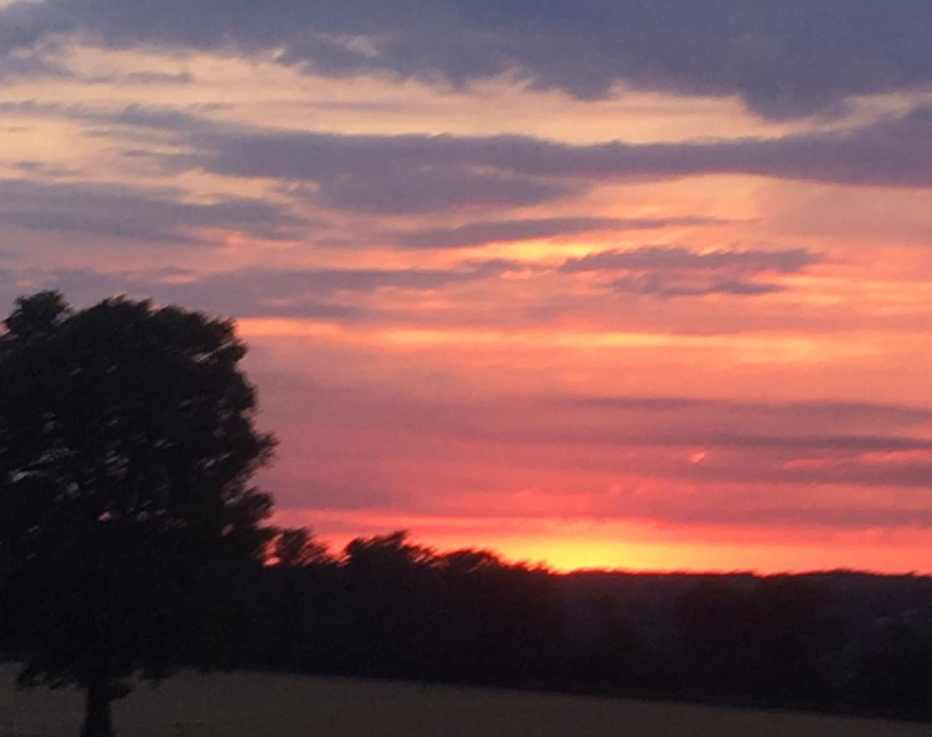
What are the 2 major parts of the Bible & what are the books know as the Gospels?
The Old Testament & the New Testament
Matthew, Mark, Luke & John

Slide 5
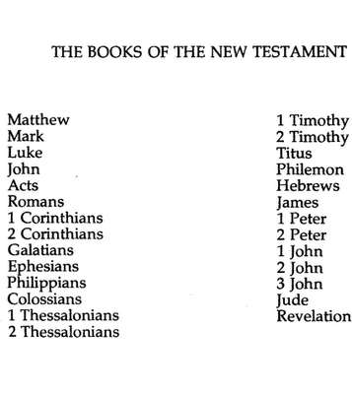
NAME the new testament books in order?

Slide 6

The Bible stories you need to have listened to or read are:
A. David & Jonathan
B. Abraham & Isaac
C. Noah and the flood
D. Samuel called by the Lord
A= 1 Samuel
B= Genesis
C= Genesis
D= 1 Samuel
Can you tell me which Bible book tells each story?
Answers in the chat please

Slide 7

Read or listen to the first 9 chapters of Genesis

Slide 8
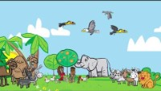

Slide 9
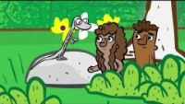

Slide 10
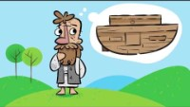

Slide 11

Memorize 3 of the following 5 verses:

Slide 12
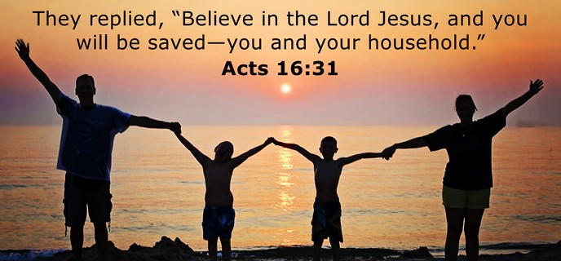
A. Acts 16:31

Slide 13
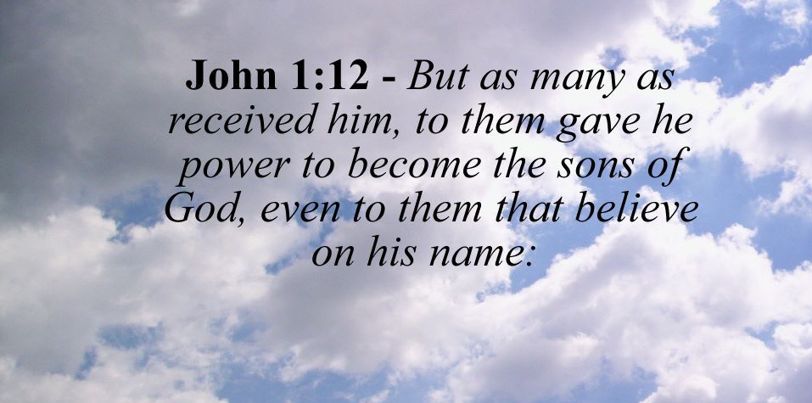
B. John 1:12

Slide 14
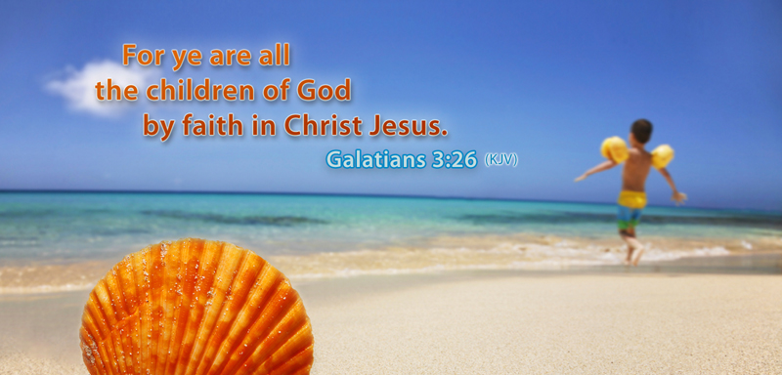
C. Galatians 3:26

Slide 15
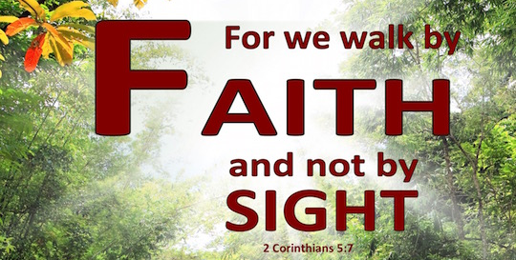
D. 2 Corinthians 5:7

Slide 16
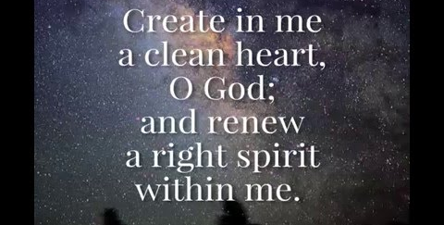
E. Psalm 51:10

Slide 17

Question 1:
Quiz
Answer: To never flood the whole earth ever again
What was God`s promise when he showed the rainbow?
Type in the chat

Slide 18

Question 2:
David and Jonathan were?
A) Enemies
B) Brothers
C) Friends
D) Sisters
The answer: C) Friends

Slide 19
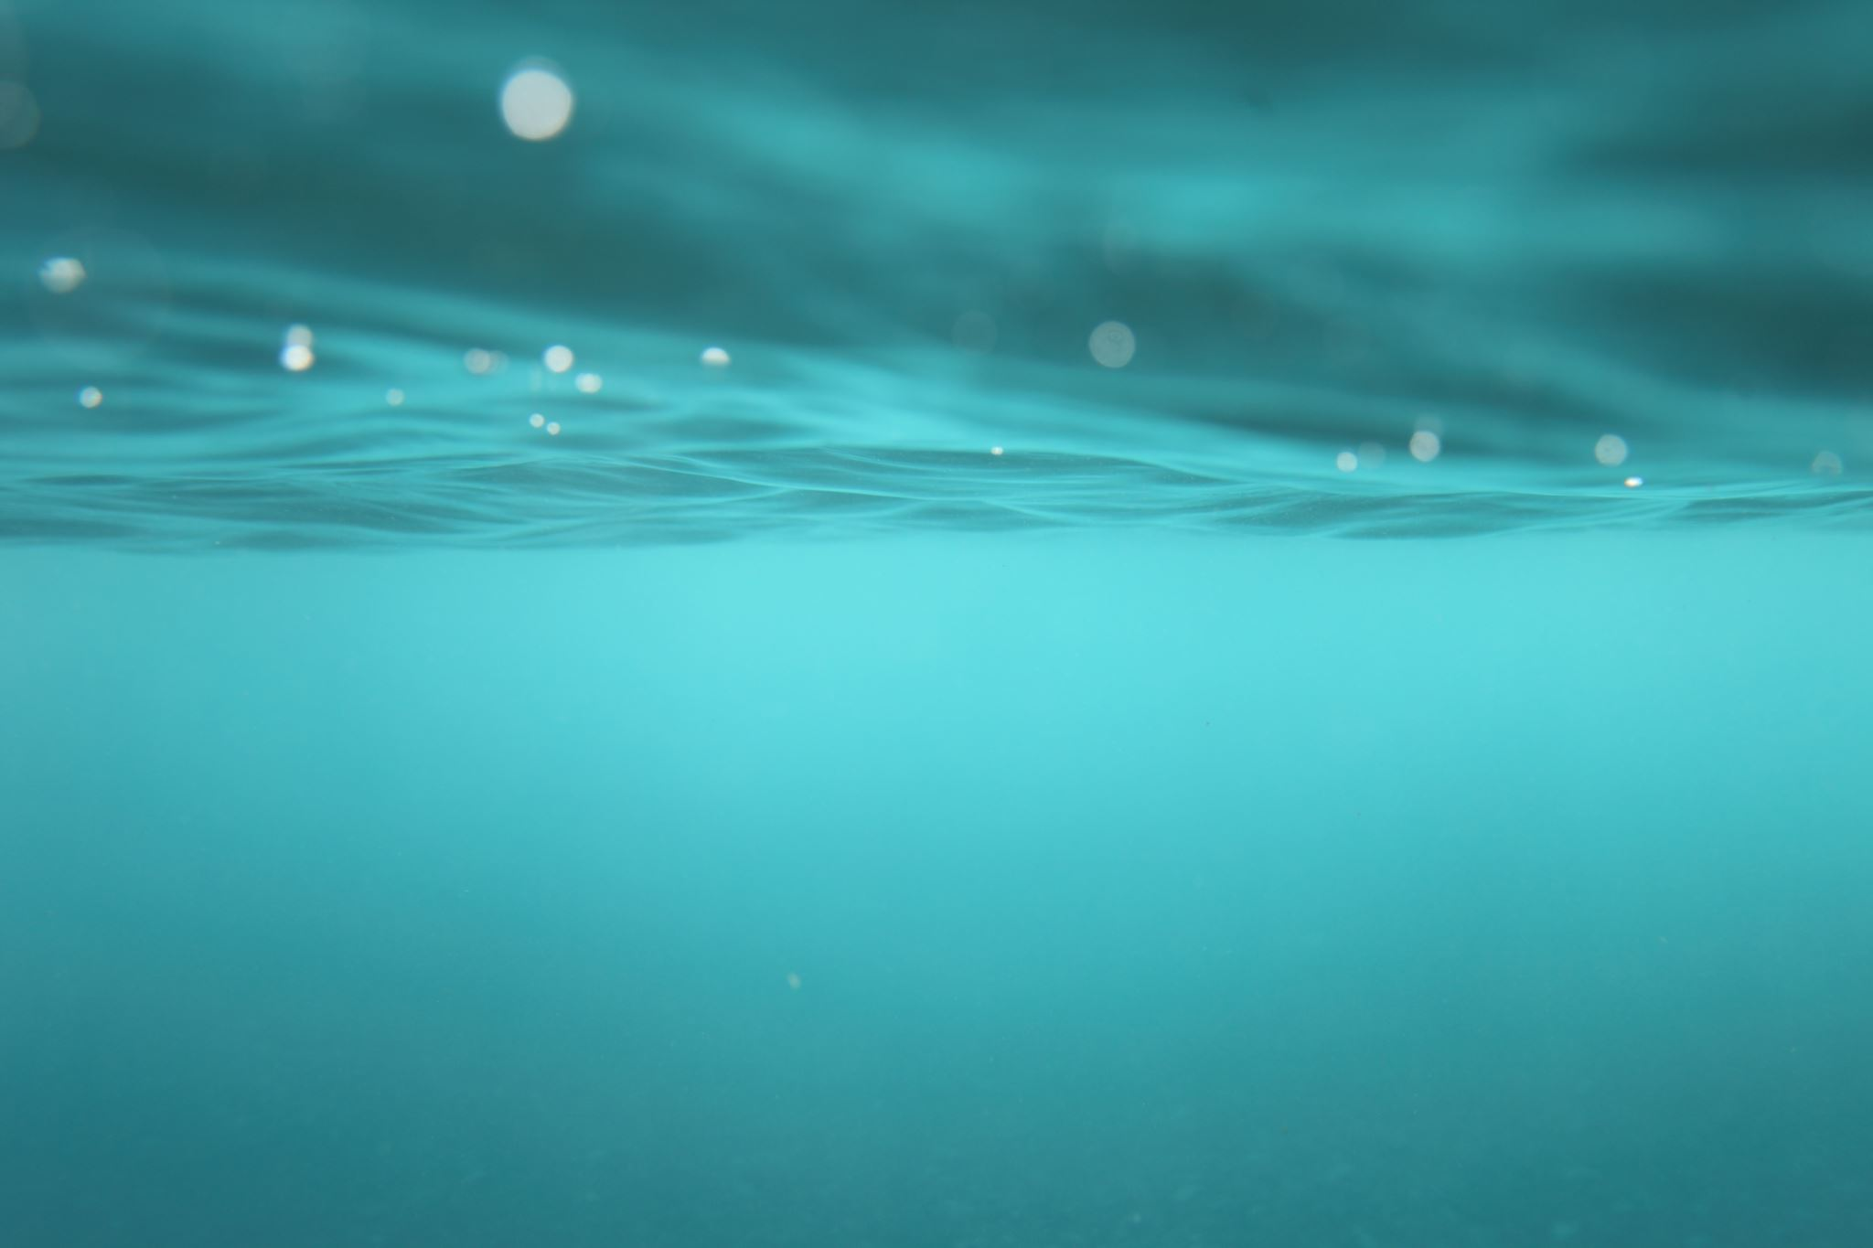
Question 3:
What weapon did Jonathan use to warn David?
A) sword
B) arrow
C) bread
D) apple
Answer: B) arrow

Slide 20
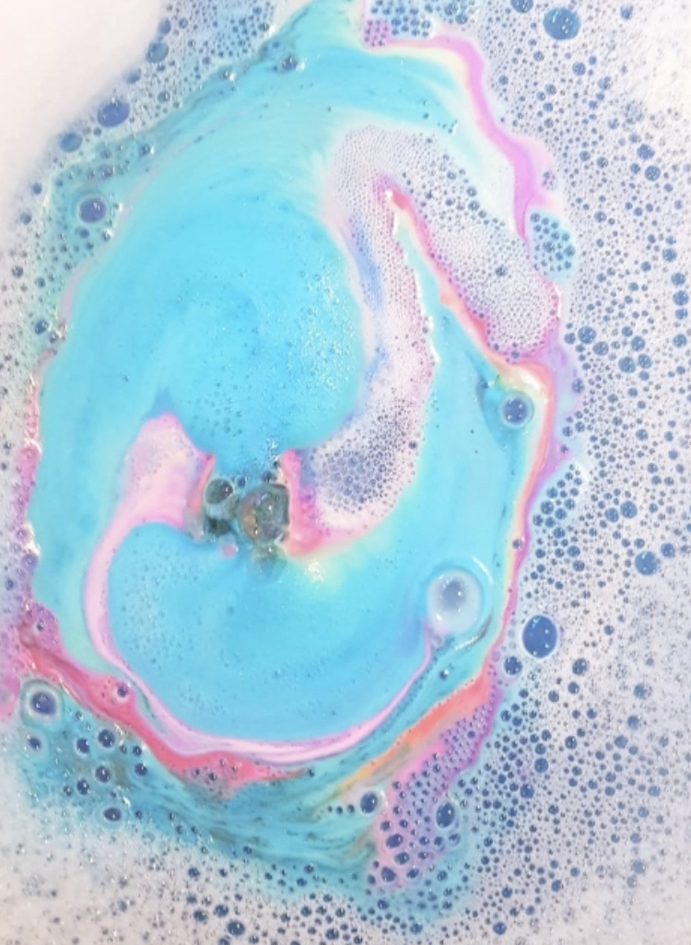
Question 4:
Abraham and Isaac were:
A) brothers
B) friends
C) father and son
D) cousins
Answer: C) Father and son

Slide 21

Question 5:
What did Abraham and Isaac build on the mountain:
A) House
B) Table
C) Altar
D) Chair
Answer: C) Altar

Slide 22

Question 6:
What did Noah build?
A) House
B) Toys
C) Ark
D) Car
Answer: C) Ark

Slide 23

Question 7:
Why did Noah build the ark?
A) He wanted to go fishing
B) It was his hobby
C) God told him to
D) His wife told him to
Answer: C) God told him to

Slide 24

Question 8:
What was going to happen once the Ark was built?
Type in the chat
Answer: It was going to rain

Slide 25
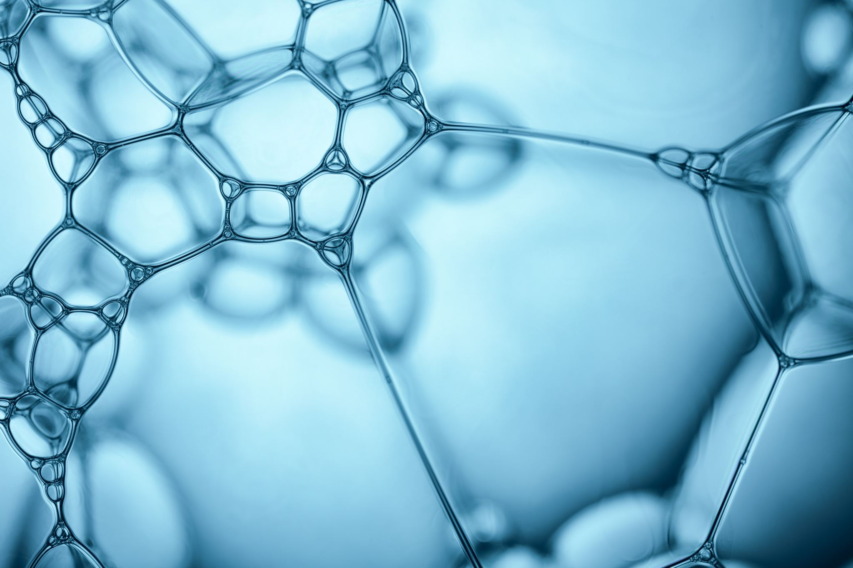
Question 9:
Who did Samuel live with when he lived in the temple?
A) John
B) Fred
C) Eli
D) Isaac
Answer: C) Eli

Slide 26


Question 10:
Answer: True
True or false
David and Samuel knew each other.
Type in the chat

Slide 27

I hope you enjoyed my presentation!!!

