Slide 1
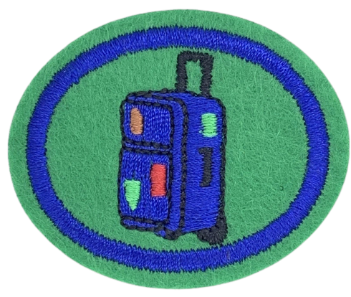
BUC PATHFINDERS
TRAVEL HONOUR
Saturday 5th December 2020

Slide 2

Where are you watching from?

Slide 3
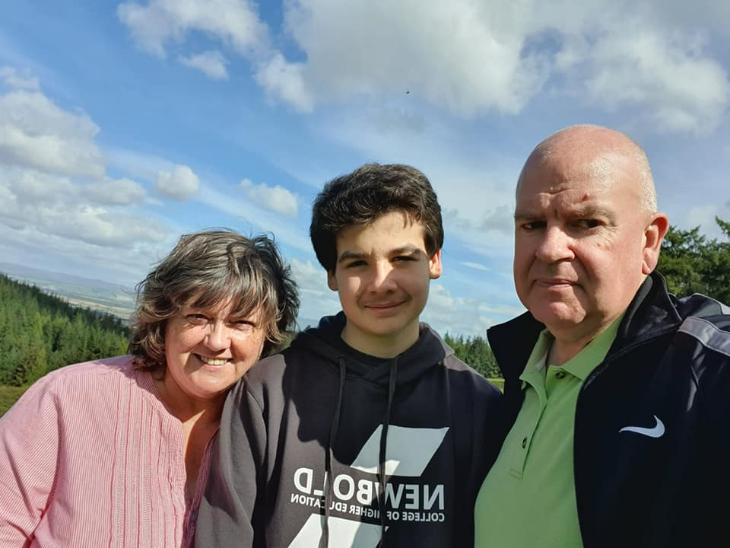
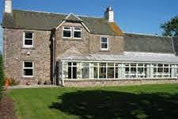
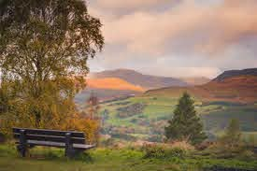
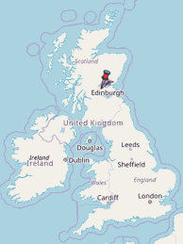
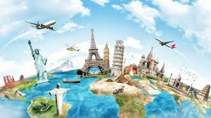
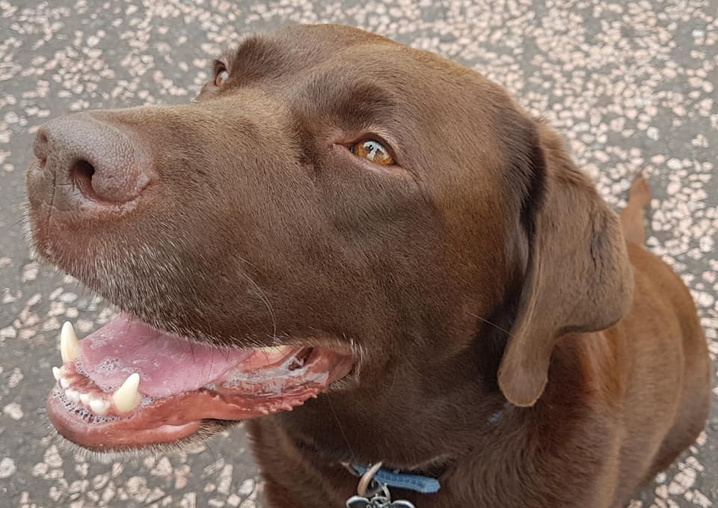
Who am I?

Slide 4
Honour Requirements:
List as many types of transportation you can think of that people use to get around the planet.
Make a “Top Five” from that list of the most common types of transport.
List the pros and cons of each of the “Top Five”.

Slide 5
Honour Requirements:
List some of the pros and cons of the following types of lodging:
a) Hotel or motel
b) Youth hostel
c) Friends or family
d) Caravan/Motor Home/Camping
e) All Inclusive Resorts
What types of documentation are necessary for travel? Explain the purpose of each type of document.
Watch a travelogue programme that shows travel scenery and the geography of a unique location.

Slide 6
Honour Requirements:
Discuss what kind of attitude travellers should have when travelling abroad.
Create a simple 7-day travel plan for a family holiday. Our travel plan should include:
a) Details on one historic place to visit
b) Details on two natural sites to visit
c) Details of one recreational site to visit
List a few different ways that people got around in Bible times.
Calculate approximately how long it would have taken to walk between JERUSALEM and DAMASCUS
Sketch a map of this journey:
a) Include names of people and paths taken including notable stops made.
b) Show different types of lines for each different mode of transport made.
c) Show a “legend/key” for identifying the markings and transport types.

Slide 7
What is Travel?
Travel is defined as:
the movement of people between distant geographical locations. Travel can be done by foot, bicycle, automobile, train, boat, bus, airplane, ship or other means, with or without luggage, and can be one way or round trip
Any type of travel requires the use of transportation.

Slide 8
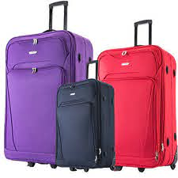

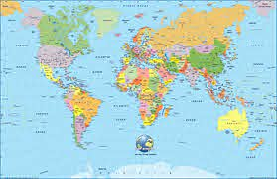

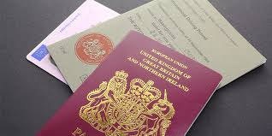


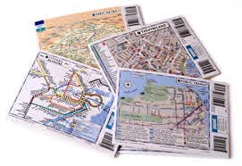
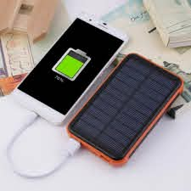
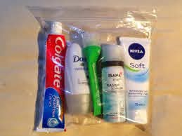
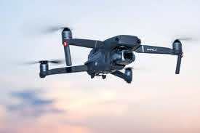
WHAT TO THINK ABOUT WHEN TRAVELLING

Slide 9
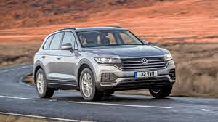
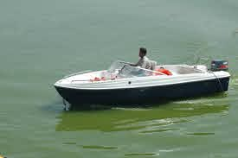
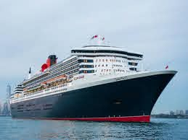
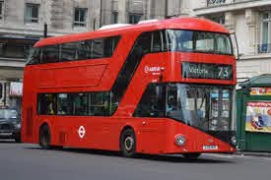
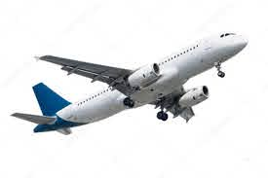
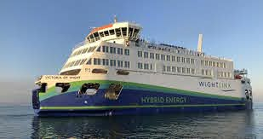
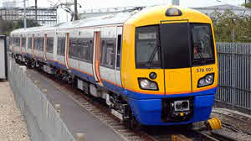
Types of Transportation

Slide 10
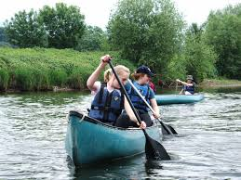
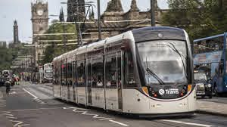
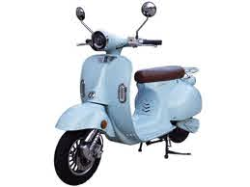
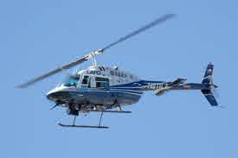
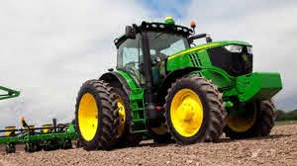
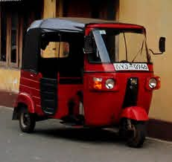
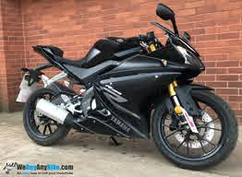
Types of Transportation

Slide 11
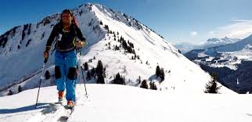
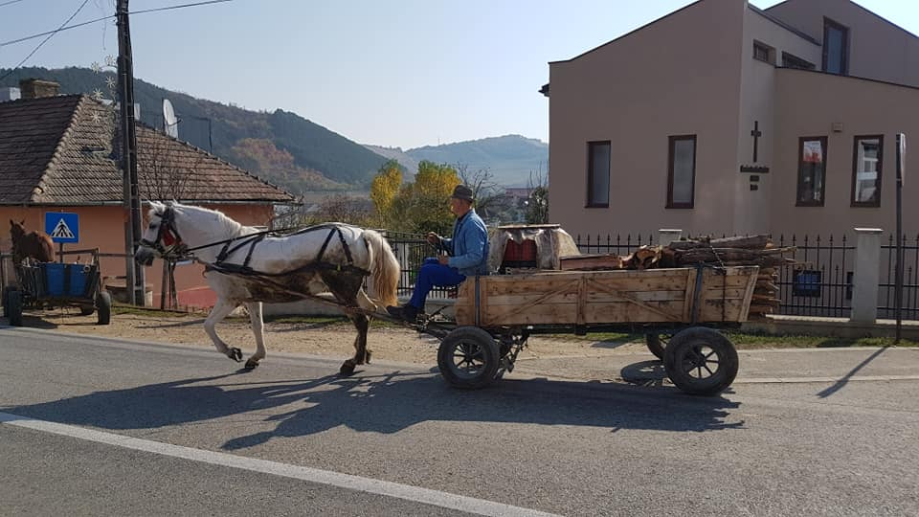
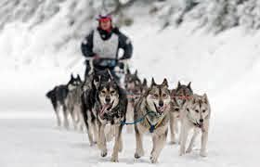
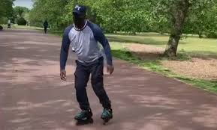

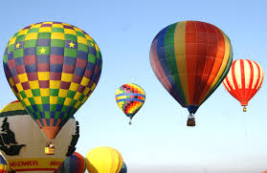
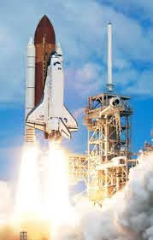
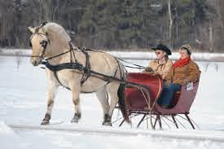
Types of Transportation

Slide 12
Top Five Types of Transportation
Railway (trains/trams/trolley cars)
Road (car/bus/coach/motorbike)
Air (airplane/helicopter)
Water (ship/ferry/boat/canoe)
Powered by Feet/Hands (bicycle/walk/skates/scooter/wheelchair)

Slide 13
Pros of the Top Five Types of Transportation
Rail: Can take large loads and/or lots of people on long trips.
Environmentally friendly – low carbon footprint.
Road: Cars allow you to go when you want to.
Road network means virtually everywhere is accessible.
Air: Airplanes mean international travel. Everywhere is accessible.
Fastest means of travel.
Water: Water travel enables international travel.
Relatively cheap. Larger items can be transported.
Feet/Hands: Inexpensive form of transport.
Kinder to the environment.

Slide 14
Cons of the Top Five Types of Transportation
Railway: Huge set-up costs for infrastructure and stock.
Inflexible in timings and availability of locations.
Road: Fuel costs are variable. Damaging to the environment.
Greater potential for accidents.
Air: Operating costs are extremely high.
Environmentally harmful.
Water: Slower so unsuitable for perishable goods.
More prone to bad weather = delays.
Feet/Hands: Relying on human strength and skill.
Unable to carry large loads.

Slide 15

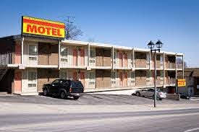
Hotel/Motel

Slide 16
Hotels and Motels – Pros and Cons
PROS
CONS
No personality – bland and uniform.
May not reflect local culture.
Lacking human interaction.
Expensive if in best locations.
Expensive to stay in for a longer period of time.
No catering facilities so have to eat out all the time.
Quality is consistent.
You know what you are getting when staying in a hotel chain.
Easy to book.
Location is usually good.
You can be anonymous.
Can book it last minute.
Everything is done for you.

Slide 17

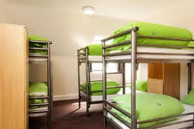
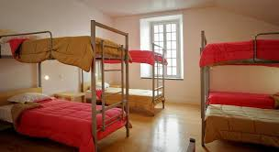
Youth Hostels

Slide 18
Youth Hostels – Pros and Cons
PROS
CONS
Lack of privacy.
Usually have to share a bathroom.
Share with strangers.
Can be basic.
Risk of theft.
Might have to get back at a certain time or risk being locked out.
Inexpensive.
Great when you are travelling in a group.
Do your own thing.
Meet new people.
Offer fun activities in the local area.
Can do your own catering.

Slide 19
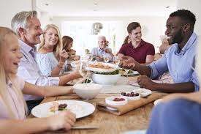
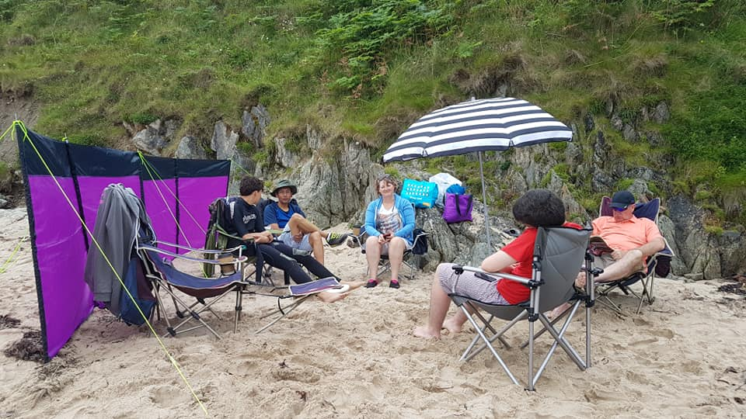

Friends and Family

Slide 20
Friends and Family – Pros and Cons
PROS
CONS
Have to fit into another household’s routine.
Eat what they eat – less choice.
You have to do what they think is best to do/see.
Lack of privacy.
Relationships can get tricky if they think you are taking advantage – or staying too long.
You are with people you have chosen to be with!
They know you and you know them – usually!
They care about you.
Generous with their time/food/money/wifi.
Chance to relax and catch up.
Spontaneous happenings!

Slide 21
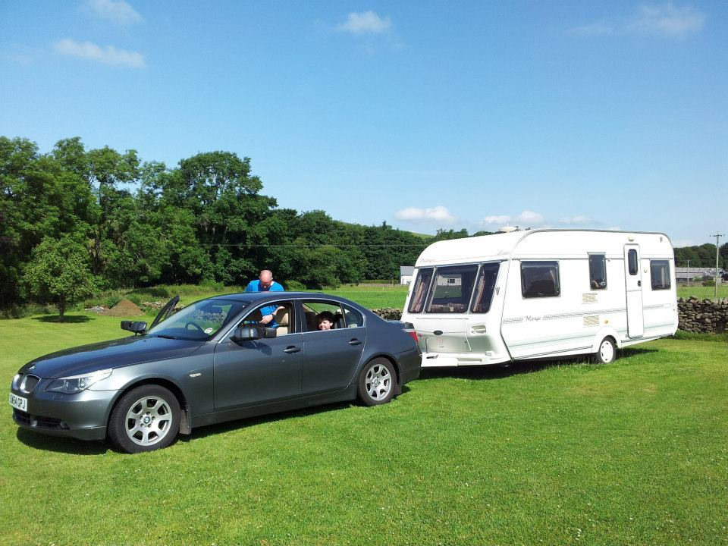
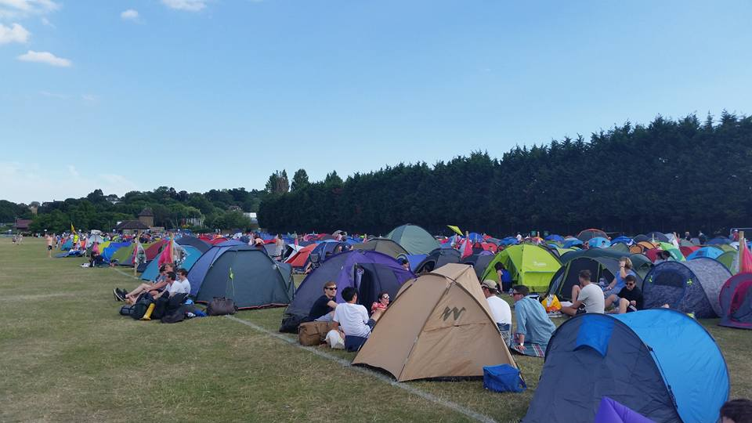
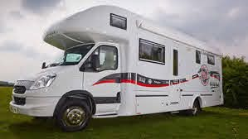
Caravan/Motorhome/Camping

Slide 22
Caravan/Motorhome/Camping
Pros and Cons
PROS
CONS
Caravans and motorhomes – expensive to purchase.
Sites might be noisy.
Lack of privacy. Shared wash facilities.
Camping – basic cooking facilities.
Bad weather can make everything miserable.
Motorhome – when you want to travel, you have to pack everything up to go anywhere.
Freedom to go anywhere!
Inexpensive to stay somewhere.
Learn new skills from other people on sites.
Keep your own timetable.
Use your money to do things you want to do.
In nature and surrounded by nature.

Slide 23
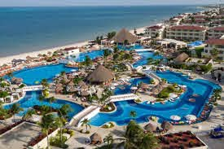
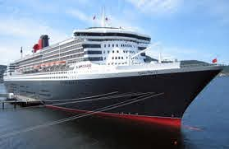
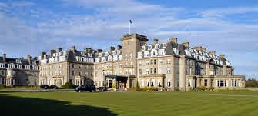
All Inclusive Resorts/Resort Hotels

Slide 24
All Inclusive Resorts/Resort Hotels
Pros and Cons
PROS
CONS
Can be very expensive.
Resorts – tend to stay in the one place and miss out on local culture.
Not authentic experience of where you are.
Can be extremely busy and noisy.
Cruise – stuck with the same people.
Too much of everything is sometimes not great!
Luxurious!
Usually everything is included – makes it easier to budget.
Everything available 24 hours a day.
Meet new people.
Cruises – new places every other day.
Relaxing – everything is done for you.

Slide 25
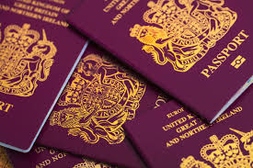
Travel Documentation

Slide 26
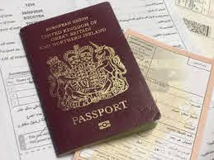
Passport
An internationally accepted identity document used to travel abroad.
In the United Kingdom, they have been in existence in some form since 1414. King Henry V of England is credited with inventing some sort of document that identified his subjects travelling to foreign lands.
Have to pay for them.
In the UK, if you are 15 and under, your passport lasts for 5 years. If you are 16 and over, your passport lasts for 10 years.
Has to have a current photograph inside. No smiling or silly faces. Hair off the face. You must be looking forward. Eyes must be open.
You might not be allowed to travel if your passport is ripped or torn or in bad condition.
Different countries have different rules regarding their passports.

Slide 27
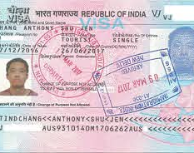
Visa
The word “Visa” comes from the Latin charta visa, meaning "paper that has been seen"
Important to check that you actually require a visa.
A visa is authorisation granted by a country to a foreigner allowing them to enter, stay and leave a country.
Usually stamped or secured inside your passport.
Also get visas which allow you to work or study or allow you to travel through to another country (transit visa).
Visas usually come with restrictions. Limits on how long you can stay and where you can travel are common.
A visa is always subject to entry permission by an immigration official and can be taken away at any time.
Have to pay for them.

Slide 28
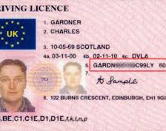
Drivers Licence
Usually credit card size.
Allows the individual to operate one or more types of motorised vehicles on a public road.
Proves that they have shown they are capable of operating a motorised vehicle in a safe manner on a public road.
In the UK, you don’t have to carry it with you. In other countries, such as the USA, you do.
First issued in the UK in 1903.
Must have a photograph on it – similar to a passport photograph.
Must have a signature on it.
In the UK, they have to be renewed every 10 years.
In the UK, after 70 years of age, they have to be renewed every 3 years.
Have to pay for a licence.
Different countries have different rules!

Slide 29

Travel Insurance
Protects you when things go wrong on a trip such as:
Cancellations
Delays
Sickness/Hospital visits/Death
Loss of belongings
Repatriation
Travel insurance will cover most unforeseen expenses incurred while you are travelling.
Have to pay for it. Many types of travel insurance available.
Good idea to take a copy of the document with you when you travel.
Not a legal requirement but some countries like USA will insist on travel insurance where there is no public health system.

Slide 30

Travelogue

Slide 31
How to act when travelling
Always be respectful of the country and its culture
Always be respectful of the inhabitants and their customs
Seek out interesting places and events that deepen your knowledge of the place you are visiting.
Eat where the locals eat and try eating what the locals eat.
Don’t try to cram too much into your travel plans. The place is not going to go away.
Relax. Look around. Take photographs but ALWAYS be respectful.

Slide 32
7 Day Family Trip
Work out how long it will take you to travel to the destination.
Your first and last day may need to be travel days.
Use the internet to find out about local attractions and events.
Try and include something for everyone in the group.
Include 1 historical site
Include 2 nature sites
Include 1 recreational site
If possible, include a day to relax and rest!

Slide 33






7 Day Family Trip
What can you do to pass the time in the car?
Play travel games
I-Spy Books
Listen to music
Listen to audio books
Sleep
Watch dvds
Read a book

Slide 34

7 Day Family Trip to Scotland
Travelling from the south of England to
Dumfries and Galloway in Scotland
Approximately 380 miles each way
Taking approximately 8 hours each way

Slide 35





Travel in Bible Times

Slide 36

Jerusalem to Damascus
The journey that Saul of Tarsus took.
On this journey, Saul of Tarsus became Paul.
You can read about it in the Book of Acts, Chapter 9

Slide 37



Jerusalem to Damascus

Slide 38
How long would it have taken?
The Distance
Jerusalem to Damascus is 324 km
1 km is equal to 0.62 miles
324 km / 0.62 = 201 miles
The Time
Normal walking speed is 3 to 4 miles per hour
201 miles / 4 miles per hour = 50.25 hours.
50.25 hours / 8 hours walking per day = 6.28 days
Given that a walking route 2,000 years ago might have been more direct than a modern driving route, and considering that Saul was young, fit and motivated, plus he may have walked more than 8 hours in a day,
then the journey probably took just over 6 days.

Slide 39


Slide 40






Information on a Map

Slide 41
Worksheet Requirements
Travel documentation – write a paragraph on the different types of travel documentation that are relevant for your country.
Watch a travelogue programme for somewhere you want to travel to so that you can learn more about that country.
Create your own 7 day “family trip”. Research where you want to go. Work out how long the travel will take you. Remember to include:
1 historic place to visit
2 natural sites to visit
1 recreational site to visit

Slide 42
Worksheet Requirements
List a few different ways that people travelled in Bible times.
Sketch a map of a trip mentioned in the Bible:
Show name of person(s) and path taken including notable stops made.
Show different types of lines for each different type of transport taken.
Show a “legend/key” for identifying markings and transport types. Remember to include a title.

Slide 43

Thank you for watching and happy travelling (when it is safe to do so)!

