Slide 1

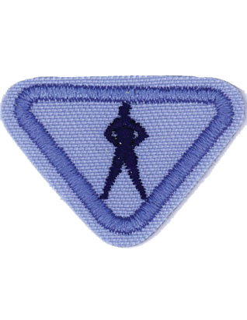
Fitness Fun -Award
Adventurers E-Award

Slide 2



Requirements
1. Read and discuss Jeremiah 29:11.
2. List at least four things that contribute to physical fitness.
3. Do three different stretches. Hold each for a minimum of 15 seconds.
a. Leg
b. Back
c. Arms and shoulders
4. Do four of the following:
a. Run, jog, or walk one-half mile
b. Skip
c. Jump rope for three minutes
d. Jumping jacks—do at least 15
e. Hop on one leg at least five times—see how many you can do
f. Sit-ups
g. Exercise of your choice
5. Participate in two of the following:
a. Obstacle course
b. Leap frog
c. Relay race
6. Participate in an organized game that requires physical exercise.

Slide 3
1. Read and discuss Jeremiah 29:11.

Slide 4
2. List at least four things that contribute to physical fitness.
Proper nutrition
Rest
Water
Exercise
Strength
Cardiovascular fitness
Flexibility
Endurance

Slide 5
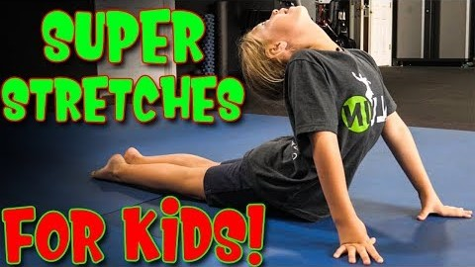
3. Do three different stretches. Hold each for a minimum of 15 seconds. a. Leg b. Back c. Arms and shoulders

Slide 6
4.Do four of the following: a. Run, jog, or walk one-half mile b. Skip c. Jump rope for three minutes d. Jumping jacks—do at least 15 e. Hop on one leg at least five times—see how many you can do f. Sit-ups g. Exercise of your choice

Slide 7
5.Participate in two of the following: a. Obstacle course - family activity b. Leap frog – family activity c. Relay race – family activity

Slide 8
6. Participate in an organized game that requires physical exercise.
Example:
Tip the Can
Build up
Catch the flag
Hide and seek
The floor is lava
Any game organised in school

Slide 9
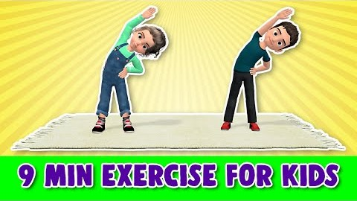
Recomandation:

Slide 10
Thank You !

