Slide 1
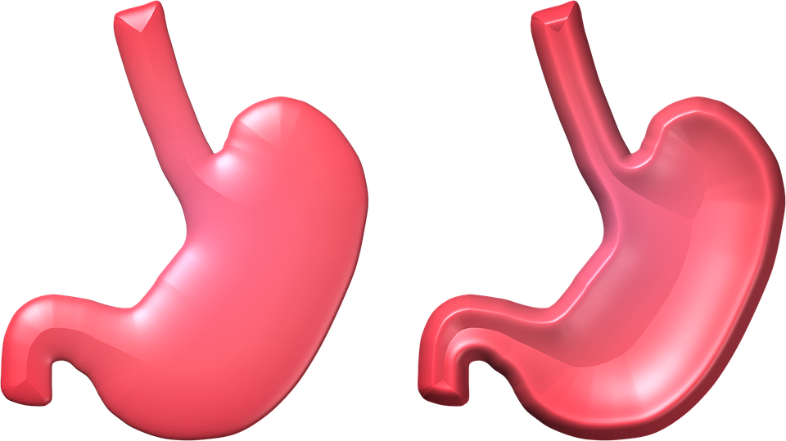
I CAN CARE FOR MY BODY
HEALTH SPECIALIST AWARD
Presenter Faith Moyo

Slide 2

1 CORINTHIANS 6:19,20
19 Or do you not know that your body is the temple of the Holy Spirit who is in you, whom you have from God, and you are not your own?
20 For you were bought at a price; therefore glorify God in your body]and in your spirit, which are God’s.

Slide 3
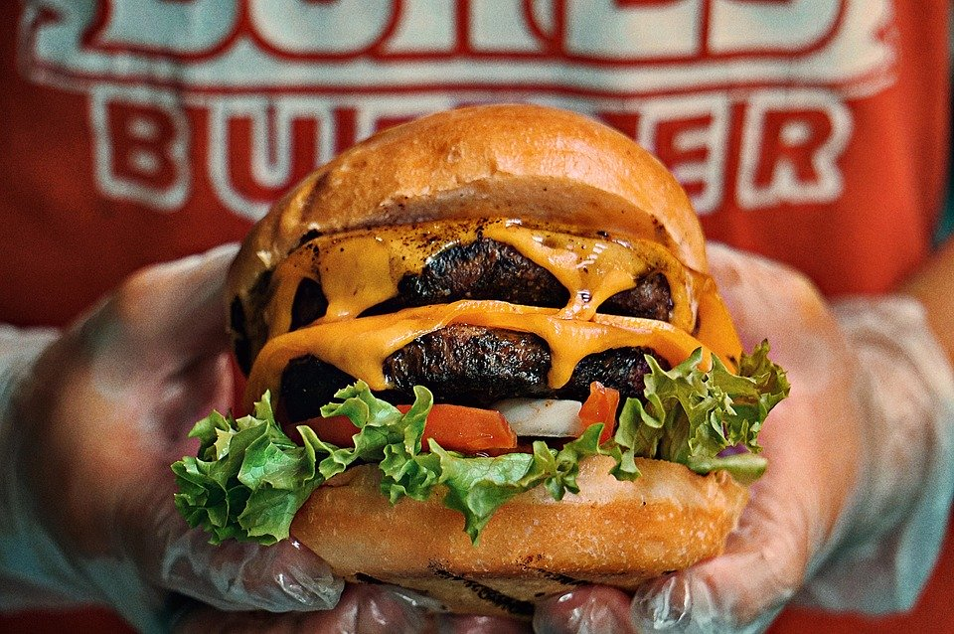


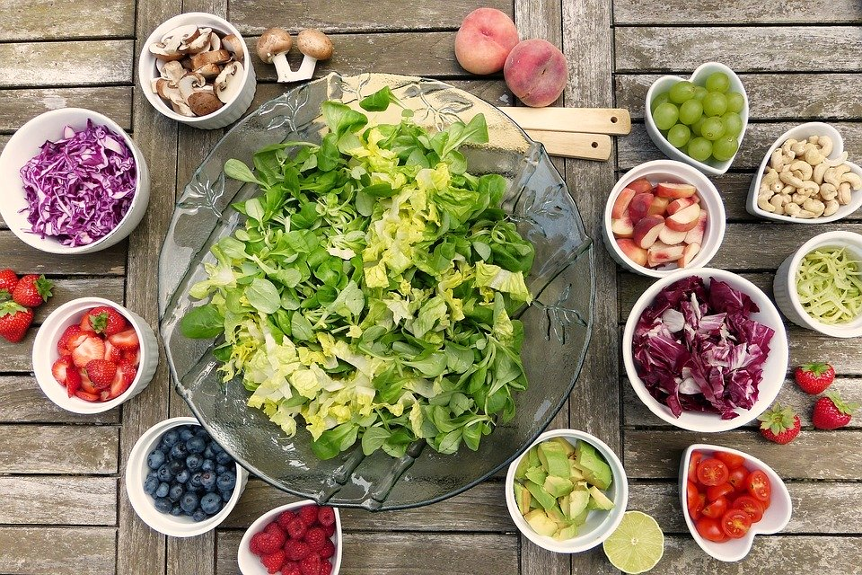
Describe a proper diet,and list the basic food groups.
Cross out the diets that will hurt you.

Slide 4

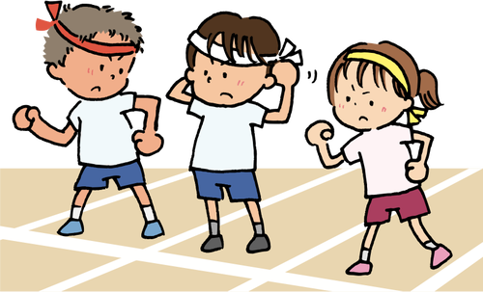
Explain why your body needs exercise.

Slide 5
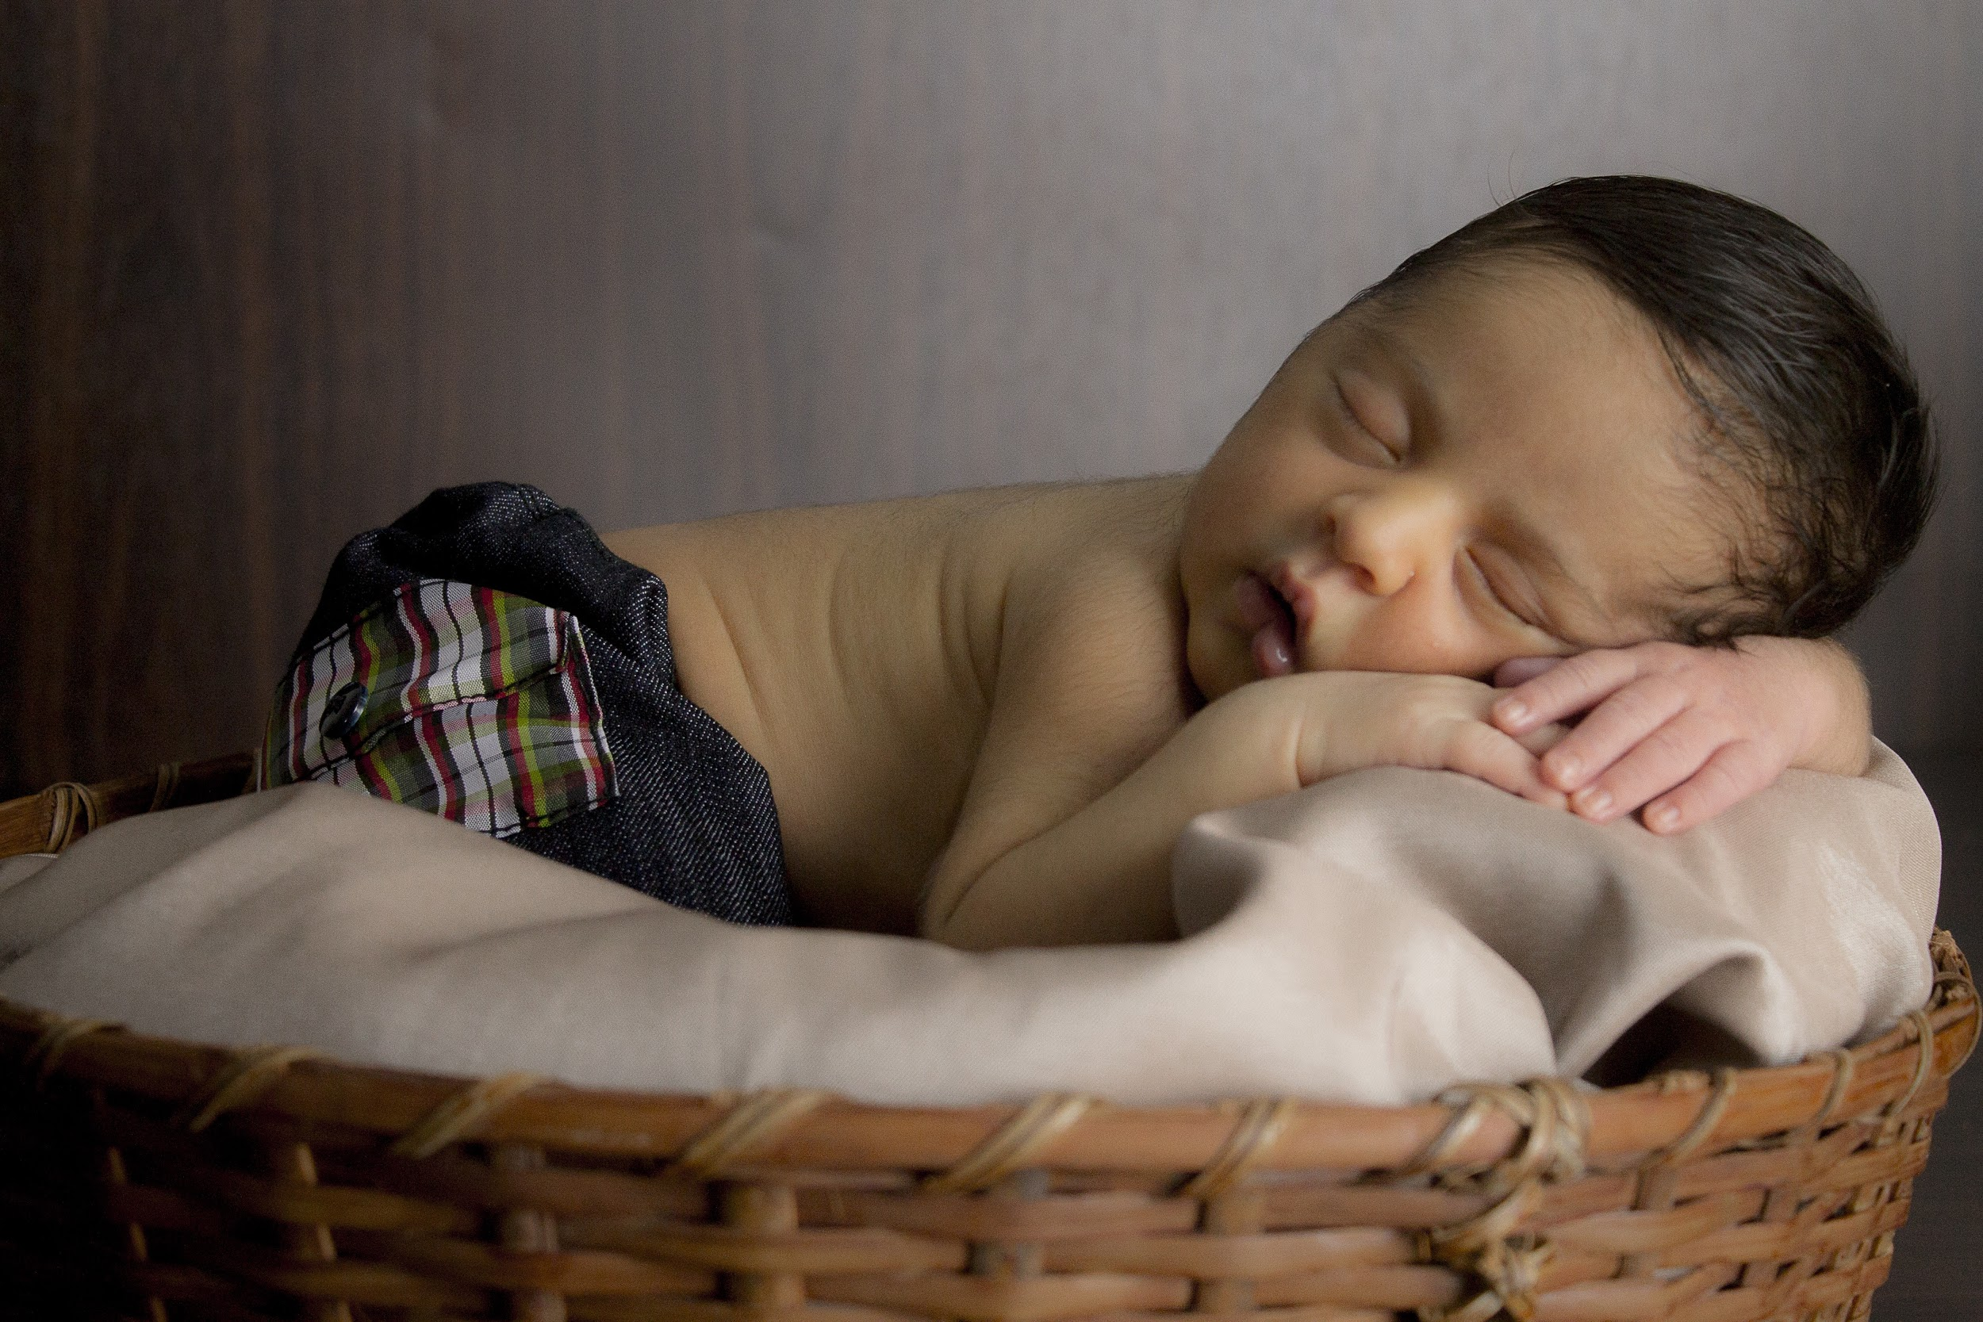
Record the hours you sleep,and tell why you need rest.
I sleep ________hours every night.

Slide 6


Explain why you need fresh air and sunlight.

Slide 7

Explain why water is important for your body.
List the number of glasses of water you should drink each day.

Slide 8
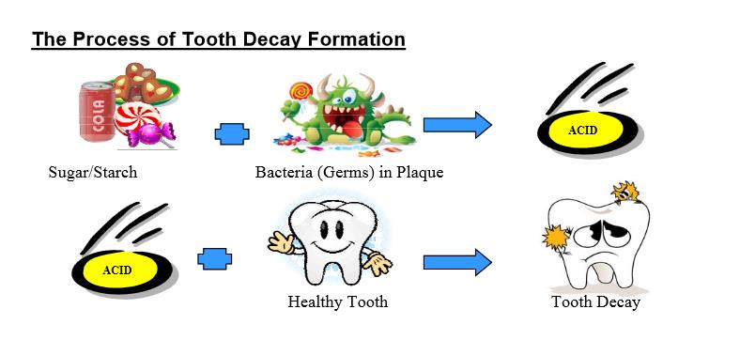
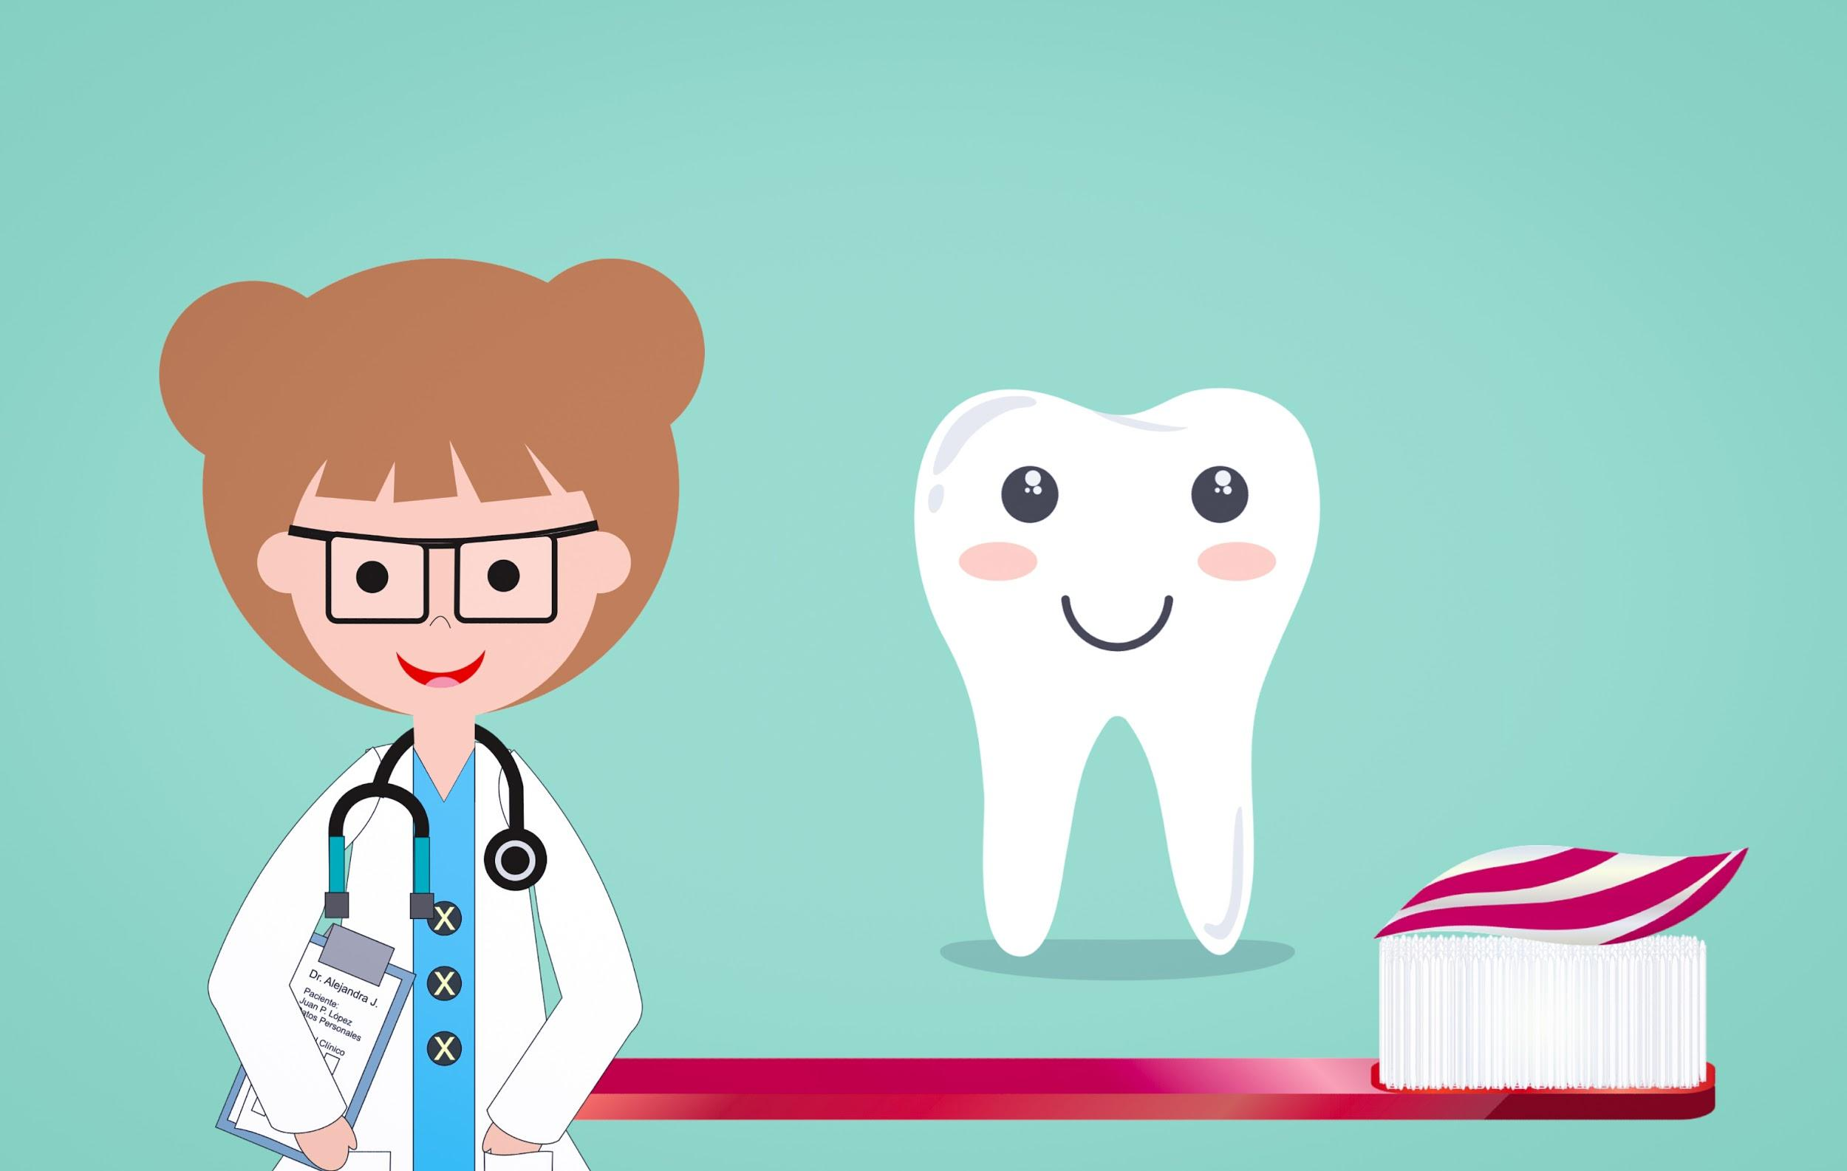
Describe and illustrate good dental hygiene.

Slide 9
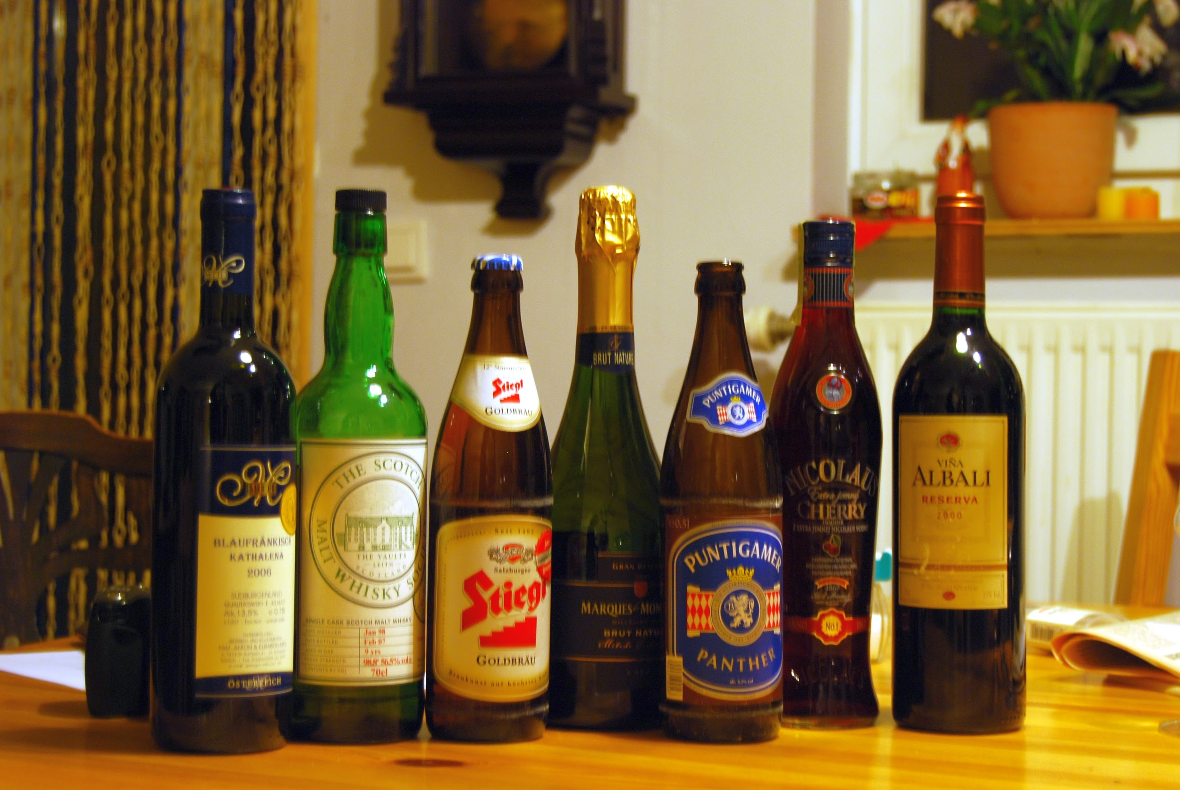
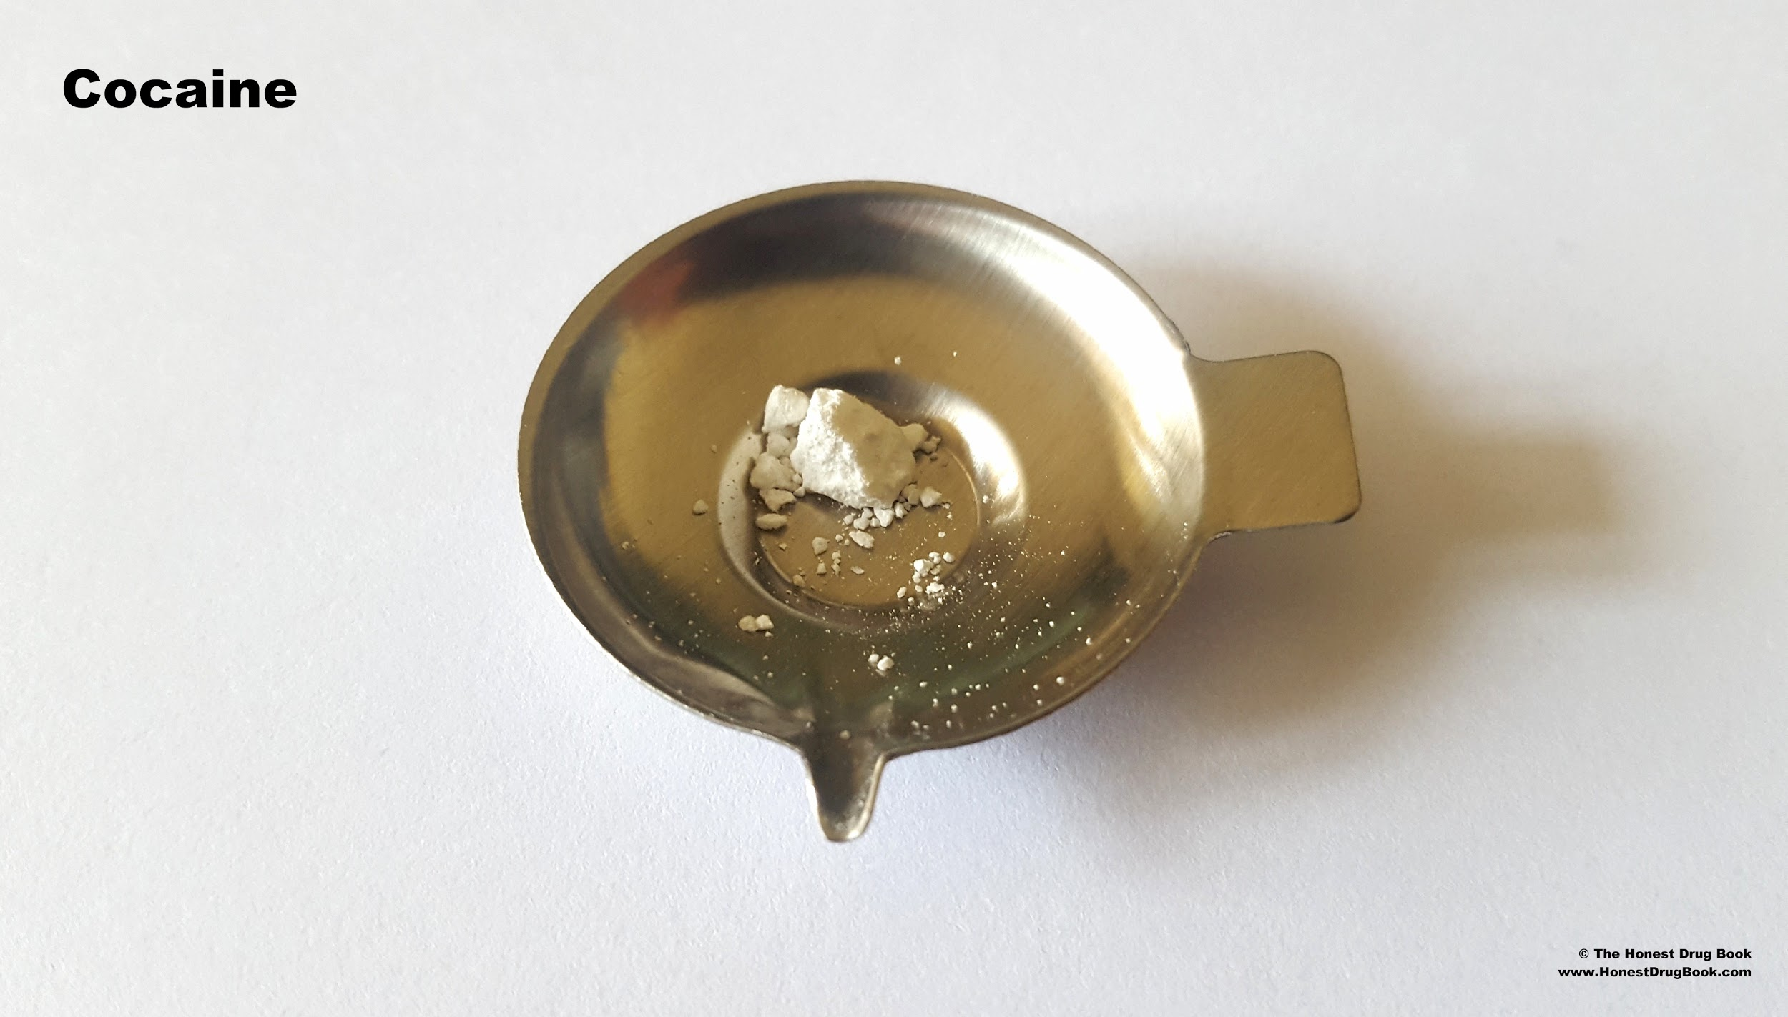

Name three things that may harm your health.

Slide 10
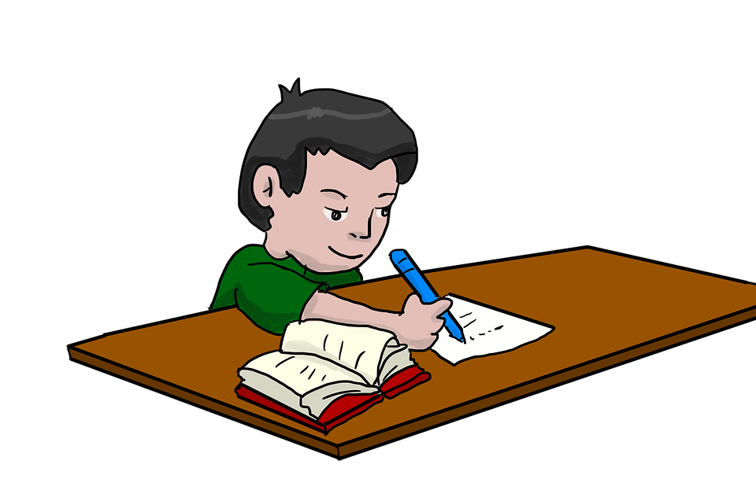
HOMEWORK
Participate in a recognized fitness test
President’s challenge
An equivalent program

