Slide 1
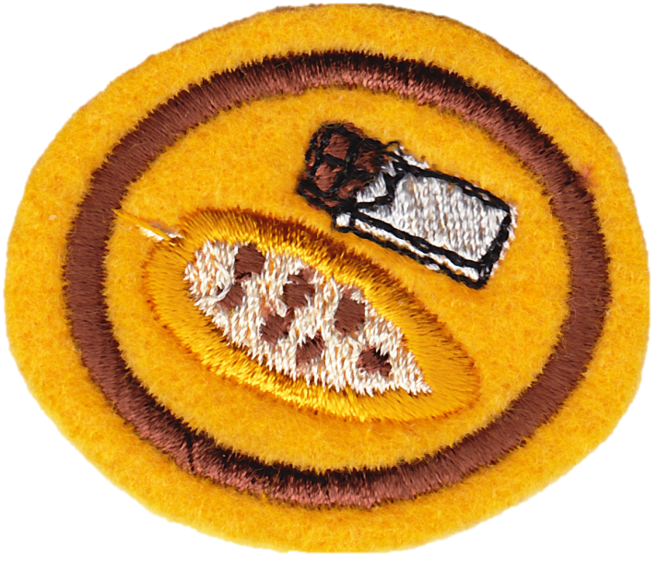
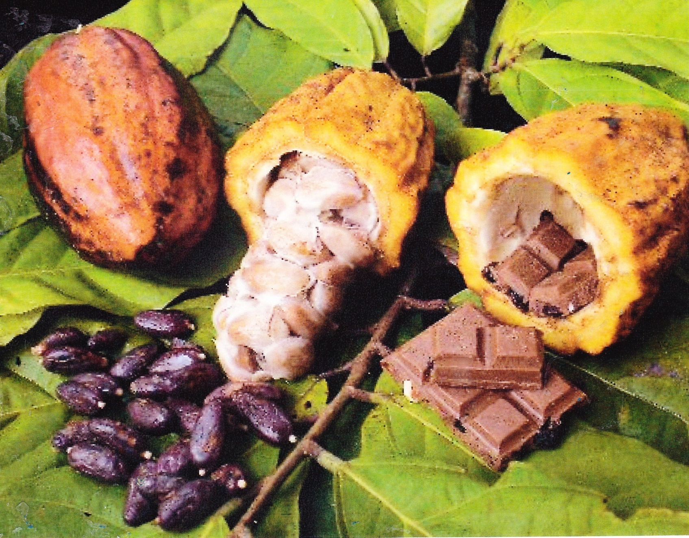
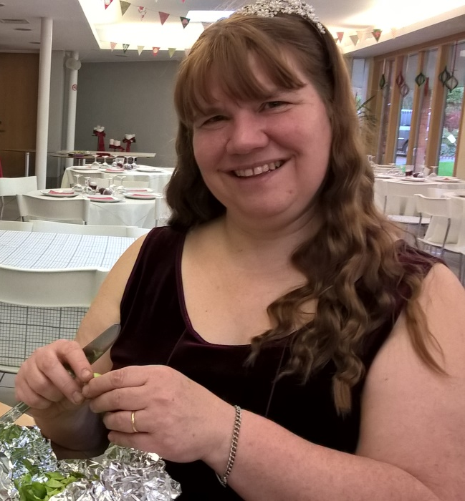
The Chocolate Honour Online
By Heather Hanna
Notes:
Introduction –
To me – wife, mother, was a nurse, now a teacher at Imperial College teaching doctors
What the honour is about… chocolate – something I am passionate about
… and why it is important – knowing where your food comes from, looking after your body and being healthy, appreciating God’s gifts to us

Slide 2
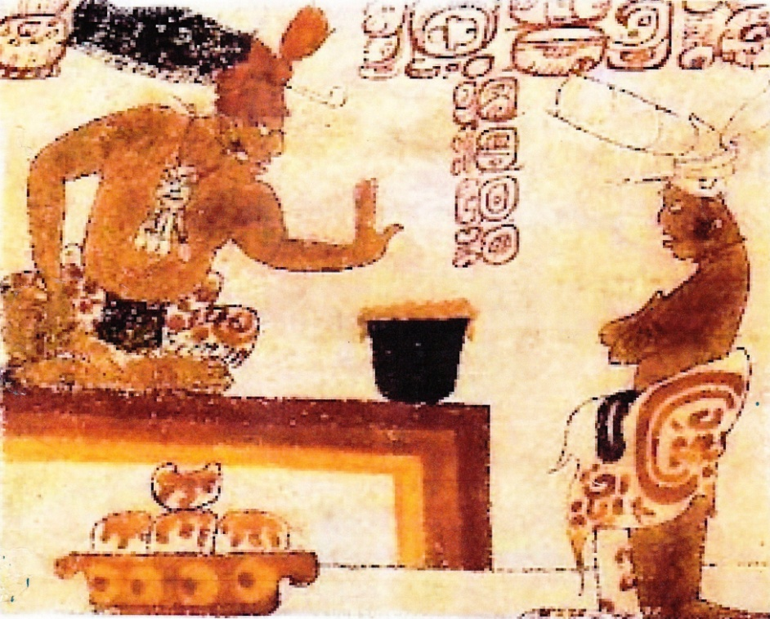
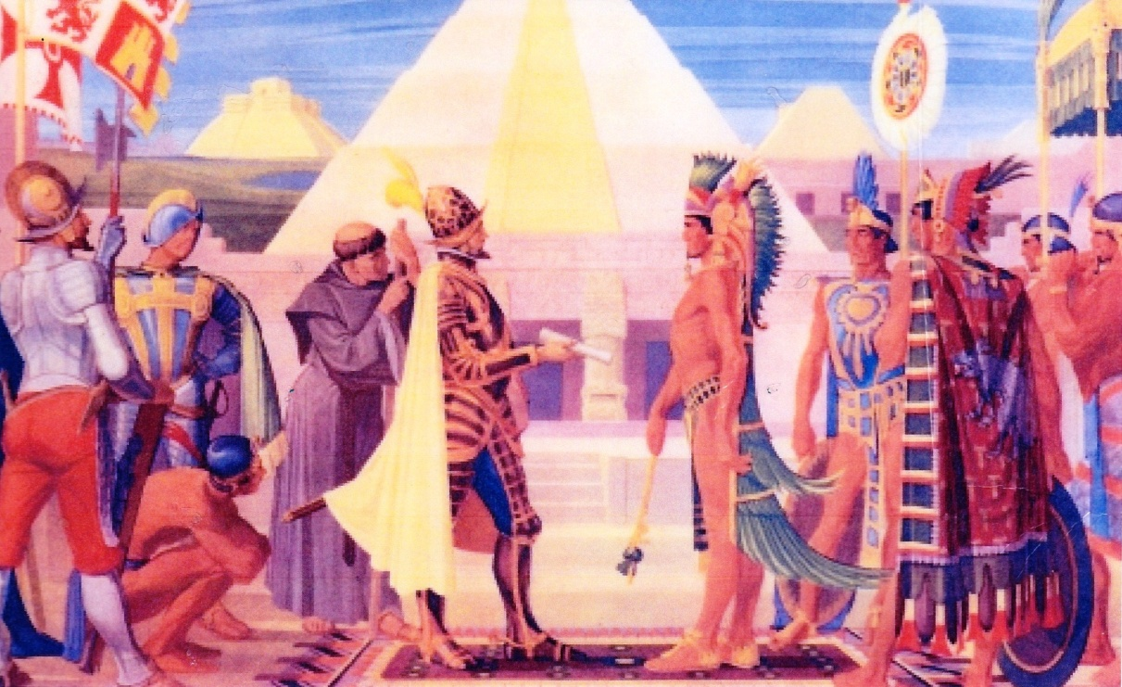
A Brief History of Chocolate
Notes:
It was the Maya who provided tangible evidence of cacao as a domesticated crop. Archaeological evidence in Costa Rica indicates that cacao was drunk by Maya traders as early as 400 BC. The Aztec culture, dominant in Mesoamerica from the fourteenth century to the Conquest, placed much emphasis on the sanctity of cacao.
The first outsider to drink chocolate was Christopher Columbus, who reached Nicaragua in 1502 searching for a sea route to the spices of the East. But it was Hernan Cortés, leader of an expedition in 1519 to the Aztec empire, who returned to Spain in 1528 bearing the Aztec recipe for xocoatl (chocolate drink) with him. The drink was initially received unenthusiastically and it was not until sugar was added that it became a popular drink in the Spanish courts.
https://www.icco.org/about-cocoa/growing-cocoa.html

Slide 3
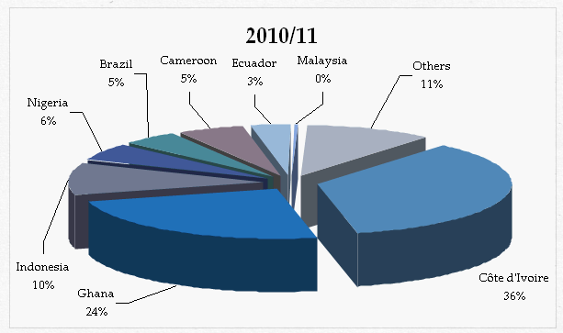
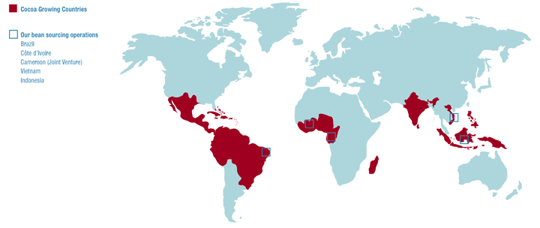
Where Does Our Chocolate Come From?
Map Image Source: http://www.cargillfoods.com/emea/en/products/cocoa-chocolate/origins/index.jsp
Pie Chart Image Source: UNCTAD based on the data from International Cocoa Organization, quarterly bulletin of cocoa statistics.
Notes:
Cocoa is produced in countries in a belt between 10ºN and 10ºS of the Equator, where the climate is appropriate for growing cocoa trees. The largest producing countries are Côte d'Ivoire, Ghana and Indonesia.
Cocoa plants respond well to relatively high temperatures, with a maximum annual average of 30 - 32ºC and a minimum average of 18 - 21ºC.
Rainfall should be plentiful and well distributed through the year. A hot and humid atmosphere is essential for the optimum development of cocoa trees. In cocoa producing countries, relative humidity is generally high: often as much as 100% during the day, falling to 70-80% during the night. The cocoa tree will make optimum use of any light available and traditionally has been grown under shade. Its natural environment is the Amazonian forest which provides natural shade trees. Shading is indispensable in a cocoa tree's early years.
https://www.icco.org/about-cocoa/growing-cocoa.html

Slide 4
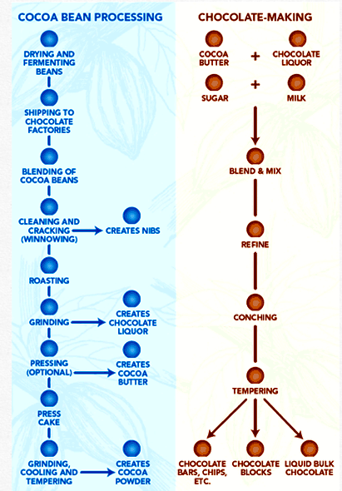
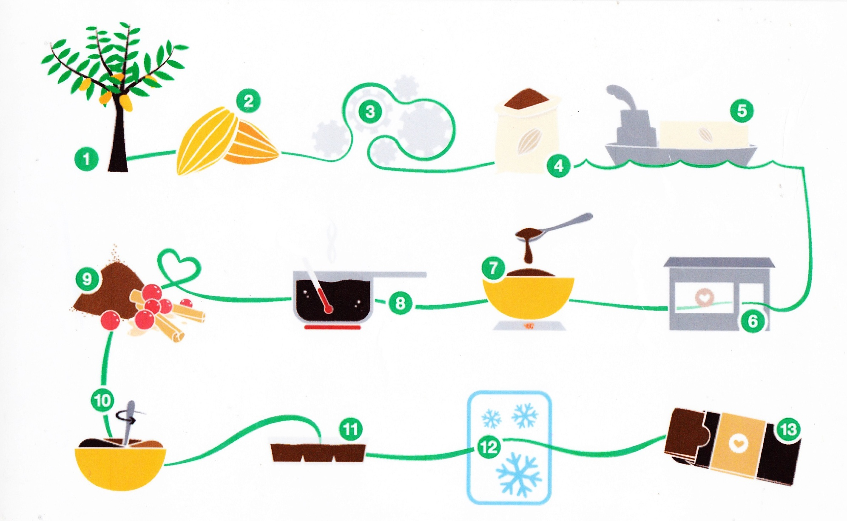
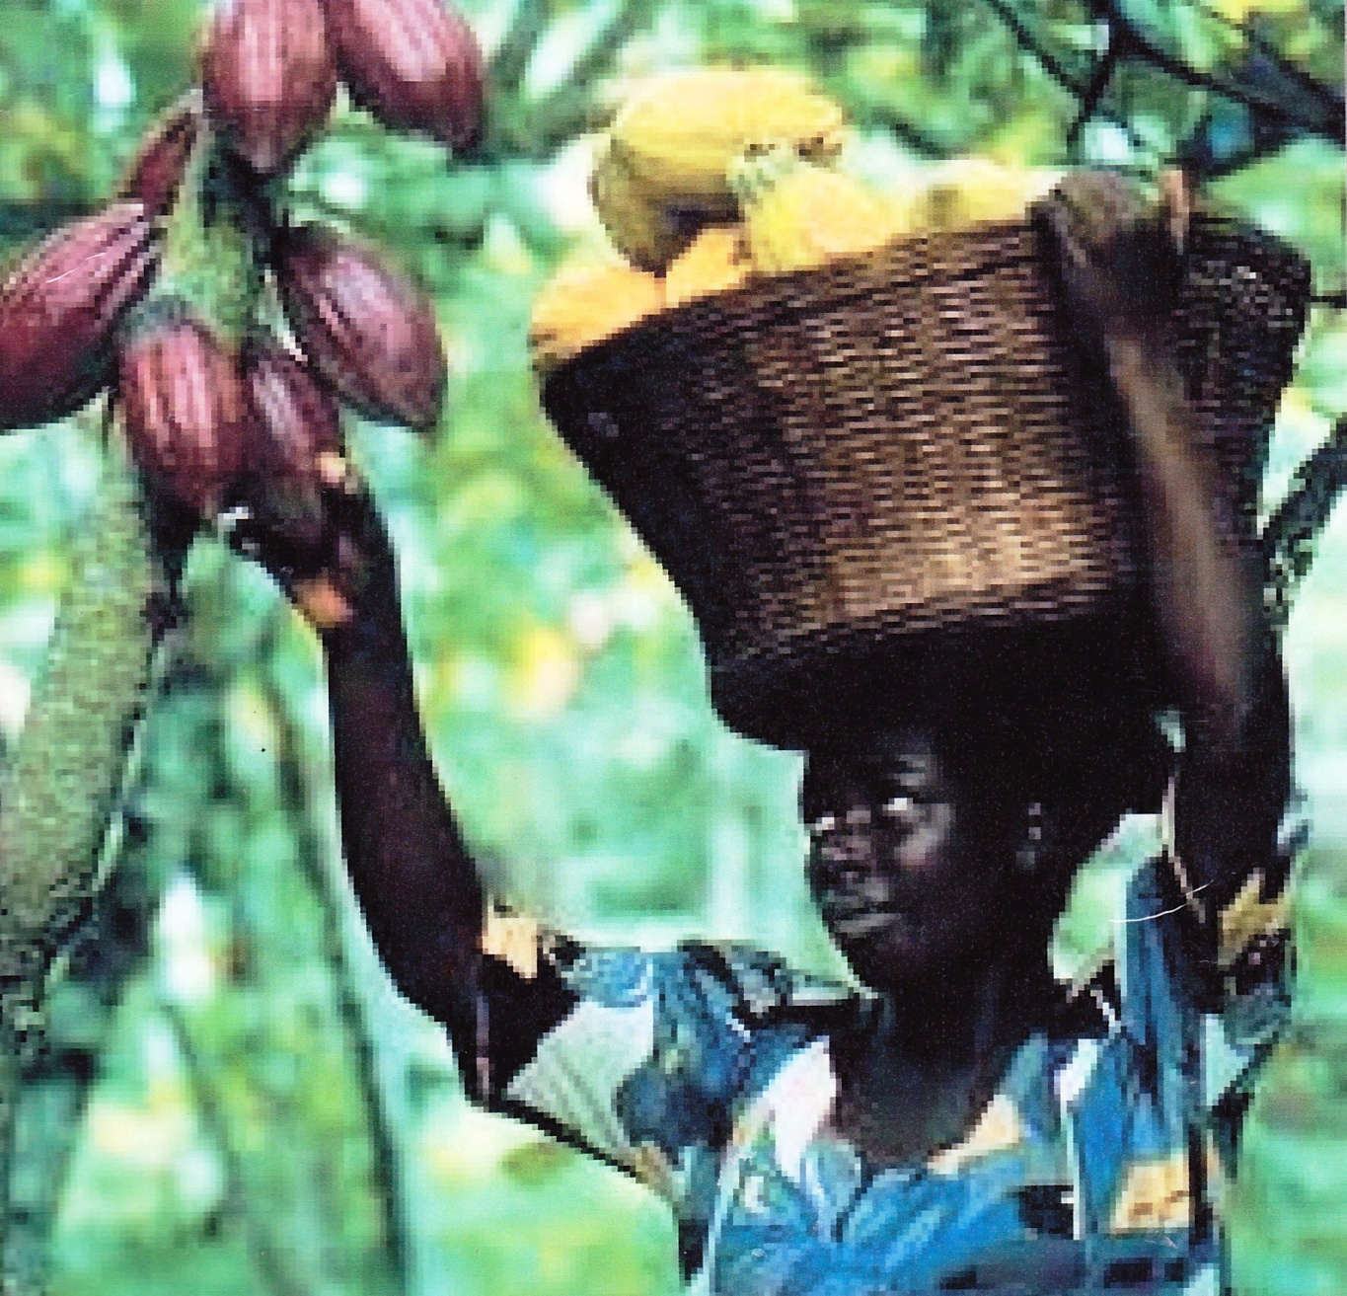
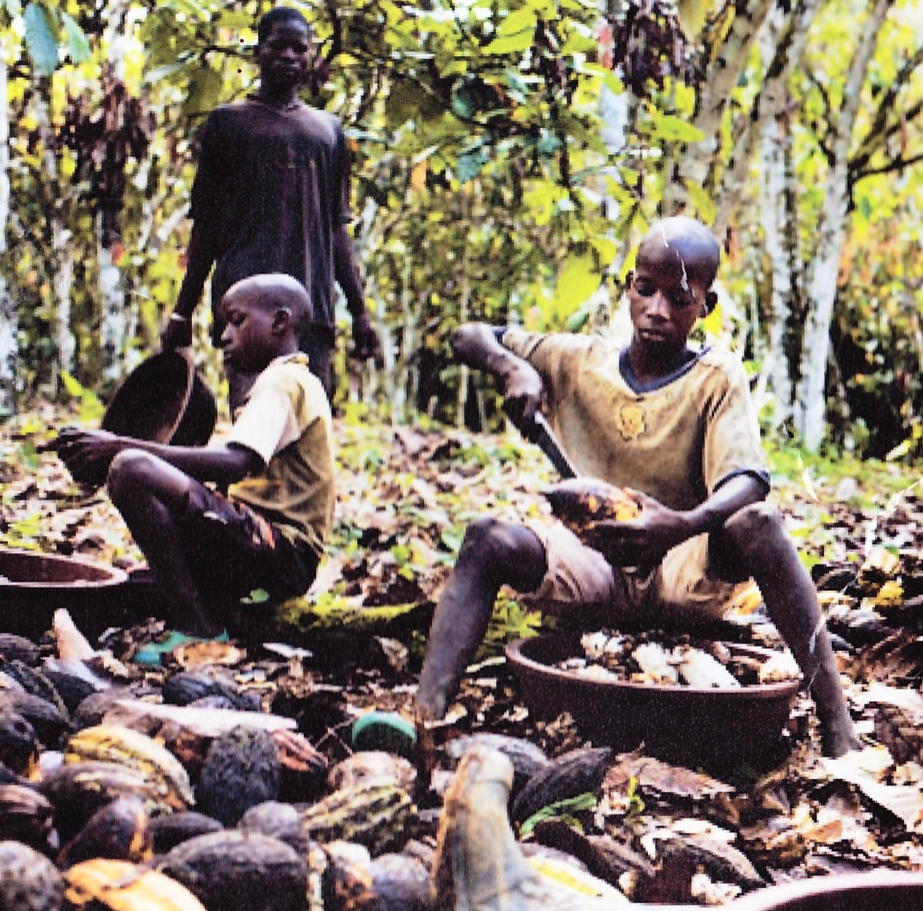
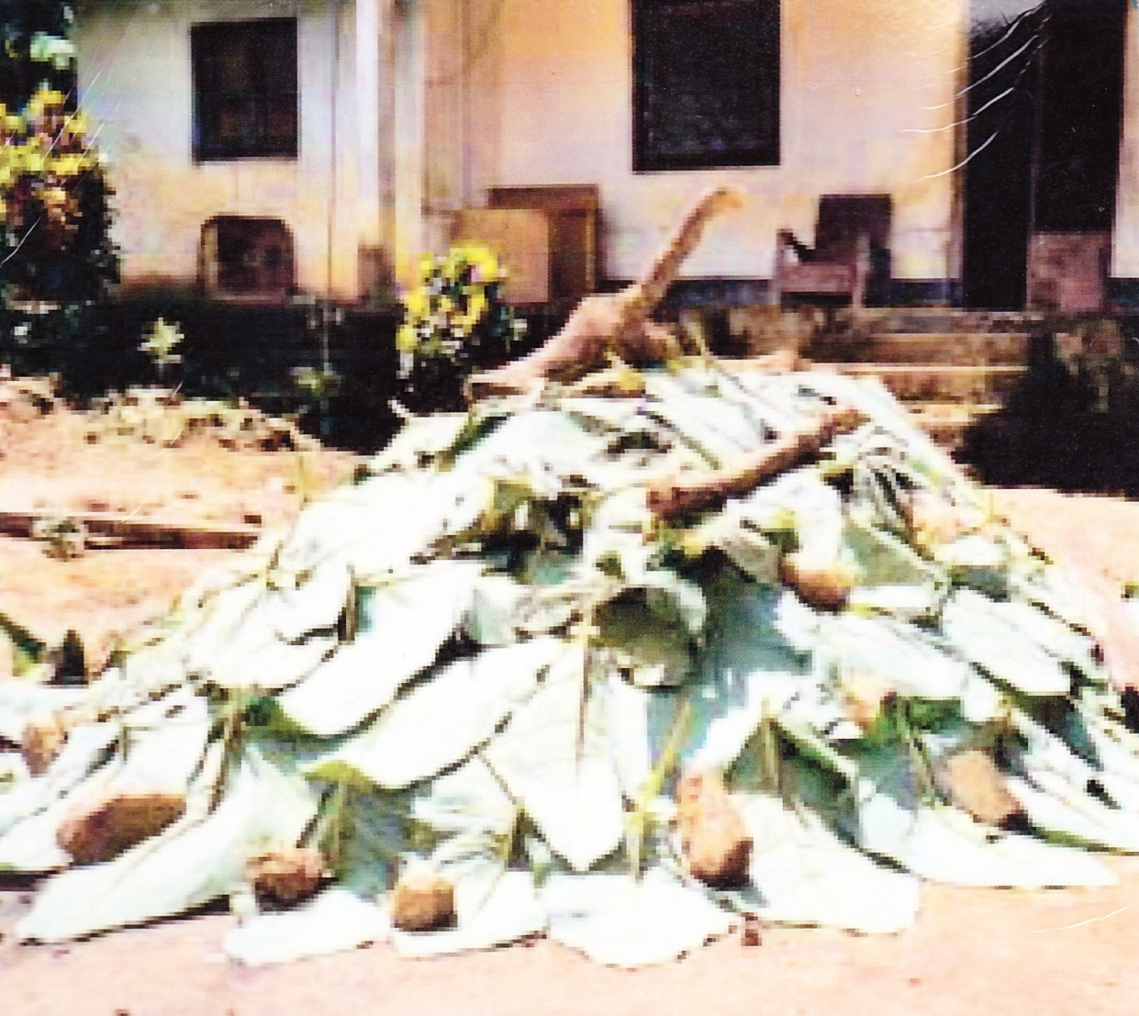
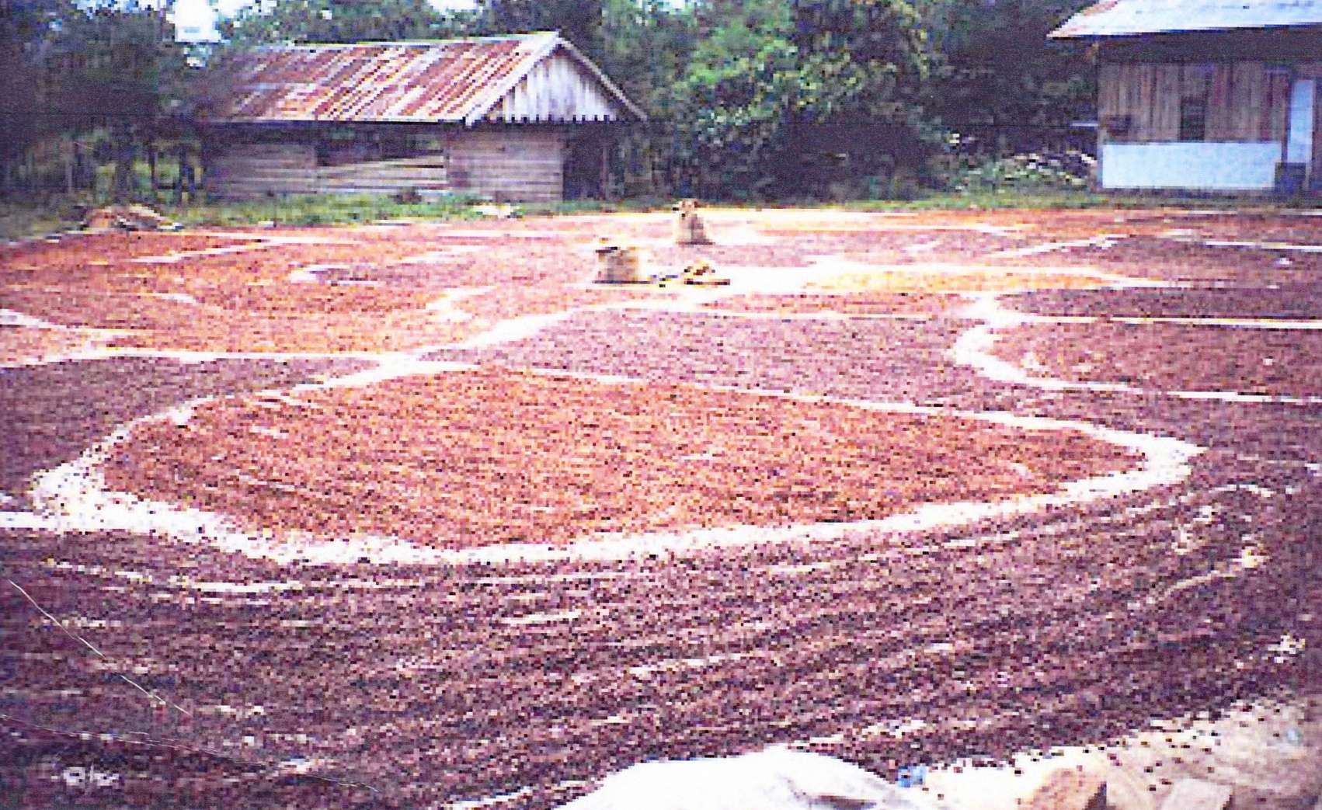
Describe the process by which cocoa beans are turned in to chocolate
Notes:
Harvesting Cocoa Beans
Harvesting of the pods in cocoa beans is very labour intensive. During peak season, ripe pods are gathered every few weeks. Workers use large knifes attached to poles to cut down the high pods. Other workers collect the pods in baskets and carry the basket on their heads to be piled up and ready for splitting.
These pods are split open by hand and the seeds/beans (that are covered in sweet white pulp) are removed so they are able to undergo the two part curing process, called fermentation. Methods of fermentation very between countries, however, there are two main methods – Heap and Box.
The Heap method is usually used on farms in West Africa. In this method wet cocoa beans, surrounded by pulp, are piled on banana or plantain leaves. These leaves are spread in a circle on the floor. More leaves are then placed on top of the heap and it is left for 5-6 days. The pods are turned to ensure even fermentation.
During fermentation the pulp of the beans is removed as the sugar in the pulp begins to turn to alcohol and other vinegary liquids, which drain away and the true chocolate flavour starts to develop. At the completion of the fermentation process the wet mass of beans is dried, traditionally by being spread on mats in the sun.
In places such as the West Indies, Latin America and Malaysia the Box method is used in plantations. Box fermentation involves using strong wooden boxes with small drainage holes/gaps in the base (to allow an air passage and the removal of liquid products). This process takes 6-8 days and in this time the beans are mixed twice. The fermented beans are then dried using special drying equipment rather then the sun.
The cured beans are then packed into sacks and transported all over the world.

Slide 5
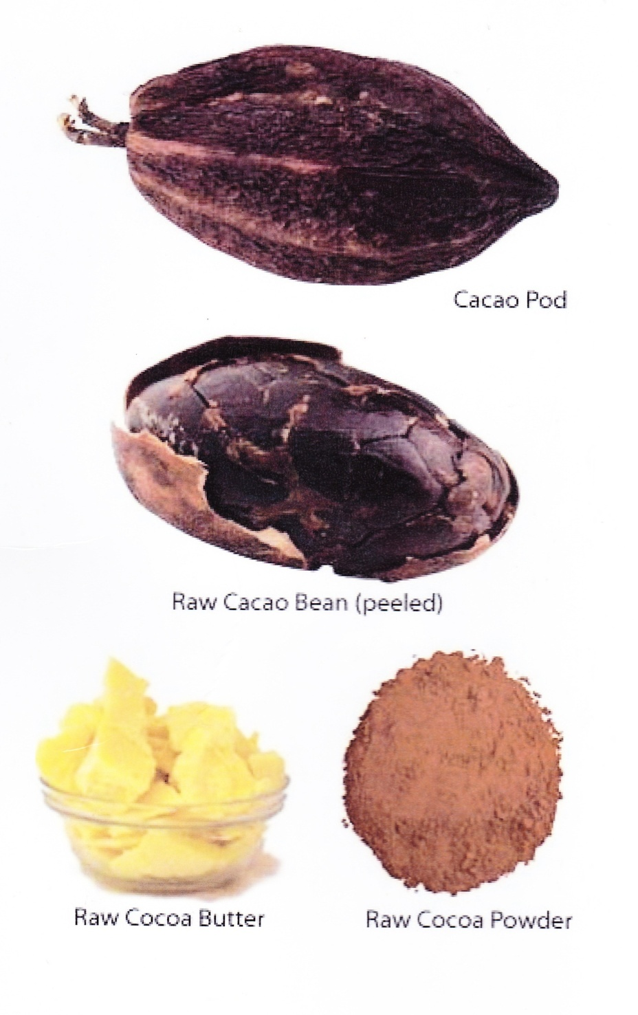
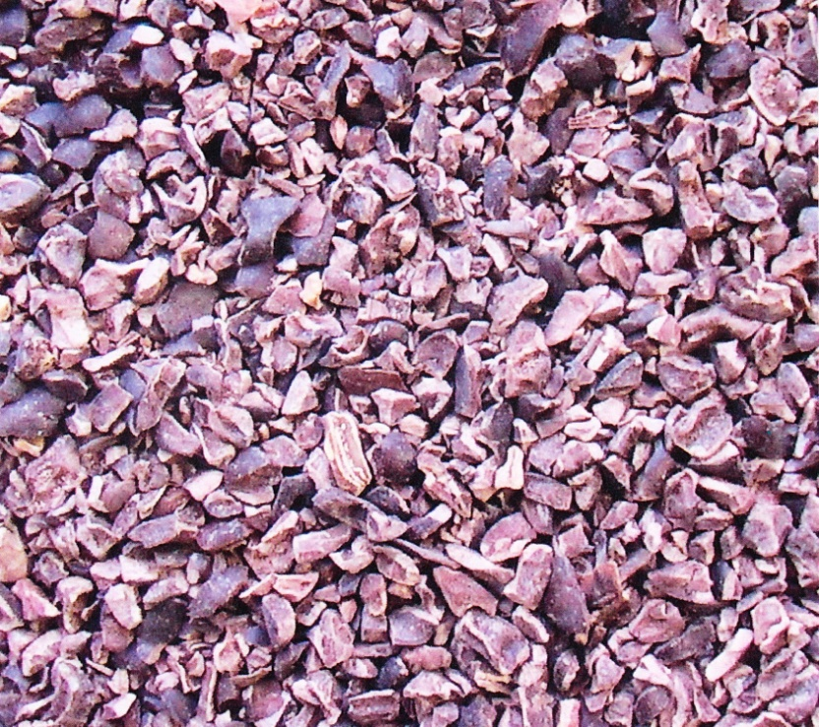
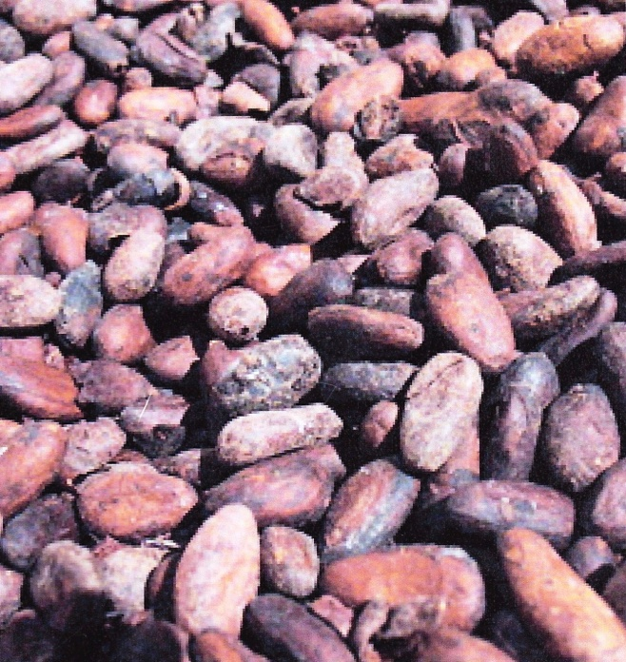
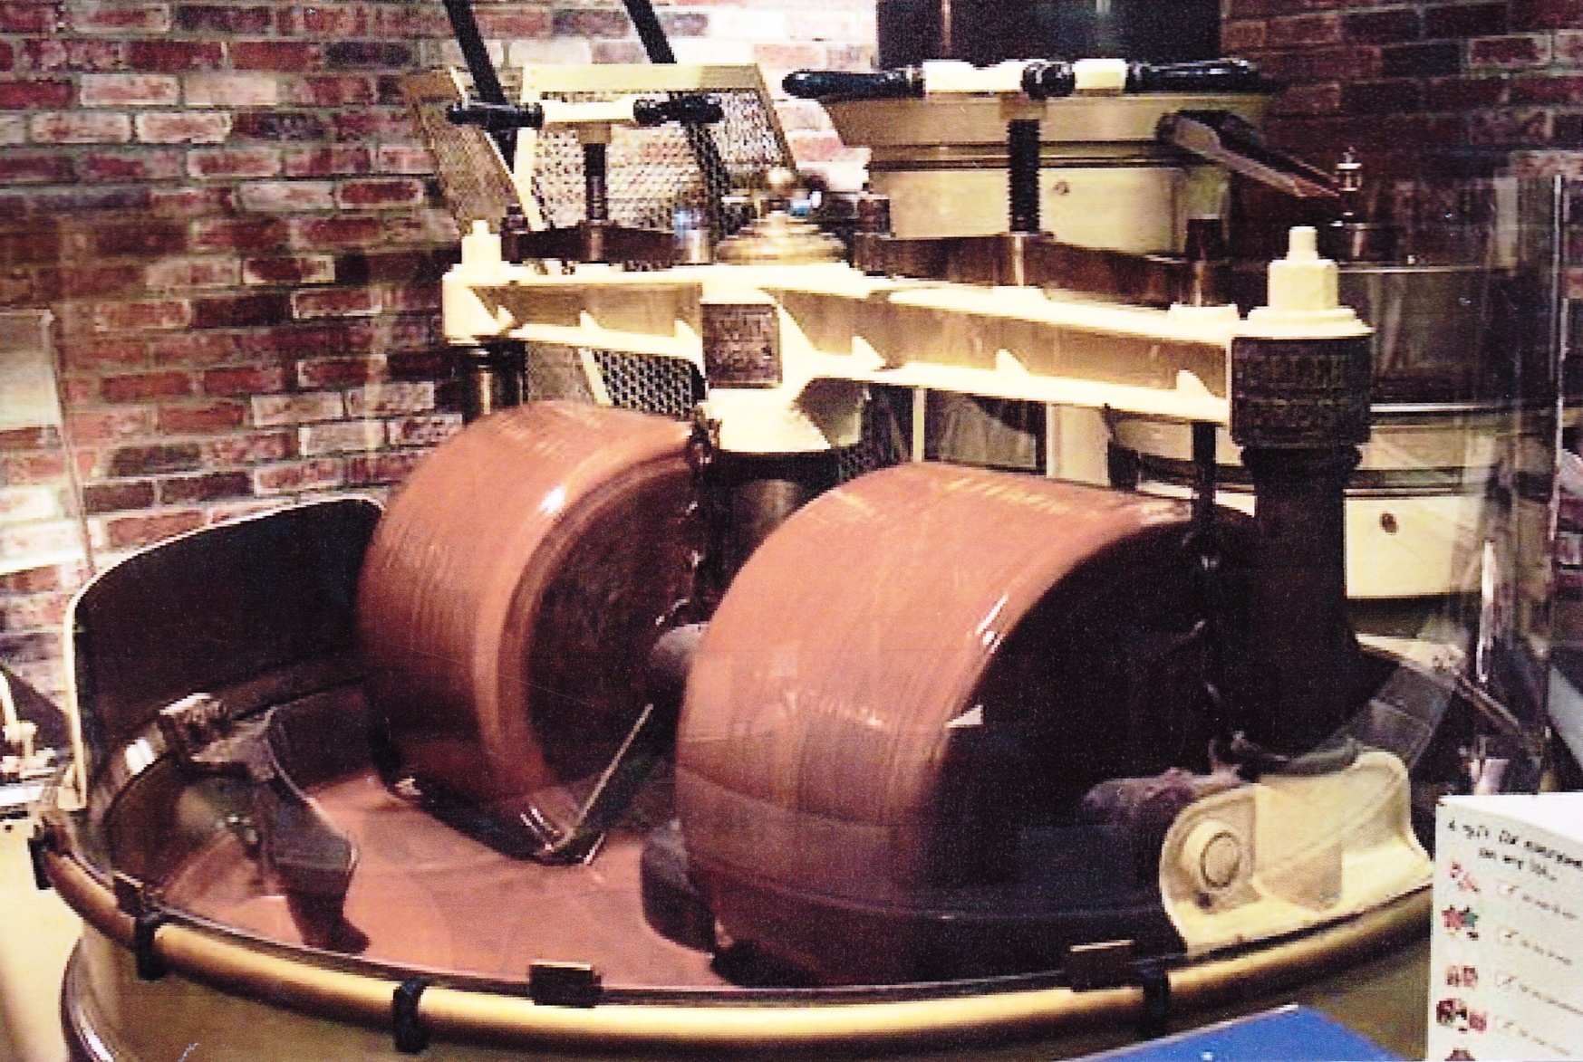
Describe the process by which cocoa beans are turned in to chocolate
Notes:
As well as the fermentation and harvesting process, cocoa beans must also go through the process of drying and bagging; where the mass of cocoa beans is dried, winnowing; where the beans are cracked and the shell is separated from the nib, roasting; where the nibs are roasted in special ovens at between 105-120 degrees Celsius, grinding; where the cocoa nibs are ground in stone mills so that the nibs become a thick liquid called cocoa mass and the final stage is the pressing stage; where the cocoa mass is pressed using large machines into cocoa butter, which is vital for making chocolate.

Slide 6
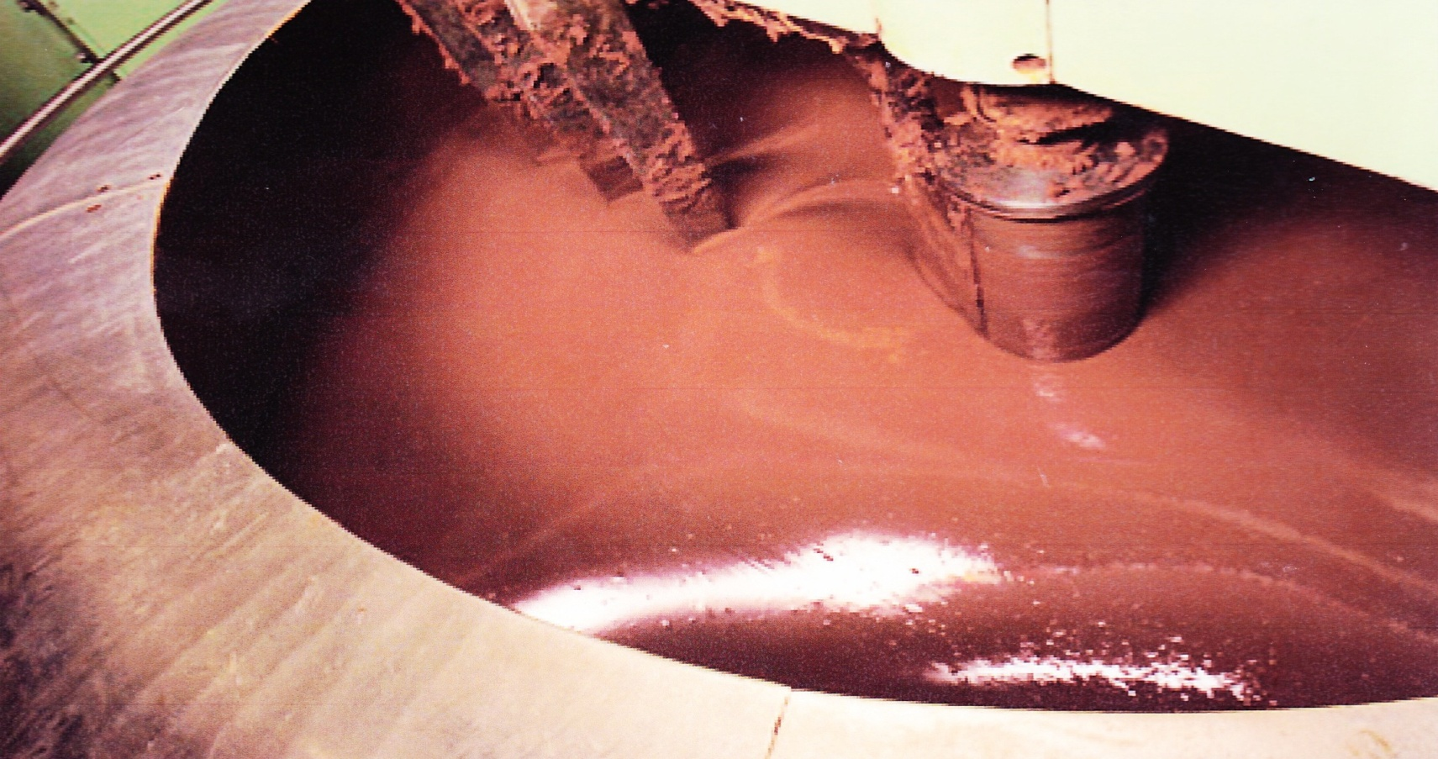
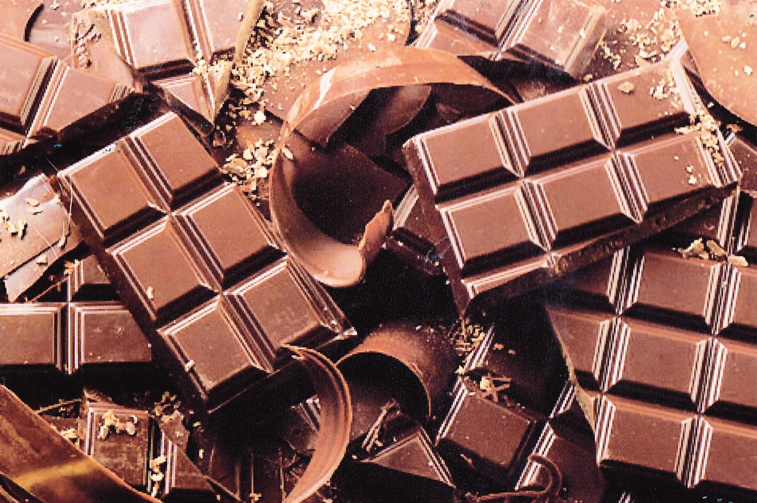
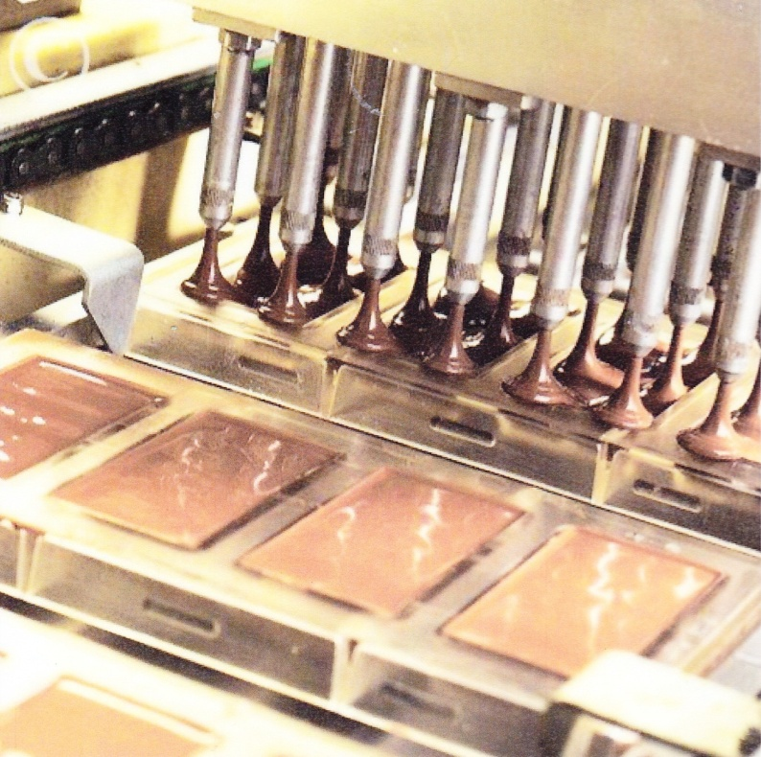
Describe the process by which cocoa beans are turned in to chocolate
Notes:
The supply chain for cocoa beans is a series of activities that are necessary to convert raw materials into the final product (chocolate) that is meant for consumers.
Just like many other manufacturing industries, creating chocolate products involves a chain of production that has many links. The supply chain is split into two main parts: the producing countries and the consuming countries.
The beans start in producing countries where there are the small farmers; who grow the cocoa beans. The local traders then trade cocoa beans amongst other local traders and finally the exporters distribute the cocoa beans.
The cocoa beans then enter the international market where there are international traders who trade the cocoa beans among other international traders. This is called integration trading/processing.
Cocoa beans finally make their way to consuming countries where there are cocoa processors and coverture manufacturers. Chocolate manufacturers such as Cadbury and Nestle then manufacture the cocoa beans into chocolate. Retailers such as supermarkets then sell the many different types of chocolate to us, the consumers, who buy and eat the chocolate.
These supply chains are very complex and there would be additional services that help producers including banking and insurance services, packaging firms and transport specialists produce the chocolate.
Cocoa Bean Imports & Exports
The use of imports and exports among countries contributes largely to the growth of the economy. Importing and exporting products allows for the creation of jobs and it connects countries through the concept of trade. Places and countries are interconnected through cocoa production and demand as it creates networks of trade and economic interdependence. Networks are created due to the trade of cocoa beans between importing and exporting regions. There is a large interdependence between cocoa producing countries and cocoa manufacturing countries.
There are between 5 and 6 million cocoa farmers worldwide and over 40-50 million people depend on cocoa for their livelihood. While cocoa production creates jobs for people working on the cocoa farms in developing countries, other jobs are created from importing and exporting cocoa beans in both importing and exporting countries. These jobs include: labourers, administrators, truck and car drivers, shipping companies, dock and railway workers, chocolate producing companies, chocolate shop owners and confectionary company employees as well as retailers and buyers.
The flow chart above shows the manufacturing process of chocolate. The blue flow chart shows the procedure used for cocoa bean processing, while the brown flow chart shows the procedure used when making chocolate.
Source: http://www.thenibble.com/reviews/main/chocolate/from-pod2.asp

Slide 7
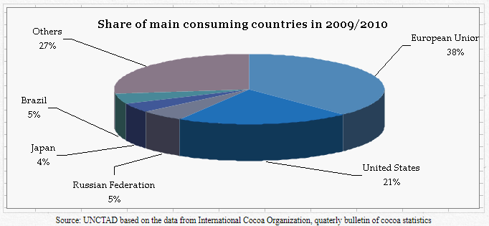
Chocolate Consumers

Slide 8
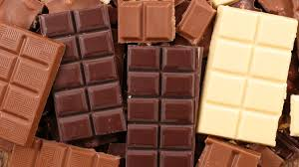
What’s In That?
Milk chocolate
Sweet chocolate
Bitter chocolate
White chocolate
Carob
Notes:
Discuss the differences between milk chocolate, sweet chocolate, bitter chocolate, white chocolate and carob.

Slide 9
What’s In That?
Chocolate liquor
Milk chocolate
Milk solids
Sweet chocolate
made from the fruit of the carob plant instead of the cacao tree
Bitter chocolate
Sugar
Cocoa butter
White chocolate
Hardened
chocolate liquor
Carob
Vanilla
Notes:
Discuss the differences between milk chocolate, sweet chocolate, bitter chocolate, white chocolate and carob.

Slide 10
What’s In That?
Chocolate liquor
Milk chocolate
Milk solids
Sweet chocolate
made from the fruit of the carob plant instead of the cacao tree
Bitter chocolate
Sugar
Cocoa butter
White chocolate
Hardened
chocolate liquor
Carob
Vanilla
Notes:
Discuss the differences between milk chocolate, sweet chocolate, bitter chocolate, white chocolate and carob.

Slide 11
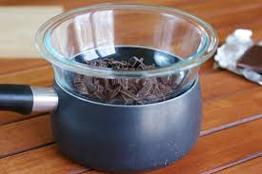
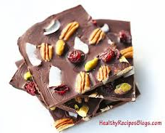
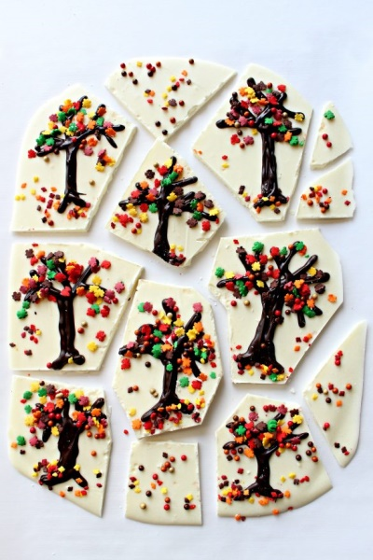
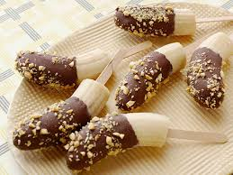
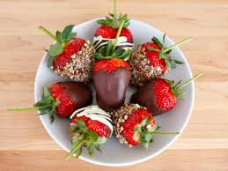
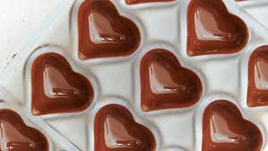
Melting Chocolate
Demonstrate the correct way of melting chocolate
Make:
  Chocolate egg
  Box of chocolate
  Chocolate covered strawberries
  Chocolate frozen banana
  Chocolate Bark

Slide 12
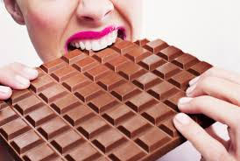
State the proper storage for chocolate

Slide 13
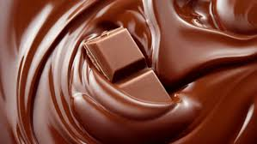
Discuss the properties of chocolate
Discuss the properties of chocolate at:
  cold temperatures
  warm temperatures
  hot temperatures
  very hot temperatures

Slide 14
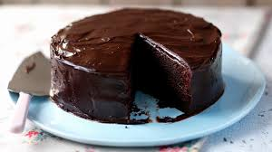
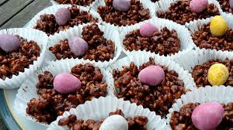
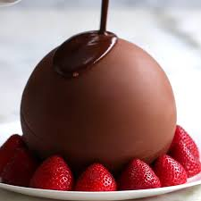
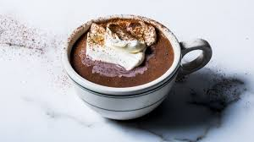
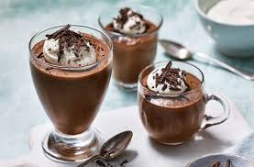
List 10 uses of chocolate in recipes
Here are some:

Slide 15
List six health benefits of chocolate
VITAMINS
FLAVONOIDS
MOOD ELEVATOR
TANNINS
ANTI-OXIDENTS
PREVENTS DENTAL CARIES
Notes:
In the past, chocolate has been appreciated as a high-calorie food to boost energy, for example for athletes and soldiers. Recently, more and more research has been conducted on the health and nutritional attributes of cocoa and chocolate. Research findings indicate that some components in cocoa help prevent cardiovascular disease and reduce the risk of cancer. These positive findings seem, however, often to be overshadowed using chocolate as the scapegoat as a cause of obesity. Certain people readily classify chocolate as "junk food", because of its high calorie content.
The inventory elaborates on the evidence of the cardiovascular benefits of cocoa. These benefits are not only due to the fats in cocoa (cocoa butter), but, even more importantly, to the fact that cocoa beans contain a large number of phytochemicals. These are physiologically active compounds found in plants, for example grapes, apples, tea, vegetables, etc. One group of these compounds is called flavonoids. There is a growing body of evidence about the health benefits of cocoa flavonoids.
Flavonoids are powerful antioxidants and are believed to help the body’s cells resist damage by free radicals, which are formed by numerous processes including when the body’s cells utilize oxygen for energy. Laboratory and human studies have indicated that cocoa flavonoids can inhibit the oxidation of the low-density lipoprotein (LDL-cholesterol) associated with heart disease. There is also emerging evidence which suggests that cocoa and chocolate may be able to contribute to reducing the risk of certain types of cancer. This beneficial property originates from some of the other phytochemicals in cocoa.
https://www.icco.org/about-cocoa/health-and-nutrition.html

Slide 16
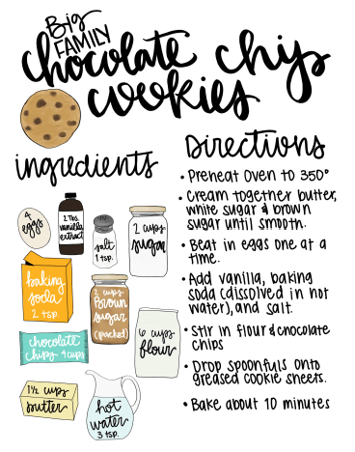
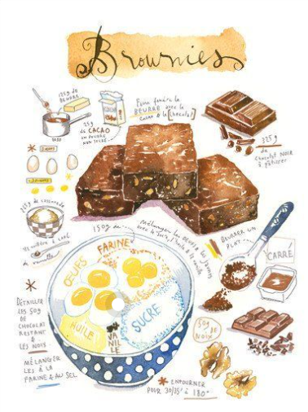
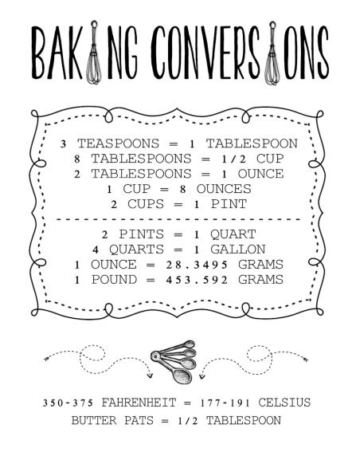
Make Chocolate chip
Cookies or Brownies
https://4570book.info/amazing-cliparts/chocolate-chip-cookie-recipe-clipart.htm
thetaylor-house.com
lucileskitchen.com

Slide 17
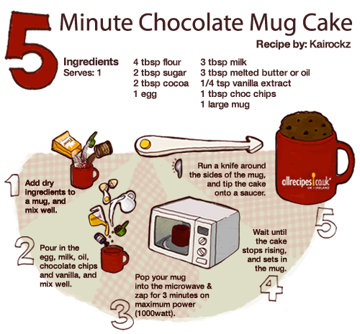
Make Chocolate Mug Cake
<a href="http://allrecipes.co.uk/recipe/7622/5-minute-chocolate-mug-cake.aspx?mugcake"><img src="http://ukcdn.ar-cdn.com/special/infographic/allrecipes_chocolate-mug-cake_500.gif" width="500" height="465" border="0" alt="5 Minute Chocolate Mug Cake - from Allrecipes UK | Ireland" /></a>
Notes:
<a href="http://allrecipes.co.uk/recipe/7622/5-minute-chocolate-mug-cake.aspx?mugcake"><img src="http://ukcdn.ar-cdn.com/special/infographic/allrecipes_chocolate-mug-cake_500.gif" width="500" height="465" border="0" alt="5 Minute Chocolate Mug Cake - from Allrecipes UK | Ireland" /></a>

Slide 18
The Ethics of Chocolate Production
Research the ethics of chocolate production and distribution.
Present your findings and the way Christians should behave in relation to them, using the method of your choice (oral presentation to a group, PowerPoint, essay, article, skit, poem, poster or other suitable method which you send it to this address:
hjshanna@msn.com
and put a copy in your portfolio!
Notes:
Ethics –
Ethical Behaviour –
From the fourth World Cocoa Conference, held in Berlin in April of 2018:
Too many cocoa farmers are still living in poverty. Deforestation, child labour, gender inequality, human rights violations and many other challenges are a daily reality in many cocoa regions. The cocoa sector will not be sustainable if farmers are not able to earn a living income. A sustainable cocoa sector is a collective responsibility of all stakeholders, and we should work together to achieve this ambitious goal. Areas should be identified for increased non-competitive collaboration, at local, national and global level, avoiding a proliferation of efforts that lack coordination.
https://www.icco.org/about-us/icco-news/387-berlin-declaration-of-the-fourth-world-cocoa-conference.html
How to improve?
Mapping cropping systems and farming practices
Improved planting material for superior flavour and yields
Controlling Pests and diseases
Assessing soil fertility and improving fertilization
Market outlook and market structure- Competition, structure and pricing in the cocoa and chocolate sector
Better incomes and livelihoods for farmers
Child labour: upscaling on successful experiences
Raising women’s voice and attracting the young generation
Adapting to climate change and benefiting from environmental schemes
Roles of Certification and Standards
https://www.icco.org/about-us/icco-news/318-1-300-participants-address-sector-issues-at-the-third-world-cocoa-conference.html
Cocoa Bean Effects & Impact
Environmental Effects:
In recent years the demand for chocolate has dramatically increased. The cocoa farmers are struggling to match the increasing demand for
chocolate and therefore have turned to less environmentally friendly practices to meet these demands.
Some farmers have moved their crops into direct sunlight and out of the shade. In turn, the cocoa trees with no shade tend to accumulate more weeds as well as some diseases. When the crops begin to accumulate weeds and pests, farmers use large amounts of herbicides to get rid of these pests. However, these herbicides are causing damage to the land and health of the people spraying the chemical as well as damaging the cocoa beans crops. Cocoa farming is also contributing to deforestation in rainforests around the world.
Slavery and Child Labour:
Not many people may know that there is a secret ingredient in the production of chocolate, an ingredient that has no taste – slavery and child labour. As the demand for cheap cocoa has increased so has the demand for physical labour on the cocoa farms. Today, cocoa farmers barely make a living selling the beans and have often resorted to child labour in order to keep their prices competitive. Children between the ages of 12 and 16 have been recorded working on the farms. Some of these children find themselves on the cocoa farms because they need work and are told the pay is good. Other children are ‘sold’ by relatives to traffickers or farm owners. Unfortunately most of these relatives don’t realise that these children will be exposed to an unsafe working environment such as the use of hazardous equipment and dangerous chemicals, will not have adequate food, water and housing conditions and will be deprived of an education once arriving on the farms. Sadly, the children working on these farms have very little hope of breaking the cycle of poverty.

Slide 19
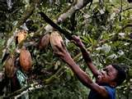
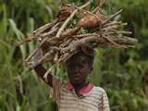
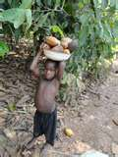
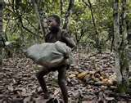
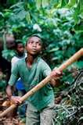
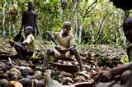
The Cost of Chocolate
Child
Labour

Slide 20
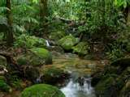
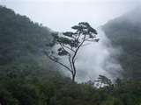
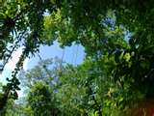
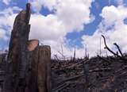
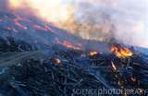



The Cost of Chocolate
Rainforest
Destruction

Slide 21







Judges 14:18
Answer the question…
https://www.etsy.com/listing/83341311/make-your-own-chocolate-chip-cookie-mix
Notes:
The cocoa bean industry is spatially organised – there are regions of the world that produce cocoa and regions of the world that demand cocoa. The countries that produce cocoa have the natural characteristics and usually forced labour to do so. The countries that demand cocoa have the enterprise to manufacture and the income to demand cocoa. For these reasons networks of trade and economic interdependence at many scales have been created. This shows that the demand for a bar of chocolate economically connects
different places around the world.
It is shown that these connections can often lead to mistreatment and exploitation. Consumers should make careful choices when purchasing products if they do not want to contribute to this manipulation. Consumers should select Fair Trade labelled chocolate to support the wellbeing of farmers and children working in the cocoa farms. They should also support the development of ethical trading s0 that farmers and labourers in cocoa producing countries can ensure fair payment and a better lifestyle.

Slide 22




































The Story of the Prodigal Son…
by Andy Back © 2001 Children’s Ministry
Used with permission.
…a chocolate story!

Slide 23


Thank you for Learning with me today!
Photo credit:
Asun Olivan Photography
T-shirt:
https://www.furyshirt.com/

