Slide 1
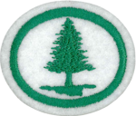
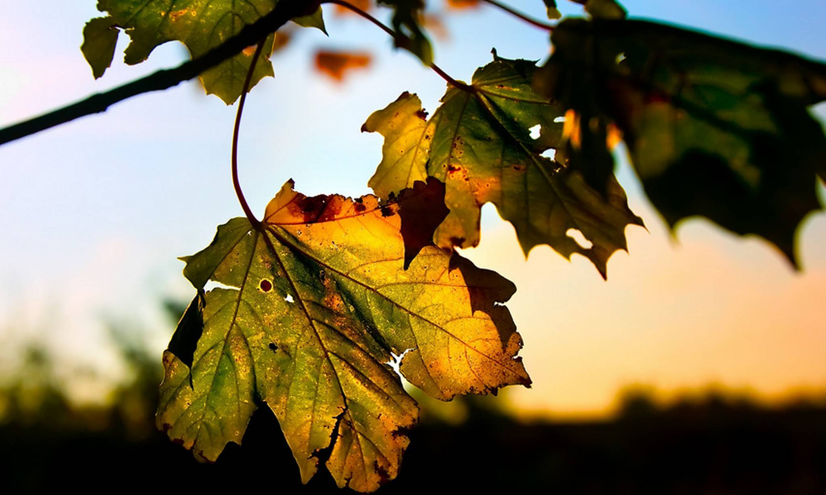
TREE HONOUR
By Peter Bo Bohsen

Slide 2
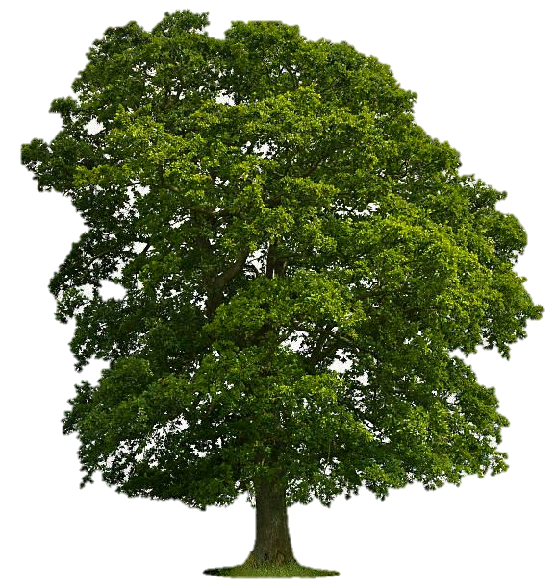
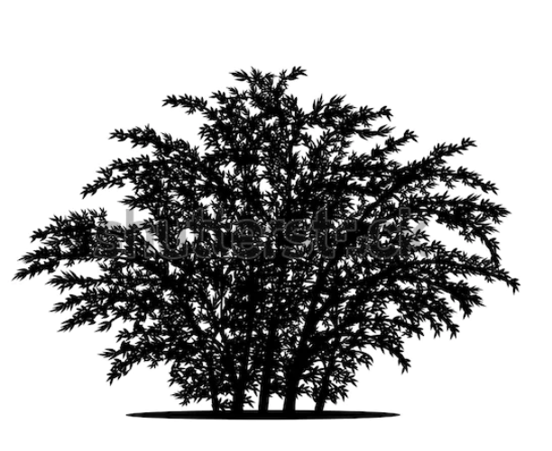
1. Describe the ways in which trees and shrubs differ
5 m

Slide 3
1. Describe the ways in which trees and shrubs differ
Tall
Main trunk
All branches from the trunk
Shorter
Multiple stems rather
than a single trunk.
Some plants can be considered either shrubs or trees depending on their growing conditions, so it can not always be considered exact.

Slide 4
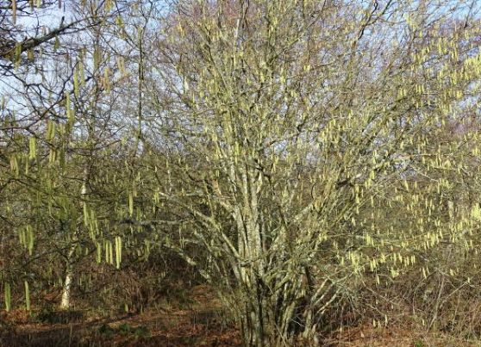
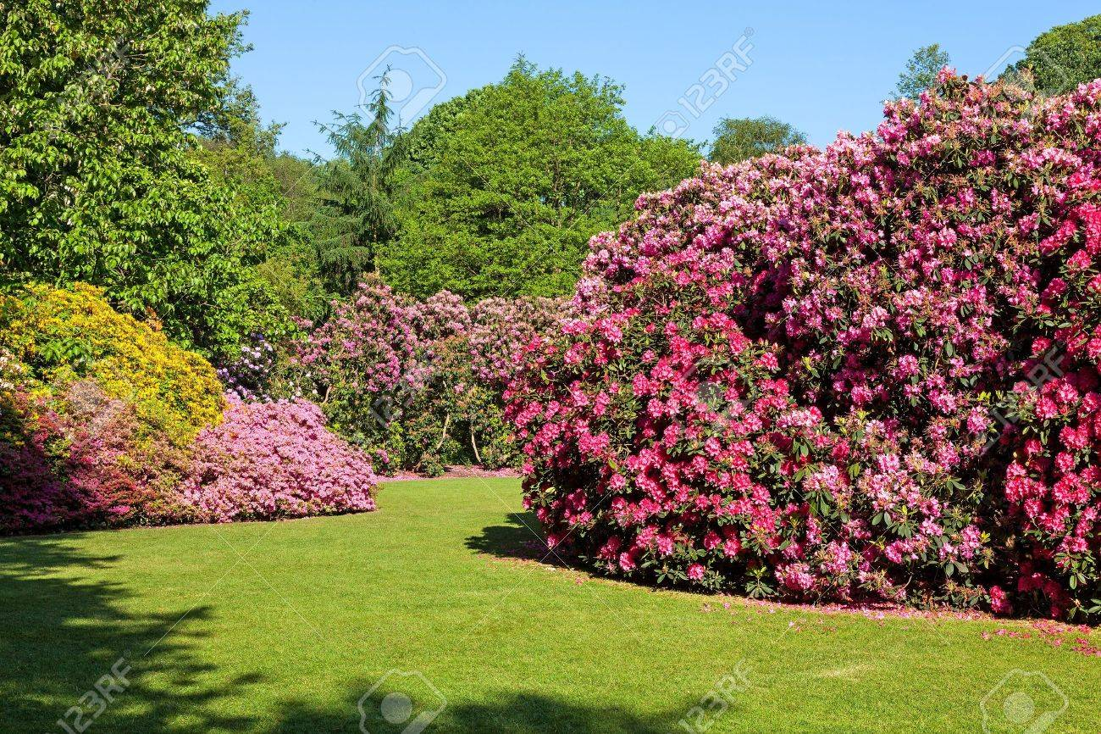
1. Describe the ways in which trees and shrubs differ
Hazel
rhododendron

Slide 5

2. Collect and Identify leaves from 15 species
Use a guidebook
Look at bark, environment, buds,
shape of the tree
App: “iNaturalist”

Slide 6
2. Collect and Identify leaves from 15 species
Spread neatly
Press dry
Mount
Label in a suitable notebook or on
uniform-size sheets of paper

Slide 7
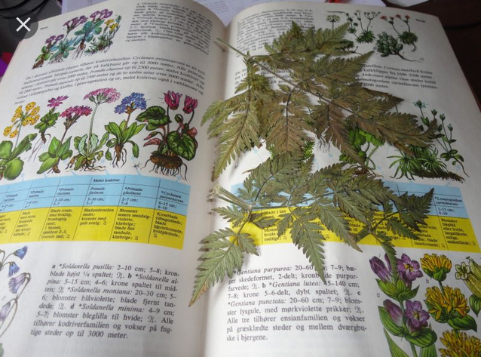
2. Collect and Identify leaves from 15 species
Press the leaves in a book, and keep them pressed for some days, depending on the leaves.
Create your book as you want to have it.

Slide 8
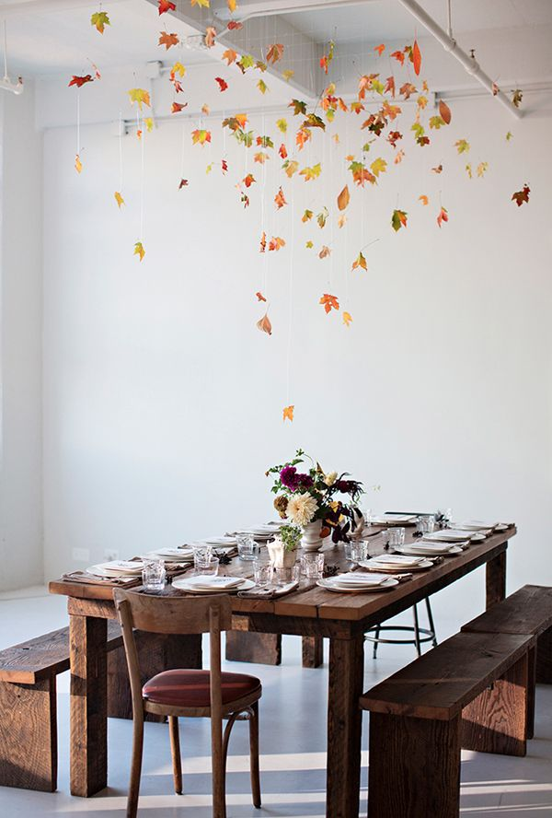
2. Collect and Identify leaves from 15 species
Try also to laminating leaves

Slide 9

2. Collect and Identify leaves from 15 species
KAHOOT Challange :
tinyurl.com/treehonour
Challenge PIN: 09459085
Open until May 10.

Slide 10
3. Name two examples each of trees that have been named for:
a. What they are used for
b. The surroundings or environment in which they grow
c. Some distinctive feature
d. The geographic region in which they live
e. Persons who first found and described them

Slide 11
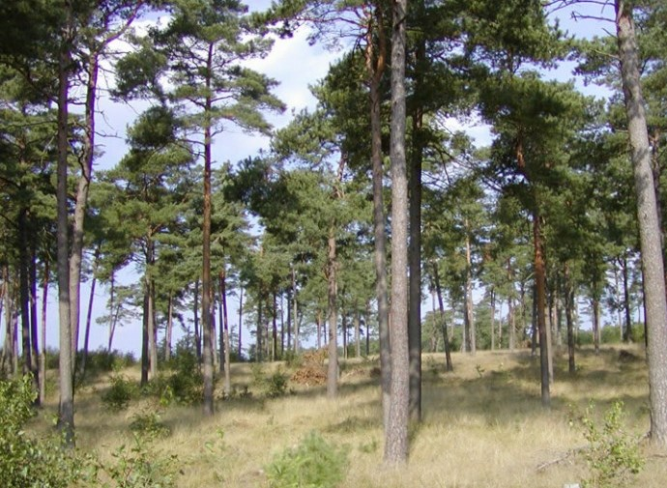
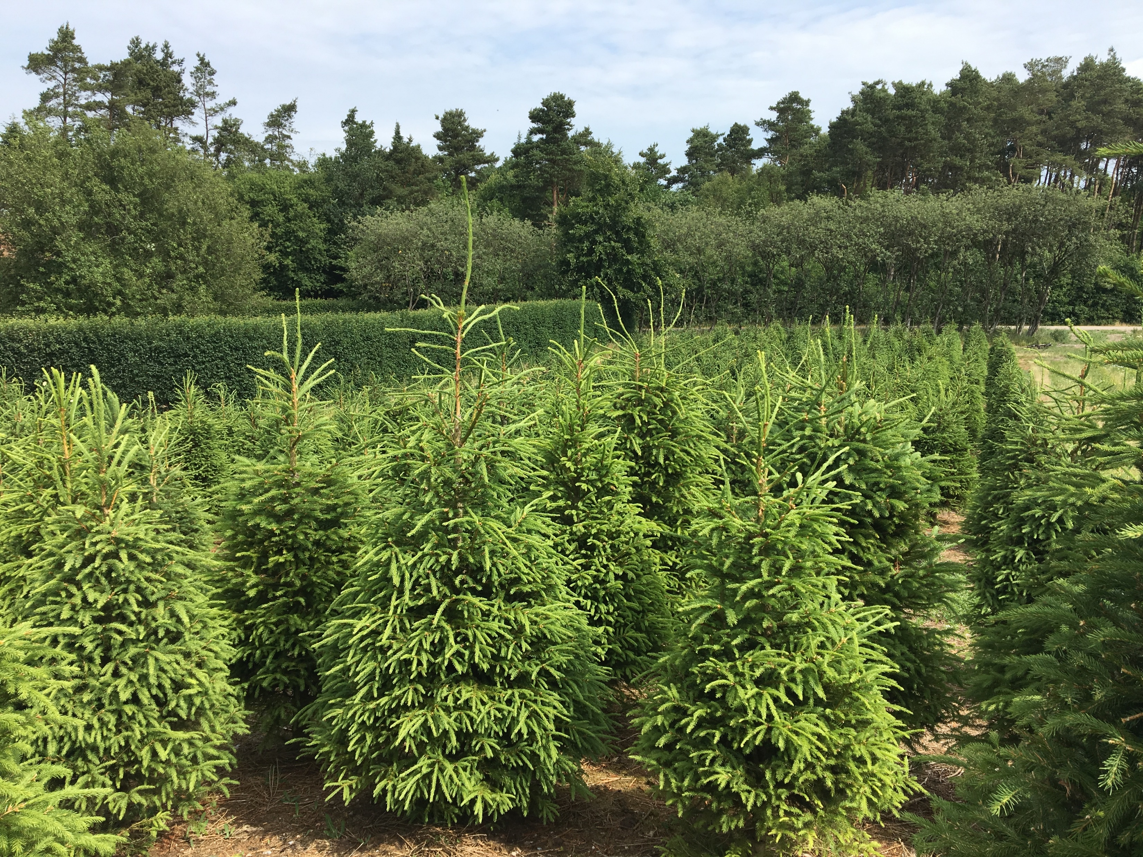
3. Name two examples each of trees
that have been named for:

Slide 12
3. Name two examples each of trees
that have been named for:
a. What they are used for Cork Oak, Sweet Gum
b. The surroundings or environment in which they grow Mountain Ash, Field elm
c. Some distinctive feature Sugar Maple, Hornbeam
d. The geographic region in which they live: Plymouth pear tree, Scotch Pine
e. Persons who first found and described them Douglas Fir, Fraser Fir

Slide 13
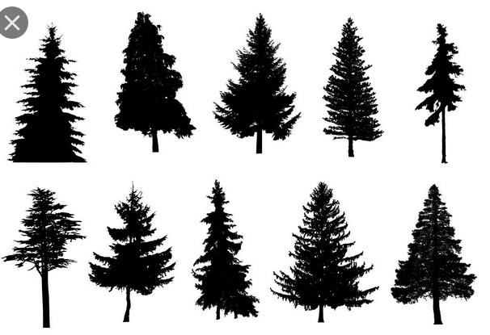
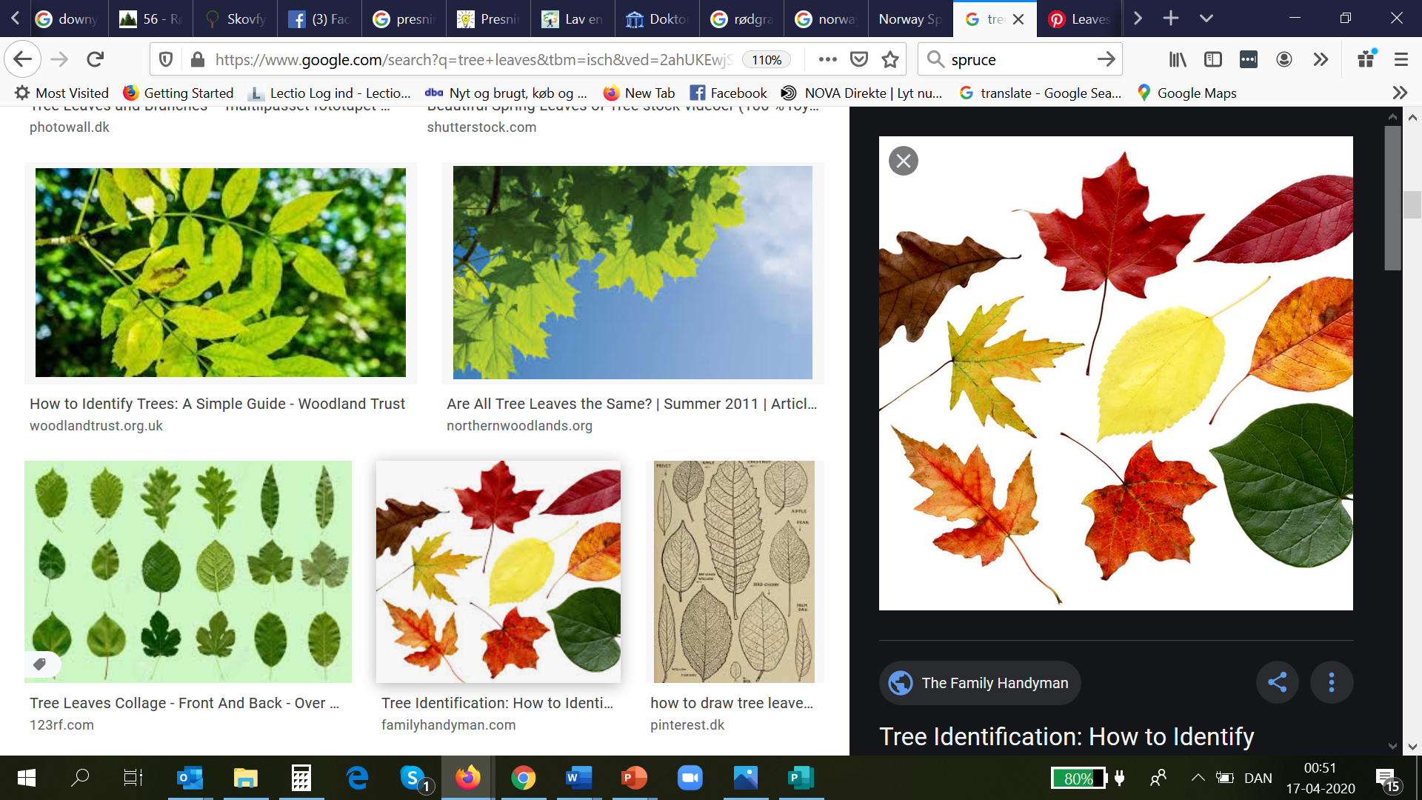
4. Give the common name, and tell the difference between the two great classes of trees
Gymnosperms
Angiosperms

Slide 14
4. Give the common name, and tell the difference between the two great classes of trees
Angiosperms
(Hardwood)
Leaves
Flowers
Drops the leaves during winter
Roots are deep

Slide 15
4. Give the common name, and tell the difference between the two great classes of trees
Gymnosperms
(Softwood)
Evergreens
Needles
No flowers
Naked seeds ( in a cone)
Grows in poor soil

Slide 16
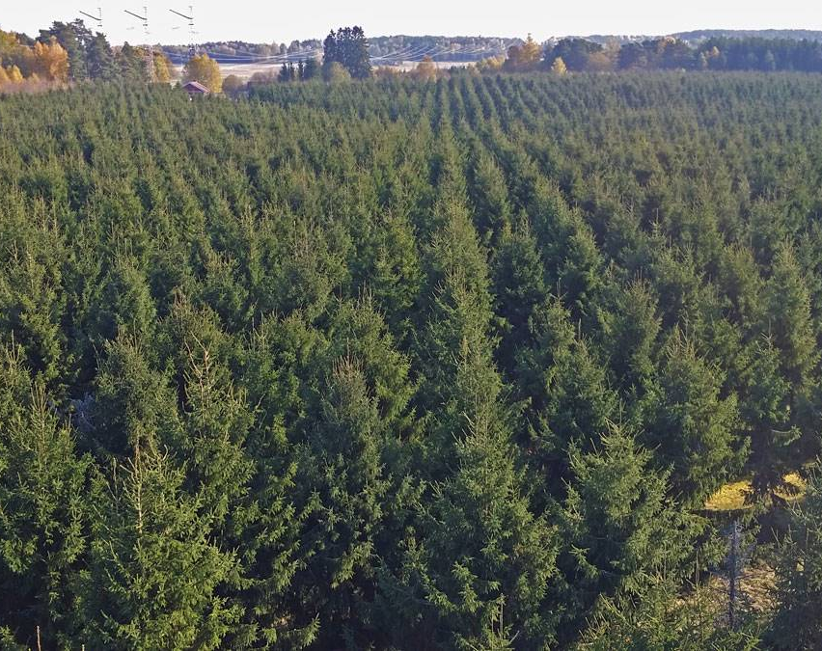
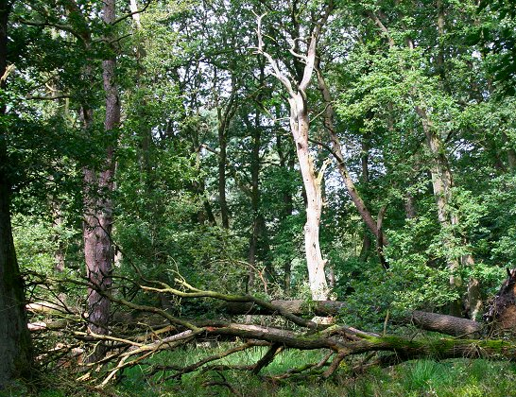
5. Describe the importance of forest conservation in your area

Slide 17
5. Describe the importance of forest conservation in your area
Lumber and timber
Trees in rows
Indivdual tree species
Biodiversity
Losing species

Slide 18
5. Describe the importance of forest conservation in your area
Biodiversity
Losing species
Fungi
Dead trees are important for life
Forests are a renewable resource.
Important habitat for several species
(plants die, animals leave or dies)

Slide 19
6. Name several examples of the kinds of woods used in each of the following:
a. Flooring for houses
b. Common plywood
c. Furniture
d. Axe handles
e. Fence posts
f. Railroad ties
g. Support beams for construction work
h. Bows and arrows
i. Ideal for use as kindling
j. Burns slowly and leaves a bed of hot coals

Slide 20
6. Name several examples of the kinds of woods used in each of the following:
a. Flooring for houses Oak, Beech, Ash, Pine,
b. Common plywood Pine, fir, spruce
c. Furniture Oak, Beech, Birch Pine, Mahogany, Teak
d. Axe handles Hickory, Ash,
e. Fence posts Oak, treated pine, Robinia, Cedar
f. Railroad ties Beech, Oak, treated wood
g. Support beams for construction work Pine, Oak
h. Bows and arrows Ash, Hickory, Yew, Osage Orange
i. Ideal for use as kindling Softwood, pine, Fir, Spruce Birch
j. Burns slowly and leaves a bed of hot coals Hardwood Ash, Oak, Beech

Slide 21
7. Name two examples each of trees which:
a. Grow best in wetlands
b. Grow best at high levels in mountains

Slide 22
7. Name two examples eac of trees which:
a. Grow best in wetlands
Sycamore, Willow, Birch, Swamp White Oak, Swamp Chestnut Oak,
b. Grow best at high levels in mountains
Norway Spruce, Larch, Pine, Birch.

