Slide 1

Christian Manners & Grooming
Pathfinder Honor
for Explorers

Slide 2

Introducing Speakers

Slide 3
With thanks to
Alan Cole

Slide 4
JESUS
Luke 2:52
Jesus grew in wisdom (Mentally)
What well balanced combination of strengths did Jesus develop as a growing youth?
and STATURE - (PHYSICALLY)
and in favor with God
and man (SPIRITUALLY AND SOCIALLY)
Notes:
This verse indicates that Jesus grew mentally (wisdom)
as well as physically (stature). He also grew spiritually (in favor of God) and emotionally (in favor of men). These four aspects of personal growth are the focus of the Adventist education system as well as the Pathfinder program.

Slide 5
These four aspects of personal growth are the focus of the Adventist education system as well as the Pathfinder program.
Notes:
This verse indicates that Jesus grew mentally (wisdom)
as well as physically (stature). He also grew spiritually (in favor of God) and emotionally (in favor of men). These four aspects of personal growth are the focus of the Adventist education system as well as the Pathfinder program.

Slide 6



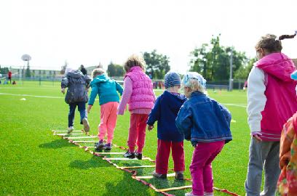

According to Psalm 8, what estimate does God place on your personal worth?
Crowned with what?
glory and honor

Slide 7

Are names important to God?
Does He know your name?
Read:
Isaiah 34:1

Slide 8
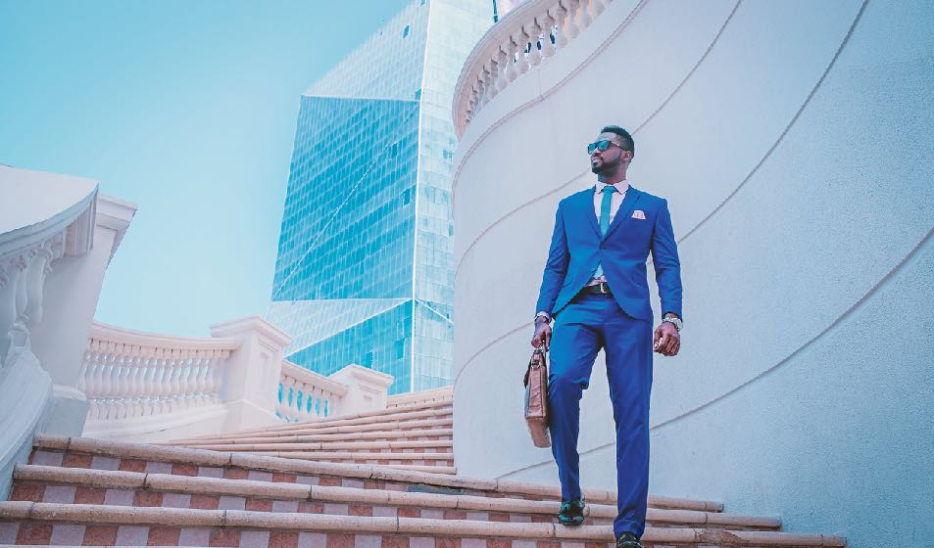

1995

Slide 9
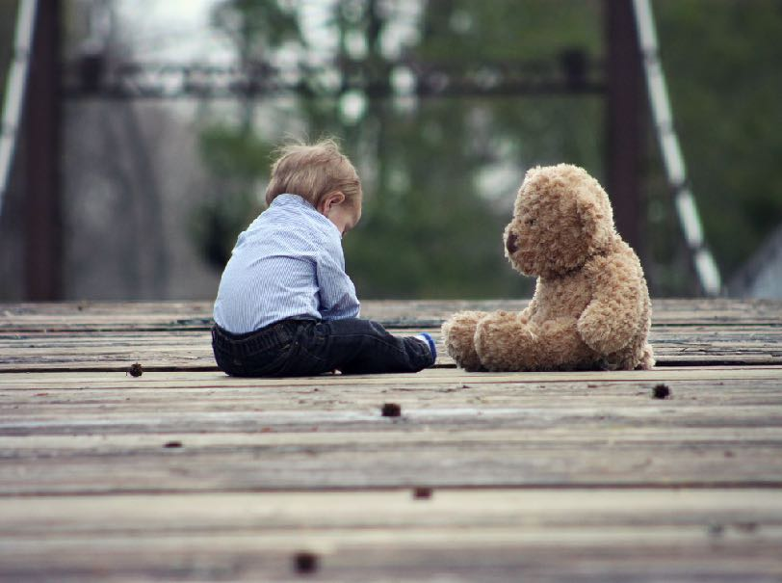
PROPER Behavior
Being Ladies and Gentlemen

Slide 10

What are some proper conversational skills?
Introduce adults using their proper title and how you know them.
Introduce a woman before a man
Introduce an older person before a younger person
Tell each person something about the other person that will interest them.
Address older people using a proper title -- such as:
Mr.
Mrs.

Slide 11

Singapore

Slide 12

What should I say?
AVOID
Don’t comment on physical defects
Don’t ask personal questions
SUCH AS
"When last did you have a shower?"
"Don't you think you should try to lose a little weight?"
"How much money do you make?"
"How old are you?" -- Speaking to someone your senior
DO TALK ABOUT
pleasant things
things that interest both of you
family & friends
special events
ASK QUESTIONS
about their family
about their work, school, or special events
about their favourite things

Slide 13
How do you show concern for others?

Slide 14
How do you show concern for others?
Active listening; Show interest, be empathetic, and don’t change the subject before they are ready to.
Which is a better response if someone tells you about something bad that happened such as:
Alice: "My sister was in a car accident yesterday."
Option 1
Bob: "That's too bad. Did I tell you I beat level 14 in 'Mega Chipmunk Death Rally' this morning?“
Option 2
Bob: "Your sister was in an accident? Is she OK?
… What happened? … Where is she now?"

Slide 15
Try it – Be empathetic
Bill broke his arm. How can you help him?
Hazel is on her hands and knees looking for something. Her bike is beside her. She says she lost her contact and can’t see.
Sally walked through the door with a pile of books. You accidently bumped her, sending the books flying.
For more scenarios go to: http://www.uua.org/re/tapestry/children/tales/session4/123257.shtml

Slide 16
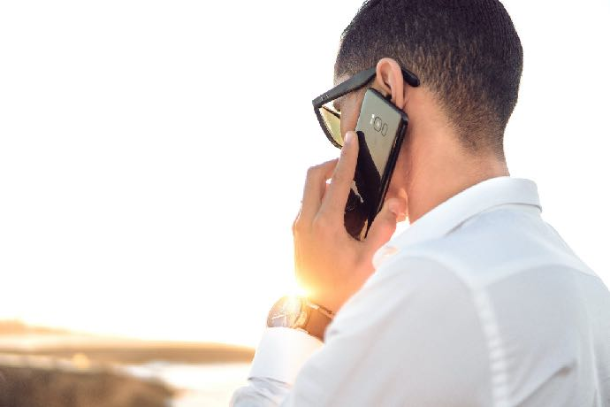
How should I answer the phone?

Slide 17
Let the words of my mouth and the meditation of my heart
Be acceptable in Your sight,
O Lord, my strength and my Redeemer.
      ~ Psalms 19:14
If you want to use your gift of speech to God's glory, what should your prayer be?

Slide 18
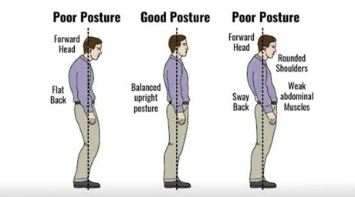
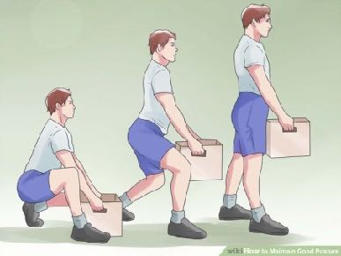
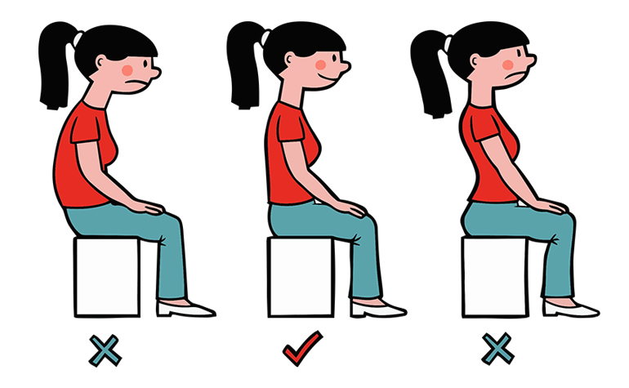

Describe good posture.

Slide 19
Describe the benefits of good posture
"Among the first things to be aimed at should be a correct position, both in sitting and in standing. God made man upright, and He desires him to possess not only the physical but the mental and moral benefit, the grace and dignity and self-possession, the courage and self-reliance, which an erect bearing so greatly tends to promote. Let the teacher give instruction on this point by example and by precept. Show what a correct position is, and insist that it shall be maintained."
-- Education, page 198, paragraph 3

Slide 20
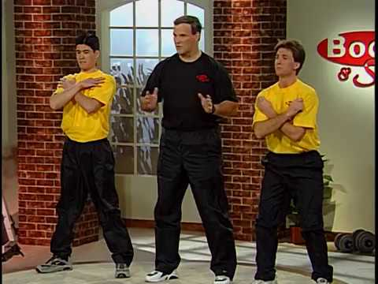

Exercise to improve your posture

Slide 21
Describe the benefits of good posture.
Good posture does the following:
Provides optimal balance
Optimises breathing
Reduces back pain
Expresses confidence
Is considered an integral part of physical attractiveness.
Improves the body's ability to carry heavy loads.
Protects against spinal deformity as a person ages.

Slide 22
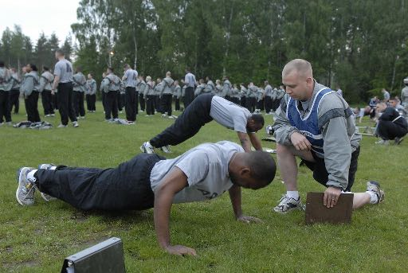
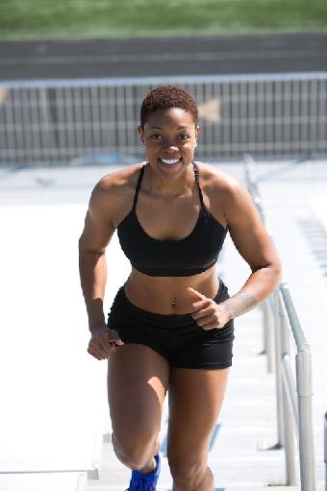
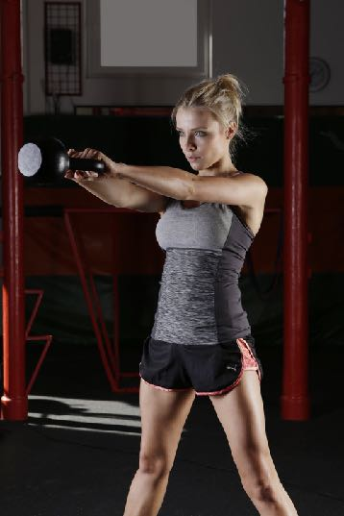
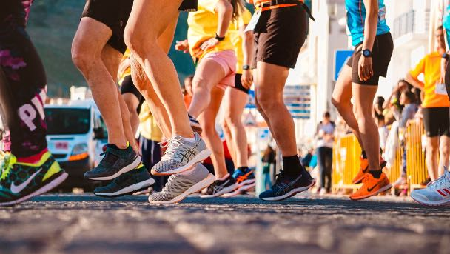
Why is physical fitness important?
https://live.staticflickr.com/3618/3615996533_d0f6926384_b.jpg

Slide 23

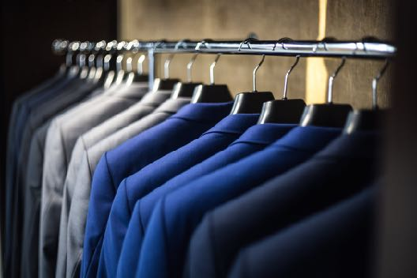
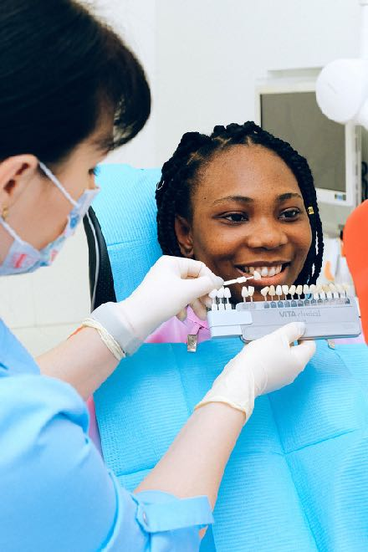

What is the importance of proper grooming? Why should we do the following:

Slide 24
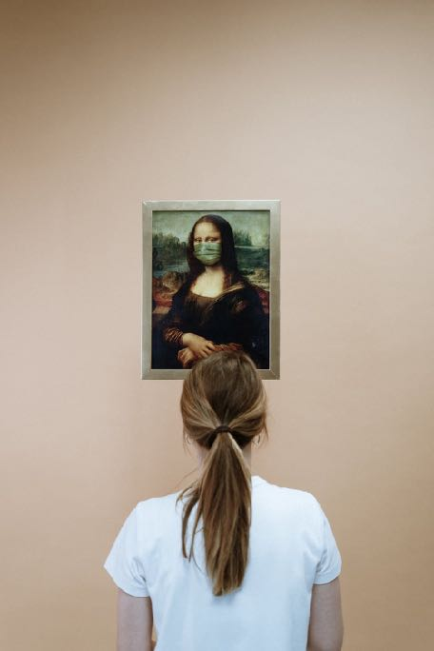
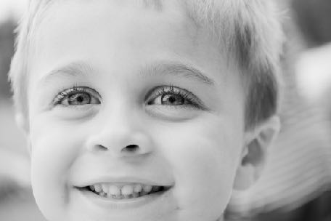
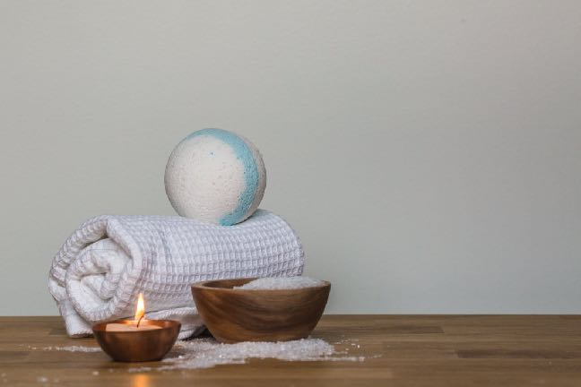
Bathing and Brushing Teeth

Slide 25


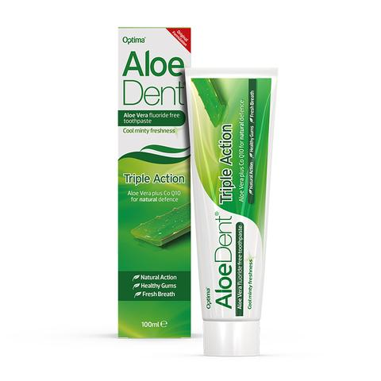
How can you overcome self-consciousness and social embarrassment

Slide 26
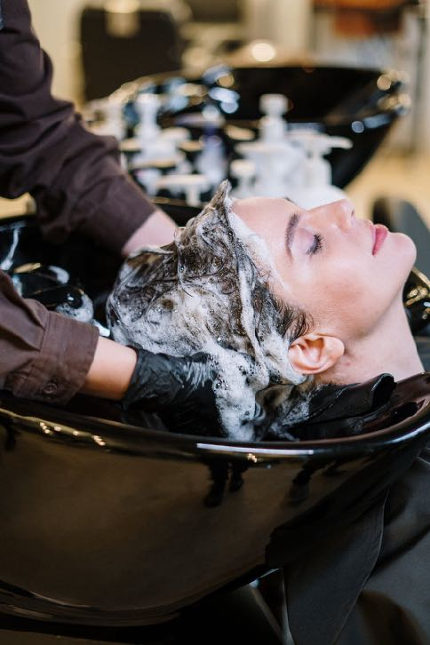
Hair Care

Slide 27
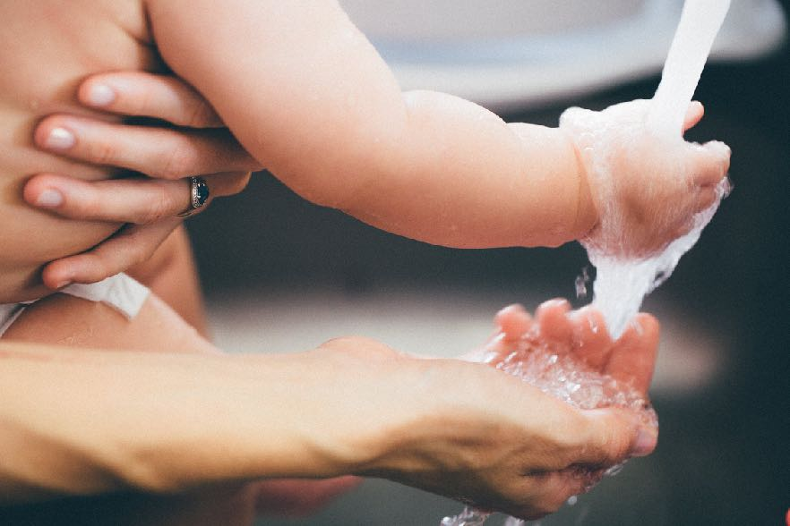
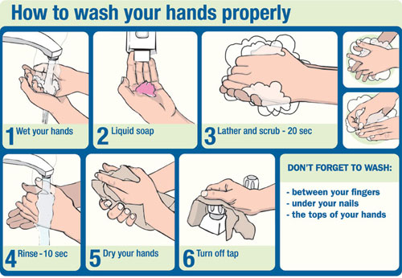
How to wash hands

Slide 28
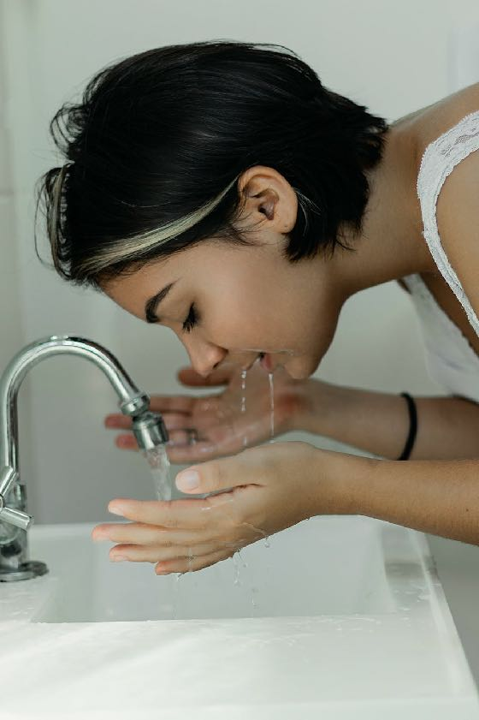
Care for your face

Slide 29
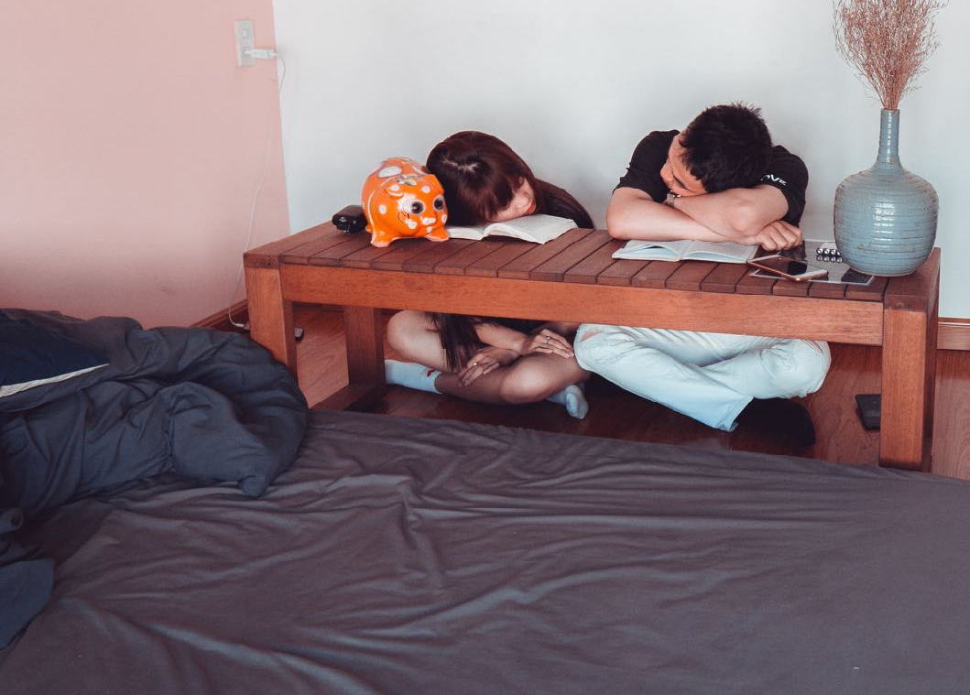
Sleep affects your face & appearance

Slide 30


How can I keep my soul “clean”?
Confess sin
Believe Jesus forgives your sin
Remember you are a child of God
Trust and obey

Slide 31
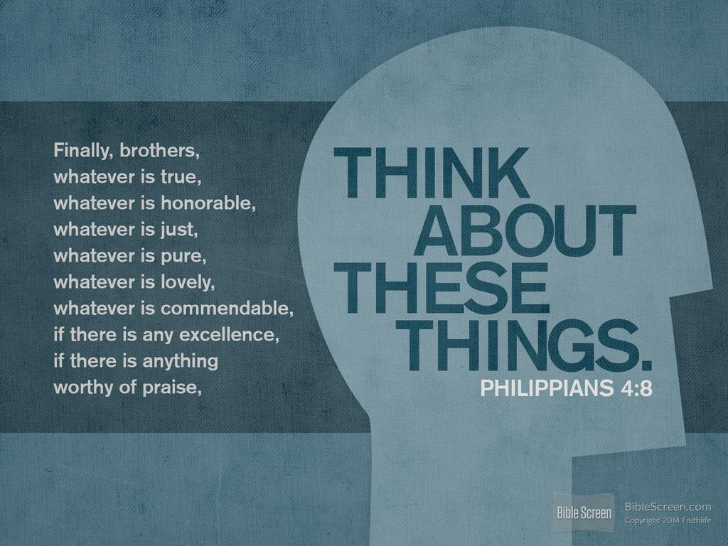

Slide 32
Maintain sexual purity
Read the following verses
Exodus 20:14
1 Corinthians 6:9-10
Matthew 5:27-28
Adultery and sexual immorality are any sexual activities that take place outside the marriage.
This text tells us that adultery is a sin that a person can commit in private. Do not entertain ideas of sexual immorality, even in your own private thoughts.

Slide 33
Maintain sexual purity
Flee also youthful lusts; but pursue righteousness, faith, love, peace with those who call on the Lord out of a pure heart.
  ~ 2 Timothy 2:22 (NKJV)

Slide 34
Maintain sexual purity
Remember now your Creator in the days of your youth,
Before the [a]difficult days come,
And the years draw near when you say,
“I have no pleasure in them”:
  ~ Eccl 12:1 (NKJV)

Slide 35
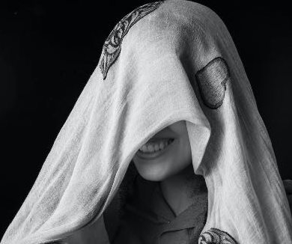
Why is your face important?
It is the first thing that others see
It is one of the main communicators of your emotions
Most people define "pretty" or "handsome" based on the way a person's face appears.
People recognise you more by your face than by any other part of your body. Your face defines you.

Slide 36
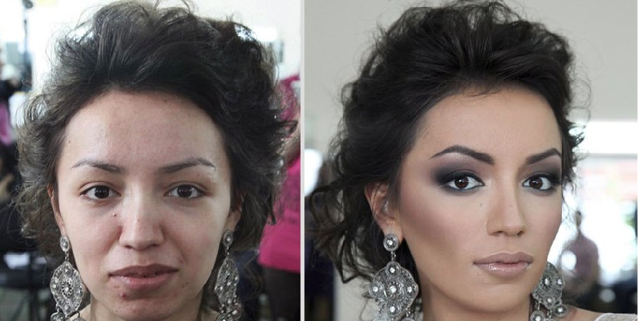
Importance of Face
‘This Man Is Suing His Wife For Fraud After Seeing Her Without Makeup For The First Time’
https://www.sickchirpse.com/man-suing-wife-fraud-seeing-her-without-makeup/

Slide 37
Facial Expressions
I want you to look at the following and guess what the expression means:

Slide 38
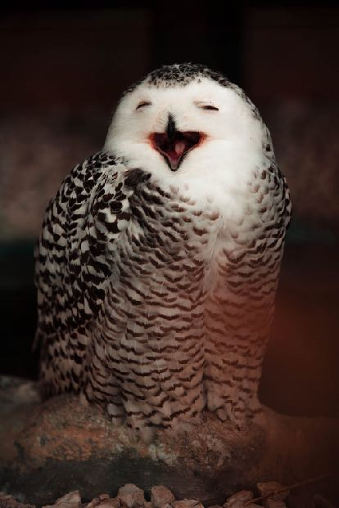

Slide 39
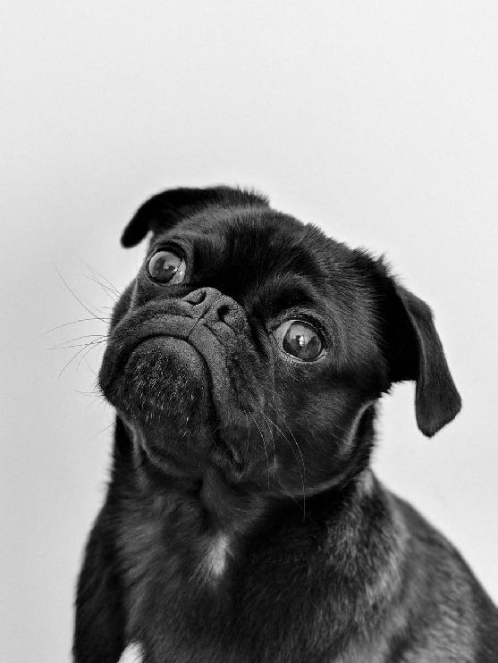

Slide 40


Slide 41
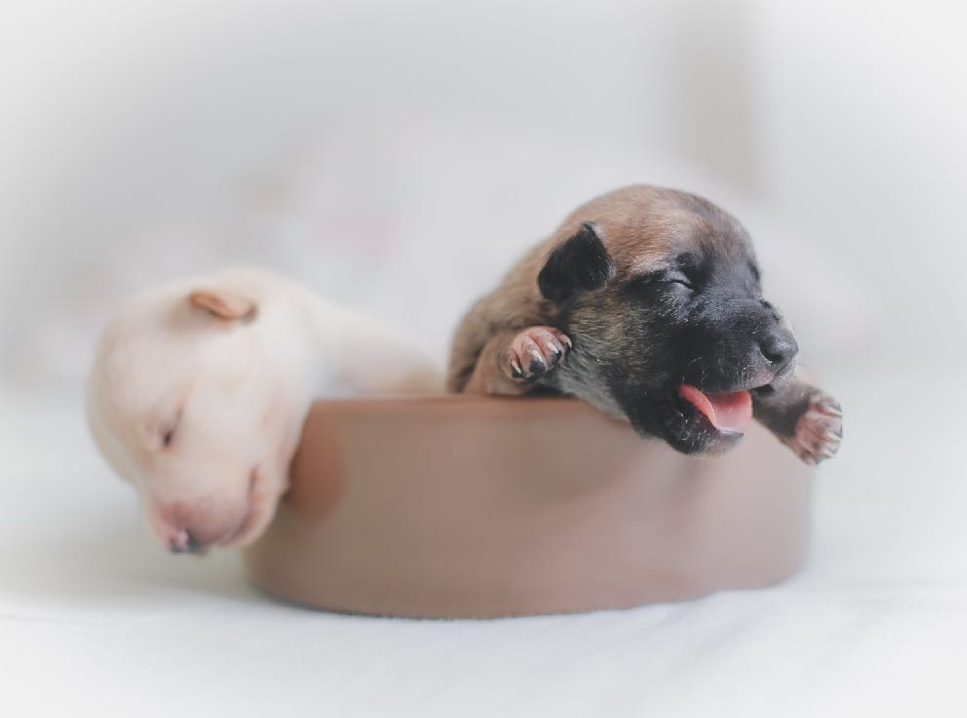

Slide 42
How should I answer the phone?
When answering the phone at home, nothing beats this old classic: "Hello?" It is also good to say after this greeting the period of day, such as “Good morning!” or “Good evening”
When answering for a business, the rules change. In this case, you are expected to answer with the name of the company, as in "Spacely Sprockets, how may I help you?"

Slide 43
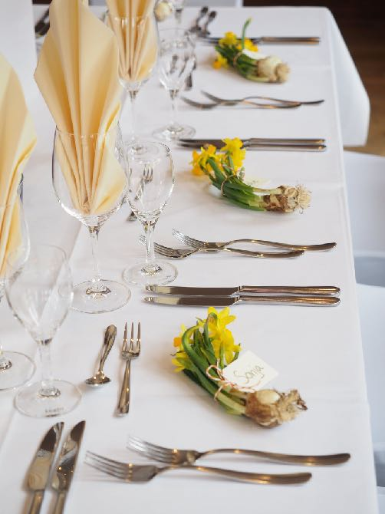
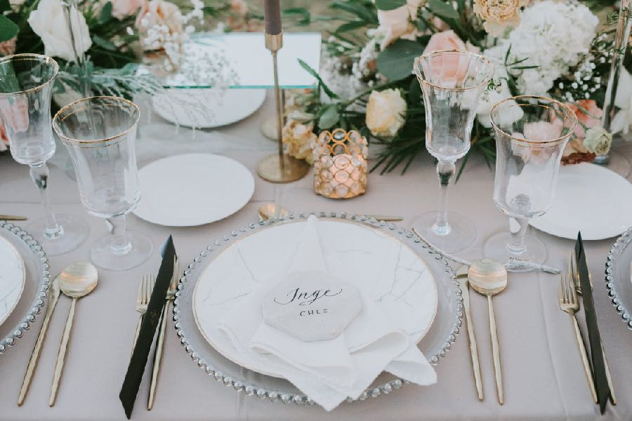
Properly set a table
DO it

Slide 44
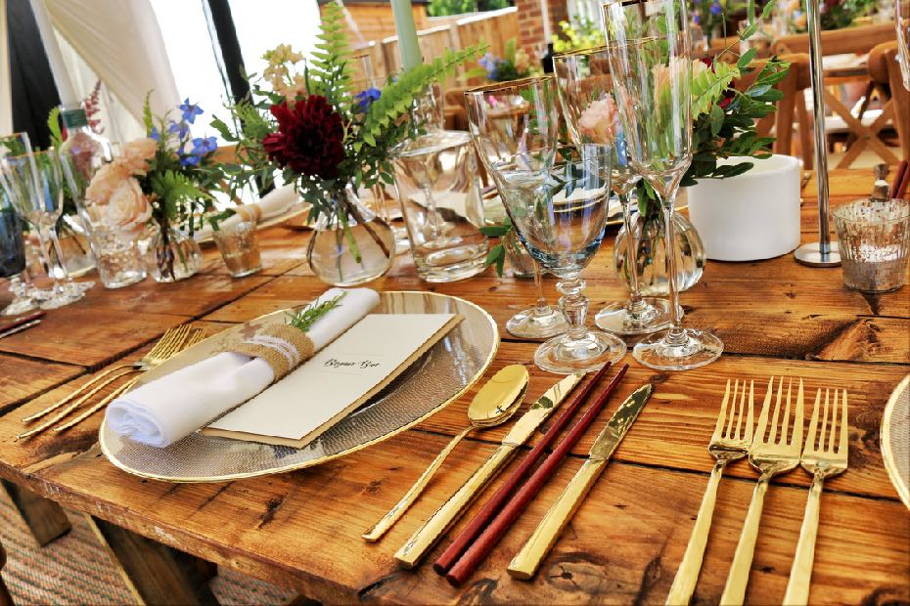
Formal Table setting
Start on the outer edge and move towards the dinner plate

Slide 45
A perfect date
It’s with someone you want to get to know better
You are super respectful to them & their parents
  You meet & greet their parents
  Men escort the lady, open the door for the lady, seat the lady, help the lady with her coat, care for the lady! Ladies, you show appreciation for the man’s respectful care for you
  You stay within the boundaries expected
  You get back on time
You both have fun – simple, pure fun with no regrets; You talk and get to know each other

Slide 46
A perfect date….

Slide 47
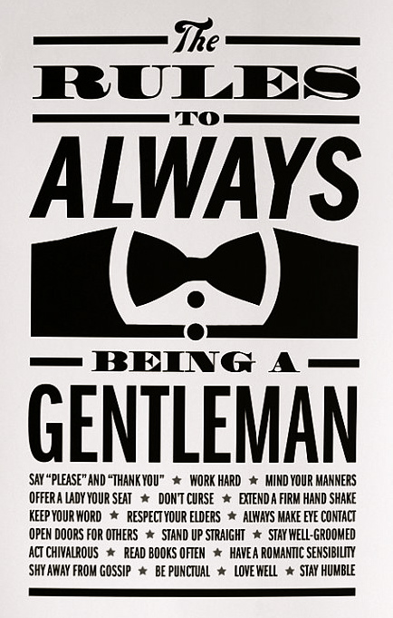
Chivalry is alive: Be a Gentleman

Slide 48

Ladylike charm with grace & elegance

Slide 49
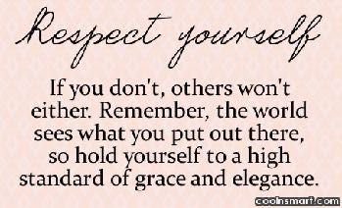
Be a lady with GRACE and elegance
Gracefully walk and talk
Respect yourself & others
Always smile
Confidence
Elegantly act and dress

Slide 50
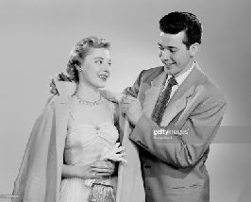
Gentlemen assist a lady with a coat
This is an art for both the guy and the girl. Practice makes perfect.

Slide 51
What has your family taught you about meal-time etiquette?

Slide 52
Proper mealtime behaviour
Chew with your mouth closed.
Do not talk at an excessively loud volume.
Refrain from coughing, sneezing or blowing nose at the table.
Never tilt back your chair while at the table, or at any other time.
Do not make unbecoming noises while eating.
Do not play with food or table utensils.
Do not single out or chastise someone who has shown poor table manners.
Do not put your elbows on the table or slouch. It is acceptable, however, to rest forearms, up to the elbow, on the table.
Always ask the host or hostess to be excused before leaving the table.
Do not stare at anyone while he or she is eating.
Never talk on your phone at the table. If urgent, ask host or hostess to be excused, and go outside. Apologise after returning.

Slide 53
Proper mealtime behaviour
A prayer or 'blessing' may be customary in some families, and the guests should join in even if they are not religious or do not follow the same religion. Most prayers are made by the host before the meal is eaten. Instead or in addition, a 'toast' may be offered.
Do not start eating until (a) every person is served or (b) those who have not been served request that you begin without waiting. At more formal occasions all diners will wait to begin until the hostess or host lifts a fork or spoon.
When a dish is presented 'family style', the food is served to one's plate and then passed on to the next person. Put the food on your left, take some and pass to the person next to you.
When serving, serve from the left and pick up the dish from the right. Beverages are both served and removed from the right.
Eat soup noiselessly and with the side of the spoon.
Hot drinks should never be poured into the saucer to cool but should be sipped from the cup. Alternatively, ice may be used to cool them.
Seasoning ones meal prior to tasting can be considered rude and may insult the chef.

Slide 54
Proper mealtime behaviour
It is acceptable in most places TO NOT finish all of the food on your plate.
When finished with your meal, place your knife and fork with handles at the 4 o'clock position and the tines of the fork down to signal to the server you are done.
Except in a public restaurant, DO NOT ask to take some of your uneaten food away from the meal after it ends, and never when attending a formal dinner.

Slide 55
How can you overcome self-consciousness and social embarrassment
Christ died for you
Make sure your hair is clean and combed.
Make sure your face and body are clean
Wear deodorant/antiperspirant.
Brush your teeth and have a breath mint or sugar-free gum
You are not the only self-conscious person
People are unlikely to be focusing on you
Admit your mistakes
Admit your embarrassment
A little humour goes a long way

Slide 56
Dress Your Best
Finding your style

Slide 57
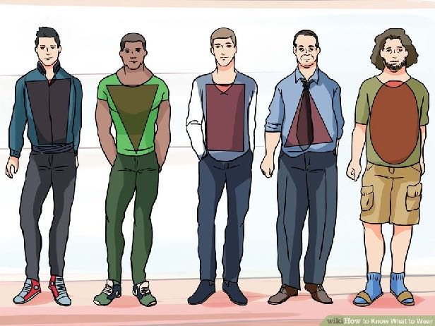
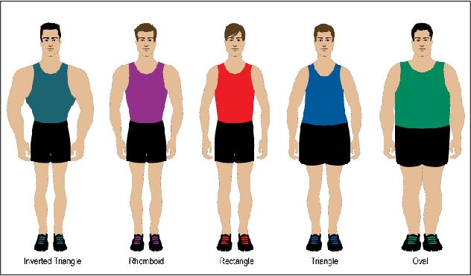
Dressing for your Body Type
Skinny? Add bulk with pockets, horizontal stripes, patterns, and thicker fabric
Short? Add height with well fitted pants and V necks. Wear shorter jackets.
Stocky? Less bulk with straight pants, mid fit raise, sleek shirts & shoes

Slide 58
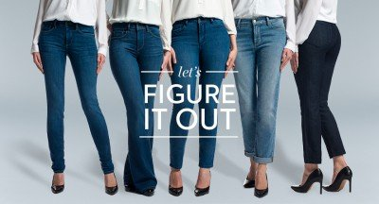
Choosing jeans for your body type

Slide 59
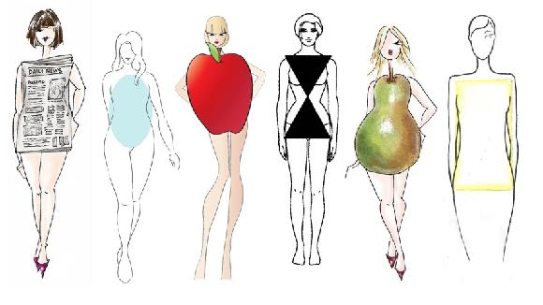
5 dresses for
5 body types
Accentuate the smaller body parts, drawing attention away from ‘bulky’ areas

Slide 60
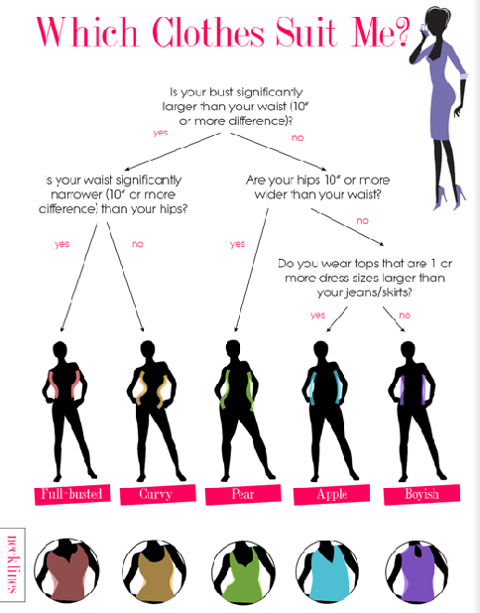
See more at:
http://visual.ly/guide-womens-clothing-based-body-type

Slide 61
Choose fashions for a body
BOYS
Choose fashions from a clothing advertisement that would look good on your body type. Remember the pointers learned.
OR
Go online to the following site and dress the guy:
http://hair-boys.goldhairgames.com/hair-games-for-boys/153-hair-games-and-dress-up-for-boys
GIRLS
Choose fashions from a clothing advertisement that would look good on your body type. Remember the pointers learned.
OR
Go online to the following site and dress the girl:
http://hairstyles.goldhairgames.com/hairstyles/148-cold-fashion-and-hair-styles

Slide 62
Choose a hairstyle that fits you
When identifying the best hairstyle for you it’s crucial you first identify:
1) Your face shape, and
2) Your hair texture.
Website resources:
http://www.thehairstyler.com/features/articles/hairstyles/the-right-hairstyle-for-your-face-shape

Slide 63
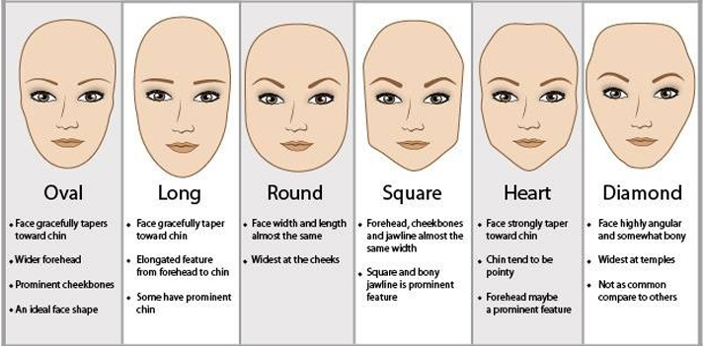
Another look …. choosing hairstyle

Slide 64
For men – how to choose a hairstyle

Slide 65

Young Men and Women Etiquette
By Helen and Lupa Mwasumbi

Slide 66

Young Ladies

Slide 67
Demonstrate two exercises that improve your posture
1. Lying on your back:
Lie on your back on the floor with your knees bent and feet flat on the floor.
Use your bottom muscles to lift up your back
Maintain the pressure for 5 – 10 seconds and slowly let go.
Repeat 10 times.

Slide 68
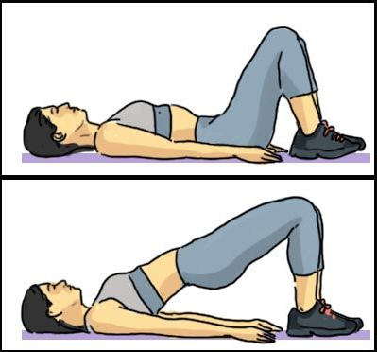
Why should you do this?
This helps strengthen your abdominal muscles and helps if you're pregnant because it reduces peri-partus-pelvic pain (a back pain caused by the baby bump)

Slide 69




Another exercise that improve your posture…
2. Sitting on a chair
Lift your arms to a horizontal position
Swing them slowly outwards and backwards as far as possible.
Repeat 10 times.
Strengthens the muscles of the back of your shoulders, stretches the muscles in the front of your chest and curves your upper spine meaning you have more space the your lung and heart

Slide 70
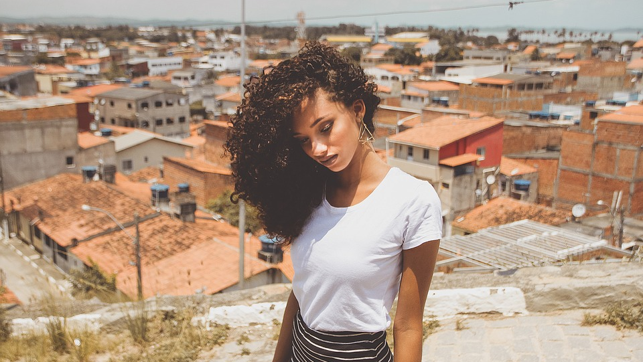
Choosing a good hairstyle that suits you best
The choice of a hairstyle is a personal one, but if the goal is to look your best, the generally accepted advice is to style it to even out the shape of your head and face
A girl with a long, narrow face should choose a hairstyle that makes her face look a little wider. A girl with a round, wide face should use her hair to "lengthen" her face by exposing more of her forehead and adding height.

Slide 71
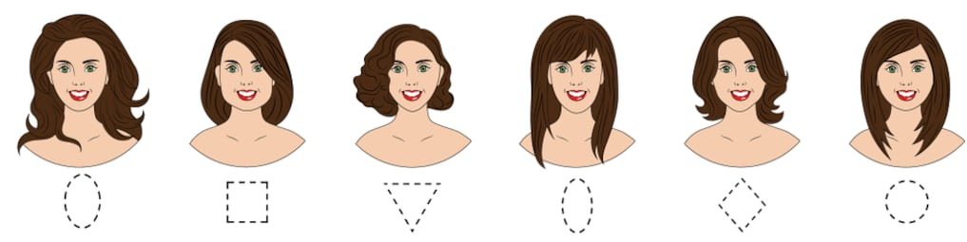
Hairstyles for different face shapes (e.g.)

Slide 72




Proper Style of Clothing for women
It's always best to dress modest because you don't want anyone to get the wrong picture of you
Stripes can be used to emphasize or play down height or width.
Vertical stripes make you look taller while making you look thinner
Horizontal stripes add weight while making you look shorter

Slide 73
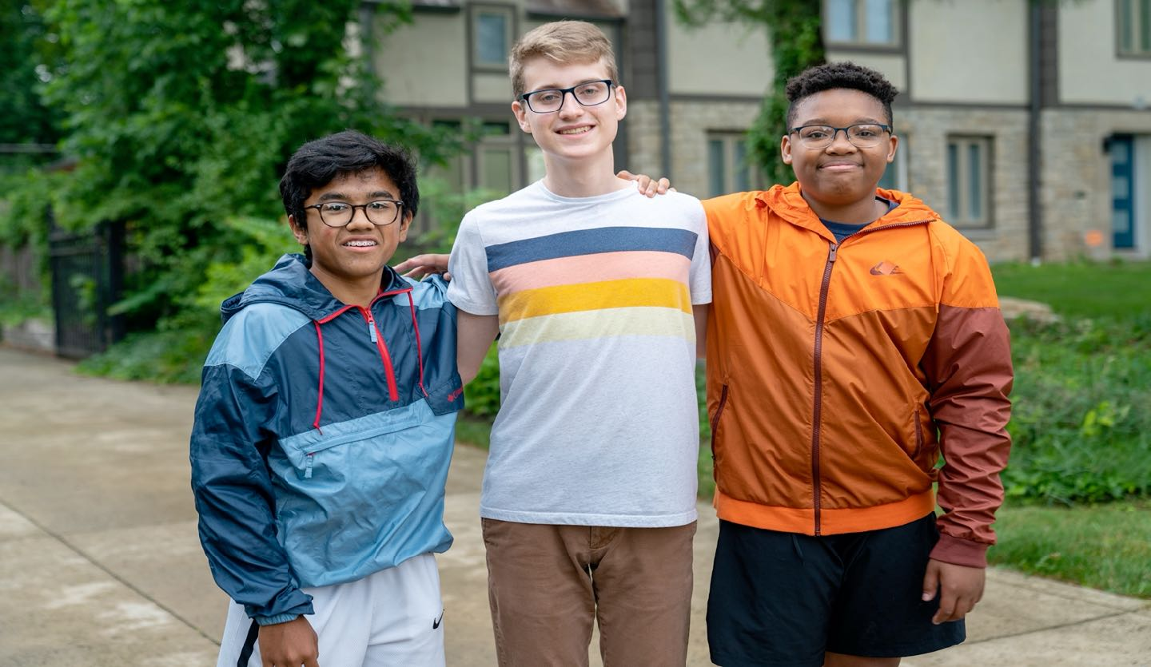
Young Men

Slide 74
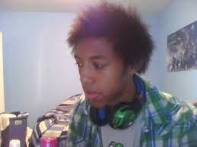
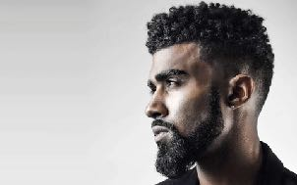
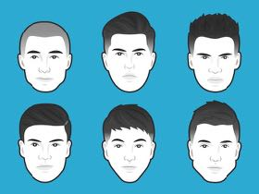
How to have well- groomed hair
X
Wash your hair regularly, and comb it several times between shampooing. Hair at any length should still be washed daily or every other day.
The choice of a hairstyle is a personal one, but if the goal is to look your best, the generally accepted advice is to style it to even out the shape of your head. This helps in finding suitable touches for everyone.

Slide 75
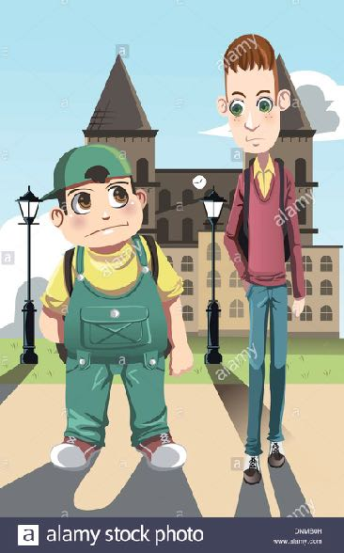
The proper style of clothes to wear if you are tall and thin, or short and chubby
A tall, thin boy should wear a shirt with horizontal stripes, and a short stocky boy should wear a shirt with vertical stripes. Horizontal stripes emphasise width and make someone look shorter. Vertical stripes emphasise height and make you look taller.

Slide 76
Dressing for your Body Type

Slide 77
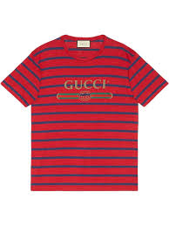

E.G.

Slide 78


