Slide 1
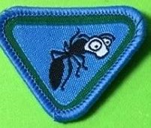
Ant Award
By Dionne Corrodus-Weekes

Slide 2


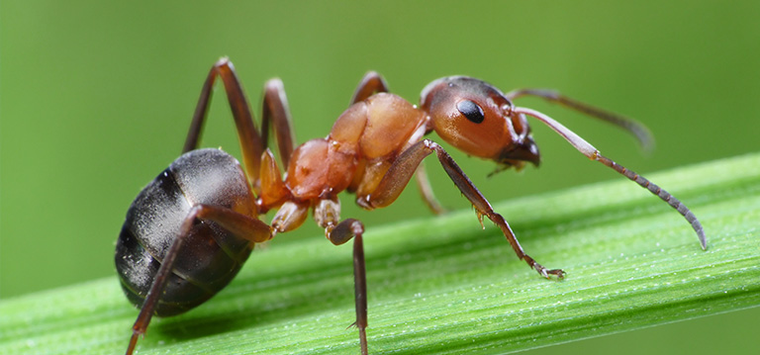
Requirement 1
What is an Ant?

Slide 3
Requirement 1
What is an Ant?
Ants are social insects known for working hard and being strong.

Slide 4
Requirement 1
Your Turn=> What is an Ant?
Fill In the blanks using the word bank
[strong, social, hard, insects]
Ants are __________ _____________ known for working_________ and being ______________.

Slide 5
Requirement 1
What is an Ant? Answer
Ants are social insects known for working hard and being strong.

Slide 6

Well Done!
.

Slide 7
Requirement 2a
What does the Bible say about ants in Proverbs 30:24-25?
24 There are four things which are little on the earth, But they are exceedingly wise:
25 The ants are a people not strong, Yet they prepare their food in the summer; (NKJV)

Slide 8
Requirement 2a
Your Turn=> What does the Bible say about ants in Proverbs 30:24-25?
Fill In the blanks using the word bank
[Ants, four, wise, summer, strong, prepare, earth]
There are _________________ things which are little on the _______________, But they are exceedingly
_______________:25 The ___________ are a people not ________________, Yet they _________ their food in the _________________ ; (NKJV)

Slide 9
Requirement 2a
What does the Bible say about ants in Proverbs 30:24-25? Answer
24 There are four things which are little on the earth, But they are exceedingly wise:
25 The ants are a people not strong, Yet they prepare their food in the summer; (NKJV)

Slide 10
Well Done!
.

Slide 11
Requirement 2b
Learn and explain Proverbs 6:6

Slide 12
Requirement 2b
Activities To Quickly Learn Proverbs 6:6
Floor Mats & Play Hop Scotch
Puzzles/ Jigsaw
Lego
Stones/Musical Cups

Slide 13
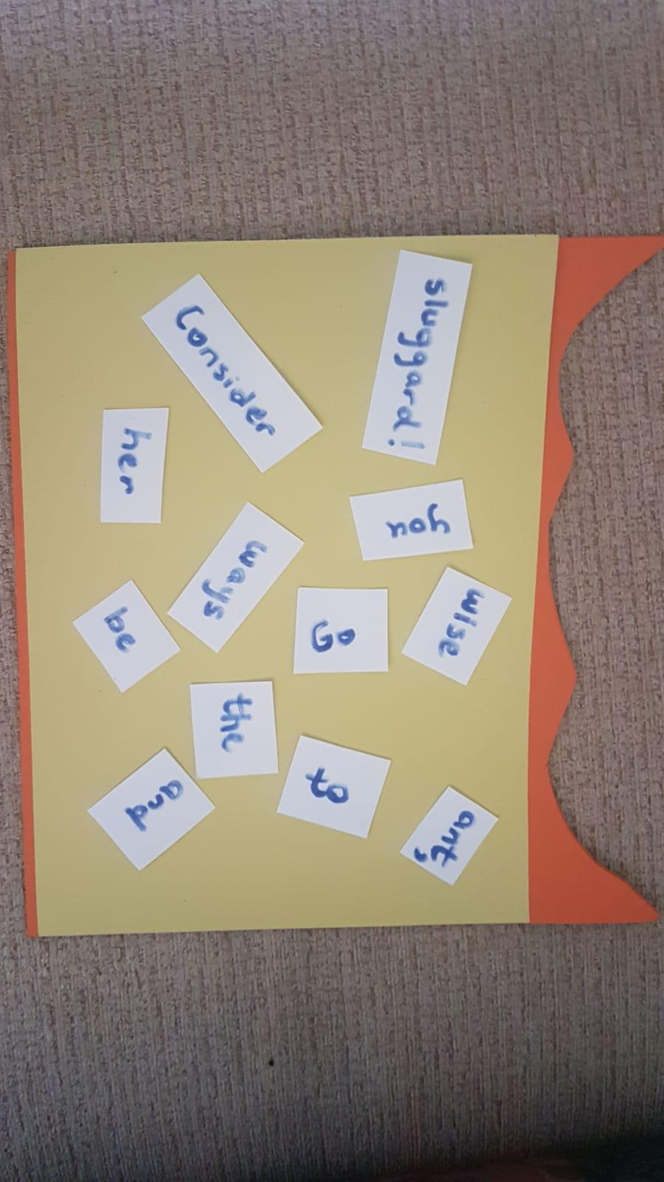
Requirement 2b
Word Scramble To Quickly Learn Proverbs 6:6

Slide 14
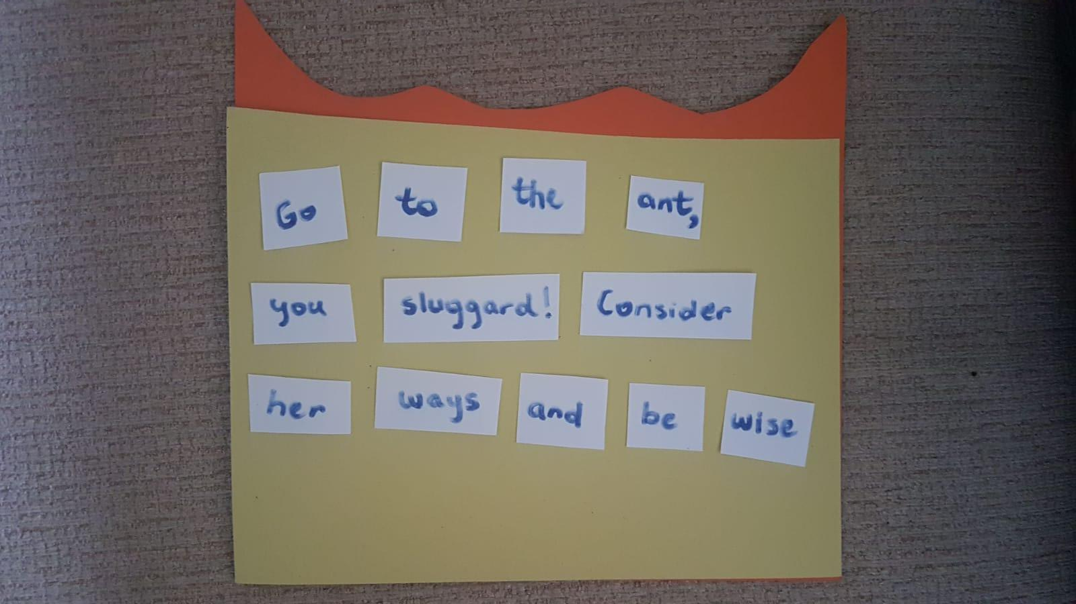
Requirement 2b
Word Scramble Answer

Slide 15
Well Done!
.

Slide 16
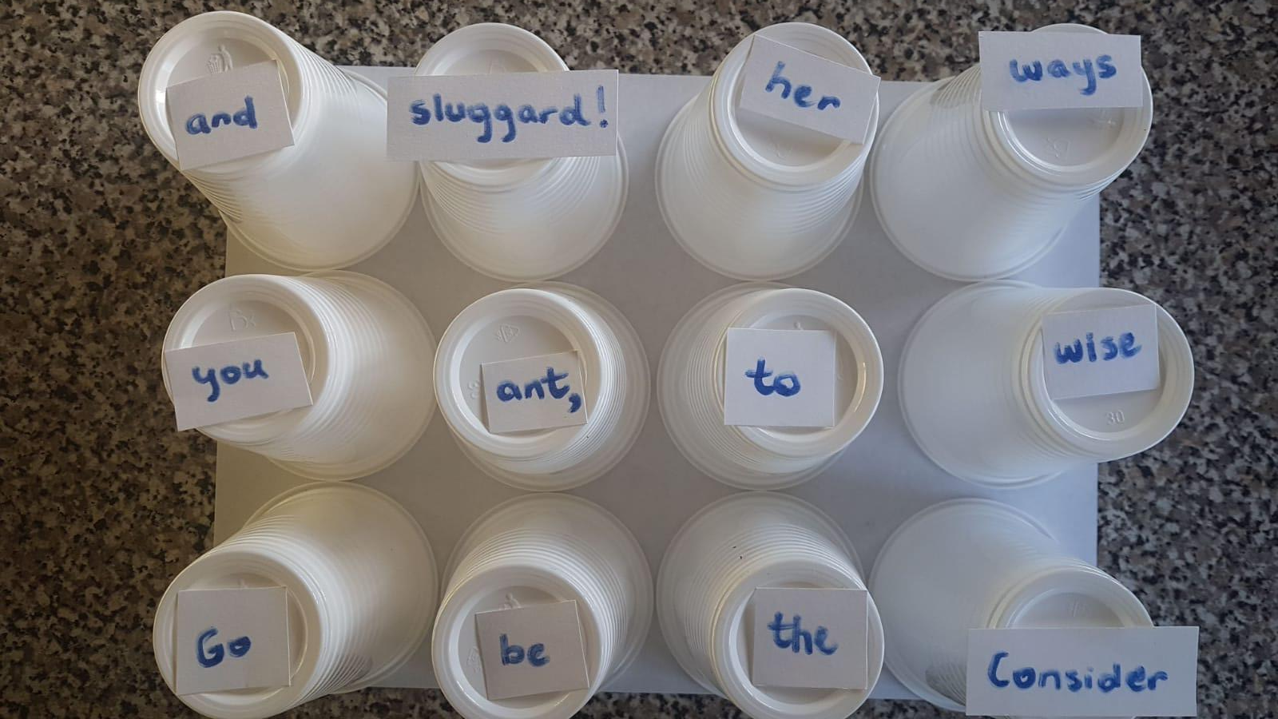
Requirement 2b
Musical Cups Activity To Quickly Learn Proverbs 6:6
Use Floor Mats & Play Hop Scotch
Puzzles
Lego
Stones

Slide 17
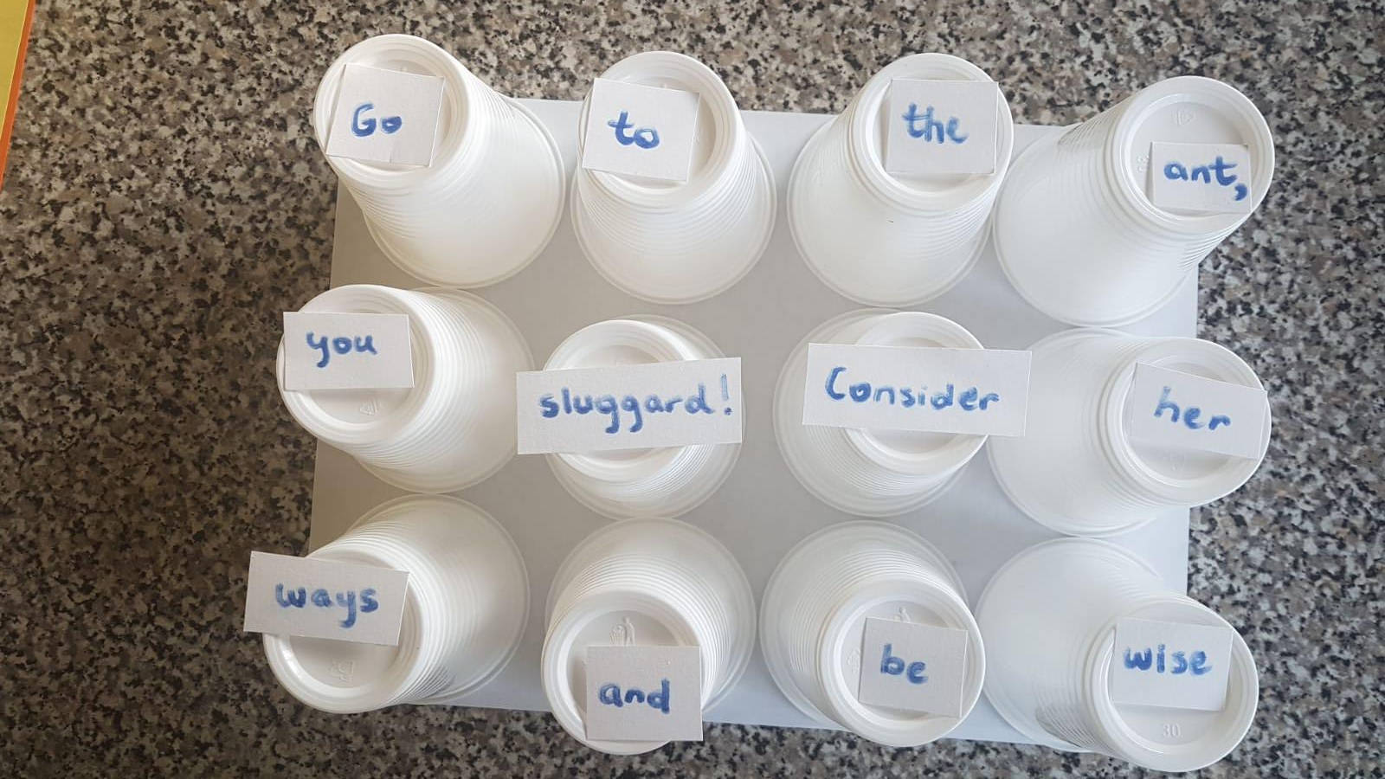
Requirement 2b
Musical Cups Activity Answer
G to the ant, you sluggard! Consider her ways and be wise

Slide 18
Well Done!
.

Slide 19
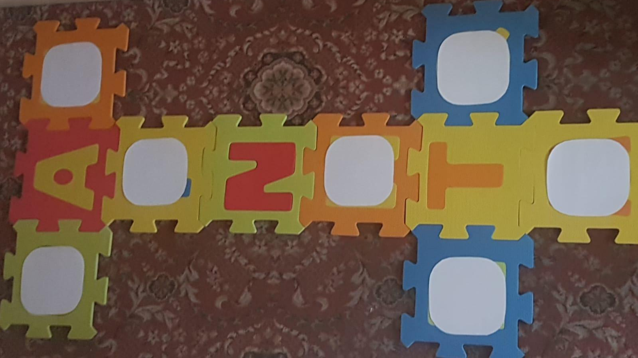
Requirement 2b
Hop Scotch Activity To Quickly Learn and Explain Proverbs 6:6
6
be wise

Slide 20
Requirement 2b
Learn and explain Proverbs 6:6
Go to the ant, you sluggard! Consider her ways and be wise

Slide 21
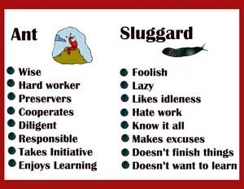
Requirement 2b
Proverbs 6:6 Explained

Slide 22
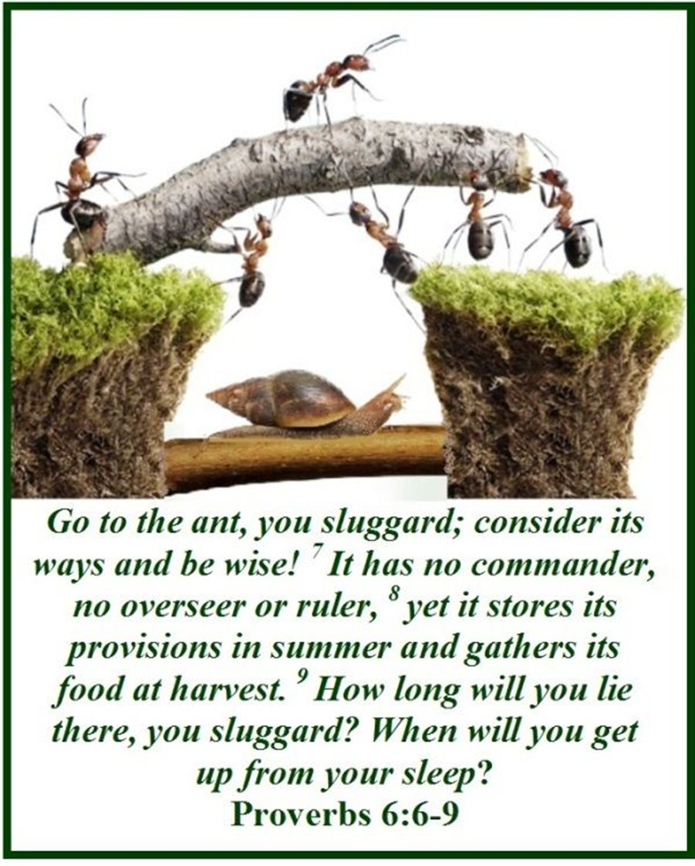
Requirement 2b
.

Slide 23
Well Done!
.

Slide 24
Requirement 3
How do ants communicate?

Slide 25
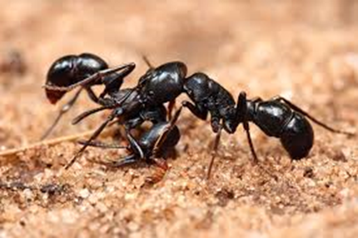
Requirement 3
How do ants communicate?
1. Rubbing two hard parts of their abdomens together makes scraping sounds
Notes:
To get organized, communicate with mates, and calling for help! Action: Let’s practices rubbing you hands together and calling for help. 1-2-3- HELP! Shall we call for help again?

Slide 26
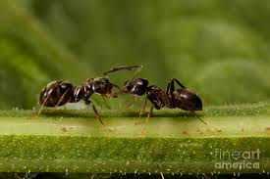


Requirement 3
How do ants communicate?
“Communication is crucial to the survival of ants…!
2. Ants touch: “high five” with their antennas

Slide 27
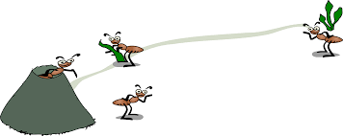
Pheromones
(Ant scents)
Pheromones
.
Ants are experts in track and trail!
This is the key ant communication language of attraction, alarm, identification of other castes, recognition of larvae, and discrimination between nest-mates and strangers.
The queen use it to stop her daughters from laying their own eggs and the development of her own daughter eggs/larvae from becoming rival queens.
The queen determines how many soldier castes are born, ensuring a balance within the colony.

Slide 28
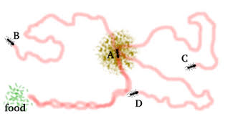
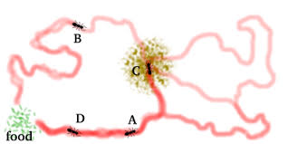
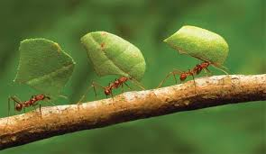
Requirement 3
How do ants communicate?
.
3. Unique scent trails: mark where food is found for other comrades to follow and take back home

Slide 29
Requirement 3
How do ants communicate?
Ants communicate with each other using pheromones (scent), sounds and touch

Slide 30



Requirement 3
How do ants communicate?
1. Scent
3. Touch
2. Rubbing Sound

Slide 31
Requirement 3
Your Turn=> How do ants communicate?
Fill In the blanks using the word bank
[sounds, touch, pheromones]
Ants communicate with each other using _________________________ (scent), _________________, and _________________.

Slide 32
Requirement 3
How do ants communicate? Answer
Ants communicate with each other using pheromones (scent), sounds and touch

Slide 33
Well Done!
.

Slide 34
Requirement 4
Name four main body parts of the ant.

Slide 35
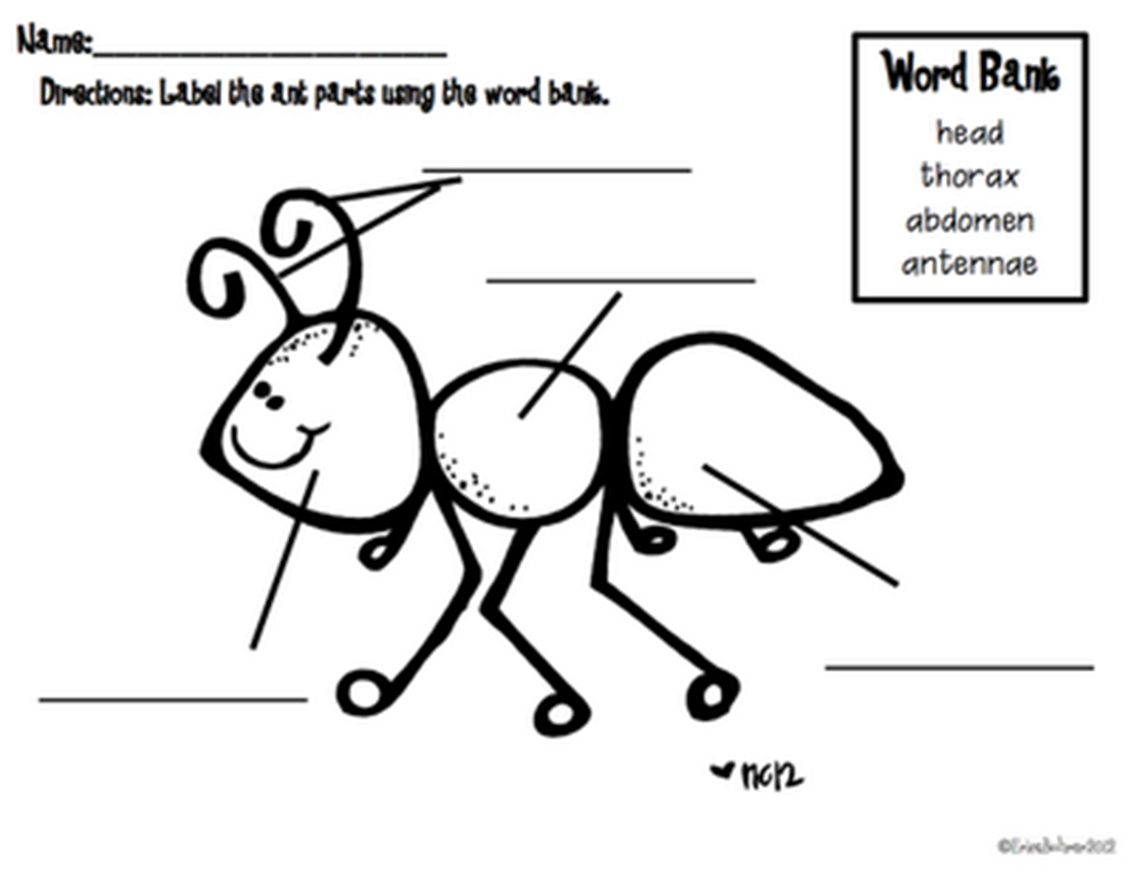
Requirement 4
Name four main body parts of the ant.

Slide 36
Requirement 4
Name four main body parts of the ant.
Head
Thorax
Abdomen
Antennae

Slide 37
Well Done!
.

Slide 38
Requirement 5a
What do ants use their jaws to do?

Slide 39
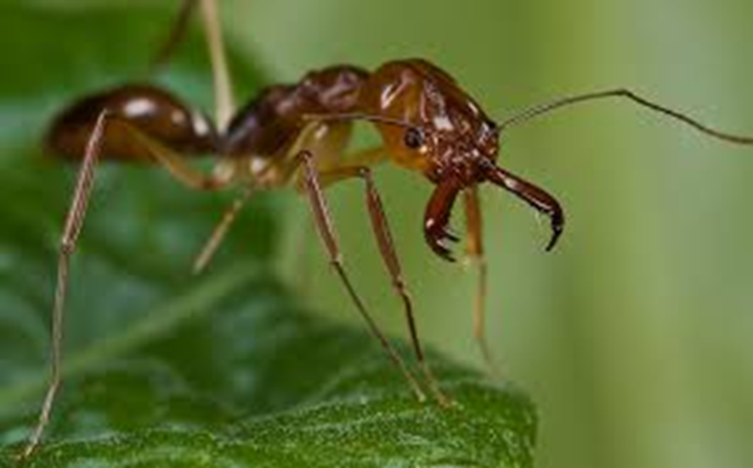
Requirement 5a
.
What do ants use their jaws to do?
The ant head has two strong jaws, (the mandibles), used to carry food, manipulate objects, construct nests, and for defence.
Ants defend and attack themselves by biting and, in many species, by stinging often injecting or spraying chemicals such as formic acid.

Slide 40
Requirement 5a
Your Turn=> What do ants use their jaws to do?
Fill In the blanks using the word bank
[biting, construct, stinging, defence, formic, acid
attack, strong, defend, carry, objects]
The ant head has two s_________________ jaws, (the mandibles), used to c_________________ food, manipulate o_________________, c___________________________ nests, and for d__________________.
Ants d_________________ and a_________________ themselves by b________________ and, in many species, by s_______________________, often injecting or spraying chemicals such as f__________________ a___________________.

Slide 41
Requirement 5a
What do ants use their jaws to do? Answer
The ant head has two strong jaws, (the mandibles), used to carry food, manipulate objects, construct nests, and for defence.
Ants defend and attack themselves by biting and, in many species, by stinging often injecting or spraying chemicals such as formic acid.

Slide 42
Well Done!
.

Slide 43
Requirement 5b
Why do ants have "hooked claws"?

Slide 44
Requirement 5b
Why do ants have "hooked claws"? Answer
Ants have hooked claws at the end of each leg which helps them to climb and to hang onto surfaces.

Slide 45
Requirement 5b
Your Turn=> Why do ants have "hooked claws"?
Fill In the blanks using the word bank
[leg, climb, hang]
Ants have hooked claws at the end of each _____________ which helps them to _________________ and to_____________ onto surfaces.

Slide 46
Well Done!
.

Slide 47
Requirement 6
Observe a group of ants in its colony and keep a log of their activity for 10 minutes

Slide 48
Requirement 6
Observe a group of ants in its colony and keep a log of their activity for 10 minutes
2 mins
4 mins
6 mins
8 mins
10 mins

Slide 49
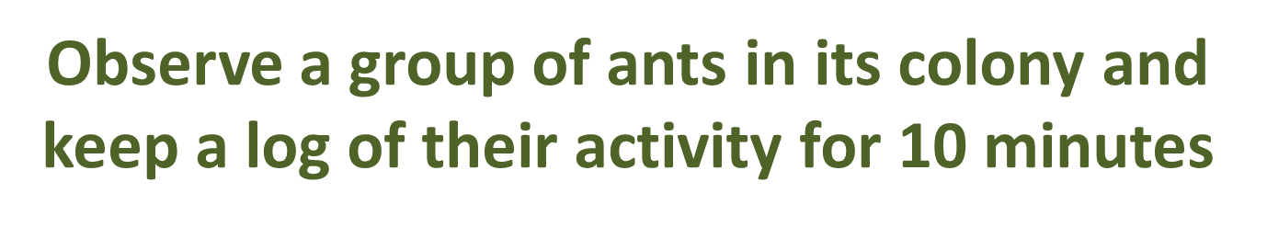
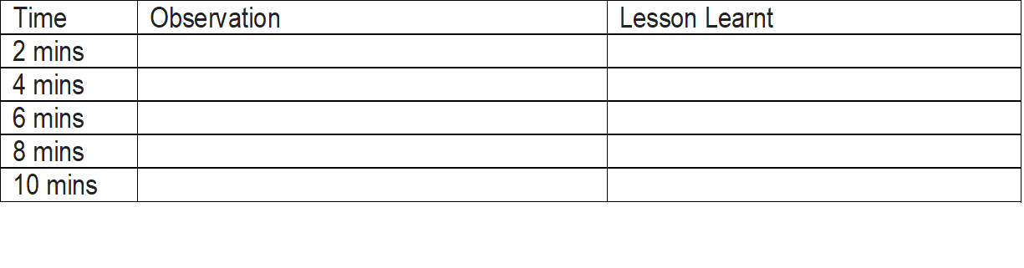


Requirement 6a
http://www.parsonrob.com/proverbs-66-go-to-the-ant-thou-sluggard.html

Slide 50
Well Done !
.

Slide 51
Requirement 7
Discuss and list ten things we can learn lessons for life from ants

Slide 52
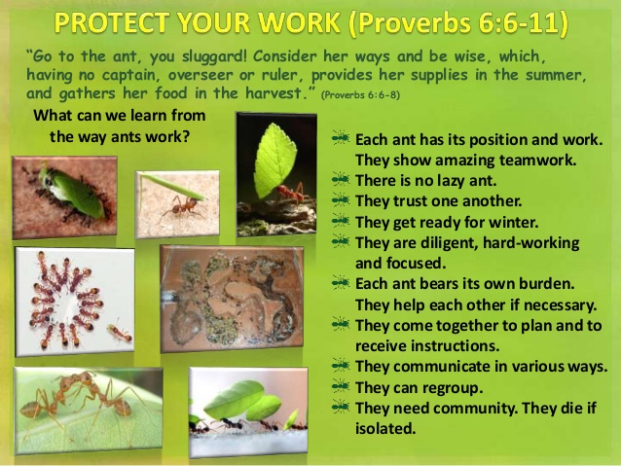
Requirement 7

Slide 53
Well Done !
.

Slide 54
Requirement 8
Make an ant craft

Slide 55

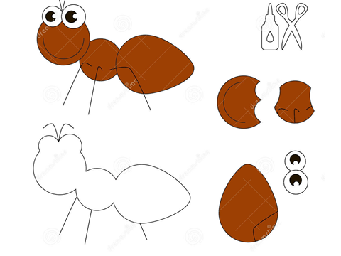
Requirement 8

Slide 56

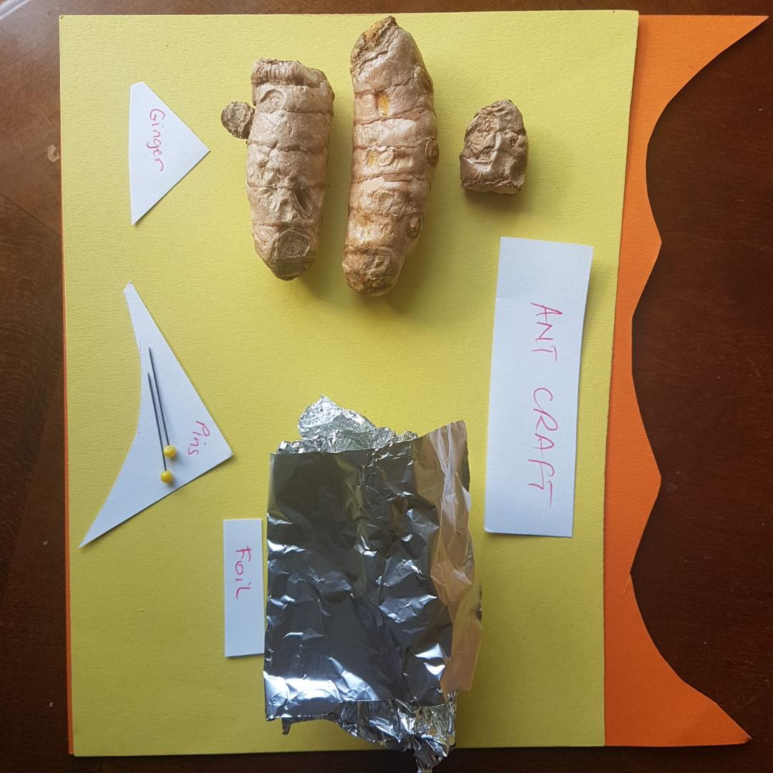
Requirement 8
.

Slide 57
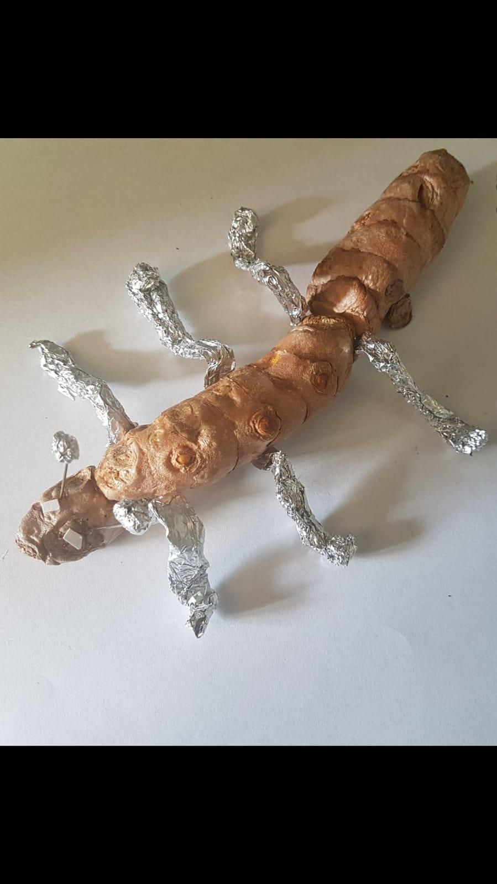
Requirement 8
Make an ant craft

Slide 58
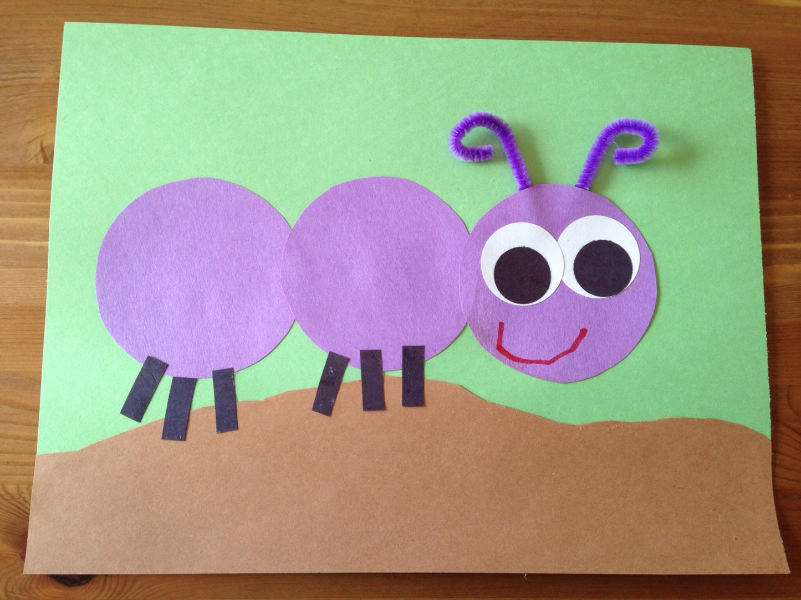
Requirement 8
.

Slide 59
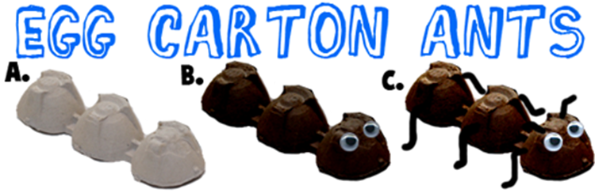
Requirement 8
Make an ant craft

Slide 60
Well Done !
.

Slide 61
Requirement 9
Learn and sing the ant song "the ants go marching ....."

Slide 62
Requirement 9
Learn and sing the ant song....."
At home, learn to count, sing and march to the song, “ The ants go marching...”

Slide 63
Well Done !
.

Slide 64
References
https://www.youtube.com/watch?v=AsZkKcv4sH0
https://www.youtube.com/watch?v=XNc-ob6344M
https://www.youtube.com/watch?v=SQAHEXOvXik
https://www.youtube.com/watch?v=iIrAQm21JaQ
http://www.sketchyscience.com/2015/09/study-spotlight-virtues-of-laziness.html
https://www.youtube.com/watch?v=cPPj9KAC_P8
https://www.slideshare.net/JoenardNunez/the-ant-sermon

